Slide 1

Apache Solr
Dima Ionut Daniel

Slide 2
Contents
What is Apache Solr?
Architecture
Features
Core
Solr Concepts
Configuration
Conclusions
Bibliography

Slide 3

What is Apache Solr?
Solr is an open source enterprise search written in Java, from the Apache Lucene project.
Its major feature include full-text search, dynamic clustering, rich document handling, etc.
Solr is written in Java and runs as a standalone full-text search within a servlet container as Tomcat or Jetty.
Solr uses Lucene library as it's core full-text indexing and search and has REST, HTTP/XML and JSON APIs.

Slide 4
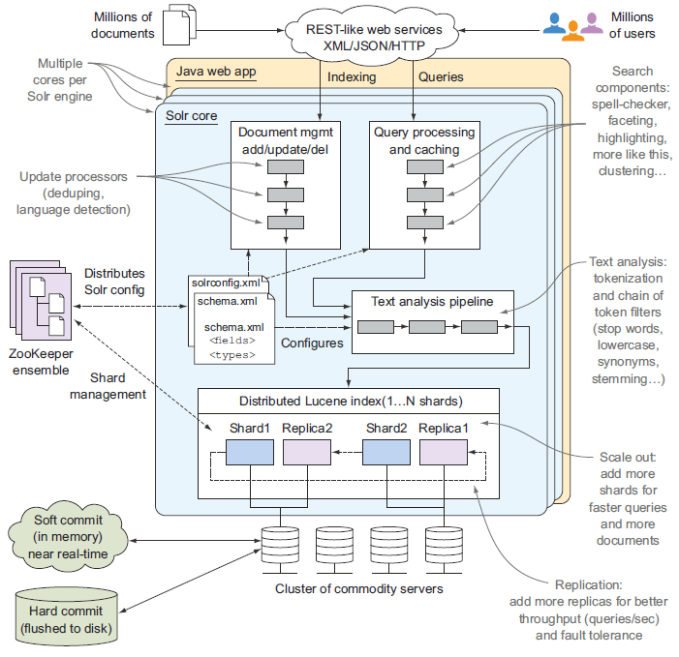
Architecture

Slide 5
Features
Scalable: Solr scales by distributing work (indexing and query processing) to multiple servers in a cluster.
Ready to deploy: Solr is open source, is easy to install and configure, and provides a preconfigured example to help you get started.
Optimized for search: Solr is fast and can execute complex queries in subsecond speed, often only tens of milliseconds.
Large volumes of documents: Solr is designed to deal with indexes containing many millions of documents.
Text-centric: Solr is optimized for searching natural-language text, like emails, web pages, resumes, PDF documents, and social messages such as tweets or blogs.
Results sorted by relevance: Solr returns documents in ranked order based on how relevant each document is to the user’s query.

Slide 6
Core
The main configuration file in Solr, solrconfig.xml, contains numerous settings, some of which (such as cache management settings) are useful when just starting out, while others are intended for advanced users.
Solr adds a simple, declarative way to define the structure of your index and how you want fields to be represented and analyzed: an XML-configuration document named schema.xml.
Solr uses schema.xml to represent all of the possible fields and data types necessary to map documents into a Lucene index.

Slide 7
Core (cont.)
Solr provides copy and dynamic fields.
Copy fields provide a way to take the raw text contents of one or more fields and have them applied to a different field.
Dynamic fields allow you to apply the same field type to many different fields without explicitly declaring them in schema.xml.
Lucene provides a powerful library for indexing documents, executing queries, and ranking results.
With schema.xml we define the index structure using an XML-configuration document instead of having to program to the Lucene API.
Solr runs as a Java web application and integrates with other technologies, using proven standards such as XML, JSON, and HTTP.

Slide 8
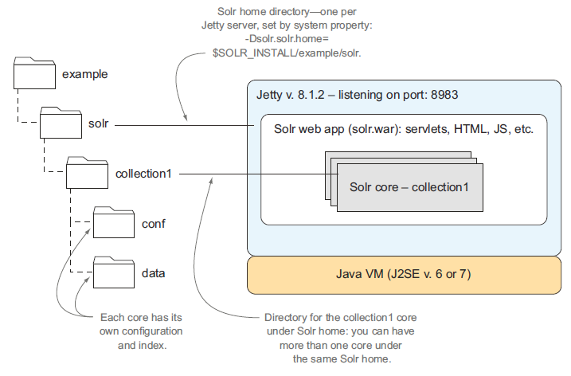
Core (cont.)

Slide 9
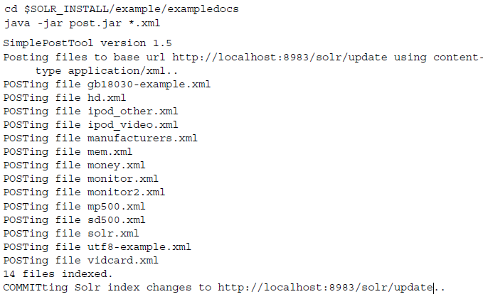
Core (cont.)
We can index data by running a tool that will call SOLR URL: http://localhost:8983/solr/update.

Slide 10
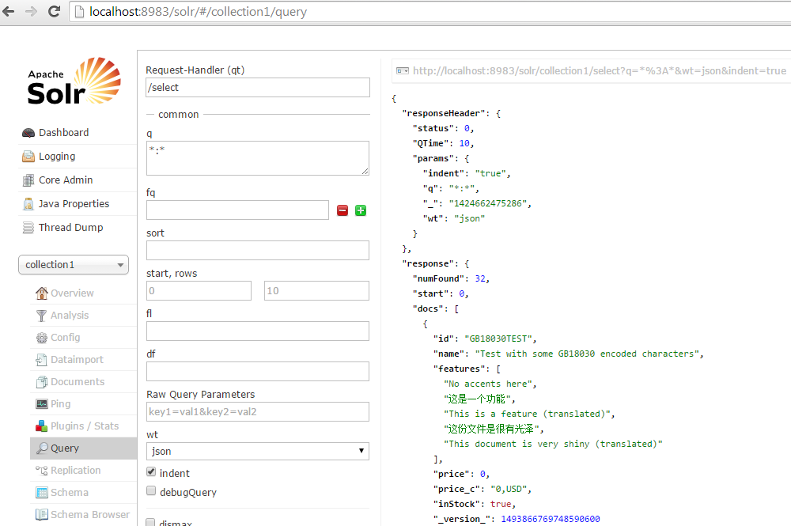
Core (cont.)
From Solr GUI we can query the data that we just added.

Slide 11
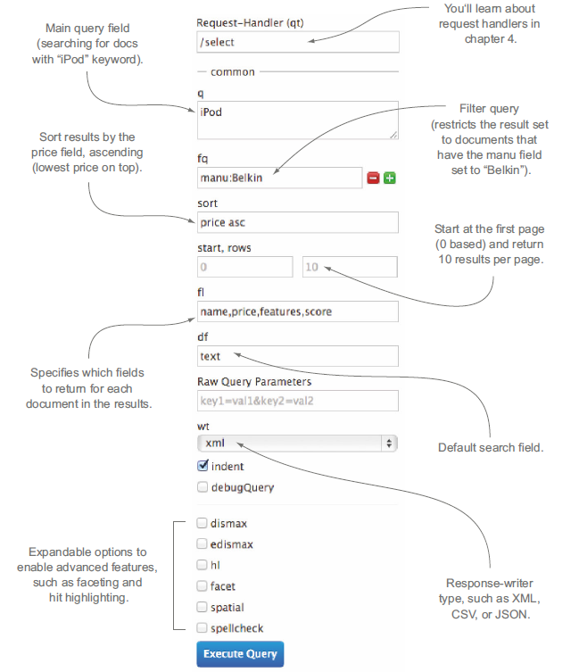
Core (cont.)

Slide 12
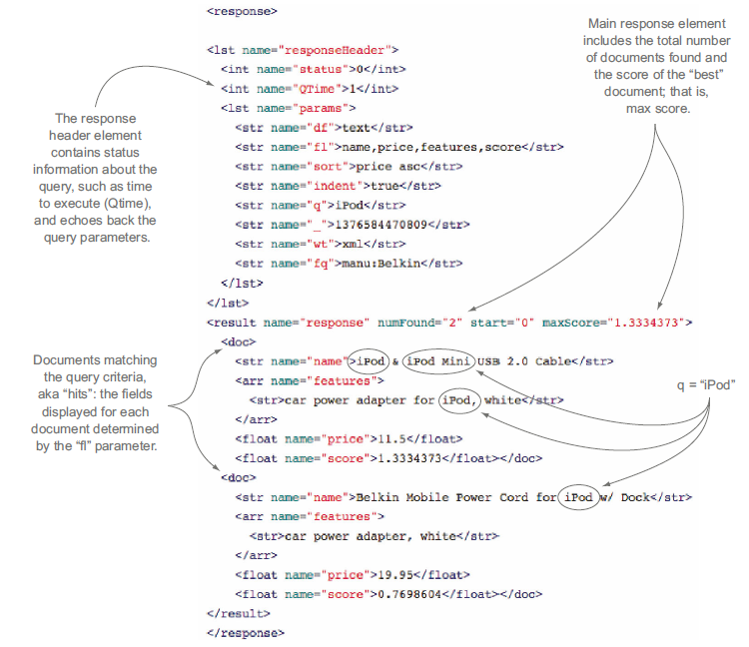
Core (cont.)

Slide 13
Core (cont.)
In Solr, a core is composed of a set of configuration files, Lucene index files, and Solr’s transaction log.
One Solr server running in Jetty can host multiple cores.
Solr also uses the term collection, which only has meaning in the context of a Solr cluster in which a single index is distributed across multiple servers.
Solr home is a directory structure that encapsulates one or more cores, which historically were configured by a configuration file named solr.xml.

Slide 14
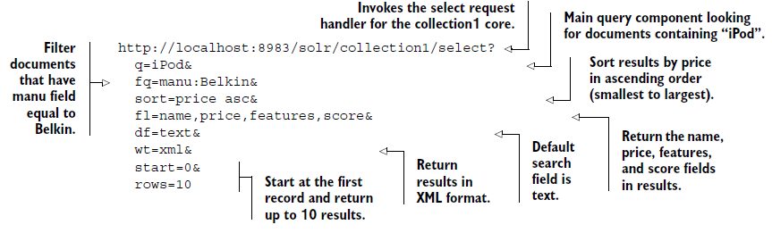
Core (cont.)
Requests to Solr happen over HTTP.
Query is done using HTTP GET requests.

Slide 15
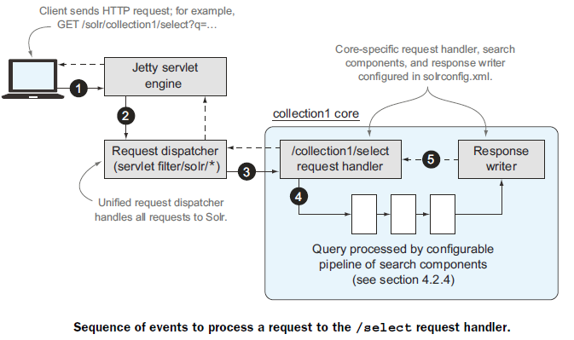
Core (cont.)
The main purpose of the request dispatcher is to locate the correct core to handle the request, such as collection1, and then route the request to the appropriate request handler registered in the core, in this case /select.

Slide 16
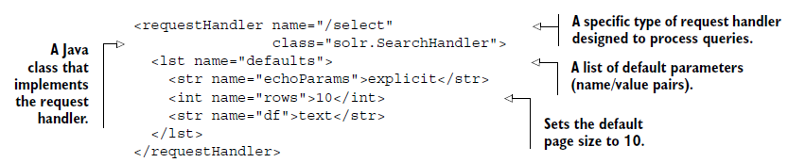
Core (cont.)
All select request handlers are implemented by solr.SearchHandler.
In Solr there are 2 main types of request handlers:
search handlers for query
update handler for indexing

Slide 17
Core (cont.)
Solr provides a number of built-in caches to improve query performance.
There are four main concerns when working with Solr caches:
Cache sizing and eviction policy
Hit ratio and evictions
Cached-object invalidation
Autowarming new caches

Slide 18
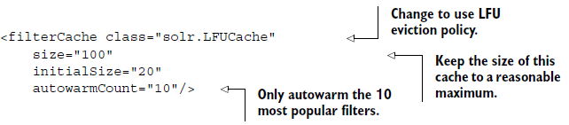
Core (cont.)
Solr requires you to set an upper limit on the number of objects in each cache.
Solr will evict objects when the cache reaches the upper limit, using either a Least Recently Used or Least Frequently Used eviction policy.
Solr creates a new searcher after a commit, but it doesn’t close the old searcher until the new searcher is fully warmed.
Some of the keys in the soon-to-be-closed searcher’s cache can be used to populate the new searcher’s cache, a process known as autowarming in Solr.
Every Solr cache supports an autowarmCount attribute that indicates either the maximum number of objects or a percentage of the old cache size to autowarm.

Slide 19
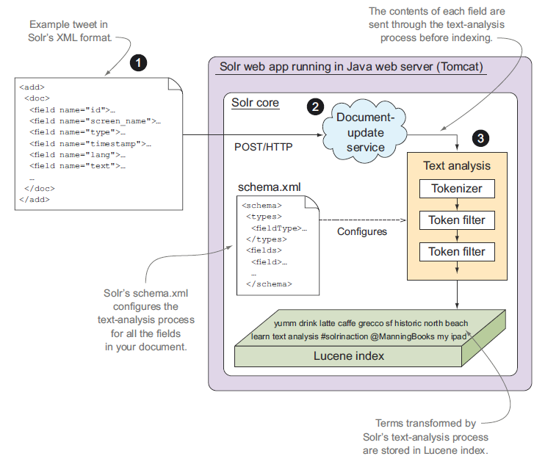
Core (cont.)

Slide 20
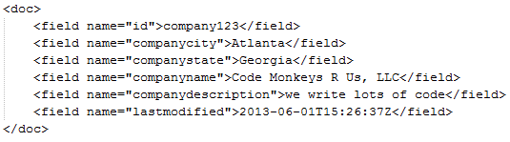
Solr Concepts
Solr is a document storage and retrieval engine.
Each document contains one or more fields, modeled as a particular field type: string, tokenized text, Boolean, date/time, lat/long, etc.
Each field is defined in Solr’s schema as a particular field type, which allows Solr to know how to handle the content as it’s received.

Slide 21
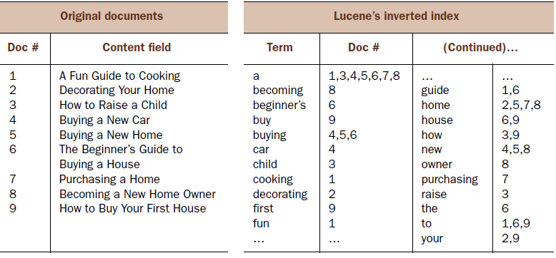
Solr Concepts (cont.)
A document is a collection of fields that map to particular field types defined in a schema.
Solr uses Lucene’s inverted index to power its fast searching capabilities.

Slide 22
Configuration
Solr focuses around three main XML files:
solr.xml: defines properties related to administration, logging, sharding, and SolrCloud.
solrconfig.xml: defines the main settings for a specific Solr core.
schema.xml: defines the structure of your index, including fields and field types.
The Solr web application uses a global Java system property (solr.solr.home) to identify the root directory from which to look for configuration files.
Solr scans the home directory for subdirectories containing a core.properties file, which defines basic properties for autodiscovered cores.
The core.properties file contains a single line defining the name of the core (ex: name=collection1).

Slide 23
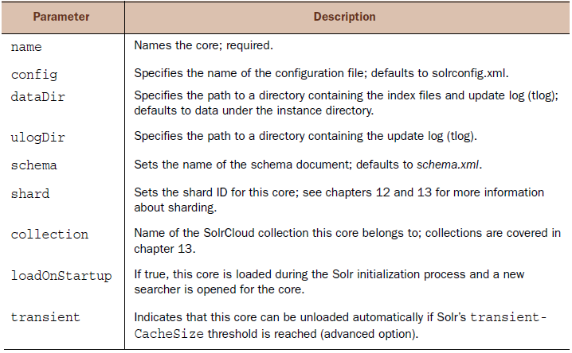
Configuration (cont.)
Bellow is a list of allowed parameters from core.properties.

Slide 24
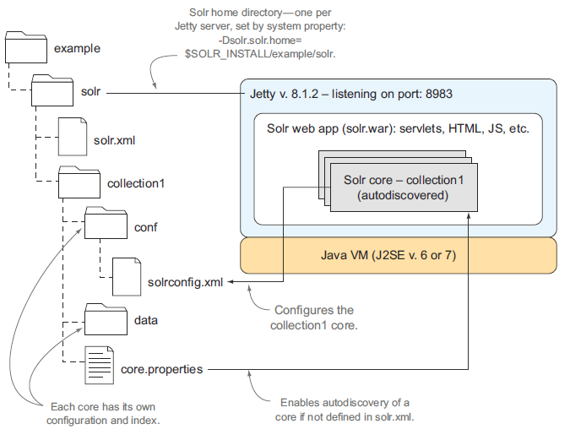
Configuration (cont.)

Slide 25
Configuration (cont.)
Solr can autodiscover cores during startup using core.properties.
Once a core is discovered, Solr locates the solrconfig.xml file under $SOLR_HOME/$instanceDir/conf/solrconfig.xml, where $instanceDir/ is the directory containing the core.properties file.
Solr uses the solrconfig.xml file to initialize the core.
The solrconfig.xml file contains index-management settings and contains a large number of complex sections.

Slide 26
Conclusions
High Performance .
High Scalability to very large clusters.
Solr has a web GUI based admin.

Slide 27

Bibliography
http://en.wikipedia.org/wiki/Apache_Solr
Manning – Solr in Action

