Slide 1

DWR
Dima Ionut Daniel

Slide 2

Contents
What is DWR?
Architecture
DWR Features
Creating Web Application
Annotations
Advanced DWR
Reverse Ajax
Security
Backend Integration
Conclusion
Bibliography

Slide 3

What is DWR?
DWR(Direct Web Remoting) is a Java open source library that helps developers write web sites that include Ajax technology. It allows code in a web browser to use Java functions running on a web server as if those functions were within the browser.
DWR is licensed under the commercial-friendly Apache Software License v2 for building AJAX applications.
DWR's main idea is to hide AJAX implementation details, like XMLHttpRequest so developers can concentrate on developing the application and business objects and leave the AJAX details behind the scenes.
DWR allows server-side Java classes to be used in the browser and also allows JavaScript functions to be used in the server (Reverse AJAX).
The term Reverse AJAX is used when a server is used to query and/or control the client browser behavior. DWR supports three different methods to do reverse AJAX in applications: Piggyback, Polling (by the client), and Comet (server push).
DWR dynamically generates JavaScript functions from Java classes via XML-based configuration, which can be called from browser via the DWR JavaScript library.
DWR includes a couple of JavaScript libraries that are required for DWR to work, and are also helpful for developers.
DWR supports: Firefox 1.x, Internet Explorer 6.0, Mozilla-based browsers from version 1.7, Opera version 7.5.4, Safari browsers from version 1.2, Konqueror browser.

Slide 4
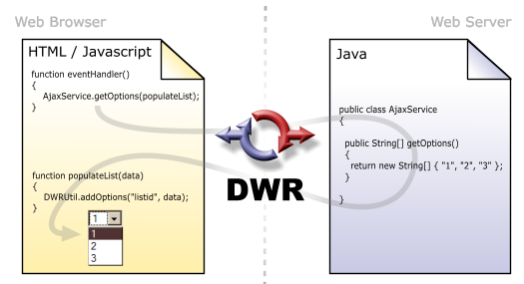
Architecure
DWR consists of two main parts:
- Code to allow JavaScript to retrieve data from a servlet-based web server using Ajax principles.
- A JavaScript library that makes it easier for the web site developer to dynamically update the web page with the retrieved data.
DWR allows to call server-side code in a way that looks like it is running locally in the browser from the point of view of the client-side JavaScript that makes the calls.

Slide 5
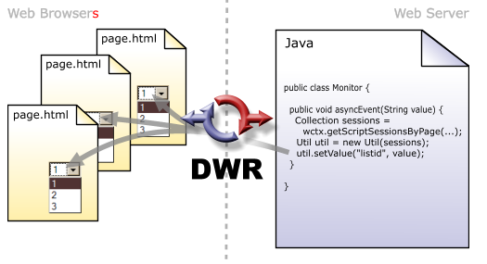
Architecure
Reverse Ajax (available since DWR version 2.0) allows Java code running on the server to find out what clients are viewing certain pages, and to send to them JavaScript, generated either manually or using a Java API.
DWR works by dynamically generating Javascript based on Java classes. The code does some Ajax magic to make it feel like the execution is happening on the browser, but in reality the server is executing the code and DWR is marshalling the data back and forwards.
This method of remoting functions from Java to JavaScript gives DWR users a feel much like conventional RPC mechanisms like RMI or SOAP, with the benefit that it runs over the web without requiring web-browser plug-ins.

Slide 6
DWR Features
Easy to use → we don't need to know about XmlHttpRequest or how to send a Java object to a browser. DWR is performing the required marshaling/unmarshaling of Java objects to JavaScript and vice versa.
Reverse Ajax → a server is used to query and/or control a client-browser behavior. A browser must always be the initiator of the connection. DWR supports three different methods to do Reverse AJAX in applications: Piggyback, Polling (by the client), and Comet (server push).
Provides a framework to expose JavaBeans as remote objects.
Supports call batching → can send many calls in a single request
Custom error handling.
Supports remote hooks → get notifications before/after a call.
Internal customizations like: POST/GET requests or XMLHttpRequest/IFrame.
Has a debug mode for testing RPCs.
Can be integrated with other web frameworks.

Slide 7
DWR Features
Reverse Ajax (available since DWR version 2.0) allows Java code running on the server to find out what clients are viewing certain pages, and to send to them JavaScript, generated either manually or using a Java API.
DWR works by dynamically generating Javascript based on Java classes. The code does some Ajax magic to make it feel like the execution is happening on the browser, but in reality the server is executing the code and DWR is marshalling the data back and forwards.
This method of remoting functions from Java to JavaScript gives DWR users a feel much like conventional RPC mechanisms like RMI or SOAP, with the benefit that it runs over the web without requiring web-browser plug-ins.

Slide 8
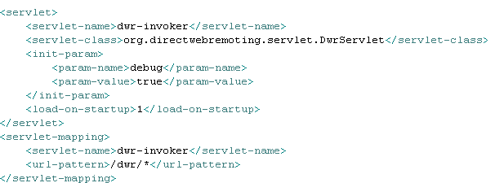
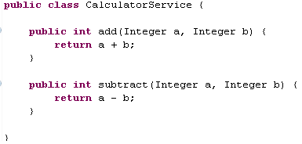
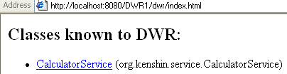
Creating Web Application
For using DWR we need to copy dwr.jar file into WEB-INF/lib directory and we need to declare DWRServlet into WEB-INF/web.xml descriptor. Into the web page we will need to import engine.js and the other generated client-side proxy stub our class(CalculatorService). The web application is named DWR1.

Slide 9
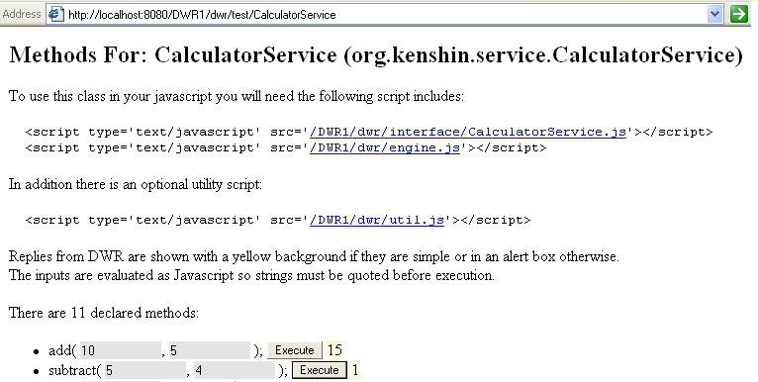
Creating Web Application
We can also test the CalculatorService class and we are suggested how to include the client-side library to use the remote bean.

Slide 10
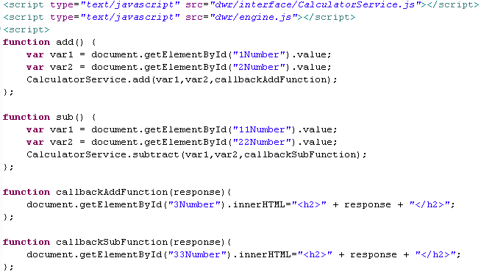
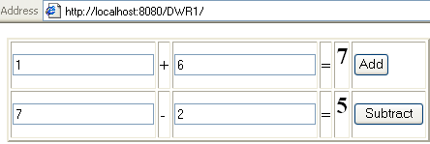
Creating Web Application
We import the 2 javascript libraries. The add() and the sub() functions are called when the Add button and the Subtract button is clicked.
When the Add button is called it will extract the 2 text fields values and will call the CalculatorService.add function.
The CalculatorService.add function has 3 parameters: the 2 operands and the callback function that is called when the response from the server arrives.

Slide 11

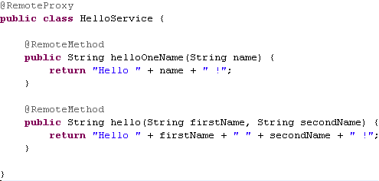

Annotations
DWR supports configuration by annotations instead of (or in conjunction with) XML configuration. To use annotations the DWR servlet entry in the web.xml file must have all the annotated classes specified in the classes init parameter.
The annotation @RemoteProxy makes a class available for remoting, and the name of its attribute specifies the JavaScript name for the object. The @RemoteMethod annotation defines the methods.
Conversions to make custom bean classes are available through @DataTransferObject and @RemoteProperty annotations.

Slide 12
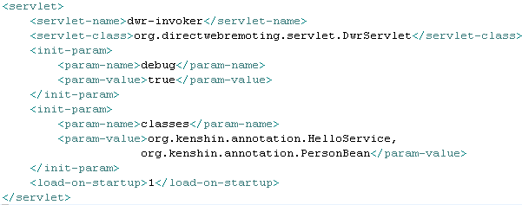
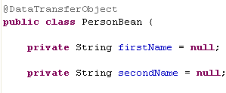

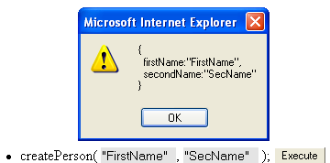
Annotations
We crete PersonBean as @DataTransferObject containing setters and getters. We define a new @RemoteMethod method that creates the PersonBean and wraps it to the client.
When we invoke the method, DWR creates the object from server side and then DWR it wraps it into the client-side format.

Slide 13
Advanced DWR
DWR includes a few JavaScript libraries that are required for DWR to work and utilities: engine.js, util.js, and gi.js. The core of DWR's browser-side functionality consists in engine.js and is required for all the pages that use AJAX and DWR. The util.js library contains useful utility functions but is not required for DWR. The gi.js library is used to integrate DWR with TIBCO General Interface(GI) for AJAX Applications.
The engine.js library is mandatory for DWR applications since it has functions to marshal calls from the dynamically generated JavaScript functions to remote Java classes in the server.
<script type='text/javascript' src='/<web_app_name>/dwr/engine.js'>
</script>
The engine.js library is also used to set the pre-and post-hook functions that are executed before the remote call and after the remote call is finished.
dwr.engine.setPreHook(requestStart);
dwr.engine.setPostHook(requestEnd);
function requestStart() {
alert('Request start');
}
function requestEnd() {
alert('Request end');
}
This feature is useful for debugging and also if we need to do modifications to the user interface, such as disabling components. Post hooks are used for enabling components disabled in the pre-hook function.

Slide 14
Advanced DWR
Other features of engine.js include the possibility to call the server in a batch with one or more remote functions that are called together. The example bellow calls three remoted methods in a batch with a timeout of 5 seconds.
dwr.engine.beginBatch();
Calculator.loadData();
Calculator.calculate(inputData);
Calculator.displayResults(data);
dwr.engine.endBatch({
timeout:5000
});
With the 'call ordering' feature enabled, responses to remote calls are received in the order they were sent.By default, call ordering is not enabled because it may slow down the application.
If call ordering is needed, it is enabled by adding dwr.engine.setOrdered(true) to the web page.

Slide 15
Advanced DWR
The org.directwebremoting.servlet.DrwServlet has many init parameters:
allowGetForSafariButMakeForgeryEasier → In Safari 1.x, there is a browser bug that causes the body contents of POST requests to be dropped. Setting this to true will make DWR work in that browser regardless. This defaults to false.
crossDomainSessionSecurity → Setting this to false will enable requests from other domains other than the one that app is hosted on. The default value is true.
allowScriptTagRemoting → Script tag remoting is a method of Ajax where a <script> tag is dynamically added to the page. The browser then goes and retrieves the specified JavaScript file. The default value is true.
debug → setting this value to true enables the test/debug page .Default value is false.
scriptSessionTimeout → the amount of time in milliseconds before a script session times out. The default is 1800000(30 minutes).
maxCallCount → the maximum number of requests allowed in a batch. The default is 20.
activeReverseAjaxEnabled → Used for the polling and Comet reverse Ajax techniques Default is false.
maxWaitingThreads → how many threads the servlet will keep in an active state for handling requests. The default is 100.
maxPollHitsPerSecond → when using the polling reverse Ajax method, this is the maximum number of requests per second allowed. The default value is 40.

Slide 16
Advanced DWR
preStreamWaitTime →the maximum amount of time in milliseconds to wait before opening a stream to reply. Default value is 29000.
postStreamWaitTime → the maximum amount of time in milliseconds to wait after opening a stream to reply. Default value is 1000.
ignoreLastModified → By default this is false. DWR uses Last-Modified headers to help the client determine when a request for a given resource should be made, thereby reducing those requests due to smart caching. Setting this to true will disable this capability.
scriptCompressed →DWR has the ability to perform a very simple compression of the returned JavaScript, and setting this parameter to true enables that compression (by default it’s false).
sessionCookieName → to support session, DWR can use URL rewriting to include the session cookie with each request it makes. The standard JSESSIONID cookie name is used, but this parameter we can use a different cookie name .
normalizeIncludesQueryString → When using reverse Ajax, pages with differing query strings are considered the same page. Setting this parameter to true (the default being false) will force DWR’s reverse Ajax implementation to consider the query string when comparing URLs.
overridePath → Using this parameter, you can override the path DWR uses to account for this. By default, this is not used.

Slide 17
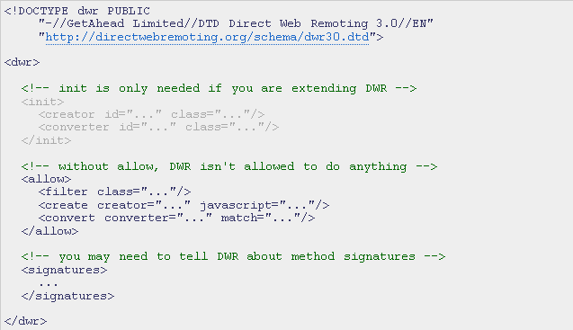
Advanced DWR
DWR actually offers two ways of configuring the DWR-specific configuration, through Java 5 (and up) annotations and the dwr.xml file.
The dwr.xml file consists in 3 main sections: init, allow and signature. The init section it’s used when we want to extend DWR. In the allow section we defined which classes DWR can create and convert for usage. DWR uses reflection to find out which types it should use in the conversion process. Sometimes the type information isn’t available so we’ll give a hint in the signature section.

Slide 18
Advanced DWR
DWR comes with a number of creators to deal with a number of bean types. Built-in DWR creators:
new → uses the new operator.
none → doesn’t create objects
spring →gives access to beans through Spring
jsf → Uses objects from JSF, or Java Server Faces.
struts → Uses Struts ActionForm beans.
pageflow → Gives access to a PageFlow from Beehive or WebLogic.
ejb3 → An experimental creator to give access to EJB3 session beans.
The <init> section is used to create custom creators and converters. We declare elements in the <init> section, giving it an ID that we can reference in the rest of the configuration. In the <allow> section we tell DWR what beans can be remoted or how custom beans that are parameters or return types will be marshaled to and from JavaScript.
The <create> element from <allow> section is used for creating. The javascript attribute represents the name of the object we’ll interact with in your client code. Optionally, the scope attribute can be used with these values: application, request, session, and page The default value is page.
The <param> element from <create> element gives additional pieces of information for the creator.
The <auth> element, also a child of the <create> element, is for integrating with J2EE container-managed security.

Slide 19
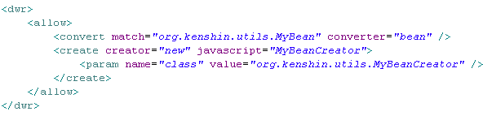
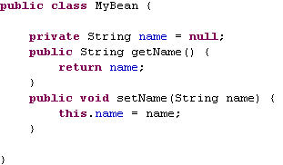
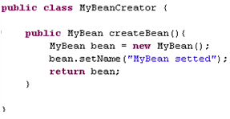
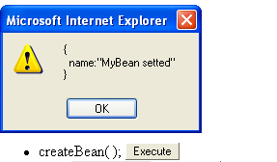
Advanced DWR
Finally, the <include> and <exclude> elements, again children of the <create> element, define a list of methods the creator will allow or deny access to.
We can return an "MyBean" instance from inside "MyBeanCreator" using the "bean" converter. This is disabled by default due to security concerns. DWR will be able to marshal the MyBean instance into a suitable JavaScript object,and vice versa.

Slide 20
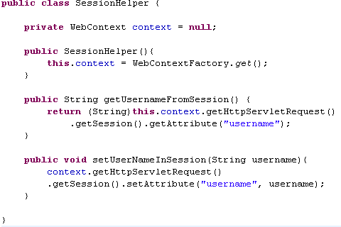
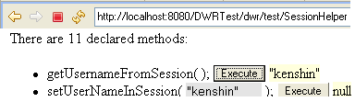
Advanced DWR
DWR can interact with it from the server-side code with 2 classes: WebContext and WebContextFactory.
org.directwebremoting.WebContext wc = org.directwebremoting.WebContextFactory.get();
javax.servlet.http.HttpServletRequest request = wc.getHttpServletRequest();
javax.servlet.http.HttpServletResponse response = wc.getHttpServletResponse();
javax.servlet.ServletConfig config = wc.getServletConfig();
javax.servlet.ServletContext context = wc.getServletContext();
javax.servlet.http.HttpSession session = wc.getSession();

Slide 21
Advanced DWR
The engine.js code exports a DWREngine object. This object allows you to set a number of options to control how DWR works with many options.
async → used to specify whether Ajax calls made via DWR are asynchronous or not.
headers → set extra headers to attach to the Ajax calls.
parameters → set request parameters to go along with the request, accessed on the server via request.getParameter() as usual.
httpMethod → sets the HTTP method (generally GET or POST).
rpcType → can use the typical XMLHttpRequest object, or it can use a method based on iFrames, or another
method based on dynamically creating <script> tags.
timeout → amount of time, in milliseconds, after which a request will be cancelled.
errorHandler → set a JavaScript function to call when any client-side errors occur.
warningHandler → by default not used, but it allows you to handle errors.
textHtmlHandler → set JavaScript to execute when a response is received from the server that isn’t a proper DWR-created response.
preHook → a function to be executed just before the Ajax call is made.
postHook → a function to be executed just after the Ajax call is made.
ordered → specifies whether DWR should provide ordered execution of multiple calls.
pollType → When using reverse Ajax it specifies whether to use the XMLHttpRequest method or iFrame method.
reverseAjax → specifies if DWR should be looking for inbound calls with each outbound request.

Slide 22
Advanced DWR
Each of these options can be set in three ways. They can be set globally, so that they affect every call DWR makes(example DWREngine.setTimeout()). Second, they can be set at the batch level (by passing them as parameters to the endBatch() function). Third, they can be set at a call level, by sending them as parameters to the method itself.
One other thing of note is that certain options like: ordered, pollType, and reverseAjax, cannot be applied to an individual call, whereas the other options can.
The util.js library contains many useful JavaScript functions. This library is designed to be used even without the rest of DWR functionality. The library has functions to manipulate HTML elements including tables, lists, and images.
addOptions → Allows addition of elements without page refresh to lists and select elements (ol, ul, and select) specified by ID(dwr.util.addOptions(id, [ "1", "2", "3" ])).
byId → finds the element in the current HTML document with the given ID.
getValue → gets value from HTML elements such as div and input elements(dwr.util.getValue(id)).
getText → designed for select lists and returns the displayed text instead of the value of the current option.
onReturn → useful to catch an event when return is pressed on a text element(dwr.util.onReturn(event,
submitFunction)).
setValue → sets the value of specified HTML element.
toDescriptiveString → prints a JavaScript object in human-readable form.
useLoadingMessage → DWR-specific loading message that shows "loading" on the top right corner.

Slide 23
Advanced DWR
DWR has a concept called handlers for error handling and exception handling on the browser side.
There are 4 handlers specified by DWR:
- errorHandler → something is broken(like server crushed)
- warningHandler → something is wrong and DWR can't detect the severity
- exceptionHandler → catch exceptions that are thrown by the server side code.
- textHtmlHandler → handles non-JavaScript responses.
Handlers are set in JavaScript code on the client as: dwr.engine.setErrorHandler(handlerFunction);
Exceptions are handled by exceptionHandler or errorHandler. DWR does not include any information about the exception in the error message. An exception object may look like:
{
javaClassName:'java.lang.Throwable',
message:'Error'
}
More detailed exceptions are enabled by adding the following line to dwr.xml:
<convert match="java.lang.Exception" converter="exception"/>

Slide 24
Reverse Ajax
DWR supports three different methods to do Reverse AJAX in applications: Piggyback, Polling (by the client), and Comet (server push).
Piggyback → Whenever a server has an update to be sent to the client, it waits until the client opens a connection and requests some content from the server. The Piggyback method is the default method for Reverse AJAX in DWR and it is called Passive Reverse AJAX. The other methods are called Active Reverse AJAX. A downside to Piggyback is that any update that happens on the server side may take a long time before it is visible to users. DWR has a class called ScriptProxy that is used to execute JavaScript functions on the client.
Polling → DWR periodically polls the server if there are any events on the server side of the application that require updates to the web page. In order to use Polling we need to configure DWR to Active Reverse AJAX using init parameter to the DWR servlet in the web.xml.
<init-param>
<param-name>activeReverseAjaxEnabled</param-name>
<param-value>true</param-value>
</init-param>
Reverse AJAX using: dwr.engine.setActiveReverseAjax(true);
There is also the optional init parameter for specifying the poll interval with default interval is 5 seconds and can be changed:
<init-param>
<param-name>disconnectedTime</param-name>
<param-value>60000</param-value>
</init-param>

Slide 25
Reverse Ajax
Comet → The browser opens the connection and it is kept open so that the server can push updates to the browser when needed, and the latency for updates is very low.
Comet enables the server to send updates in response to the events, almost in real–time, and there is no need to wait for the user to open a connection or to use Polling.
Comet requires only the enabling of Active Reverse AJAX in the init parameter and the enabling of Reverse AJAX in the web page.
Active Reverse AJAX using Comet has two modes: Full Streaming Mode (default in DWR 2.0.3 and earlier versions) and Early Closing Mode (default in DWR 2.0.4 and later versions).
The Full Streaming Mode it the fastest and it enables near real-time responses to the client when an event occurs on the server. Every 60 seconds, DWR checks whether the browser is active or not by closing the connection and reopening it.
Early Closing Mode causes DWR to close the connection when browser receives the output and then to reopen it. There is the init parameter called maxWaitAfterWrite in milliseconds to wait before closing the connection (and reopening it) after receiving input from the server.

Slide 26
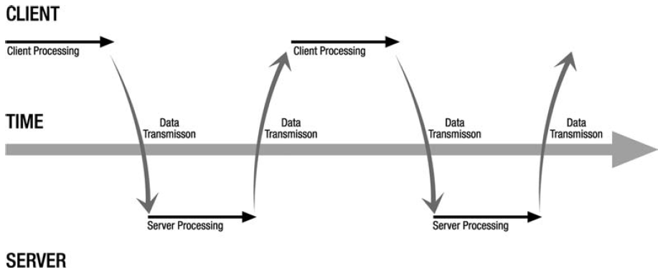
Reverse Ajax
The basic concept for Reverse Ajax is that instead of the client having to pull information from the server, the server can push information directly to the client.
The classic Web has a specific flow of events that characterizes it.
A user action on the client results in a request to the server, then some processing occurs on the server, and a response is returned to the client, the response being an entirely new UI view.

Slide 27
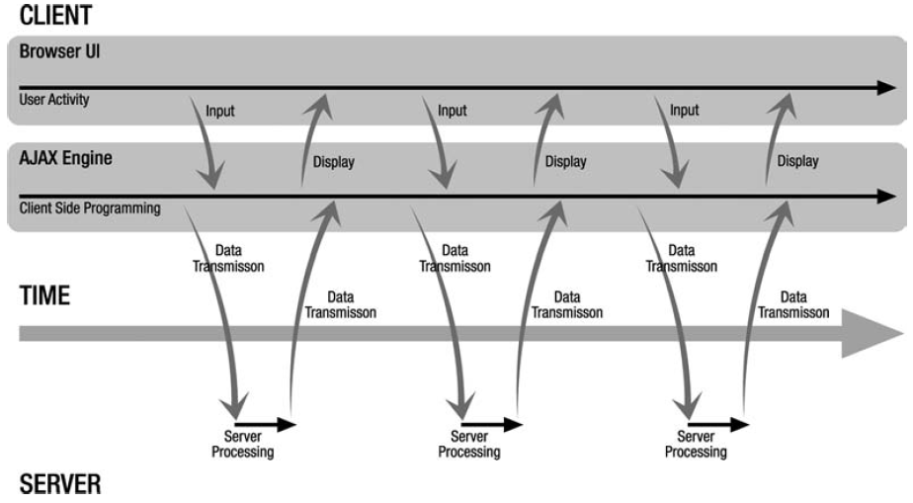
Reverse Ajax
An Ajax-based application has a slightly different sequence.
The user activity results in a call to some client-side Ajax engine, whether that’s our own JavaScript code or some library. This engine makes a request to the server, which does its processing as in the non-Ajax model, then returns the response. The response is handled initially by the Ajax engine, which then typically calls on some client code to update the page.
This sequence continues indefinitely until the user navigates away from the page.

Slide 28
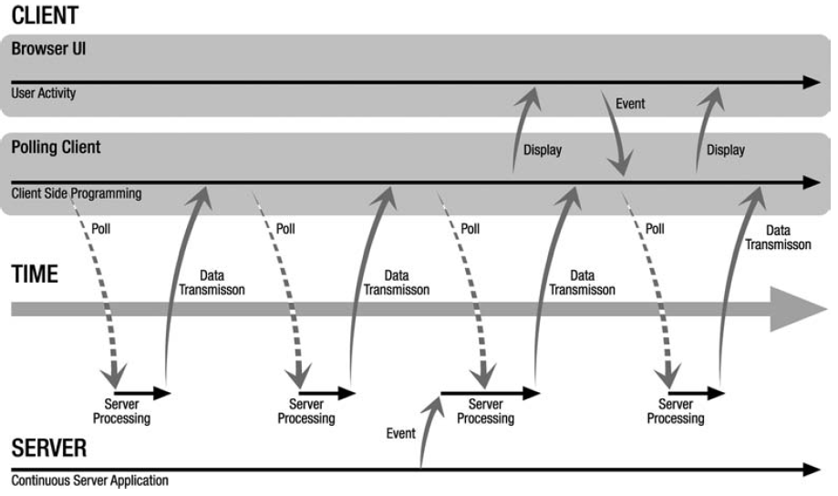
Reverse Ajax
The polling technique isn't specific to Ajax and is the simplest form of "server push" .

Slide 29
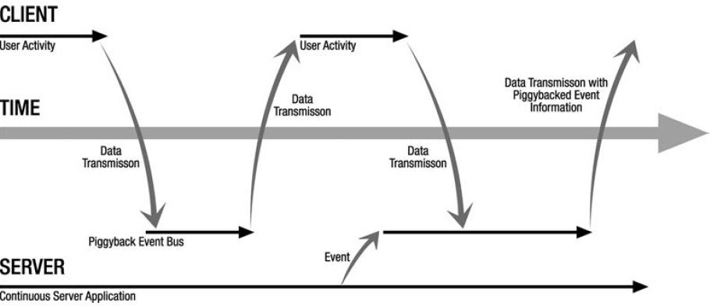
Reverse Ajax
The piggyback approach is the one “passive” method offered by DWR.
It is called passive because there is a user interaction that is required to make it work.

Slide 30
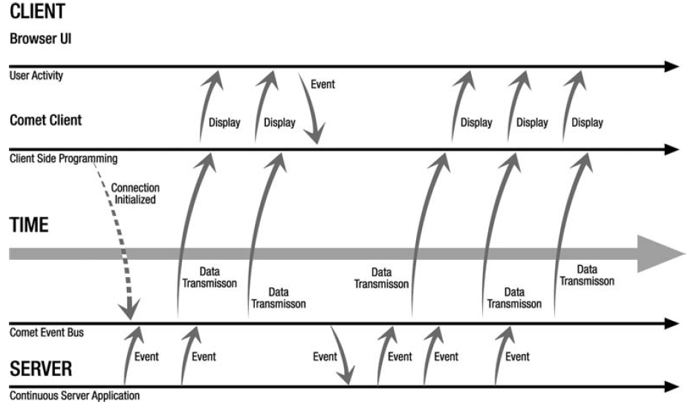
Reverse Ajax
Comet is the second active reverse Ajax method. The basic concept is very simple: a client makes a request to the server, and the server starts to respond. Data can then flow across this connection in both directions, giving you the potential for truly real-time updates initiated by the server.

Slide 31
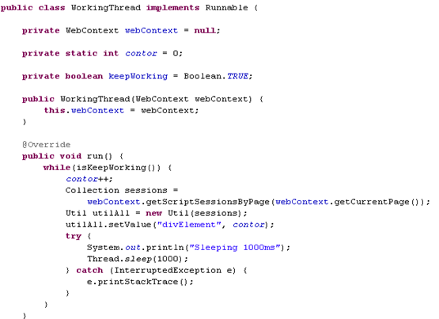
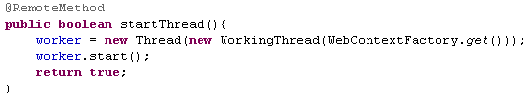
Reverse Ajax
DWR keeps track of each client that contacts it by storing a session for each. This is different from the usual HTTP session.
Once we have the name of the current page (as known to DWR), we can get a list of all the sessions currently connected to that page.
We can then get an instance of the Util class, which is the main interaction point in DWR between your Java code and the JavaScript on the client.
Here, we tell it to update the contents
of “divElement” with the contor element.

Slide 32
Security
Using DWR we specify in the dwr.xml configuration which Java classes and methods we want to remote to JavaScript.
The configuration in dwr.xml also includes a create entry for each remoted Java class. We can limit which methods are allowed using the include and exclude elements in dwr.
DWR automatically will not allow remoting of any class. For every class we wish to have remote access to, we must add a <create> element in the config file. By default, all methods of an allowed class will be accessible via remote call.
There are also security parameters in the web.xml configuration file such as allowScriptTagRemoting and crossDomainSessionSecurity, which when enabled, may be a huge security risk.
DWR can also be integrated with Spring Security.
By default, DWR looks for a file named dwr.xml in WEB-INF of your webapp. We can place the config file elsewhere adding an init parameter to the servlet like so:
<init-param>
<param-name>config</param-name>
<param-value>configFiles/dwrConfig.xml</param-value>
</init-param>
DWR will now load the file dwrConfig.xml from the directory configFiles, relative to the root of the webapp.

Slide 33
Security
We can specify multiple configuration files. We add more init parameters with a name in the form configXXXX, where XXXX can be anything.
The init parameters must all have different names, so the XXXX portion simply serves to make them unique.
<init-param>
<param-name>config1111</param-name>
<param-value>configFiles/dwrConfig1111.xml</param-value>
</init-param>
<init-param>
<param-name>config2222</param-name>
<param-value>configFiles/dwrConfig2222.xml</param-value>
</init-param>
DWR will load all the config files and combine them into one master configuration. We can define multiple instances of DWRServlet and assign them different url-pattern and different role access to secure.

Slide 34
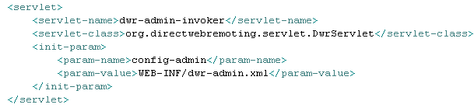

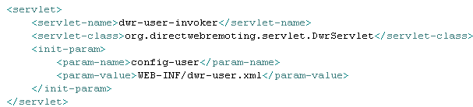

Security
We’ll protect the /dwradmin/* and /dwruser/* url pattern using the <security-constraint> element from the web-app.

Slide 35
Backend Integration
DWR integrates with the following:
JSF →Java Server Faces
Spring → complete Java/EE application framework
WebWork → web application framework
Struts → web application framework
Hibernate → object/relational persistence framework
Apache Jetspeed using JSR 168 portlets

Slide 36
Backend Integration
The Spring Framework is a very popular library , known for one component in particular: its IoC container.
The Spring beans are Java object (bean) that Spring creates automatically and injects into your classes.
Where DWR and Spring meet is in the ability of DWR to create beans via Spring and then call methods on it. DWR provides the spring creator, which knows how to look up a given bean in the beans.xml file, applicationContext.xml, depending on which version of Spring we are using.
<context-param>
<param-name>contextConfigLocation</param-name>
<param-value>/WEB-INF/beans.xml</param-value>
</context-param>
<listener>
<listener-class>org.springframework.web.context.ContextLoaderListener</listener-class>
</listener>
When the application starts up, this listener will execute and will configure Spring using the configuration file pointed to by the context parameter. If we don’t specify the contextConfiLocation context parameter the default value would be /WEB-INF/applicationContext.xml.

Slide 37
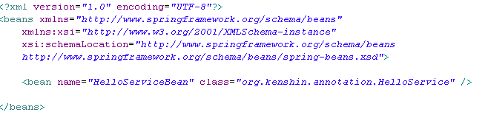

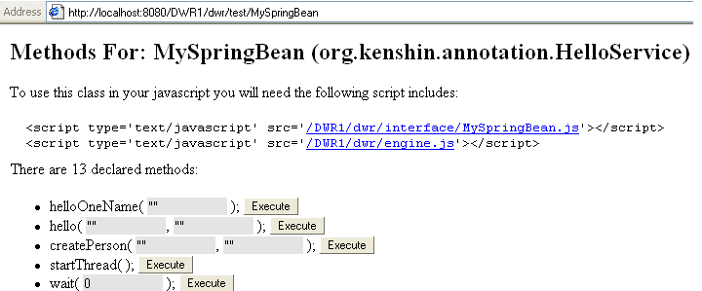
Backend Integration
We define in beans.xml the HelloServiceBean using the name and class attribute.
The “HelloServiceBean” name is used as reference in the dwr.xml file when the “MySpringBean” javascript object is created.

Slide 38
Backend Integration
JSF (Java Server Faces) is a popular for web application development, beeing part as a JavaEE specification.
DWR’s support of JSF is very similar to that of Spring in that it allows you to remote your managed JSF beans, and not much more.
We need a new filter added to web.xml to activate the JSF support and be able to use the JSFCreator:
<filter>
<filter-name>DwrFacesFilter</filter-name>
<filter-class>org.directwebremoting.faces.FacesExtensionFilter</filter-class>
</filter>
<filter-mapping>
<filter-name>DwrFacesFilter</filter-name>
<url-pattern>/dwr/*</url-pattern>
</filter-mapping>

Slide 39
Backend Integration
JSF (Java Server Faces) is a popular for web application development, beeing part as a JavaEE specification.
DWR’s support of JSF is very similar to that of Spring in that it allows you to remote your managed JSF beans, and not much more.
We need a new filter added to web.xml to activate the JSF support and be able to use the JSFCreator:
<filter>
<filter-name>DwrFacesFilter</filter-name>
<filter-class>org.directwebremoting.faces.FacesExtensionFilter</filter-class>
</filter>
<filter-mapping>
<filter-name>DwrFacesFilter</filter-name>
<url-pattern>/dwr/*</url-pattern>
</filter-mapping>

Slide 40


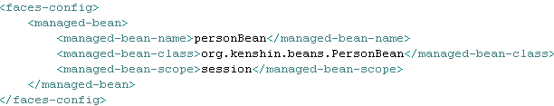
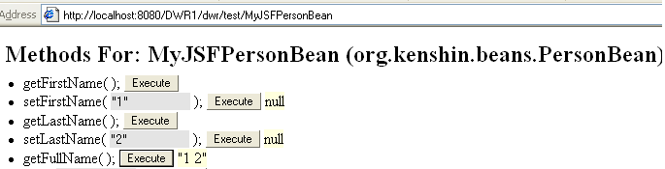
Backend Integration
We create a managed JSF bean “PersonBean”, we defined in the faces-config.xml file.
In the dwr.xml file we create a “MyJSFPersonBean” javascript object with the jsf creator.
In the debug page we can see the “MyJSFPersonBean” object defined by the DWR.

Slide 41

Conclusion
PROS
Client-side code is simplier
The business class(remote class) is not tied to HTTP. It means it will be more simplier to use unit tests and is more portable
The Ajax client side code is hidden
Can be integrated with other web frameworks
Fast response time
CONS

Slide 42

Bibliography
Apress Practical DWR 2 Projects
Packt DWR JavaAJAX Applications
http://en.wikipedia.org/wiki/DWR_(Java)
http://www.webperformancematters.com/journal/2006/3/25/managing-rias-6-measurement-challenges.html

