Slide 1

Selenium
Dima Ionut Daniel

Slide 2
Contents
What is Docker?
Architecture
Linux Containers
Copy on Write
Features
Core
Building Containers
Conclusions
Bibliography

Slide 3

What is Docker?
Docker is an open-source project that automates the deployment of applications inside software containers by providing an additional layer of abstraction and automation of OS virtualization.
Docker uses resource isolation features of the Linux kernel to allow independent containers to run within a single Linux instance avoiding the overhead of starting virtual machines.
Docker implements a high-level API to provide lightweight containers that run processes in isolation.
It is build on top of facilities provided by Linux kernel(cgroups and namespaces) and it doesn't require or include a separate operating system.

Slide 4
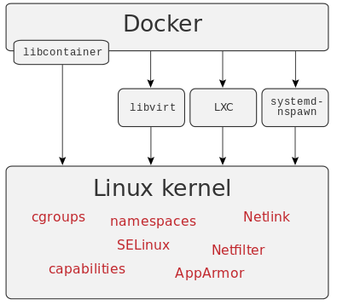
Architecture
Docker is a way of managing multiple containers on a single machine.
Fundamental support for containerization was actually included in the Linux 2.6.24 kernel to provide operating system-level virtualization and allow a single host to operate multiple isolated Linux instances, called Linux Containers (LXC).
LXC is based on Linux control groups (cgroups) where every control group can offer applications complete resource isolation (including processor, memory and I/O access).

Slide 5
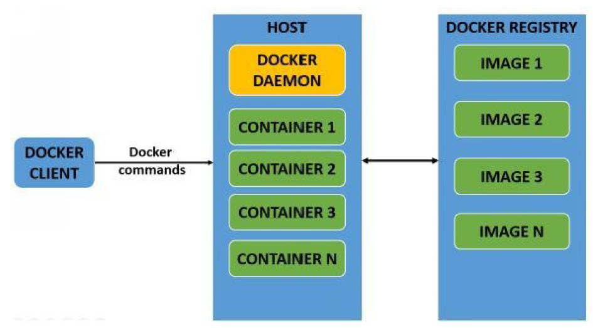
Architecture (cont.)
Docker has client/server architecture.
The Docker client instructs the Docker daemon for all the container specific tasks.
The communication between them is done by REST API.
Docker client and Docker daemon can be on the same host or different hosts.

Slide 6
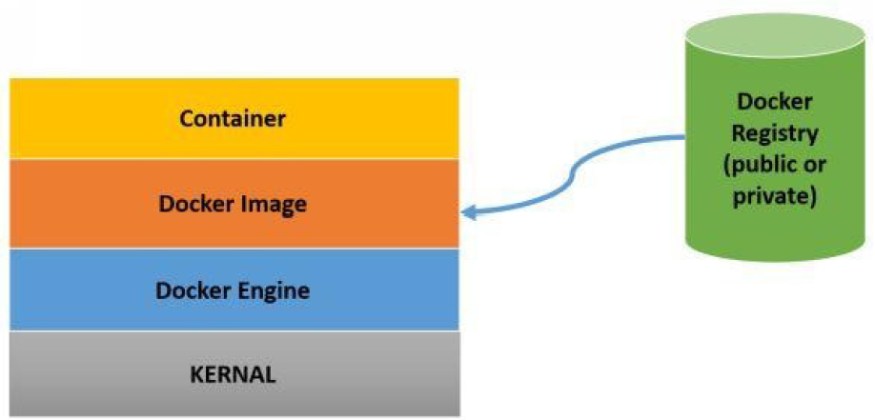
Architecture (cont.)
Docker daemon is responsible for all container operations.
Docker client can either be installed on the same host as Docker daemon or in a different host.
Docker has 3 internal components:
1. Docker image
2. Docker registry
3. Docker container

Slide 7
Architecture (cont.)
Docker image:
The Docker image is a template that consists of OS(Ubuntu,etc) and applications installed on it.
A Docker base image is the building block of a Docker container from where container is created.
Docker registry:
Docker registry is a repository for Docker images.
It can be public(Docker hub) or private.
The public Docker registry has a vast collection of official and user created images.
Docker container:
A container contains the execution environment for applications.
Each container has its own user space, network, security settings associated with it.

Slide 8
Linux Containers
Virtualization refers to the creation of virtual machines which have an independent OS.
It's possible that multiple virtual machines can share the same underlying hardware.
The software that provides virtualization capabilities and abstracts the hardware is called a “Virtual Machine Manager” or a “Hypervisor”.
Popular hypervisor platforms are VMware, HyperV, Xen and KVM

Slide 9
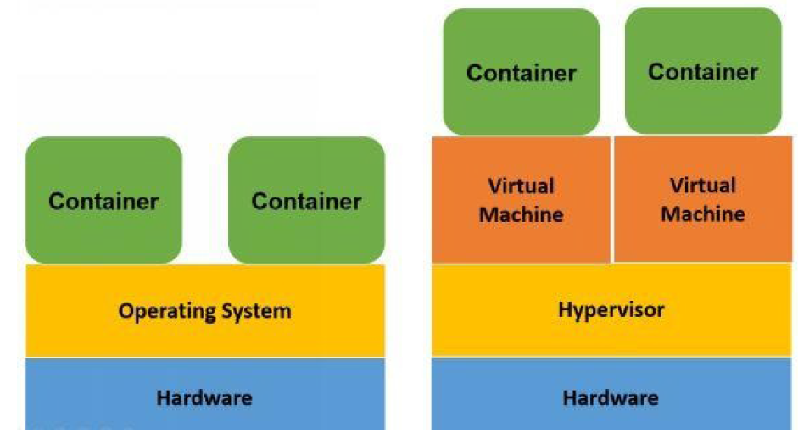
Linux Containers (cont.)
Docker works on a technology called Linux containers.
Linux containers are light weight virtualization system running on top of an operating system.

Slide 10
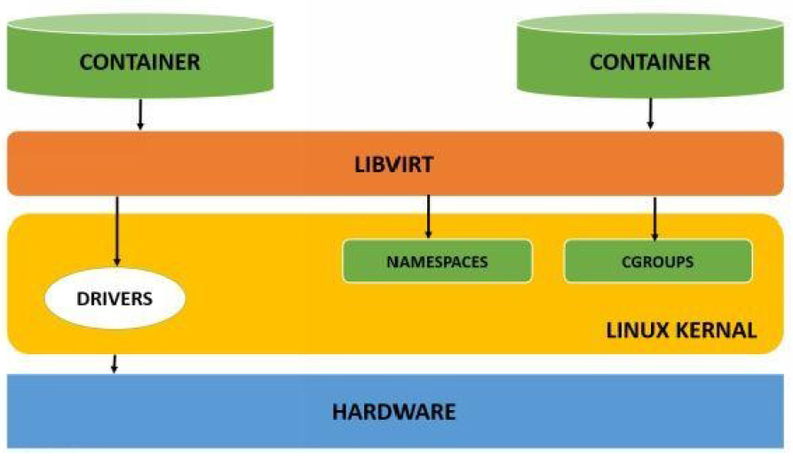
Linux Containers (cont.)
LXC containers have been gaining popularity in recent years because they can run on any Linux platform.
Linux based containers have 2 main concepts involved:
1. Namespaces.
2. Cgroups (Control groups.)

Slide 11
Linux Containers (cont.)
In Linux there are 6 types of namespaces that offer process level isolation for Linux resources.
Namespaces allow containers to have it's own network devices so that each container can have it's own IP address and hostname.
This lets each container run independently of each other.
Pid namespace
Every pid namespaces have own hierarchy and will be tracked by the kernel.
The parent pid’s can control the children pid’s but the children pid’s cannot signal or control the parent pid.
Net namespace
Each net namespace can have its own network interface.
Ipc namespace
This namespace isolates the inter-process communication.

Slide 12
Linux Containers (cont.)
Mnt namespace
It isolates the file system mount points for a set of processes.
Uts namespace
It provides isolation for hostname and NIS domain name.
User namespace
This namespace isolates the user and group ID namespaces.
User namespace allows per-namespace mappings of user and group IDS.
Cgroups(control groups) is a feature of Linux kernel for accounting, limiting and isolation of resources.
It provides means to restrict resources that a process can use.
Linux container is basically a process or a set of processes than can run in an isolated environment on the host system.

Slide 13
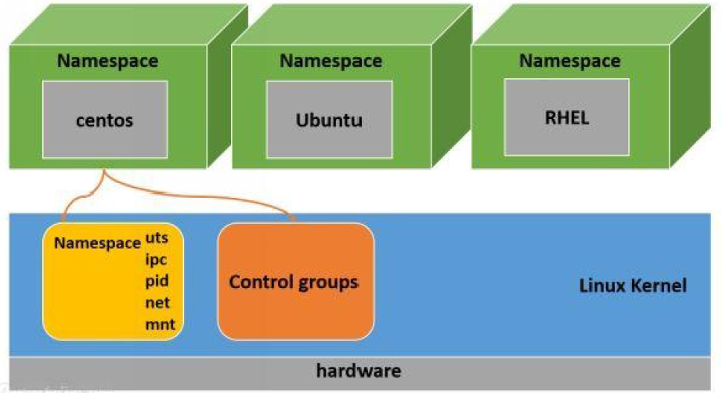
Linux Containers (cont.)

Slide 14
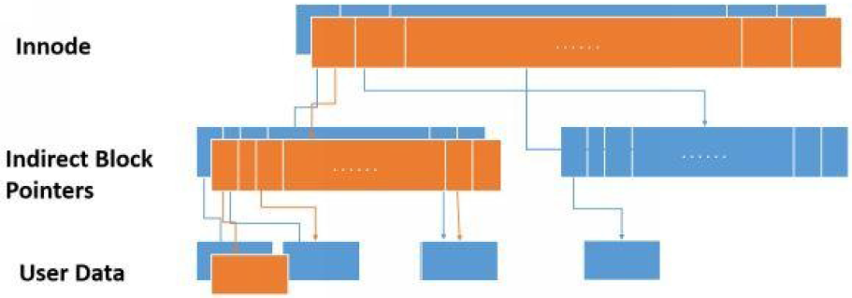
Copy on Write
All new data is overwritten on top of existing data and creates a new copy.
Linux file system copy on write file system never overwrites the live data.
Instead its updating using the existing unused blocks in the disk using copy on write functionality(COW).
When we modify an existing data, it will be written on unused blocks in the file system leaving the original data unmodified.
Once the modification is complete, the pointers to original data remain unmodified and there will be new set of pointers, blocks and innode for the updated data

Slide 15
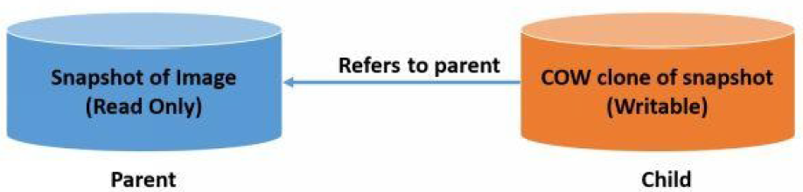
Copy on Write (cont.)
One of the file systems used by Docker is BTRFS.
Resources are handles using Copy on Write (COW) when same data is utilized by multiple tasks.
BTRFS uses the file system level snapshot ting to implement layers.
A snapshot is a read-only, point-in-time copy of the file system state.
Whenever a snapshot is created, the metadata associated with the original data is stored as a copy.

Slide 16
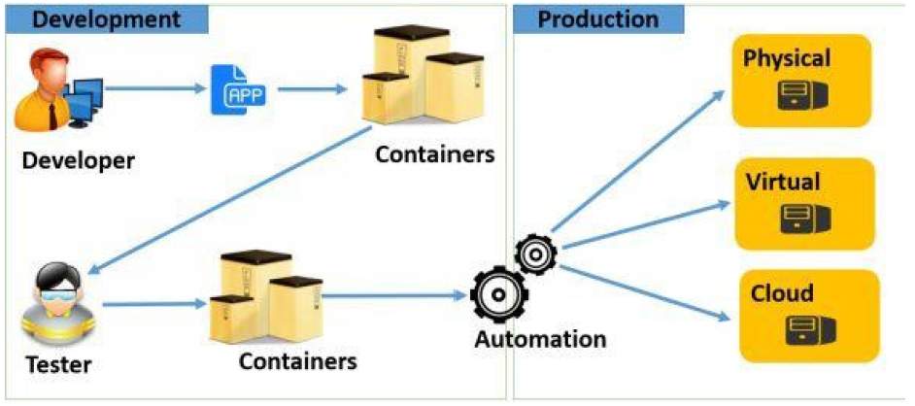
Features
Portable Deployments:
as containers are portable, the applications can be bundled in to a single unit and can be deployed to various environments without making any changes to the container
Scale and deploy with ease:
Docker containers can virtually run on any Linux system.
Containers can be deployed on cloud environments, desktops, on premise datacenters, physical servers and so on.
Fast application delivery:
deploy the applications to production environments really fast.

Slide 17
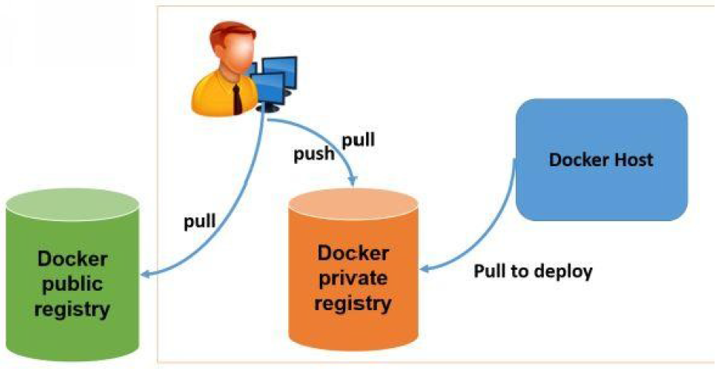
Features (cont.)
Images can be searched from Docker client and Docker hub web ui.

Slide 18
Core
Docker platform can be used by developers and system administrators for developing and shipping applications to different environments.
A developer can install and configure an application in Docker container, pass it on to an ops person and he can deploy it on to any server running Docker.
A container is started from an image, which may be locally created, cached locally, or downloaded from a registry.
Docker Inc operates the Docker Hub public registry, which hosts official repositories for a variety of operating systems, middleware and databases.

Slide 19
Core (cont.)
There are two ways to create application packages for containers Manual and Dockerfile.
Manual builds
It starts by launching a container with a base operating system image.
Normal process for installation of an application on the operating system is performed and once the application is installed.
The container can be exported to a tar file or can be pushed to a registry like Docker Hub.
Dockerfile
The Dockerfile specifies the base image to start and then the other installation on top are defined as a series of commands that are run or files that are added to the container.
The Dockerfile also can specify other aspects of configuration of a container such as ports, default commands to be run on startup, etc.

Slide 20
Core (cont.)
Docker Hub is a repository for uploading and downloading Docker images.
The Docker command is associated with several arguments and flag.
The standard use of a Docker command is: docker [flags] [command] [arguments].
The -t flag assigns a terminal session for the container.
The -i assigns an interactive session for the container by getting the STDIN of the container.
The -d flag will run the container in the background.
docker run -i -t busybox /bin/sh --> will download busybox image and start a container with sh shell.
docker ps –a --> shows created containers.
docker run -i –t centos /bin/sh --> will download centos image and start the container with sh shell.
The docker command will list all the commands.

Slide 21
Core (cont.)
Docker images are the basic building blocks of a container.
All the images downloaded from the Docker hub reside in the Docker host.
In an image specified by the Docker run command isn't present in the Docker host by default, the Docker daemon will download the image from the Docker public registry.
Container is awritable layer on a top on an image.
We can list the Docker images by running "docker images" command.

Slide 22
Core (cont.)
Docker host will not have any images by default.
All the images have the following information: REPOSITORY, TAG, IMAGE ID, CREATED, VIRTUAL SIZE.
Once the image is downloaded we can create a container in seconds.
Images can be searched using Web Interface: https://registry.hub.docker.com/ or using the command line: "Docker search [image name]".

Slide 23
Core (cont.)
Dockerfile is a normal text file with instructions for configuring an image.
Instructions include tasks such as creating a directory, copying file from host to container, etc.
Every line in a Dockrefile starts with an instruction followed by a statement.
Every instruction creates a layer on the image when the image gets build from the Dockerfile.
Sample:
FROM ubuntu:14.04
MAINTAINER bibin wilson <bibin.w@hcl.com>
RUN apt-get update && apt-get install -y ruby ruby-dev
RUN gem install sinatra

Slide 24
Building Containers
Building docker images manually by executing commands can take a while.
There is no need for creating images manually when it can be automated using dockerfile.
Dockerfile contains instructions(commands) and arguments listed sequentially to automate the process of image building.
Dockerfile supports the following instructions
FROM
MAINTAINER
RUn
ENV
CMD
ADD
EXPOSE
ENTRYPOINT
USER
VOLUME
WORKDIR

Slide 25
Building Containers (cont.)
FROM: every dockerfile should begin with the FROM instruction and denotes the base image from which the new image will be created.
MAINTAINER: sets the author for the image.
RUN executes a shell command.
ENV set the evirnoment variables and it takes a key value pair as an argument.
CMD, like RUN can execute a specific command. The diference is that the command is executed after the container is created and not during the image building process.
ADD have a source and a destination and copies files.
COPY is used for copying files and folders from a source to the destination.

Slide 26
Building Containers (cont.)
The .dockerignorefile should contain all files and directories which has to be excluded.
Sample:
FROM ubuntu
MAINTAINER Bibin Wilson
RUN apt-key adv —keyserver keyserver.ubuntu.com —recv 7F0CEB10
RUN echo “deb http://downloads-distro.mongodb.org/repo/ubuntu-upstart dist 10gen” | tee -a /etc/apt/sources.list.d/10gen.list
RUN apt-get update
RUN apt-get -y install apt-utils
RUN apt-get -y install mongodb-10gen
CMD [“/usr/bin/mongod”, “—config”, “/etc/mongodb.conf”]

Slide 27
Building Containers (cont.)
EXPOSE associates the specified port for enabling networking between a docker coantainer and the outside world.
ENTRYPOINT starts every time a container is created using the image. It can be used with CMD command.
USER sets the UID(username) which has to be used to run the container from the image.
VOLUME is used to mount a specific file or a directory to a container.
WORKDIR sets the working directory for the RUN, CMD and ENTRYPOINT instructions.

Slide 28
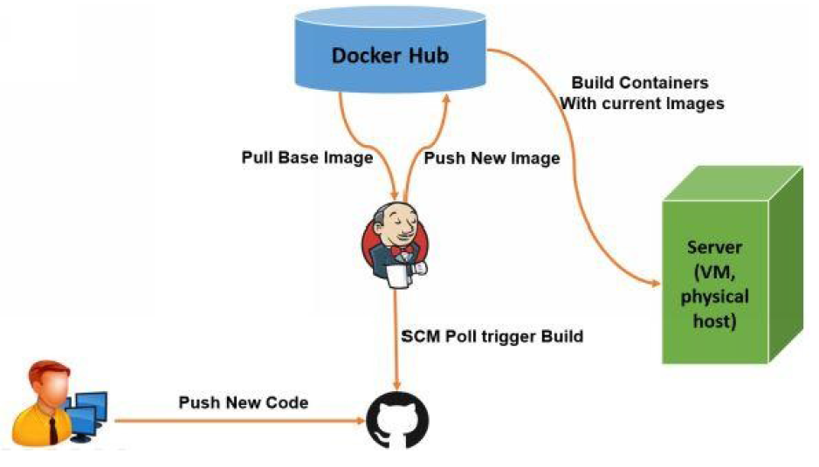
Building Containers (cont.)
Docker can be used with Jenkins.

Slide 29

Bibliography
http://en.wikipedia.org/wiki/Docker_%28software%29
Docker Hands on Deploy Administer Docker Platform

