Slide 1

ElasticSearch
Dima Ionut Daniel

Slide 2
Contents
What is ElasticSearch?
Architecture
Features
Terms
Configuration
Core
REST API
Indexing
Searching
Clustering
Bibliography

Slide 3

What is ElasticSearch?
Elasticsearch is a search server based on Lucene.
it provides a distributed, multitenant-capable full-text search engine with a REST web interface and schema-free JSON documents.
Elasticsearch is developed in Java and it released as open source under the terms of the Apache License.

Slide 4
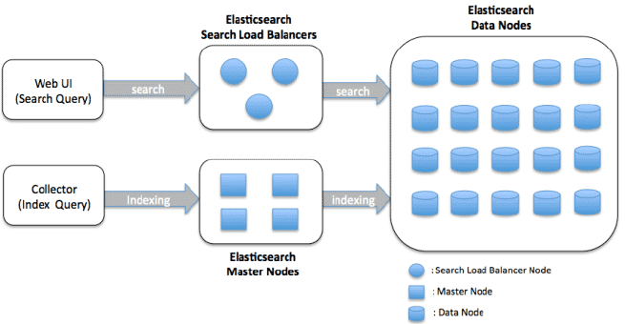
Architecture

Slide 5
Features
REST API based
used for communication
Scalable Map/Reduce model
every operation results in multiple Hadoop tasks that interact in parallel.
Memory and I/O efficient
focused on performance.
Adaptive I/O
elasticsearch detects transport errors and retries automatically.
Facilitates data co-location
integrates with Hadoop exposing its network access information, allowing co-located Elasticsearch and Hadoop clusters to be aware of each other and reduce network IO.

Slide 6
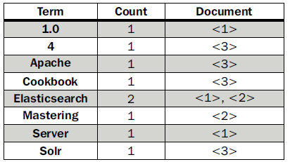
Terms
Document : main data carrier used during indexing and searching, comprising one or more fields that contain the data.
Field: section from document which is build of 2 parts: the name and the value.
Term: unit of search representing a word from the text.
Token: occurrence of a term in the text of the field.
If we have 3 documents the index will look like:
Elasticsearch Server 1.0 (document 1)
Mastering Elasticsearch (document 2)
Apache Solr 4 Cookbook (document 3)

Slide 7
Configuration
The configuration is located in the config directory.
There are 2 files: elasticsearch.yml(or elasticsearch.json) and logging.yml.
Elasticsearch.yml is setting the default configuration.
These values can be changed ar runtime without the cluster.name and node.name values.
Logging.yml file defines which information should be logged.

Slide 8
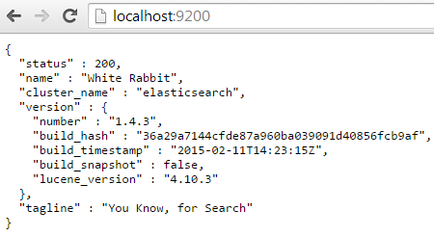
Core
Analysis represents the process of transforming the data.
Analysis is done by the analyzer, which is built of a tokenizer and 0 or more token filters and can have 0 or more character mappers.
The Lucene tokenizer is spliting text into tokens, and the work is called token stream.
The default port used for the HTTP API is 9200 and if we access http://127.0.0.1:9200/ we get from ElasticSearch the following response.
The output is structured as a JSON (JavaScript Object Notation) object.

Slide 9
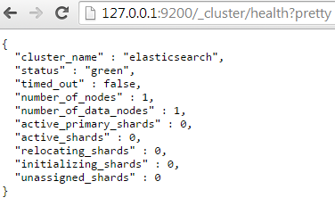
Core (cont.)
We can check cluster health using the URL: http://127.0.0.1:9200/_cluster/health?pretty.
We can close the ElasticSearch by closing the process POST request to http://localhost:9200/_cluster/nodes/_shutdown.

Slide 10
Core (cont.)
Elasticsearch is built to be always available and scalable.
A node is a running instance of Elasticsearch, while a cluster consists of one or more nodes with the same cluster.name that are working together to share their data and workload.
As nodes are added to or removed from the cluster, the cluster reorganizes itself to spread the data evenly.
One node in the cluster is elected to be the master node, which is in charge of managing cluster-wide changes like creating or deleting an index, or adding or removing a node from the cluster.

Slide 11
Core (cont.)
To add data to Elasticsearch, we need an index, a place to store related data.
An index is just a “logical namespace” which points to one or more physical shards.
A shard is a low-level “worker unit” which holds just a slice of all the data in the index.
Shards are how Elasticsearch distributes data around your cluster.
The documents are stored and indexed in shards, but the applications don’t talk to them directly, they talk to an index.
A shard can be either a primary shard or a replica shard.
Replicas are used to provide redundant copies of your data to protect against hardware failure, and to serve read requests like searching or retrieving a document.

Slide 12
Core (cont.)
In Elasticsearch, all data in every field is indexed by default.
Most entities or objects in most applications can be serialized into a JSON object, with keys and values.
A document doesn’t consist only of its data because it contains metadata:
_index: Where the document lives.
_type: The class of object that the document represents.
_id: The unique identifier for the document.
An index is like a “database” in a relational database — it’s the place we store and index related data.
In Elasticsearch the type attribute for documents represent the same class of “thing”, because they share the same data structure.
The id is a string that, when combined with the _index and _type, uniquely identifies a document in Elasticsearch.

Slide 13
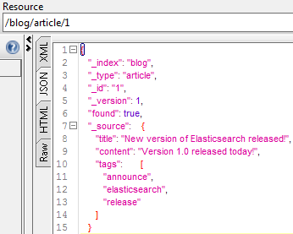
REST API
In Elasticsearch we can store information using the PUT HTTP request.
curl -XPUT http://localhost:9200/blog/article/1 -d '{"title": "New version of Elasticsearch released!", "content": "Version 1.0 released today!", "tags": ["announce", "elasticsearch", "release"] }'
We can retrieve the stored information using the GET request.
curl -XGET http://localhost:9200/blog/article/1
In order to delete the document the DELETE HTTP method can be used:
curl -XDELETE http://localhost:9200/blog/article/1

Slide 14
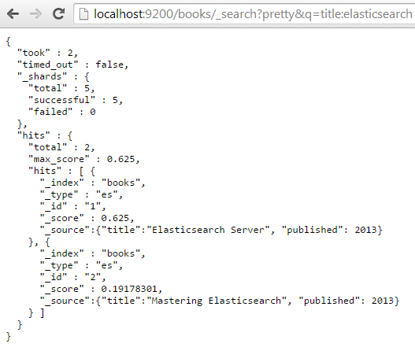
REST API (cont.)
By default, Elasticsearch increments the version when a document is added, changed or deleted.
We can perform query using in the URL the "q" parameter and we need to specify the terms.

Slide 15
REST API (cont.)
The default_operator property can be set to OR or AND and allows to specify the default Boolean operator used for query.
By default it's set to OR, which means that a single query term match will be enough for a document to be returned.
By default Elasticsearch doesn't have timeout for queries, but we can use the timeout parameter to return data using timeout.
Sample query URL: http://localhost:9200/books/_search?pretty&q=published:2013&df=title&explain=true&default_operator=AND.

Slide 16
REST API (cont.)
We can use the sort parameter to specify custom sorting.
By default Elasticsearch is returning documents by their score in descending order.
We can sort by certain field like: sort=published:desc.
We can specify the window size results using 2 parameters: size and from.
The size parameter has 10 as default and defines the maximum number of results returned.
The from parameter defaults to 0 and specifies from which document the results should be returned.
If we want to retrieve 5 documents starting from the 11 one we use in the query: size=5&from=10.

Slide 17
REST API (cont.)
Sample update request:
POST /website/blog/1/_update
{
"doc" : {
"tags" : [ "testing" ],
"views": 0
}
}

Slide 18
Indexing
Elasticsearch index is build of 1 or more shards and each of them contains part of document set.
Each of these shards can have replicas(copies of the shard).
During index creation we can specify how many shards and replicas should be created.
Having a shard and its replica, in general, means that when we index a document we will modify them both.

Slide 19
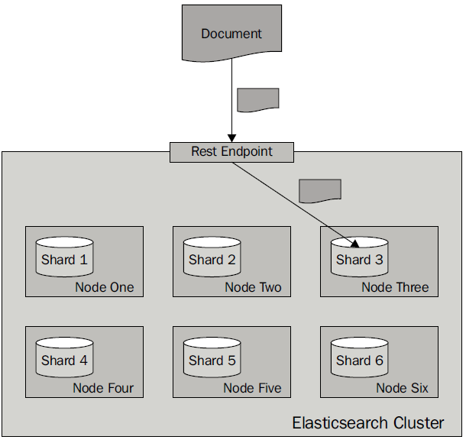
Indexing (cont.)
More shards allow to spread indeces to more server and we can handler more documents without losing performance.
More shards means that fewer resources are required to fetch a particular document because fewer document are stored in a single shared compared to the documents stored in a deployment with fewer shards.
When we have more replicas the higher the query throughput will be because the query can use either a shard or any of its copies.

Slide 20
Indexing (cont.)
Indexing corresponds to both "Created" and "Update" documents based on a given type and ID.
URL: http://localhost:9200/<index>/<type>/[<id>]
Index and type are required while the id part is optional.
If we don't specify an ID ElasticSearch will generate one.
If we don't specify an ID it's best to use POST method instead of PUT.
The index name is arbitrary.

Slide 21
Searching
Elasticsearch supports two kinds of queries: basic ones and compound ones.
Basic queries such as the term query are used for querying the actual data.
The second type of query is the compound query, such as the bool query, which can combine multiple queries.
In addition we can have filter queries that are used to filter the results with certain criteria.

Slide 22
Searching (cont.)
In order to search with ElastiSearch we can use the _search endpoint optionally with an index and type.
The search URL pattern is <index>/<type>/_search where index and type are both optional.
http://localhost:9200/_search - Search across all indexes and all types.
http://localhost:9200/movies/_search - Search across all types in the movies index.
http://localhost:9200/movies/movie/_search - Search explicitly for documents of type movie within the movies index.

Slide 23

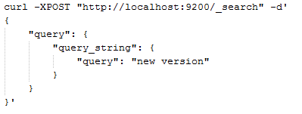
Searching (cont.)
ElasticSearch can search using the query DSL.
The request body should be a JSON object that can contain certain query property.
The query result will contain information about:
execution time
actual results
total number of documents that match the query
array with search hits
metadata about the hit

Slide 24
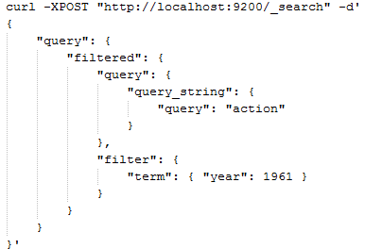
Searching (cont.)
To the query DSL we can add filters like:

Slide 25
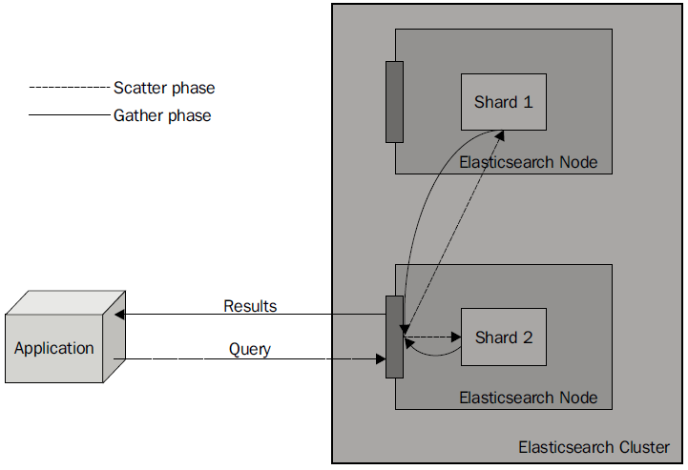
Searching (cont.)
the query process will consist of two phases: scatter and gather.

Slide 26
Searching (cont.)
When we send a query, we send it to one of the Elasticsearch nodes.
The query is distributed to all the shards that our index is built of.
Ex: if it is built of five shards and one replica, then five physical shards will be queried.
Each of the queried shards will only return the document identifier and the score of the document.
After all the documents have been gathered, the final response is built and returned as the query result.

Slide 27
Clustering
When Elasticsearch node start its looking for a master node that has the same cluster name and is visible.
If a master is found, the node joins a cluster that is already formed.
If no master is found, the node itself is selected as a master.
The process of forming a cluster and finding nodes is called discovery.
By default Elasticsearch uses the zen discovery, which provides multicast and unicast discovery.

Slide 28
Clustering (cont.)
Master node
The master node is the one that checks all the other nodes to see if they are responsive.
Other nodes ping the master too.
The master node will also accept the new nodes that want to join the cluster.
If the master is somehow disconnected from the cluster, the remaining nodes will select a new master from among themselves.

Slide 29
Clustering (cont.)
By default, Elasticsearch allows every node to be a master node and a data node.
For performance reasons is best to have different data nodes.
We need to setup in elasticsearch.yml configuration file:
node.master: false
node.data: true

Slide 30

Bibliography
http://en.wikipedia.org/wiki/Elasticsearch
Packt Publisher – Elasticsearch Server 2nd Edition
http://joelabrahamsson.com/elasticsearch-101/
http://www.elasticsearch.org/guide/en/elasticsearch/hadoop/current/features.html

