Slide 1

Glasshfish 3
Dima Ionut Daniel

Slide 2
Contents
What is Glassfish?
Glassfish Goals
Architecture
Java EE 6
Glassfish Administration
EJB 3.1/JPA 2.0
Java Servlet 3.0
Java Serves Faces 2.0
Web Services with JAX-WS
REST, JAX-RS and Jersey
Context and Dependency Injection
Conclusion
Bibliography

Slide 3


What is Glassfish?
GlassFish is an open-source application server project started by Sun Microsystems for the Java EE platform and now sponsored by Oracle Corporation.
GlassFish is free software, dual-licensed under two free software licences: the Common Development and Distribution License (CDDL) and the GNU General Public License (GPL) with the classpath exception.
Glassfish is a highly configurable server that is capable of delivering high quality of service.
GlassFish supports all Java EE API specifications. GlassFish is based on source code released by Sun and Oracle Corporation's TopLink persistence system. It uses a derivative of Apache Tomcat as the servlet container for serving Web content, with an added component called Grizzly which uses Java New I/O (NIO) for scalability and speed.

Slide 4
What is Glassfish? (cont.)
Sun Microsystems launched the GlassFish project on 6 June 2005. On 4 May 2006, Project GlassFish released the first version that supports the Java EE 5 specification.
On 10 December 2009 GlassFish v3 was released being the Java EE 6 reference implementation for Java EE 6 JSR 316. In this version GlassFish adds new features to ease migration from Tomcat to GlassFish. The other main new features are around modularity (GlassFish v3 Prelude already shipped with an Apache Felix OSGi runtime), startup time (a few seconds), deploy-on-change (provided by NetBeans and Eclipse plugins), and session preservation across redeployments.

Slide 5
Glassfish goals
The Glassfish community defines the goals:
Open source, modular, extensible platform
Easy, fast, reliable server
Massive scalability and sophisticated administration
Support for OSGI
Support for java EE 6
Support for dynamic languages as PHP and Groovy

Slide 6
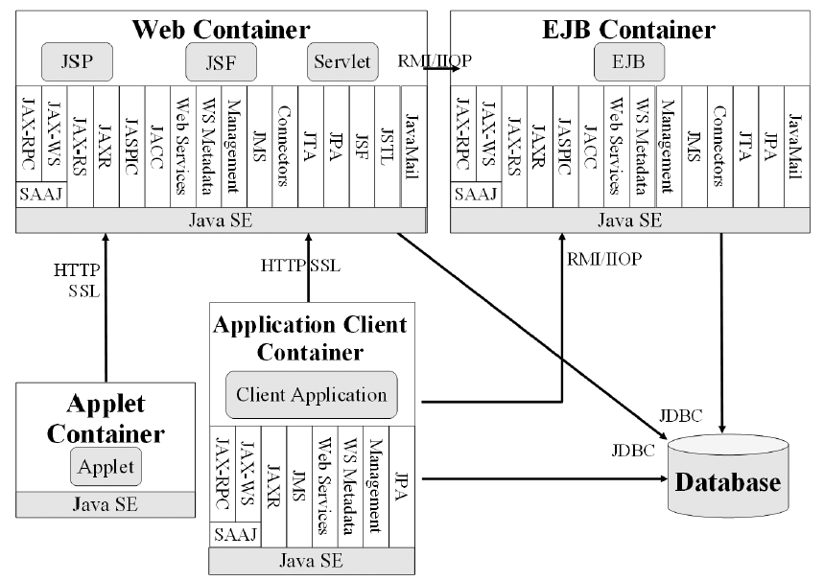
Architecture
Containers are Java EE runtime environments that provide certain services to the components they host such as lifecycle management, dependency injection, and so on. They need to be packaged in a standard way (via archive files) before being deployed.

Slide 7
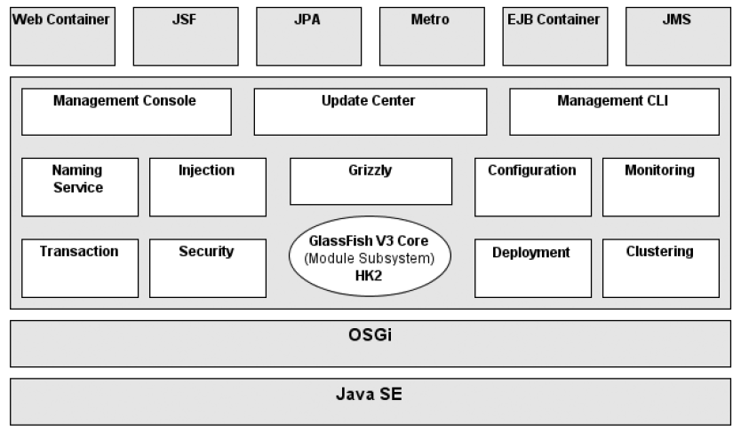
Architecture (cont.)

Slide 8
Architecture (cont.)
The Java EE runtime environment defines 4 types of components that an implementation must support: applets, applications, web applications, EJBs.
The Java EE infrastructure is partitioned into logical domains called containers . Each container has a specific role, supports a set of APIs, and offers services to components like security, database access, transaction handling, naming directory, resource injection.
Containers hide technical complexity and enhance portability.
Components need first to be packaged in a standard formatted archive before been deployed in a container. Java EE defined different types of modules that have their own packaging format based on this common jar format.
The main features of an application server are: data integrity, load balancing, security, centralised configuration, scalability, robustness.

Slide 9
Java EE 6
Java Platform, Enterprise Edition or Java EE is a enterprise java computing platform.
The platform provides an API and runtime environment for developing and running enterprise software, including network and web services, and other large-scale, multi-tiered, scalable, reliable, and secure network applications.
Java EE is a set of specifications intended for enterprise applications.
A Java EE application server can handle transactions, security, scalability, concurrency and management of the components that are deployed to it, in order to enable developers to concentrate more on the business logic of the components rather than on infrastructure and integration tasks.
Java EE 6 is an important milestone, not only does it follow the steps of Java EE 5 by focusing on an easier development model, it also adds new specifications and brings profiles and pruning to make it lighter.
Java EE 6 (JSR 316) follows the path of easy development by embracing the concepts of annotations, POJO programming, and the configuration-by-exception mechanism throughout the platform, including the web tier.
It comes with a rich set of innovations such as the brand-new JAX-RS 1.1, it simplifies mature APIs like EJB 3.1, and enriches others such as JPA 2.0 or the timer service.
Java EE 6 new technologies are: JAX-RS 1.1, Bean Validation 1.0, DI 1.0, CDI 1.0, Managed Beans 1.0.

Slide 10
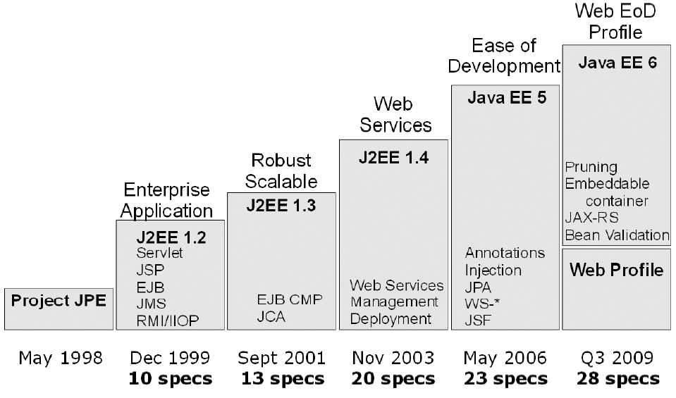
Java EE 6 (cont.)
History of J2EE/Java EE

Slide 11
Java EE 6 (cont.)
An application server has to implement 28 specifications in order to be compliant with Java EE 6.
Java EE 6 defines a single profile called the Web Profile. Its aim is to allow developers to create web applications with the appropriate set of technologies.
Web Profile 1.0 is specified in a separate JSR and is the first profile of the Java EE 6 platform.
Specification | Version | JSR
JSF | 2.0 | 314
JSP | 2.2 | 245
JSTL | 1.2 | 52
Servlet | 3.0 | 315
Expression Lang. | 1.2
EJB Lite | 3.1 | 318
JPA | 2.0 | 317
JTA | 1.1 | 907
Commons Annotations | 1.0 | 250

Slide 12
Glassfish Administration
GlassFish implements the Java EE 6 specifications, but it also has additional features ,such as its administrative capabilities, be it through the admin console or via a powerful asadmin command-line interface. Almost all the configuration is stored in a file called domain.xml (located in domains\domain1\config).
By default the port number for the Web Console is 4848 and the listener listens on all available network interfaces on the server machine.
Glassfish uses a separate Virtual Server for Web Console for independent configuration.

Slide 13
Glassfish Administration (cont.)
From the Web Console we can create JDBC connection pools, JMS destinations, thread pools, listeners, security, clusterization, container configuration, etc.
We can also administrate Glassfish using the CLI(Command Line Interfaces).
The administration CLI is accessible through the asadmin utility located at glassfish_home/bin directory. It is either a batch file named asadmin.bat for Windows or a shell script named asadmin for Linux and UNIX.
We can run the asadmin help command to see a list of possible commands.
The CLI also enables automation of routine tasks through shell scripts, as well as integration with provisioning tools.
The 2 essential components of Glassfish from the administration view are :
The server instance
The administrative domain

Slide 14
Glassfish Administration (cont.)
The Server instance is the Java EE process that hosts the Java EE applications. It implements the containers for the Java EE components .
The Server instance provides the capability necessary for enabling client access and resource management.
The administrative domain(s) is a group of one or multiple server instance that are administrate together.
Each domain has one domain administration server and one or multiple server instances.
A domain maintains its own configuration, log files, and application deployment areas.

Slide 15
Glassfish Administration (cont.)
A server instance always belong to a single domain and server instances in a single domain can run on different physical hosts.
Glassfish allows the clustering of application server instances. Clusters in an application server enhance scalability and availability Clusters provide high availability by using failover and load-balancing.
Server instances can be added to a cluster, even while the application is running making clustering scalable.
Node agents, server instances, and clusters can be created at GlassFish installation time.
Clusters and instances are organized into administrative domains, that are characterized by the Domain Administration Server (DAS).
The administrative infrastructure in the DAS is based on Java Management Extensions (JMX) technology.

Slide 16
EJB 3.1/JPA 2.0
The EJB 1.0 specification was created in 1998 and EJB 3.1 was released in 2009 with java EE6.
The EJB 3.1 specification helps to avoid vendor lock-in by providing features that were previously nonstandard(non-standard JNDI names, embedded containers).
With EJB 3.1 specification(JSR 318) the JPA specification is no longer part of EJB and is a separate specification (JSR 317). The JPA new specification is organized into different documents:
EJB core contracts and requirements: main document that specifies the EJBs
Interceptor Requirements: document that specifies interceptors.

Slide 17
EJB 3.1/JPA 2.0 (cont.)
The Java EE 6 expert group has compiled a list of features for possible future removal:
Entity Beans 2.x
Client view of an entity bean 2.x
EJB QL (query language for container-managed persistence)
JAX-RPC – based web service endpoints
Client view of a JAX-RPC web service
The EJB 3.1 specification includes new functionalities and simplifications:
War deployment: we can package the EJB components in a war file
Embedded container: a new embeddable API is available for executing EJB components into JAVA SE environment
Singleton beans: a new type of component provides easy access to shared state.
Richer timer service: creation of EJB timers and calendar-based expressions.
No-interface-view: Session beans with a local view can be accessed without a separate local business interface
EJB Lite: subset of functionalities can be provided within Java EE profiles.
Portable JNDI Names: the syntax for looking the EJB components is specified now.

Slide 18
EJB 3.1/JPA 2.0 (cont.)
The principle of ORM involves delegating access to relational databases to external tools or frameworks. Mapping tools have a bidirectional correspondence between the database and objects.
Several frameworks achieve this, such as Hibernate, TopLink, and Java Data Objects (JDO), but Java Persistence API (JPA) is the preferred technology, as it has been included in Java EE 6.
JPA 1.0 was created with Java EE 5 to solve the problem of data persistence and brings the object-oriented and relational models together.
In Java EE 6, JPA 2.0 follows the same path of simplicity and robustness, and adds new functionalities.
A component is a reusable software unit that can be integrated into an application. Clients interact with components via a well-defined contract.

Slide 19
EJB 3.1/JPA 2.0 (cont.)
The standard component model for Java EE is the Enterprise JavaBeans model. The EJB’s type determines the contract required to interact with it.
There are 3 EJB types: session beans, entity beans and message driven beans.
Session beans are divided into: stateless, stateful and singleton.
Stateful session beans are good for accumulating state during a conversation
Stateless session beans are designed to carry out independent operations very efficiently and encapsulates business services.
Singleton Beans are primarily used to store application-wide shared data.
The Glassfish naming convention for looking into EJB is:
java:global[/<app-name>]/<module-name>/<bean-name>[!<fully-qualified-interface-name>]

Slide 20
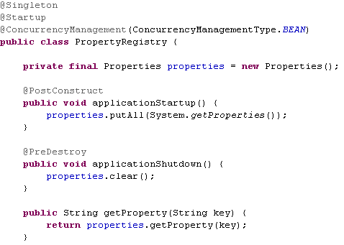
EJB 3.1/JPA 2.0 (cont.)
A javax.ejb.Singleton is a session bean with a guarantee that there is at most one instance in the application.
The @Startup annotation causes the bean to be instantiated by the container when the application starts. Singleton beans with @ConcurrencyManagement(BEAN) are responsible for their own thread-safety. Possible values for ConcurrencyManagementType are BEAN and CONTAINER,.

Slide 21
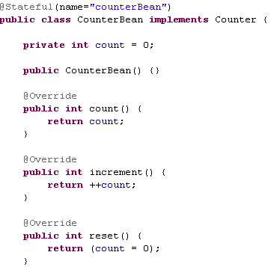
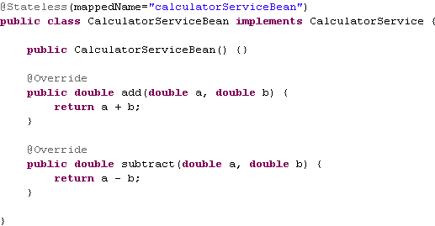
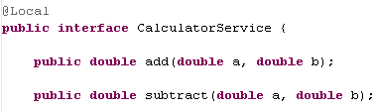
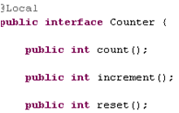
EJB 3.1/JPA 2.0 (cont.)
Stateless session beans are session beans whose instances have no conversational state. A stateful session bean is similar to an interactive session. A stateful session bean is not shared.
Stateful and Stateless beans implement Local and/or Remote interfaces to determine which methods should be exposed.

Slide 22
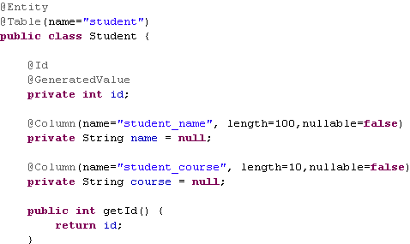
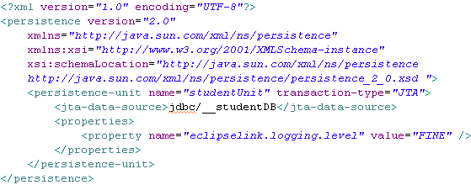
EJB 3.1/JPA 2.0 (cont.)
Simple entity bean sample using JPA annotations and META-INF/persistence.xml file that references the JTA data source defined in the Glassfish.

Slide 23
EJB 3.1/JPA 2.0 (cont.)
The EJBs are server-side component and needs to be executed in a container. This runtime environment provides core features common to many enterprise applications such as:
Remote client communication: the EJB client can invoke methods remotely via standard protocols.
Dependency injection: components can be injected into other components .
State management: the container manages the beans state transparently.
Pooling: the container can create a pool of instances that can be shared.
Component life cycle: the container is responsible for managing the life cycle of each component.
Messaging: the container allows MDBs to listen to destinations and consumes messages without complex code.
Transactional management: and EJB can inform the container about the transactional policy it should use. The container takes care of the commit or rollback.
Security: the EJB can specify the access level to enforce the user and role authentication.
Concurrency support: all the EJB are thread-safe by nature, except the singletons where some concurrency declaration is needed.
Interceptors: The container can create cross-cutting strategy to inject extra functionality to the components.
Asynchronous method invocation: with EJB 3.1 it is possible to have asynchronous calls without involving messages.

Slide 24
EJB 3.1/JPA 2.0 (cont.)
The embedded container is to be able to execute EJB applications within a Java SE environment allowing clients to run within the same JVM and class loader. This provides better support for testing, offline processing and the use of the EJB in desktop applications. The embeddable container API is defined in javax.ejb.embeddable.
EJBContainer ec = EJBContainer.createEJBContainer();
Context ctx = ec.getContext();
PhoneEJB ref = (PhoneEJB) ctx.lookup("java:global/PhoneEJB");
ref.createPhone(phone);

Slide 25
Java Servlet 3.0
A servlet is a Java class that is used to extend the capabilities of servers that host applications. Servlets can respond to requests and generate responses. The base class for all servlets is avax.servlet.GenericServlet. This class defines a generic, protocol-independent servlet.
The most common type of servlet is an HTTP servlet. This type of servlet is used in handling HTTP requests and generating HTTP responses.
Servlet 3.0 makes the web.xml deployment descriptor completely optional. Servlets can be configured via annotations instead of XML.
If a web application is configured both through annotations and through a web.xml deployment descriptor, settings in web.xml take precedence.
Servlets can be decorated with the @WebServlet annotation to specify their name, URL pattern, initialization parameters, and other configuration items usually specified in the web.xml deployment descriptor.

Slide 26
Java Servlet 3.0 (cont.)
Filters were introduced to the servlet specification in version 2.3. A filter is an object that can dynamically intercept a request and manipulate its data before the request is handled by the servlet.
Filters can also manipulate a response after a servlet's doGet() or doPost() method finishes, but before the output is sent to the browser.
Servlet 3.0 introduced the ability to configure servlets via the @WebFilter annotation. During the lifetime of a typical web application, a number of events take place, such as HTTP requests are created or destroyed, request or session attributes are added, removed, or modified, etc.
The Servlet API provides a number of listener interfaces we can implement in order to react to these events. All of these interfaces are in the javax.servlet package.
We can use @WebListener annotation to register a listener and not using the <listener> tag in web.xml descriptor.

Slide 27
Java Servlet 3.0 (cont.)
Java web applications are built using the Servlet API directly. All of these frameworks use the Servlet API "under the covers". Setting up an application to use one of these frameworks has always involved making some configuration in the application's web.xml deployment descriptor. In some cases, some applications use more than one framework.
This tends to make the web.xml deployment descriptor fairly large and hard to maintain.
Servlet 3.0 introduces the concept of pluggability. Framework developers can choose to use annotations instead of a web.xml to configure their servlets.
Framework developers may choose to include a web-fragment.xml file as part of the JAR file to be included in web applications that use their framework.
web-fragment.xml is almost identical to web.xml. The main difference is that the root element of a web-fragment.xml file is <web-fragment> as opposed to <web-app>.

Slide 28
Java Servlet 3.0 (cont.)
One of the significant enhancements made is support for asynchronous processing.
With this support, a servlet no longer has to wait for a response from a resource. Previous to Servlet 3.0, asynchronous support in the Java EE web container was provided in a proprietary way — either through APIs built on top of the Servlet 2.5 API or through non-Servlet APIs or implementations.
@WebServlet(url="/simple“, asyncSupported=true)
The asyncSupported attribute is needed to differentiate code written for synchronous processing from that written for use in an asynchronous context.
The AsyncContext class is a new class in Servlet 3.0 that provides the execution context for an asynchronous operation. The class provides a variety of methods that you can use to get access to the underlying request and response objects. We can use the AsyncContext.dispatch(), AsyncContext.dispatch(path), or AsyncContext.dispatch(servletContext, path) method to dispatch the request to the container.

Slide 29
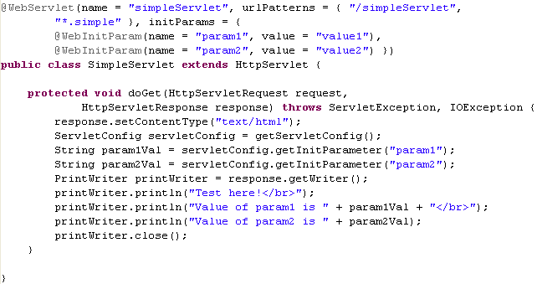
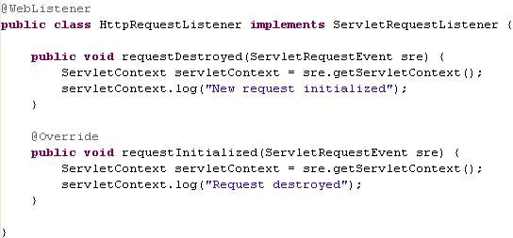
Java Servlet 3.0 (cont.)

Slide 30
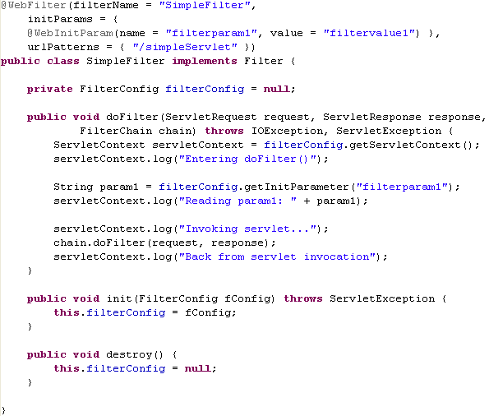
Java Servlet 3.0 (cont.)

Slide 31
Java Servlet 3.0 (cont.)
Servlet 3.0 also adds a new listener class for asynchronous processing, AsyncListener.
We can use this class in an application to get notified when asynchronous processing is completed, if a timeout has occurred, an error has occurred, or a subsequent call to startAsync has occurred.
AsyncContext ac = req.startAsync();
req.addAsyncListener(new AsyncListener() {
public void onComplete(AsyncEvent event) throws IOException {
...
}
...
}
The parameter passed to the onComplete method is an AsyncEvent object.
The AsyncEvent class is another new class provided as part of the Servlet 3.0 support for asynchronous processing. It represents an event that gets fired when the asynchronous operation initiated on a ServletRequest has completed, timed out, or produced an error.

Slide 32
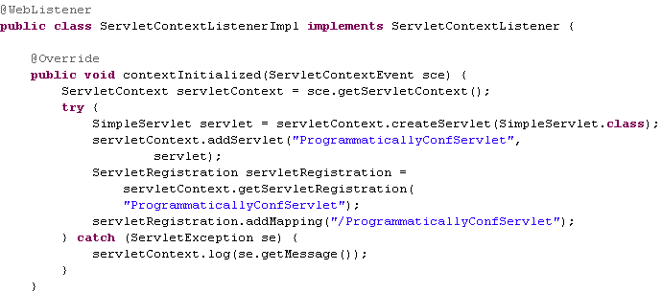
Java Servlet 3.0 (cont.)
We call the createServlet() method of ServletContext to create the servlet that we are about to configure. This method returns a class implementing javax.servlet.Servlet.
Once we create our servlet, we need to invoke addServlet() on our ServletContext instance to register our servlet with the servlet container.
Once we have registered the servlet, we need to add a URL mapping to it. We need to invoke the getServletRegistration() method on our ServletContext instance, passing the servlet name as a parameter. This method returns the servlet container's implementation of javax.servlet.ServletRegistration.

Slide 33
Java Serves Faces 2.0
JavaServer Faces (JSF) is a Java-based Web application framework intended to simplify development integration of web-based user interfaces.
JSF is a request-driven MVC web framework for constructing user interfaces using components.
As a display technology, JSF 2 uses Facelets, an efficient, simple, and powerful view description language (VDL).
Facelets was adopted as the official view technology for JSF 2.0.Facelets allows easy component/tag creation using XML markup instead of Java code.
Since JSF 2.0 include built-in Ajax support using <f:ajax />.
JSF goal is to make web development faster and easier by supporting user interface components in a rapid application development (RAD) approach.
JSF Versions:
JSF 1.0 (2004-03-11) — (DEPRECATED) the initial release of the JSF specification.
JSF 1.1 (2004-05-27) — (DEPRECATED) bug fix release.
JSF 1.2 (2006-05-11) — improvements to core systems and APIs. Coincides with Java EE 5. Initial adoption into Java EE.
JSF 2.0 (2009-06-28) — Major release for ease of use, enhanced functionality, and performance. Coincides with Java EE 6.
JSF 2.1 (2010-10-22) — Second maintenance release of 2.0.
JSF 2.0 is a major release evolving in JSR 314 and is the preferred choice for web development in Java EE 6.

Slide 34
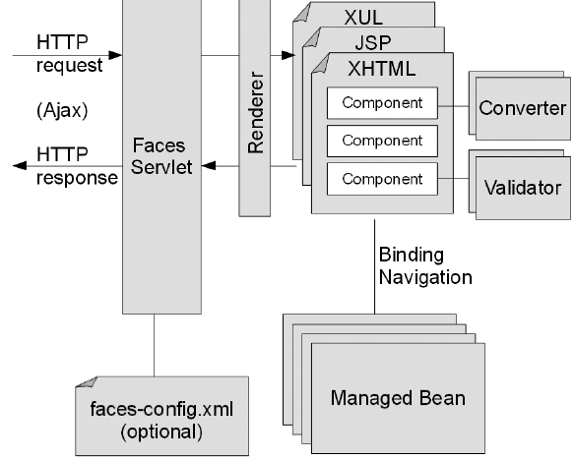
Java Serves Faces 2.0 (cont.)
New features in JSF 2.0
Alternative viewing technology to JSP based on Facelets
New resource-handling mechanism (for images, CSS, JavaScript files, and so on)
Additional scopes (view scope and component scope)
Easy development with annotations for managed beans, renderers, converters, validators, and so on
Reducing XML configuration by exploiting annotations and configuration by exception (faces-config.xml is optional)
Ajax support and easy component development
Java Server Faces Architecture

Slide 35
REST, JAX-RS and Jersey
Representational State Transfer (REST) is an architectural style in which web services are viewed as resources and can be identified by Uniform Resource Identifiers (URIs). Web services developed using the REST style are known as RESTful web services.
Java EE 6 adds support to RESTful web services through the addition of the Java API for RESTful Web Services (JAX-RS).
Before Java EE 6, the JAX-RS has been available as a standalone API.
Jersey is the default implementation for JAX-RS included by GlassFish.

Slide 36
REST, JAX-RS and Jersey (cont.)
REST goals:
Scalability of component interactions
Generality of interfaces
Independent deployment of components
Intermediary components to reduce latency, enforce security and encapsulate legacy systems
RESTful web services can consume several types of different MIME types, although they are typically written to consume and/or produce XML or JSON (JavaScript Object Notation).
Web services must support one or more of the following four HTTP methods:
GET – a GET request is used to retrieve an existing resource
POST – a POST request is used to update an existing resource
PUT – a PUT request is used to create a new resource
DELETE – a DELETE request is used to delete an resource

Slide 37
REST, JAX-RS and Jersey (cont.)
A RESTful web service with JAX-RS can be created using a class with annotated methods that are invoked when our web service receives one of these HTTP request methods
Jersey—the JAX-RS implementation included with GlassFish—includes an API that we can use to easily develop RESTful web service clients. Jersey's client-side API is a value-added feature and is not part of the JAX-RS specification.
Each of our RESTful web services needs to be invoked via its Unique Resource Identifier (URI).
This URI is specified by the @Path annotation, which we need to use to decorate our RESTful web service resource class.
Server side components need to implement methods to handle one or more of the four types of requests that RESTful web services handle: GET, POST, PUT, and/or DELETE. The JAX-RS API provides four annotations that we can use to decorate the methods in our web service: @GET, @POST, @PUT, and @DELETE.

Slide 38
REST, JAX-RS and Jersey (cont.)
Each method in our service must produce and/or consume a specific MIME type. The MIME type to be produced needs to be specified with the @Produces annotation. The MIME type to be consumed must be specified with the @Consumes annotation.
Before successfully deploying a RESTful web service developed using JAX-RS, we need to configure the REST resources path for our application. There are two ways of doing this: we can either use the web.xml deployment descriptor or develop a class that extends javax.ws.rs.core.Application and decorate it with the @ApplicationPath annotation.
We can call the RESTful web services passing parameters. There are two types of parameters we can use: query and path parameters. We can add parameters to methods that will handle HTTP requests in our web service.
Parameters decorated with the @QueryParam annotation will be retrieved from the request URL.
Another way by which we can pass parameters to our RESTful web services is via path parameters using the @PathParam annotation.

Slide 39
Context and Dependency Injection
Contexts and Dependency Injection (CDI) is a new addition to the Java EE specification as of Java EE 6.
Allows any JavaBean to be used as a JSF managed bean, including stateless and stateful session beans.
CDI simplifies dependency injection in Java EE applications.
CDI provides us with the ability(Named beans) to name our beans via the @Named annotation.
Named beans allow us to easily inject our beans into other classes that depend on them and to easily refer to them from JSF pages via the Unified Expression Language.
Dependency injection is a technique for supplying external dependencies to a Java class.
Java EE 5 introduced dependency injection via the @Resource annotation but is limited to injecting resources such as database connections, JMS resources, and so on.

Slide 40
Context and Dependency Injection (cont.)
Java EE 6 introduces the @Inject annotation that can be used to inject instances of Java classes into any dependent objects.
In some instances, the type of bean we wish to inject into our code may be an interface or a Java superclass,
but we may be interested in injecting a subclass or a class implementing the interface. CDI provides qualifiers we can use to indicate the specific type we wish to inject into our code. A CDI qualifier is an annotation that must be decorated with the @Qualifier annotation.
Just like JSF managed beans, CDI named beans are scoped. CDI beans are contextual objects.
Available scopes: Request, Conversation, Session, Application, Dependent.
@RequestScoped → beans are shared through the duration of a single request. A single request could refer to an HTTP request, an invocation to a method in an EJB, a web service invocation, or sending a JMS message to a message-driven bean.

Slide 41
Context and Dependency Injection (cont.)
@ConversationScoped → can span multiple requests and it's shorter than the session scope.
@SessionScoped → beans usees HTTP session and each user of an application gets their own instance of a session-scoped bean.
@ApplicationScoped → all the application lifetime. Beans in this scope are shared across user sessions.
@Dependent → beans are not shared. Anytime a dependent-scoped bean is injected, a new instance is created.

Slide 42
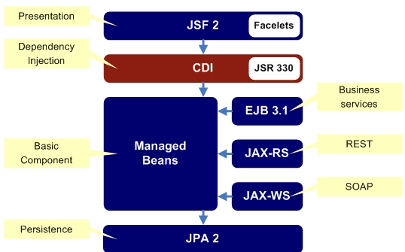
Context and Dependency Injection (cont.)
CDI includes all scopes supported by JSF, plus adds a couple of its own. CDI's request scope differs from JSF's request scope in which a request does not necessarily refer to an HTTP request. It could be an invocation on an EJB method, a web service invocation, or sending a JMS message to a message-driven bean.

Slide 43

Bibliography
http://en.wikipedia.org/wiki/JavaServer_Faces
http://www.theserverside.com/news/1373391/Dependency-Injection-in-Java-EE-6-Part-1
http://en.wikipedia.org/wiki/Representational_state_transfer
Packtpub Java EE 6 with GlassFish 3 Application Server
Beginning java EE 6 platform with glassfish 3 from novice to professional

