Slide 1

Google Code Libraries
Dima Ionut Daniel

Slide 2

Contents
What is Google Code?
LDAPBeans
Object-ldap-mapping
Ldap-ODM
Bug4j
jOOR
Rapa
jongo
Conclusion
Bibliography

Slide 3

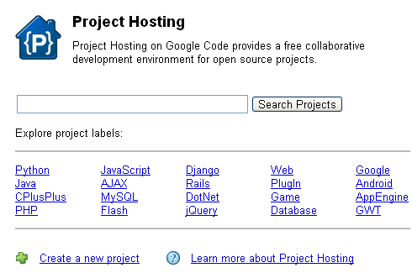
What is Google Code?
Google Code is a site for developing APIs and technical resources.
The site features a variety of developer products and tools build specifically for developers.
Also reference information can be found for community.
Google Code runs on a project hosting service that provides revision control: Subversion, Mercurial, Git, a wiki for documentation and a file download feature. The site limits the number of projects one person can have to 25. Also there is a limit of projects created in one day.

Slide 4
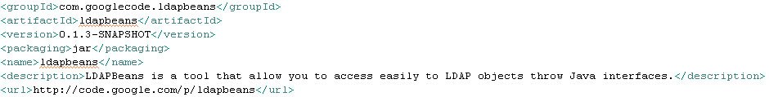
LDAPBeans
Project provided mapping between java interfaces and LDAP attributes. LDAPBeans is a tool that allows easy access to LDAP objects throw Java interfaces.
We declare java interfaces describing LDAP objects without having to write the implementation of our beans.
Features:
Primitive type mapping
Complex mapping using regular expressions
Mapping to other LdapBean object
LDAP directory access cache

Slide 5
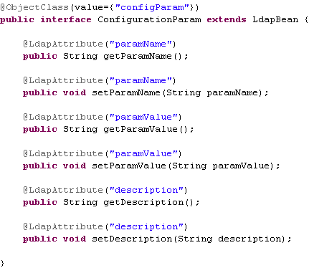
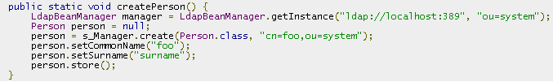
LDAPBeans (cont.)
LdapBeanManager is used as utility class that can create java proxy objects based on the interface declared. It’s also responsible for working with the internal ldap connection pool and doing the cleanup process.

Slide 6
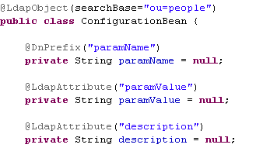

Object-ldap-mapping
Project provides a mapping between java POJO classes and LDAP attributes in a JPA similar way.
Annotations used from the library: LdapObject, DnPrefix, LdapAttribute.
It depends on Spring Ldap library.

Slide 7
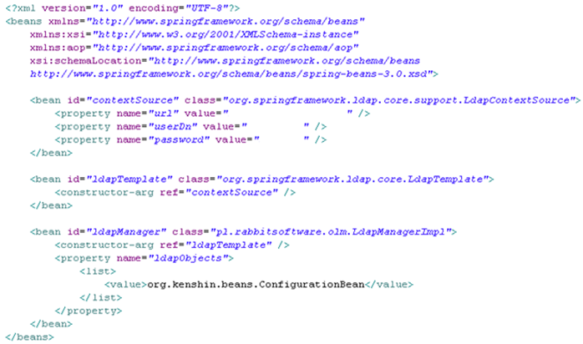
Object-ldap-mapping (cont.)
Beans.xml spring context file needed for creating a LdapManager object.

Slide 8
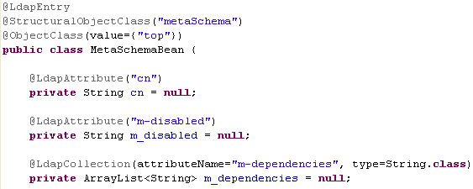
Ldap-ODM
LDAP-ODM is a framework for mapping LDAP directory entries to Java objects.
It uses Spring 2.0, Spring-Ldap 1.1 and CGLib 2.0 to provide object-oriented access to LDAP directory entries.
Features:
LDAP metadata at class-level annotations
Caching of mapped objects
Collections support
Loading objects by DN and query via standard LDAP query.

Slide 9
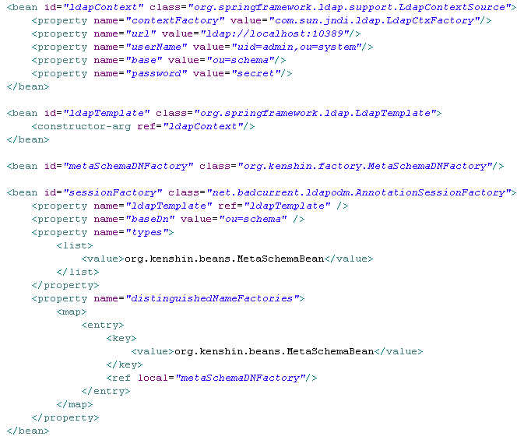
Ldap-ODM (cont.)
The entry point for working with LDAP entry object-oriented is the SessionFactory class.

Slide 10
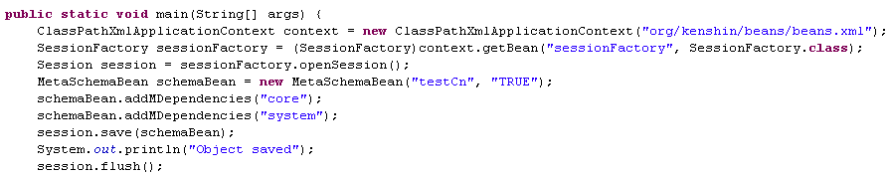
Ldap-ODM (cont.)
After obtaining the Session object we can create, modify, find ldap entries.

Slide 11

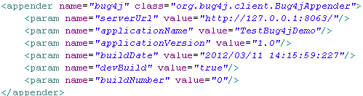
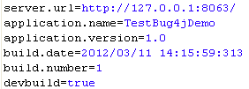
Bug4j
Bug4j is an automated bug reporting tool. It contains a centralized reporting server and an client API which we can use in our applications. We can instrument your application with Bug4j agent and all the bugs will be reported in our Bug4j server. There are different ways to configure bug4j agent in your application. We can use Apache Log4j adding an appender, or we can call the bug4j agent.
Bellow are some examples from log4j appender (log4.properties and log4j.xml)and bug4j.properties.

Slide 12
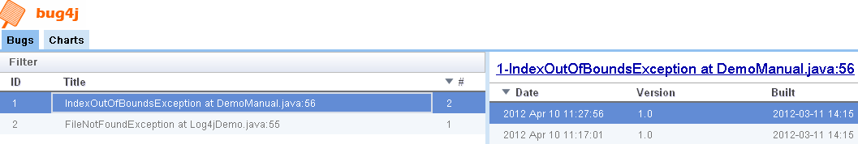
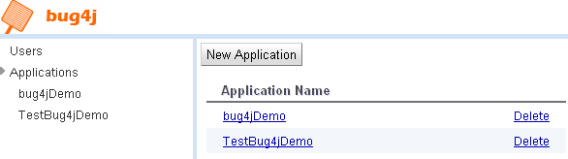
Bug4j (cont.)
In the Bug4j server we can see all the bugs that are logged. We can administrate bug4j users.
We can filter the applications from where we can receive bugs and also use package filter.

Slide 13
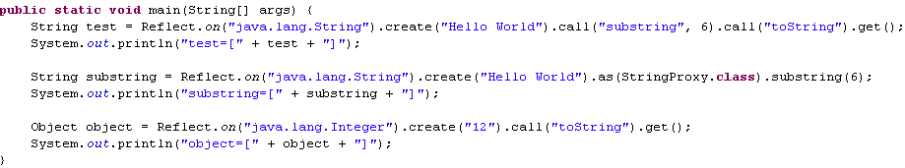


jOOR
jOOR(Java Object Oriented Reflection) is a simple wrapper for the java.lang.reflect package.
The library consists in the Reflect and ReflectException classes.

Slide 14
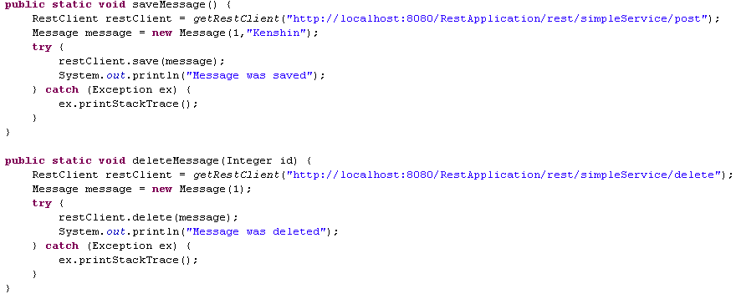
Rapa
Rapa is a java library as REST client. The exchange messages can be done in XML and JSON formats.

Slide 15
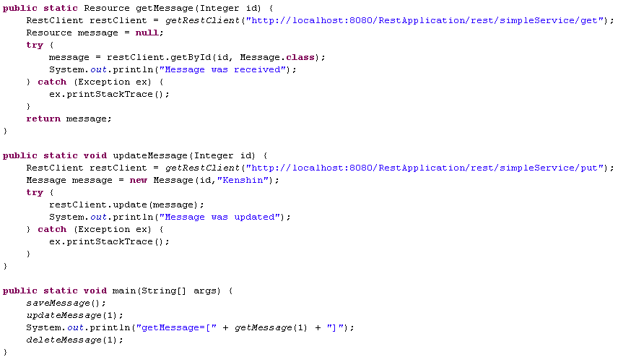
Rapa (cont.)

Slide 16
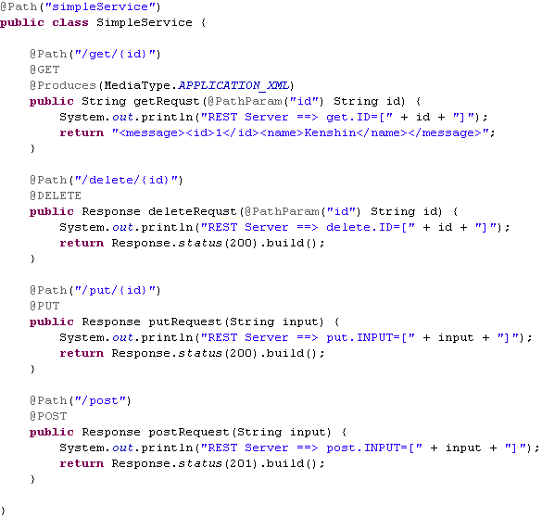

Rapa (cont.)
We create a REST Web Application that manages GET, DELETE, PUT, POST requests that will correspond to GET, DELETE, UPDATE and UPDATE operations.
Message class is used on the client REST side for sending the REST CRUD requests.

Slide 17
Jongo
Jongo is a java server (ussing Jetty embedded) which provides CRUD operations over any JDBC supported RDBMS using REST.
Features:
Easy installation and configuration
Support for any RDBMS with a JDBC driver
Can call functions and procedures
Can be deploy in JEE application servers like Jboss, Tomcat, Glassfish,etc.
Support for multiple databases.

Slide 18

Bibliography
http://en.wikipedia.org/wiki/Google_Code

