Slide 1

Hadoop
Dima Ionut Daniel

Slide 2
Contents
What is Hadoop?
History
Big Data
Hadoop Goals
Architecture
SQL vs Hadoop
MapReduce Basics
Hadoop Basics
Hadoop Components
Configuration
Hive
Pig
Who uses Hadoop?
Bibliography

Slide 3

What is Hadoop?
Apache Hadoop is an open-source software framework for storage and large scale processing of data-sets on clusters of commodity hardware.
Hadoop is an Apache top-level project being built and used by a global community of contributors and users.
Hadoop is licensed under the Apache License 2.0

Slide 4
History
Hadoop started out as a subproject of Nutch , which in turn was a subproject of Apache Lucene.
Nutch is a Lucene extension; it tries to build a complete web search engine using Lucene as its core component.
Around 2004, Google published two papers describing the Google File System (GFS) and the MapReduce framework.
On February 19, 2008, Yahoo! announced that Hadoop running on a 10,000+ core Linux cluster was its production system for indexing the Web.

Slide 5
Big Data
Characteristics Big Data:
Volume: the volume of data is massive.
Variety: data would be semi-structured and may originate from variety of sources and in variety of formats.
Velocity: the rate which data comes into the system is really fast.

Slide 6
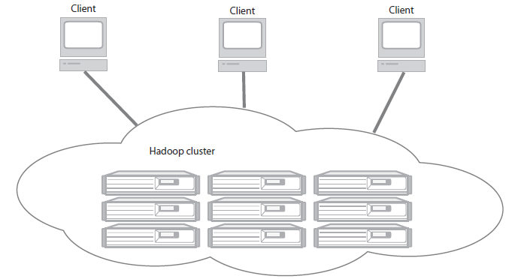
Hadoop Goals
Hadoop is running distributed applications that process large amounts of data:
Accessible: runs on large clusters or on cloud computing services such as Amazon’s Elastic Compute Cloud (EC2)
Robust: is architected with the assumption of frequent hardware malfunctions. It can gracefully handle most such failures.
Scalable: scales linearly to handle larger data by adding more nodes to the cluster.
Simple: allows users to quickly write efficient parallel code.

Slide 7
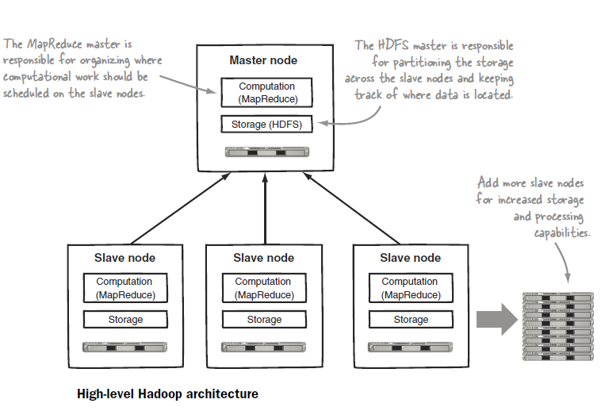
Architecture

Slide 8
SQL vs Hadoop
Hadoop is is a framework for processing data
Many of Hadoop’s initial applications deal with unstructured data such as text.
In principle, SQL and Hadoop can be complementary.
Hadoop is designed to be a scale-out architecture operating on a cluster.
Hadoop clusters with ten to hundreds of machines is standard.
Hadoop uses key/value pairs as its basic data unit, which is flexible to work with the less-structured data types.

Slide 9
SQL vs Hadoop (cont.)
Under MapReduce we specify the actual steps in processing the data, which is more analogous to an execution plan for a SQL engine.
MapReduce allows you to process data in a more general fashion than SQL queries.
Hadoop is designed for offline processing and analysis of large-scale data.
Hadoop is best used as a write-once , read-many-times type of data store.

Slide 10
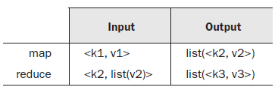
MapReduce Basics
MapReduce is a data processing model.
Under the MapReduce model, the data processing modules are called mappers and reducers.
MapReduce programs are executed in two main phases, called mapping and reducing.
MapReduce takes the input data and feeds each data element to the mapper.
In the reducing phase, the reducer processes all the outputs from the mapper and arrives at a final result.
Partitioning and shuffling are common design patterns that go along with mapping and reducing.

Slide 11
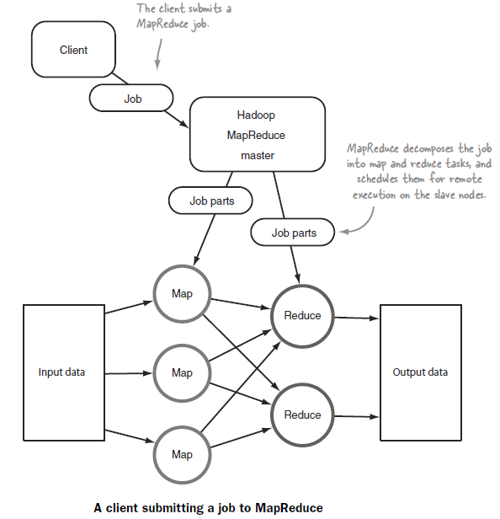
MapReduce Basics (cont.)

Slide 12
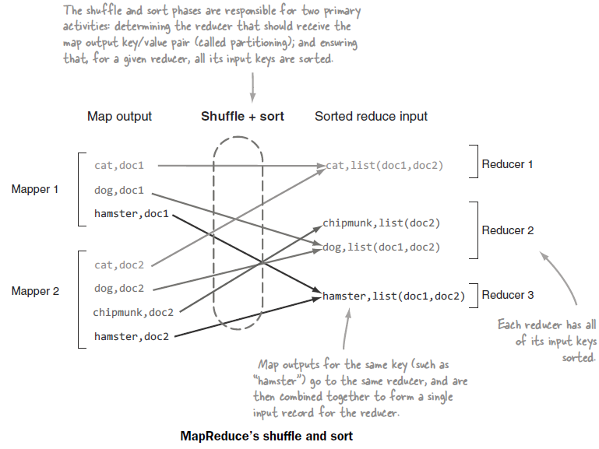
MapReduce Basics (cont.)

Slide 13
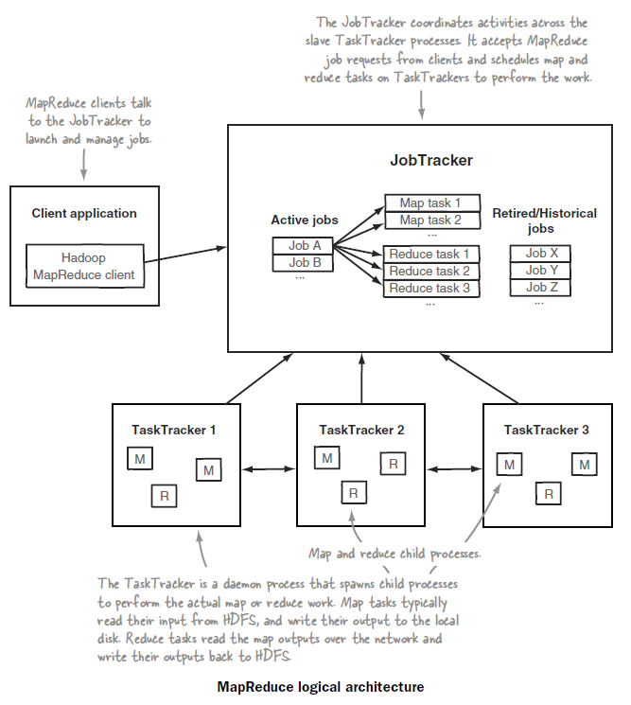
MapReduce Basics (cont.)

Slide 14
Hadop Basics
On a cluster Hadoop runs a set of daemons, or resident programs, on the different servers in the network.
These daemons have specific roles; some exist only on one server, some exist across multiple servers.
The daemons include:
NameNode:
DataNode:
Secondary NameNode:
JobTracker:
TaskTracker:

Slide 15
Hadop Basics (cont.)
NameNode
The distributed storage system is called the Hadoop File System(HDFS).
The NameNode is the master of HDFS that directs the slave DataNode daemons to perform the low-level I/O tasks.
The function of the NameNode is memory and I/O intensive.
DataNode
Each slave machine in the cluster will host a DataNode daemon to perform I/O HDFS blocks to actual files on the local filesystem.
A DataNode may communicate with other DataNodes to replicate its data blocks for redundancy.
If any one DataNode crashes or becomes inaccessible over the network , we'll still be able to read the data.
Secondary NameNode
SNN is an assistant daemon for monitoring the state of the cluster HDFS.
Like the NameNode, each cluster has one SNN, and it typically resides on its own machine as well.
SNN communicates with the NameNode and takes snapshots of the HDFS metadata at intervals defined by the cluster configuration.

Slide 16
Hadop Basics (cont.)
JobTracker
Once we submit the code to cluster, the JobTracker determines the execution plan by determining which files to process, assigns nodes to different tasks, and monitors all tasks as they’re running.
If a task fail, the JobTracker will automatically relaunch the task, on a different node, up to a predefined limit of retries.
There is only one JobTracker daemon per Hadoop cluster.
TaskTracker
The JobTracker is the master overseeing the overall execution of a MapReduce job and the TaskTrackers manage the execution of individual tasks on each slave node
Each TaskTracker is responsible for executing the individual tasks that the JobTracker assigns.
If the JobTracker fails to receive a heartbeat from a TaskTracker within a specified amount of time, it will assume the TaskTracker has crashed and will resubmit the corresponding tasks to other nodes in the cluster.

Slide 17
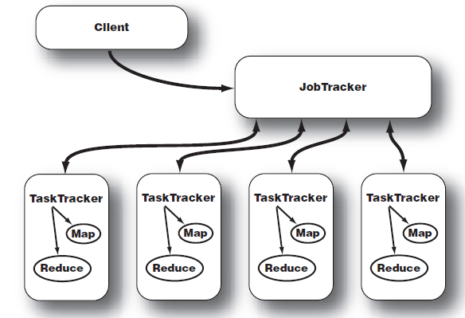
Hadop Basics (cont.)
When a client calls the JobTracker to begin a data processing job, the JobTracker partitions the work and assigns different map and reduce tasks to each TaskTracker in the cluster

Slide 18
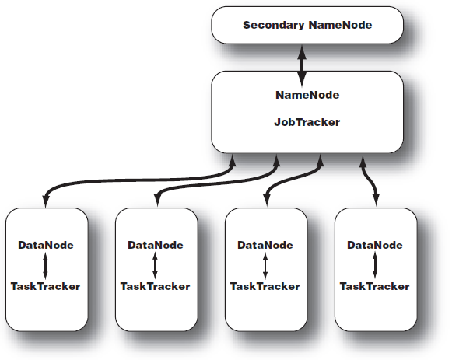
Hadop Basics (cont.)
The topology of a typical Hadoop cluster is a master/slave in which the NameNode and JobTracker are masters and the DataNodes and TaskTrackers are slaves.

Slide 19
Hadop Basics (cont.)
Hadoop can run in multiple modes:
Standalone mode
Pseudo-distributed mode
Fully distributed mode
Standalone mode
The standalone mode is the default mode for Hadoop.
Hadoop contains 3 xml configurations and if they are empty Hadoop will run completely on the local machine.
Because there’s no need to communicate with other nodes, the standalone mode doesn’t use HDFS, nor will it launch any of the Hadoop daemons.
Pseudo-distributed mode
The pseudo-distributed mode is running Hadoop in a "cluster of one" with all daemons running on a single machine.
This mode complements the standalone mode for debugging your code, allowing you to examine memory usage, HDFS input/output issues, and other daemon interactions

Slide 20
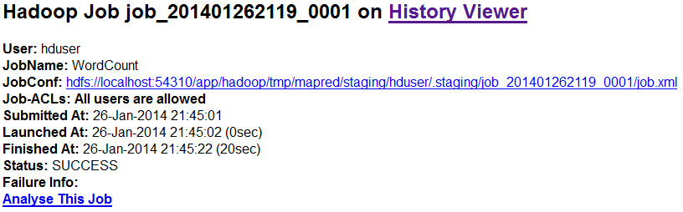
Hadop Basics (cont.)
Hadoop provides a similar status overview of ongoing MapReduce jobs on port 50030.

Slide 21
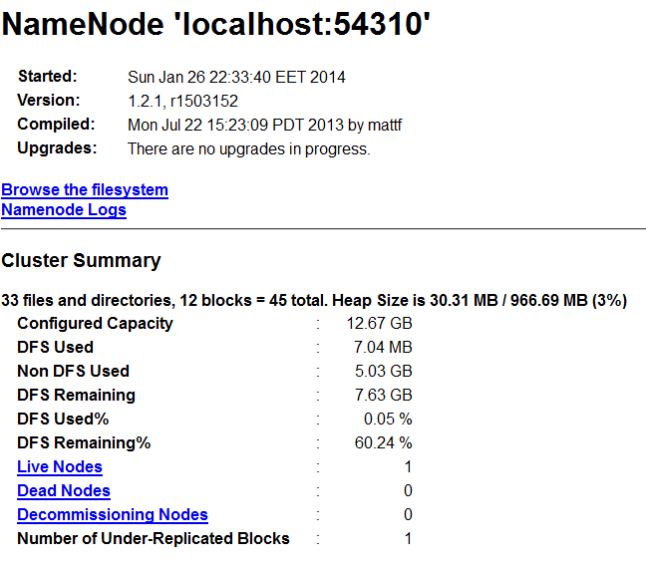
Hadop Basics (cont.)
The NameNode hosts a general report on port 50070 and gives an overview of the state of your cluster’s HDFS.

Slide 22
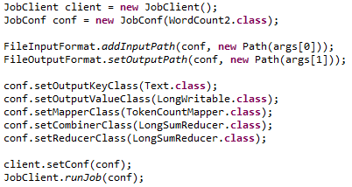
Hadop Basics (cont.)
HDFS is a filesystem designed for large-scale distributed data processing under frameworks such as MapReduce.
Hadoop provides a set of command line utilities that work similarly to the Linux file commands.
A typical Hadoop workflow creates data files elsewhere and copies them into HDFS using one of the command line utilities.
The MapReduce framework reads and parses the HDFS files into individual records (key/value pairs).
Hadoop file commands take the form of: hadoop fs -cmd <args>
The most common file management tasks in Hadoop includes:
Adding files and directories
Retrieving files
Deleting files

Slide 23
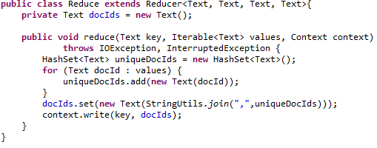
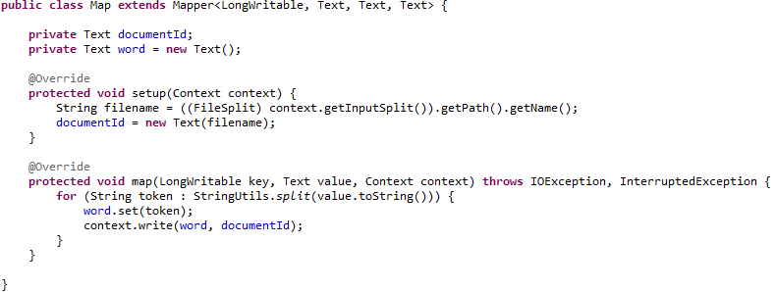
Hadop Basics (cont.)
Bellow is a sample with Reducer and Mapper implementations.

Slide 24
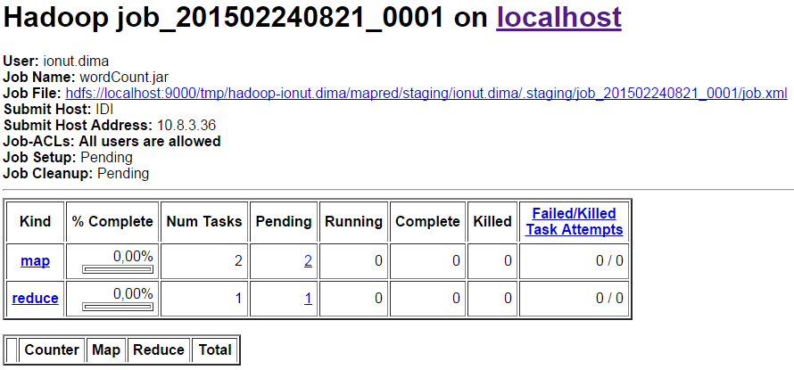
Hadop Basics (cont.)
In order to start the Hadoop execution the command: “hadoop jar <jar> MAIN_CLASS <args>” needs to be used.
Details about the hadoop job can be checked using the Hadoop Map/Reduce Administration.

Slide 25
Hadop Basics (cont.)
We can check HDFS root directory: "hadoop fs -ls /".
Running jobs can be checked using the command: "hadoop job -list".
The command "bin/hadoop fs -put file*.txt /" will copy all txt files to HDFS / folder.

Slide 26
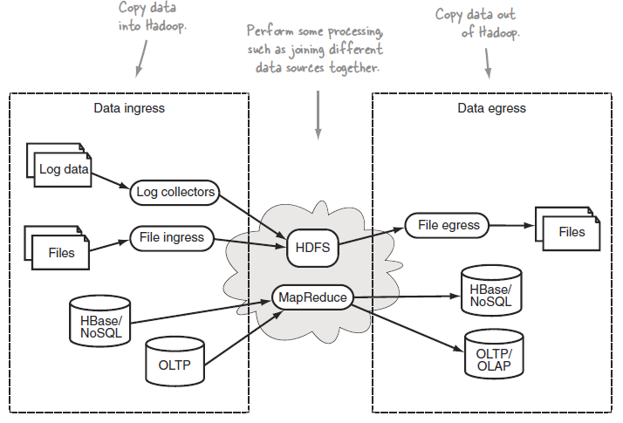
Hadop Basics (cont.)
Moving data in and out of Hadoop (or data ingress and egress), is the process by which data is transported from an external system into an internal system, and vice versa.

Slide 27
Hadop Basics (cont.)
Flume, Chukwa, and Scribe are log collecting and distribution frameworks that have the capability to use HDFS as a data sink for that log data.
Apache Flume is a distributed system for collecting streaming data.
Chukwa is an Apache subproject of Hadoop that also offers a large-scale mechanism to collect and store data in HDFS.
Scribe is a rudimentary streaming log distribution service, developed and used heavily by Facebook.

Slide 28
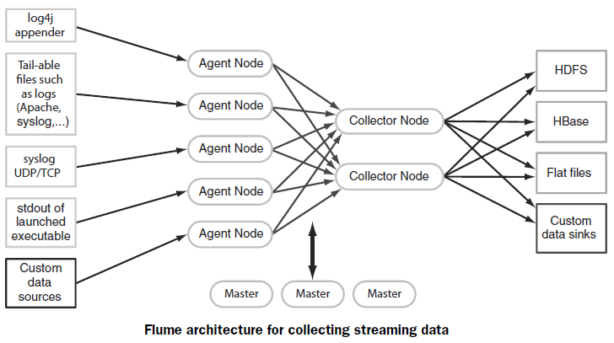
Hadop Basics (cont.)
Apache Flume offers various levels of reliability and transport delivery guarantees that can be tuned to your needs.
It’s highly customizable and supports a plugin architecture where you can add custom data sources and data sinks.

Slide 29
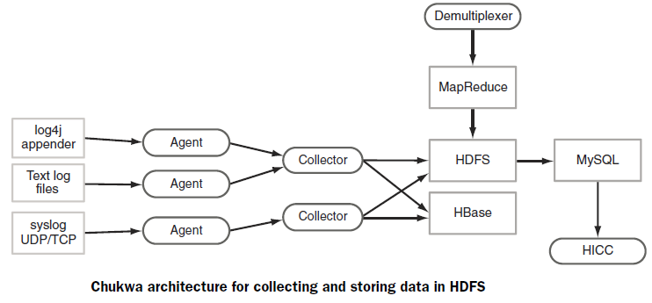
Hadop Basics (cont.)
Chukwa’s reliability model supports two levels: end-to-end reliability, and fast-path delivery, which minimizes latencies.
After writing data into HDFS Chukwa runs a MapReduce job to demultiplex the data into separate streams.
Chukwa also offers a tool called Hadoop Infrastructure Care Center (HICC), which is a web interface for visualizing system performance.

Slide 30
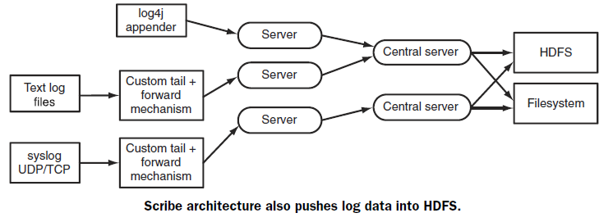
Hadop Basics (cont.)
A scribe server that collects logs runs on every node and forwards them to a central Scribe server.
Scribe supports multiple data sinks, including HDFS, regular filesystems, and NFS.
Unlike Flume or Chukwa, Scribe doesn’t include any convenience mechanisms to pull log data.

Slide 31
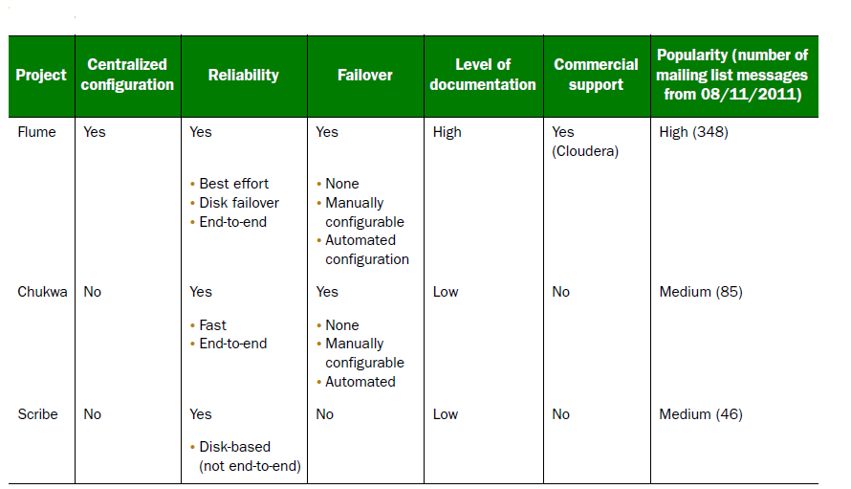
Hadop Basics (cont.)
Each of these three tools can fulfill the criteria of providing mechanisms to push log data into HDFS.

Slide 32
Hadoop Components
The Apache Hadoop framework contains following modules:
Hadoop Common - contains libraries and utilities needed by other Hadoop modules
Hadoop Distributed File System (HDFS) - a distributed file-system that stores data on the commodity machines, providing very high aggregate bandwidth across the cluster.
Hadoop YARN - a resource-management platform responsible for managing compute resources in clusters and using them for scheduling of users' applications.
Hadoop MapReduce - a programming model for large scale data processing.

Slide 33
Hadoop Components (cont.)
HDFS is the storage component of Hadoop.
It’s a distributed filesystem that’s modeled after the Google File System (GFS) paper.
HDFS is optimized for high throughput and works best when reading and writing large files (gigabytes and larger).
HDFS replicates files for a configured number of times, is tolerant of both software and hardware failure, and automatically re-replicates data blocks on nodes that have failed.

Slide 34
Configuration
Configs are contained under /etc/hadoop/conf.
core-site.xml --> contains system-level Hadoop configuration items such as HDFS URL, Hadoop temporary directory, script locations.
hdfs-site.xml --> contains HDFS settings such as the default file replication count, block size, permissions.
mapred-site.xml --> HDFS settings such as the default number of reduce tasks, memory settings.

Slide 35
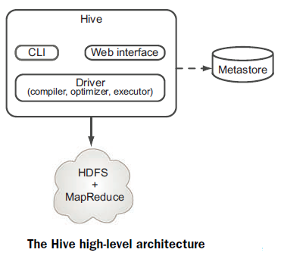
Hive
Hive is one of the easiest to use of the high-level MapReduce frameworks.
Hive was originally an internal Facebook project, but became an Apache project.
It was created to simplify access to MapReduce by exposing a SQL-based language for data manipulation.

Slide 36
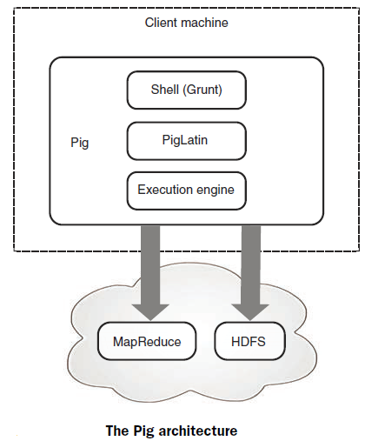
Pig
Pig consists of a shell, which allows for interactive command execution, PigLatin, its data flow language.
The execution translates the PigLatin commands into MapReduce execution plans and executes them.

Slide 37
Who uses Hadoop?
Facebook uses Hadoop, Hive, and HBase for data warehousing and real-time application serving.
Twitter uses Hadoop, Pig, and HBase for data analysis, visualization, social graph analysis, and machine learning.
Yahoo! uses Hadoop for data analytics, machine learning, search ranking, email antispam, ad optimization, ETL,9 and more.
eBay, Samsung, Rackspace, J.P. Morgan, Groupon, LinkedIn, AOL, Last.fm, and StumbleUpon are some of the other organizations that are also heavily invested in Hadoop.
Google, in its MapReduce paper, indicated that it used its version of MapReduce to create its web index from crawl data.

Slide 38
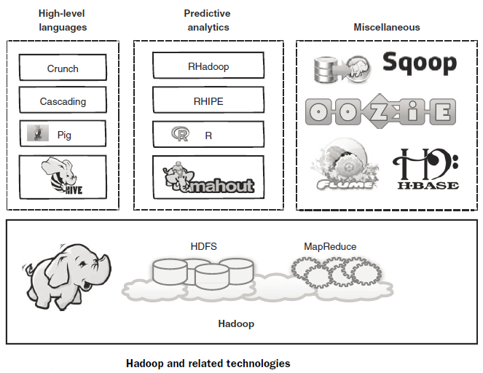
Who uses Hadoop? (cont.)

Slide 39

Bibliography
http://en.wikipedia.org/wiki/Apache_Hadoop
Manning - Hadoop in Action

