Slide 1

Hazelcast
Dima Ionut Daniel

Slide 2
Contents
What is Hazelcast?
Hazelcast Features
Hazelcast Core
Distributed Events
Concurrent Features
Distributed Computing
Transactions
Storage
Clients
Security
Configuration
Conclusions
Bibliography

Slide 3

What is Hazelcast?
Hazelcast is an in-memory Open Source data grid based on Java.
It allows horizontal scalability both in terms of available storage space and processing power.
Hazelcast is a new aproach to data.

Slide 4
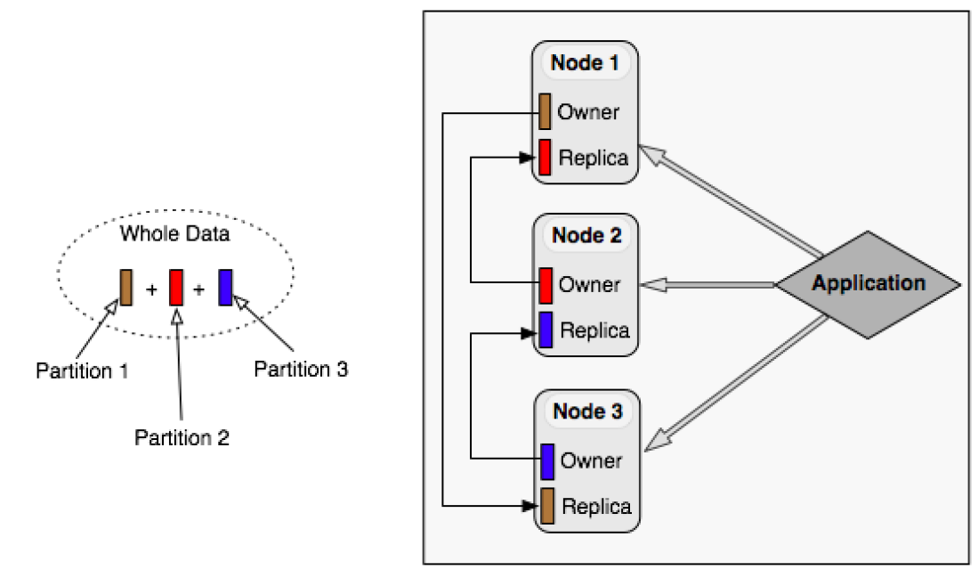
Hazelcast Features
It’s open source
It is a small Jar file for installing.
Provides distributed data structures.
Each node in the cluster is configured to be functionally the same.
Nodes are always aware of each other.

Slide 5
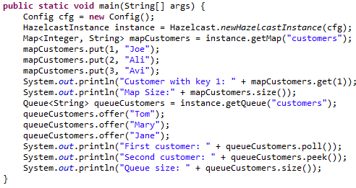
Hazelcast Core
Hazelcast nodes are “masteless” which means that it isn’t a client-server system.
There is a cluster leader which is by default the oldest member of the cluster which manages how data is spread across the system.
Having a bunch of distributed Maps, Lists, Queues, etc, means that everything is held in memory.

Slide 6
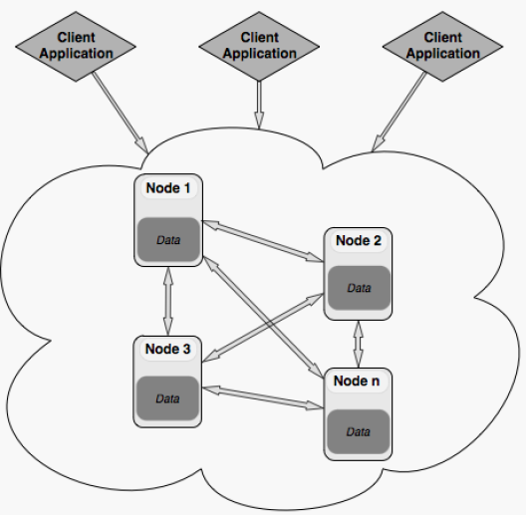
Hazelcast Core (cont.)
com.hazelcast.core.Hazelcast class is used to create and run Hazelcast cluster members in the JVM.
com.hazelcast.client.HazelcastClient class enables to do all Hazelcast operations being a member of the cluster.

Slide 7
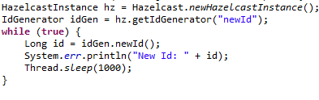
Hazelcast Core (cont.)
com.hazelcast.core.IdGenerator class provides a cluster-wide identifier generator from which unique identifier can be issued.
The internal counter state is only persisted during the life span of the cluster.
The maximum value is the Long.MAX_VALUE.

Slide 8
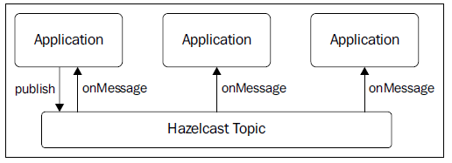
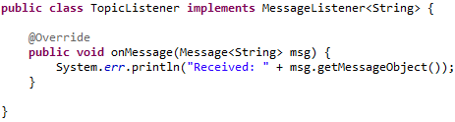
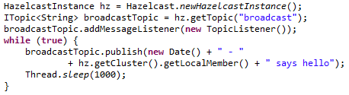
Hazelcast Core (cont.)
Hazelcast has a broadcasst messaging system.
The messaging system is similar to JMX topics.
Hazecalst can create topics and MessageListener(s) in order to handle the received messages.

Slide 9
Hazelcast Core (cont.)
We can add intercept operations and execute custom logic synchronously blocking the operation.
We can change the returned value for a get operations,etc.
Interceptors are different from listeners as the action is taken before the operation is completed.
IMap API provides 2 methods for adding and removing interceptor to the map: addInterceptor,removeInterceptor.

Slide 10
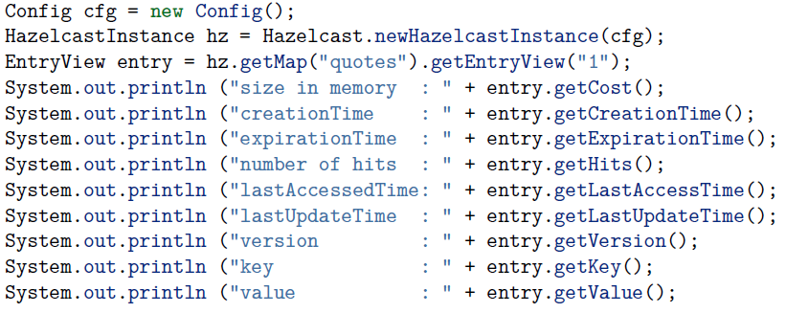
Hazelcast Core (cont.)
Hazelcast keeps extra information about each map entry such as:
creation time
last update time
Last access time
number of hits
version
This informations are exposed using the IMap.getEntryView(key) method.

Slide 11
Hazelcast Core (cont.)
Distributed map has in-memory-format configuration option.
By default, Hazelcast stores data into momory in binary(serialized) format.
Possible options:
BINARY(default) → data stored in serialized binary format
OBJECT →data ill be stored in de-serialized form.

Slide 12
Distributed Events
Hazelcast allows the registering for entry events to get notified when events occured.
Event Listeners are cluster-wide so when a listener is registered in one member of a cluster, it is registering for events originated at any member in the cluster.
An Event is created only if there is a listener registered.
Event listener shouldn’t implement heavy processes in its event methods which block the thread for long time.
If needed ExecutorService can be used to transfer long running processes to another thread and offload current listner thread.

Slide 13
Distributed Events (cont.)
Event Listeners types:
MembershipListner → cluster membership events
DistributedObjectListener → distributed object creationg and destroy events
MigrationListener → partition migration start and complete events
LifecycleListener → HazelcastInstance lifecycle events
EntryListener → Imap and MultiMap entry events
ItemListener → Iqueue, Iset, Ilist item events
MessageListener →ITopic message events
ClientListener →client connection events

Slide 14
Concurrent Features
Hazelcast provides complementary capabilities allowing to further parallelize applications.
Concurrent features:
Atomic and consistent nature of simple collections
Distributed locking to provide a cluster wide mutex
Transactional support for more complex operations
Cluster-wide atomic ID generator
JMX like topics for broadcas messaging(publish, subscribe)

Slide 15
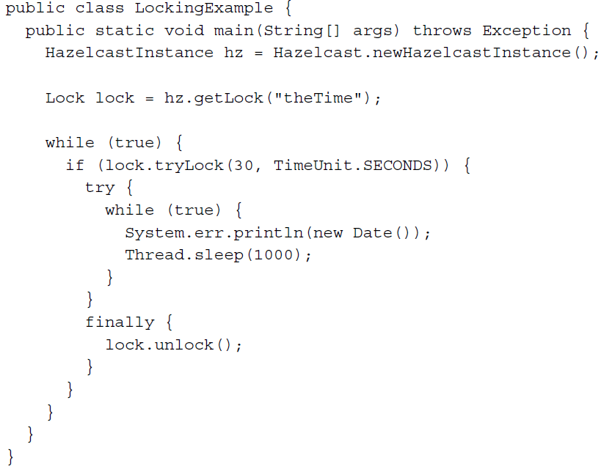
Concurrent Features (cont.)
Atomic Control:
When interacting with Hazelcast’s distributed collections we set and retrieve data in a consistent and atomic way.
If changes are done on entries there are immediately avaiable on other nodes .
Distributed locking:
Hazelcast offers a distributed locking facility allowing to attempt to acquire a cluster-wide named lock.

Slide 16
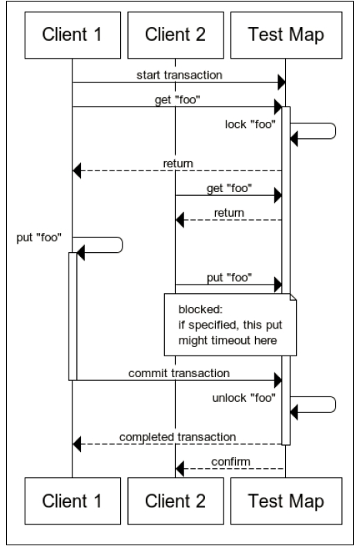
Concurrent Features (cont.)
Tactical locking:
Hazelcast can lock on specific context.
Instead of using the Lock object, Imap provides key locking capabilities.
Transactionally Rolling On
Hazelcast provides transactional capabilities.
Using REPEATABLE_READ transactino isolation once entering a transaction, Hazelast will automatically acquire locc for each entry that is interacting.

Slide 17
Distributed Computing
Distributed execturo service is a distributed implementation of java.util.concurrent.ExecutorService.
It allows the execution of code in the cluster.
We can ask Hazelcast to execute the code using Runnable, Callable:
On a specific cluster member
On the member owning the key
On the member Hazelcast will pick
On all or subset of the cluster members.

Slide 18
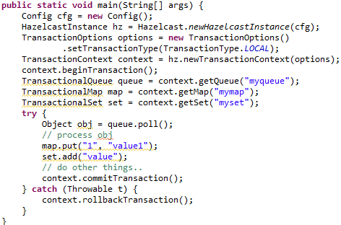
Transactions
Hazelcast can be used in transactional context.
The com.hazelcast.core.Transaction is used to being, commit and rollback a transaction.
Hazelcast supports LOCAL(One Phase) and TWO_PHASE(default option) transactions.
The isolation is always REPEATABLE_READ→inside and outside the transaction data commited can be read.

Slide 19
Storage
By default Hazelcast store the distributed data(map entries,etc) into java heap which is subject to garbage collection(GC).
Elastic Memory is Hazelcast with off-heap(direct) memomory storage to avoid GC pauses.
Steps to enable Elastic Memory:
Set maximum direct memory JVM: java –XX:maxDirectMemorySize=60G.
Enable Elastic Memory by setting hazelcast.elastic.memory.enabled configuration property to true.
Set the total direct memory size using hazelcast.elasstic.memory.total.size.
Set the chunk size by setting hazelcast.elastic.memory.chunk.size.
Enable sun.misc.Unsage based off-heap storage implementation instead of java.nio.DirectByteBuffer based one.
Configure maps that will use Elastic Memory by setting InMemoryFormat to OFFHEAP. Default value is BINARY.

Slide 20
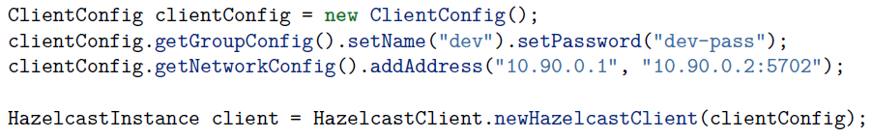
Clients
There are currenlty 3 ways to connect to a running Hazelcast cluster:
Native clients → Java,C++,C# clients.
Memcache clients
REST clients
Native clients allows to perform all Hazelcast operations without being a member of the cluster.
Name and Password parameter can be used to create a secure connection between the client and cluster.

Slide 21
Clients (cont.)
Hazelcast provides REST interface in search node so that the maps/queues can be accessed using HTTP protocol.
http://node IP address:port/hazelcast/rest/maps/mapName/key
http://node IP address:port/hazelcast/rest/queues/queueName
A Memcache client written in any language can communicate directly to Hazelcast cluster.

Slide 22
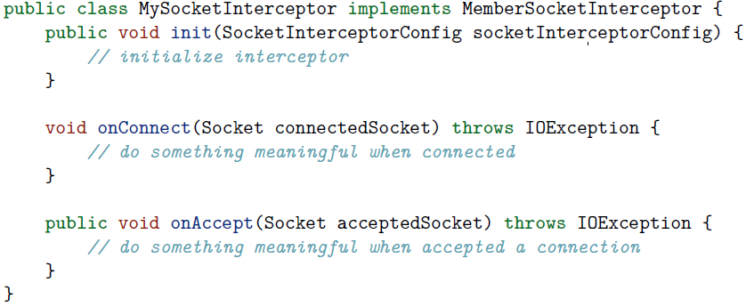
Security
Hazelcast allows to incercept socket connections before anode joins the cluster or a client connecting to a node.
This provides the ability to add custom hooks to join/connection procedure.
com.hazelcast.nio.MemberSocketInterceptor can be used for members and com.hazelcast.nio.SocketInterceptor for clients.

Slide 23
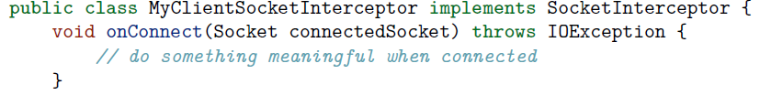
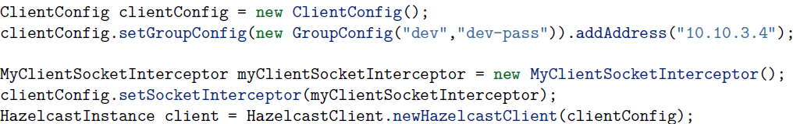
Security(cont.)

Slide 24
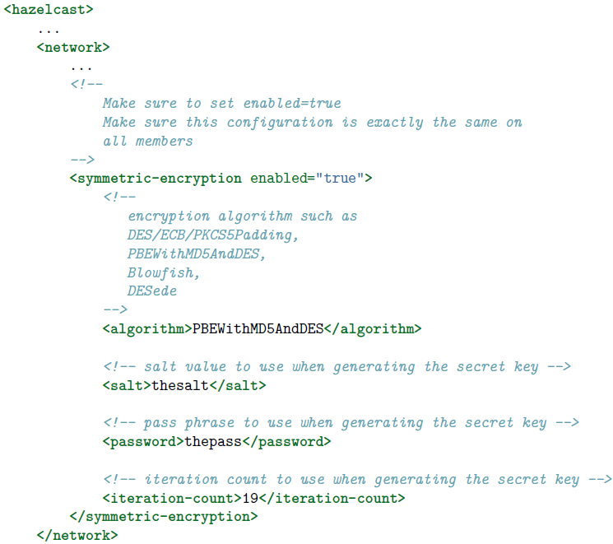
Security (cont.)
Hazelcast allows the encryption of the entire socket level communications among all members.
Encryption is based on Java Cryptography Architecture.

Slide 25
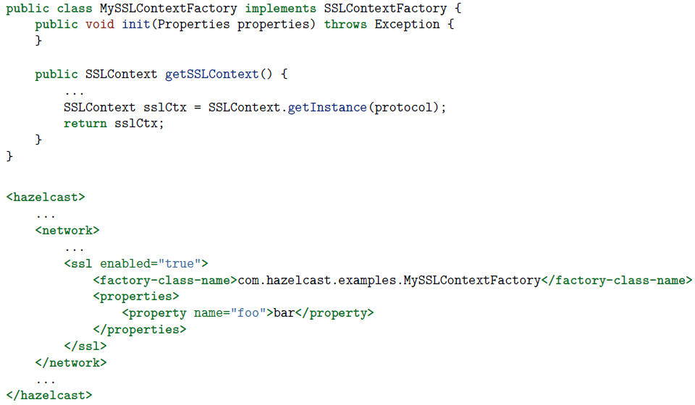
Security (cont.)
Hazelcast allows the use of SSL socket communications among all Hazelcast members.
com.hazelcast.nio.ssl.SSLContextFactory needs to be implemented and configured in network configuration.

Slide 26
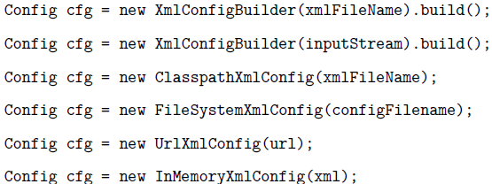
Configuration
Hazelcast can be configured declaratively(XML) or programmatically (API) or event by the mix of both.
Configuration can be created using the com.hazelcast.config.Config class.
Hazelcast supports several ways including filesystem, classpath, InputStream, URL, etc.

Slide 27
Conclusions
Pros:
Easy to configure
Built-in support for distributed queues
Cons:
Distribiuted objects are in memory so messages would be lost if all nodes are down.

Slide 28

Bibliography
http://hazelcast.org/
http://en.wikipedia.org/wiki/Hazelcast
http://www.captaindebug.com/2013/10/getting-started-with-hazelcast.html
hazelcast-documentation-3.2.4
Packt – Getting started with Hazelcast

