Slide 1

HornetQ
Dima Ionut Daniel

Slide 2
Contents
What is HornetQ?
Architecture
MOM Arhitecture
Features
API and Protocols
JMS Point-To-Point
JMS Publish/Subscribe
Configuration
Transport
Clustering
Conclusions
Bibliography

Slide 3

What is HornetQ?
HornetQ is an open source asynchronous messaging project from JBoss.
HornetQ is build a multi-protocol, embeddable, very high performance, clustered, asynchronous messaging system.
HornetQ code base was developed under the name JBoss Messaging 2.0
The HornetQ project is licensed using the Apache Software License v 2.0.

Slide 4
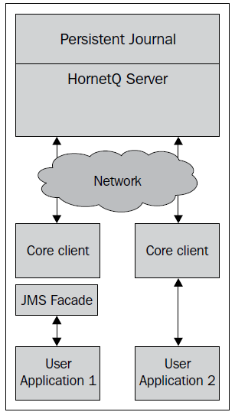
Architecture
HornetQ can boot in following modes:
Standalone - single instance of the server running on a machine
Integrated - from JBoss AS 6, HornetQ is default Java messaging system.
Embedded
HornetQ server uses a JMS to core HornetQ API translator.

Slide 5
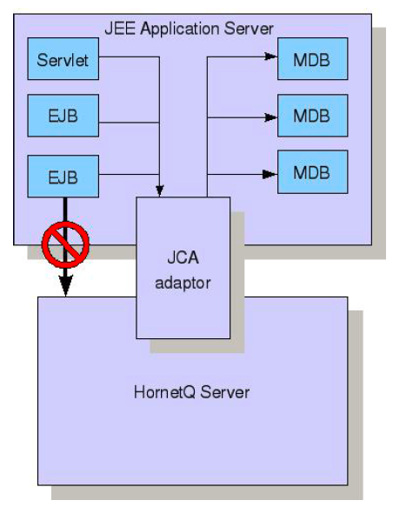
Architecture (cont.)
HornetQ provides its own fully functional JCA adaptor which enables to be integrated with JEE complian application server.
The application server's JCA service provides extra functionality such as connection pooling and automatic transaction.

Slide 6
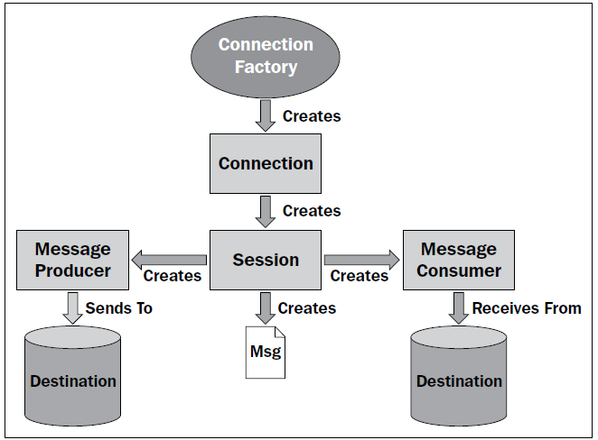
MOM Architecture
To produce/consume messages we need to have a ConnectionFactory that handles the Connection.
The connection handles the Session both for the consumer and the producer that send/receive message in that session.

Slide 7
Features
100% JMS compliant.
JMS Bridges to connect to other JMS compatible servers.
Supports Master/Slave architecture for fault tolerance.
Supports discovery groups for dynamic node clusters.
XA and JTA transaction support.
JMX based management.
Security features integrated with JAAS.
Clustering for scalability and reliability.
Supports STOMP protocol for cross language clients.
Filters and wildcard support.
Simple XML configuration.
Application Server integration using the JCA standard (allows MDBs too).

Slide 8
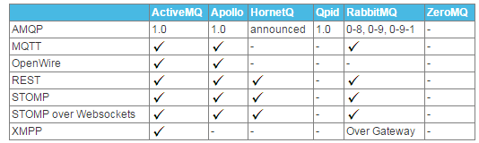
API and Protocols
Several messaging systems provide their own proprietary APIs.
JMS is part of Sun's JEE specification.
REST approaches in messaging is to manipulate resources using HTTP protocol.
STOMP is a very simple text protocol for interoperating with messaging systems.
AMQP is a specification for interoperable messaging.

Slide 9
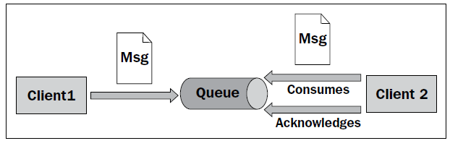
JMS Point-To-Point
In Point-To-Point approach messages are sent to a queue and the consumer is sending acknowledgement after the message is consumed.
Each message has only one consumer.
A sender and a receiver of a message work in an asynchronous way.

Slide 10
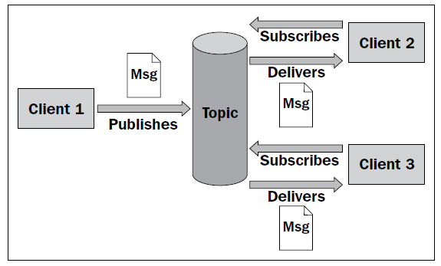
JMS Publish/Subscribe
The publish/subscribe approach has following characteristics:
Each message may have multiple consumers.
A client that subscribes to a topic can consume messages published only after the client has created a subscription. The subscriber must continue to be active in order for it to consume messages.

Slide 11
Configuration
HornetQ can take a system property or command line for configuration logging.
Configuration directory is specified on the classpath in the run.sh/run.bat scripts.
hornet-beans.xml: contains beans that will be used in JBoss microcontainer.
hornetq-configuration.xml: main HornetQ configuration file.
hornetq-queues.xml: contains predifined queues, security settings.
hornetq-users.xml: security manager setup
hornetq-jms.xml: configurtion for JMS
logging.properties: logging setup.

Slide 12
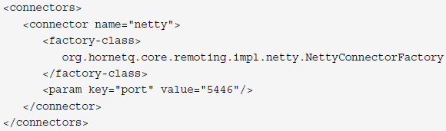
Transport
HornetQ has a fully plugable and flexible transport layer.
Acceptors defines a way in which connections can be made to the HornetQ server.
Connectors are used by a client to define how it connects to a server.
HornetQ uses Netty as high performance low level network library.
Netty can be configured in several different ways: old Java IO(Blocking), NIO(non-blocking).

Slide 13
Clustering
HornetQ provides very configurable state-of-the-art clustering model where messages can be intelligently load balanced between the servers in the cluster.
The cluster can be configured in the hornetq-configuration.xml.
When a node forms a cluster connection to another node, internally it creates a core bridge.
Server discovery uses UDP multicast or JGroups to broadcast server connection settings.

Slide 14
Conclusions
Easy to use
Simple API
Documented
Minimal third-party dependencies

Slide 15

Bibliography
http://en.wikipedia.org/wiki/HornetQ
HornetQ User Manual

