Slide 1

Infinispan
Dima Ionut Daniel

Slide 2
Contents
What is Infinispan?
Features
Inifinispan modes
Core API
Listeners
Configuration
Cache Loaders
Cache Stores
Batching
Clustering
Transactions
Monitoring
Advanced
Conclusions
Bibliography

Slide 3

What is Infinispan?
Infinispan is a high scalability data grid platform written in Java.
Infinispan is based on JBoss Cache code.
Is more scalable than JBoss Cache.
Several ideas for JSR-107(Java Temporary Cache API) and JSR-347(Data Grid for java platform) have come from Infinispan.

Slide 4
Features
API
Map API
RESTful API for remote access
Support for non-JVM clients via RESTful API
Operational modes
Clustered and non-clustered operation modes
Distribution with optional L1 caching
JTA support
JTA-compliant transaction manager
Supports batching
Pluggable cache stores
Configurable
Support for custom implementations
Eviction and expiration
FIFO and LRU based eviction policies
Expiration of data based on lifespan and idle time
Management
JMX statistics and monitoring
JOPR-based GUI management

Slide 5
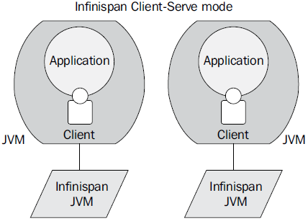
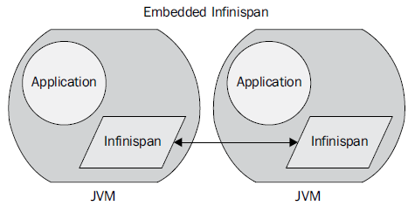
Infinispan modes
Infinispan operational modes:
embedded: in the same JVM with applications
client-server: start instance remote and connect using a variety of different protocols
Starting a cache in embedded mode requires only the CacheManager interface.

Slide 6
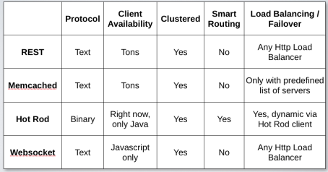
Infinispan modes (cont.)
In embedded mode the node instances are able to find each other and are sharing the distributing data across the grid.
In client/server mode, clients are connecting using different clients protocols. Clients can be written in Java,Jython, JRuby, Scala, Groovy, etc.
The server can be started:
Non-gui mode: startServer -r <protocol> where protocol can be: hotrod, memcached, websocket
Gui demo mode: runGuiDemo

Slide 7
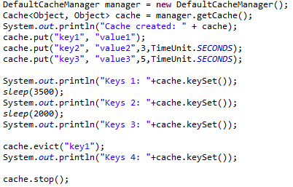
Core API
The core interface of Infinispan is org.infinispan.Cache(extends the ConcurrentMap).
Storing data in memory provides the fastest data access.
Mechanisms to control memory usage:
Eviction
Expiration
Eviction is used to prevent your application from running out of memory using configuration or programmatically.
We can attach lifespan and/or maximum idle times to entries.

Slide 8
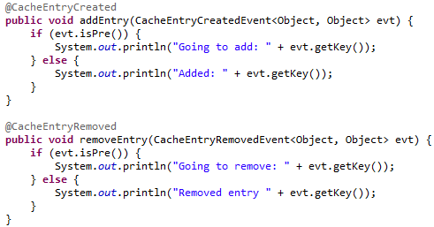
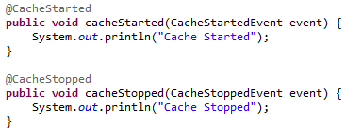
Listeners
We can receive notifications when certain events happen.
Listeners can be attached to Cache and Cache Manager.
At cache-level there are events such as adding or removing entries from the cache.
At cache manager level events are related to the startup/shutdown of the cache or topology change in the cluster.
Listeners are marked using the @org.infinispan.notifications.Listener annotation.
There are a large number of annotations to use for Infinispan events.

Slide 9
Listeners (cont.)
Cache-related events are triggered twice by Infinispan and isPre method can detect if the event took place before or after.
Notifications are by default synchronously as call-backs triggers.
Using @Listener(sync=false) for a better performance, not to block the running thread.

Slide 10
Configuration
We can configure Infinispan:
declarative: based on XML.
programatic: based on Infinispan API
The XML configuration contains 3 sections:
global: global settings shared among all cache instances
default: default behaviour for all named caches
namedCache: additional configuration for named caches.
Sample of elements that can be configured:
Clustering
Eviction
Expiration
Loaders
Locking
Transaction
Indexing
Data Container

Slide 11
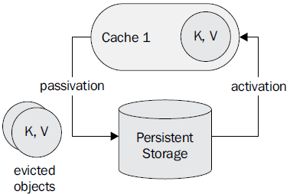
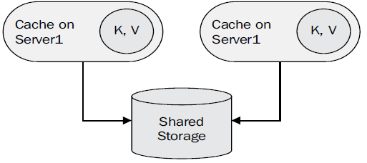
Cache Loaders
Entries can be saved also in other storages using cache storage.
CacheLoader - loads entry from persistent storage
CacheStore - stores entries to persistent storage.
When passivation is enabled entries that are evicted are removed from memory, and they are persisted using a cache store.
Activation involves loading the entry into memory, and then removing it from the cache store.

Slide 12
Cache Stores
CacheStores can be also chained.
Samples of CacheStore implementations:
FileCacheStore – store persistent data on non transactional filesystem.
BdbjeCacheStore – oracle BerkeleyDB cache store implementation.
JdbcBinaryCacheStore/JdbcStringBasedCacheStore/JdbcMixedCacheStore
CasandraCacheStore
CloadCacheStore – uses Jclouds for CRUD operation on Amazon S3 or Amazon EC2.
HBCacheStore
RemoteCacheStore
JdbmCacheStore

Slide 13
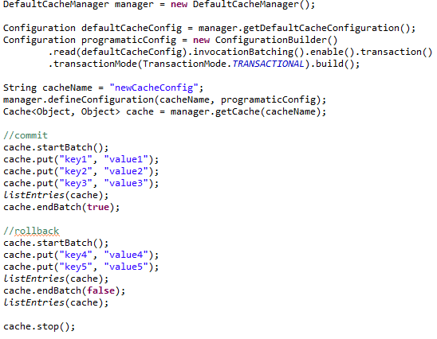
Batching
It’s simple to use batch and is less expensive then transactions.
Multiple operations are grouped and executed “atomically”.
Can be integrated with JTA.

Slide 14
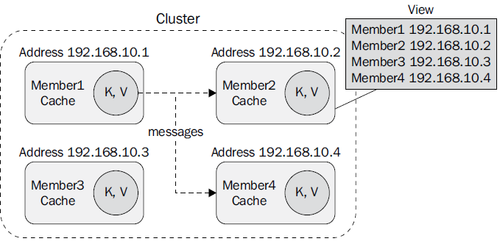
Clustering
A cluster consists of a number of Infinispan instances.
Each cluster in turn has a view, which is the list of cluster members.
Infinispan uses JGroups for communications within a cluster.
The distribution has a default JGroups configuration containing:
Jgroups-udp.xml : discovery configuration, using UDP
Jgroups-tcp.xml: uses TCP transport and UDP multicast for discovery
Jgroups-ec2.xml: TCP transport and experimental S3_PING protocol for discovery.
JGroups configuration parameters are passed at JVM startup.

Slide 15
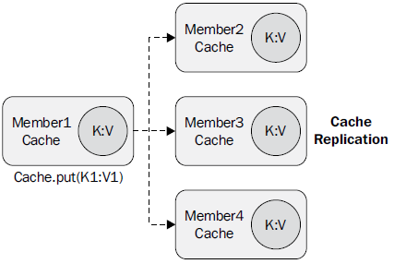
Clustering (cont.)
Any cache from the cluster can define a cluster cache mode:
replication: replica
distribution: default, increases scalability
invalidation: doesn't share data, remove data from another remote caches minimizing network traffic.
All clustering modes provide for automatic discovery of new members in a cluster.
Replication is the simplest clustered mode. After a new member joins a cluster, if state transfer is enabled.
Replication can be synchronous or asynchronous.

Slide 16
Transactions
Infinispan is a compatible JTA-compliant transaction manager.
The transaction manager is responsible for either commit or roll back any distributed transaction.
Keys that are a part of the transaction are locked for writes, although you can still read the keys in another concurrent transaction.
Transactional mode:
TRANSACTIONAL
NON_TRANSACTIONAL: default
Locking mode:
Optimistic: default
Pessimistic: locks are acquired on every update
Lock timeout can be also configured.
A safe mechanism implemented when using locks is deadlock detection.

Slide 17
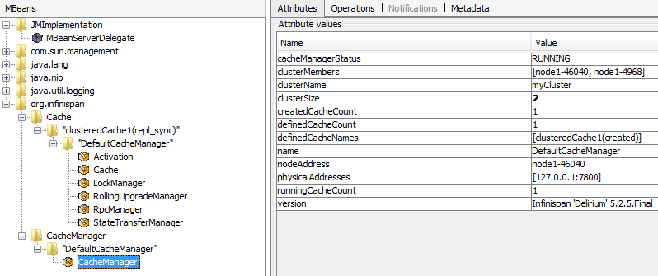
Monitoring
Infinispan uses JMX to expose management operations and statistical data.
Expanding the org.infinispan folder statistics will be found on Cache and CacheManager nodes.
We can use RHQ server to monitor.

Slide 18
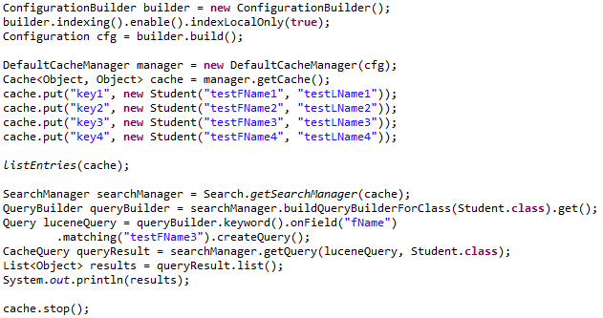
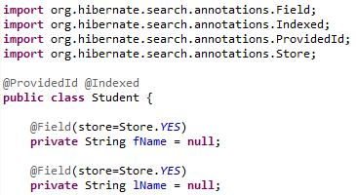
Advanced
Infinispan can be used with CDI.
The asynchronous API provides non-blocking cache methods: put, get, and remove.
Infinispan exposes a querying API that allows users to write queries using either Lucene's object-oriented query API or Hibernate Search's compatible, but much simpler.

Slide 19
Conclusions
PROS:
High scalability
Documented, API
Can be integrated very easy.
Scalable
Transactions
Plugable

Slide 20

Bibliography
http://refcardz.dzone.com/refcardz/getting-started-infinispan
http://www.jboss.org/infinispan/
Packtpub - Infinispan Data Grid Platform

