Slide 1

Java IO NIO
Dima Ionut Daniel

Slide 2
Contents
What is Java?
Java IO
Java NIO
JAVA NIO 2
JAVA IO vs NIO
Conclusions
Bibliography

Slide 3

What is Java?
Java is a programming language created by Sun Microsystems.
Java is used in a wide variety of computing platforms from embedded devices and mobile phones on the low end, to enterprise servers and supercomputers on the high end.
Java eliminates certain low-level constructs such as pointers and has a very simple memory model where every object is allocated on the heap and all variables of object types are references.
Memory management is handled through integrated automatic garbage collection performed by the JVM.
The heart of the Java platform is the concept of a "virtual machine" that executes Java bytecode programs. This bytecode is the same no matter what hardware or operating system the program is running under.
There is a JIT(Just-In-Time) compiler within the Java Virtual Machine, or JVM. The JIT compiler translates the Java bytecode into native processor instructions at run-time and caches the native code in memory during execution. The use of a JIT compiler means that Java applications, after a short delay during loading and once they have "warmed up" by being all or mostly JIT-compiled, tend to run about as fast as native programs.
The Java programs are cross-platform or platform independent, but the code of the Java Virtual Machines (JVM) that execute these programs is not.

Slide 4
Java IO
Java's I/O libraries is designed in an abstract way that enables to read from external data sources and write to external targets. The java.io package contains classes that support input and output. The classes in the package are primarily stream-oriented;
A stream is an ordered sequence of bytes of indeterminate length. Input streams move bytes of data into a Java program from some generally external source. Output streams move bytes of data from Java to some generally external target.
The central classes in the package are InputStream and OutputStream which are abstract base classes for reading from and writing to byte streams, respectively.
Input and output streams are fundamentally byte-based. Readers and writers are based on characters, which can have varying widths depending on the character set. ASCII and Latin-1 use 1-byte characters, UTF-32 uses 4-byte characters.
The related classes Reader and Writer are abstract base classes for reading from and writing to character streams, respectively.
The stream classes follow the decorator pattern by extending the base subclass to add features to the stream classes.
Almost every method that performs input or output is declared to throw an IOException or other IOException sublasses.

Slide 5
Java IO
The console is the default destination for output written to System.out or System.err and the default source of input for System.in. On Unix systems the console refers to a very specific command-line shell rather than to command-line shells overall.
System.out is the first instance of the OutputStream class most programmers are using.
It's an instance of java.io.PrintStream, a subclass of java.io.OutputStream. Output sent to System.out appears on the console.
System.err is most commonly used inside the catch clause of a try/catch block when errors are logged.
System.in is the input stream connected to the console.
Java 6 added a singleton new java.lang.Console class that provides a few convenience methods for input and output. Example: Console theConsole = System.console( );
Java 5 added a Closeable interface that many io classes are implementing. A Closeable is a source or destination of data that can be closed. The close method is invoked to release resources that the object is holding (such as open files).
Many output streams buffer writes to improve performance. Rather than sending each byte to its destination as it's written, the bytes are accumulated in a memory buffer ranging in size from several bytes to several thousand bytes. When the buffer fills up, all the data is sent at once.
The flush( ) method forces the data to be written whether or not the buffer is full.
Java 5 added a Flushable interface, having the flush method that is implemented by io classes.

Slide 6
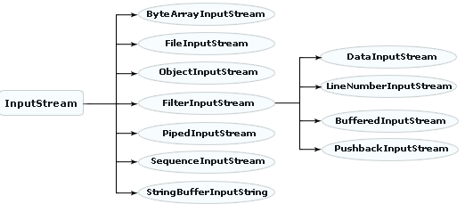
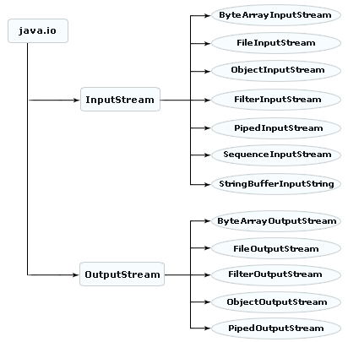
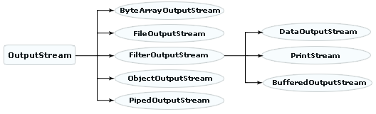
Java IO

Slide 7
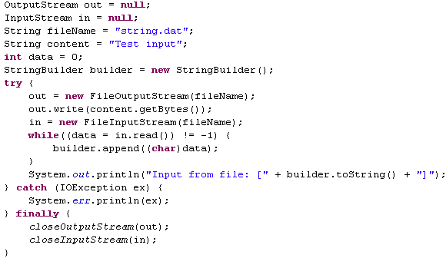
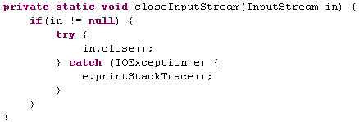
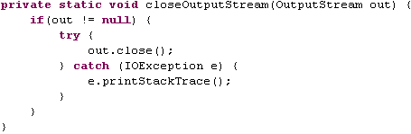
Java IO

Slide 8
Java IO
The java.io.FileInputStream and java.io.FileOutputStream classes provide methods for reading and writing data in files.They don't provide is file management, like finding out whether a file is readable or writable or moving a file from one directory to another.
FileInputStream is a concrete class and provides an input stream connected to a particular file.Methods most used: read( ), available( ), skip( ), and close( ). The FileInputStream class has one method that's not declared in the InputStream superclass: getFD( ), returning a FileDescriptor class.
The java.io.FileOutputStream class provides output streams connected to files. Methods commonly used write( ), flush( ), and close( ). Also FileOutputStream can return a FileDescriptor object calling getFD().
On network programming we use sockets.The socket provides a reliable connection for the transmission of data between two hosts. It isolates you from the details of packet encodings, lost and retransmitted packets, and packets that arrive out of order. A socket performs four fundamental operations:
Connects to a remote machine
Sends data
Receives data
Closes the connection
A socket may both send data to and receive data from the remote host it's connected to. The java.net.Socket class is Java's interface to a network socket and allows you to perform all four fundamental socket operations.
Data is sent across the socket via streams. These are the methods to get both streams for the socket: getInputStream(), getOutputStream().

Slide 9
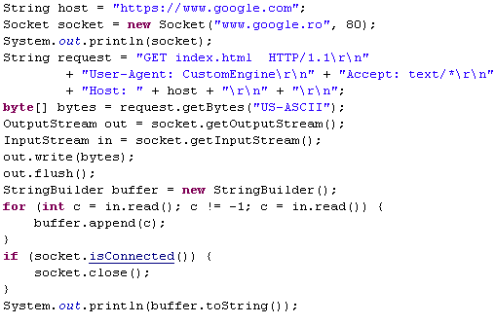
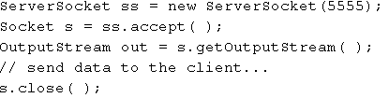
Java IO
A server socket binds to a particular port on the local machine (the server). Then it listens for incoming connection attempts from remote machines (the clients). When the server detects a connection attempt, it accepts the connection. This creates a socket between the two machines over which the client and the server communicate. Multiple clients can connect to a server simultaneously.
The java.net.ServerSocket class represents a server socket. There aren't methods for getting input and output streams.Instead, accept() returns a client Socket object: this Socket's getInputStream() or getOutputStream() methods return the streams used to communicate.

Slide 10

Java IO
The java.io package provides a set of abstract classes that define and partially implement filter streams.
A filter stream filters data as it's being read from or written to the stream. The filter streams are FilterInputStream and FilterOutputStream.
Common filter streams classes: DataInputStream,DataOutputStream, BufferedInputStream, BufferedOutputStream, PrintStream.
The java.util.security package contains the DigestInputStream and DigestOutputStream filter streams.
The Java Cryptography Extension (JCE) adds two more filter streams to this package, CipherInputStream and CipherOutputStream, which can encrypt or decrypt data using a variety of algorithms.
PrintStream is a filter stream and thus can be connected to any other output stream: FileOutputStream, ByteArrayOutputStream, TelnetOutputStream.
The println( ) method always adds a line break at the end of each line it prints. The line break character varies from platform to platform.
PrintStream methods never throw IOExceptions. Each method in the class catches IOException. When an exception occurs, an internal flag is set to true. We can test this flag using the checkError() method.
There's also a protected setError() method we can use to signal an error from a subclass. Once an error has been set, there's no way to unset it.

Slide 11
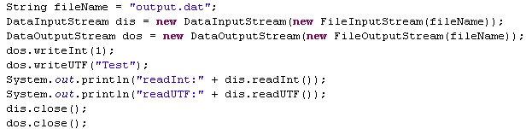
Java IO
Data streams read and write strings, integers, floating-point numbers, and other data at a higher level than bytes. The java.io.DataInputStream and java.io.DataOutputStream classes read and write the primitive Java data types and strings in a particular, platform-independent format.
The java.io.DataInput interface declares 15 methods for reading various data: readBoolean, readByte, readUnsignedByte, readShort, readUnsignedShort, readChar, readInt, readLong, readFloat, readDouble, readLine,readUTF.
The java.io.DataOutput interface declares 14 methods, complementary to those in DataInput: write, writeBoolean, writeByte, writeShort, writeChar, writeInt, writeLong, writeFloat, writeDouble, writeBytes, writeChars, writeUTF.
The DataInputStream class also has a commonly used but deprecated readLine() .

Slide 12
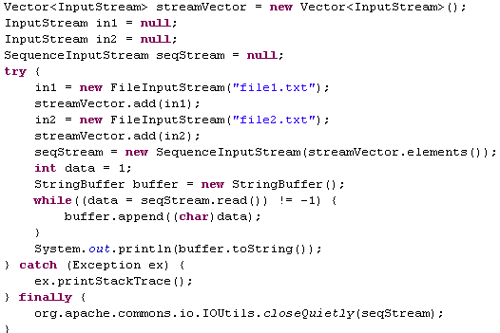
Java IO
Sequence input streams chain input streams together so that they appear as a single stream. Byte array streams allow output to be stored in byte arrays and input to be read from byte arrays.
Piped input and output streams allow output from one thread to become input for another thread.
The java.io.SequenceInputStream class connects multiple input streams together in a particular order. When the end of one stream is reached, that stream is closed.

Slide 13
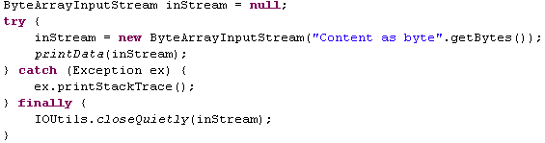
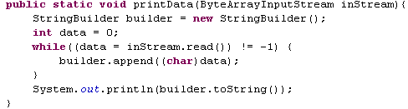
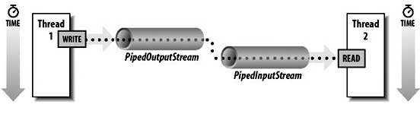
Java IO
Sometimes is convenient to use stream methods to manipulate data in byte arrays. The classes java.io.ByteArrayInputStream and java.io.ByteArrayOutputStream are the best choice.
The java.io.PipedInputStream class and java.io.PipedOutputStream classes provide a convenient means to move data from one thread to another. Output from one thread becomes input for the other thread.

Slide 14
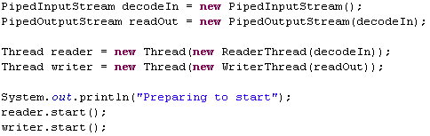
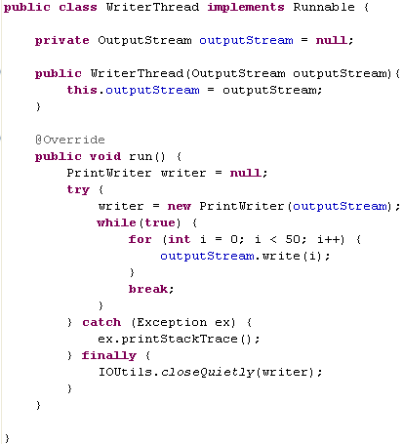
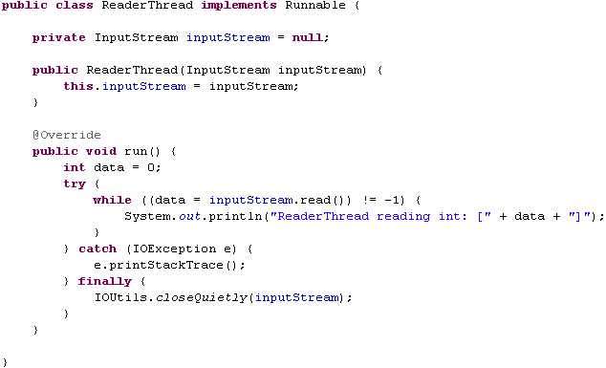
Java IO

Slide 15
Java IO
The java.io.Writer class is modeled on the java.io.OutputStream class and java.io.Reader after java.io.InputStream. The difference between readers and writers and input and output streams is that streams are fundamentally byte-based while readers and writers are fundamentally character-based.
While bytes are a more or less universal concept, characters are not. Characters can even have different sizes in different character sets. For example, ASCII and Latin-1 use 1-byte characters. UTF-8 uses characters of varying width between one and four bytes.
A language that supports international text must separate the reading and writing of raw bytes from the reading and writing of characters. Classes that write characters must be able to translate the language's native character set into a variety of formats and write those. This task is performed by the InputStreamReader and OutputStreamWriter classes.
Input and output can be time-consuming operations. It's often quicker to read or write text in large chunks rather than in many separate smaller pieces, even when you only process the text in the smaller pieces.
The java.io.BufferedReader and java.io.BufferedWriter classes provide internal character buffers.

Slide 16
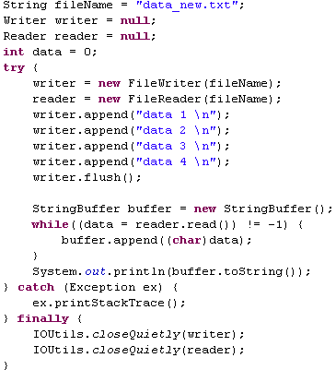

Java IO
The java.io.StringReader and java.io.StringWriter classes allow programmers to use Reader and Writer methods to read and write strings. Like char arrays, Java strings are composed of pure Unicode characters.
The FileWriter class is a subclass of OutputStreamWriter that writes text files using the platform's default character encoding and buffer size.
The FileReader class is a subclass of InputStreamReader that reads text files using the platform's default character encoding.
FileReader and FileWriter always use the local default encoding for converting characters to and from bytes. This is rarely what we want. We should almost always specify the encoding explicitly, or perhaps autodetect it.
The java.io.PrintWriter class is a subclass of java.io.Writer that contains the familiar print( ) and println( ) methods from System.out and other instances of PrintStream.
The main difference between PrintStream and PrintWriter is that PrintWriter handles multiple-byte and other non-Latin-1 character sets properly.
PipedReader and PipedWriter do for character streams what piped input and output streams do for byte streams: they allow two threads to communicate. Character output from one thread becomes character input for the other thread.

Slide 17
Java IO
The java.io.RandomAccess class allows us to read and write arbitrary bytes, text, and primitive Java data types from or to any specified location in a file. Random AccessFile implements the same interfaces as the DataInputStream and the DataOutputStream.
Random access files permit non-sequential, or random, access to a file's contents. To access a file randomly, you open the file, seek a particular location, and read from or write to that file.
File management is the manner in which files are monitored and controlled for standard I/O access.
The java.io.File class provides a constructor to create a file handle. This file handle is then used by various file class methods to access the properties of a specific file or by file stream constructors to open files.
The File class attempts to provide a platform-independent abstraction for common file operations and meta information.
Common methods used: getAbsolutePath, lastModified, length,list,listFiles, delete, mkdir, renameTo, setReadOnly, setLastModified,canRead, canWrite, exists, isDirectory, isAbsolute, isFile, isHidden.
The complete list of directories from the root to a specified file plus the name of the file itself is called the absolute path to the file. The exact syntax of absolute paths varies from system to system.
Unix (including Linux and Mac OS X) use a forward slash (/) to separate directories. DOS-based filesystems, including the variants of Windows and OS/2, use a backslash (\). Other platforms may use something completely different.
The separator used on a given system is available from the mnemonic constants java.io.File.separator and java.io.File.separatorChar. File.separatorChar is the first character of the string File.separator.

Slide 18
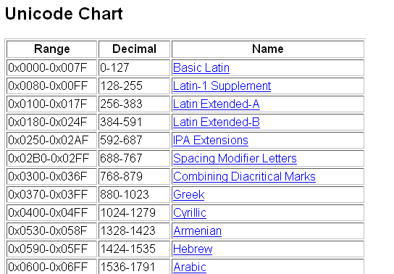
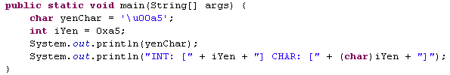

Java IO
Java adopts Unicode as its native character set.
Unicode is divided into blocks. Characters 0 through 127 are the Basic Latin block and contain ASCII. Characters 128 through 255 are the Latin Extended-A block and contain the upper 128 characters of the Latin-1 character set. The Unicode character set maps characters to integer code points.
For reference, JRE major versions with their corresponding Unicode versions:
Java 1.4 → Unicode 3.0
Java 5, Java 6 → Unicode 4.0
Java 7 → Unicode 6.0

Slide 19
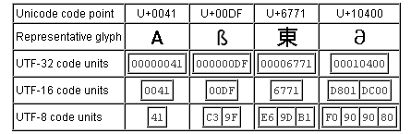
Java IO
A character is just an abstract minimal unit of text. It doesn't have a fixed shape (that would be a glyph), and it doesn't have a value. "A" is a character, and so is "€", the symbol for the common currency of Germany, etc.
A character set is a collection of characters. The Han characters are the characters originally invented by the Chinese, which have been used to write Chinese, Japanese, Korean, and Vietnamese.
A coded character set is a character set where each character has been assigned a unique number. At the core of the Unicode standard is a coded character set that assigns the letter "A" the number 004116 and the letter "€" the number 20AC16. The Unicode standard always uses hexadecimal numbers, and writes them with the prefix "U+", so the number for "A" is written as "U+0041".
Code points are the numbers that can be used in a coded character set. A coded character set defines a range of valid code points, but doesn't necessarily assign characters to all those code points. The valid code points for Unicode are U+0000 to U+10FFFF.
A character encoding scheme is a mapping from the numbers of one or more coded character sets to sequences of one or more fixed-width code units. The most commonly used code units are bytes, but 16-bit or 32-bit integers can also be used for internal processing. UTF-32, UTF-16, and UTF-8 are character encoding schemes for the coded character set of the Unicode standard.
UTF-32 simply represents each Unicode code point as the 32-bit integer of the same value.
UTF-16 uses sequences of one or two unsigned 16-bit code units to encode Unicode code points.
UTF-8 uses sequences of one to four bytes to encode

Slide 20
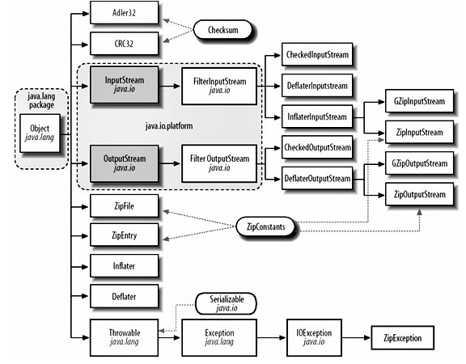
Java IO
The java.util.zip package contains six stream classes and another half dozen assorted classes that read and write data in zip, gzip, and inflate/deflate formats. Java uses these classes to read and write JAR archives and to display PNG images.

Slide 21
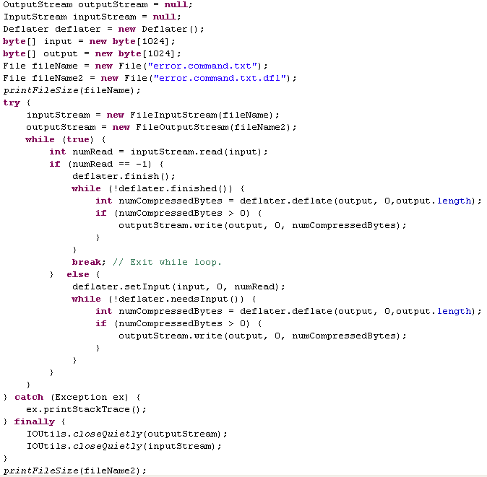
Java IO
The java.util.zip.Deflater and java.util.zip.Inflater classes provide compression and decompression services for all other classes. The Deflater class contains methods to compress blocks of data. We can choose the compression format, the level of compression, and the compression strategy.

Slide 22
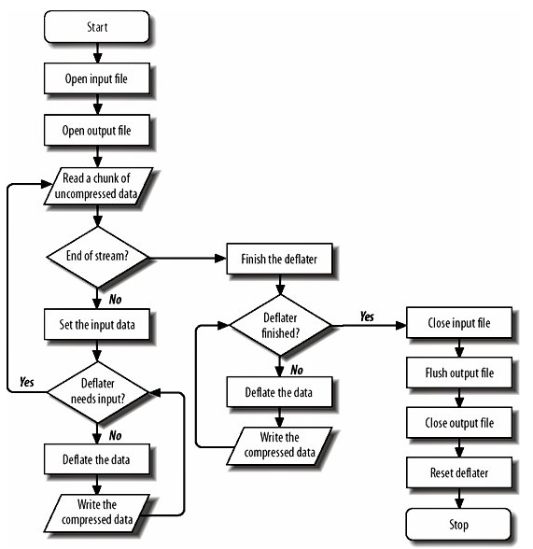
Java IO
The Inflater and Deflater classes are raw classes.
It would be more easy to write uncompressed data onto an output stream and have the stream compress, without worrying about the mechanics of deflation.
Similarly, it would be useful to have an input stream class that could read from a compressed file and return the uncompressed data.
The java.util.zip.DeflaterOutputStream class is a filter stream that compresses the data
The java.util.zip.InflaterInputStream class inflates deflated data before passing it to the reading program.
The java.util.zip.GZIPInputStream and java.util.zip.GZIPOutputStream classes do the same thing except using the gzip format.

Slide 23
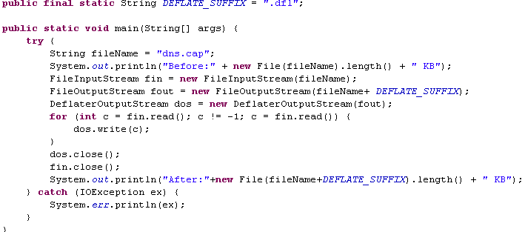

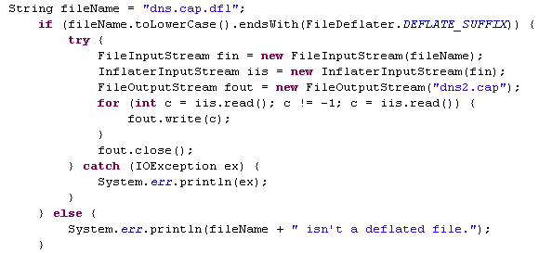
Java IO

Slide 24
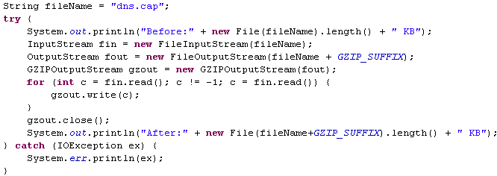

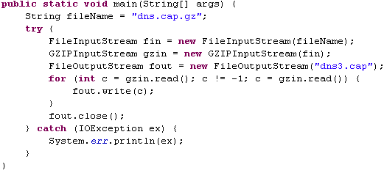
Java IO

Slide 25
Java IO
Gzip and deflate are compression formats.
Zip is both a compression and an archive format.
A single zip file may contain more than one uncompressed file, along with information about the names, permissions, creation and modification dates, and other information about each file in the archive.
The java.util.zip.ZipFile class represents a file in the zip format. Such file might be created by many other zip programs.
The java.util.zip.ZipEntry class represents a single file stored in such an archive.
A ZipEntry object contains extra information : name, comment, modification time, CRC checksum, size, compressed size, method. Common methods: getName, getTime, getSize, getCompressedSize, getCrc, getMethod, getExtra, getComment, isDirectory

Slide 26
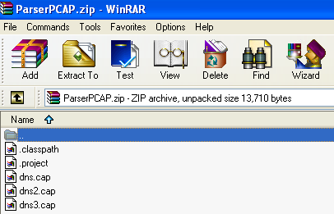
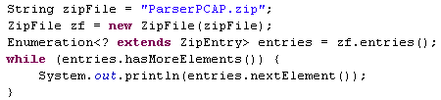

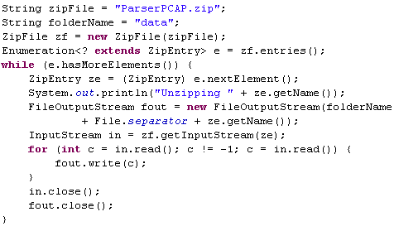

Java IO

Slide 27
Java IO
Compressed files are especially susceptible to corruption. Is common practice store a checksum with the compressed file so that the recipient can verify that the file is intact.
The zip format does this automatically, but we can use manual checksums in other circumstances.
The java.util.zip.Checksum interface is calculating a checksum for a sequence of bytes. Common methods: update, getValue, reset.
The update() methods calculate the initial checksum and update the checksum as more bytes are added to the sequence. As bytes increase, the checksum changes.
The getValue() method returns the current value of the checksum.
The reset() method returns the checksum to its initial value.
The java.util.zip package provides two concrete implementations of the Checksum interface, CRC32 and Adler32. Both produce 32-bit checksums.
The java.util.zip.CheckedInputStream and java.util.zip.CheckedOutputStream classes keep a checksum of the data they've read or written.

Slide 28
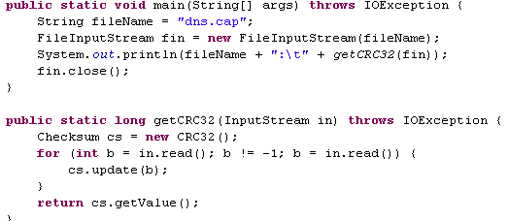
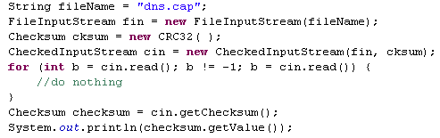


Java IO

Slide 29
Java IO
JAR archives are the standard means of packaging and distributing Java software. The content in a JAR archive can be found by the class loader as long as it is somewhere in the classpath.
JAR files also improve performance, especially in applications such as applets and Java Web Start-launched applications that download their code from a server. The content in the JAR archive is compressed.
Storing resources in a JAR file makes your applications faster, more robust, harder to accidentally break, and easier to install. The JAR file is treated like a directory in the context of the classpath.
The manifest file, which provides meta-information about the contents of the archive in a particular format, is named MANIFEST.MF and is stored in the META-INF directory at the top of the archive.The manifest is added as part of the archiving process.
At a minimum, a manifest file must contain this opening line: "Manifest-Version: 1.0".
A manifest usually contains additional entries for some of the files in the archive. Each entry is composed of a list of name/value pairs, one to a line. Names are separated from values by colons and whitespace.
The java.util.jar.JarFile class represents a file in the JAR format. The java.util.jar.Manifest class represents this manifest file.
JarInputStream is a subclass of ZipInputStream that reads data from JAR archives. JarOutputStream is a subclass of ZipOutputStream.
One of the simplest ways to get information from a JAR file is through the java.net.JarURLConnection class and represents an active connection to a JAR file, generally via either the HTTP or file protocols.

Slide 30
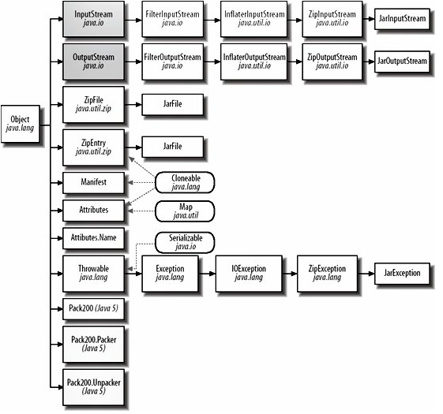
Java IO

Slide 31
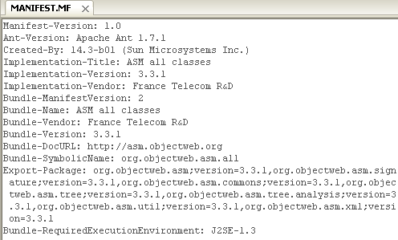
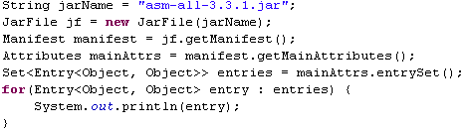
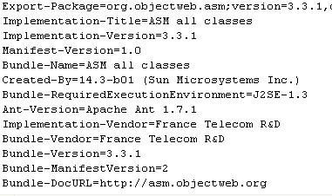
Java IO

Slide 32
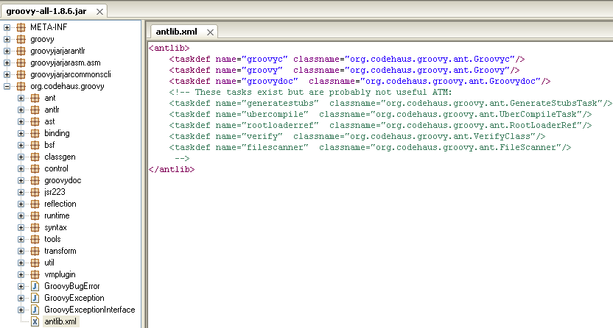
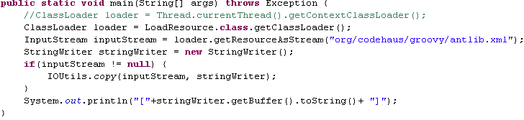
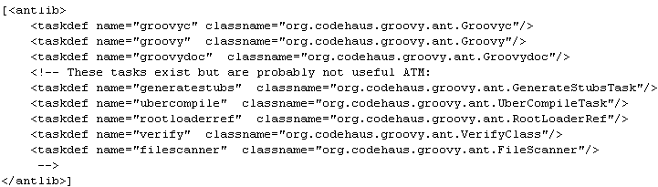
Java IO
Having groovy-all-1.8.6.jar in the classpath we can extract certain resource from the jar file as InputStream for later processing, using the getResourceAsStream method from the ClassLoader instance.

Slide 33
Java IO
The java.io.ObjectOutputStream class provides a writeObject() method you can use to write a Java object onto a stream.
The java.io.ObjectInputStream class has a readObject() method that reads an object from a stream.
Object serialization saves an object's state in a sequence of bytes so that the object can be reconstituted from those bytes at a later time. Serialization in Java was first developed for use in RMI. Object serialization is also used in the JavaBeans component software architecture.
We can only serialize instances of classes that implement the java.io.Serializable interface. By implementing this interface, a class indicates that it may be serialized without problems.
There are reasons why a class may not be serializable:
It contains native code
The object's state depends on the internals of the JVM machine or the runtime environment
Serialization is a potential security risk
The class is a holder for static methods without any real internal state
The class is a nonstatic inner class.
An alternate serialization format is preferred in a particular context.
A common problem that prevents a serializable class from being serialized is that it contains objects that do not implement Serializable. Other problem that prevents a serializable class from being deserialized is that a superclass of the class is not serializable and does not contain a no-argument constructor.
The fields we don’t want to serialize are marked with the java keyword transient.
Externalizable is an interface which subclasses the java.io.Serializable marker interface. This interface contains two methods: writeExternal(), readExternal().

Slide 34
Java IO
When an object is written onto a stream, only the state of the object and the name of the object's class are stored; The byte codes for the object's class are not stored with the object.
There's no guarantee that a serialized object will be deserialized into the same environment from which it was serialized. It's possible for the class definition to change between the time the object is written and the time it's read.
For instance, the values of static fields aren't saved when an object is serialized.
Serialization completely ignores the methods in a class, so changing method bodies or adding or removing methods does not affect serialization. However, removing an instance field does affect serialization.
Changes to a class are divided into two groups: compatible changes and incompatible changes.
Compatible changes are those that do not affect the serialization format of the object.
Incompatible changes are those that do prevent a previously serialized object from being restored.
To help identify compatible or incompatible classes, each serializable class has a stream unique identifier, SUID for short.

Slide 35
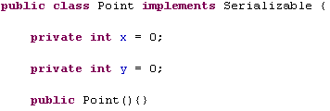
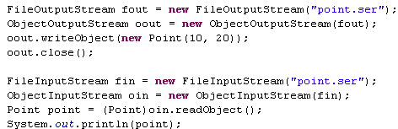

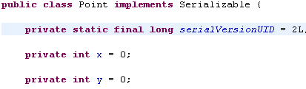
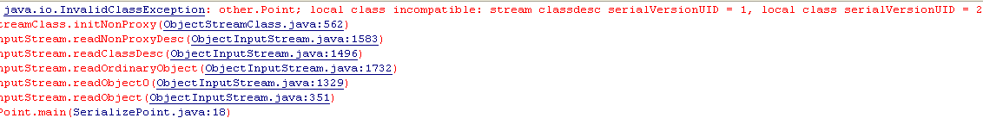
Java IO

Slide 36
Java NIO
Java 1.4 introduced a new model for I/O.
The package java.nio (NIO or New I/O) was added to support memory-mapped I/O, facilitating I/O operations closer to the underlying hardware with sometimes dramatically better performance.
The subpackage java.nio.charset provides support for different character encodings for character data.
The subpackage java.nio.channels provides support for channels, which represent connections to entities that are capable of performing I/O operations, such as files and sockets. The java.nio.channels package also provides support for fine-grained locking of files.
Whereas the traditional I/O model is based on streams, the new I/O model is based on buffers and channels.
A buffer holds the data to be read and written and can be used for both reading and writing.
java.nio has seven basic buffer classes for the seven different primitive data types: ByteBuffer, ShortBuffer, IntBuffer, CharBuffer, FloatBuffer, DoubleBuffer, LongBuffer.
You create new buffers primarily in two ways: by allocation and by wrapping.
Allocation creates a new buffer backed by memory, whereas wrapping uses a buffer as an interface to an existing array.
Eg: ByteBuffer bBuffer = ByteBuffer.allocate(1024);
Eg: int[] data = {9, 4,7}; IntBuffer buffer = IntBuffer.wrap(data);
In both cases, the arrays are not copies. These are the actual internal arrays where the buffer holds its data. Changing the data in these arrays changes the buffer's contents too, and vice versa.

Slide 37
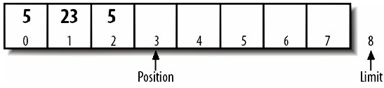
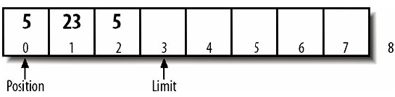
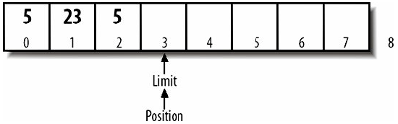
Java NIO
We can allocate an array directly using the allocateDirect().
Eg: ByteBuffer directBuffer = ByteBuffer.allocateDirect(1024);
A lot of I/O operations may be performed directly on the files without copying them to RAM first.
Common buffer methods: limit, position, flip, hasRemaining, get, put.
The flip() method sets the limit to the current position and then sets the position to 0.
The hasRemaining() method returns true as long as the position is less than the limit.
buffer.flip()
while (buffer.hasRemaining()) buffer.get( );

Slide 38
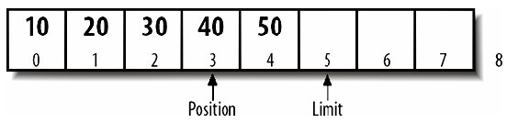
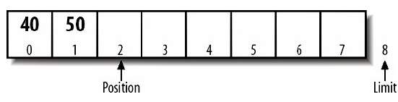
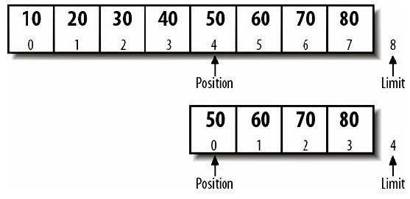
Java NIO
For both put and get, the array must fit into the available space.
If we put a larger array into the buffer than it has space left for, put() throws BufferOverflowException.
If we get a larger array than the buffer has data remaining, get() throws BufferUnderflowException.
Buffers are often used for sequential reading and writing. Compacting removes all the data from the buffer before the current position, then shifts the remaining data backwards in the buffer to the beginning.
Buffer.compact()
The duplicate method is a new buffer object that has the same internal data as the original buffer, but an independent mark, limit, and position. A duplicate is not a copy or a clone. Duplicates are useful when you want the same content to be processed simultaneously or independently.
The slice method is similar to a duplicate but includes only a subsequence.
Buffer.slice()

Slide 39
Java NIO
Buffers can be read-only. Buffers might also be read-only if they're memory mapped to a file you don't have write permission for, or to the input buffer on a network card.
Any attempt to store data into a read-only buffer will throw a runtime exception ReadOnlyBufferException. Usefull methods: isReadOnly(), asReadOnlyBuffer().
The MappedByteBuffer class maps a file directly into a ByteBuffer. However, the puts and gets access the file directly without copying a lot of data to and from RAM. Mapped byte buffers are created using the map( ) method in the FileChannel class:
Memory mapping can operate in three modes: READ_ONLY, READ_WRITE, PRIVATE.
FileChannel.MapMode.READ_ONLY → we can get data from the buffer but cannot change the data in the buffer.
FileChannel.MapMode.READ_WRITE → we can both get data from and put data in the buffer.
FileChannel.MapMode.PRIVATE → we can get data from and put data in the buffer, but the data you put is visible only through this buffer. The file itself is not changed.
Eg: RandomAccessFile file = new RandomAccessFile("file.txt", "rw");
FileChannel channel = file.getChannel( );
ByteBuffer buffer = channel.map(FileChannel.MapMode.READ_WRITE, 0, file.length( ));

Slide 40
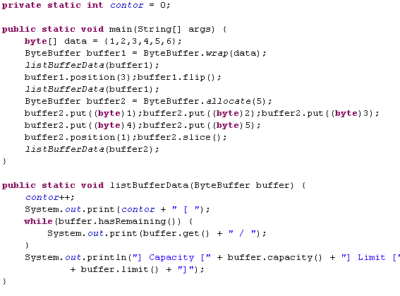

Java NIO

Slide 41
Java NIO
The superinterface for channels is java.nio.channels.Channel, having 2 methods: isOpen() and close().
The ReadableByteChannel and WritableByteChannel interfaces are used for channels that read and write bytes.
ReadableByteChannel declares a single method read() that fills a ByteBuffer with data read from the channel.
WritableByteChannel declares a single method write() that writes ByteBuffer to the channel.
Channels that can both read and write sometimes implement the ByteChannel interface. This interface is implemented by SocketChannel, DatagramChannel, and FileChannel.
The read() and write() methods are declared to throw IOException.
We cannot write to or read from a closed channel or ClosedChannelException will be thrown.
If the channel is closed by another thread while the write or read is in progress AsynchronousCloseException is thrown.
If another thread interrupts the thread's read or write operation ClosedByInterruptException is thrown.
The read() and write() methods can also throw runtime exceptions: NonReadableChannelException , NonWritableChannelException.
The InterruptibleChannel interface is a marker that, when implemented by a channel, indicates that the channel is interruptible.

Slide 42


Java NIO
The left example will concatenate the contents of the 3 files into one file named 4.txt.
The left example will copy the file from the source to the destination.

Slide 43
Java NIO
A java.nio.channels.FileChannel can potentially be both a GatheringByteChannel and a ScatteringByteChannel. Each actual FileChannel object is either readable or writable, not both.
FileChannels created by invoking the getChannel() method of a FileOutputStream are writable.
FileChannels created by invoking the getChannel() method of a FileInputStream are readable.
Invoking a write() method on a channel connected to a FileInputStream throws NonWritableChannelException.
Invoking a read() method on a channel connected to a FileOutputStream throws NonReadableChannelException.
Specific operations:
Data can be transferred from the file to a channel, or from a channel to the file easy.
File channels can be locked so that other processes cannot access them.
File channels can be flushed to write data to an associated device.
The current position in the file can be changed and we don't have to read or write a file from beginning to end. We can jump around in the file.
Unlike streams, file channels are safe for access from multiple concurrent threads. Multiple threads can read from or write to the same FileChannel simultaneously. Applications sometimes need exclusive access to particular files.
The lock() method creates a java.nio.channels.FileLock objects and locks the object. This method blocks until it can get the lock on the file.
FileLockInterruptionException is thrown if another thread interrupts the thread that is waiting for the lock.
For some use cases, it's not necessary to lock the entire file and we can lock a portion of the source.
public abstract FileLock lock(long position, long size, boolean shared).

Slide 44


Java NIO
Some operating systems, including Windows and Unix, support shared locks. A shared lock allows multiple applications, all of which have the shared lock, to access the file and no application can exclusively lock the file.
If the OS doesn't support this functionality, it just waits for an exclusive lock instead. Shared locks are allowed only on readable files. Unshared locks are allowed only on writable files.
Both lock() methods can wait for an indefinite amount of time and not to block the entire thread we can use the tryLock(). These methods act the same as lock(), except that they return immediately. If a file has already been locked, these two methods return null. To release the lock we call the release() method from FileLock.
Like file streams, file channels can be buffered. To make sure that data is written to the disk, it may be necessary to flush it by calling force().
In many cases, especially with small amounts of data, streams are just faster.
The java.nio.Channels class provides 8 static utility methods for connecting channels to streams and vice versa.

Slide 45
Java NIO
Channels serve as conduits to I/O services. I/O falls into two categories: file I/O and stream I/O, so there are two types of channels: file and socket → FileChannel class and three socket channel classes: SocketChannel, ServerSocketChannel, and DatagramChannel.
SocketChannel implements both ScatteringByteChannel and GatheringByteChannel.
There are differences between files and sockets:
- Sockets must be explicitly connected.
- Sockets can be disconnected.
- Sockets can be selected.
- Sockets support non-blocking I/O.
Eg:
SocketAddress remote = new InetSocketAddress(host, port);
SocketChannel channel = SocketChannel.open(remote);
One server thread using a ServerSocketChannel can manage many different clients because is using non-blocking I/O features.
Eg:
ServerSocketChannel channel = ServerSocketChannel.open();
SocketAddress port = new InetSocketAddress(8080);
channel.socket().bind(port);

Slide 46


Java NIO
The program will grab a HTTP resource and create a file locally with the response from the server, containing HTTP headers and body.

Slide 47


Java NIO
The program will create a server that is listening on port 23 for telnet clients.
One the client is connected is returned certain information and then is disconnected.

Slide 48
Java NIO
Data is sent across the Internet in unreliable packets called IP datagrams. These packets are automatically reassembled into the correct sequence using TCP. Lost and corrupted packets are retransmitted automatically.
Protocols like NFS, SIP, and DNS can send data over UDP instead.UDP still detects and drops corrupted datagrams. UDP does not guarantee that packets arrive in the order they were sent.
NIO includes java.nio.channels.DatagramChannel class for UDP.
DatagramChannel has both read() and write() methods because it implements both ReadableByteChannel and WritableByteChannel.
Eg:
DatagramChannel channel = DatagramChannel.open( );
SocketAddress address = new InetSocketAddress(5555);
DatagramSocket socket = channel.socket( );
socket.bind(address);
More often than read and write data with its two special methods, send() and receive(), instead:
ByteBuffer buffer = ByteBuffer.allocate(512);
buffer.put((byte) 100);
buffer.flip();
SocketAddress address = new InetSocketAddress("127.0.0.1", 37);
socket.send(buffer, address);

Slide 49



Java NIO

Slide 50
Java NIO
Non-blocking I/O is one of the most important features of the new I/O API. Traditional stream-based I/O is limited by the speed of whatever it is you're reading or writing: the disk, the network, etc.
The traditional approach to this multiple clients is to place each connection in a separate thread.
One hundred simultaneous connections require one hundred threads. It takes time to set up and tear down each thread and each uses a finite quantity of system resources.
In non-blocking I/O, one thread can manage many different connections. Rather than fully processing each one in turn, the thread asks the channels which one is ready to be read or written without blocking.
Non-blocking I/O is primarily relevant to network connections. Pipe channels that move data between two threads also support non-blocking I/O. File channels don't support it.
Using channels instead of streams we can implement using one thread and support many clients.
open a ServerSocketChannel.
set channel in nonblocking mode.
open Selector.
register the ServerSocketChannel with the Selector for accept operations.
When we register each channel with the Selector, we specify the kinds of operations for which you're registering:
SelectionKey.ACCEPT → accept connection from client.
SelectionKey.CONNECT → connection to a server.
SelectionKey.READ → read data from channel.
SelectionKey.WRITE → write data to channel.

Slide 51




Java NIO
The application will listen on port 9999 for network clients. After the client is connected a ClientThread will be created for later processing. Currently the client will receive a simple test message: “Hello from server!\n”.

Slide 52

Java NIO

Slide 53
Java NIO
By default, channels (and streams) block. Not all channels support nonblocking I/O. Network channels do, but file channels don't.
Those channels that do support non-blocking I/O are all subclasses of the java.nio.channels.SelectableChannel class.
All channels are created in blocking mode. and to switch a channel to non-blocking mode we call the configureBlocking(false) method.
Both register() methods returns a SelectionKey object that represents the unique connection between this channel and this Selector.
The java.nio.channels.Selector class is the crucial component of non-blocking I/O.
We ask the Selector which of its channels are ready with: selectNow(), select(), select(timeout).
The selectNow() method is non-blocking, whereas the other two methods block.
After we've called one of these methods, the selectedKeys() method returns a java.util.Set containing keys for all the ready channels registered with this Selector.
Selectors may use native system resources and we should use close() method in the end.
The java.nio.channels.SelectionKey class encapsulates the information about a channel registered with a Selector. The SelectionKey object holds information like: channel, Selector, object attachment.
To read or write (or accept or connect) we need the channel from its key using the channel() method:
Eg: SocketChannel client = (SocketChannel) key.channel( );
We can deregister a Selector from a channel by calling the cancel( ) method.

Slide 54


Java NIO2
The Java NIO 2(JSR 203) was introduced into JDK 1.7. The newer NIO API allows exploiting the native file-system for interacting with the file system in a clean way.
The Path object was created using invocation chaining, starting with the FileSystems class' getDefault method.
The FileSystem object normally refers to the working directory of the current user.
The Path object may consist of other paths. Subpaths can be retrieved using the subpath method.
While most of the capability of the java.io package has been supplemented by the newer packages, it is still possible to work with the older classes, in particular the java.io.File class.
1. Create a java.io.File object representing the file of interest
2. Apply the toPath method to it to obtain a Path object

Slide 55
Java NIO2
A path can be expressed either as an absolute path or a relative path. Both are common and are useful in different situations.
The Path class and related classes support the creation of both absolute and relative paths.
Common methods used when dealing with absolute and relative paths:
- getSeparator() determines the file separator.
- subpath() obtains a part or all parts/elements of a path.
- toAbsolutePath() obtains the absolute path for a relative path.
- toUri() obtains the URI representation of a path.
The getDefault method returned a FileSystem object representing the filesystem currently accessible to the JVM.
The java.nio.fil.LinkOption enumeration was added in Java 7, used to specify whether symbolic links should be followed or not.

Slide 56
Java NIO2
There are 5 general approaches to obtaining file and directory information using the java.
- using the Files.isDirectory().
- using the Files.getAttribute().
- using the Files.readAttributes().
- using the Files.getFileAttributes().
Java 7 introduces a number of interfaces that are based on a file view.
- AclFileAttributeView provides methods related to the file's Access Control List (ACL).
- FileAttributeView is the base interface for other interfaces that provide specific types of file information.
- BasicFileAttributeView is used to access basic information about a file and to set time-related attributes.
- DosFileAttributeView is designed to be used with the legacy Disk Operating System (DOS) file attributes.
- FileOwnerAttributeView is used to maintain the ownership of a file.
- PosixFileAttributeView supports Portable Operating System Interface (POSIX) attributes

Slide 57

Java NIO2
The type of a file can often be derived from its extension.
This can be misleading,and files with the same extension may contain different types of data.
The Files class' probeContentType method is used to determine the content type of a file, if possible.
This is useful when the application needs some indication of what is in a file in order to process it.
The result of the method is a String as defined by the Multipurpose Internet Mail Extension (MIME): RFC 2045.
The implementation of the probeContentType method is system-dependent.
The method will use a java.nio.file.spi.FileTypeDetector implementation to determine the content type.

Slide 58
Java NIO2
The java.nio.file.FileStore class represents a storage pool, device, partition, volume, concrete file system or other implementation specific means of the storage.
The java.nio.file.attribute.FileTime class represents the time for use with several of the java.nio package methods.
To create a FileTime object use:
- the from method, which accepts a long number representing a duration and a TimeUnit object representing a unit of time measurement.
- the fromMillis method, which accepts a long argument representing the number of milliseconds based on the epoch.
The owner of a file or directory can be modified after the file has been created.
This is accomplished by using the java.nio.file.attribute.FileOwnerAttributeView interface's setOwner method.
A java.nio.file.attribute.UserPrincipal object is used to represent a user.

Slide 59

Java NIO2
A filesystem is one or more top-level root directories containing a hierarchy of files and in Java 7 is represented by the java.nio.file.FileSystem class.
Java 7 provides a few approaches to filtering the contents of a directory using Globbing. Globbing is a pattern-matching technique that is similar to regular expressions but is easier to use.
Java 7 supports the detection of file creation, modification, and deletion within a directory by external processes. This can be very useful when it is necessary to know when changes to a directory are made.
With Java 7, it is now possible to treat the contents of a ZIP file as a filesystem. This makes it easier to manage the contents of a ZIP file and to manipulate the files contained within the ZIP file.
The getFileStores method is used to retrieve the available file stores.
The getTotalSpace method is used to obtain the total space available on the file store in bytes.
The getUnallocatedSpace contains the number of unallocated bytes.
The getUsableSpace is used to retrieve the number of usable bytes available to the JVM.
The isReadOnly if it return true, any attempts to create a file or open a file will result into an IOException.
The getRootDirectories is returning an Iterable object that permits the listing of the root directories.

Slide 60


Java NIO2
Java 7 added the java.nio.file.SimpleFileVisitor class for travering filesystem. We need to invoke the walkFileTree() method from Files class.

Slide 61

Java NIO2
The enumeration FileVisitResult contains the constants:
- CONTINUE continue the traversal
- SKIP_SIBLINGS continue without visiting the siblings of this file or directory
- SKIP_SUBTREE continue without visiting the entries in this directory
- TERMINATE terminate
The DirectoryStream interface is used for determinig the contents of a directory.
The directory consist in files or subdirectories. We call the newDirectoryStream method from Files to obtain a DirectoryStream object.
A globbing pattern is a string containing a series of characters that define a pattern.
The pattern is used to determine which directory elements to return.
A DirectoryStream.Filter interface has a single method, accept, which returns a Boolean value indicating whether the directory element should be returned or not.

Slide 62

Java NIO2
Globbing strings are based on patterns, which use special characters to match string sequences.
* → 0 or more characters of a name component without crossing directory boundaries
** → 0 zero or more characters crossing directory boundaries
? → 1 character of a name component
\ → The escape character used to match the special symbols
[ ] → Matches a single character found within the brackets.
{ } → Multiple subpatterns can be specified at the same time.

Slide 63
Java NIO2
When an application needs to be aware of changes in a directory, a watch service can listen to the changes and then inform the application of these changes.
The directory can be monitored based on the type of event that is of interest. When the event occurs, a watch event is queued.
The java.nio.file.WatchService watches registered objects for changes and events.
The java.nio.file.WatchKey is a token representing the registration of a watchable object. A watch key is created when a watchable object is registered with a watch service. The key remains valid until it is cancelled, cancelled implicity(the object is no longer accessible) of by closing the watch service.
The java.nio.file.Watchable represents the object that is registered within a watch service.
The java.nio.file.WatchEvent represents the event occurred for an object registered with a WatchService.
The java.nio.file.StandardWatchEventKinds defined the standard event kinds: ENTRY_CREATE, ENTRY_DELETE, ENTRY_MODIFY, OVERFLOW. The OVERFLOW event indicates that the events may have been lost or discarded.

Slide 64

Java NIO2
When an event occurs, we obtain the WatchKey object which contains the information about the event.
The pollEvents method returned a list of all pending events.
The type, context, and count value associated with the event were displayed.
The last activity reset the watch key. This was needed to put the key back into a ready state until it is needed again.
The Watch service is thread-safe. The watch service can be closed using the close method. If multiple threads are using this service, subsequent attempts to retrieve a watch key will result in a CloseWatchServiceException.

Slide 65

Java NIO2
In Java 7 the ZIP files handling is much simplier. The ZIP filesystem provider was introduced for handling ZIP and JAR files.
We can manipulate them as ordinary files: copy, delete,move, rename operations. Also we can change certain attributes of the file.
The java.nio.file.DirectoryStream represents an object to iterate entries from a directory. It can be used with for-each construct to iterate over a directory.

Slide 66
Java NIO2
In Java 7 there are numerous improvements to IO capabilities, found in the java.nio package.
A stream is a sequence of data. Stream IO acts on a single character at a time, while channel IO works with a buffer for each operation.
The java.nio.channels package's ByteChannel interface is a channel that can read and write bytes. The SeekableByteChannel interface extends the ByteChannel interface to maintain a position within the channel. The current position can be queried and modified.
Support for asynchronous channel has been added.
There are four new java.nio.channels package asynchronous channel classes:
- AsynchronousSocketChannel
- AsynchronousServerSocketChannel
- AsynchronousFileChannel
- AsynchronousChannelGroup
The AsynchronousFileChannel class is used for file manipulation operations that need to be performed in an asynchronous manner. The AsynchronousChannelGroup class provides a means of grouping asynchronous channels together in order to share resources.
When we open a file we can specify how the file should be open. The java.nio.file.OpenOption specifies how the file is open. Posibble values for StandardOpenOption: CREATE, CREATE_NEW, DELETE_ON_CLOSE, APPEND, DSYNC, READ, SPARSE, TRUNCATE_EXISTING, WRITE.

Slide 67

Java NIO2
The java.nio.channels.NetworkChannel interface was introduced in Java 7, representing a channel to a network socket. Also java.nio.channels.MulticastChannel is used to support multicast operations for a group.
The Sockets Direct Protocol (SDP) is a network protocol, which supports stream connections using InfiniBand (IB). The IB technology supports point-to-point bi-directional serial links between high-speed peripherals, such as disks. A significant part of IB is its ability to move data from the memory of one computer directly to the memory of another computer. SDP is supported in Java 7 on Solaris and Linux operating systems. Several classes in the java.net and java.nio.channels packages support it transparently. SDP must be enabled before it can be used. .
In many cases the files we are reading are text files. We can use readAllBytes() method from Files class. For writing the contents on an text file we can use the write() method from Files class.

Slide 68
Java NIO2
Java 7 supports asynchronous communications between a server and a client.
The java.nio.channels package's AsynchronousServerSocketChannel class supports server operations for streaming IO in a thread-safe manner.
Server side:
1. Use AsynchronousServerSocketChannel.open method to get an instance of a AsynchronousServerSocketChannel
2. Bind the channel to a local address and port number
3. Use the accept method to accept a connection request from a client
4. Process messages as they are received
Client side:
1. Create an AsynchronousSocketChannel object using the static open method
2. Create an instance of an InetSocketAddress object for the server
3. Connect to the server
4. Send messages as needed

Slide 69
Conclusions
A stream-oriented I/O system deals with data one byte at a time.
An input stream produces one byte of data, and an output stream consumes one byte of data.
It is also relatively simply to chain several filters together so that each one does its part in what amounts to a single, sophisticated processing mechanism.
A block-oriented I/O system deals with data in blocks.
Each operation produces or consumes a block of data in one step.
Processing data by the block can be much faster than processing it by the (streamed) byte.
The java.nio is much more efficient, but is difficult to code around.
Larger files in sizes are better to be processed with java.nio that is faster than java.io.
Good NIO frameworks: Grizzly, Jboss Netty, Apache Mina, Nioframework.

Slide 70

Bibliography
O'Reilly – Java I/O, 2nd Edition
O'Reilly – Java NIO
Apress – Pro java 7 NIO
http://javasefx.blogspot.ro/2010_02_06_archive.html
http://www.ssec.wisc.edu/~tomw/java/unicode.html
http://java.sun.com/developer/technicalArticles/Intl/Supplementary/

