Slide 1

JDBC
Dima Ionut Daniel

Slide 2
Contents
What is JDBC?
History
Architecture
Features
JDBC Driver Types
Core
Advanced
Data Types
Metadata
RowSets
Blob/Clob
Bibliography

Slide 3

What is JDBC?
JDBC(Java Database Connectivity) is an API for the Java programming language that defines how a client may access a database.
It provides methods for querying and updating data in a database.
JDBC is oriented towards relational databases.

Slide 4
History
Sun Microsystems released JDBC as part of JDK 1.1 on 19 February 1997.
Starting with version 3.1, JDBC has been developed under the JCP.
JSR 54 includes JDBC 3.0 and was included in J2SE 1.4.
JSR 114 specifies the JDBC Rowser additions and JSR 221 is the specification of JDBC 4.0 included in Java SE 6.
JDVB 4.1 is specified in JSR 221 and was included in Java SE 7.
JDBC 4.2 is included in JSR 221 and it's included in Java SE 8,

Slide 5
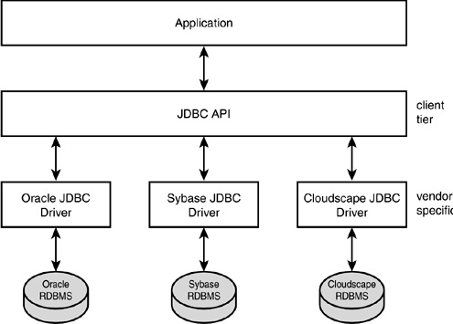
Architecture

Slide 6
Features
1. Get a connection. A java application can be connected to a database either using DriverManager or DataSource object.
2. Connection Pooling. It allows the java application to reuse database connection the connection that has been created already instead of creating a new connection every time.
3. Rowsets. The rowsets objects contains the tabular data. It makes the possible to pass the rows data to the network. Therefore they are widely used in distributed application.
4. New data type supports. This is the ability of JDBC to manipulate large object such as BLOB and CLOB.
5. Batch Updating. This feature provides the ability to send multiple updates to the database to be executed as batch rather than sending each update separately.

Slide 7
Features (cont.)
6. Result set enhancement .
a. Scrollable Result set. It provides the ability to move the cursor backward and forward to a specific position. This feature is used by GUI took for programmatic updating.
b. Updateable Result set. It allows the modification of data in a database table using result set.
7. Savepoints. JDBC contains a Savepoint interface which contains a new method to set a savepoints, to release a save point and to rollback a transaction to desired savepointsEasy to

Slide 8
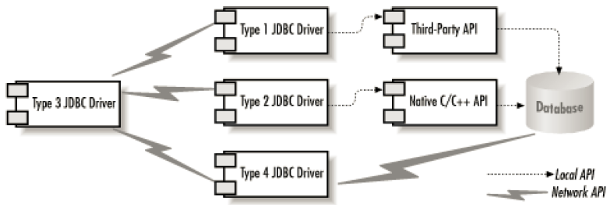
JDBC Driver Types
JDBC drivers are client-side adapters that converts requests from Java programas to a protocol that the DBMS can understand.
There are commercial and free drivers available for most relational database servers.
Type 1 calls native code of the locally available ODBC driver.
Type 2 calls database vendor native library on a client side.
Type 3 is a pure-java driver that talks with server-side middleware that then talks with the DB.
Type 4 is a pure-java driver that uses database native protocol.

Slide 9
Core
JDBC makes it possible to perform three tasks:
Establish a connection with a relational database.
Using the established database connection, send SQL statements (such as a select, insert, update, metadata request, and so on) and result sets.
Process the result sets (retrieved from the database).
JDBC consists of classes in the package java.sql and some JDBC extensions in the package javax.sql.

Slide 10
Core (cont.)
java.sql:
provides API for accessing and processing data stored in a data source.
provides classes like: Connection, ResultSet, Statement, PreparedStatement.
provides metadata classes/interfaces like DatabaseMetaData and ResultSetMetaData.
javax.sql:
provides API for server-side data source access.
provides services for J2EE such as DataSource and RowSets.
contains clases/interfaces like RowSetMetaData that deal with row set metadata.

Slide 11
Core (cont.)
DriverManager → loads JDBC drivers in memory and it's used as factory for Connection objects.
Connection → represents connection with a data source.
DatabaseMetaData → provides detalied information about the DB.
Statement → represents a static SQL.
PreparedStatement → represents a precompiled SQL statement.
CallableStatement → represents a database stored procedure
ResultSet → represents a database result set generated by SELECT SQL statement.
ResultSetMetaData → provides information about the types and properties of the columns from ResultSet.
SQLException → exception class that provides informaiton on a DB access error or other errors.

Slide 12
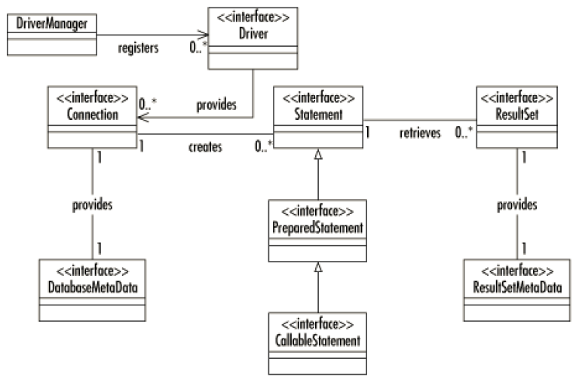
Core (cont.)

Slide 13
Core (cont.)
Example loading JDBC drivers: Class.forName("com.mysql.jdbc.Driver");
The specified driver must implement the java.sql.Driver interface.
In order to get a Statment object we call the createStatement() method on Connection object.
In order to retrieve data from DB we use the ResultSet object by calling executeQuery(<SQL_QUERY>) on Statement object.
In order to perform cleanup the close() method is called on ResultSet, Statement ,Connection objects.

Slide 14
Core (cont.)
A JDBC URL identifies the data source so that the appropriate driver will recognize it and establish a connection with it.
The standard syntax for JDBC URLs has 3 parts, which are separated by colons.
jdbc:<subprotocol>:<subname>
<subprotocol>→ the name of the driver or the name of a database connectivity mechanism, which may be supported by one or more drivers.
<subname>→ a way to identify the data source. The subname can vary, depending on the subprotocol.

Slide 15
Core (cont.)
A ConnectionEvent object, part of the event model for pooled connections, informs a component managing the pooling of connections that an event has occurred on a PooledConnection object.
The ConnectionEvent object always contains the PooledConnection object that generated the event, and if an error occurred, it also contains the SQLException that explains the event.
ConnectionEventListener is used to receive the events and provides two methods (connectionClosed, connectionErrorOccurred), one for each type of event that can occur on a pooled connection.

Slide 16
Core (cont.)
In JDBC errors,exceptions are identified by the java.sql.SQLException class which is a checked exception.
SQLWarning class (,subclass of SQLException) represents nonfatal errors or unexpected conditions that can be ignored.
BatchUpdateException is thrown when an error occurs during a batch update operation.
DataTruncation is an exception that reports a DataTruncation warning when JDBC unexpectely truncates a data value.

Slide 17
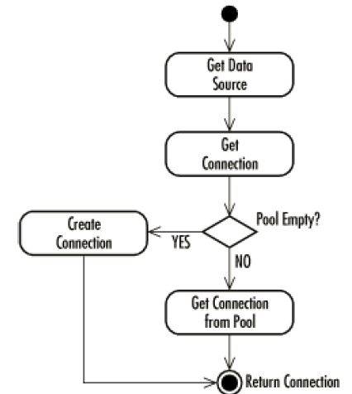
Core (cont.)
When the application calls getConnection() in the DataSource instance, it pulls a Connection out of the connection pool.
Its close() method returns it to the connection pool. If you try to use that Connection again without getting it from the connection pool, it will throw an exception.

Slide 18
Core (cont.)
The Connection object has the setTransactionIsolation method that can set the SQL transaction isolation.
We can retrieve the current SQL transaciton isolation using the getDefaultTransactionIsolation from DatabaseMetaData object. Possible transaction isolation:
TRANSACTION_NONE:
Transactions are not supported.
TRANSACTION_READ_UNCOMMITTED:
"dirty reads," nonrepeatable reads, and phantom reads can occur.
allows a row changed by one transaction to be read by another transaction before any changes in that row have been committed.
TRANSACTION_READ_COMMITTED:
"dirty reads" are prevented; however, nonrepeatable reads and phantom reads can occur.
TRANSACTION_REPEATABLE_READ:
"dirty reads" and nonrepeatable reads are prevented; phantom reads can occur.
TRANSACTION_SERIALIZABLE:
"dirty reads," nonrepeatable reads, and phantom reads are all prevented.

Slide 19
Core (cont.)
The Savepoint interface, one of the features added in the JDBC 3.0 API, gives a developer more control over transactions.
A Savepoint object provides a way to mark an intermediate point within a transaction, thus making it possible to roll back the transaction to that point instead of rolling back the entire transaction.
The method Connection.setSavepoint creates and sets a Savepoint object.
Savepoint save1 = con.setSavepoint("SAVEPOINT_1");
A Savepoint object is used by passing it to the method Connection.rollback.
con.rollback(save1);
Savepoint object can be released by calling method releaseSavepoint.
con.releaseSavepoint(save1);

Slide 20
Advanced
An XAConnection object is a PooledConnection object that can be used in a distributed transaction.
The XADataSource interface is similar to the DataSource interface except that it creates XAConnection objects instead of Connection objects
The XAResource interface is the mapping in the Java programming language of the industry standard Open Group XA interface.
A transaction manager uses an XAResource object to control the distributed transactions associated with an XAConnection object.

Slide 21
Advanced (cont.)
An XADataSource object creates XAConnection objects, connections derived from PooledConnection that can be used for distributed transactions.
An application that uses distributed transactions will need to be run using a JDBC driver that supports the XADataSource and XAConnection interfaces.
The Connection objects created by PooledConnection objects and XAConnection objects are handles for the underlying physical connections they represent.

Slide 22
Data Types
The class Types contains a list of constants that are used to identify generic SQL data types.
These generic SQL type identifiers are called JDBC types, which distinguishes them from database-specific SQL types.
The constant java.sql.Types.OTHER indicates that the data type is not one of the standard JDBC types.
The JDBC 2.0 core API added 7 JDBC types to the class Types, and the JDBC 3.0 API 2 more: JAVA_OBJECT, ARRAY, BLOB, CLOB, DISTINCT, REF, STRUCT, BOOLEAN, DATALINK.
Initial types: BIG, TINYINT, SMALLINT, INTEGER, BIGINT, FLOAT, REAL, DOUBLE, NUMERIC, DECIMAL, CHAR, VARCHAR, LONGVARCHAR, DATE, TIME, TIMESTAMP, BINARY, VARBINARY,LONGVARBINARY, NULL, OTHER.

Slide 23
Metadata
ResultSetMetaData provides metadata for the ResultSet object.
ResultSetMetaData enables to get information about the types and properties of the columns in a ResultSet object.
The java.sql.ParameterMetaData is a new interface defined in JDBC 3.0.
The ParameterMetaData interface contains methods that retrieve information about the parameter markers (indicated with a ?) in a PreparedStatement object.
The method PreparedStatement.getParameterMetaData() returns a ParameterMetaData object that describes the parameter markers that appear in the PreparedStatement object.
ParameterMetaData is an optional interface, and some vendors might not implement it.

Slide 24
Metadata (cont.)
The java.sql.DriverPropertyInfo class extends the java.lang.Object class and provides Driver properties for making a database connection.
JDBC’s Driver.getPropertyInfo() method returns the database connection properties for which it should prompt a user in order to get enough information to connect to a database.
The javax.sql.RowSetMetaData object contains information about the columns in a javax.sql.RowSet object.

Slide 25
RowSets
A RowSet object represents a set of rows returned by a database server as a result of running a SQL query or opening a table.
A RowSet object extends the ResultSet interface, which means that it can be scrollable, can be updatable.
There are different kinds of rowsets:
Cached rowset(javax.sql.CachedRowSet) → can operate without being connected to data source.
JDBC rowset(javax.sql.JdbcRowSet) → wrapper around ResultSet object that makes it possible to use the result set as JavaBeans component.
Web rowset(javax.sql.WebRowSet) → offers CachedRowSet capabilities and can be imported/exported as XML.
Filtered rowset(javax.sql.FilteredRowSet) → RowSet object can provide a degree of filtering on its contents.
Join rowset(javax.sql.JoinRowSet) → provides a mechanism to combine data from different RowSet.
Synchronized Resolver rowset(javax.sql.rowset.spi.SyncResolver) → represents a specialized RowSet object that implements the SyncResolver interface.

Slide 26
RowSets (cont.)
Rowsets may be either connected or disconnected.
A connected RowSet object maintains a connection to its data source the entire time it is in use.
A disconnected rowset is connected to its sdata source only while it's reading/writing data from/to it.
RowSetInternal: By implementing the RowSetInternal interface, a RowSet object gets access to its internal state and is able to call on its reader and writer.
RowSetReader: A disconnected RowSet object that has implemented the RowSetInternal interface can call on its reader to populate it with data.
RowSetWriter: A disconnected RowSet object that has implemented the RowSetInternal interface can call on its writer to write changes back to the underlying data source.

Slide 27
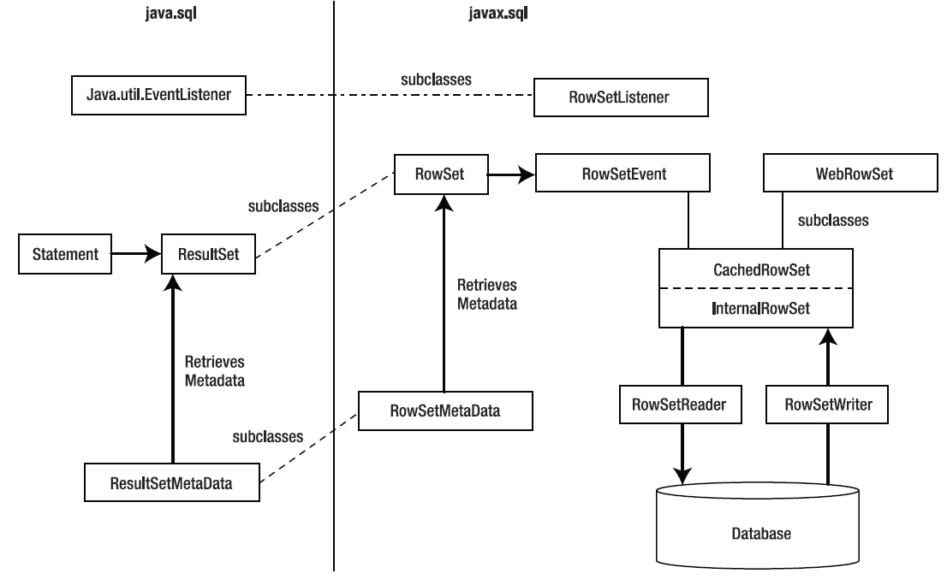
RowSets (cont.)

Slide 28
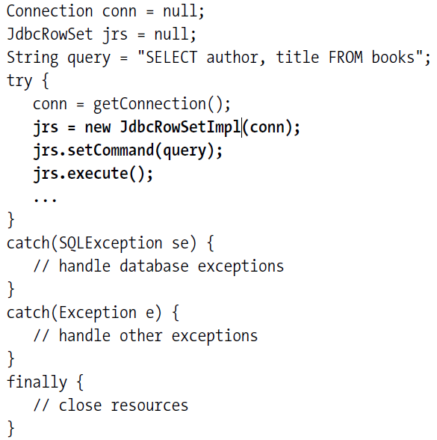
RowSets (cont.)

Slide 29
RowSets (cont.)
A RowSet object has the ability to participate in event notification.
The RowSetListener interface contains 3 methods: rowChanged, rowSetChanged, and cursorMoved.
The implementations of these methods specify what the listener will do when an event occurs on the CachedRowSet object.
A RowSetEvent object is used to notify a listener component that an event has occurred in a particular RowSet object.
A RowSetEvent object is initialized with the RowSet object as source.

Slide 30
Blob/Clob
A Blob object represents the Java mapping of an SQL BLOB(Binary Large Object).
An SQL BLOBL is a built-in type that stores a Binary large Object as a column value in a row of a DB table.
A Clob object represents the Java mapping of an SQL CLOB(Character Large Object).
The SQL CLOB is a built-in type that stores a Character large Object as a column value in a row of a database table.
The Blob/Clob objects can be retrieved/stored in the DB and can be iterated as streams.

Slide 31

Bibliography
http://en.wikipedia.org/wiki/Java_Database_Connectivity
http://www.roseindia.net/tutorial/java/jdbc/featuresofjdbc.html
Apress - JDBC Metadata, MySQL,and Oracle Recipes
O'Reilly - Database Programming with JDBC and Java 2nd Edition
Addison Wesley - JDBC API Tutorial and Reference, 3rd Ed

