Slide 1

JMX
Dima Ionut Daniel

Slide 2
Contents
What is JMX?
Architecture
Features
JMX Terms
Managed Bean
MBean Code Rules
MX Beans
MBean Server
Dynamic Loading
Monitoring Services
Timer Services
Relation Services
Bibliography

Slide 3

What is JMX?
Java Management Extensions(JMX) is a java technology tht suplies tools for managing and montoring applications.
The resources are represented by objects called MBeans(Managed Bean).
JMX 1.0, 1.1 and 1.2 are defined in the JSR 003.
The JMX Remote API 1.0 for remote management and monitoring is specified by JSR 160.
An extension of the JMX Remote API for Web Services is being developed under JSR 262.
Adopted early on by the J2EE community, JMX has been a part of J2SE since version 5.0.

Slide 4
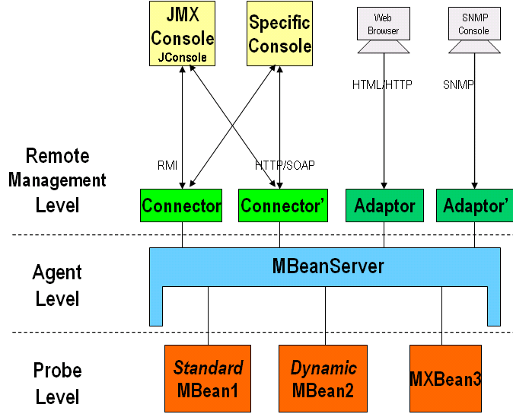
Architecture

Slide 5
Architecture (cont.)
JMX uses a three-level architecture:
The Probe(Instrumentation) level contains the probes (called MBeans) instrumenting the resources.
The Agent level(MBeanServer) represents the core of JMX and acts as an intermediary between the MBean and the applications.
The Remote Management level enables remote applications to access the MBeanServer through connectors and adaptors. A connector provides full remote access to the MBeanServer API using various communication (RMI, IIOP, JMS, WS-* …), while an adaptor adapts the API to another protocol (SNMP, …) or to Web-based GUI (HTML/HTTP, WML/HTTP, …).

Slide 6
Features
Easy to use:
Modularization:
Alerts, events, statistics: provides notification system
Rapid monitoring solutions: applications can be monitored using application MBeans.

Slide 7
JMX Terms
Manageable resource
resource that can be accessed/wrapped by Java.
resource is the entity managed by a JMX Mbean.
MBean
An MBean is a Java class that needs to respect the JMX spec.
Management applications access MBeans to access attributes and invoke operations.
There are 3 types of MBeans: Standard, Dynamic and Model MBeans.
MBean server
A MBean server is a java class that manages a group of MBeans.
It acts as a registry for looking up MBeans.
The MBean server provides methods for performing queris to find MBeans and other objects to register as notification listeners.

Slide 8
JMX Terms (cont.)
JMX Agent
A JMX agent is a Java process that provides a set of services for managing a set of MBeans.
Agents can expect to have a set of protocol adapters and connectors that enable remote and different clients to make use of the agent.
Protocol adapters/connectors
Protocol adapters/connectors are objects residing within a JMX agent that expose the agent to management application and protocols.
An agent can have any number of adapters/connnectors.
Management application
A management application is an applicaiton that communicates with the JMX agents.
Notification
Notifications are Java objects emitted by MBeans and these evets are received by the MBean server.
Other MBeans or Java objects can register as listeners to receive notifications.
Instrumentation
Instrumentation represents the process of exposing manageable resource using MBean(or set of MBeans).

Slide 9
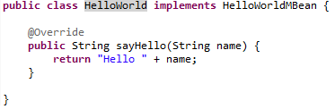

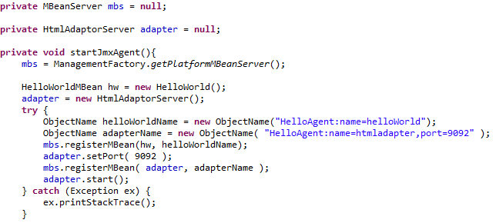
Managed Bean
Bellow it’s an example how to create and register agents and adaptors(HTTP).

Slide 10
Managed Bean (cont.)
The ObjectName uniquely identifies the instance.
Domain names provides context for the agent in relation to other agents.
JMX notifications are Java objects used to send information from MBeans and agents to other objects that have registers to receive them.

Slide 11
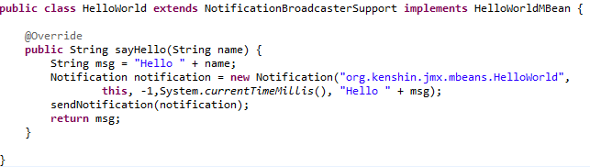
Managed Bean (cont.)
JMX supports 2 mechanism for MBeans to provide listeners to register for notifications:
implement javax.management.NotificationBroadcaster interface.
extend javax.management.NotificationBroadcasterSupport class.
In order to emit notifications the javax.management.Notification class is used.

Slide 12
Managed Bean (cont.)
Notification parameters:
type → identifies notification
source → MBean that is generating the notification
sequenceNumber → number that identifies the notification
timestamp → creation of the notification
message → message from the notification
By extending the NotificationBroadcasterSupport we can use the sendNotification() for sending notification.
TO receive notifications we need to implement the NotificationListener interface, the handleNotification method.

Slide 13
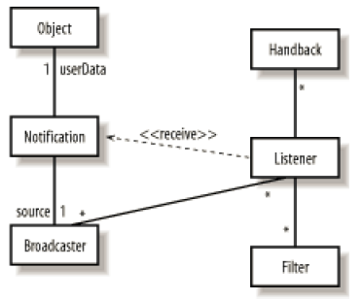
Managed Bean (cont.)
The JMX specification provides generic notification mechanism.
Notification → represents the contents of a single notification and is sent by the broadcaster to the listener.
NotificationFilter → give information about a subset of potential notifications
NotificationBroadcaster → interface implemented by all notification broadcasters
NotificationListener → interface implemented by all receivers

Slide 14
Managed Bean (cont.)
There are 4 types of Mbeans:
Standard MBean
Dynamic MBean
Model MBean
Open MBean
The ObjectName class contains 2 components: domain name and key property list.
Example: domain-name:key1=value1[,key2=value2,...,keyN=valueN]
Without an ObjectName instance, an MBean cannot be registered with the MBean server.

Slide 15
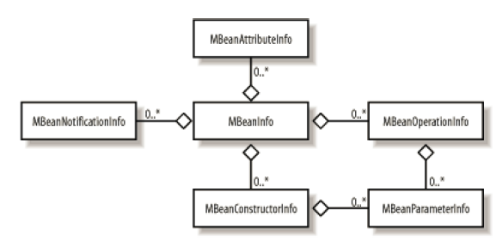
Managed Bean (cont.)
JMX agents recognize Dynamic MBeans because they must implement the javax.management.DynamicMBean interface.
MBeans cannot implement both their own MBean interface and the DynamicMBean interface.
DynamicMBean interface contains 5 methods: getAttribute, setAttribute, getAttributes, setAttributes, getMBeaninfo, invoke.
The MBeanInfo class contains information about: MBeanFutureInfo, MBeanParameterInfo, MBeanConstructorInfo, MBeanAttributeInfo, MBeanOperationInfo, MBeanNotificationInfo.

Slide 16
Managed Bean (cont.)
The interface ModelMBean extends the DyanamicMBean interface.
Model MBeans introduce the concept of a descriptor adding additional set of metadata.
Certain predefined descriptor values provide support for functionality:
Automatic attribute change notifications.
Persistence of the MBean's state at a specified interval.
Logging of MBean state changes.
Caching of an MBean feature (such as an attribute value or the return value of an operation) to improve performance for static (or relatively static) MBean features.

Slide 17
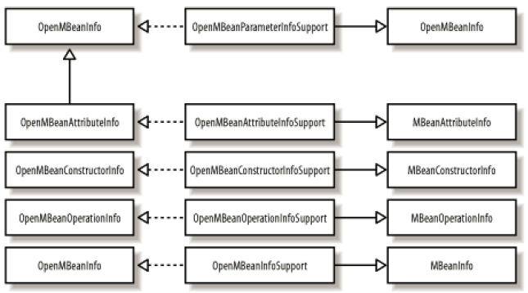
Managed Bean (cont.)
Sometimes MBean attributes are complex. Open MBeans were designed to make MBeans accessible to the widest possible range of management applications.
Every open MBean type is a concrete or abstract class called OpenType. In order to build complex types 3 types can be used:
ArrayType → describes an n-dimensional array of any open MBean type
CompositeType → describes an arbitrarly complex structure of open MBean type
TabularType → describes a tabular structure of any number of rows where the same ComposityType describes each row in the table.

Slide 18
Mbean Code Rules
When developing MBeans following rules must be followed:
MBean must be a concrete java class.
MBean must have public constructor.
MBean must implement either its own MBean interface or javax.management.DynamicMBean.
MBean interface must follow the naming scheme ClassNameMBean.
MBean can optionally implement javax.management.NotificationBroadcaster in order to send notifications to interested listeners.

Slide 19
MX Beans
An MXBean is a type of MBean that references a predefined set of data types.
MXBeans are defined in the package java.lang.management: BufferPoolMXBean, ClassLoadingMXBean, CompilationMXBean, GarbageCollectorMXBean, MemoryManagerMXBean, MemoryMXBean, MemoryPoolMXBean, OperatingSystemMXBean, PlatformLoggingMXBean, RuntimeMXBean, ThreadMXBean.

Slide 20
Mbeans Server
The MBean server is the heart of the agent.
The primary function is to act as registry for MBeans.
Every MBean must be registered in order to be managed.
A secondary function of the MBean server is to act as intermediary between agents and application.
Operations:
register and deregister MBeans
register interest in MBean and MBean server notifications
invoke MBeans
query to return subsets of the MBeans that are registered within it

Slide 21
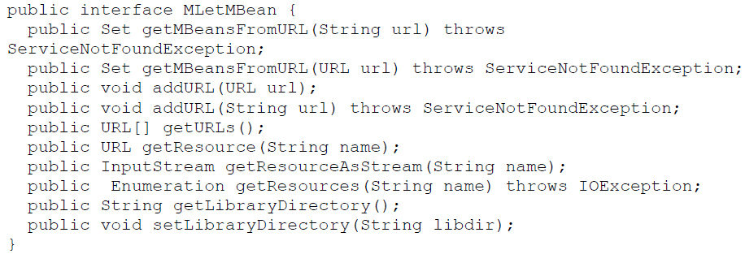
Dynamic Loading
M-Let(management applet) allows MBeans to be loaded into an agent dynamically.
The M-Let service is implemented in a class called MLet wich implements and interface called MLetMBean.
The MLetMBean interface allows agents(and management applications) to manipulate the M-Let service to load MBeans and to manage the M-Let service itself.

Slide 22
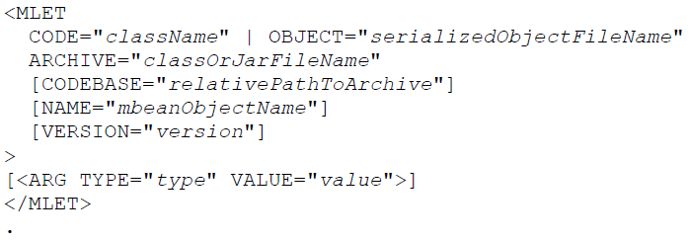
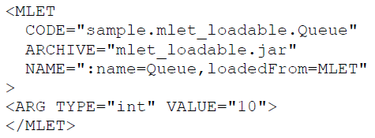
Dynamic Loading (cont.)
The M-Let service must be created and registered with the MBean server before you can use it.
The M-Let file is a text file that looks like XML but is not required to be well-formed XML.
There is one MLET tag for each MBean to be loaded.

Slide 23
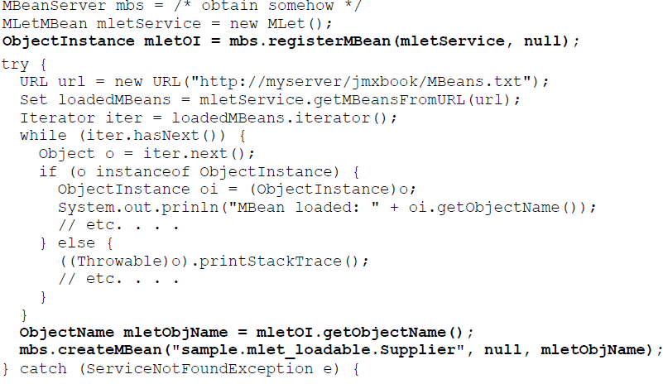
Dynamic Loading (cont.)

Slide 24
Monitoring Services
A monitor observes the attribute value of an MBean called observer object at specific intervals called granularity period.
From this observation, the monitor calculates a value called the derived gauge, which is either the value of the attribute or the difference between the values of the attribute at the two most recent observations.
If certain conditions are met certain notifications are sent.
There are 3 types of monitors: counter,gauge and string.

Slide 25
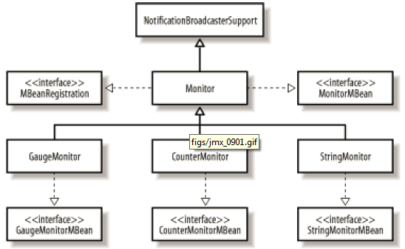
Monitoring Services (cont.)
Counter monitors
observe nonnegative MBean integer attributes(like byte, short, int, long) and send a notification when the derived gauge exceeds a certain thresholds.
Gauge monitors
send notification when the derived gauge exceeds an upper limit(high threshold) or drops bellow a lower limit(low threshold)
String monitor
send notification when the derived value differs from a predefined string value

Slide 26
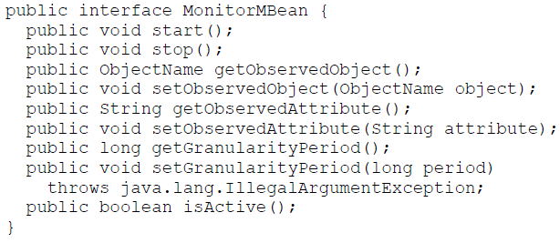
Monitoring Services (cont.)
Each of the monitors is an MBean that can be managed.
The base class Monitor contains functionality common to all the monitoring services and exposes a management interface MonitorMBean.
Each monitor runs in its own thread of execution so that it can monitor an MBean attribute.
The start() method is used to start the monitor thread, and stop() is used to stop the thread.

Slide 27
Monitoring Services (cont.)
MonitorNotification is extending Notification class that contains attributes specific to monitors.
Error notification have the jmx.monitor.error namaspace.
Notification types:
jmx.monitor.error.mbean
sent when the MBean to be observed isn't registered in the MBean server
jmx.monitor.error.attribute
sent when an attribute of an MBean that needed to be observed doesn't exists.
jmx.monitor.error.type
Sent when the MBean attribute's type doesn't match that of the type of monitor in use.
jmx.monitor.error.runtime
when an error has occurred that doesn't fit into other categories.
jmx.monitor.error.threshold
Sent when the threshold value is not of the same type as the derived gauge

Slide 28
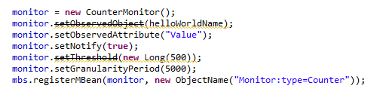
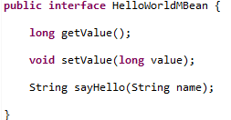
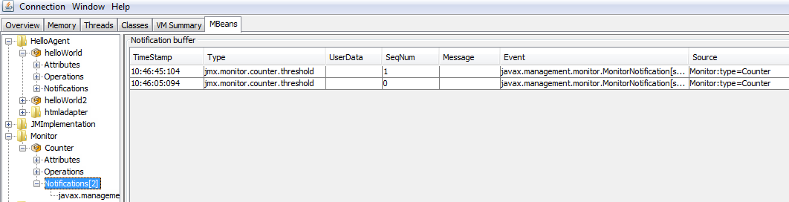
Monitoring Services (cont.)

Slide 29
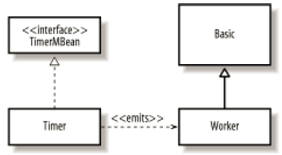
Timer Services
The timer service is a special-purpose notification broadcaster designed to send notifications at specific time intervals, starting at a particular date and time.
There are two primary uses of the timer service:
To send a single notification to all listeners interested in that notification type
To send multiple notifications that repeat at specific intervals for a set number of times, or indefinitely

Slide 30
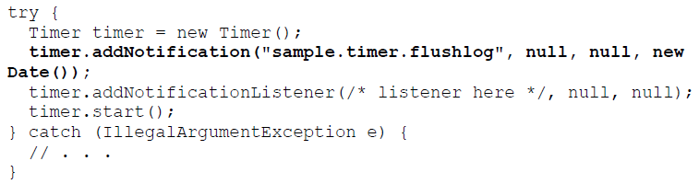
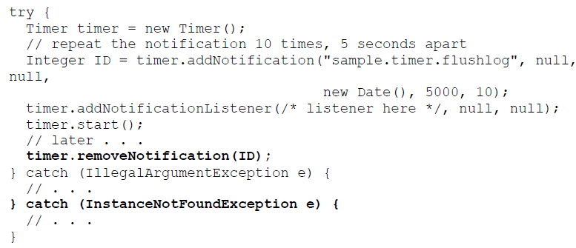
Timer Services (cont.)
The Timer class is part of the IR and contains implementation of the timer services.

Slide 31
Relation Services
The relation service provides a facility to associate MBeans with each other.
Role:
named category of functionality that is performed by an MBean and implemented by the Role class.
Role Information:
Metadata about the role, information implemented by the RoleInfo class.
Relation Type:
Metadata that describes the relationship between RoleInfo objects.
Relation:
An instance of a relation type

Slide 32

Bibliography
http://en.wikipedia.org/wiki/Java_Management_Extensions
Manning - JMX In action
O’Reilly - Java Management Extensions

