Slide 1

JMeter
Dima Ionut Daniel

Slide 2

Contents
What is JMeter?
JMeter setup
Running JMeter
JMeter elements
Thread Groups
Samplers
Listeners
Configurations
Controllers
Timers
Pre/Post - Processors
Assertions
Variables and functions
Performance
Extending JMeter
Conclusion
Bibliography

Slide 3

What is JMeter?
100% pure Java application from Apache project (http://jmeter.apache.org/)
Open source
load testing tool for analyzing and measuring the performance of a variety of services.
can be used as a unit test tool.
can be used for regression.
JMeter is extensible, its architecture is based on plugins.
full multithreading framework.
the GUI design allows faster operation and more precise timings.
JMeter is documented .
The results can be retrieve and loaded into analyzers.

Slide 4
JMeter setup
We need at least JVM (Java Virtual Machine) 1.4 to start JMeter.
To start JMETER go to <JMETER_HOME>/bin
Windows: jmeter.bat, jmeterw.cmd
Unix: jmeter.sh
The saveservice.properties, upgrade.properties are used for backward compatibility issues.
The jmeter.properties can be used for:
Look and Feel configuration
SSL configuration
Logging Configuration
Results file configuration
Per Sampler configuration

Slide 5
Running JMeter
1)GUI mode
Used to create and save test plans (JMX files)
2)Non-GUI mode (command line)
Useful command options:
n - specifies JMeter is to run in non-gui mode
t - name of JMX file to be executed
l – name of JTL file to log sample results
3)Server mode
For distributed testing

Slide 6
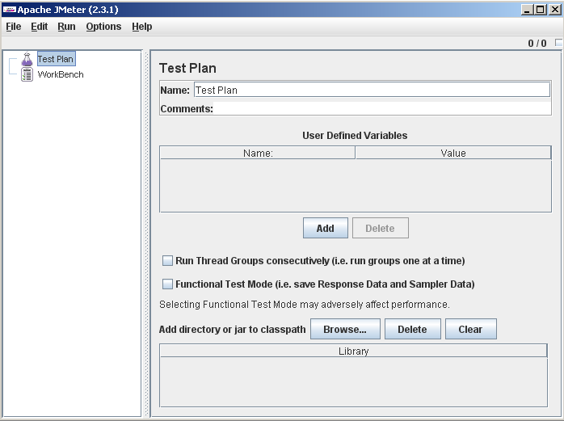
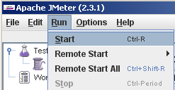
Running JMeter
"Test Plan" and "WorkBench" tree nodes are always present.

Slide 7
JMeter elements
A typical test plan will consist of following element types:
Thread Group - each thread simulates a single user.
Samplers - perform the actual work of Jmeter; generates one or more sample results.
Listeners - gathers sampler results while JMeter runs.
Controllers — are elements used for logic customization
Timers — allows delays between each request that a thread makes.
Assertions — tests that your application is returning the results you expect it to.
Configuration – setup elements used later by samplers.
Pre-Processors – are used to modify the Samplers in their scope.
Post-Processors - are applied after samplers.
Miscellaneous Features – elements of other type.

Slide 8
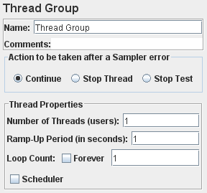
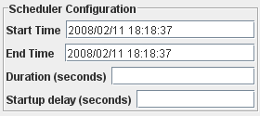
Thread Groups
The start point of any test plan.
All elements of a test plan must be under a thread group.
Can specify number of running threads, a ramp-up period, and loop-count(number of times to execute the test) .
As example 5 threads and 10 seconds of ramp-up time, it will take 2 seconds between each thread creation.
The scheduler configures the delay overrides start-time and duration overrides end-time.

Slide 9
Samplers
Samplers executes certain work unit based on it’s type and produce results.
JMeter executes in order the elements from the Test Plan tree(top-bottom).
JMeter contains built-in samplers as: FTP, HTTP, JDBC, LDAP, SOAP requests.
In the most cases the sampler can be configured with lots of parameters (GUI parameters) to achieve its goals.

Slide 10
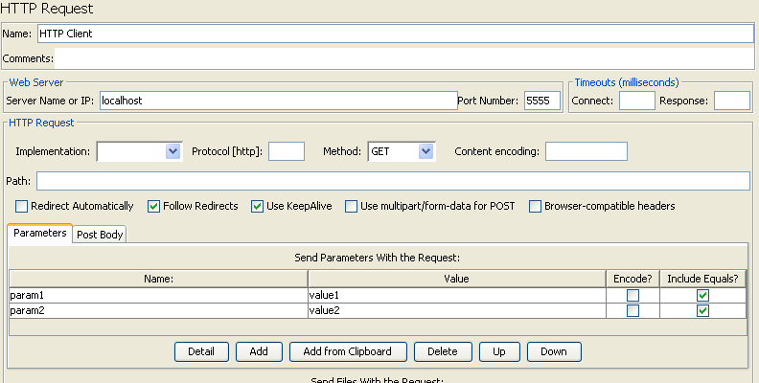
Samplers
Http Sampler Request is used to simulate a HTTP request to the Server: localhost who is listening on port 5555. The HTTP request is sending the GET request and contains 2 parameters: param1 and param2

Slide 11
Listeners
Display results of the samplers: tree, table, graphs, log files.
Based on the listener type it can be applied to one or many samplers.
Each Listener displays the response information in specific way.
The "Configure" button to choose the information to write to the file for later use, or whether to save (with .jtl extension) in XML or CSV format—the latter being smaller and less detailed.
Jmeter contains in jmeter.properties default configuration parameters for “Configure” button.

Slide 12
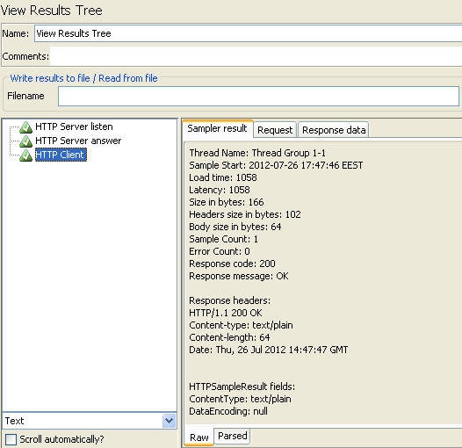

Listeners
The “View Results Tree” listener is gathering the results generated by samplers.
The green icon indicates that the sampler was executed with success.
The orange icon with exclamation mark indicates that the sampler has failed, due to certain reasons.

Slide 13
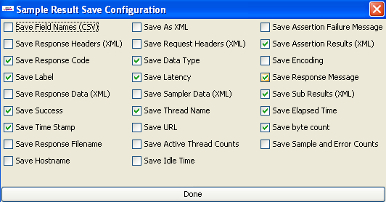
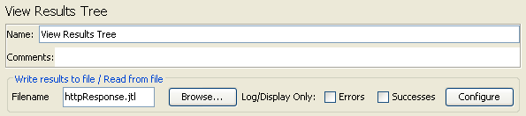
Listeners
The “View Results Tree” listener can save into “httpResponse.jtl” the test plan result in certain formats for later visualization, investigations,etc.
There are applications like Hudson/Jenkins (continuous integration) that know how to parse the JTL file and generate sanity reports.

Slide 14
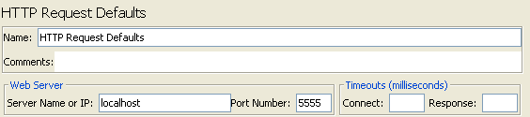
Configurations
Contains default values are set for properties used in samplers (e.g.: target machine and port)
The configuration elements can be overwritten by values from samplers.
Useful when sending multiple requests of the same type to the same server

Slide 15
Controllers
Customize the logic that JMeter uses to decide when to send requests:
Can change order of requests coming from child elements
Can modify requests
Can repeat requests
Simple Controller - Used to organize Samplers and Logic Controllers, has no functionality
Loop Controller - simple loop for number of times or forever
Once Only Controller - process the controllers inside it only once and ignores them during further iterations through the test plan
Random Controller - similarly to the Interleave Controller, picks each sub-controller at random
Random Order Controller - similar with Simple Controller, but execution order is random
Runtime Controller - controls how long its children are allowed to run.

Slide 16
Controllers
Switch Controller - acts like the Interleave Controller in that it runs one of the subordinate elements on each iteration, but rather than run them in sequence.
ForEach Controller - loops through the values of a set of related variables.
Module Controller - substitutes test plan fragments into the current test plan at run-time.
Include Controller - is designed to use an external jmx file.
While Controller - runs its children until the condition is "false".
Throughput Controller - allows the user to control how often it is executed.

Slide 17
Timers
The default behaviour of JMeter is that for a thread send requests without pausing between each request.
- can cause a delay before the request
- can cause a delay between grouped requests
JMeter provides:
Constant Timer
Gaussian Random Timer
Uniform Random Timer
Constant Throughput Timer
Synchronizing Timer
BeanShell Time

Slide 18
Timers
The Constant Timer is causing each thread to pause for the same amount of time between requests.
The Gaussian Random Timer pauses each thread request for a random amount of time, with most of the time intervals occurring near a particular value(constant delay + random value).
The Constant Throughput Timer calculates a delay so that to keep the total throughput (in terms of samples per minute).

Slide 19
Pre/Post - Processors
Pre-processors allow you to modify the Samplers in their scope. They are often used to modify the settings of a Sample Request just before it runs, or to update variables that are not extracted from response text.
All JMeter Pre-Processor elements provides: HTML Link Parser, HTTP URL Re-writing Modifier, HTML Parameter Mask, HTTP User Parameter Modifier, User Parameters, Counter, BeanShell PreProcessor
Post-processors execute after a request has been made from a Sampler. A good way is to place them as a child of a Sampler, to ensure that it runs only after a particular Sampler, not to Sampler afterwards.
All JMeter Post-Processor elements provides: Regular Expression Extractor, XPath Extractor, Result Status Action Handler, Save Responses to a file, Generate Summary Results, BeanShell PostProcessor

Slide 20
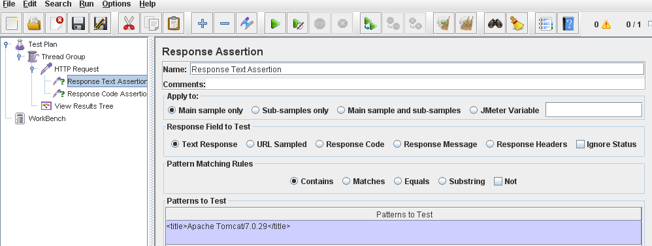
Assertions
Perform basic validation on the response of sampler’s request.
They are inserted as a child component of a Sampler.
JMeter built-in assertions: Response Assertion,Duration Assertion, Size Assertion, XML Assertion, BeanShell Assertion, MD5Hex Assertion, HTML Assertion, XPath Assertion, XML Schema Assertion

Slide 21
Variables and functions
Functions:
Built-in functions or custom created functions
Referenced as: ${__functionName(var1,var2,var3)}
In JMeter they are prefixed by “__”
Functions that require no parameters can leave off the parentheses
Last parameter is usually optional and contains the result
Variables:
Referenced as: ${VARIABLE}
JMeter variables are local to each thread
may have the same value for each thread or they may be different
Properties are common to all threads and are not the same as variables

Slide 22
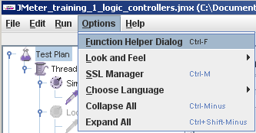
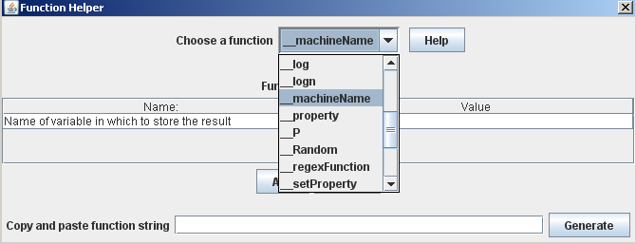
Variables and functions
We can list and select the JMeter functions or custom functions from “Function Helper Dialog”

Slide 23
Performance
A single JMeter client running on a 1.4-3Ghz CPU can handle 100-300 threads depending on the type of test.
Use JMeter in non-GUI mode
Use same sampler in loop rather than multiple samplers
Use as few Listeners as possible
Use CSV output rather than XML

Slide 24
Extending JMeter
We can create cumstom JMeter elements like: samplers, listeners, config, timers, controllers, functions, etc.
For GUI elements we extend methods from JMeter API like: createTestElement, clear, configure, modifyTestElement
JMeter API: http://jmeter.apache.org/api/index.html or in docs folder from the distribution
After the create the new plugin we deploy it into the lib or lib/ext folder.

Slide 25

Conclusion
PROS
It’s easy to use and GUI is very simple.
It is open source, so, you can modify or change or add new features.
It is free, no license cost.
Has API and can be extended
CONS
…

Slide 26

Bibliography
http://jmeter.apache.org/

