Slide 1

Java Enterprise Edition 7
Dima Ionut Daniel

Slide 2
Contents
What is Java EE?
History
JAVA EE7 Specifications
Java EE7 new features
Java EE7 Implementations
Servlet 3.1
JSF 2.2
EJB 3.2
JPA 2.1
CDI 1.1
JMS 2.0
JSON-P
WebSockets
Interceptors 1.2
Bean Validation 1.1
JTA 1.2
JCA 1.7
JAX-RS 2.0
Batch Applications
Conclusions
Bibliography

Slide 3

What is Java EE?
Java Platform, Enterprise Edition or Java EE is Oracle's enterprise Java computing platform.
Java EE extends the Java Platform, Standard Edition providing an API for object-relational mapping, distributed and multi-tier architectures, and web services.
Java EE is defined by its specification.

Slide 4
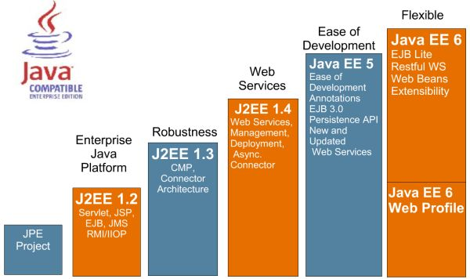
History

Slide 5
Java EE7 Specifications
Java EE 7 is defined in the JSR342.
New specifications were added into Java EE7.
Technology | JSR
Java API for WebSocket | JSR 356
Java API for JSON Processing | JSR 353
Batch applications for Java platform | JSR 352
Concurrency Utilities for Java EE | JSR 236
Debugging support for other languages | JSR 45

Slide 6
Java EE7 new features
Servlets 3.1:
Asynchronous IO based on NIO 2.0
Simplified asynchronous servlets
Utilized java EE concurrency utilities
Enable support for WebSockets
Java Message Server 2.0:
Integration with CDI
Java Server Faces 2.2
Support implementation for Portlet Bridge 2.0
Integration with CDI, OSGI, JSF artefacts
EJB 3.2
New annotations
Bean Validation 1.1
Integration with javaEE specs
Jcache
New API for temporary, in-memory cache
Java API for JSON
Produces and consumes JSON using api similar to DOM and StaX
Batch application for Java platform
Programming model for batch applications

Slide 7
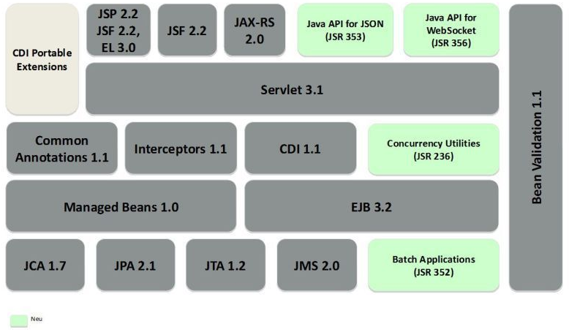
Java EE7 Implementations
Glassfish 4 implements the Java EE 7 specifications.
Glassfish is the first server compatible with the enterprise Java standard.

Slide 8
Servlets 3.1

Slide 9
Servlet 3.1
Servlets 3.1 includes features like:
Non-Blocking I/O API
WebSocket API for working with WebSocket protocol
Security enhancements
Miscellaneous updates
ReaderListener/WriteListener were added for nonblocking API and have callback methods.
AsyncContext context = request.startAsync();
ServletInputStream input = request.getInputStream();
input.setReadListener(new ReadListenerImpl(input, context));
AsyncContext was added in Servlet 3.0 for asynchronous operation and servlet should be annotated as @WebServlet and asyncSupported attribute set to true.

Slide 10
Servlet 3.1 (cont.)
The Servlet 3.0 API included a new FileUpload mechanism.
Servlet marked with the @MultipartConfig annotation can handle file upload requests.
In the Servlet 3.1 there is support for containers that do not provide multipart/form-data processing.
If the container does not provide the processing, then the data will be available via HttpServletRequest.getInputStream.
Security roles that are defined for a particular application can be mapped to a servlet by annotating the servlet class with @RunAs.

Slide 11
Java Server Faces 2.2

Slide 12
JSF 2.2
JSF 2.2 added :
Faces Flows
Multi-Templating Deferred
Sensible HTML5 support
Stateless views

Slide 13
Enterprise Java Beans 3.2

Slide 14
EJB 3.2
EJB 3.2 added:
more features EJBLite
asynchronous session bean
non-persistent EJB Timer service
Some features from Java EE6 are now optional
ThreadContext in Singleton is guaranteed to be thread-safe.
Embeddable container implements Autocloseable.

Slide 15
Java Persistence API 2.1

Slide 16
JPA 2.1
The JPA 2.1 specification adds several enhancements to the JPA 2.0 specification including:
Converters - allowing custom code conversions between database and object types.
Criteria Update/Delete - allows bulk updates and deletes through the Criteria API.
Stored Procedures - allows queries to be defined for database stored procedures.
ConstructorResult support for SQLResultSetMapping
Runtime creation of named queries
Injectable EntityListeners
Unsynchronized persistence contexts
DDL generation - automatic table, index and schema generation.
Entity Graphs - allow partial or specified fetching or merging of objects.
JPQL/Criteria enhancements - arithmetic sub-queries, generic database functions, join ON clause, TREAT option.

Slide 17
Context Dependency Injection 1.1

Slide 18
CDI 1.1
CDI 1.1 new features:
"Global ordering of interceptors and decorators, as well as global enablement of alternatives [CDI-48]
An API for managing built in contexts, allowing the built in implementation of the conversation context to be used outside of JSF [CDI-30]
An embedded mode allowing startup outside of a Java EE container [CDI-26]
Declarative control over which packages/classes are scanned in a bean archive [CDI-87]
Bean declaration at constructor level [CDI-55]
Static injection [CDI-51]
Inclusion of @Unwraps from Seam Solder [CDI-89]
Align with current version of @Inject [CDI-51]
Numerous minor enhancements to the Portable Extensions SPI
Client controlled contexts allowing for SaaS style multi-tennancy [CDI-103]
Better support for CDI in libraries when used in the Java EE platform [CDI-84]
Send CDI events for Servlet events [CDI-38]
Application lifecycle events [CDI-86]"

Slide 19
Java Message Service 2.0

Slide 20
JMS 2.0
JMS 2.0 was released in April 2013 and added a new API for sending/receiving messages that reduces the amount of code a developer must write. The new API also supports resource injection.
The simplified API consists of 3 new interfaces: JMSContext, JMSProducer, and JMSConsumer.
JMSContext replaces the separate Connection and Session objects in the classic API with a single object.
JMSProducer is a lightweight replacement for the MessageProducer object in the classic API. It allows message delivery options, headers, and properties to be configured using method chaining (sometimes known as a builder pattern).
JMSConsumer replaces the MessageConsumer object in the classic API and is used in a similar way.

Slide 21
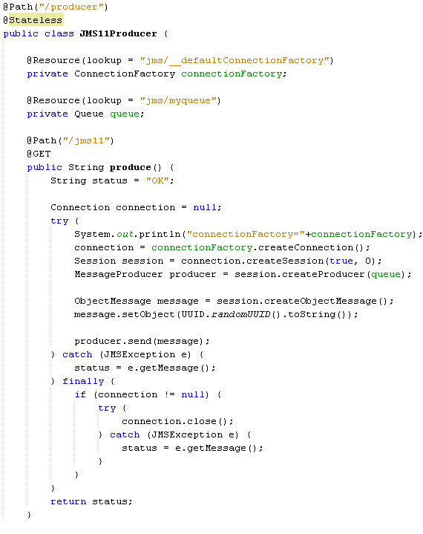
JMS 2.0 (cont.)
Using JMS 1.1 we need to create multiple objects in order to send/receive JMS messages.

Slide 22
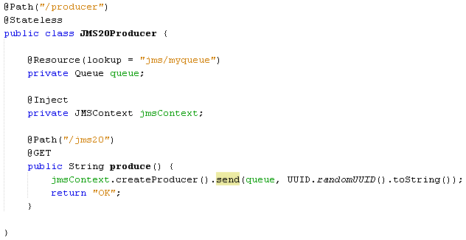
JMS 2.0 (cont.)
Using the JMSContext interface we can very easy send/receive JMS messages.

Slide 23
JSON Processing

Slide 24
JSON-P
Provides methods for parsing and generating data in JSON format.
The API is similar to the JAXP API and has support for Streaming API and DOM API.
The Streaming API is a low level API which works on the ‘events‘ obtained from the JSON data stream.
The DOM API, creates an in-memory Java object model for the JSON data (similar to the XML DOM API).

Slide 25
JSON-P (cont.)
javax.json.stream.JsonGenerator creates JSON objects very easy.
javax.json.stream.JsonParser provides a depth first traversal of events corresponding to the JSON structure.
JsonProvider is searching for JSON providers using ServiceLoader mechanism.
The Object Model API core classes include JasonObject and JsonArray as well as JsonBuilder, JsonReader, and JsonWriter.

Slide 26
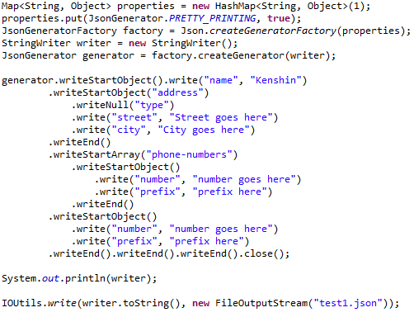
JSON-P (cont.)
Bellow example shows how to create a JSON complex object using JSON Stream API.

Slide 27
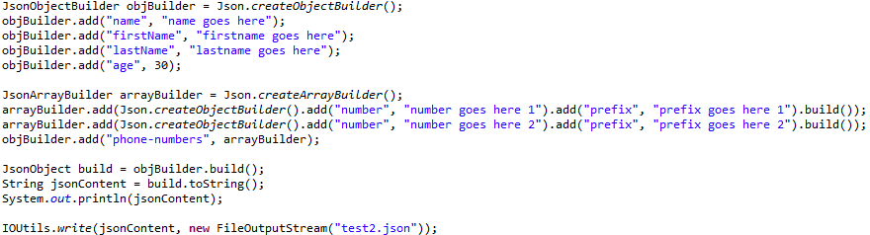
JSON-P (cont.)
Bellow example shows how to create a JSON complex object using JSON Object API.
javax.json.Json is a core class because using we can create different builder starting from it

Slide 28
WebSockets

Slide 29
WebSockets
WebSocket implementation is a combination of IETF RFC 6455 protocol and W3C JavaScript API.
The API enables web pages to use WebSocket protocol for two-way communication with the remote host.
Tyrus represents an open source Web Socket RI for JSR 356.
Tyrus is already integrated into GlassFish 4.0 Promoted builds.
A websocket connection is the networking connecting between the two endpoints which are interacting using the websocket protocol.
A websocket session is used to represent a sequence of websocket interactions between an endpoint and a single peer.

Slide 30
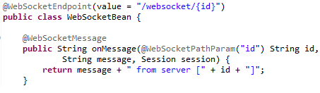
WebSockets (cont.)
The abstract class javax.websocket.Endpoint represents one side of a sequence of websocket interactions between two connected peers and contains methods like onOpen, onClose, onError.
As alternative @WebSocketEndpoint annotation indicates that a Java class is to become a websocket endpoint at runtime.
@WebSocketOpen and @WebSocketClose annotations allow the developers to decorate methods on their @WebSocketEndpoint.
The @WebSocketMessage is used to process incomming messages.
The @WebSocketPathParam is used for retrieving path information.

Slide 31
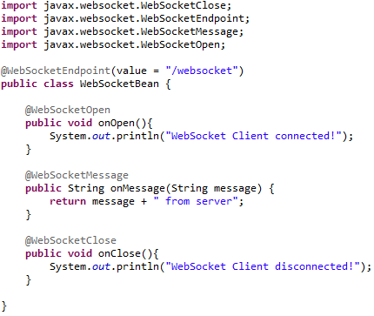
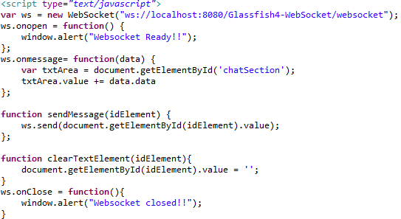
WebSockets (cont.)
WebSocket implementation and JavaScript setup for communication.

Slide 32
Interceptors 1.2

Slide 33
Interceptors 1.2
Better, more organized, cleaner specification with better separation from other specs.
Interceptor binding is now part of this specification (moved from CDI spec).
No ejb-jar.xml elements in the specification (moved to EJB spec).
New @AroundConstruct annotation to apply around object constructors. Note that this completes before injection happens!
New @Priority annotation in EE 7 for ordering interceptors.

Slide 34
Interceptors 1.2 (cont.)
Interceptor Metadata Annotations:
javax.interceptor.AroundInvoke → Designates the method as an interceptor method.
javax.interceptor.AroundTimeout → Designates the method as a timeout interceptor, for interposing on timeout methods for enterprise bean timers.
javax.annotation.PostConstruct → Designates the method as an interceptor method for post-construct lifecycle events.
javax.annotation.PreDestroy → Designates the method as an interceptor method for pre-destroy lifecycle events.

Slide 35
Bean Validation 1.1

Slide 36
Bean Validation 1.1
Bean Validation defines a metadata model and API for JavaBean validation.
The metadata source is annotations, with the ability to override and extend the meta-data through the use of XML validation descriptors.
The Hibernate team provides with Hibernate Validator the reference implementation of Bean Validation.

Slide 37
Bean Validation 1.1 (cont.)
Process, store, retrieve data
Constraint our model
Ensure data is valid
The service will behave correctly
Give feedback to the users

Slide 38
Bean Validation 1.1 (cont.)
Constraints:
@NotNull → value must be not null.
@Null → value must be null.
@Digits → the value must be number within a specific range.
@Max → value must be an integer value lower or equal to number in the value.
@Min → value must be an integer value greater or equal to number in the value.
@Past → the value of the field must be a date in the past.
@Future → the value of the field must be a date in the future .
@Size → the size of the field is evaluated and must match the specified boundaries.
@Pattern → the value of the field must match the regular expression.
@DecimalMax →the value must be a decimal value lower or equal to the number in the value element.
@DecimalMin → the value must be a decimal value greater or equal to the number in the value element.

Slide 39
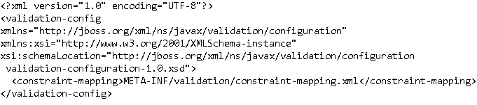
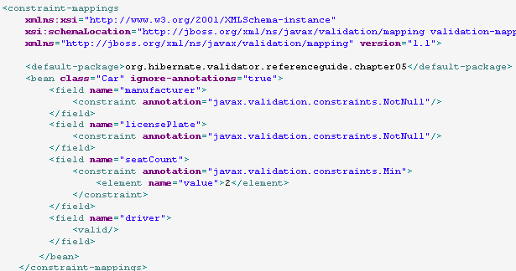
Bean Validation 1.1 (cont.)
Instead of using annotations we can use the META-INF/validation.xml
The constraint-mapping.xml file contains beans validation declarations.

Slide 40
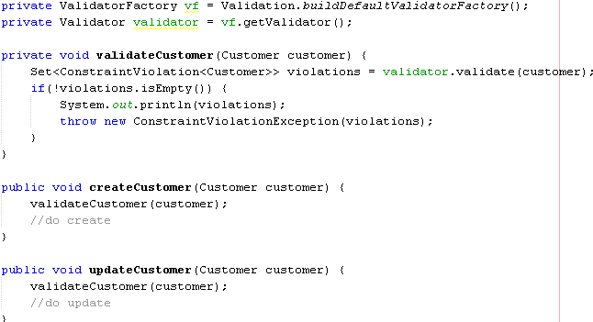
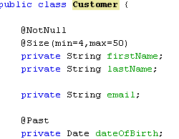
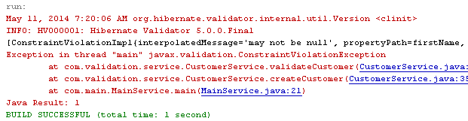
Bean Validation 1.1 (cont.)

Slide 41
Java Transaction API 1.2

Slide 42
JTA 1.2
JTA enables distributed transactions to be done across multiple X/Open XA resources in a Java environment.
In the X/Open XA architecture, a transaction manager coordinates the transactions across multiple resources such as databases and message queues.
The JTA API consists of classes in two Java packages: javax.transaction and javax.transaction.xa.
The javax.transaction.Transactional annotation provides the application the ability to control transaction boundaries declaratively.
The javax.transaction.TransactionScoped annotation provides the application the ability to declare that the scope during which a bean lives is tied to the time a given transaction is active.

Slide 43
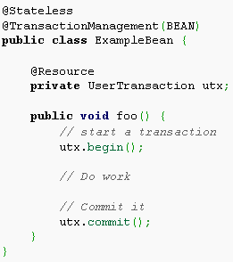
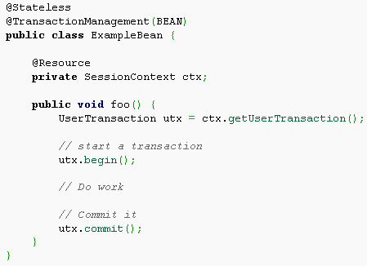
JTA 1.2 (cont.)
The javax.transaction.UserTransaction interface provides the application the ability to control transaction boundaries programmatically. This interface may be used by Java client programs or EJB beans.
The UserTransaction.begin() method starts a global transaction and associates the transaction with the calling thread. The transaction-to-thread association is managed transparently by the Transaction Manager.
EJB servers are required to support the UserTransaction interface for use by EJB beans with the BEAN value in the javax.ejb.TransactionManagement annotation.
The UserTransaction should be available under java:comp/UserTransaction.

Slide 44
Java Connector Architecture 1.7

Slide 45
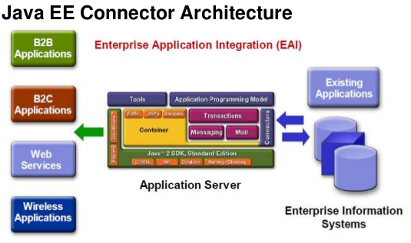
JCA 1.7
JCA 1.7 new features:
Richer inbound message delivery
Resource Definition annotations:
@ConnectionFactoryDefinition,
@AdministeredObjectDefinition

Slide 46
JCA 1.7 (cont.)
The Java EE Connector Architecture features three different types of resource adapters
Outbound: The resource adapter allows the application to communicate to the Enterprise Information System (EIS).
Inbound: The resource adapter allows messages to flow from the Enterprise Information System (EIS) to the application.
Bi-directional: The resource adapter features both an outbound and an inbound part.

Slide 47
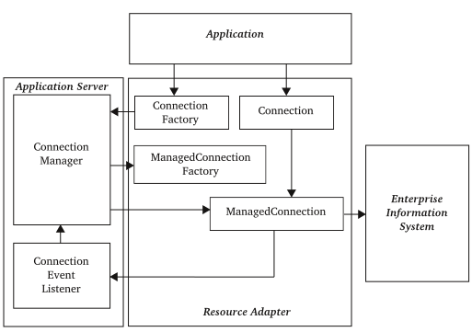
JCA 1.7 (cont.)
ConnectionFactory is looked up in the JNDI and used for creating connections.
The outbound resource adapter contains:
ManagedConnectionFactory: for creating managed connections.
ManagedConnection: represents a physical connection to the target Enterprise Information System (EIS).

Slide 48
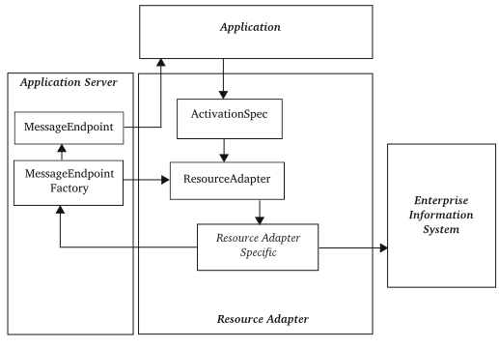
JCA 1.7 (cont.)
ActivationSpec: specifies the different properties that the application is looking for the RA.
The inbound resource adapter contains:
ResourceAdapter: provides the activation point for inbound communication.
Resource adapter specific: handles communication with the Enterprise Information System (EIS) and deliver messages through the MessageEndpoint

Slide 49
Java API for RESTFul WebServices 2.0

Slide 50
JAX-RS 2.0
A RESTful web service (RESTful web API) is a web service implemented using HTTP and the principles of REST.
Set of operations supported by the web service using HTTP methods: GET, PUT, POST, or DELETE.
REST has increasingly replaced other design models such as SOAP and WSDL due to its simpler style.
REST is client/server architecture

Slide 51
JAX-RS 2.0 (cont.)
Client API was added to access Web resources.
Filters and Interceptors are a benefit to separate business logic from certain common features: log, security,etc.
The Bean Validation specification is added to support the input request parameters validation.
With JAX-RS 2.0, asynchronous processing is supported both in the Client API and in the Server API.
JAX-RS 2.0 has improved the connection negotiation.

Slide 52
Batch Applications

Slide 53
Batch Applications
Suitable for execution of bulk jobs which do not require human intervention and can be scheduled
Provides a complete programming model for ‘batch’ oriented applications.
Defines a Job Specification Language which is the basis for defining ‘jobs’ within an XML. The Job XML captures the entire batch process.
Supports two contrasting ‘processing’ mechanisms:
Chunk Style Processing involves, ‘reading’ the input ‘bulk’ data, ‘processing’ it and finally ‘writing’ it as the final step in the process. All these operations are abstracted through specific interfaces, namely, ItemReader, ItemProcessor and ItemWriter
A batchlet style processing model is also supported by this API which defines’ tasks’ which once completed, mark the end of the job

Slide 54
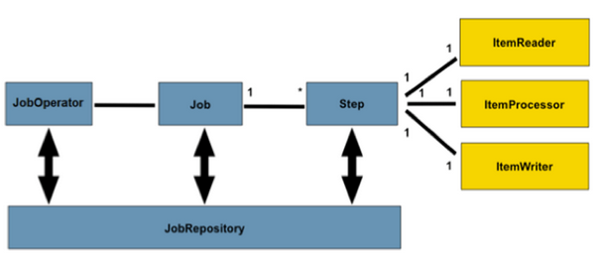
Batch Applications (cont.)
Job → encapsulates an entire batch process and consists of multiple steps. The Job Specification Language for JSR 352 is implemented with XML and is referred as "Job XML".
Step → encapsulates an independent, sequential phase of a job and control the actual batch processing.
JobOperator → can manage all aspects of job processing
JobRepository → holds information about jobs current running and jobs that run in the past.
Reader-Processor-Writer pattern is the primary pattern and is called as Chunk-oriented processing. Once the 'chunk' number of items are aggregated, they are written out, and the transaction is committed.

Slide 55
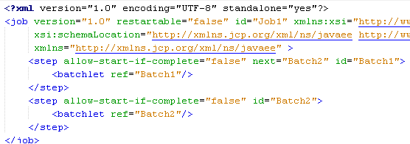
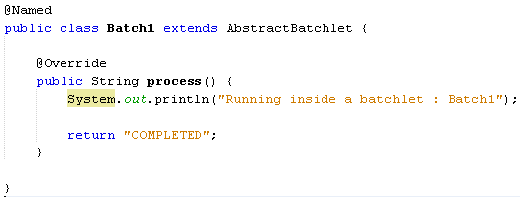
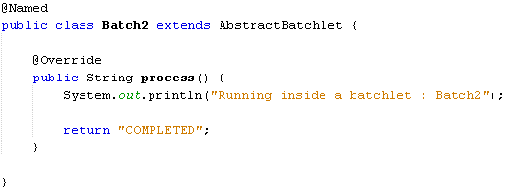
Batch Applications (cont.)
We create in the META-INF/batch-jobs folder the SampleJob.job.xml file.

Slide 56
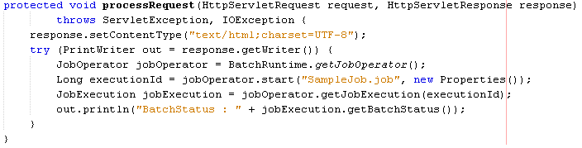
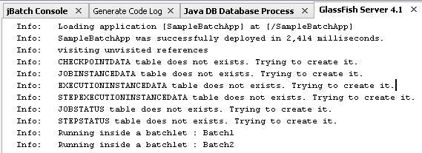
Batch Applications (cont.)
We create a Servlet that invokes the Batch Application.

Slide 57
Conclusions
Java EE 7 brings lots of power to web/enterprise applications.
JAVA EE 7 is documented.
The focus in this release has been on stabilizing and modernization.

Slide 58

Bibliography
http://javathreads.de/2010/01/java-ee-6-web-profile-technologien/
http://en.wikipedia.org/wiki/Java_Platform,_Enterprise_Edition
http://docs.oracle.com/javaee/7/tutorial/doc/home.htm
http://www.h-online.com/open/news/item/Java-EE-7-reference-implementation-GlassFish-4-0-released-1886390.html
https://blogs.oracle.com/arungupta/entry/batch_applications_in_java_ee
http://www.javacodegeeks.com/2014/03/java-ee-7-whats-new.html
Packt Publisher Java EE 7 with GlassFish 4 Application Server

