Slide 1

Java FX
Dima Ionut Daniel

Slide 2
Contents
What is Java FX ?
History
Architecture
Features
Runtime Libraries
Core
FXML
Event Handling
Layout Panes
CSS
Controls
2D Shapes
Canvas
Effects/Transformations
Animation
Bibliography

Slide 3

What is Java FX ?
Java FX is a software platform for creating and delivering rich internet applications (RIAs) that can run across a wide variety of devices.
Java FX is intended to replace Swing as the standard GUI library for Java SE.
The current release has support for desktop computers and web browsers on Windows, Linux and Max OS X.

Slide 4
What is Java FX ? (cont.)
Java FX 2.0 is implemented as a native Java library.
Java FX doesn't suport the Solaris OS and mobile phones.
It's comparable to other frameworks on the market as Adobe Flex and Microsoft Silverlight.
Java FX library is available as a public Java API.

Slide 5
History
Java FX script began as a project by Chris Oliver called F3.
Sun Microsystems first announced JavaFX at the JavaOne conference on May 2007.
Java FX 1.0 was released on 4 December 2008.
Java FX 1.1(Franca) for mobile development was released on 12 February 2009.
Java FX 1.2(Marina) was released on 2 June 2009.
Java FX 1.3(Soma) was released on 22 April 2010.
Java FX 2.0(Presidio) was released on 10 October 2011.
Java FX 2.1 was released on 27 April 2012.
Java FX 2.2 was released on 14 August 2012.
Java FX 8 was included in JRE/DJK 8.

Slide 6
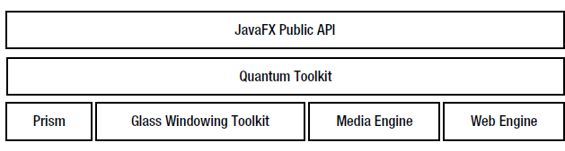
Architecture
The JavaFX platform consists of the following components to take advantage of the Java native libraries:
JavaFX Public API
Quantum Toolkit
Prism
Glass Windowing Toolkit
Media Engine
Web Engine

Slide 7
Architecture (cont.)
The GUI in JavaFX is constructed as a scene graph.
A scene graph is a collection of visual elements called nodes that are arranged in a tree-like hierarchy and it's built using the public JavaFX API.
Prism is a hardware accelerated graphics pipeline used for rendering the scene graph.
The Glass Windowing Toolkit provides graphics and windowing services such as windows and the timer using the native operating system.
In JavaFX, event queues are managed by a single, operating system level thread called JavaFX Application Thread.
The media engine is responsible for providing media support in JavaFX, for example, playing back audios and videos.

Slide 8
Architecture (cont.)
The media engine is based on GStreamer, which is an open source multimedia framework.
Prism is responsible for rendering the web content.
The web engine is based on Webkit, which is an open source web browser engine.
It supports HTML5, Cascading Style Sheets (CSS), JavaScript, and Document Object Model (DOM).
The Quantum toolkit is an abstraction over the low-level components such as Prism, Glass, Media Engine, and Web Engine.

Slide 9
Features
Java API
FXML and SceneBuilder
FXML is an XML-based declarative markup language for building UI.
SceneBuilder generated FXML markup that can be ported to IDE where developer can add business logic.
WebView
web component that uses WebKitHTML tehcnology to make possible embed web pages within a JavaFX application
Swing interoperability
Build-in UI controls and CSS
JavaFX provides all the major UI controls.
Components can be skinned with standard Web technologies as CSS.
3D Graphipcs Features
3D Graphics library was added in JavaFX 8.

Slide 10
Features (cont.)
Canvas API
enable drawing directly within an area of the JavaFX scene.
Printing API
The javafx.print package was added in Java SE 8 release.
Rich Text Support
JavaFX 8 enhanced text support, including bi-directional text and complex text scripts.
Multitouch Support
JavaFX provides support for multitouch operations, based on the capabilities of the OS.
High performance media engine
The media pipeline supports the playback of web multimedia content, based on GStreamer media framework.
Hardware-accelerated graphics pipeline
JavaFx graphics are based on Prism rendering pipeline.

Slide 11
Runtime Libraries
All JavaFX classes are packaged in a jar called jfxrt.jar that is located in the JRE_HOME\lib\ext directory.
The Java 8 compiler(javax command) and launcher(java command) automatically include the JavaFX runtime JAR file in the CLASSPATH.
The Netbeans IDE automatically includes the JavaFX runtime JAR file in the CLASSPATH when creating Java/JavaFX projects.

Slide 12
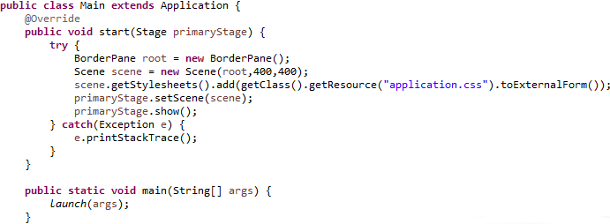
Core
JavaFX application needs to extends javafx.application.Application.
It contains the abstract method start(Stage) that needs to be implemented.
In order to launch the Java FX application the static method launch() needs to be called in main().

Slide 13
Core (cont.)
Java FX runtime creates 2 threads:
JavaFX launcher
JavaFX application thread
The launch() method of the Application class creates these threads and calls:
no-args constructor
init() method
start() method
stop() method

Slide 14
Core (cont.)
It is not allowed to create a Stage or a Scen on the JavaFX Launcher Thread.
They must be created on the JavaFX Application Thread.
It is fine to create UI controls(buttons,shapes) in the init(0 method.
A JavaFX application can be terminated by calling Platform.exit() method.
A JavaFX application can be terminated implicitly when the last window is closed.
This behaviour can be turned on/off using the static setImplicitExit(boolean) on the Platform class.
When this behavior is turned on, the stop() method of the Application class is called before terminating the JavaFX Application Thread.

Slide 15
Core (cont.)
JavaFX supports properties, events, and binding through Properties and Binding APIs.
All properties in JavaFX are observable.
All read-write properties support binding.
A property in JavaFX can represent a value or a collection of values.
Property classes provide two pairs of getter and setter methods: get(), set(), getValue(), setValue() methods.

Slide 16
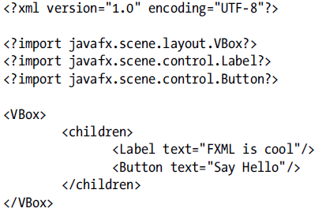
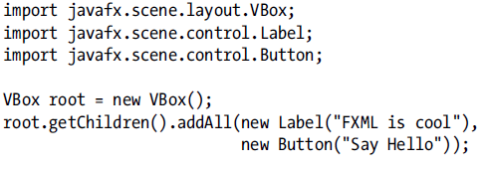
FXML
FXML is an XML-based language for building a user interface for JavaFX applications.
We can use FXML to build an entire scene or part of a scene.
FXML allows application developers to separate the logic for building the UI from the business logic.
If the UI part of the application changes, we don't need to recompile the JavaFX code.
We can change the FXML using a text editor and rerun the application.

Slide 17
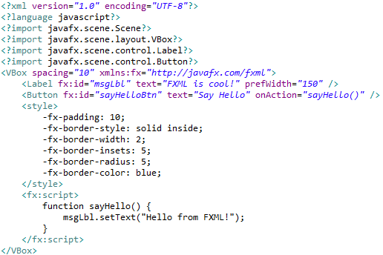
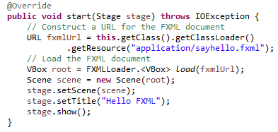
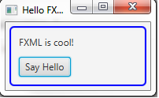
FXML (cont.)

Slide 18
Event Handling
The event is an occurence of a user interaction with the application.
An event in JavaFX is represented by an javafx.event.Event class or any of its subclasses.
Every event in JavaFX has 3 properties:
event source
event target
event type
The code that is executed in response to an event is known as an event handler or event filter.
When an event occurs it passes through a chain of event dispatchers.

Slide 19
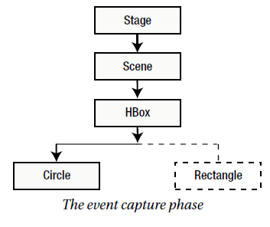
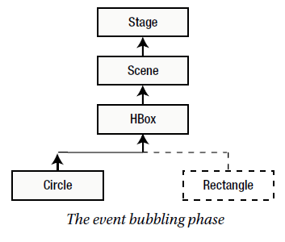
Event Handling (cont.)
An event route travel consists of 2 phases:
Capture phase
Bubbling phase
During the capture phase, an event travels from the head to tail of its event dispatch chain.
During the bubbling phase, an event travels from the tail to head of its event dispatch chain.
We can register multiple event filters for a node.

Slide 20
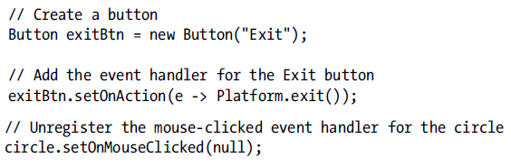
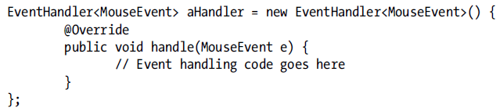
Event Handling (cont.)
When the event occurs, the handle() method of the registered event filters and handlers for the node are called.
The Node, Scene, and Window classes contain event properties to store event handlers of some selected event types.
The onMouseClicked property stores the event handler for the mouse-clicked event type, the onKeyTyped property stores the event handler for the key-typed event, etc.

Slide 21
Layout Panes
We can use 2 types of layouts to arrange nodes in a scene graph:
static layout
dynamic layout
In static layout, the position and size of nodes are calculated once they stay the same as the window is resized.
In dynamic layout, nodes are laid out every time a user action necessitates a change in their position, size or both.
Both static and dynamic layouts have advantages and disadvantages.
A static layout gives developers full control over the design of the user interface.
A dynamic layout requires more programming work and the logic is much more involved.

Slide 22
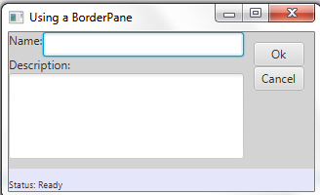
Layout Panes (cont.)
A layout pane is a node that contains other nodes known as its children.
A layout pane is also known as a container or layout container.
A layout pane has a layout policy that controls how the layout pane lays out its children.
Most of the containers attempt to give its children their preferred size
JavaFX contains several container classes.
A container class is a subclass, direct or indirect, of the Parent class.

Slide 23
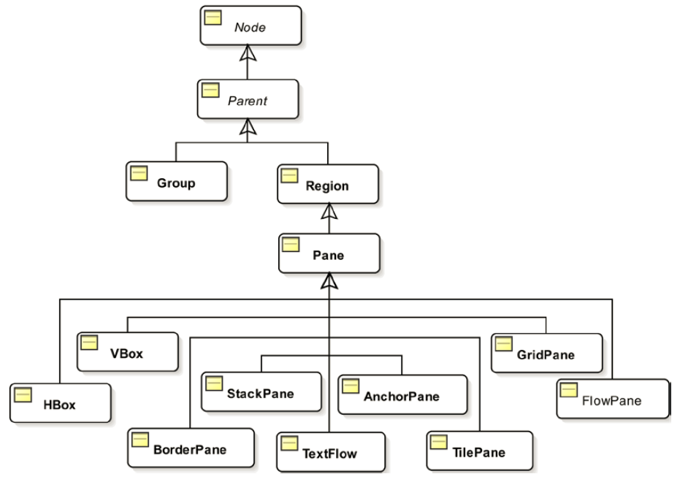
Layout Panes (cont.)

Slide 24
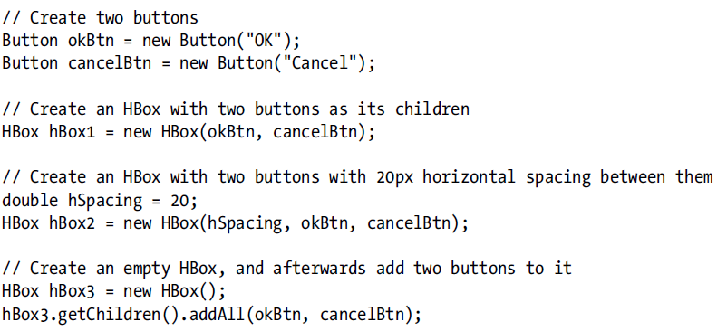
Layout Panes (cont.)
A Group lets apply effects and transformations to all it children collectively.
The Group class is in the javafx.scene package.
A container needs to be a subclass of the Parent class.
A node must be added to a container to be part of a scene graph.
If a node is added to a container while it is already the child node of another container, the node is removed from the first container before being added to the second one.

Slide 25
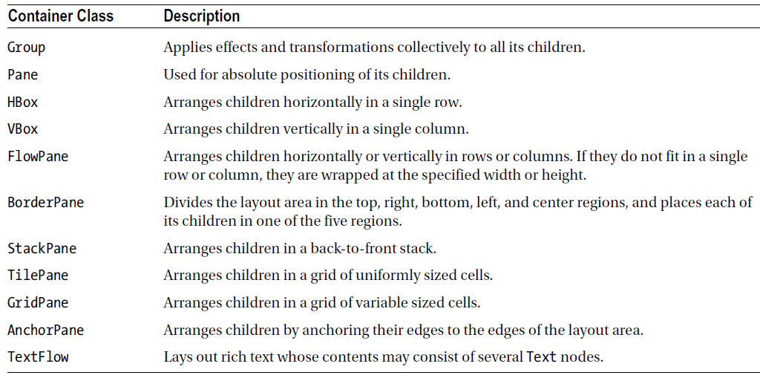
Layout Panes (cont.)

Slide 26
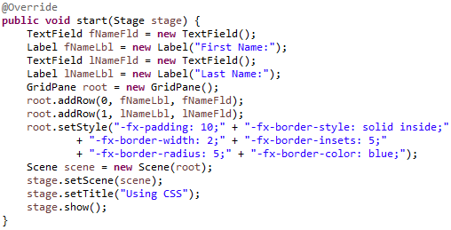
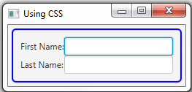
CSS
JavaFX CSS is based on W3C CSS v2.1 with some additions from current work on version 3.
JavaFx CSS also has some extensions to CSS in support of specific JavaFX features.
CSS styles are applied to nodes in the JavaFX scene-graph in a way similar to the way CSS styles are applied to elements in the HTML DOM.
Styles are first applied to the parent then to its children.
In order to apply CSS styles the setStyle() method from Node is called.
Also styles can be applied to Parent class that has the getStylesheets() method.

Slide 27
Controls
JavaFX allow the creation of applications using GUI components.
A GUI application usually is doing the following:
accepts input from input devices(keyboard, mouse, etc)
processes the input
displays output
Users interact with a GUI application using graphical elements called controls or widgets.
Controls generate events that indicate occurences of user interaction.
Control classes are in the javafx.scene.control package.
A control class is a subclass of the Control class.

Slide 28
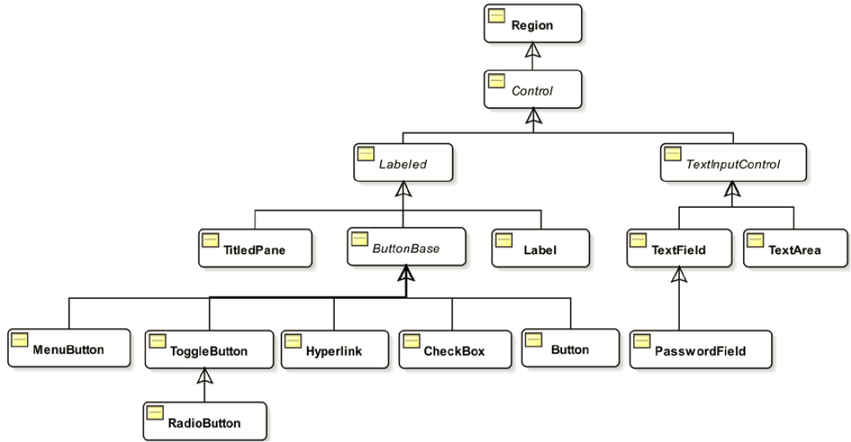
Controls (cont.)

Slide 29
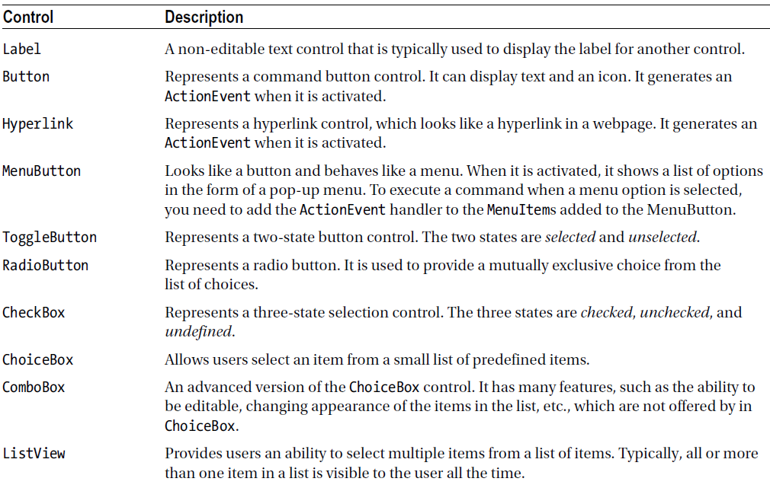
Controls (cont.)

Slide 30
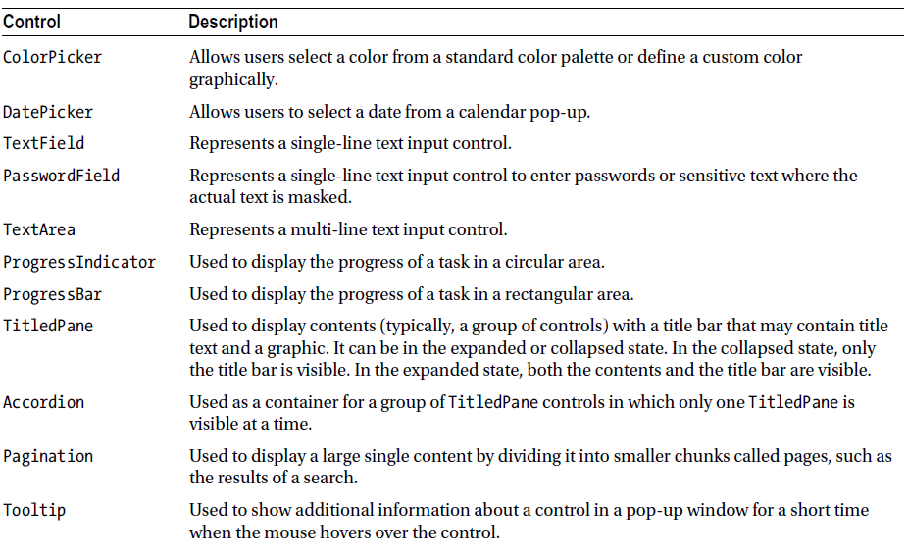
Controls (cont.)

Slide 31
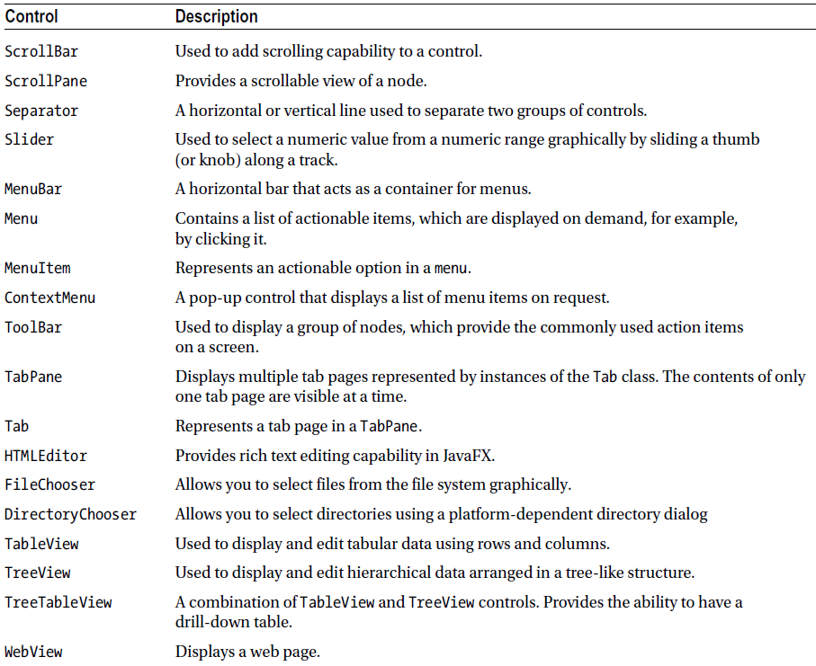
Controls (cont.)

Slide 32
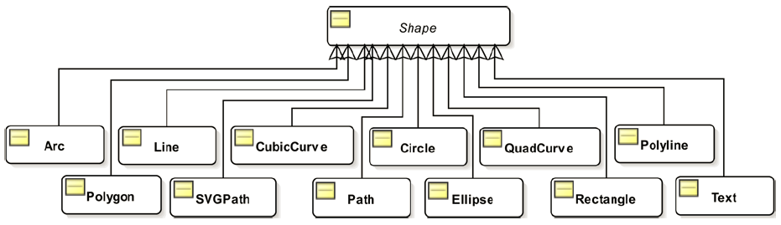
2D Shapes
JavaFX offers variety nodes to draw different types of shapes, lines, circles, etc.
We can draw 2D and 3D shapes.
Shape has a size and a position that are defined by its properties.
Shapes aren't resized by their parents during layout.
Shapes have an interior and a stroke.

Slide 33
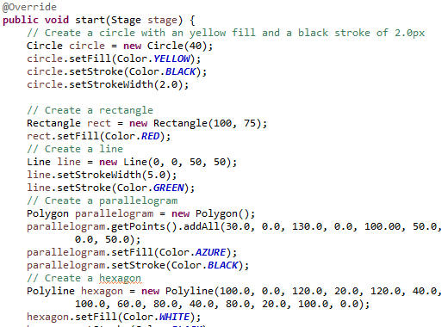
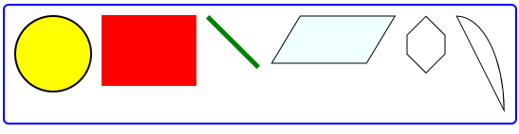
2D Shapes (cont.)

Slide 34
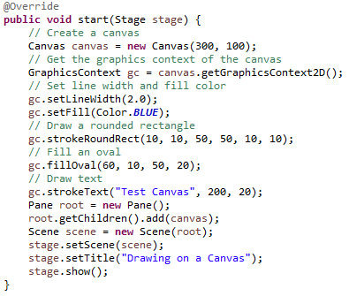
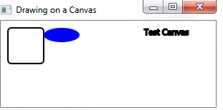
Canvas
JavaFX contains the javafx.scene.canvas package that contains the Canvas API that offers a drawing surface to draw shapes, images, text, etc.
The API gives pixel-level access to the drawing surface where we can write pixels on the surface.
The API has 2 classes: Canvas and GraphicsContext.

Slide 35
Effects/Transformations
An effect is a filter that accepts one or more graphical inputs and produces an output.
Example of effects: shadow, blur, warp, glow, reflection, blending, ligthing, etc.
The JavaFX library provides several effect-related classes.
An effect applied to a Group is applied to all its children.

Slide 36
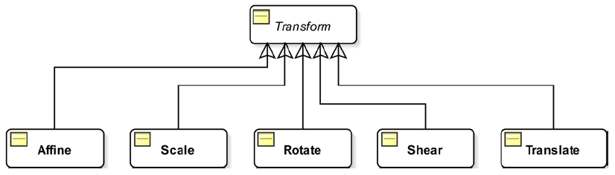
Effects/Transformations (cont.)
A transformation is a mapping of points in a coordinate space.
JavaFX support the following types of transformation: Translation, Rotation, Shear, Scale, Affine.
The Transform class contains common methods and properties used by all types of transformations on nodes.
Transformation classes can be found in javafx.scene.transform package.

Slide 37
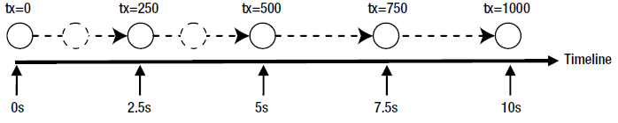
Animation
In JavaFX animation is defined as changing the property of a node over time.
it the property that changes determines the location of the node, the animation in JavaFX will produce an illusion of motion.
Animation terms: Timeline, Key frame, Key value, Interpolator.
Animation is performed over a period of time.

Slide 38
Animation (cont.)
A timeline denotes the progression of time during animation with an associated key frame at a given instant.
A key frame represents the state of the node being animated at a specific instant on the timeline.
A key frame has associated key values.
A key value represents the value of a property of the node along with an interpolator to be used.
Classes providing animation in JavaFX are in the javafx.animation package, except the Duration class, which is in the javafx.util package.

Slide 39
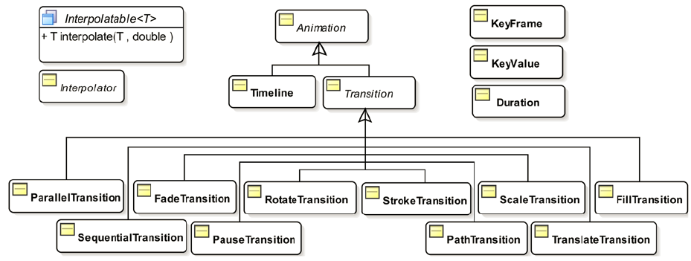
Animation (cont.)

Slide 40
Animation (cont.)
The abstract Animation class represents an animation. It contains common properties and methods used by all types of animations.
JavaFX supports two types of animations:
Timeline Animations
Transitions
In a timeline animation, you create a timeline and add key frames to it. JavaFX creates the intermediate key frames using an interpolator.

Slide 41
Animation (cont.)
An instance of the Timeline class is represented by a timeline animation.
This type of animation requires more coding on your part, but it gives you more control.
Transitions are animations that can change it's internal properties like opacity over time,etc.
The SequentialTransition and ParallelTransition classes let you perform a set of transitions sequentially and simultaneously.

Slide 42
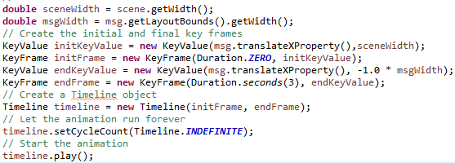
Animation (cont.)
A timeline animations is used in order to animate any properties of a node.
In order to create a timeline animation we need to:
construct key frames
create Timeline object with key frames
set animation properties
use the play() method to run the animation

Slide 43

Bibliography
http://en.wikipedia.org/wiki/JavaFX
http://docs.oracle.com/javase/8/javafx/get-started-tutorial/jfx-overview.htm
http://docs.oracle.com/javase/8/javafx/api/javafx/scene/doc-files/cssref.html
Beginning Java 8 APIs Extensions and Libraries

