Slide 1

Jolokia
Dima Ionut Daniel

Slide 2
Contents
What is Jolokia?
Architecture
Agents
Security
Jolokia Protocol
Jolokia Mbeans
Clients
Jolokia JMX
Spring Support
Conclusions
Bibliography

Slide 3

What is Jolokia?
Jolokia is an agent that uses JSR-160(JMX Remote API).
Jolokia uses JSON as payload over HTTP transport protocol.
JMX (Java Management Extensions) is the standard management solution in the Java world sincer JDK 1.5.

Slide 4
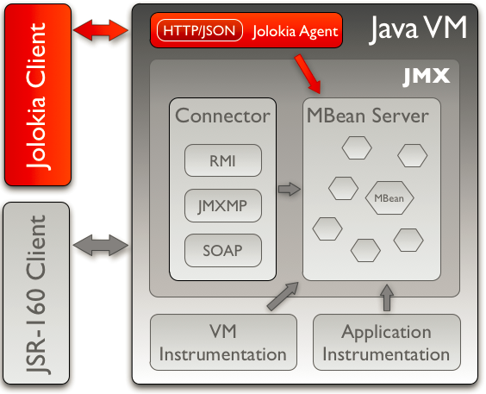
Architecture
Jolokia can run in agent mode.
The agent exports on the frontside a JSON based protocol over HTTP.
The agent invokes the JMX Mbeans.

Slide 5
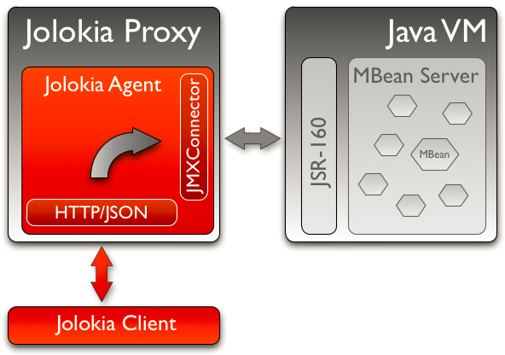
Architecture (cont.)
Jolokia can run in proxy mode.
This solution is used when it’s hard/imposssible to deploy the agent on the target platform.

Slide 6
Agents
Jolokia is an JMX agent which requires that clients install an extra piece of software.
The agent is deployed on the target server which should be access via remote JMX.
There are 4 types of agent:
Webarchive agent:
agent packaged as WAR
OSGI agent:
OSGI used, so HttpService depedency is needed
Mule agent:
Provides management API
JVM agent
From Java 6 the Http Server is used

Slide 7
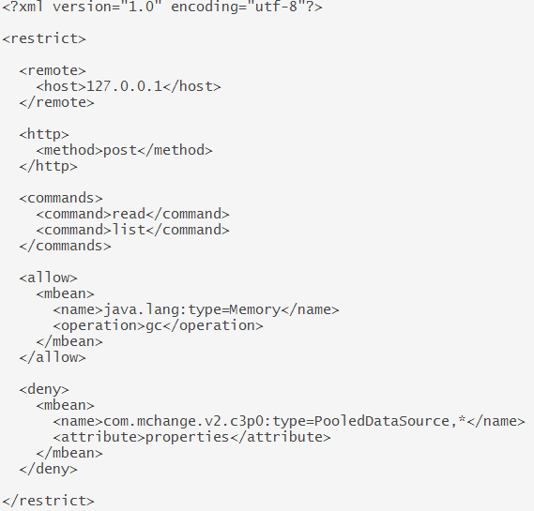
Security
Security in JSR-160 remoting is an all-or-nothing option.
Access to Mbean and to the Jolokia agents in general can be restricted with an XML policy file.

Slide 8
Jolokia Protocol
Jolokia uses a JSON-over-HTTP protocol.
The communications is based on a request-response paradigm.
Requests can be sent in 2 ways:
HTTP GET request, where all the parameters are coded in URL.
HTTP POST request where the request is put into a JSON payload in the HTTP request body
GET request pattern: <base-url>/<type>/<arg1>/<arg2>.../.
Sample GET request: http://localhost:8080/jolokia/read/java.lang:type=Memory/HeapMemoryUsage
Sampler POST request :
{
"type" : "read",
"mbean" : "java.lang:type=Memory",
"attribute" : "HeapMemoryUsage",
"path" : "used",
}

Slide 9
Jolokia Protocol (cont.)
Jolokia has a object serialization facilities in order to convert complex Java data types to JSON and vice-versa.
Complex data rtpes returned from the agent can serialized completely into a JSON value object.
Primititve and simple types are directly converted into their string presentation.
The protocol definition is versioned; Sample: version 7.2 from jolokia 1.2.2.

Slide 10
Jolokia MBeans
Jolokia agents have their own Mbeans which provides extra services details.
The Mbean registered under the name jolokia:type=Config allows changing configuration parameters.
Changes are non-persistent and get logs after a restart of target application server.
The Mbean jolokia:type=ServerHandler has a single operation mBeanServersInfo with no arguments.
The operation can be used to dump out all the names of registered MBeans found on MBeanServer.
The MBean jolokia:type=Discovery can be used to detect other MBeans by sending multicast discovery UDP requests.

Slide 11
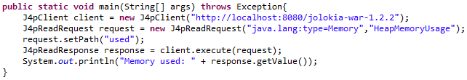
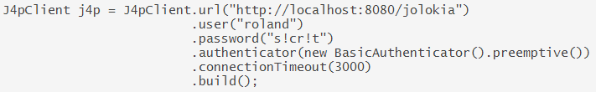
Clients
There are 3 client implementation for Jolokia: Jmx4Perl, Java library and Javascript library.
The java client library provides an easy access to the Jolokia agent from within Java.
The jolokia-client-java library depends on Apache HttpClient 4.3.3 and json-simple 1.1.
J4pClient is the entry point for sending request to a remote Jolokia agent.
J4pClient can use preemptive HTTP Basic authenticator.

Slide 12
Clients (cont.)
The base class for request types is J4pRequest.
Customized request/response types: J4pReadRequest/J4pReadResponse, J4pWriteRequest/J4pWriteResponse, J4pExecRequest/J4pExecResponse, J4pSearchRequest/J4pSearchResponse, J4pListRequest/J4pListResponse, J4pVersionRequest.
The base class for exceptions is J4pException.

Slide 13
Jolokia JMX
Allows easy access to JMX Mbeans.
Multiple MBeanServers can co-exists in a single JVM.
The Jolokia MBeanServer can be easily created and used with a locator:
MBeanServer server = JolokiaMBeanServerUtil.getJolokiaMBeanServer().
Server is trated specially by a Jolokia Agent:
Every Mbean registered at the Jolokia MBeanServer will never show up remotely via JSR-160.
Jolokia MBeanServer is also responsible for managing so calles JSON Mbeans.
@JsonMBean is used for marking an MBean as a JSON MBean.

Slide 14
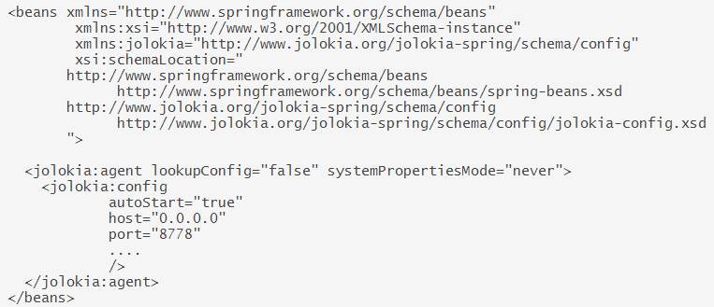
Spring Support
A Jolokia agent can be easily integrated into a Spring application context.
There are 2 directives available:
<jolokia:agent> - declares a Jolokia server with a configuration
<jolokia:config> - defines configuration
By default the Jolokia agent starts on port 8778 on every IP-Address of host without security.

Slide 15
Conclusions
Easy to Use
Documented
Multiple agents

Slide 16

Bibliography
http://www.jolokia.org/reference/html/index.html
http://www.jolokia.org/reference/pdf/jolokia-reference.pdf

