Slide 1

Lucene 3
Dima Ionut Daniel

Slide 2
Contents
What is Lucene?
History
Architecture
Features
Core Classes
Indexing
Searching
Analysis
Luke
Advanced
Extensibility
Conclusions
Bibliography

Slide 3

What is Lucene?
Apache Lucene is a free/open source information retrieval software library, under the Apache Software License.
The Lucene search engine is used to build and search indexes.
Lucene can index any text-based information you like and then find it later based on various search criteria.
It provides a basic framework that you can use to build full-featured search into your web sites.

Slide 4
History
Lucene was created in 1999 by Doug Cutting and was available for download from SourceForge.
In september 2001 joined the Jakarta project and became its own top-level Apache project in February 2005.
Lucene 2.0 released in may 2006.
Lucene 3.0 released in november 2009.
It included a number of sub-projects: Lucene.NET, Mahout, Solr and Nutch.
Solr has merged into the Lucene project itself and Mahout, Nutch, and Tika have moved to become independent top-level projects.
Lucene has been ported to other programming languages including Delphi, Perl, C#, C++, Python, Ruby, and PHP.

Slide 5
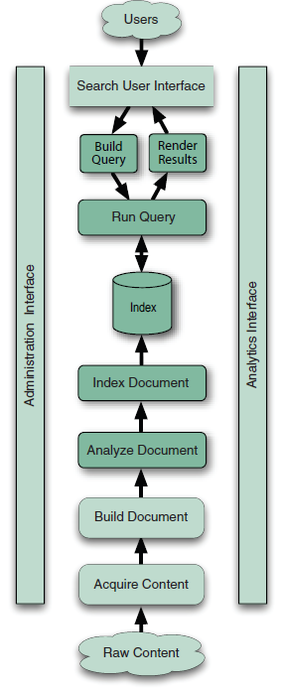
Architecture
Lucene it’s simply the core indexing and searching component.
When searching large data we must first index that text and convert it into a format that will let us search it rapidly, eliminating the slow sequential scanning process.
Searching is the process of looking up words in an index to find documents where they appear.

Slide 6
Features
Scalable, High-Performance Indexing
small RAM requirements
Powerful, Accurate and Efficient Search Algorithms
pluggable
sorting features
query API
fast access
configurable storage engine
Cross-Platform Solution
implementations in other programming languages available that are index-compatible

Slide 7
Core Classes
IndexWriter is used for creating and adding documents to the index and returns the number of documents indexed.
IndexSearcher is used to open the index for searching.
QueryParser is used to parse human-readable search text.
Directory represents location of the Lucene index.
Document represents a collection of fields.
Field represent the document or metadata associated with that document.
A Term is the basic unit for searching; it's a pair for the field name and the text value of that field.
The TermQuery is the most basic type of query supported by Lucene.
TopDocs is representing the searching return hits.

Slide 8
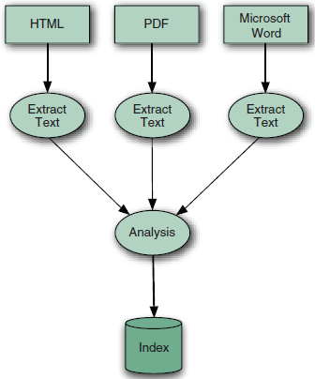
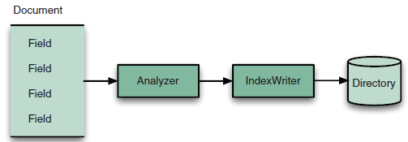
Indexing
IndexWriter is the central component of the indexing process.
The indexes are saved into the Directory. Lucene includes a number of interesting Directory implementations.
The Analyzer is in charge of extracting data that should be indexed.

Slide 9
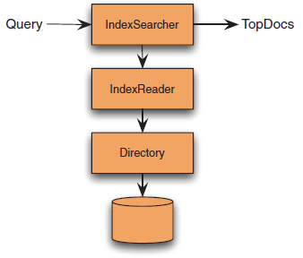
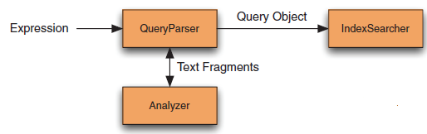
Searching
IndexSearcher is opening the index in read-only mode for searching.
Lucene comes with a number of concrete Query subclasses, for several types of query operations.

Slide 10
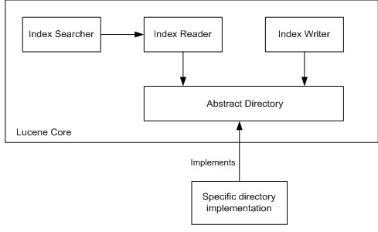
Searching (cont.)
Opening an IndexReader is costly so it's best to use a single instance for all of your searching when possible, and limit how often you open a new one.

Slide 11
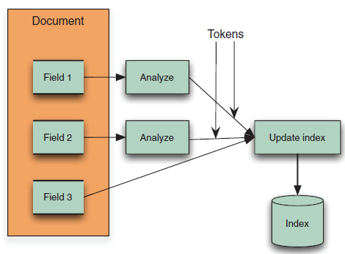
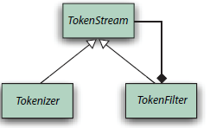

Analysis
Analysis is the process of converting field text into indexed representation called terms.
An analyzer is an encapsulation of the analysis process.
TokenStream (abstract) is producing tokens.
Tokenizer creates tokens from a Reader.
TokenFilter filters any other TokenStream.

Slide 12
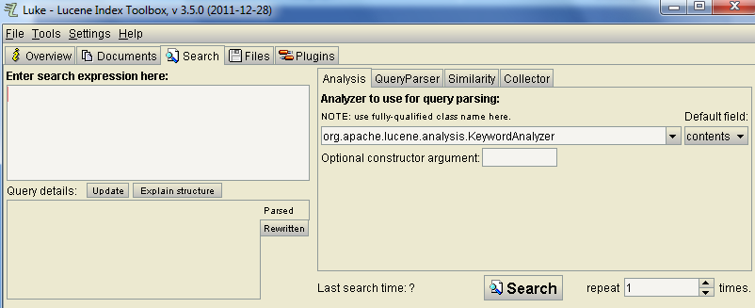
Luke
Luke is a handy development and diagnostic tool, which accesses already existing Lucene indexes and allows you to do CRUD operations:
Browse by term
View documents
retrieve a ranked list of most frequent terms
Execute a search and browse the results
Analyze search results
Optmize indexes
selectively delete documents from the index

Slide 13
Advanced
Directory implementations:
SimpleFSDirectory --> uses java.io.* API.
NIOFSDirectory --> uses java.nio.* API.
MMapDirectory --> uses memory-mapped I/O.
RAMDirectory --> all files are stored in RAM.
Only a single writer may be open on an index at once.
IndexReaders may be open even while an IndexWriter is making changes to the index.
Any number of threads can share a single instance of IndexReader or IndexWriter.

Slide 14
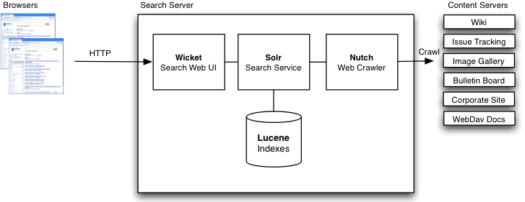
Extensibility
Lucene is used in other projects like:
Apache Nutch – web crawler and HTML parsing
Apache Solr – enterprise search server
ElasticSearch – enterprise search server
Compass – search engine framework
DocFetcher – multiplatform desktop search application

Slide 15
Conclusions
PROS
Real time searching
High performance text search engine library
Used in many open source projects like: Wikipedia, Internet Archive, Linkedin, Technorati, etc.
Lucene’s primary goal is to facilitate information retrieval.

Slide 16

Bibliography
http://en.wikipedia.org/wiki/Lucene
http://lucene.apache.org
http://www.javaranch.com/journal/2004/04/Lucene.html
http://code.google.com/p/luke/
Manning – Lucene In Action 2nd Edition

