Slide 1

Maven
Dima Ionut Daniel

Slide 2
Contents
What is Maven?
History
Arhitecture
Features
Concepts
Project Object Model
Dependencies Management
Build Lifecycles
IDE Integration
Examples
Extending Maven
Conclussion
Bibliography

Slide 3

What is Maven?
build automation tool.
similar to Apache Ant, but it is based on different concepts .
hosted by the Apache Software Foundation.
can be used to build and manage projects written in C#, Ruby, Scala, and other languages.

Slide 4
History
Maven began its life in the Jakarta Alexandria project.
The first prototype was released in August 2001.
In Octomber 2005 Maven was removed from Alexandria project.
Though Maven started in Alexandria the test bed for its use was the Turbine project.

Slide 5
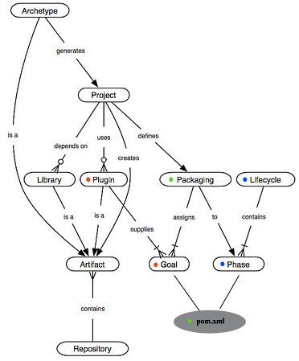
Arhitecture
Based on the concept of POM(Project Object Model), Maven can manage a project’s build, reporting and documentation from a central piece of information.

Slide 6
Features
Uses an XML file to describe the project being built, its dependencies on other external modules and components, the build order, directories, and required plug-ins.
Model based builds: Maven is able to build any number of projects into predefined output types such as a JAR, WAR, or distribution based on metadata about the project.
Dynamically downloads Java libraries and Maven plug-ins from one or more repositories and stores them in a local cache.
Extensible, with the ability to easily write plugins in Java or scripting languages.
Dependency management.
Able to easily work with multiple projects at the same time.

Slide 7
Concepts
Project Object Model(POM)
provides all the configuration for a single project
we can configure individual phases of the build process
POMs can also inherit configuration from other POMs
Plugins
resides most Maven functionality.
provides a set of goals that can be executed as: mvn [plugin-name]:[goal-name]
lots of plugins for: building, testing, source control manangement, running a web server, generating Eclipse project files,etc.
Example: mvn compiler:compile, mvn surefire:test, mvn jar:jar.
are configured in <plugins> section of a pom.xml.
are the primary way to extend Maven(org.apache.maven.plugin.AbstractMojo class).
Build lifecycles
is a list of named phases that are executed.
default phase: process-resources, compile, process-test-resources, test-compile, test, package, install, deploy.
goals provided by plugins can be associated with different phases of the lifecycle.

Slide 8
Project Object Model
Every Maven project contains a pom.xml file.
The pom.xml file is the XML representation that contains all metadata for the project.
Project co-ordinates are the minimal basic fields that a POM definition must contain: groupId, artifactId, and version.
POM sections:
basics: co-ordinates, dependency management, inheritance details.
build settings: build details for the project.
metadata: name,organization, developers, URL, inception year, etc.
envirnoment: source version control info, issue management, continuous integration, mailing lists, repositories, etc.

Slide 9
Project Object Model (cont.)
Projects in Maven are configurable using the build profiles. Build profiles can be trigger:
Explicit command-line trigger (mvn install -P prof1,prof2,!prof3)
Maven settings trigger (using <activeProfiles>,<activeProfile> from settings.xml configuration)
Environment specific trigger (using <profiles>, <profile> xml configuration,ex: mvn clean install -Denvironment=dev)
A large project can be grouped into subprojects or modules.
Apache Maven provides support for project modularization.
The parent project's POM file contains references to all these sub-modules.
Each module can be of a different type, containing different packaging value.

Slide 10
Dependencies Management
Dependency management is managed by Apache Maven.
Apache Maven dependencies are transient, which means Maven will automatically discover artifacts that your dependencies require.
Maven dependencies have six possible scopes:
Compile: compile dependencies are available in the classpaths(default scope).
Provided: assumes that the JDK or the environment provides dependencies at runtime.
Runtime: Dependencies that are required at runtime and are specified in the runtime classpaths.
Test: Dependencies required for test compilation and execution.
System: Dependency is always available, but the JAR is provided nonetheless.
Import: Imports dependencies specified in POM included via the <dependencyManagement/> element.
The "maven-dependency-plugin" provides a number of very useful goals like: analyze, analyze-duplicate, resolve, resolve-plugin, tree. (ex: mvn dependency:tree).
Dependencies can be inherited from parent POM files, added in <dependencies> section.

Slide 11
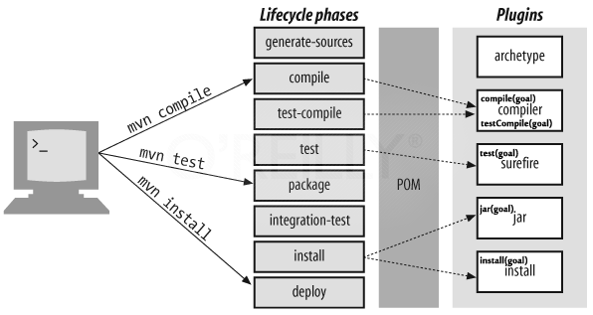
Build Lifecycles
The build lifecycle concept is very clearly defined.
There are three built-in build lifecycles: default, clean and site.

Slide 12
Build Lifecycles (cont.)
The default lifecycle handles the project compilation, test, and deployment.
It contains over 20 build phases, the following are the most important phases:
Validate: validates that all project information is available and is correct
Compile: compiles the source code
Test: runs unit tests within a suitable framework
Package: packages the compiled code in its distribution format
Integration-test: processes the package in the integration-test environment
Verify: runs checks to verify that the package is valid
Install: installs the package in the local repository
Deploy: installs the final package in a remote repository
The clean lifecycle handles the project cleaning and contains the following build phases:
Pre-clean: executes processes required before project cleaning
Clean: removes all files generated by previous builds
Post-clean: executes processes required to finalize project cleaning
The site lifecycle handles the generation and deployment of the project’s site documentation:
Pre-site: executes processes required before generation of the site
site: generates the project’s site documentation
Post-site: executes processes required to finalize the site generation and prepares the site for deployment
Site-deploy: deploys the site documentation to the specified web server

Slide 13
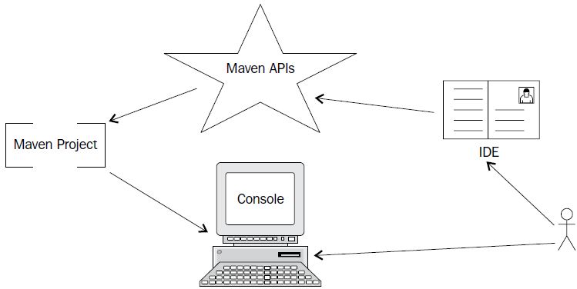
IDE Integration
Popular IDE supporting development with Maven:
Eclipse
Netbeans
IntellijIDEA
JBuilder
JDeveloper
MyEclipse
These add-ons also provide the ability to edit the POM or use the POM to determine a project's complete set of dependencies directly within the IDE.

Slide 14
Examples
We can use Maven archetype:generate goal to generate our first Maven Java project.
A large list of archetypes, each having a number, a name, and a short description will be listed.
The "org.apache.maven.archetypes:maven-archetype-quickstart" will generate an empty Maven project having pom.xml and 2 java sources: App.java and AppTest.java.
Cobertura is a toolthat analyzez source and test code and calculates the percentage of code accessed.
The plugin provides 5 goals:
cobertura:check: check last results
cobertura:clean: clean files being tracked
cobertura:dump-datafile: provides a data file dump
cobertura:instrument: instruments compiled classes
cobertura:cobertura: instruments, tests and generate reports
Checkstyle is helping developers adhere to coding standards.
The Maven Checkstyle plugin introduces two goals:
checkstyle:checkstyle: Performs analysis and generates a report
checkstyle:check: Checks for violations against the last checkstyle run

Slide 15
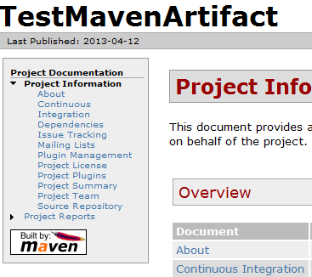
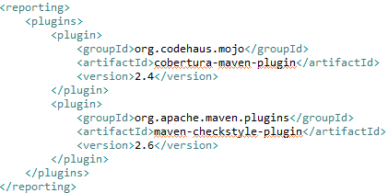
Examples (cont.)
mvn cobertura:cobertura will generate the report in a standalone mode.
Maven site command will also lead to the generation of the Cobertura report: mvn:site.

Slide 16
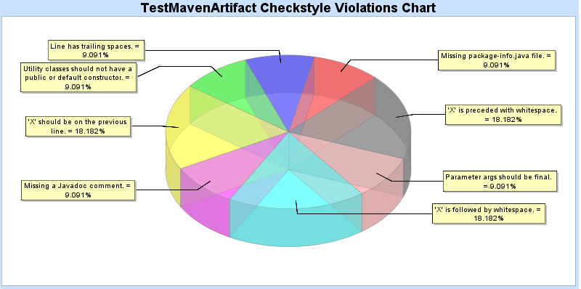
Examples (cont.)
The Maven dashboard plugin commits to centralizing and enabling effective sharing of information.
It supports a large list of plugins: test coverage, cobertura, clover, PMD/CPD, FindBugs, JDepend, Surefire.
The goals are:
dashboard:dashboard: Generates the dashboard to aggregate all reports
dashboard:persist: Preserves the dashboard in a backend database

Slide 17
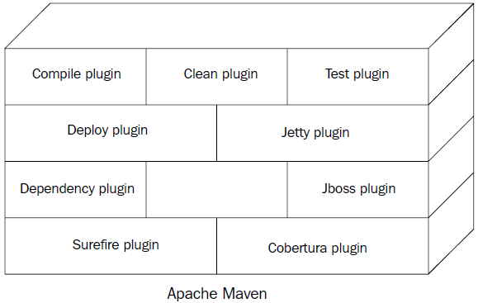
Extending Maven
Plugins are where the real action happens.
A plugin can have one or more goals that can be called upon explicitly from the command line or sometimes be integrated with one of the project build phases.
Apache Maven can be defined as no more than a framework with collections of plugins.
We can create custom plugin by extending org.apache.maven.plugin.AbstractMojo.AbstractMojo from Maven plugin API.
Maven 2 plugin API uses JavaDoc annotations for defining goals.
Maven 3 plugin API can use Java Annotations for defining goals.

Slide 18
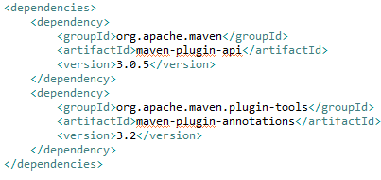
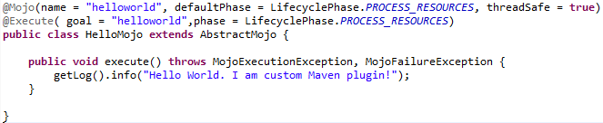
Extending Maven (cont.)
For developing Maven 3 plugins we need to have declared the pom of type maven-plugin(<packaging> POM element) and having added the correct maven-plugin-api dependency.
Starting from Maven 3 we need to add in <build> section the maven-plugin-plugin. This will generate the custom plugin descriptor that will be stored in META-INF/maven/plugin.xml in the plugin's jar artifact.

Slide 19
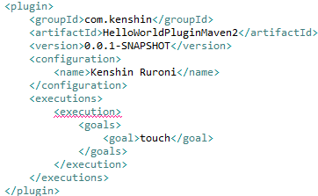
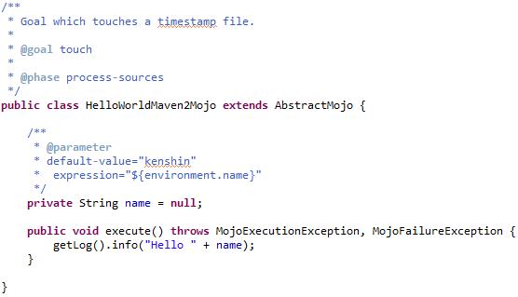

Extending Maven (cont.)
The AbstractMoJo has only one method execute().
Plugins can receive also parameters via @parameter javadoc
annotation or @Parameter java annotation
POM invoking
custom plugin→

Slide 20
Conclussion
Standardization
Reuse
Dependency management
Enforces modular design of code.
Scalability
Build lifecycle management
Large existing repository
Documented
Setting up a project is really fast.
All artifacts are versioned and store in a repository.
Provide quality project information with generated site

Slide 21

Bibliography
http://en.wikipedia.org/wiki/Apache_Maven
http://maven.apache.org
http://warren.chinalle.com/2011/07/25/apache-maven/
PacktPub – Apache Maven 3 Cookbook

Slide 22
Questions ?

