Slide 1

Memcached
Dima Ionut Daniel

Slide 2
Contents
What is Memcached?
Architecture
Features
Installation
Core
Telnet Commands
Java API
Conclusions
Bibliography

Slide 3

What is Memcached?
Memcached is a general-purpose distributed memory caching system.
Memcached is free and open-source under BSD licence.
Memcached runs on Unix-like OS and Windows.

Slide 4
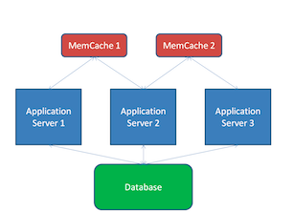
Architecture
Memcached server can listen on TCP or UDP port for caching calls.

Slide 5
Features
Memcached API provide a very large hash table distributed across multiple machines.
The size of this table is very large;it's limited by available memory across a large number of server in a data centre.

Slide 6
Installation
On Ubuntu, Memcahed can be installed using: sudo apt-get install memcahed.
In order to verify the installation was done with success use following command : ps aux | grep memcahed.
Memcache was designed with Linux and not windows, but there is also Windows distribution and dll for Win x64 OS.
To install run following command in cmd using administrator: memcached.exe –d install
To start: memcached.exe –d start

Slide 7
Core
On Unix the configuration can be found on /etc/memcached.conf.
Memcached can be used with languages as: PHP, Ruby, Python, Java, Rails, Django, Play.
Memcached default listening interface is 127.0.0.1
Memcached will start on default port 11211 waiting for TCP connections.
The number of thread used is 4.
Memcached starts with 64MB RAM assigned.
The number of simulatenous incoming connections can be limited.Default value is 1024.

Slide 8
Telnet Commands
We can connect to Memcached using telnet and use commands like:
get: get <key> * \r\n
set: set <key> <flags> <exptime> <bytes> [noreply] \r\n<value>\r\n
add: add <key> <flags> <exptime> <bytes> [noreply]\r\n<value>\r\n
replace: replace <key> <flags> <exptime> <bytes> [noreply]\r\n<value>\r\n
append: append <key> <flags> <exptime> <bytes> [noreply]\r\n<value>\r\n
prepend: prepend <key> <flags> <exptime> <bytes> [noreply]\r\n<value>\r\n
cas: cas <key> <flags> <exptime> <bytes> <cas unique> [noreply]\r\n
delete: delete <key> [<time>] [noreply]\r\n

Slide 9
Telnet Commands (cont.)
We can connect to Memcached using telnet and use commands like:
incr: incr <key> <value> [noreply]\r\n
decr: decr <key> <value> [noreply]\r\n
touch: touch <key> <exptime> [noreply]\r\n
stats: stats\r\n
flush_all: flush_all [<time>] [noreply]\r\n
version: version\r\n
verbosity: erbosity <level> [noreply]\r\n
quit: quit

Slide 10
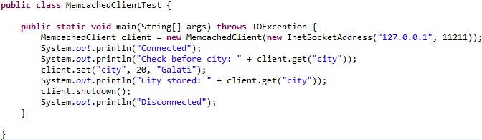
Java API
We need to include the spymemcached library in order to use Memcache.
MemcachedClient creates the memcached connection.
The set method works like "fire and forget" and it's not blocking.
The get method is synchronous and blocks until data is retrieved.
We can store Java Serializable objects.

Slide 11
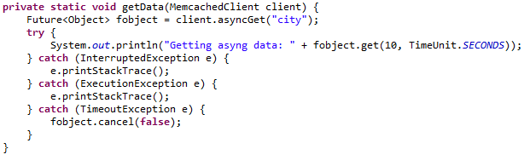
Java API (cont.)
Spymemcahed offers asynchronous API with asyncGet method that returns a Future object.
If we get timeout expired, we receive TimeoutException and it's best to safely cancel the operation using the cancel() method.

Slide 12
Java API (cont.)
Memcached usual methods:
set adds a new item in cache.
get returns the value of the cache key.
add adds a new key only if it doesn't already exist.
replace will replace a value only if the key exists.
delete deletes the cache entry for the key.

Slide 13
Conclusions
Pros:
Memcached is cross-platform.
Memcached never blocks.
Memcached is cheap.
Cons:
If we update content it's best to delete associated keys related to new content so that data is new. If we don't do this we have stale content
Memcached requires size requirements.
Volatility.
Security issues as Memcached doesn’t require security information.

Slide 14

Bibliography
http://en.wikipedia.org/wiki/Memcached
Packt Publisher Getting Started with Memcached
http://blog.elijaa.org/?post/2010/05/21/Memcached-telnet-command-summary

