Slide 1

NOSQL
Dima Ionut Daniel

Slide 2
Contents
What is NoSQL?
NoSQL Types
Concepts
NoSQL Benefits
RDBMS vs NoSQL
ACID vs BASE
NoSQL Products
Conclusions
Bibliography

Slide 3

What is NoSQL?
A NoSQL (Not Only SQL) database provides a mechanism for storage and retrieval of data that is modeled in means other than the tabular relations used in relational databases.
Motivations for this approach include simplicity of design, horizontal scaling, and finer control over availability.
NoSQL databases are increasingly used in big data and real-time web applications.

Slide 4
NoSQL Types
NoSQL frameworks have different ways of storing and accesing data:
Document store → MongoDB and CouchDB
Key/value store (in-memory, persistent and even ordered) → Redis and BerkeleyDB
Column-family-based store → HBase and Hypertable
Eventually consistent key/value store → Apache Cassandra and Voldermot
Graph →Neo4j, OrientDB, Allegro.

Slide 5
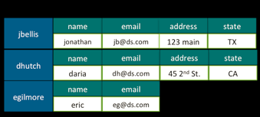
Concepts
Column-oriented databases:
Column-oriented databases are among the most popular types of non-relational databases.
Google’s Bigtable and Apache HBase, part of Hadoop, are both column-oriented databases.
A column-oriented DBMS it stores data tables as sections of columns of data rather than as rows of data.
As data is inserted into the table, it's assigned an internal ID(rowid).

Slide 6
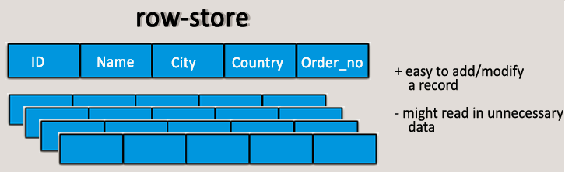
Concepts (cont.)
Maps of Key/Value Pairs:
Maps or hash maps, which are also referred to as associative arrays, are pairs of keys and their corresponding values.
Keys need to be unique to avoid collision and values can often be any array of bytes.
All or part of the data model may be expressed as a collection of tuples <attribute name, value>; each element is an attribute–value pair.

Slide 7
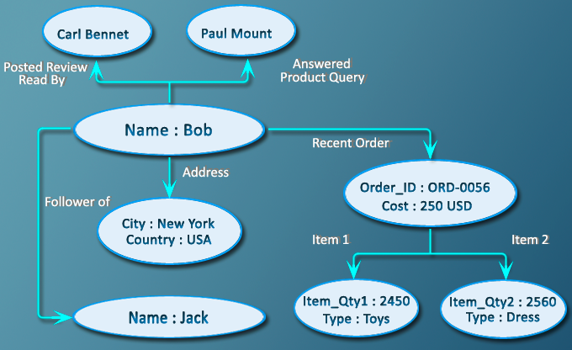
Concepts (cont.)
Graph database:
A graph database is a database that uses graph structures for semantic queries with nodes, edges, and properties to represent and store data.
Every element contains a direct pointer to its adjacent elements and no index lookups are necessary.
Graph databases are based on graph theory and contains nodes, properties, and edges.
Nodes represent entities, properties are pertinent information that relate to nodes.
Edges connects nodes to nodes or nodes to properties and they represent the relationship between the two.

Slide 8
Concepts (cont.)
Memory-Mapped Files:
A memory-mapped file is a segment of virtual memory that is assigned byte-for-byte to a file.
Applications can interact with such files as if they were parts of the primary memory.
It improves I/O performance as compared to usual disk read and write.
The major reason to choose memory mapped file I/O is performance.

Slide 9
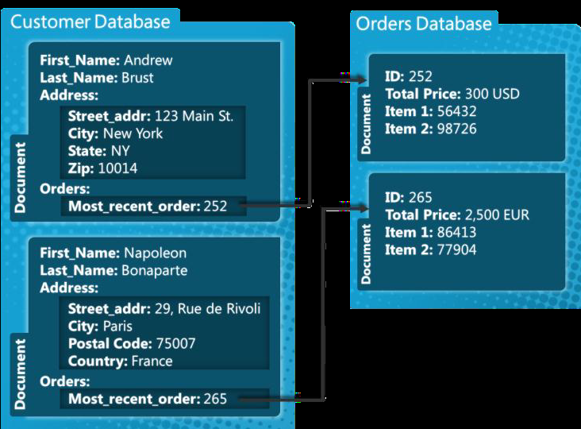
Concepts (cont.)
Document database:
A document stores documents, where they are grouped together into collections.
Arbitrary documents could be grouped together in a single collection.
Each document is stored in BSON format.
BSON is a binary-encoded representation of a JSON-type document format where the structure is close to a nested set of key/value pairs.

Slide 10
Concepts (cont.)
BSON (http://bsonspec.org/) is similar to protobuf.
Protocol buffers, sometimes also referred to as protobuf, is Google’s way of encoding structured data for efficient transmission.
Google uses it for all its internal Remote Procedure Calls (RPCs) and exchange formats.
Protobuf is a structured format like XML but it’s much lighter, faster, and more efficient.
Protobuf is a language and platform-neutral specification and encoding mechanism, which can be used with a variety of languages.
BSON is more schema-less as compared to protobuf.
BSON is used by MongoDB drivers.

Slide 11
NoSQL Benefits
NoSQL databases are more scalable and provide superior performance
NoSQL databases are built to allow the insertion of data without a predefined schema.
NoSQL databases, on the other hand, usually support auto-sharding(they natively and automatically spread data across an arbitrary number of servers, without requiring the application to even be aware of the composition of the server pool).
Most NoSQL databases also support automatic replication(,get high availability and disaster recovery without involving separate applications to manage these tasks).
NoSQL database technologies have excellent integrated caching capabilities, keeping frequently-used data in system memory.

Slide 12
RDBMS vs NoSQL
RDBMS
Structured and organized data
Structured query language (SQL)
Data and its relationships are stored in separate tables.
Data Manipulation Language, Data Definition Language
Tight Consistency
BASE Transaction
NoSQL
Stands for Not Only SQL
No declarative query language
No predefined schema
Key-Value pair storage, Column Store, Document Store, Graph databases
Eventual consistency rather ACID property
Unstructured and unpredictable data
CAP Theorem
Prioritizes high performance, high availability and scalability

Slide 13
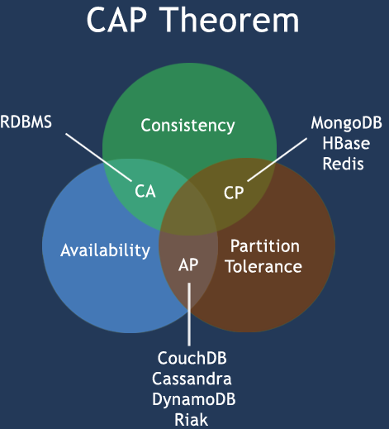
RDBMS vs NoSQL (cont.)
CAP theorem states that there are 3 basic requirements:
Consistency: the data in the database remains consistent after the execution of an operation.
Availability: the system is always on, no downtime.
Partition Tolerance: the system continues to function even the communication among the servers is unreliable.
CA - Single site cluster, all nodes are always in contact. When a partition occurs, the system blocks.
CP - Some data may not be accessible, but the rest is still consistent/accurate.
AP - System is still available under partitioning, but some of the data returned may be inaccurate.

Slide 14
ACID vs BASE
ACID(Atomicity, Consistency, Isolation, and Durability) has become an important standard to define the highest level of transactional integrity in database systems.
Atomicity → Either a transactional operation fully succeeds or completely fails.
Consistency → Consistency implies that data is never persisted if it violates a predefined constraint or rule.
Isolation → Isolation gets relevant where data is accessed concurrently.
Durability → Durability implies that once a transactional operation is confirmed.

Slide 15
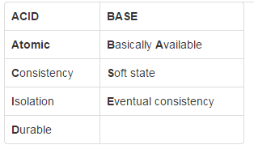
ACID vs BASE (cont.)
The CAP theorem states that a distributed computer system cannot guarantee all of the following three properties at the same time:
Consistency
Availability
Partition tolerance
A BASE system gives up on consistency.
Available indicates that the system does guarantee availability, in terms of the CAP theorem.
Soft state indicates that the state of the system may change over time, even without input. This is because of the eventual consistency model.
Eventual consistency indicates that the system will become consistent over time, given that the system doesn't receive input during that time.

Slide 16
NoSQL Products
Apache Cassandra
Open-source, distributed database-management system designed to handle very large amounts of data
Provides a high degree of service availability with no single point of failure.
HBase
Open-source, distributed database modeled after Google’s BigTable.
Scales linearly with the number of nodes and can quickly return queries on tables consisting of billions of rows and millions of columns.
BigTable
BigTable is designed to scale into the petabyte range – a petabyte is equivalent to 1 million gigabytes, across hundreds or thousands of machines.
MongoDB
Document database that provides high performance, high availability, and easy scalability

Slide 17
NoSQL Products (con.)
Neo4j
Supports query language named Cypher.
Represents semi-structured data very easily.
Uses simple/powerful data model
CouchDB
Stores data with JSON documents.
Access to documents can be done by query the indexes with the web browser, via HTTP.
Works well with modern web and mobile apps.

Slide 18
Conclusions
Advantages :
High scalability
Distributed Computing
Lower cost
Schema flexibility, semi-structure data
No complicated Relationships
Disadvantages:
No standardization
Limited query capabilities
Eventual consistent is not intuitive to program for

Slide 19

Bibliography
http://en.wikipedia.org/wiki/NoSQL
http://en.wikipedia.org/wiki/Column-oriented_DBMS
http://en.wikipedia.org/wiki/Graph_database
http://www.w3resource.com/mongodb/nosql.php
Wrox - Professional NoSQL

