Slide 1

Neo4j
Dima Ionut Daniel

Slide 2
Contents
What is Neo4j?
Neo4j Features
Graph Concepts
Neo4j API
Traversal API
Cypher
Conclusions
Bibliography

Slide 3

What is Neo4j?
Neo4j is an open-source graph database implemented in Java.
The community edition is licensed under the free GPL (GNU General Public License) v3.
The additional modules such as online backup and high availability are licensed under AGPL (Affero General Public License)v3.
Neo4j version 1.0 was developed by neo Technology and released in February 2010 .

Slide 4
Neo4j Features
Neo4j can be used in lightweight projects.
It supports true ACID transactions.
Neo4j can scale billions of nodes and relationships.
Neo4j has a query language for node traversal.

Slide 5
Graph Concepts
A graph database store data in a graph and contains nodes and relationships.
A graph database elaborated a key-value store.
Both nodes and relationships can have properties.
A path is one or more nodes with connecting relationships, typically retrieved as a query or traversal result.

Slide 6
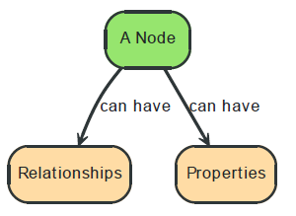
Graph Concepts (cont.)
Nodes store entity information.
Nodes are the fundamental units within a graph.
Nodes often represents entities.

Slide 7
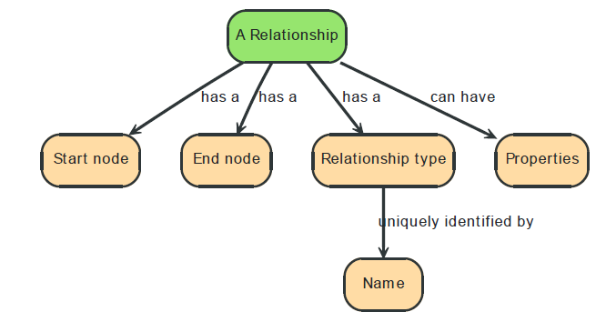
Graph Concepts (cont.)
Relationships connects nodes to one another explicitly.
Both nodes and relationships are containers for properties, which are effectively name/value pairs.
Labels were added to Neo4j version 2.0 at the end of 2013 and are used for efficiently create subgraphs.

Slide 8
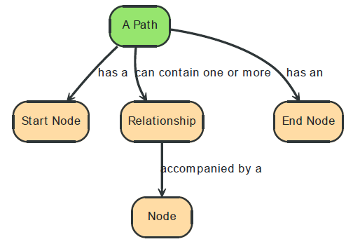
Graph Concepts (cont.)
A path is one or more nodes with connecting relationships

Slide 9
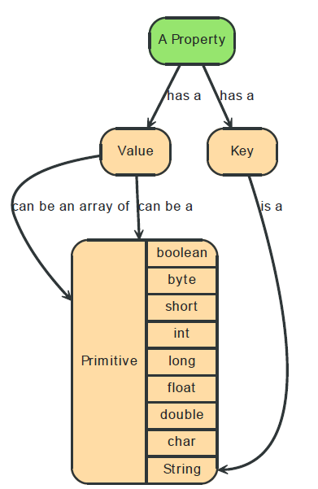
Graph Concepts (cont.)
Properties are key-value pairs where the key is a string.Property values can be either a primitive or an array of one primitive type.

Slide 10
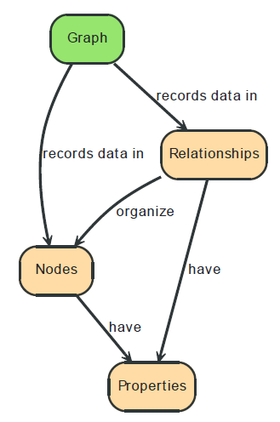
Graph Concepts (cont.)
The simplest graph is a single Node that has names values(properties).

Slide 11
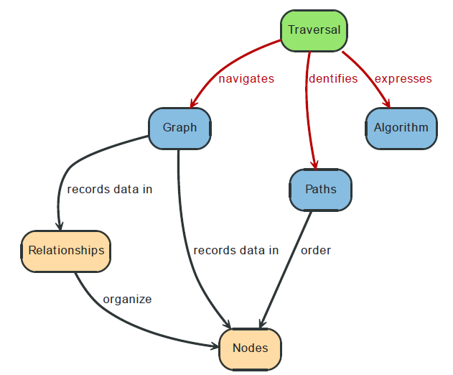
Graph Concepts (cont.)
A traversal is the query of a Graph, navigating from starting nodes to related nodes based on algorithm.

Slide 12
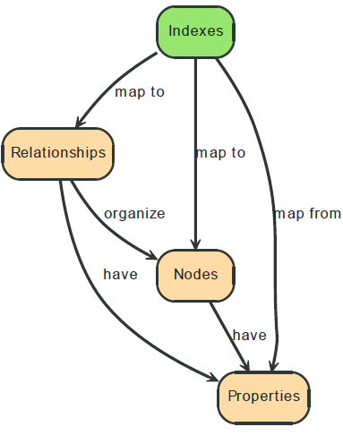
Graph Concepts (cont.)
Rather than traversing the entire graph, we can use Index to perform look-ups.

Slide 13
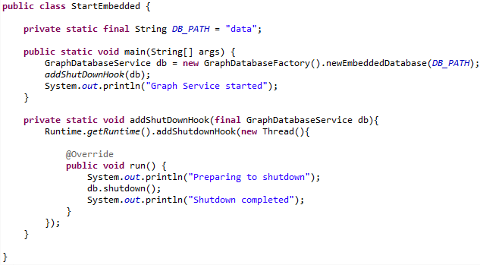
Neo4j API
We can use GraphDatabaseFactory to create GraphDataBaseService to start the Neo4j in embedded mode.

Slide 14
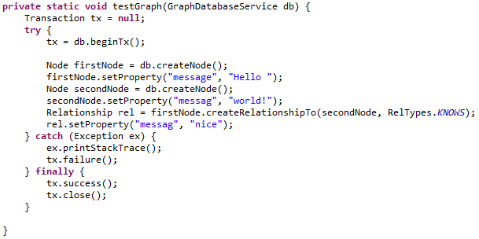

Neo4j API (cont.)
We can create nodes and add properties to them.
Relationships can be created between nodes and they can have properties.
All the operations are created within a transaction.

Slide 15
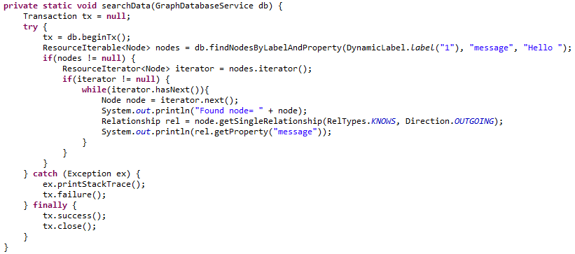
Neo4j API (cont.)
We can search for nodes using labels and properties.
Labels can be attached to Nodes at creation time or later.

Slide 16
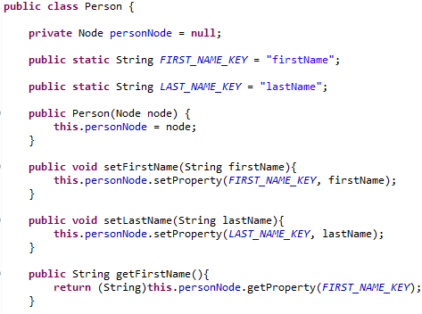
Neo4j API (cont.)
We can create domain objects by wrapping entities around a node.
The same approach can be used with relationships.

Slide 17
Traversal API
Neo4j Traversal Api is callback based, lazily executed.
It consists of main interfaces: Relationship, TraversalDescription, Evaluator, Traverser, Uniqueness.
Other options to traverse or query graphs in Neo4j are Cypher and Gremlin.

Slide 18
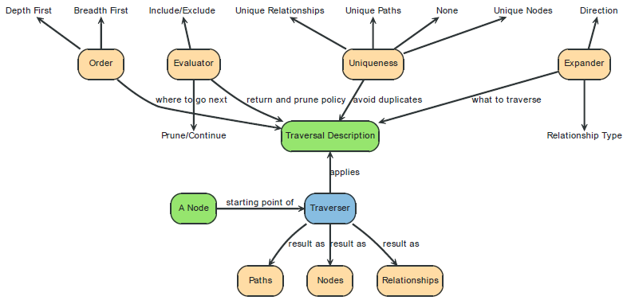
Traversal API (cont.)
Expanders: define what to traverse, typically in terms of relationship direction and type.
Order — for example depth-first or breadth-first.
Uniqueness — visit nodes (relationships, paths) only once.
Evaluator — decide what to return and whether to stop or continue traversal beyond the current
position.
Starting nodes where the traversal will begin.

Slide 19
Cypher
Cypher is a query language used for dealing with graph data structures.
Cypher is declarative as we define the pattern that we are looking for.
Cypher is a pattern matching query language.

Slide 20
Cypher (cont.)
The query language has several distinct clauses.
START: Starting points in the graph, obtained via index lookups or by element IDs.
MATCH: The graph pattern to match, bound to the starting points in START.
WHERE: Filtering criteria.
RETURN: What to return.
CREATE: Creates nodes and relationships.
DELETE: Removes nodes, relationships and properties.
SET: Set values to properties.
FOREACH: Performs updating actions once per element in a list.
WITH: Divides a query into multiple, distinct parts.

Slide 21
Cypher (cont.)
Each query describes a pattern that can have multiple starting points.
A starting point is a relationship or a node where a pattern is anchored.
Binding a node as a starting point is done with the node(*) function.
Binding a relationship as a starting point is done with the relationship(*) function.

Slide 22
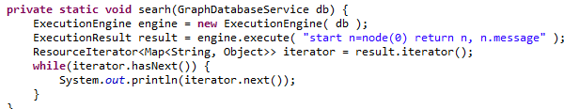
Cypher (cont.)
ExecutionEngine and ExecutionResult cna be used to interogate Neo4j graph database.

Slide 23
Conclusions
All kind of data can be saved in a graph database.

Slide 24

Bibliography
http://en.wikipedia.org/wiki/Neo4j
http://blog.neo4j.org/2010/02/top-10-ways-to-get-to-know-neo4j.html
http://www.neo4j.org/learn/graphdatabase
neo4j-manual-stable.pdf
Packt Publishing – Learning Neo4j

