Slide 1

OSGI
Dima Ionut Daniel

Slide 2
Contents
What is OSGI?
Architecture
OSGI Implementations
Create and deploy bundles
OSGI Metadata
OSGI Core Classes
OSGI Services
OSGI Internals
Advanced component frameworks
Spring DM
SpringSource Dm Server/Eclipse Virgo
Benefits of using OSGI
Conclusion
Bibliography

Slide 3

What is OSGI?
OSGI (Open Services Gateway initiative) → module system and service platform for the Java programming language that implements a complete and dynamic component model. Applications or components (bundles) can be remotely installed, started, stopped, updated and uninstalled without requiring a reboot.
OSGi enables the creation of highly cohesive, loosely coupled modules that can be composed into larger applications. Each module can be individually developed, tested, deployed, updated, and managed with minimal or no impact to the other modules.
The OSGi specification defines a deployment model for Java-based modules. The unit of deployment in OSGi is known as a bundle. A bundle can be installed, started, stopped, and uninstalled from the framework, following the life cycle prescribed by the OSGi specification.
OSGi also provides a service registry, with which bundles may publish and/or consume services. The services are known by their published interfaces, not by the implementation. This means that the coupling is kept low between service publishers and those that consume their services.
In OSGi each bundle is loaded into its own class space. This makes it possible for a bundle’s internal implementation to evolve without impacting other bundles that depend on its relatively stable public API.
OSGi bundles are discretely identified by a name (bundle’s symbolic name) and version number in the bundle’s manifest.
OSGi Specification Release 4 was first released in October 2005. Version 4.1 was released in May 2007. Core and Compendium Version 4.2 was released in September 2009. Enterprise Version 4.2 was released in March 2010. Core Version 4.3 was released in April 2011.

Slide 4
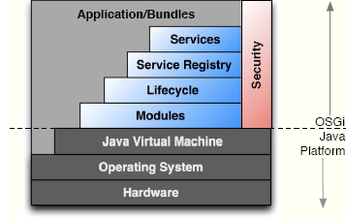
Architecture
The module layer doesn’t have any service API, but defines the modularization characteristics.
The security layer is based on Java 2 security architecture and defines how a bundle can be digitally signed and how security checks can be enforced in the context of the framework.
The life-cycle layer defines and manages the states an OSGi bundle can find itself in at any time. The transition of a bundle from each of these states is caused by either an administrative console or the framework performing dynamically based on what other actions are taking place in dependent bundles.
The service registry layer provides a cooperation model for bundles to share objects between bundles. A number of events are defined to handle the coming and going of services.
The Service Layer. A service in OSGi is a Java object inside a bundle, which is listed in an OSGi service registry for the benefit of other bundles running in the same JVM. The bundle can register a service, it can search for a service, or it can receive notifications when a service changes.

Slide 5
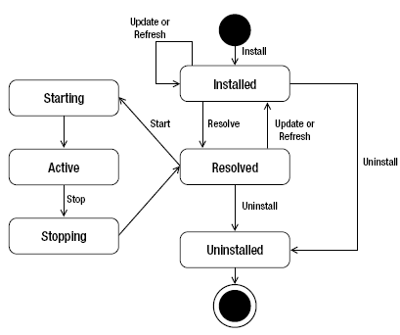
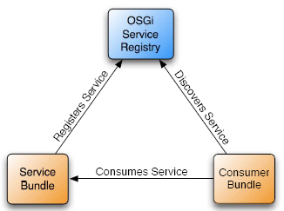
Architecture
Installed → a bundle has been validated and is prepared to be activated.
Resolved → all dependencies declared for a bundle have been resolved.
Starting → a bundle is in the process of transitioning to an active state.
Active → a bundle has been loaded into the actual JVM footprint.
Stopping → bundle is in the process of being stopped.
Uninstalled →a bundle is effectively uninstalled, meaning no verification process has taken place.
OSGi bundles can both publish and consume services (like an SOA in a JVM).

Slide 6
OSGI Implementations
Apache Felix → open source implementation for OSGi Release 4 core.
Equinox → open source Eclipse project that provides a certified implementation of the OSGi R4.x core framework specification. Equinox started as a project to replace the original Eclipse plug-in runtime in version 3.0 of Eclipse.
Knopflerfish → a non-profit organization, developing OSGi related material and provides an easy to use open source certified implementation of the OSGi R4 v4.2 core framework specification as well as related build tools and applications. Knopflerfish is available under a BSD style license.
Apache Aries → consists of a set of pluggable Java components enabling an enterprise OSGi application programming mode. This includes implementations and extensions of application-focused specifications defined by the OSGi. It provides also BlueprintContainer and projects to integrate enterprise technologies such as JTA, JNDI, JPA.
Apache Karaf → small OSGi based runtime which provides a lightweight container onto which various components and applications can be deployed. Supports exploded bundles and custom deployers such as blueprint and spring ones.
Concierge → OSGI R3 framework implementation intended for resource-constrained devices like mobile and embedded systems.

Slide 7
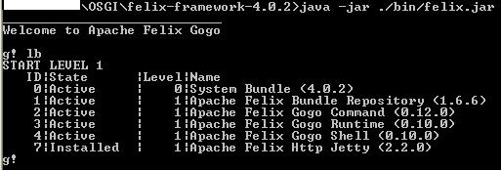
OSGI Implementations
To run Apache Felix OSGi we download, unpack and run the following commands:
cd felix-framework_version_x.x.x.
java -jar bin/felix.jar.
The newer Apache Felix versions include Apache Felix Gogo a subproject, implementing the OSGi RFC 147.
The framework launcher starts the framework and installs and starts all bundles contained in the bundle directory of the current directory. By default, the framework creates a cache directory, called felix-cache, in your current working directory. If you want to start the framework using a different bundle cache directory we execute:
java -jar bin/felix.jar <cache-path>
In Gogo, command names are made up of two parts: <scope>:<name>. To install bundles, use the felix:install command. Example: felix:install file:/path/to/bundle/bundle.jar
Common commands: felix:stop, felix:start, felix:uninstall.
Bundles can be updated using the felix:update command. The update command allows you to specify an URL from which to retrieve the updated bundle, but if one is not specified it will try to update the bundle from the bundle's Bundle-UpdateLocation manifest attribute, if present.

Slide 8
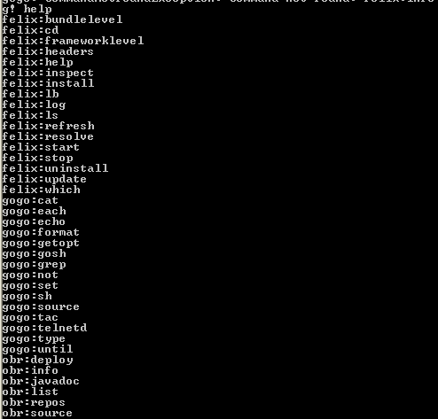
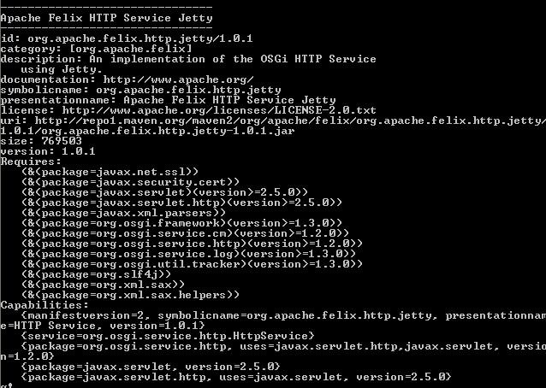
OSGI Implementations
obr info <bundle-name>[;<version>] → displays the meta-data for the specified bundles. It is also possible to specify the version if more than one version exists

Slide 9
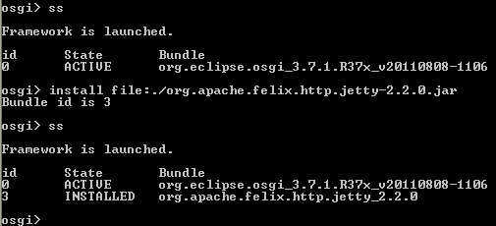
OSGI Implementations
To start Equinox OSGi framework we execute the following command:
java -jar org.eclipse.osgi_3.2.0.jar –console
Common commands: install <bundle_URL>, start <bundle>, stop <bundle>, ss (status installed bundles), diag <bundle> (reports any problems).
The Equinox OSGi implementation is extremely configurable. The default configuration is found in /configuration/config.ini file. If we want to specify a different configuration, add -configuration <location> to the command line.
If we have bundles B1.jar and B2.jar that we want to have installed and started when Equinox is run we configure in config.ini:
osgi.bundles=B1.jar@start, B2.jar@start
eclipse.ignoreApp=true #Normally the eclipse launcher expects an eclipse app
When Equinox is started using the command line above, B1 and B2 are installed and started.

Slide 10
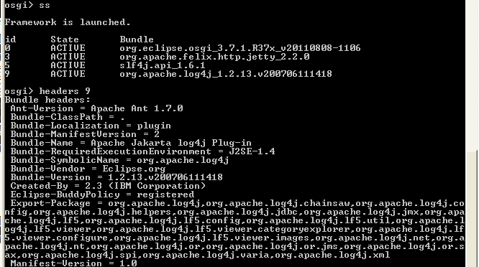
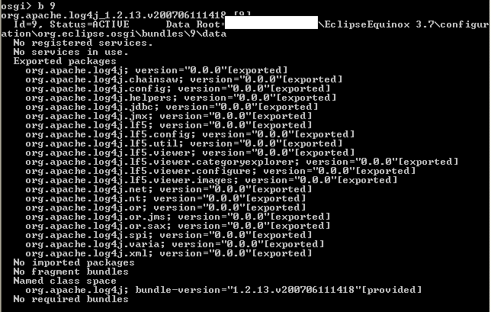
OSGI Implementations
headers <bundle_id> → list the headers for a particular bundle.
b <bundle_id> → print all the meta data related to this bundle. That includes imported packages, exported packages, host bundle, required bundles etc.
packages <package-name> → list all the bundles which use the given package.

Slide 11
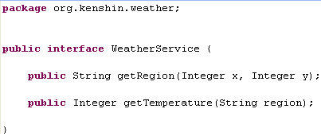

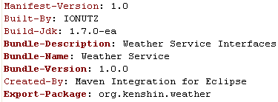
Create and deploy bundles
We build the org.kenshin.weatherBroadcast-0.0.1-SNAPSHOT.jar bundle that contains the interface plus extra entries in the META-INF/MANIFEST.MF file.

Slide 12
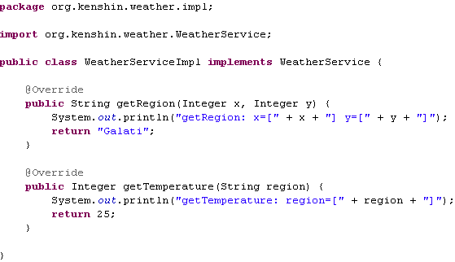

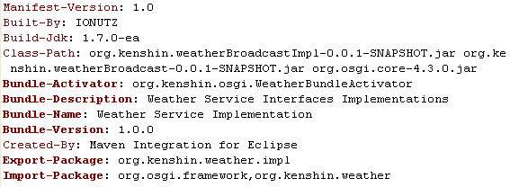
Create and deploy bundles
We build the org.kenshin.weatherBroadcastImpl-0.0.1-SNAPSHOT.jar bundle that contains the interface implementation and the BundleActivator for the module plus extra entries in the META-INF/MANIFEST.MF file.

Slide 13
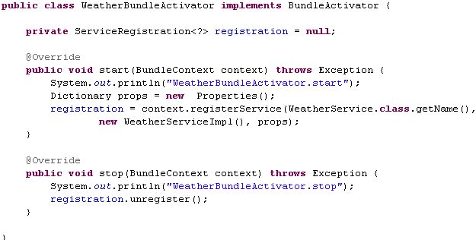
Create and deploy bundles
We define the BundleActivator implementation that binds WeatherService interface to WeatherServiceImpl class.

Slide 14
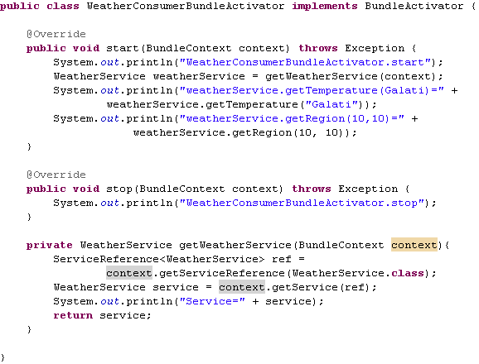

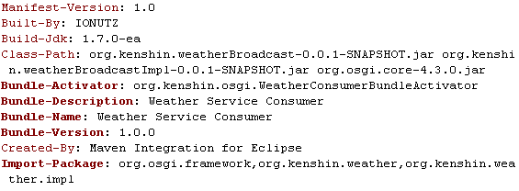
Create and deploy bundles
We build the org.kenshin.weatherBroadcastConsumer-0.0.1-SNAPSHOT.jar bundle that contains the interface implementation and the BundleActivator for the module plus extra entries in the META-INF/MANIFEST.MF file. When this bundle is started it would call(consume) the WeatherService.

Slide 15
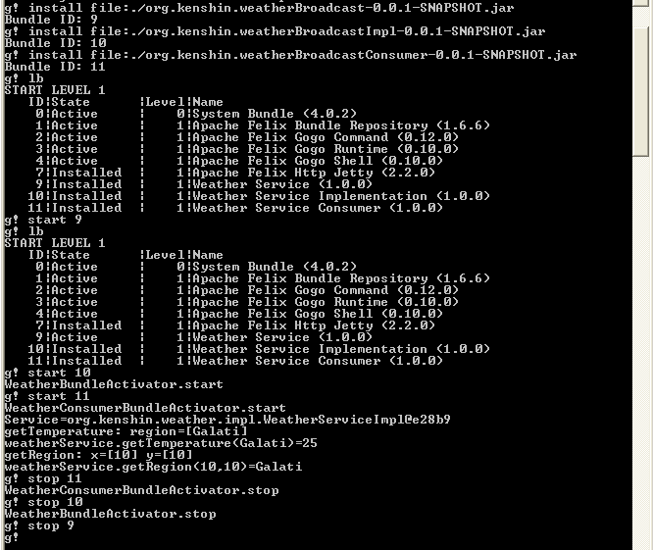
Create and deploy bundles
We install the 3 bundles: interface, implementation and consumer. When the implementation bundle is started the WeatherService implementation is created. When the consumer bundle is started it would invoke the interface methods.

Slide 16
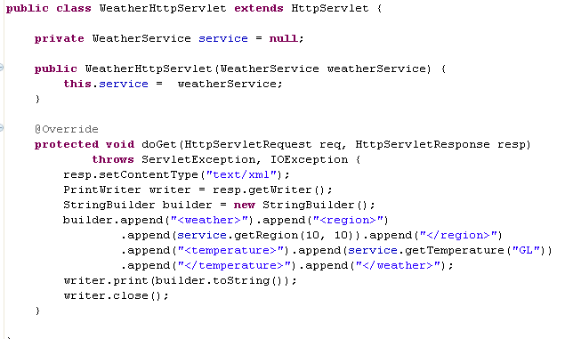
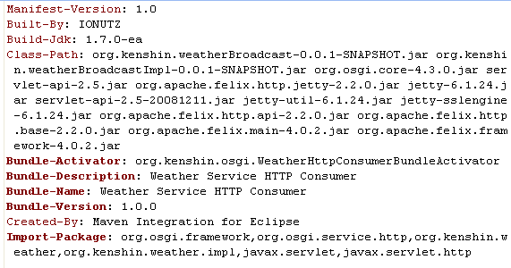

Create and deploy bundles
We build the org.kenshin.weatherBroadcastHttpConsumer-0.0.1-SNAPSHOT.jar bundle that contains the http servlet consumer and the BundleActivator for the module plus extra entries in the META-INF/MANIFEST.MF file. When this bundle is started it would call the WeatherService and HttpService.

Slide 17
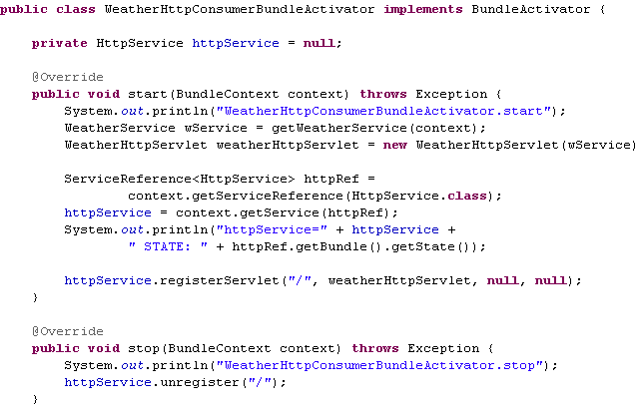
Create and deploy bundles
The Weather Http Consumer bundle obtains a reference for the weather service needed for WeatherHttpServlet. Also this bundle obtains the reference for org.osgi.service.http.HttpService service class that permits to register(deploy) on the “/” context the weather servlet.

Slide 18
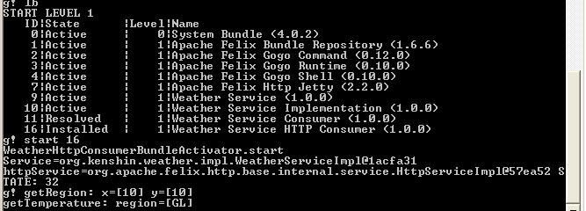
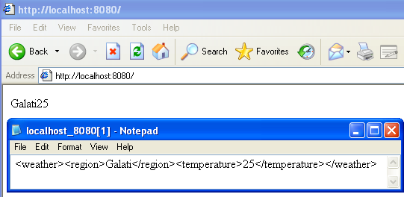
Create and deploy bundles
We started the weather http consumer module and we tested the localhost:8080/ context to check if the weather servlet was correctly registered.

Slide 19
OSGI Metadata
A bundle can carry meta information in the manifest file that is contained in its JAR file under the name of META-INF/MANIFEST.MF. An OSGI Framework implementation must process the main section of the manifest and ignore unrecognized manifest headers.
Bundle-Name → Simply assigns a short name to the bundle.
Bundle-Description → description for what the bundle will do.
Bundle-Version → version number to the bundle
Bundle-Activator → Indicates the class name to be invoked once a bundle is started and stoped.
Export-Package → what Java packages contained in a bundle will be made available to the outside world.
Import-Package → Indicates what Java packages will be required, dependencies needed in a bundle.
Bundle-ClassPath → defines a comma-separated list of JAR file path names or directories
(inside the bundle) containing classes and resources.
Bundle-Copyright → contains the copyright specification for this bundle.
Bundle-License → provides an optional machine readable form of license information.
Bundle-ContactAddress → address information.
Bundle-ManifestVersion →the rules of this specification. It is 1 (the default) for Release 3 Bundles, 2 for Release 4 and later.
Bundle-NativeCode → contains a specification of native code libraries contained in this bundle.
Bundle-Vendor → contains a human-readable description of the bundle vendor.
Bundle-UpdateLocation → specifies a URL where an update for this bundle should come from.
Bundle-DocURL →URL pointing to documentation about this bundle.

Slide 20
OSGI Metadata
Bundle-SymbolicName →helps uniquely identify a bundle. The value of the symbolic name follows rules similar to Java package naming.
Most OSGi manifest attribute values are a list of clauses separated by commas, such as
Property-Name: clause, clause, clause
Each clause is further broken down into a target and a list of name-value pair parameters separated by semicolons. Parameters are divided into two types, called attributes and directives.
Directives alter framework handling of the associated information and are explicitly defined by the OSGi specification.
Attributes are arbitrary name-value pairs.
Different syntax is used to differentiate directives (:=) from attributes (=), which looks something like this:
Property-Name: target1; target2; dir1:=value1; attr1=value2
One important concept in OSGi is a version number, which appears in the bundle-identification metadata.
A version number is composed of three separate numerical component values separated by dots;
Example: 1.0.0 . The first value is referred to as the major number, the second value as the minor number, and the third value as the micro number.
In situations where you wish to limit your assumptions about backward compatibility, OSGi allows to specify an explicit version range using interval notation, where the characters [ and ] indicate inclusive values and the characters ( and ) indicate exclusive values. Example bellow:
Import-Package: org.osgi.framework; version="[1.3.0,2.0.0)"

Slide 21

OSGI Core Classes
The BundleActivator is called when the bundle is started and stopped. The activator class is the bundle's hook to the lifecycle layer for management. When the bundle is installed and started, the framework constructs an instance of this activator class and invokes the start() method. When the bundle is stopped, the framework invokes the stop() method.
The BundleContext is used to grant access to other methods so that this bundle can interact with the Framework.:
Subscribe to events publish by the framework.
Register service objects with the service registry.
Retrieve ServiceReferences from the service registry.
Get and release service objects for a referenced service.
Install new bundles in the framework.
Get the list of bundles installed.
Get the Bundle object for a bundle.

Slide 22
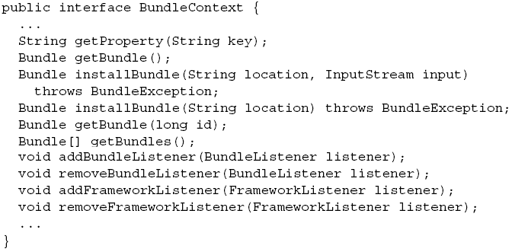
OSGI Core Classes
A BundleContext object will be created for a bundle when the bundle is started. The Bundle object associated with a BundleContext object is called the context bundle.
One important aspect of the bundle context object is its role as the unique execution context of its associated bundle.
Because it represents the execution context, it’s only valid while the associated bundle is active.
Most bundle context methods throw an exception if used when the associated bundle isn’t active.
The framework uses this context for security and resource allocation purposes for each individual bundle.
Two BundleContext objects are equal if they both refer to the same execution context of a bundle.

Slide 23
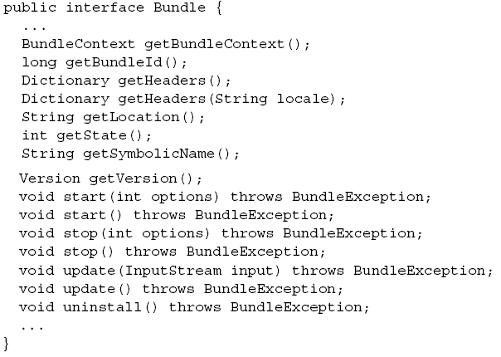
OSGI Core Classes
For each installed bundle, the framework creates a Bundle object to logically represent it. The Bundle interface defines the API to manage an installed bundle’s lifecycle;
A bundle must have a unique identity and can be in one of six states: UNINSTALLED, INSTALLED, RESOLVED, STARTING, STOPPING ,ACTIVE.
From the Bundle object, you can also access two additional forms of bundle identification: the bundle identifier and the bundle location.

Slide 24
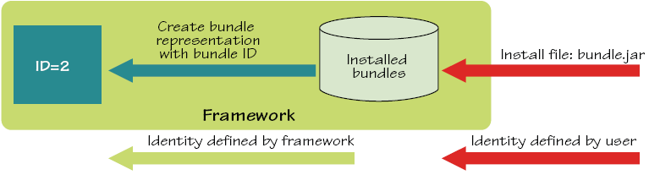
OSGI Core Classes
When installing a bundle we specify a location typically interpreted as a URL to the bundle JAR file or an input stream from which the bundle JAR file is read. The framework reads the bundle JAR file and saves a copy in a private area known as the bundle cache.
Installing a bundle into the framework is a persistent operation. After the bundle is installed, the framework no longer needs the original copy of the bundle JAR file.
At execution time, the framework is represented as a bundle with an identifier of 0, called the system bundle. The system bundle always exists while the framework is running.
Lifecycle operations performed on the system bundle have special meanings when compared to normal bundles. Stopping the system bundle shuts down the framework in a well behaved manner.

Slide 25
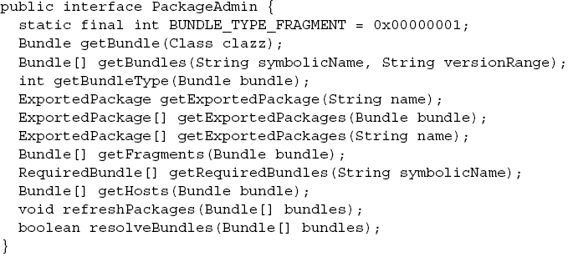
OSGI Core Classes
Constants class contains the standard configuration properties and can be retrieve from the BundleContext object with the getProperty() method.
FrameworkListener/FrameworkEvent --> A FrameworkListener object is registered with the Framework using the BundleContext.addFrameworkListener() method. FrameworkListener objects are called with a FrameworkEvent objects when the Framework starts and when asynchronous errors occur.
BundleListener/BundleEvent --> A BundleListener object is registered with the Framework using the BundleContext.addBundleListener() method. BundleListeners are called with a BundleEvent object when a bundle has been installed, started, stopped, updated, or uninstalled.
ServiceListener/ServiceEvent --> A ServiceListener object is registered with the Framework using the BundleContext.addServiceListener() method. ServiceListener objects are called with a ServiceEvent object when a service has been registered or modified, or is in the process of unregistering.
PackageAdmin → allows bundle programmers to inspect the packages exported in the Framework and eagerly update or uninstall bundles.

Slide 26
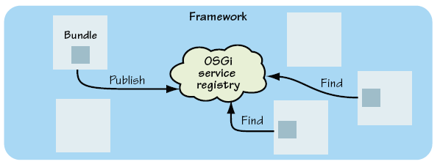
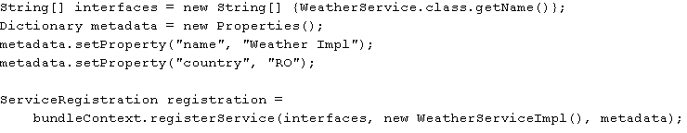
OSGI Services
The OSGi framework has a centralized service registry that follows a publish-find-bind model.
A providing bundle can publish Plain Old Java Objects (POJOs) as services. A consuming bundle can find and then bind to services. We access the OSGi service registry through the BundleContext interface.
Before we can publish a service, we need to describe it so others can find it. We need to take details from the implemented contract and record them in the registry.

Slide 27
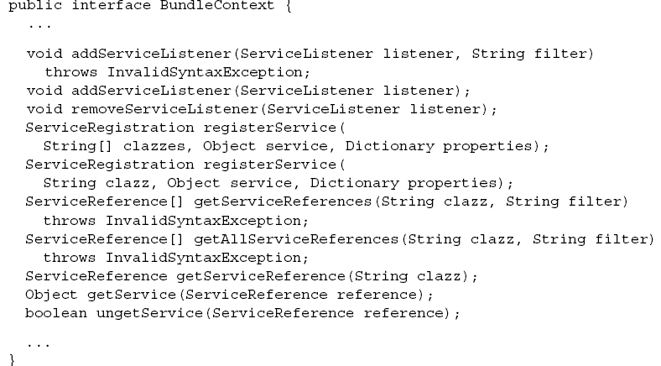
OSGI Services
The registry returns a service registration object for the published service, which you can use to update the service metadata or to remove the service from the registry.
Service registrations are private and they shouldn’t be shared with other bundles, because they’re tied to the lifecycle of the publishing bundle.
We can change the metadata any time using its service registration: registration.setProperties() method.

Slide 28
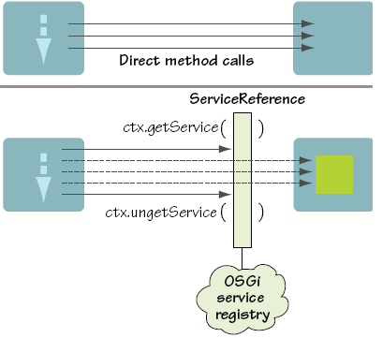
OSGI Services
As with publishing, we can query for service contract to discover the right services in the registry. The simplest query takes a single interface name, which is the main interface you expect to use as a consumer of the service:
ServiceReference reference = bundleContext.getServiceReference(WeatherService.class.getName());
The registry returns a service reference, which is an indirect reference to the discovered service.
This service reference can safely be shared with other bundles, because it isn’t tied to the lifecycle of the discovering bundle.
The registry must decouple the use of a service from its implementation. By using an indirect reference, it can track and control access to the service, support laziness, and tell consumers when the service is removed.

Slide 29
OSGI Services
If multiple services match the given query, the framework chooses what it considers to be the “best” services. The bundle context provides another query method that accepts a standard LDAP filter string, described in RFC 1960,4 and returns all services matching the filter.
Before you can use a service, you must bind to the actual implementation from the registry:
ServiceReference<WeatherService> ref = context.getServiceReference(WeatherService.class);
WeatherService service = context.getService(ref);
Each time you call getService(), the registry increments a usage count so it can keep track of who is using a particular service. We should tell the registry when you’ve finished with a service:
bundleContext.ungetService(ref);
service = null;
There are 3 ways to access OSGi services: directly through the bundle context, reactively with service listeners, and indirectly using a service tracker.

Slide 30
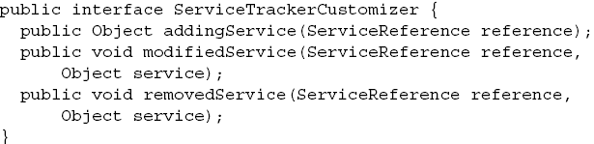
OSGI Services
The OSGi ServiceTracker class provides a safe way for you to get the benefits of service listeners. This object can then be opened to begin tracking all services in the OSGI service registry that match the specified search criteria.
The ServiceTracker object correctly handles all of the details of listening to ServiceEvent objects and getting and ungetting services. The getServiceReferences method can be called to get references to the services being tracked. The getService and getServices methods can be called to get the service objects for the tracked service.
ServiceTracker httpServiceTracker = new ServiceTracker(context,HttpService.class.getName(), null);
HttpService httpService = (HttpService)httpServiceTracker .getService();
The ServiceTracker instance should call the open() method in the BundleActivator.start() method and close() method in the BundleActivator.stop() method.
Every time a service is added, modified or removed from this the tracking count is incremented and can be retrieve with the ServiceTracker.getTrackingCount() method.
The ServiceTrackerCustomizer provides a safe way to enhance a tracker by intercepting tracked service instances:

Slide 31
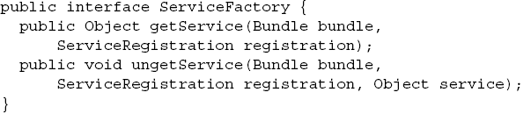
OSGI Services
Like a service listener, a customizer is based on the three major events in the life of a service: adding, modifying, and removing.
The associated tracker calls this whenever a matching service is added to the OSGi service registry.
ServiceTracker httpServiceTracker = new ServiceTracker(context,HttpService.class.getName(), new LogDecorator());
HttpService httpService = (HttpService)httpServiceTracker .getService();
Service tracker customizers are especially useful in separating code from OSGi specific interfaces, because they act as a bridge connecting your application code to the service registry.
The OSGi framework defines a special interface to use when registering a service. The ServiceFactory interface acts as a marker telling the OSGi framework to treat the provided instance not as a service, but as a factory that can create service instances on demand. A factory can potentially create a number of instances at the same time, so it must be thread safe:
The framework caches factory-created service instances, so a bundle requesting the same service twice receives the same instance. This cached instance is removed only when the bundle has completely finished with a service (that is, the number of calls to get it match the calls to unget it), when the bundle has stopped, or when the service factory is unregistered.

Slide 32
OSGI Services
Like a service listener, a customizer is based on the three major events in the life of a service: adding, modifying, and removing.
Services are important feature that they’re used throughout the OSGi specification. Almost all extensions to OSGi have been specified as optional add-on services without requiring any changes to the core specification.
These standard OSGi services are divided into two categories: core and compendium.
Service | Type | Description
Package Admin | Core | Manages bundle updates and discovers who exports what.
Start Level | Core | Queries and controls framework and bundle start levels
Permission Admin | Core | Manages bundle and service permissions
URL Handlers | Core | Handles dynamic URL streams
Event Admin | Compendium | Provides a topic-based publish-subscribe event model
Configuration Admin | Compendium | Manages and persists configuration data
User Admin | Compendium | Performs role-based authentication and authorization
HTTP | Compendium | Puts simple servlets and resources onto the web

Slide 33
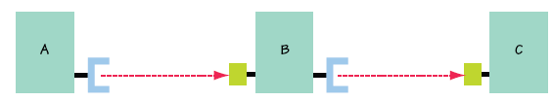
OSGI Internals
The Export-Package and Import-Package metadata declarations included in bundle manifests form the backbone of the OSGi bundle dependency model. One of the most important tasks performed by the OSGi framework is automating dependency management, which is called bundle dependency resolution.
A bundle’s dependencies must be resolved by the framework before the bundle can be used and the dependency resolution algorithm is sophisticated.
Transitive dependencies occur when bundle A depends on packages from bundle B and bundle B in turn depends on packages from bundle C. To use bundle A, you need to resolve the dependencies of both bundle B and bundle C.
If any dependency can’t be satisfied, then the resolve fails, and the instigating bundle can’t be used until its dependencies are satisfied.
At execution time, each OSGi bundle has a class loader associated with it, which is how the bundle gains access to all the classes to which it should have access.
Transitive dependencies occur when bundle A depends on packages from bundle B and bundle B depends on packages from bundle C. To use A, you need to resolve the dependencies from B and C.

Slide 34
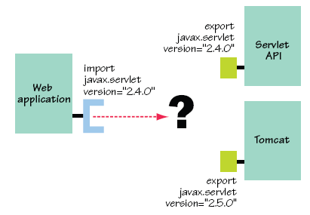
OSGI Internals
What happens when multiple candidates are available to resolve the same dependency? A web application needs to import the javax.servlet package and both a servlet API bundle and a Tomcat bundle provide the package.
When the framework tries to resolve the dependencies of the web application, it determines that the web application requires javax.servlet with a minimum version of 2.4.0 and both the servlet API and Tomcat bundles meet this requirement.
The framework favors the highest matching version, so in this case it selects Tomcat to resolve the web application’s dependency.
If both bundles export the same version the framework chooses between candidates based on the order in which they’re installed in the framework. Bundles installed earlier are given priority over bundles installed later;

Slide 35
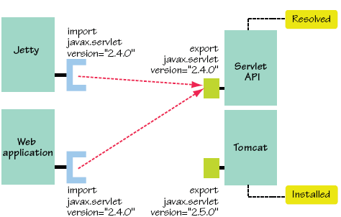
OSGI Internals
The OSGi framework allows bundles to be dynamically installed at any time during execution. The framework doesn’t always start from a clean slate. It’s possible for some bundles to be installed, resolved, and already in use when new bundles are installed. This creates another means to differentiate among exporters: already-resolved exporters and not-yet resolved exporters.
The framework gives priority to already-resolved exporters.
Bundles can only collaborate if they’re using the same version of a shared package.

Slide 36
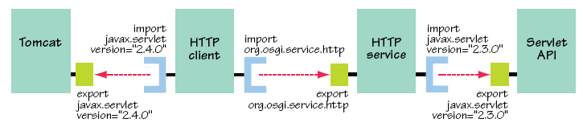
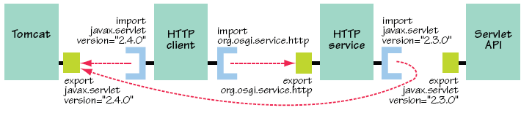
OSGI Internals
A class space from the bundle's perspective is a set of visible packages to it. A bundle’s class space must be consistent, which means only a single instance of a given package must be visible to the bundle.
In the example we define instances of a package as those with the same name, but from different providers. The OSGi framework strives to ensure that the class spaces of all bundles remain consistent.
Because the HTTP service bundle is wired to the Servlet API bundle, its parameter type is version 2.3.0 of javax.servlet.Servlet.
When the HTTP client bundle tries to invoke HTTPService.registerServlet(), it’s wired to the Tomcat bundle and creates a 2.4.0 instance of javax.servlet.Servlet.
The class spaces of the HTTP service and client bundles aren’t consistent; two different versions of javax.servlet are reachable from both.
Problem !!!
OSGI decision →
increment version

Slide 37
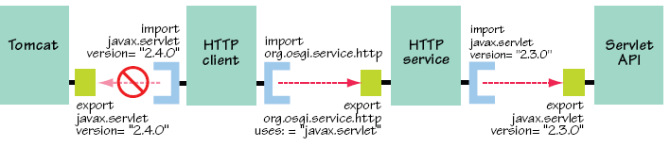
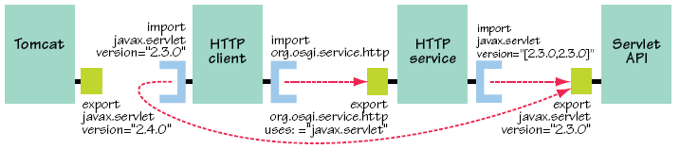
OSGI Internals
Directives are additional metadata to alter how the framework interprets the metadata to which the directives are attached.
Export-Package: org.osgi.service.http;
uses:="javax.servlet"; version="1.0.0"
Import-Package: javax.servlet; version="2.3.0"
This indicates that org.osgi.service.http uses javax.servlet. The framework ensures that importers of org.osgi.service.http also use the same javax.servlet used by the HTTP service implementation.
Uses constraints detect class-space inconsistencies, so the framework can't resolve the HTTP client bundle.
Http Client
dependencies
unresolved
Http Client bundle resolved after changing javax.servlet version

Slide 38
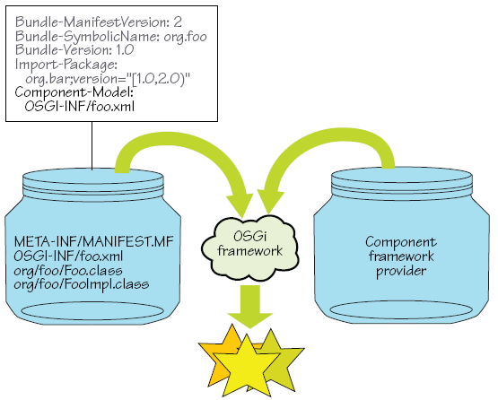
Advanced component frameworks
A component model describes what a component looks like, how it interacts with other components, and what capabilities it has (such as lifecycle or configuration management). A component framework implements the runtime needed to support a component model and execute the components.
Modules and components are packaged as independent deployment units. Modules deal with code packaging and the dependencies among code. Components deal with implementing higher-level functionality and the dependencies among components. The advantage of using component orientation is that we can create easy applications, easy snapping them together and reusing them.
The core OSGi specification defines a component model and the framework for executing the corresponding components. The type of component model defined by OSGi is called a service-oriented component model.
Component frameworks in OSGi are generally implemented as other bundles using the extender pattern.

Slide 39
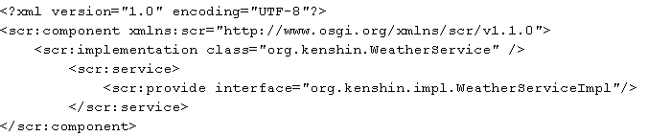
Advanced component frameworks
The Declarative Services specification was defined by the OSGi Alliance as part of the R4 compendium specification. It defines a lightweight approach for managing service dependencies. The focus of the Declarative Services specification is:
Startup time → the initialization time of each bundle adds to the initialization time of the entire application.
Memory footprint → registering services implies the creation of many classes and services. These classes and objects consume memory and resources even if these services are never used.
Complexity → a large amount of code is required to handle complex service-dependency scenarios.
Example of header: Service-Component: OSGI-INF/weather.xml
This header is defined by the Declarative Services specification and has 2 meanings:
- its existence tells the Declarative Services framework that this bundle contains components.
- the referenced XML file contains metadata describing the contained components.
When a bundle is installed into the OSGi framework, the Declarative Services framework follows the extender pattern and probes for this manifest entry. If it exists, the Declarative Services framework takes over management of the contained components according to the information in the referenced file. In Declarative Services, the convention is to place component description files in the bundle’s OSGI-INF/ directory following an OSGI-INF/<component-name>.xml naming convention.

Slide 40
Advanced component frameworks
Declarative Services defines a similar lifecycle for components, where they’re enabled, then satisfied, and then activated. The Declarative Services specification defines the following stages to a component lifecycle:
- Enabled → a boolean flag controls whether the component is eligible for management.
- Satisfied → the component is enabled, its mandatory dependencies are satisfied, any provided services are published in the service registry, but the component itself isn’t yet instantiated.
- Activated → The component is enabled, its mandatory dependencies are satisfied, any provided services are published in the service registry, and the component instance has been created as a result of a request to use its service.
- Modified → The configuration associated with the component has changed, and the component instance should be notified.
- Deactivated →Either the component has been disabled or its mandatory dependencies are no longer satisfied, so its provided services are no longer available and its component instance, if created, is dereferenced for garbage collection.
We can enable/disable a component declaratively using the enabled attribute of the <component> XML element and programmatically using the ComponentContext interface.
When a component is enabled, it may become satisfied. A component can become satisfied only if all of its mandatory dependencies are satisfied. After it’s satisfied, it may become activated if its provided service is requested.
The component lifecycle is coupled to the lifecycle of its containing bundle. Only components in activated bundles are eligible for lifecycle management. If a bundle is stopped, the Declarative Services framework automatically deactivates all activated components contained in it.

Slide 41
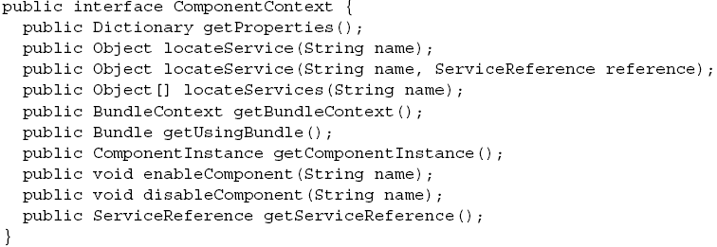
Advanced component frameworks
The names of callback methods (activate() and deactivate()) are defaults. The activation and deactivation methods are optional. For example, the following code snippet redefines the activation and deactivation methods to be start() and stop(), respectively:
<component name="org.kenshin.weather" activate="start" deactivate="stop">
There’s also a callback method for the modified component lifecycle stage. Unlike the activation and deactivation methods, this lifecycle callback has no default method name, so you must define the method name in the <component> element, as follows:
<component name="org.kenshin.weather" modified="modified">
The Declarative Services framework creates a unique ComponentContext object for each component it activates and has a similar role as BundleContext.

Slide 42
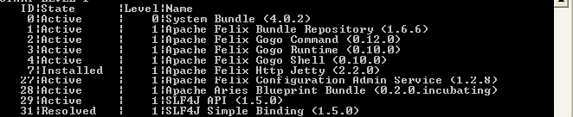
Advanced component frameworks
The OSGi Alliance has defined two "standard" component frameworks: Declarative Services and Blueprint.
Both specifications are interoperable at execution time via services, so either can be used to implement a given service interface without impacting clients.
- Declarative Services focuses on building lightweight components with quick startup times.
- Blueprint focuses on building highly configurable enterprise-oriented applications.
Blueprint component container features:
Provides components with the same basic semantics as Spring beans: Injection, lifecycle callbacks, support for singletons or prototype instances, Construction via reflective construction or static factory methods
Gets one or more services from the OSGi service registry for the component based on the service interface and an optional filter over the service properties.
Allows components to provide OSGi services
Provides components access to the OSGi framework and the Blueprint container, including the bundle context of the component.
The Apache Aries and Eclipse Gemini projects are popular blueprint component frameworks.

Slide 43
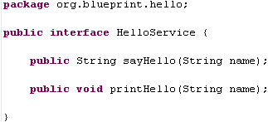

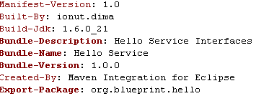
Advanced component frameworks
We build the org.blueprint.helloService-0.0.1-SNAPSHOT.jar bundle that contains the interface plus extra entries in the META-INF/MANIFEST.MF file.

Slide 44
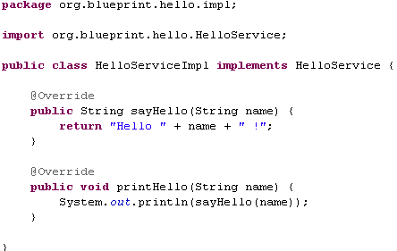

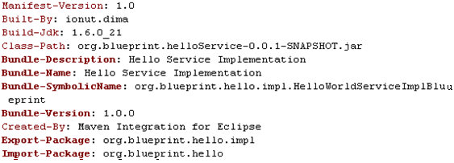
Advanced component frameworks
We build the org.blueprint.helloServiceImpl-0.0.1-SNAPSHOT.jar bundle that contains the interface plus extra entries in the META-INF/MANIFEST.MF file. Also we provide the OSGI-ING/blueprint/config.xml file that exports the service.

Slide 45
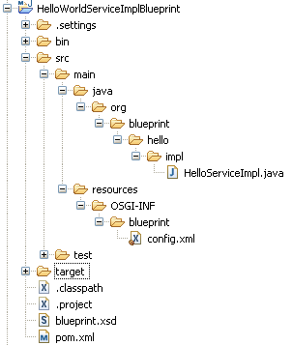
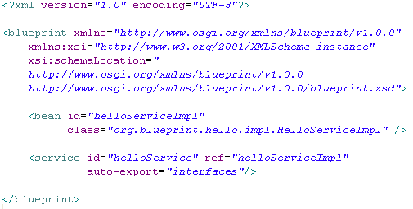
Advanced component frameworks
The OSGI-INF/blueprint/config.xml file creates the service and exports the “helloService”. In the <service> tag it’s indicated to use auto-export=“interfaces”. The default value for this attribute is “disabled” and in this case we need to provide in the META-INF/MANIFEST.MF file a new entry Export-Service with the service interface(full java path)

Slide 46
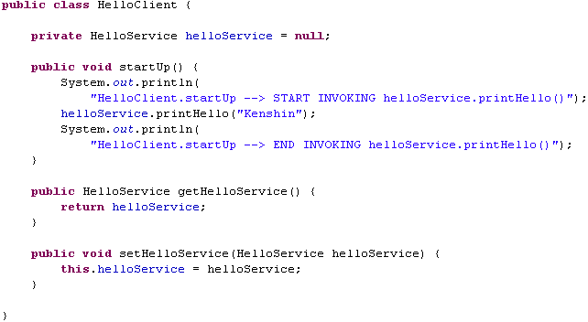


Advanced component frameworks
We build the org.blueprint.helloClient-0.0.1-SNAPSHOT.jar bundle that contains the interface plus extra entries in the META-INF/MANIFEST.MF file. Also we provide the OSGI-ING/blueprint/config.xml that uses the exported “helloService” service.

Slide 47


Advanced component frameworks
The OSGI-INF/blueprint/config.xml file uses the service and injects it into the “helloClient” client.

Slide 48

Advanced component frameworks
When the “Hello Client” component is stated the Blueprint containers reads the OSGI-ING/blueprint/config.xml descriptor file, injects the “helloService” and invokes the HelloClient.startUp() method as defined in the descriptor.

Slide 49
Spring DM
At the center of Spring-DM(Dynamic Modules) is the Spring-DM extender.
The Spring-DM extender’s purpose is to watch for other bundles to be started, and if they are Spring-enabled, it will create a Spring application context for them. Spring-enabled means that the bundle contains one or more Spring context definition files.
By default, the Spring-DM extender looks for Spring context definition files in the META-INF/spring directory; it creates a separate Spring application context for each Spring-enabled bundle.
We can tell Spring-DM where to look for the Spring context definition files using the header Spring-Context in the manifest file(META-INF/MANIFEST.MF).
Examples:
Spring-Context: spring-config/*.xml
Spring-Context: spring-config/some-beans.xml, \
spring-config/some-more-beans.xml
Spring DM Extender comes as a bundle and needs to be installed into a OSGI runtime.
Any bundle deployed into an OSGi environment running Spring-DM will always be inspected for the presence of a Spring-DM trigger point and automatically will be assigned a Spring context of the OsgiBundleXmlApplicationContext class.
In Spring-DM there are two types of extenders, those applicable to bundles using standard Spring artifacts, and those having to do with bundles using Spring web artifacts.
To declare a service in Spring-DM we need to wire a bean in the Spring application context. We configure the beans that Spring creates defining a Spring application context in an XML file. We can easy add any other Spring namespace to support many more Spring artifacts in the same configuration file.

Slide 50




Spring DM
We’ve defined the interface, the implementation and the client that will call the method. The 2 properties “hello” and “name” from the client have the getter and setter defined.

Slide 51



Spring DM
We’ve defined the 2 xml files in the META-INF/spring directory for the current bundle: org.service.helloService-0.0.1-SNAPSHOT.jar.
The first xml creates and binds the service in the OSGI Service Registry.
The seconds xml obtains a reference from the OSGI Service Registry and injects it into the client.

Slide 52


Spring DM
The Spring-DM’s web extender is a bundle that has an activator whose job is to watch for web bundles to
be installed into the OSGi framework and deploy that bundle to either Tomcat or Jetty.
To deploy web bundles we don't need Spring-DM in OSGi.
The HTTP Service doesn’t support filters, listeners, or even JSP. The Spring-DM’s web extender allows to deploy web applications in a bundle that resembles a traditional WAR file, right down to the web.xml file that registers servlets.
In a conventional Java web application, all of the application’s modules end up packaged within a single WAR file.
An OSGi web bundle resembles a WAR file but collaborates with other bundles instead of carrying its own dependencies.
In a conventional Java web application, all of the application’s modules end up packaged within a single WAR file.
An OSGi web bundle resembles a WAR file but collaborates with other bundles instead of carrying its own dependencies.

Slide 53
SpringSource Dm Server/Eclipse Virgo
SpringSource dm Server is an open source, OSGi-based, Java application server. It supports the deployment of OSGi bundles and unmodified Java web applications as OSGi-influenced Shared Libraries WARs and Shared Services WARs. SpringSource dm Server is based on the Equinox OSGi implementation, part of the Eclipse project.
SpringSource dm Server v1.0 was released in 2008 and v2.0 in 2010. SpringSource donated dm Server to Eclipse as the Virgo project later in 2010.
The Platform supports applications packaged in three forms: Java EE WAR, Raw OSGi bundles, Platform Archive (PAR).
The SpringSource dm Server offers native WAR support just like any other Java EE server container and has supports Shared Library WARs. A Shared Library WAR allows the SpringSource dm Server to use its shared bundle repository to fulfill a WAR’s dependencies. Instead of a WAR loading its library dependencies (JARs) from the standard /WEB-INF/ lib directory, libraries are taken from the SpringSource dm Server shared bundle repository. This makes a WAR file not only smaller in size, but also a contributor to reducing overall memory usage, since a WAR uses Shared Library instances.
A PAR is simply a collection of OSGi bundles (modules) grouped together in a standard JAR file, along with a name and a version that uniquely identify the application. The PAR file is deployed as a single unit into the Platform. The Platform will extract all the modules from the PAR and install them. Third-party dependencies will be installed on-the-fly as needed.
PAR format benefits: modularization, robust versioning, improved manageability.
We can create plans (from version 3.0.2.RELEASE) that are similar to a PAR because it encapsulates all the artifacts in a single deployment unit.
The main difference is that the plan is a XML file that lists the artifacts from the application. In contrast the PAR is an actual JAR file that physically encapsulates the artifacts.
A configuration (from version 3.0.2.RELEASE) is simply a Java properties file. When deployed it will be recognized by the deployer and installed in to Configuration Admin for later use by your applications. VTS supports both singleton (ManagedService) and factory (ManagedServiceFactory) configurations.

Slide 54

SpringSource Dm Server/Eclipse Virgo
The core components of the dm Server:
- OSGI R4.2 as the core technology
- Eclipse Equinox as OSGI container(RI)
- Spring framework as application framework
- Spring Dynamic Modules to add Spring support to OSGI bundles
- OSGI web container
Spring framework architecture is divided into modules. Spring's core is a lightweight IoC container that is able to manage the components(beans).
Spring-DM comes with an extender bundle that can automatically discover Spring bases bundles and manage Spring application context for each of these bundles.
An OSGI web container is included with the dm Server to support Java web appliactions. An OSGI web container provides an implementation to run servlets and JSP components with OSGI features.
Spring framework
application components

Slide 55

SpringSource Dm Server/Eclipse Virgo
SpringSource Dm directory structure:
bin → start/stop scripts for Unix and Windows envirnoments.
config → configuration files for Apache Tomcat container, Eclipse’s OSGi Equinox environment, SpringSource dm Server.
docs → users and programmers guide for SpringSource dm Server
lib → contains Java libraries required to bootstrap the SpringSource dm Server.
licenses → various licenses applicable to components used bySpringSource dm Server.
pickup → hot deploy for each unit at startup.
serviceability → Contains diagnostic information generated by the SpringSource dm Server
work → directory containing running application classes and configuration file snapshots.
repository → various bundles and libraries used by the SpringSource dm Server

Slide 56

SpringSource Dm Server/Eclipse Virgo
The dm Server provides a solution by supporting the concept of an application that consists of a set of bundles, the PAR(Platform Archive) format. A PAR file contains multiple bundle JAR and a MANIFEST.MF file.
A PAR scopes OSGi services, making them visible only in the same deployment unit. This eliminates any possibility of name clashes, if more than two applications using the same service name, but different logic, are deployed on the platform.
To start the dm Server we run the startup script located in the bin subdirectory(statup.bat for Windows).
Default admin console credentials are: admin/springsource.

Slide 57



SpringSource Dm Server/Eclipse Virgo
Admin console provides some basic configuration: deploy, list bundles, list services, OSGI bundles states, OSGI bundle headers inspector.

Slide 58

SpringSource Dm Server/Eclipse Virgo
The Virgo project is intended to provide a runtime platform for the development of server-side enterprise applications built on top of Equinox, and optionally using modules from the Gemini project(Blueprint Service projects). Virgo will be a subproject of the Eclipse Runtime Project. Virgo is licensed under the Eclipse Public License. Both SAP and Tasktop have expressed interest in participating in the Virgo project.

Slide 59

SpringSource Dm Server/Eclipse Virgo
The Virgo Tomcat Server introduces a number of features to solve common issues:
- full set of OSGi bundles for many popular Java libraries
- OSGi library concept that obviates the need to duplicate verbose Import-Package statements
- the concept of a plan, which is an XML file that lists a collection of bundles that Virgo Tomcat Server should load together as a single application

Slide 60
SpringSource Dm Server/Eclipse Virgo
We’ve defined the interface, the implementation and the client that will call the method. The 2 properties “hello” and “name” from the client have the getter and setter defined.

Slide 61
SpringSource Dm Server/Eclipse Virgo
We’ve defined the interface, the implementation and the client that will call the method. The 2 properties “hello” and “name” from the client have the getter and setter defined.

Slide 62
SpringSource Dm Server/Eclipse Virgo
We’ve defined the interface, the implementation and the client that will call the method. The 2 properties “hello” and “name” from the client have the getter and setter defined.

Slide 63

Benefits of using OSGI
Reduced Complexity - The modules(bundles) hide their internals from other bundles and communicate through well defined services.
Reuse - The OSGi component model makes it very easy to use many third party components in an application.
Dynamic - The OSGi framework can update bundles on the fly and services.
Easy Deployment - The OSGi technology is not just a standard for component, but also specifies how components are installed and managed. The standardized management API makes it very easy to integrate OSGi technology in existing and future systems.
Dynamic Updates - Bundles can be installed, started, stopped, updated, and uninstalled without bringing down the whole system(reduces deployment times).
Adaptive - The OSGi component model is designed from the ground up to allow the mixing and matching of components. The OSGi service registry is a dynamic registry where bundles can register, get, and listen to services.
Transparency - Bundles and services are main components in the OSGi environment. The management API provides access to the internal state of a bundle as well as how it is connected to other bundles.
Versioning - OSGi technology solves JAR hell. JAR hell is the problem that library A works with library B;version=2, but library C can only work with B;version=3. In the OSGi environment, all bundles are carefully versioned and only bundles that can collaborate are wired together in the same class space.

Slide 64
Benefits of using OSGI
Simple - The core API is only one package and less than 30 classes/interfaces and is sufficient to write bundles, install them, start, stop, update, and uninstall them and includes all listener and security classes.
Small - The OSGi Release 4 Framework can be implemented in about a 300KB JAR file. OSGi therefore runs on a large range of devices: from very small, to small, to mainframes. It only asks for a minimal Java VM to run and adds very little on top of it.
Fast - One of the primary responsibilities of the OSGi framework is loading the classes from bundles. OSGi pre-wires bundles and knows for each bundle exactly which bundle provides the class.
Lazy - The OSGi technology has many mechanisms in place to do things only when they are really needed. For examples, bundles can be started eagerly, but they can also be configured to only start when another bundle is using them.
Widely Used - The OSGi specifications started out in the embedded home automation market but since 1998 they have been extensively used in many industries: automotive, mobile telephony, industrial automation, gateways & routers, private branch exchanges, fixed line telephony, and many more. Since 2003, the highly popular Eclipse Integrated Development Environment runs on OSGi technology and provides extensive support for bundle development. Today, we can find OSGi technology at the foundation of IBM Websphere, SpringSource Application Server, Oracle (formerly BEA) Weblogic, Sun's GlassFish, and Redhat's JBoss.

Slide 65
Conclusions
OSGi reduces complexity by providing a modular architecture for today's large-scale distributed systems as well as small, embedded applications. The OSGi modular and dynamic model reduces operational costs and integrates multiple devices in a networked environment.
The OSGi component system is used to build highly complex applications like IDEs (Eclipse), application servers (GlassFish, IBM Websphere, Oracle/BEA Weblogic, Jonas, JBoss), application frameworks (Spring, Guice), industrial automation, residential gateways, phones, and so much more.
OSGI provides an extensive security model so that components can run in a shielded environment. With the proper permissions, components can reuse and cooperate, unlike other Java application environments.

Slide 66
Bibliography
http://en.wikipedia.org/wiki/OSGi
http://www.osgi.org
Manning – OSGi in Depth
Manning – OSGi in Action
Manning – Spring Dynamic Modules in Action
Apress - Pro Spring Dynamic Modules for OSGI Service Platforms
Pragmatic Bookshelf - Modular Java Creating Flexible Applications with OSGi and Spring
Packtpub - OSGi and Apache Felix 3 0 Beginners Guide
OSGi Service Platform Core Specification Release 4, Version 4.3 April 2011
Spring Dynamic Modules Reference Guide 2.0.0.M1
http://forum.springsource.org/showthread.php?82969-Eclipse-Virgo-project-proposal
http://blog.springsource.com/2010/01/12/dm-server-project-moves-to-eclipse-org/
Apress – Pro SpringSource dm Server
Eclipse Virgo 3.0 Programmer Guide

Slide 67
Questions?

