Slide 1

PowerMock
Dima Ionut Daniel

Slide 2
Contents
What is PowerMock?
Core
Conclusions
Bibliography

Slide 3

What is PowerMock?
PowerMock consists of two extension API's: EasyMock and Mockito.
PowerMock supports JUnit and TestNG.
PowerMock enables to write good unit tests for even the most untestable code.
PowerMock can mock static methods and final classes.

Slide 4
Core
PowerMock uses a custom classloader and bytecode manipulation to enable mocking of static methods, constructors, final classes and methods, private methods, removal of static initializers and more.
PowerMock aims to extend the existing API's with a small number of methods and annotations to enable the extra features.
Currently PowerMock supports EasyMock and Mockito.

Slide 5
Core (cont.)
The @RunWith(PowerMockRunner.class) annotation is used at the class-level of the test case.
The @PrepareForTest annotation is used to inform PowerMock about the classes to be prepared for the test.
The @SuppressStaticInitializationFor("org.mycompany.ClassWithEvilStaticInitializer") annotation can remove the static initializer for the the org.mycompany.ClassWithEvilStaticInitializer class.

Slide 6
Core (cont.)
Use Whitebox.setInternalState(..) to set a private member of an instance or class.
Use Whitebox.getInternalState(..) to get a private member of an instance or class.
Use Whitebox.invokeMethod(..) to invoke a private method of an instance or class.
Use Whitebox.invokeConstructor(..) to create an instance of a class with a private constructor.

Slide 7
Core (cont.)
How to mock and stub:
1) Add @PrepareForTest at class level
@PrepareForTest(Static.class) // Static.class contains static methods
2) Call PowerMockito.mockStatic() to mock a static class (use PowerMockito.spy(class) to mock a specific method):
PowerMockito.mockStatic(Static.class);
3)Use Mockito.when() to setup your expectation:
Mockito.when(Static.firstStaticMethod(param)).thenReturn(value);

Slide 8
Core (cont.)
Mockito.startsWith() method can be used for mathing correct arguments to the method calls when the method is invoked.
Built-in argument matchers:
Mockito.eq: verifies that the argument is exactly equal to the passed value.
Mockito.matches: matches using a regular expression.
Mockito.any: maches based on the type of the argument.
Mockito.isNull: maches the null argument value for a certain class.
Mockito.isNotNull: matchs the non null argument value for certain class.
Mockito.endsWith: similar to startWith, but checks the end with the given value.

Slide 9
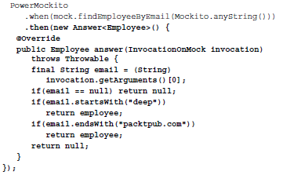
Core (cont.)
It might be hard to create the mocks by using the PowerMockito.when().thenReturn() syntax.
Instead the generic Answer interface could be very handy.

Slide 10
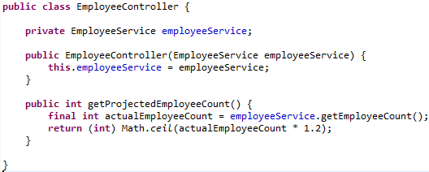
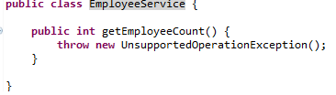
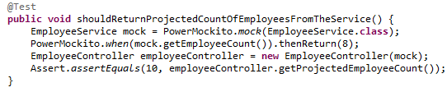
Core (cont.)
PowerMockito class is used to mock clases and instructc them what to do when methods calls are made.

Slide 11
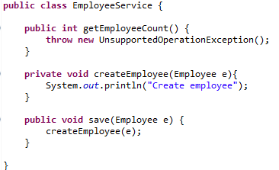
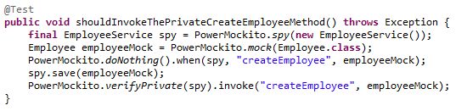
Core (cont.)
PowerMockito class can mock private methods and verify that they are called.

Slide 12
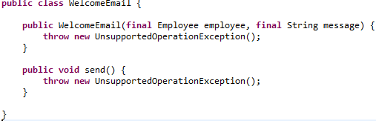
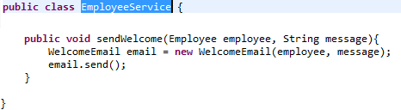
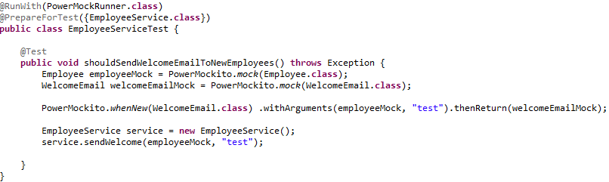
Core (cont.)
PowerMockito can mock constructors.

Slide 13
Conclusions
PowerMock is an open source framework that extends EasyMock with more powerful capabilities.
Developers familiar with EasyMock will find PowerMock easy to use.

Slide 14

Bibliography
https://code.google.com/p/powermock/wiki
Packt Publishing - Instant Mock Testing with PowerMock

