Slide 1

SIP
Dima Ionut Daniel

Slide 2
Contents
What is SIP?
History
Type of Services
Architecture
SIP Entities
SIP Services
SIP Protocol
SIP Message
Session Description
Standard APIs
JAIN SIP
JAIN SDP
RTP
Conclussion
Bibliography

Slide 3

What is SIP?
The Session Initiation Protocol (SIP) is a signaling communications protocol, used for controlling multimedia communication sessions such as voice and video calls over Internet Protocol (IP) networks.
SIP has been developed and standardized in RFC 3261 under the auspices of the Internet Engineering Task Force (IETF).
SIP can be used for two-party (unicast) or multiparty (multicast) sessions.
The protocol defines the messages that are sent between endpoints, which govern establishment, termination and other essential elements of a call.

Slide 4
History
SIP was originally designed by Henning Schulzrinne and Mark Handley in 1996.
The protocol was standardized as RFC 2543 in 1999.
In November 2000, SIP was accepted as a 3GPP signaling protocol and permanent element of the IP Multimedia Subsystem (IMS) architecture for IP-based streaming multimedia services in cellular systems.
As of 2013, the latest version of the specification is RFC 3261, published in June 2002.

Slide 5
Type of Services
Basic Session Management Services
voice/video communications
instant messaging
text over IP
peer-to-peer gaming
file transfer
Enhanced Control Services
identification of a originator
call-forwarding, call-blocking, call-hold services
Media Services
voice mail
music on hold, ringback tones
Conferencing Services
multipart call
dial-in, dial-out conferences

Slide 6
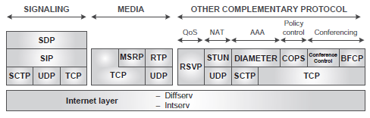
Architecture
Multimedia communication is enabled in the Internet by IP-based application-level protocols.
There are 2 types of protocols form the core of multimedia communication systems:
The signaling protocols
The media transport protocols

Slide 7
Architecture (cont.)
Signaling:
The core signaling protocol for multimedia communication is the Session Initiation Protocol.
SIP works in with the Session Description Protocol.
SIP deals with the session-management issues;.
SDP is responsible for session description.
The SDP messages are transported in the body of SIP messages.
SDP offers a generic mechanism to describe multimedia sessions.

Slide 8
Architecture (cont.)
The core protocols used for media transport are:
Real-time Transport Protocol (RTP).
Message Session Relay Protocol (MSRP) .
Transmission Control Protocol (TCP) .
RTP is typically used to carry pure real-time media, such as voice or video.

Slide 9
SIP Entities
SIP basically solves two key aspects in IP multimedia communications:
Session setup, modification, and termination
Location of users
The SIP specifications define a number of SIP elements as part of the SIP architecture:
User Agents (UAs)
Registrars
Proxies
Back-to-Back User Agents (B2BUAs)

Slide 10
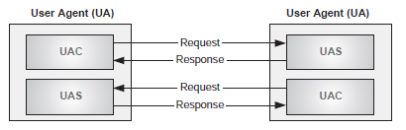
SIP Entities (cont.)
User Agents are typically located at the SIP endpoints.
A SIP UA has two components:
User Agent Client (UAC) → responsible for the generation of new SIP requests and the reception of the associated responses.
User Agent Server (UAS) → responsible for receiving SIP requests and generating the appropriate responses

Slide 11
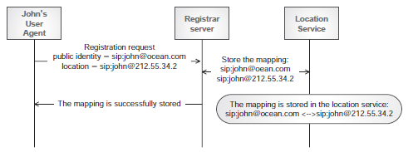
SIP Entities (cont.)
A registrar is a server that accepts registration requests from the User Agents.
The registration is the process by which a SIP UA communicates its current location along with its externally visible identifier to the registrar server.
A SIP UA needs to be registered before it can receive multimedia calls.
The Location Service is not a SIP entity.
A Location Service is a database that contains a list of mappings between Addresses of Record (AORs), which represent public SIP identities, and Contact Addresses (which represent the user location) for a specific domain.
AORs and Contact Addresses are expressed as SIP URIs.

Slide 12
SIP Entities (cont.)
Proxies are also useful for enforcing policy (for example, making sure a user is allowed to make a call).
A proxy server is an intermediary entity and are performing SIP routing
outbound → helps the UAs to route outgoing requests.
inbound → handles incoming requests for an administrative domain.

Slide 13
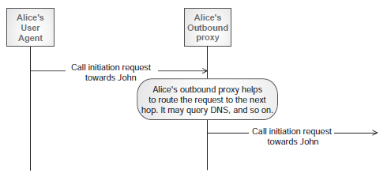
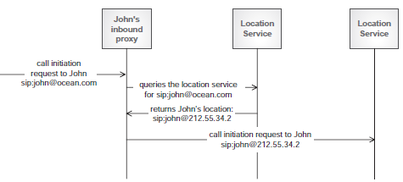
SIP Entities (cont.)
An outbound proxy helps the UAs to route outgoing requests. .
An inbound proxy is a proxy server that handles incoming requests for an administrative domain.

Slide 14
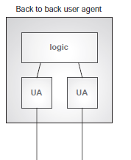
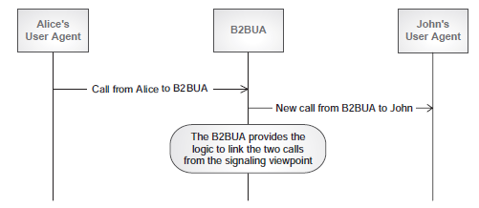
SIP Entities (cont.)
A B2BUA is a logical entity that acts as a User Agent to both ends of a SIP call.
They are responsible for handling all SIP signaling between both ends of the call, from call establishment to termination.
They remain in the call path for the complete duration of the call.

Slide 15
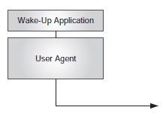
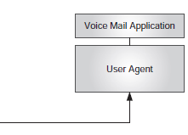
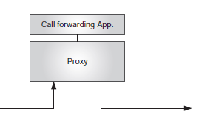
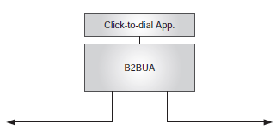
SIP Services
A SIP service is an application on top of a SIP entity that delivers an enhanced functionality.
Depending on the requested functionality, SIP services may sit on top of a User Agent (UA), a proxy, or a Back-to-Back User Agent (B2BUA).
A Click-to-Dial (CTD) service, where a user who is browsing on a web site that sells “something ” can click on a “customer care” link and have the server automatically establish a call between that user and the customer-care center.

Slide 16
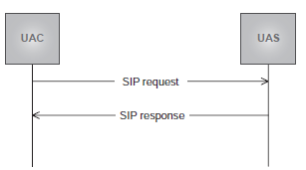
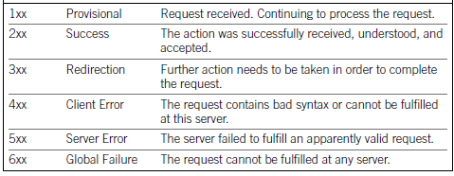
SIP Protocol
SIP operation is based on the exchange of SIP messages.
A SIP request, together with all the responses associated with it, is called a transaction.
SIP defines response codes that are set to responses.

Slide 17
SIP Protocol (cont.)
RFC 3261 defines 6 types of SIP requests, so-called methods:
REGISTER
INVITE
ACK
CANCEL
BYE
OPTIONS
SIP extensions documented in other RFCs may define additional methods.

Slide 18
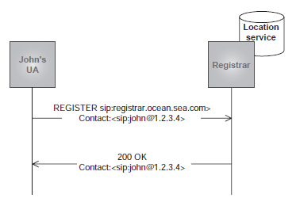
SIP Protocol (cont.)
REGISTER:
This method is used by a User Agent in order to perform the registration procedure.
It allows the UA to associate its public identity, the so-called Address of Record (AOR), to its current location, called Contact Address, from which the IP address can be easily obtained.

Slide 19
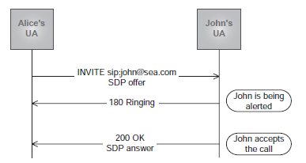
SIP Protocol (cont.)
INVITE:
A UAC generates an INVITE method in order to initiate a session with a UAS.
The request will contain the public identity, as a SIP URI, of the user to which the request is addressed in a field called Request-URI.
The request can go directly from UAC to UAS, or may traverse one or more proxies, which can then assist in the routing of the request.

Slide 20
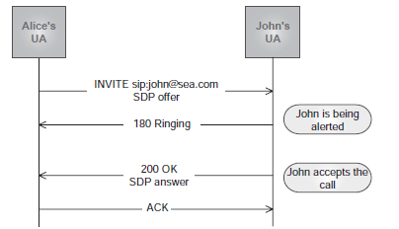
SIP Protocol (cont.)
ACK
The INVITE transaction is the only transaction in SIP that uses a three-way handshake, as opposed to a two-way handshake used by the rest.

Slide 21
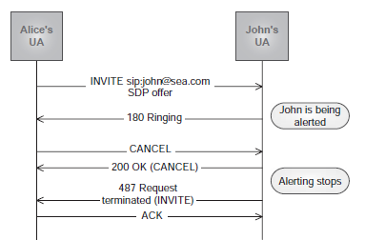
SIP Protocol (cont.)
CANCEL
A UAC generates a CANCEL request in order to cancel a pending request. The
CANCEL request is part of a different transaction, but it refers to the original transaction.
The reception of a CANCEL request causes the UAs to stop processing the pending transaction.
When a CANCEL request is received for a transaction that is already completed, it has no effect.

Slide 22
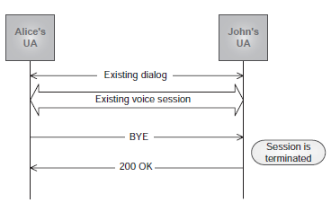
SIP Protocol (cont.)
BYE
The BYE request is used to terminate a session.
When a UAS receives a BYE request for an existing dialog, the UAS must terminate the session associated with that dialog.

Slide 23
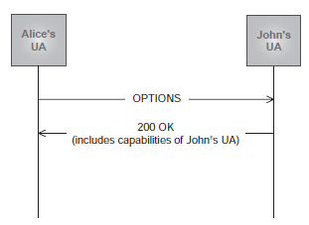
SIP Protocol (cont.)
OPTIONS
The OPTIONS request allows a UA to query a server about its capabilities.
These capabilities include information about the supported methods, content types, extensions, codecs, and so on.

Slide 24
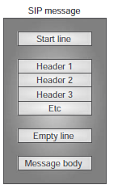
SIP Message
SIP is a text-based protocol.
SIP messages are divided into lines of characters.
A line is a series of characters that is delimited with the two characters Carriage Return and Line Feed (CRLF).
There are two types of SIP messages:
requests
responses.

Slide 25
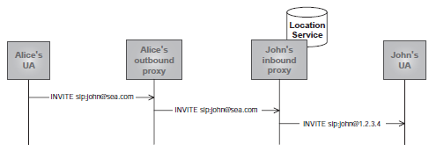
SIP Message (cont.)
In SIP requests, the start line is called a request line, and contains a method name, a Request-URI, and the protocol version, all them separated by a single space character.
Method <SP> Request-URI <SP> Protocol-version
In SIP responses, the start line is called a status line, and consists of the protocol version followed by a numeric status code and its associated reason phrase
Protocol-version <SP> Status-Code <SP> Reason-phrase

Slide 26

SIP Message (cont.)
SIP Header Fields are after the start line in requests and responses.
They provide information about the request or response and about the body it contains.
Each header field consists of a field name followed by a colon (:) and the field value

Slide 27
SIP Message (cont.)
The From header field indicates the logical identity of the initiator of the request.
The To header field specifies the logical recipient of the request.
These logical identities are typically expressed as a SIP URI.
The Call-ID header field acts as a unique identifier to group together a series of messages.
It is generated by the UA as a combination of a random string and the UA ’ s host name or IP address.
The combination of the To tag, From tag, and Call-ID completely identifies a dialog.
The Call-ID must be the same for all requests and responses sent within a dialog.
The Via header field indicates the path taken by the request so far, and so expresses the path that should be followed in routing the responses.

Slide 28
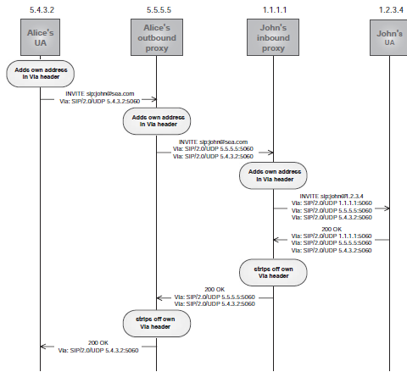
SIP Message (cont.)

Slide 29
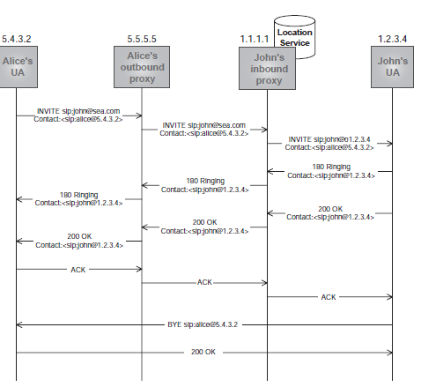
SIP Message (cont.)
The Contact header field is generated by a UA, and provides a SIP URI that can be used to contact that specific instance of the UA for subsequent requests.

Slide 30
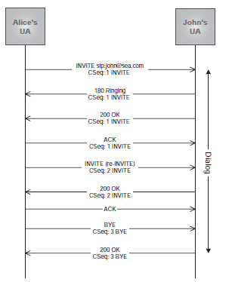
SIP Message (cont.)
The Command Sequence (CSeq) header field consists of a sequence number and a method(Example: CSeq: 5 INVITE).
The sequence number is used to order end-to-end requests within the same dialog.
A UA generating requests within a dialog must increment by 1 the value of the sequence number in all subsequent end-to-end requests it sends.
The ACK and CANCEL requests do not cause the sequence number to be incremented.

Slide 31
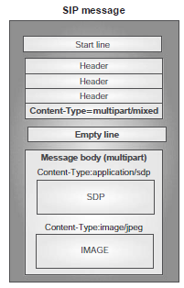
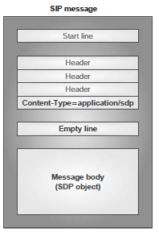
SIP Message (cont.)
SIP requests and responses may contain message bodies of different Internet media types.
The message body in a SIP message is an SDP session description, but it may consist of any object, such as a photo or image.
In order to qualify the message body, a number of SIP headers are defined:
Content-Type
Content-Length
Content-Encoding
Content-Disposition

Slide 32
Session Description
SDP was originally conceived to describe multicast sessions on the MBone.
SDP is used in many scenarios, including streaming, IP communications, and others.
SDP is specified in RFC 4566 and is rather a language for representing the key parameters that characterize a multimedia session.
SDP is text based and an SDP message consists of a set of lines of text of the form: <type> = <value>.

Slide 33
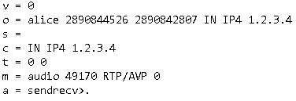
Session Description (cont.)
An SDP message contains 3 levels of information:
Session-level description : contains lines that describe characteristics of the whole session.
Time description: contains lines indicating time-related aspects of the session.
Media description: contains lines that characterize the different media present in the session.

Slide 34
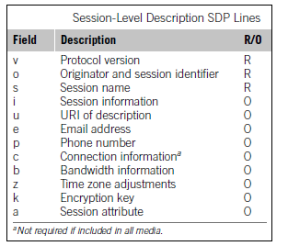
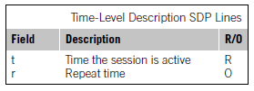
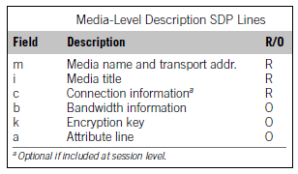
Session Description (cont.)
Tables bellow are from RFC 4566 , show the different types of lines for each level, indicating whether the field is required (R) or optional (O).

Slide 35
Standard APIs
SIP Standard APIs:
JAIN SIP
JAIN SDP
SIP Servlets
SIMPLE Instant Messaging
SIP API for J2ME
JAIN SLEE
IMS API
OSA/PARLAY
PARLAY X

Slide 36
Standard APIs (cont.)
JAIN SIP
JAIN (Java APIs for Integrated Networks) SIP is a Java standard for a low-level SIP interface.
Its programming constructs represent low-level concepts such as messages, headers, parameters, ports, and IP addresses.
JAIN SIP, being so low level, gives access to the full power in the SIP protocol and enables the creation of SIP applications of any type.
JAIN SIP is specifi ed in [JSR 032] under the Java Community Process (JCP).1
JAIN SDP
SIP programming almost always implies manipulation of SDP (Session Description Protocol) content.
JAIN SDP corresponds to [JSR 141].

Slide 37
Standard APIs (cont.)
SIP Servlets
The SIP servlets API represents an interface to a Java container for SIP applications, including the functional interface.
The functional interface is a higher level than the one offered by JAIN SIP.
The SIP servlets API is one of the most popular for creating server-side pure SIP applications.
The SIP servlets API is specified in [JSR 116]. Version 1.1 is under [JSR 289].
SIP API for J2ME
[JSR 180] defines a multipurpose SIP API for the Java 2 Platform, Micro Edition.
It enables SIP applications to be executed in memory-limited terminals, specially targeted to mobile phones.
JAIN SLEE
JAIN SLEE is another Java standard ([JSR 22] and [JSR 240]) that defines just the interface to a container for carrier-grade telecommunication applications.

Slide 38
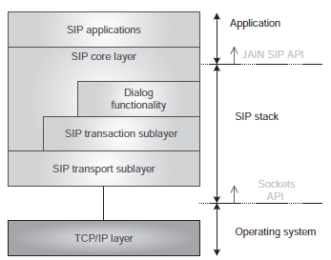
JAIN SIP
JAIN SIP is a Java API specification for the Session Initiation Protocol.
It is developed for the J2SE environment, and provides application developers with a standardized interface for SIP services that are functionally compatible with the RFC 3261 specification.
JAIN SIP API mainly provides the application developer with an interface to:
Build and parse SIP messages.
Use the transaction sublayer (i.e., send/receive messages statefully).
Use the transport sublayer (i.e., send/receive messages statelessly).

Slide 39
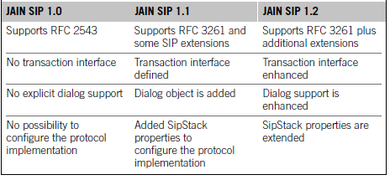
JAIN SIP (cont.)
There have been three versions of the JAIN SIP API.
The first one (1.0) was based on SIP spec RFC 2543.
The second one (1.1) was based on SIP spec RFC 3261.
The latest JAIN SIP version is 1.2 incorporates some enhancements to the 1.1.

Slide 40
JAIN SIP (cont.)
The JAIN SIP architecture is based on a number of patterns:
Peer-provider pattern
Factory pattern
Event-listener pattern
The Peer-Provider Pattern:
In the case of JAIN SIP, the provider allows applications to send and receive SIP messages.
It is represented by a Java interface called SipProvider.
The SipStack interface allows programmers to manage and configure the underlying SIP stack.
A ListeningPoint is a Java representation of the socket that a SipProvider messaging entity uses to send and receive messages.

Slide 41
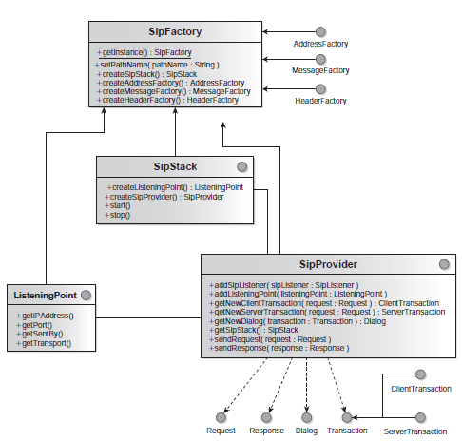
JAIN SIP (cont.)

Slide 42
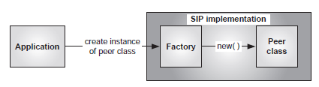
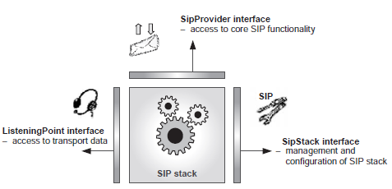
JAIN SIP (cont.)
The Factory Pattern:
A factory is an intermediary that encapsulates the method for accessing the SIP peer, and allows the application to obtain instances of the peer implementation classes.
The factory class in JAIN SIP is called SipFactory and it’s singleton.

Slide 43
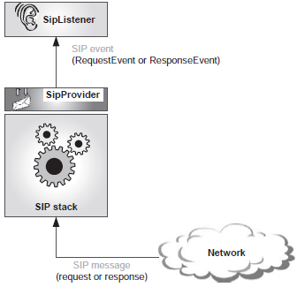
JAIN SIP (cont.)
The Event-Listener Pattern:
This pattern represents occurrences of interest as events.
Each occurrence is represented by a Java object.
When the SIP stack receives SIP messages (requests and responses) from the network, the SipProvider passes them as events on to the event listener, which is called SipListener in the JAIN SIP case.

Slide 44
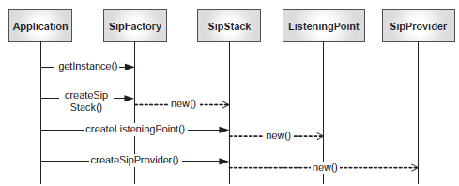
JAIN SIP (cont.)
The application developer is responsible for implementing the methods in the SipListener interface.
These methods contain the code that processes the events fired by the SipProvider.
Using the SipProvider we can send messages for transmission into the network.

Slide 45
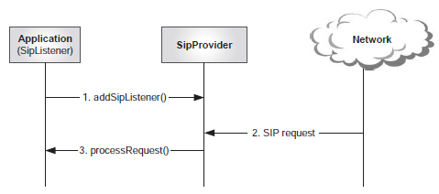
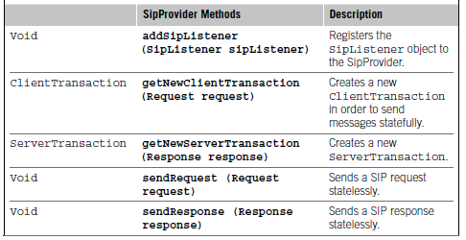
JAIN SIP (cont.)
A SipListener has to register with the SipProvider for the reception of SIP events.

Slide 46
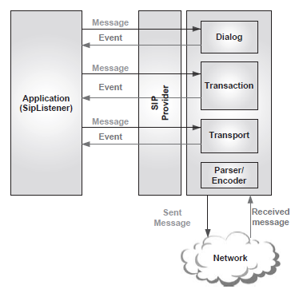
JAIN SIP (cont.)
In JAIN SIP terminology, SIP messages that are sent by the application are simply called messages, whereas SIP messages received by the application are referred to as events.

Slide 47
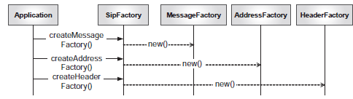
JAIN SIP (cont.)
In addition to SipFactory, the JAIN SIP API also defines three other factories: MessageFactory, HeaderFactory and AddressFactory .
The application can invoke methods on these factories in order to create Java objects that implement useful functionality for the manipulation of SIP messages, headers, and addresses.

Slide 48
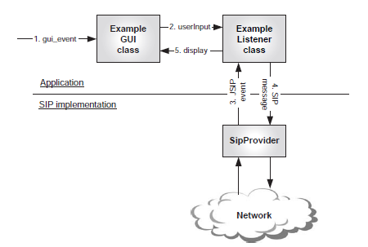
JAIN SIP (cont.)
If we create a GUI application that is able to send/receive SIP messages we need to create separate layers.

Slide 49
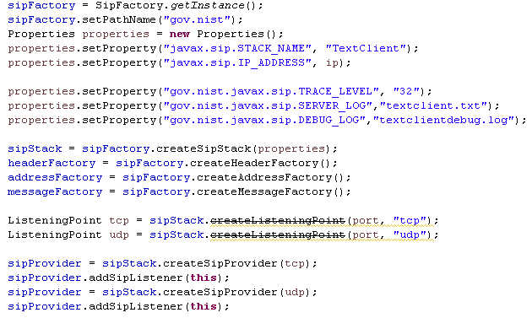
JAIN SIP (cont.)
Bellow we obtain the SipFactory instance and we create the SIP Stack implementations after setting SIP Stack properties.
Using the SipStack we can create the UDP/TCP ListeningPoint and the SipProvider implementation.
We add the SipListener implementation to the SipProvider implementation(for catching SIP in/out messages).

Slide 50
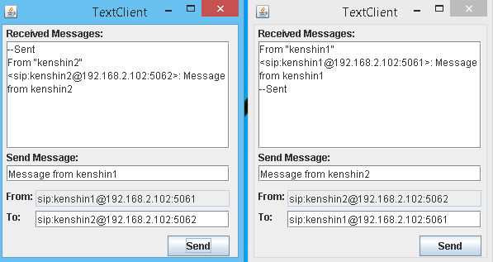
JAIN SIP (cont.)
First we are sending SIP message from client1 and then from client2.
The client 1 is using internally the port 5061 and protocol UDP.
The client 2 is using internally the port 5061 and protocol UDP.

Slide 51
JAIN SDP
JAIN SDP is a very simple API that just allows us to encode and decode SDP content.
Like the JAIN SIP API, it is also based on the factory pattern.
It defines a factory class called SdpFactory , and a number of interfaces that represent the key concepts in SDP.

Slide 52

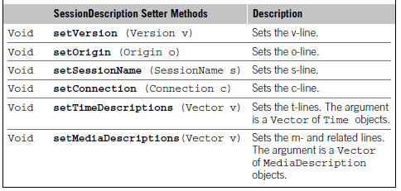
JAIN SDP (cont.)
To encode an SDP message, the following steps need to be followed:
1 . Obtain an instance of the singleton SdpFactory class:
2 . Create an empty SessionDescription object:
3 . Create the lines I will want to include in the SDP message (e.g., a “ v=0 ”line):
4 . Add those lines to the SessionDescription by invoking the appropriate “ setter ” method:

Slide 53
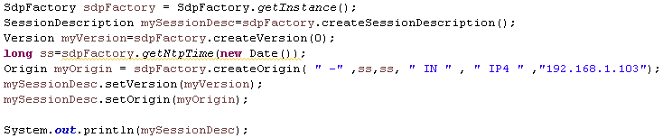

JAIN SDP (cont.)
The library used for encoding SDP message was nist-sdp-1.0.jar.

Slide 54
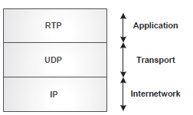
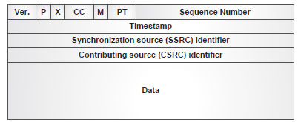
RTP
Real-time Transport Protocol (RTP) is an Internet standard (STD 64,RFC 3550) for the transport of strict real-time data such as voice or video.
RTP defines the concept of RTP session.
An RTP session is identified by a transport address, and includes just one type of media.
RTP typically runs on top of UDP.
RTP was originally conceived to be used in the remit of multicast conferences in the Internet.

Slide 55
Conclussion
Pros:
SIP works independently of the type of session, or the media used, giving it flexibility.
It's an open standard, allowing multivendor support and integration.
SIP can accommodate multiple users with differing capabilities.
Cons:
Processing text messages puts a higher load on gateways.
SIP features are still being developed, and many vendors have proprietary implementations of the protocol.

Slide 56

Bibliography
http://en.wikipedia.org/wiki/Session_Initiation_Protocol
Internet Multimedia Communications Using SIP

Slide 57
Questions ?

