Slide 1

Selenium
Dima Ionut Daniel

Slide 2
Contents
What is Selenium?
History
Components
Architecture
Features
Core
Selenium Grid
Conclusions
Bibliography

Slide 3

What is Selenium?
Selenium is a portable software testing framework for web applications.
Selenium provides a record/playback tool for authoring tests.
Tests can then be run against most modern web browsers.
Selenium it's open source, under Apache 2.0 license.

Slide 4
History
Selenium was developed by Jason Huggin in 2004 as internal tool at ThoughWorks.
The product was upgraded and changed it's name to Selenium Remote Control(RC).
In 2007, Huggins joined Google and with others continue development of Selenium RC.
In 2008 Selenium Grid was created; this provides a hub allowing the running of multiple Selenium tests concurrently on any number or local/remote systems.

Slide 5
Components
Selenium Components:
Selenium IDE
Selenium Client API
Selenium Remote Control
Selenium WebDriver
Selenium Grid

Slide 6
Components (cont.)
Selenium IDE:
complete IDE for Selenium tests
it's implemented as Firefox Add-on and allows recording, editing, debugging tests
it was knows previously as Selenium Recorder
Selenium Client API:
alternative to write tests in Selenese(domain-specific language)
these tests communicate with Selenium by calling methods in the Selenium Client API.
Selenium provides API for Java, C#, Ruby, Python.
Selenium Remote Control:
RC is a server written in Java that accepts commands for browser via HTTP.
RC allows writting of automated tests for web application in any programming language.

Slide 7
Components (cont.)
Selenium WebDriver
Succesor to Selenium RC.
WebDriver accepts commands(sent in Selenese or via Client API) and sends them to a browser.
This is implemented through a browser-specific driver.
Most browser drivers launches and access browser application(Firefox, Internet Explorer) and retrieves the results.
Selenium Grid
It's a server that allows tests to use web browser instances running on remote machines.
With Selenium Grid one server acts as the hub.
Tests contact the hub to obtain access to browser instances.
The Grid can run the tests in parallel on multiple machines and manage different browser versions and browser configurations.

Slide 8
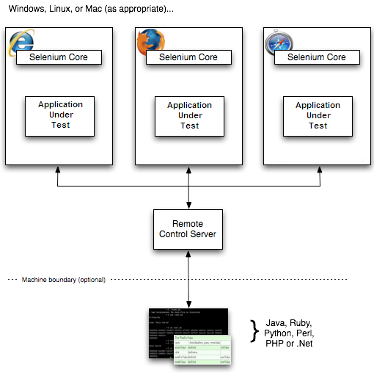
Architecture

Slide 9
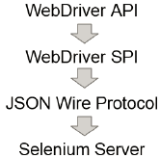
Architecture (cont.)
WebDriver API: part of the system that user interacts.
WebDriver SPI(Stateless Programming Interface)
JSON Wire Protocol is able to transport all necessary elements to the code that controls it.
Selenium server uses JSON wire commands to break down the JSON object.

Slide 10
Features
Using XPath/DOM/IDs for automating UI tests with exact position of objects.
Synchronizing the script with the mouse and keyboard related commands.
Commands for synchronization of the script execution.
Contains record and playback facility.

Slide 11

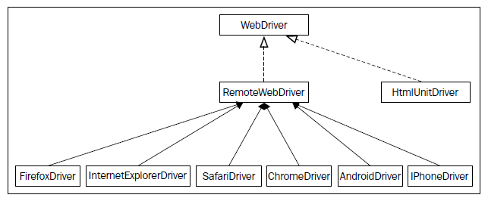
Core
A main actor in starting the testing is the WebDriver interface and it's implementations.

Slide 12
Core (cont.)
A HTML codepage contains different types of WebElements such as: <html>, <body>, <form>, <label>, <input>, <a>.
WebElement can be retrieved using the findElement() method.
The abstract class By is useful in creating By instances.
By methods: id, tagName, name, cssSelector, className, linkText. partialLinkText, xpath.

Slide 13

Core (cont.)
The getAttribute() method can be executed on all WebElements and retrieves the attribute value.
The sendKeys() action is applicable for textbox or textarea HTML elements. This is used to type text into the textbox.
API syntax looks like: void sendKeys(java.lang.CharSequence ... keysToSend)
If we want to type special keys like: Backspace, Enter, Tab, Shift, etc we can use the Keys enum class from WebDriver.

Slide 14
Core (cont.)
The clear() action is similar to sendKeys() method which is applicable to textbox and textarea elements.
This is used to erase the text that is entered in a WebElement using the sendKeys() method.
The submit() action can be taken on a form or an element inshide a fostm.
This is used to submit a form of a web page to the server hosting the web application.
If we try to execute submit() on a form element that is not present the NoSuchElementException exception will be thrown.

Slide 15
Core (cont.)
The getCssValue() method can be use to retrieve css properties.
The getLocation() method will return the relative position of an element where it's rendered on the web page.
The getSize() method can also be applied on all the visible components of HTML. It will return the width and height of the rendered WebElement.
The getText() method can be taken on all the WebElements.
The getTagName() method can be taken on all the WebElements.
The isDisplayed() method verifies if an element is displayed on the web page.
The isEnabled() method verifies if an element is enabled on the web page.
The isSelected() method verifies if an element is selected like radio button, options in select, checkbox.

Slide 16
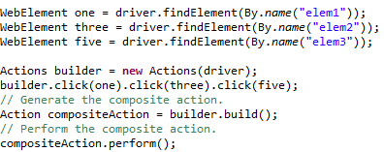
Core (cont.)
WebDriver can perform multiple actions at the same time using the Actions class to group all actions.
The moveByOffset() method is used to move the mouse from its current position to another point on the web page.
The click() method is used to simulate the left-click of mouse at its current point of location.
Keyboard interactions methods: keyUp, keyDown, sendKeys.
An IllegalArgumentException is thrown when the passes key isn't one of the Shift, Ctrl and Alt keys.

Slide 17
Core (cont.)
The clickAndHold() method is another method that left-clicks on an element and holds it without releasing the left button of the mouse.
This method will be useful when executing operations such as drag-and-drop.
The release() method is the one that can release the left mouse button.
The moveToElement() method is another method that helps to move the mouse cursor.
The dragAndDropBy() method will drag a target element by X and Y offsets.
The dragAndDrop() method will drag a source element to a target element.
The doubleClick() method emulates the double click mouse.
The contextClick() method is similar to right click mouse.

Slide 18
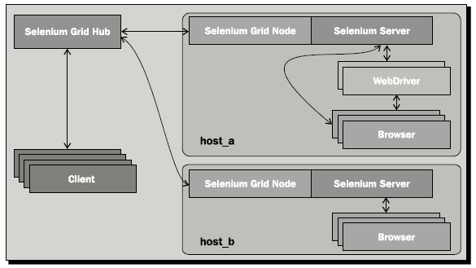
Selenium Grid
Selenium Grid is a version of Selenium that allows teams to set up a number of Selenium instances and then have once central point to send Selenium commands.
Selenium Grid allows to call specific browser on specific platform on a specific platform.

Slide 19
Selenium Grid(cont.)
Selenium Grid have central point that acts as hub and server nodes sends commands.
Selenium Grid can be started with "-role hub" arguments.
We can check the console using http://<Ip>:4444/console.
The 4444 is the default port but can be changed using -port argument.
The other server nodes can needs to be started using "-role node” argument and need the -hub "http://<Ip>:4444/register" argument to connect to the hub.

Slide 20
Conclusions
PROS:
Helps automate testing on Ajax/CSS applicaitons
Supports testing on multiple browsers.
Contains record and playback facility.
Mimics actual user experience
CONS:
Performance issues
Reporting issues
Slow when testing edge cases
Data dependency needs to be avoided

Slide 21

Bibliography
http://en.wikipedia.org/wiki/Selenium_%28software%29
Packt Publisher - Selenium WebDriver Practical Guide

