Slide 1
SpringROO
Dima Ionut Daniel

Slide 2
Contents
What is SpringROO?
Architecture
Creating applications
Using JPA
Using Spring MVC
Using Spring Web Flow
Messaging
SpringRoo Annotations
Advanced Topics
Integration
Conclusion
Bibliography

Slide 3

What is SpringROO?
Spring Roo is an open source software tool that uses convention-over-configuration principles to provide rapid application development of Java-based enterprise software.
The resulting applications use common Java technologies such as Spring Framework, Java Persistence API, Java Server Pages,GWT, Flex, Apache Maven and AspectJ.
Spring Roo is the next generation rapid application development tool for Java and comes under the SpringSource (http://www.springsource.org/) projects.
Spring Roo takes care of creating project structure for your enterprise application, adding support to use Maven for building and deploying the application.
Spring Roo provides an interactive, intuitive, text-based interface through which you enter the details of your application in a step-by-step fashion to create a working application in minutes.

Slide 4
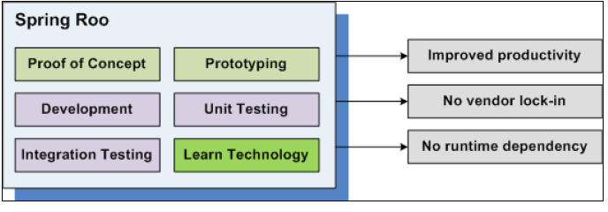
Architecture
Spring Roo improves developer's productivity by auto-generating code based on instructions provided by developer or inferred from the code already generated by Spring Roo.
Spring Roo gets you quickly started with the project but it also gives you productivity improvements over the lifetime of the project.
Spring Roo doesn't attempt to hide implementation details from enterprise developers, making it easy for developers to understand the code and modify it as per their need.
At runtime your application code is only dependent on frameworks that you used for developing the application.
We can use Eclipse IDE or STS (Spring Tool Suite—SourceSource) to remove Spring Roo specific details from your application.

Slide 5
Architecture (cont.)
The Spring Roo directory is explained below:
Annotations → contains the Spring Roo annotations packed as jar.
Bin → contains Spring Roo batch file and shell script for Roo Shell.
Bundle → contains OSGI bundles that are part of Spring Roo distribution.
Cache → contains installed OSGI bundles.
Conf → contains Spring Roo configuration file
Docs → contains Roo documentations
Samples → contains sample Roo scripts
The hints feature of Spring Roo provides step-by-step guidance on developing a working enterprise application in minutes.
If Roo finds that the directory from which the Roo shell is executing contains a Roo project but a JPA persistence provider is not set up yet, it suggests you set up a persistence provider (such as OpenJPA and Hibernate) for your project.

Slide 6
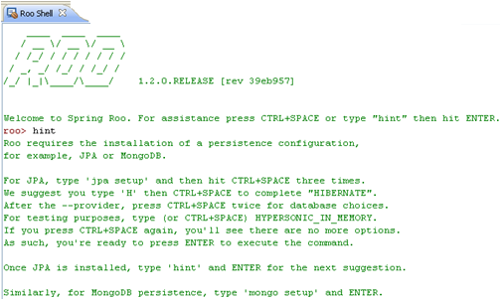
Creating applications
We can create a Roo spring project using in the SpringRoo Shell the following command: project and the --topLevelPackage argument.
Also the hint command is usefull for suggestions.
The project created will have a Maven structure.
A Roo project is a Java project whose source code consists of Java source files and .aj (AspectJ) files. If we decide to move away from Roo, we can easily do so because there is no runtime dependency of the generated code on any Roo libraries.

Slide 7
Creating applications (cont.)
Spring Roo distribution comes with a Maven add-on, which is responsible for processing the project command.
The project creates directories with name SRC_MAIN_JAVA, SCR_MAIN_WEBAPP, and so on.
SRC_MAIN_JAVA → the root of the Java source directory.
SRC_MAIN_RESOURCES →the root of the directory, which contains resources.
SRC_TEST_JAVA → the root of the Java source directory, which contains unit and integration tests.
SRC_TEST_RESOURCES → the root of the directory, which contains resources required during unit and integration testing.
SRC_MAIN_WEBAPP → the web application directory, which contains web pages, images, style sheets, and web application configuration.
ROOT → refers to the root directory of the project.
SPRING_CONFIG_ROOT → refers to the directory, which contains Spring's application context XML file.

Slide 8
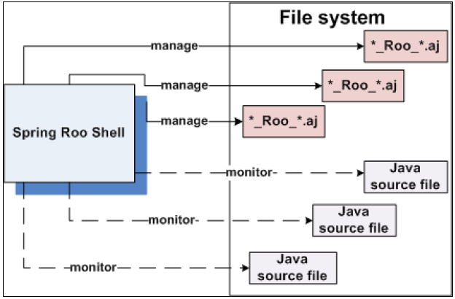
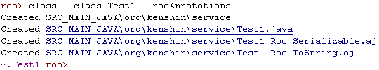
Creating applications (cont.)
We can create java classes using the class command. Spring Roo will add toString() method implemented as aspect and will add get/set methods for every field. The command has also arguments: class, rooAnnotations, path, extends, abstract. The rooAnnotations argument adds to the class the following annotations: @RooJavaBean, @RooToString, @RooSerializable to the generated class. The AspectJ files generated have the following naming convention: <java-class-name>_Roo_<add-on-name>.aj. If we add a new attribute to the class the Spring Roo shell will generated the aspects for equals, hashcode and will update other files.

Slide 9
Creating applications (cont.)
We can create application artifacts from Roo script. We can generate complete enterprise application skeleton using a set of Roo commands to Spring Roo from a text file. The convention is to name the script file containing commands with a .roo extension. Spring Roo provides the script command, which allows you to execute commands contained in a text file.
roo>script --file script_name.roo --lineNumbers
The script command accepts the following arguments:
file → specifies the name of the file that contains Roo commands.
lineNumbers → instructs the Roo shell to print the line numbers of the command being executed from file.
If a Roo command fails it is commented out in the log.roo file.

Slide 10
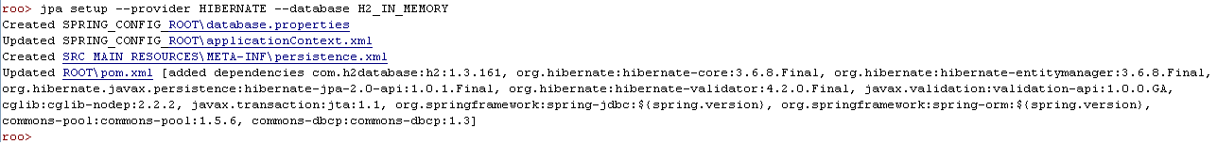
Using JPA
Java Persistence API (JPA) provides a standard API for persisting Java objects to a relational database.
We can add the configuration files needed for having a persistence layer with one command: jpa setup. We specify the persistence provider and the database. We can see in the shell the actions taken in the SpringRoo project.
Usefull common SpringRoo commands:
addon list → lists all available Spring Roo Addons
addon info id <id> →informations about Spring Roo addon specified by id
addon install id <id> → install SpringRoo addon

Slide 11
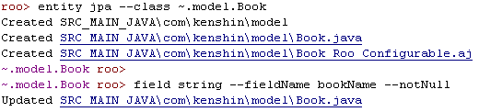
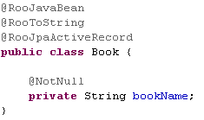


Using JPA (cont.)
After we add persistence information we can create JPA entities using the following command: entity jpa. In the left example we create a Book entity. The ~ symbol represents the topLevelPackage location.
After the entity is created the focus command prompt is on the model.Book entity. The command for adding fields is field.
When creating multiple entities we can obtain the focus of the entity using the command: focus with the --class argument.

Slide 12

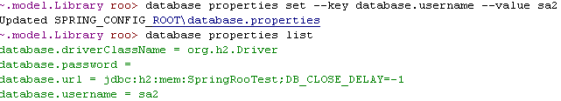
Using JPA (cont.)
We can list or alter the database properties present in the project.
To list the database properties we use the database properties list command.
When adding or updating the database properties we use the database properties set command followed by the --key and --value arguments.

Slide 13
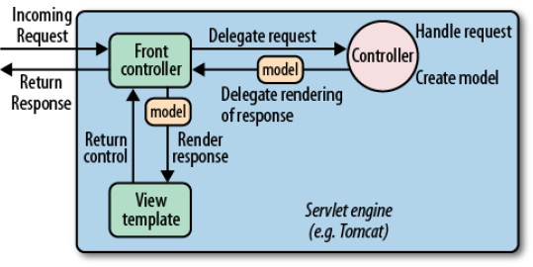
Using Spring MVC
Spring MVC is a model-view-controller framework.
Controller methods are expected to process the request, access a backend service, invoke business logic, etc.—and then set up model (your JPA entities) data that’s used to driven the generation of a view.

Slide 14
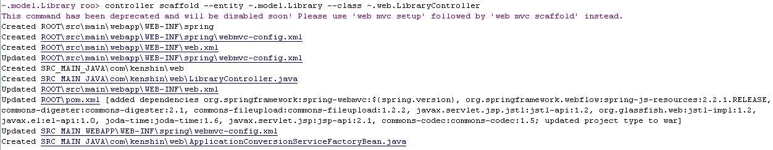
Using Spring MVC (cont.)
It’s very easy to get started using Spring MVC with Spring Roo. We create a Spring MVC simple structure using web mvc setup.
It’s very easy to create a Controller that manipulates JPA entities. The controller command will generate the web artifacts and will upgrade the project to a Web nature.

Slide 15
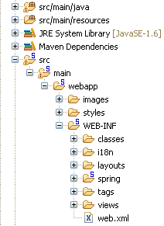
Using Spring MVC (cont.)
Spring Roo generates the layout of the web application.
WEB-INF/i18n → internationalized messages for the application.
WEB-INF/layouts → Apache Tiles layout definitions.
WEB-INF/spring → Spring configuration files.
WEB-INF/views → common fragments used across all pages: headers, footers, sidebars, etc.

Slide 16
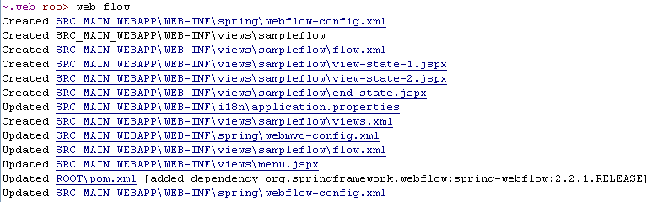
Using Spring Web Flow
It’s very easy to get started using Spring Web Flow with Spring Roo. We create a Spring Web Flow simple structure using web flow.

Slide 17
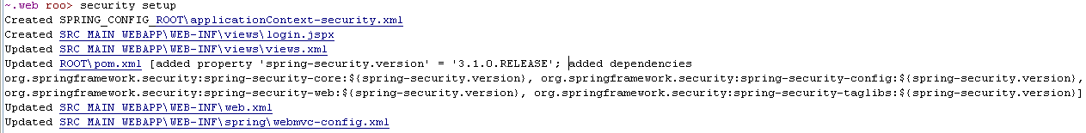
Advanced Topics
Spring Roo comes with the Log4j dependency already enabled. With the logging command(logging setup --level INFO) we can install a Log4j configuration file: log4j.properties.
Spring Security is widely considered the most powerful security framework. Spring Roo provides a way to get the basics taken care of, quickly. We must have configured a Spring MVC application, otherwise the security commands will not be available on the shell.
To get started with Spring Security we executed the following command: security setup.

Slide 18
SpringRoo Annotations
Spring Roo has annotations as internal metadata needed for Spring Roo. Common annotations:
@RooJavaBean → indicator for creating setter/getter for fields.
@RooToString → used for generating aspects with toString() method implemented. Can be used with excludeFields and toStringMethod elements for customization.
@RooEquals → indicator for creating equals() and hashCode() methods.
@RooSerializable → indicator ca o clasa ar trebui sa implementeze interfata Serializable.
@RooJpaActiveRecord → used for persistent objects and provides an ID field along with accessor and mutator.
@RooJpaEntity → basic persistence functionality for beans.

Slide 19
Conclusion
PROS
Easy-to-use
Fast and simple to remove
Extensible via Roo add-ons
Rapid results
Comprehensive tehnology integrations
CONS

Slide 20
Bibliography
http://en.wikipedia.org/wiki/Spring_Roo
Packtpub Spring Roo 1 1 Cookbook
Oreilly Getting Started with Roo

