Slide 1
TestNG
Dima Ionut Daniel

Slide 2
Contents
What is TestNG?
TestNG Features
TestNG Basics
TestNG Samples
TestNG Listeners
Enterprise Testing
Conclusion
Bibliography

Slide 3
What is TestNG?
TestNG is a testing framework designed to simply a broad range of testing needs, from unit testing to integration testing.
It was inspired from JUnit and NUnit and introduced new functionalities that make it a powerful tool and easy to use.
TestNG is designed to cover al categories of tests: unit, functional, end-to-end, integration, etc.
The TestNG project aims to help developers, the NG stands for "next generation".

Slide 4
TestNG Features
Annotations
Test that the code is multithread safe.
Flexible test configuration.
Support for parameters.
Powerful execution model
Supported by a variety of tools and plug-ins
Embeds BeanShell for further flexibility.
Support for data-driven testing
No need to extends a base class
No need to start test methods with “test”

Slide 5
TestNG Basics
We can create tests using annotation and/or XML.
Configuration annotations are all the annotations that start with @Before or @After. TestNG defines five different configuration annotations.
@BeforeSuite/@AfterSuite →before a suite starts / after all the test methods in a certain suite have been run.
@BeforeTest/@AfterTest → before a test starts / after all the test methods in a certain test have been run.
@BeforeClass/@AfterClass → before a test class starts / after all the test methods in a certain class have been run.
@BeforeMethod/@AfterMethod → before a test method is run / after a test method has been run.
@BeforeGroups/@AfterGroups → before any test method in a given group is run / after all the test methods in a given group have been run.
Another feature is the ability to put test methods in groups.

Slide 6
TestNG Basics
TestNG instantiates test classes for you by invoking their no-argument constructor and then proceeds to run all the test methods that can be found on each class.
The @Factory annotation, which must be put on top of a method that returns an array of objects. Each of these objects should be an instance of a class that contains TestNG annotations.
We can safely have both @Factory and @Test annotations on the same class since TestNG guarantees that your @Factory method will be invoked exactly once.
Whenever TestNG encounters a test class that implements the org.testng.ITest interface, it will include the information returned by getTestName() in the various reports that it generates (both text and HTML).
We can pass parameters with testng.xml. This technique lets us define simple parameters in the testng.xml file and then reference those parameters in source files.
<suite name="Parameters" >
<parameter name="parameter1" value="data present here" />
</suite>
@Test(parameters = { "parameter1"})
public void validateFile(String parameter1) {
System.out.println("Parametr")
}

Slide 7
TestNG Basics
TestNG will automatically try to convert the value specified in testng.xml to the type of your parameter. Types supported: String, int/Integer, boolean/Boolean, byte/Byte, char/Character, double/Double, float/Float, long/Long,short/Short.
TestNG will throw an exception if the parameter cannot be converted or if we reference a parameter name that isn't declared in testng.xml file.
@DataProvider defines a method as beeing data provider. If the name is missing, the Data Provider’s name will be the method’s name. A Data Provider returns Java objects that will be passed as parameters to an @Test method.
Metodele care au @DataProvider pot primi 2 tipuri de parametri: java.lang.reflect.Method si TestContext.
@DataProvider
public void create() { ... }
@DataProvider
public void create(Method method) { ... }
@DataProvider
public void create(ITestContext context) { ... }
@DataProvider
public void create(Method method, ITestContext context) { ... }
If a Data Provider declares a parameter of type ITestContext in its signature,TestNG will set it to the test context that is currently active, which makes it possible to know what runtime parameters the current test run was invoked with.

Slide 8
TestNG Basics
Using DataProvider give use an advantage because we can pass any valid java type to the test methods. This approach is very flexible because the values can be computed dynamically and fetched from any kind of storage.
The reading of the parameters from the testng.xml file is flexible because we don’t need to recompile and the values are passed automatically by TestNG to the test methods.
Asynchronous code is usually found in: JMS, Asynchronous facilities offered by java.util.concurrent, GUI developed with a toolkit such as SWT or Swing and it's dificult to test. We can't predict when an asynchronous call will be executed and when the call will complete.
@Test(timeOut = 10000)
public void waitForAnswer() throws Exception {
while (! success) {
Thread.sleep(1000);
}
}
We can instructs TestNG to invoke this method a thousand times, but to consider the overall test passed even if only 98% of the invocations succeed.
@Test(timeOut = 10000, invocationCount = 1000,successPercentage = 98)
public void waitForAnswer() {
while (! success) {
Thread.sleep(1000);
}
}

Slide 9
TestNG Basics
The invocationCount attribute indicated how many serial requests are made to the testing method. The timeOut attribute is best to be used whenever we are testing something that can potentially take a long time to return, such as network access.
The threadPoolSize attribute asks TestNG to allocate a certain number of threads and to use these threads to invoke the test methods. As soon as one test completes, the thread that was used to run it is returned to the pool, where it can be reused for the next invocation.
@Test(invocationCount = 10, threadPoolSize = 5)
public void smallThreadPool() {
System.out.println(Thread.currentThread().getId());
}
The @Parameters annotation it’s used when we want to use parameters defined in testng.xml as input parameters into our test methods.
The @Listeners defines listeners on a test class and it’s value consists of an array of classes that extend org.testng.ITestNGListener.

Slide 10
TestNG Basics
Using test groups, TestNG’s achieve to create a clean separation between the static model (the code of your tests) and the runtime model (which tests get run). Also we can create categories of tests, like:
- Test type: unit, functional, integration, system, acceptance, performance
- Test size: small, medium, large
- Functional description: web, gui, html, jsp, servlet, database, front-end, back-end
- Platform: os.win32, os.linux, os.mac-os
- Procedural description: check-in, smoke-test, milestone, release
- Runtime schedule: week-days, weekends, nightly, monthly

Slide 11
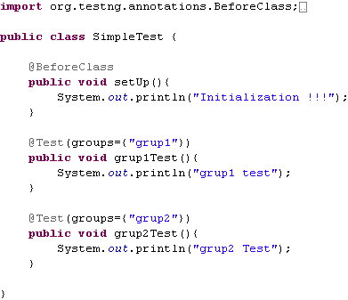
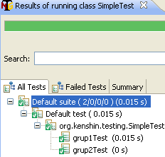
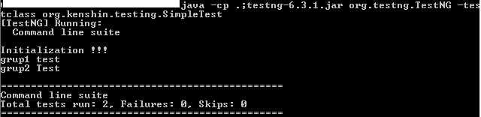
TestNG Samples
We define a SimpleTest test class and we execute the test either by command line using the org.testng.TestNG class or by using an IDE plugin.

Slide 12
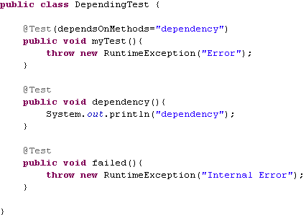
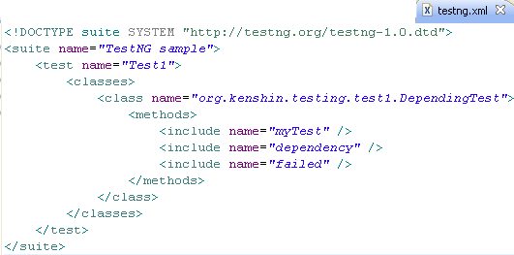
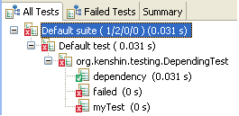
TestNG Samples
We declare myTest() test method that depends on dependency() method using dependsOnMethods attribute.
Also we can declare our suite test as XML.
Running either the annotation test class or the XML file we’ll have 2 failed tests.

Slide 13
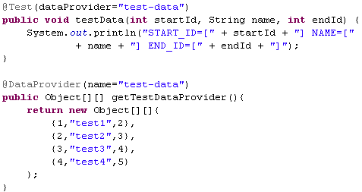
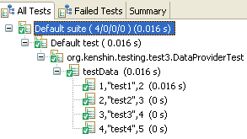
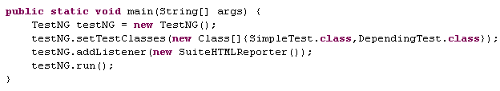
TestNG Samples
We declare a method with @DataProvider and assign the test data using @Test(dataProvider).
We can run TestNG tests using the TestNG API.

Slide 14
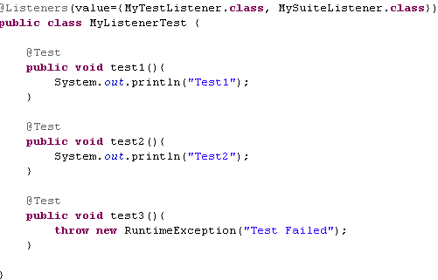
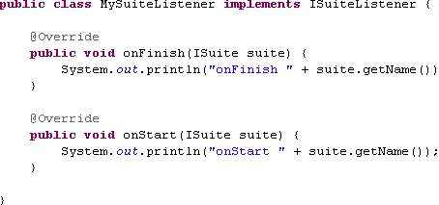
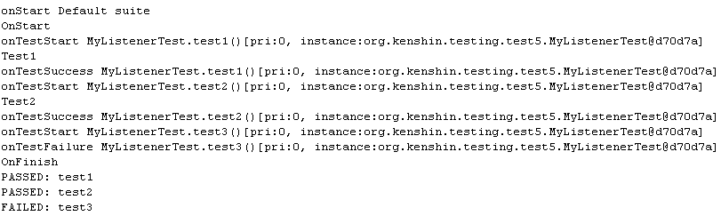
TestNG Samples
We declare with @Listeners annotation the TestNG listener classes that are used for the test methods. We can see the test methods run output above.

Slide 15
TestNG Listeners
TestNG has a few listeners:
- IAnnotationTransformer
- IAnnotationTransformer2
- IHookable → it’s run() method will be invoked on every @Test found.
- IInvokedMethodListener →before/after test method invocation
- IMethodInterceptor → intercepting test method when called
- IReporter → for generating reports
- ISuiteListener →can be used to determine when the suite was started and finished
- ITestListener →provide functionality to determine test status after every execution
We can define the listeners with annotation or in the testng.xml file:
@Listeners({ org.kenshin.MyListener1.class, org.kenshin.MyListener2.class })
public class MyTest {
// ...
}
<suite>
<listeners>
<listener class-name="org.kenshin.MyListener1" />
<listener class-name="org.kenshin.MyListener12" />
</listeners>

Slide 16
Enterprise Test
Unit tests → tests an individual unit in the system in isolation. Unit tests run very quickly since they have little to no start-up costs, and almost no external dependencies.
Functional tests → focuses on one piece of functionality. This usually involves interactions between different components.
Integration tests → An integration test is an end-to-end test that exercises the entire stack, including any external dependencies or systems.
An idempotent test is one where the result of running a test once is the same as running it multiple times. A method that writes to a database may not be idempotent; invoking it again will likely result in an error since the state of the database has changed once the method has been invoked.
There are some approaches that can help us:
- Embedded databases
- Initialized data in the test setup
- Transaction rollbacks
Embedded Databases can be created and initialized on the fly from inside the test. The disadvantage is that it deviates significantly from the environment the application will actually run in. There are also often significant differences between database features. Stored procedures are not portable across databases, and reimplementing them in our embedded database would be too much effort.
Other approach is to load our test database with a known quantity of test data. Tests do also rely on data that is specific to their business functionality. As the project progresses, there’s a strong chance that data structures and schemas will change, and the test data can become stale.
Another approach is to use Java APIs to prevent the data from being written out to the permanent data store. The general idea is to start a transaction, perform all of our write operations, verify that everything works, and then roll back the transaction. The benefit of this approach is that we do not have to worry about cleanup.

Slide 17
Enterprise Test
In-container testing matches exactly the runtime environment, is expensive to start up, difficult to deploy new tests, difficult to automate.
Out-of-container provides relatively fast start-up, allows full control over environment, easy to automate, easy to debug and is mismatched against the runtime environment.
JNDI lookups follow the Resource Locator pattern (also know as ServiceLocator). A component that requires a particular service or resource looks it up in a global registry.
The current trend is in fact to favor the exact opposite approach: Component Injection (also know as Dependency Injection, or Inversion of Control). Component dependencies are satisfied through either service locators (commonly JNDI) or injection.
Many of the components in an enterprise environment communicates with databases. There is often an object-mapping abstraction layer between the application code and the database itself. There are object-relational mapping (ORM) tools, such as Hibernate, EJB entity beans (JPA), TopLink, or some other mechanism.
The entry point for non-EE Java application is Connection:
Connection c = DriverManager.getConnection("jdbc:mydriver://server");
The entry point for EE Java application is DataSource:
InitialContext context = new InitialContext();
DataSource ds = (DataSource)context.lookup("jdbc/MyDataSource");
Connection c = ds.getConnection();

Slide 18
Enterprise Test
@BeforeSuite(dependsOnGroups = "jndi", groups = "db")
public void bindDataSources() throws NamingException {
DataSource ds = ...; // initialize DataSource
new InitialContext().bind("jdbc/MyDataSource", ds);
}
The JTA specification is responsible for specifying how to create and manage transactions in an EE environment.
The API allows for resources to participate in ongoing transactions, as well as components to start and stop transactions. In the past, JTA has been notoriously difficult to test. In many cases, frameworks have defined abstraction layers over JTA just to be able to introduce another more testable API.
InitialContext context = new InitialContext();
UserTransaction ut = (UserTransaction)context.lookup("java:/UserTransaction");
try {
ut.begin();
// perform transactional work
ut.commit();
} catch(Exception ex) {
try {
ut.rollback();
} catch(SystemException ex2) {
throw new RuntimeException("Rollback failed", ex2);
}
}

Slide 19
Enterprise Test
We need to create a UserTransaction (or TransactionManager) and put it in JNDI. Since application servers typically ship with their own transaction managers that cannot be embedded or used outside. We can use Open Transaction Manager from ObjectWeb or Atomikos TransactionEssentials for testing.
Sample set up JOTM as the transaction manager for testing:
@BeforeSuite(groups = "jta", dependsOnGroups = "jndi")
public void setupJOTM() throws NamingException {
Jotm jotm = new Jotm(true, true);
InitialContext context = new InitialContext();
context.bind("java:/UserTransaction",jotm.getUserTransaction());
context.bind("java:/TransactionManager",jotm.getTransactionManager());
}
Sample set up Atomikos for testing:
@BeforeSuite(groups = "jta", dependsOnGroups = "jndi")
public void setupAtomikos() throws NamingException {
InitialContext context = new InitialContext();
context.bind("java:/UserTransaction",new com.atomikos.icatch.jta.UserTransactionImp());
context.bind("java:/TransactionManager",new com.atomikos.icatch.jta.UserTransactionManager());
}
Atomikos TransactionEssentials is more robust and reliable. It supports many features that JOTM doesn't, including full support for JDBC and JMS, and superior performance.

Slide 20
Enterprise Test
Testing JMS can be tricky due to the asynchronous nature of the API. Messages are received asynchronously, so it is harder to coordinate between senders and receivers within a test. It is possible, via the ActiveMQ JMS library, to run JMS tests within a single JVM, without having to rely on an already running instance.
ActiveMQ is an Apache-licensed open source message broker solution that has a number of advanced features and supports a wide variety of cross language protocols and clients.
We’ll need the ActiveMQ jars and dependencies.
@BeforeClass(groups = "jms")
public void setupActiveMQ() throws Exception {
BrokerService broker = new BrokerService();
broker.setPersistent(false);
broker.setUseJmx(false);
broker.start();
URI uri = broker.getVmConnectorURI();
ConnectionFactory factory = new ActiveMQConnectionFactory(uri);
Connection connection = factory.createConnection();
connection.start();
session = connection.createSession(false, Session.AUTO_ACKNOWLEDGE);
destination = session.createQueue("TestQueue@router1");
}
String uri = "vm://localhost?broker.persistent=false";
ConnectionFactory factory = new ActiveMQConnectionFactory(uri);

Slide 21
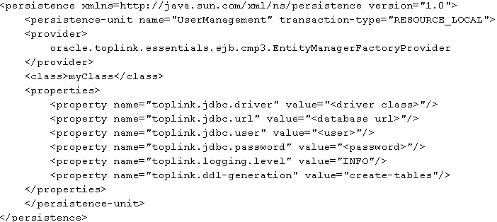
Enterprise Test
JPA is one of the more innovative APIs in Java EE 5.0. These include Hibernate, TopLink, and OpenJPA, among others. There are a number of issues to take into consideration:
- Deciding on a persistence store
- Configuring the JPA provider
- Making modifications for out-of-container testing
- Simulating an in-container environment
Running embedded databases in-memory(Hsqldb,Derby) ensures that we can have very fast tests that are easy to run without the cost of starting up a database or going over the network to connect to one.
To deploy a JPA persistence unit we need a META-INF/persistence.xml file in the classpath. We use the out-of-container functionality provided by JPA. In addition to running inside an application server, JPA can be run stand-alone in a plain Java SE environment without a container.

Slide 22
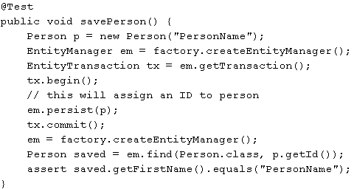
Enterprise Test
We can create the EntityManagerFactory using the Persistence utility class.
EntityManagerFactory factory = Persistence.createEntityManagerFactory("UserManagement");
To test components that use JPA themselves within a container, we’d have to create the correct environment for the JPA provider to convince it that it’s running inside of a container.

Slide 23
Enterprise Test
JAX-WS (Java API for XML Web Services) enables easy building of both Web services and clients that communicate using XML over HTTP, using the SOAP protocol. The application server is responsible for deploying the service and exposing it for remote clients. The most convenient way to specify Web service metadata is JSR 181, which specifies a number of annotations that can be used.
@WebService
public class MyService {
@WebMethod
public String getData() {
return "Data here";
}
}
On deployment, the container will process the @WebService annotation and expose MyService for remote calls via SOAP. It’s very simple to instantiate our service directly via new MyService(), then to invoke the methods we’d like to test on it. For integration testing there are problems simulating a container environment.
For integration testing we can use XFire which is a Web Server implementation. The service (being a Web service) can be invoked from a variety of clients, both Java and non-Java.
For testing XML data we can use dom4j, jdom or XMLUnit. DOM4J API enables to load a document, traverse its structure, and examine all of its contents. XMLUnit is a JUnit extension that was developed to ease some of the pain associated with comparing XML documents.

Slide 24
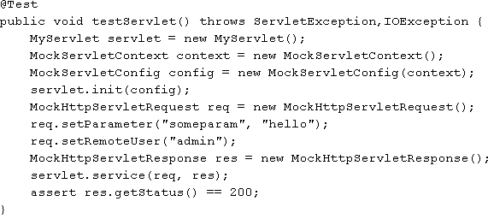
Enterprise Test
Regarding Servlets it is difficult to verify that the response has been written correctly, status codes, headers, and so on.
The mock/stub objects approach involves using custom implementations of the various parts of the Servlet API.
The bellow approach is in fact very fragile and not recommended because:
- doesn't simulate actual container behavior
- it does not capture the API
- should do rather than an officially compliant implementation.
- very hard for maintenance
An embedded container that can pe controller programmatically can be used. We can use Jetty ot Tomcat Embedded, but the best choice is Jetty.
To test the remote HTTP service we can connect directly through a socket connectionm send the appropiate headers/read the response, or we can use Jakarts's commons-httpclient.

Slide 25
Enterprise Test
When testing EE-based components, the first decision that needs to be made for any given test is whether it should run inside a container or outside.
The in-container testing is more close to the final runtime environment, but it's expensive.
The out-of-container testing requires manual environment setup using a variety of third-party libraries.
Developing a suite of unit tests that have no container dependencies and can run in isolation without requiring a complex or expensive environment.
Java EE API | Useful library to use
JNDI | Spring’s SimpleNamingContextBuilder
JDBC | C3p0, Commons DBCP, Spring’s SingleConnectionDataSource
JTA | Atomikos, JOTM
JMS | ActiveMQ
JPA | Spring
JAX-WS | XFire
Servlets | Jetty
XML | XMLUnit, dom4j

Slide 26
Conclusion
PROS
Allows named parameter sets
Supports test grouping
Good integration with IDEs(Eclipse,IDEA)
CONS:
No support for complex Java types in the testng.xml file
JUnit competitor

Slide 27
Bibliography
Next Generation Java Testing: TestNG and Advanced Concepts
http://en.wikipedia.org/wiki/TestNG
http://testng.org/doc/documentation-main.html

