Slide 1
Vaadin }>
Dima Ionuţ Daniel

Slide 2
Contents
What is Vaadin?
Architecture
Vaadin First Application
Components
Layouts
Event listener model
UIDL
Themes
Data binding
Vaadin Add-ons
Conclusion
Bibliography

Slide 3
What is Vaadin }>
Open source Ajax Web framework for RIA, server-side oriented
Large collection of UI components
It’s focused on easy-to-use, re-usability, extensibility, meeting the requirements of large enterprise applications.
It features a robust server-side architecture, a large part of application logic runs securely on the server.
It provides a library easy to use for creating custom components.

Slide 4
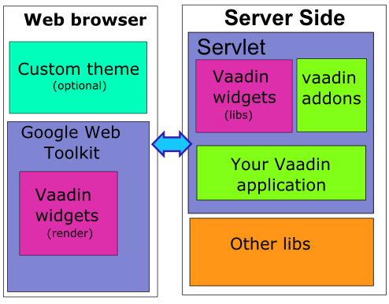
Architecture

Slide 5
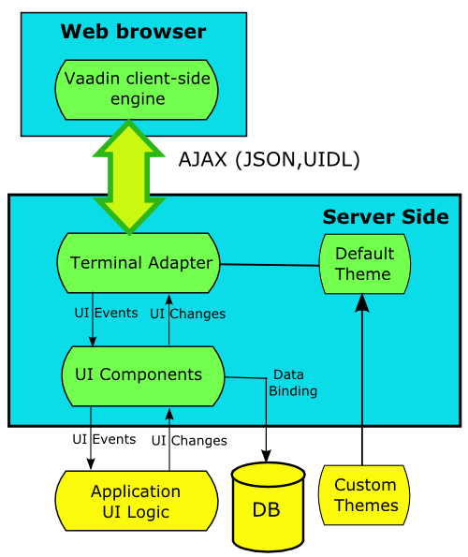
Architecture (cont.)
UIDL(User Interface Definition Language) is a language for serializing user interface contents and changes in responses from web server to a browser.
UIDL it’s based on JSON(JavaScript Object Notation) format.

Slide 6
Architecture (cont.)
Client-Side Engine → manages the rendering of the widgets using GWT. Handles (asynchronous HTTPS or HTTPS requests) user interaction and the UI changes with the server-side Terminal Adapter using UIDL language.
Terminal Adapter → UI components communicate their changes to the Terminal Adapter, which renders them for the user's browser. It delivers the user events to the UI components, which deliver them to the application's UI logic.
Themes → The user interface separates between presentation and logic. The UI logic is handled as Java code and the presentation is defined in themes as CSS.
UIDL → UIDL it's used as a communication language between Terminal Adapter and the Client-Side Engine. The UIDL communication is done using JSON, which is a lightweight human readable data interchange format.
Events → User interaction with UI components creates events, which are first processed on the client-side with JavaScript and then passed all the way through the HTTP server, terminal adapter, and user component layers to the application.
UI Components → The user interface consists of UI components that are created by the application. Each server-side component has a client-side counterpart, with which the user interacts. The server-side components can serialize themselves over the client connection using a Terminal Adapter. The client-side components, in turn, can serialize user interaction back to the application, which is received in the server-side components as events.

Slide 7
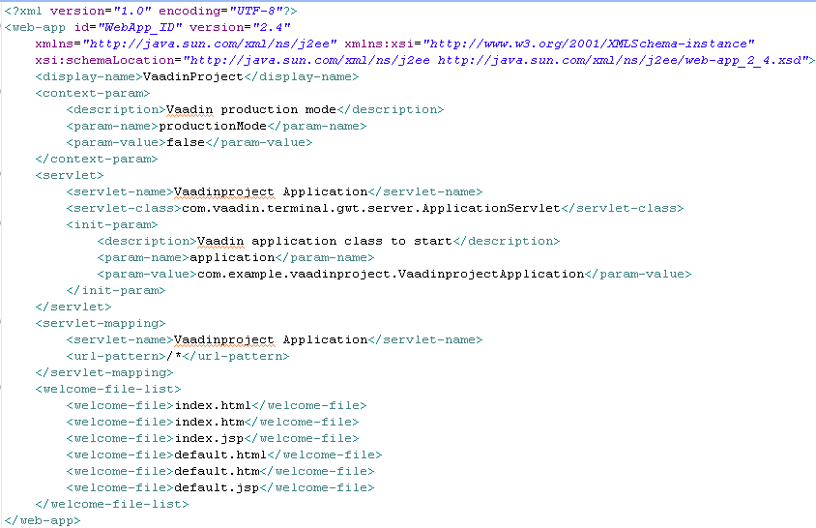
Vaadin First Application
Vaadin is supported by popular IDEs like: Eclipse, Netbeans, IntelliJ IDEA.
Sample web.xml from WAR WEB-INF directory:

Slide 8
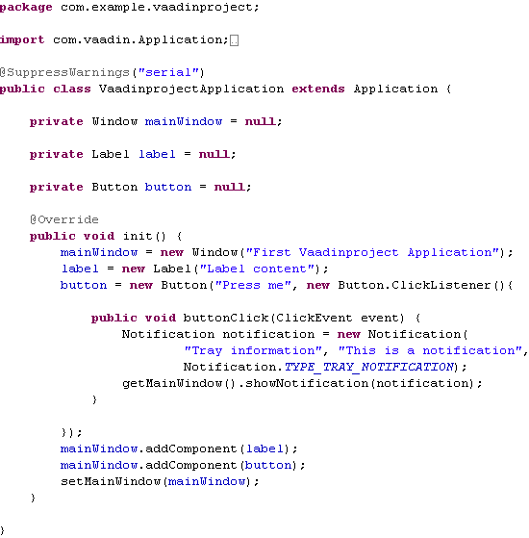
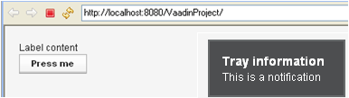
Vaadin First Application (cont.)
VaadinprojectApplication.java is the entry point of the Vaadin Application.

Slide 9
Vaadin First Application (cont.)
VaadinprojectApplication.java is the entry point of the Vaadin Application.

Slide 10
Components
Fundamental Vaadin components: Window, Label, Field, TextField, TextArea, PasswordField, RichTextArea, DateField, Button, CheckBox.
Vaadin fundamental selection components: Select, ComboBox, ListSelect, NativeSelect, OptionGroup, TwinColSelect.
Other Vaadin used components are: Link, Table, Tree, MenuBar, Slider, ProgressIndicator, Upload, Embedded, Form, Accordion, TabSheet.
For layout we can use: Layout, Panel.

Slide 11
Components (cont.)
Window → top-level container displayed in the browser and are attached to the application instance.
public class VaadinApplication extends com.vaadin.Application {
public void init() {
Window main = new Window("Main Window");
setMainWindow(main);
//…other initializations
}
}
Window objects are important as they form the bridge between the Application instance tied to the HTTP Session and other components.
A Window can have sub-windows. Sub-windows are by default non-modal, but can change the modality with setModal(boolean modal) method of the Window instance. Sub-windows instances can be customized with properties like: closable, resizable, draggable.

Slide 12
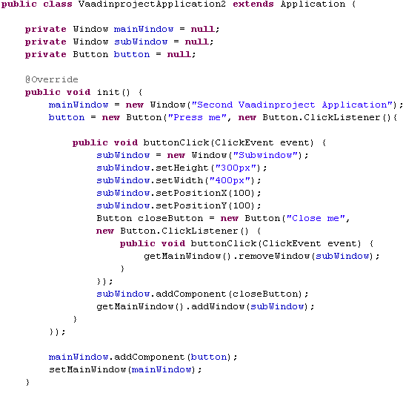
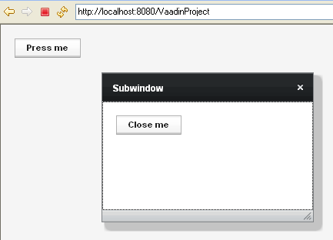
Components (cont.)

Slide 13
Components (cont.)
TextField → simple component available to users in order to send data to application.
As soon as an application needs a user input, there is a need for this input validation. In Vaadin, the validation process is handled by the Validatable / Validator pair. Some concrete validators are available in Vaadin's API: DoubleValidator, IntegerValidator, RegexpValidator, StringLengthValidator, EmailValidator, NullValidator , CompositeValidator(AND / OR mode).
TextField tf = new TextField(“Age”);
tf.setValue(“25");
CompositeValidator validators = new CompositeValidator();
validators.setMode(CompositeValidator.MODE_OR);
IntegerValidator intValidator = new IntegerValidator("{0} is not an
integer");
validators.addValidator(intValidator);
StringLengthValidator lengthValidator = new StringLengthValidator("Age
must be below 100");
lengthValidator.setMaxLength(2);
validators.addValidator(lengthValidator);
tf.addValidator(validators);

Slide 14
Components (cont.)
TextArea → multi-line version of the TextField component; setRows() can change the numbr of visible rows. The setWordwrap() sets whether long lines are wrapped.
PasswordField → TextField that hides the input.
RichTextArea → allows entering or editing formatted text(in HTML format).
DateField → displays input date and time. The date and time are normally displayed according to the default format for the current locale but can be changed to a custom format with setDateFormat("yyyy-MM-dd"). The field comes in two variations: PopupDateField(default), with a numeric input box and a popup calendar view, and InlineDateField, with the calendar view always visible.
Button → user interface component used for finalizing input and initiating some action. When pressed a Button.ClickEvent is emitted.
CheckBox → two-state selection component that can be either checked or unchecked. Vaadin provides two ways to create check boxes: individual check boxes with the CheckBox component described in this section and check box groups with the OptionGroup component in multiple selection mode.

Slide 15
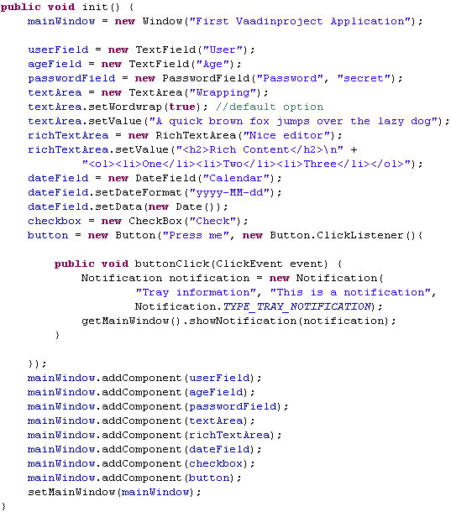
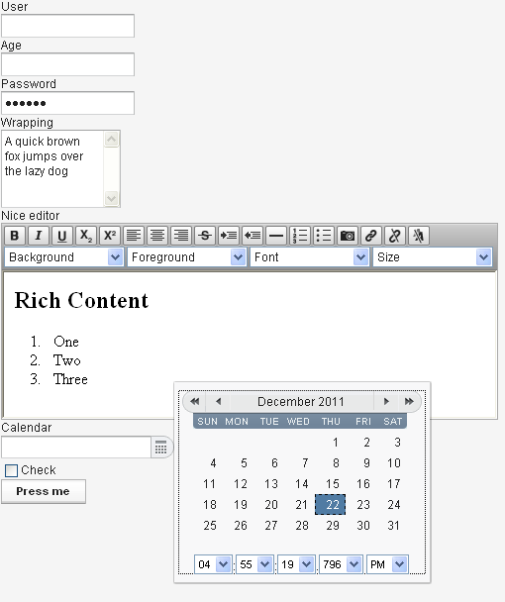
Components (cont.)

Slide 16
Components (cont.)
Select → a drop-down list with a text input area, which the user can use to filter the displayed items.
ComboBox → a drop-down list for single selection. The component also provides an input prompt.
ListSelect → A vertical list box for selecting items in either single or multiple selection mode.
NativeSelect → Provides selection using the native selection component of the browser, typically a drop-down list for single selection and a multi-line list in
multiselect mode.(uses the <select> element from HTML.)
OptionGroup →display items as a vertically arranged group of radio buttons in the
single selection mode and of check boxes in multiple selection mode. You can disable individual items using setItemEnabled() method.
TwinColSelect → Shows two list boxes side by side where the user can select items from a list of available items and move them to a list of selected items
using control buttons.
The selection components can allow to the user to add new items; we need to enable the newItemsAllowed mode using the setNewItemsAllowed(boolean enableMode) method.

Slide 17
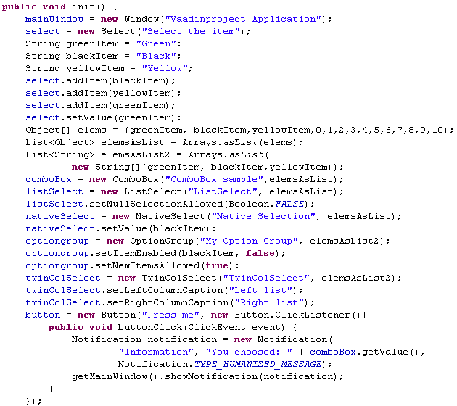
Components (cont.)

Slide 18
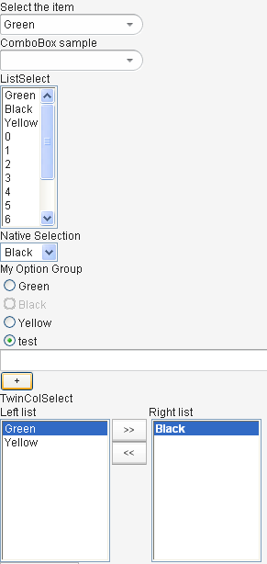
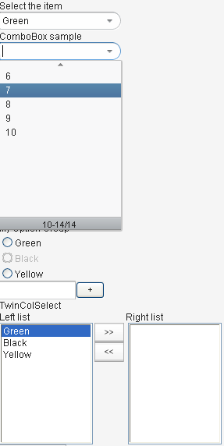
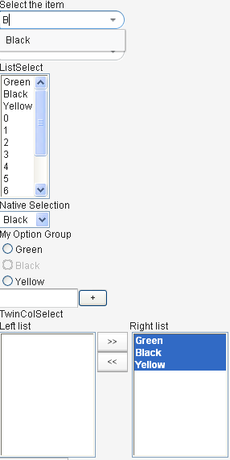
Components (cont.)

Slide 19
Components (cont.)
Link → allows marking hyperlinks. It represents a regular HTML hyperlink, an <a href> anchor that is handled natively by the browser. The Link component doesn’t causes an event on server side. Using setTargetName(), we can open the resourse in another window. Also we can provide an image icon using the setIcon() method.
Table → presents tabular data organized in rows and columns. Table cells can include text or other UI components. The data contained in a Table is managed using the Data Model through the Container interface of the Table. This makes it possible to bind a table directly to a data source.The rows of the table are items in the container and the columns are properties. Each table row (item) is identified with an item identifier (IID), and each column (property) with a property identifier (PID).
Tree → another widget that has the capability to use a container data source. Whereas tables are meant to display items of flat containers, trees are meant to do the same for hierarchical ones. From a UI point of view, trees are about nodes and parent-child relationships between them.
MenuBar → allows creating horizontal dropdown menus.
MenuItem → items of MenuBar component.
Embedded → allows displaying embedded media objects, such as animations, images or any embedded content supported by the browser. The contents of the Embedded component are managed as resources.

Slide 20
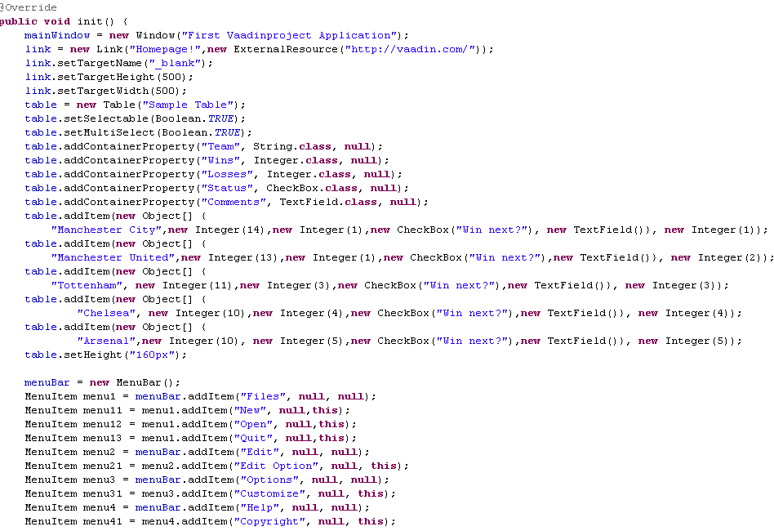
Components (cont.)

Slide 21
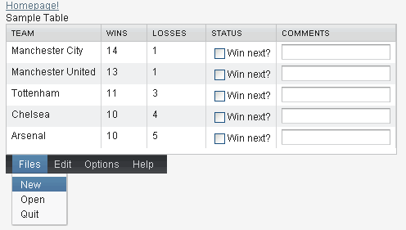
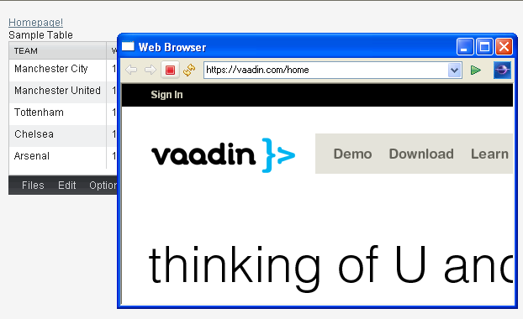
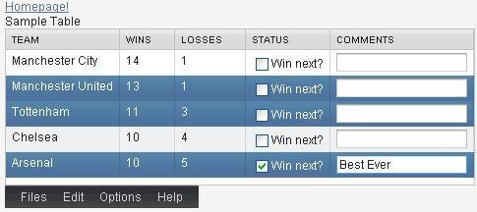
Components (cont.)

Slide 22
Components (cont.)
Slider → vertical or horizontal bar that allows the setting of a numeric value within a defined range. Common minimum value, maximum value, value, resolution, orientation.
ProgressIndicator → shows the progress of a task graphically with value between 0.0 and 1.0. The default polling frequency is 1000 milliseconds (one second), but you can set some other interval with the setPollingInterval() method.
Upload → allows a user to upload files to the server. It displays a file name entry box, a selection button and an upload submit button. After the file is selected the user sends the file by pressing the upload submit button. The upload component writes the received data to an java.io.OutputStream.
Form → allows the creation of forms with fields where the fields can be automatically generated from a data source that is bound to a form. The BeanItem adapter allows the data sources to be just java beans or POJO with setter/getter methods. To control the order and the visible fields from the fields we use the setVisibleItemProperties() method.
Accordion → multi-component container that contains “tabs” placed vertically. Clicking on a tab opens the contents of the specific tab.
TabSheet → multi-component container that allows switching between other components named tabs. The tabs are organized as a tab bar.

Slide 23
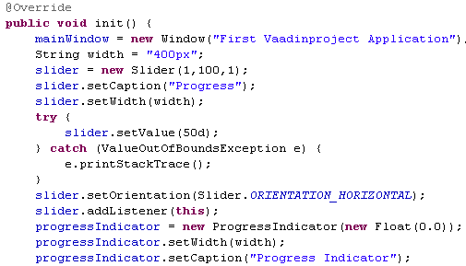
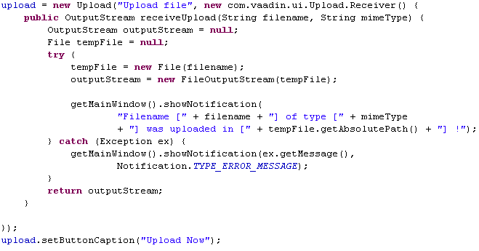
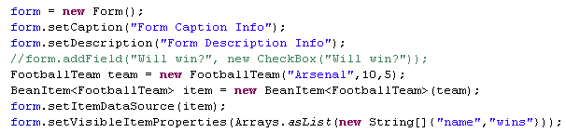
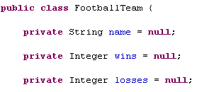
Components (cont.)

Slide 24
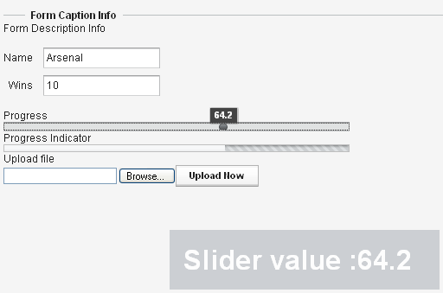
Components (cont.)

Slide 25
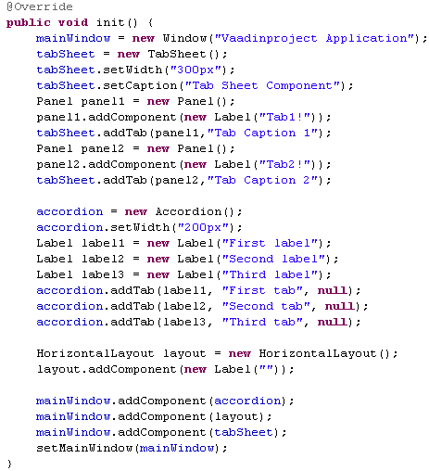
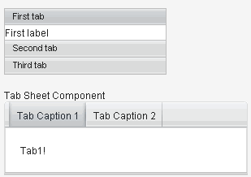
Components (cont.)

Slide 26
Layouts
Vaadin layout components allow you to position your UI components on the screen in a hierarchical fashion, much like in conventional Java UI toolkits such as AWT, Swing, or SWT.
Layouts are components and all inherits from AbstractComponentContainer.
The web browser terminal translates components into HTML elements. For layouts, this means each of them generates a <div> tag.
Vaadin provides many different layouts: Simple, Horizontal/Vertical, Grid, Form, Advanced, Absolute, CSS, Custom.
Simple layouts are efficient and let you forget CSS and HTML.
Horizontal/vertical layouts position their child elements respectively in a horizontal and vertical way.
Form layouts are used for label-field pair components.
Absolute layouts translates the absolute CSS positioning with the top, bottom, right, left attributes. (Example: layout.addComponent(new Label("Made with Vaadin"),"left:10px;bottom:10px");)
CSS layouts renders its children components in the same HTML <div> and lets the CSS position them in the end.
With Custome layouts Vaadin can be used as a templating engine with the help of the CustomLayout. The template can be stored in the VAADIN/themes/<CURRENT_THEME>/layouts/<LAYOUT_NAME>.html.

Slide 27
Layouts (cont.)
For the custom template file we set the placeholders. Placeholders must be div elements and should be set a unique location attribute.
In the end we use addComponent(Component c, String location) method; Vaadin will replace the previously defined div with the corresponding component using location as the key.
CustomLayout layout = new CustomLayout (new ByteArrayInputStream("<body><h1>Hello</h1><div location='who‘/>".getBytes()));
layout.addComponent(new TextField("name", "Vaadin!"), "who");
window.setContent(layout);
VerticalLayout and HorizontalLayout are the two most important layout components in Vaadin and some components, such as Window and Panel, have a VerticalLayout as the root layout, which you can set with setContent().
GridLayout component puts the components on a grid defined by the number of columns and rows.
Panel is a simple container with a frame and optional caption. The default content layout is a VerticalLayout, but can be change with the setContent() method.
HorizontalSplitPanel and VerticalSplitPanel are a two-component containers that divide the available space into two areas to accomodate the two components. The user can drag the bar to adjust its position.

Slide 28
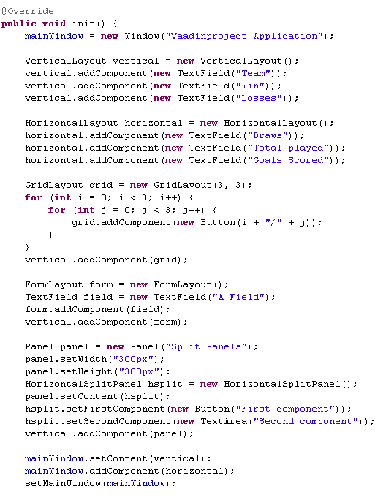
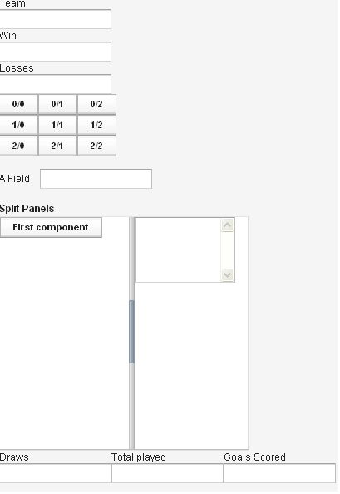
Layouts (cont.)

Slide 29
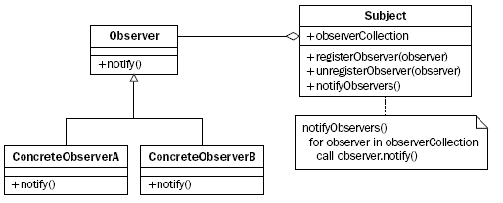
Event listener model
The event-driven model is based on the observer design pattern and adds an abstraction layer to the HTML/JavaScript event.
The root of Vaadin event class hierarchy is represented by java.util.EventObject. The event object is just a thin wrapper around the event source. The first class that Vaadin introduces is Event.
There are many listeners in Vaadin, and they all have some common features:
  There is one listener for each event type, so events and listeners go in pairs.
  They are extended from Serializable interface.
  They are defined as beeing static and are inner interfaces relevant to the class that generated the events.

Slide 30
Event listener model (cont.)
We attach the listener to the event generator component calling addListener(Class<?> eventType, Object object, String methodName) where:
  eventType represents the event class that liestener will respond to
  Object represents the listener object itself
  methodName is the method that will be called when the eventType is received.
To remove the listener we call the removeListener(Class<?> eventType, Object, object, String metodName) method.
Window window = new Window();
window.addListener(ResizeEvent.class, this, “resizeLogic");
Button button = new Button (“Press me");
button.addListener(new Button.ClickListener() {
public void buttonClick(ClickEvent event) {
button.setCaption (“Pressed!");
});

Slide 31
UIDL
UIDL - User Interface Definition Language, a language for serializing user interface contents and changes in responses from web server to a browser. The idea is that the server-side components "paint" themselves to the screen (a web page) with the language. The UIDL messages are parsed in the browser and translated to GWT widgets.
UIDL supports painting either the entire user interface or just fragments of it.
When the application is started by opening the page in a web browser, the entire user interface is painted. If a user interface component changes, only the changes are painted.
Since Vaadin Release 5, the UIDL communications are currently done using JSON.
["button",
{"id": "PID2",
"immediate":true,
"caption": "Button Caption",
"focusid":2,
"v":{"state":false}
}
]
Components are identified with a PID or paintable identifier in the id attribute. Each component instance has its individual PID, which is usually an automatically generated string, but can be set with setDebugId() method.

Slide 32
Themes
Vaadin separates the presentation layer from its logic using themes. Themes can include CSS style sheets, custom HTML layouts, and any necessary graphics. Theme resources can also be accessed from an application as ThemeResource objects.
Custom themes are placed under the WebContent/VAADIN/themes/ folder of the web application.
Vaadin currently includes two built-in themes: reindeer(default theme in Vaadin 6.0) and runo. The built-in themes are provided in the respective VAADIN/themes/reindeer/styles.css and VAADIN/themes/runo/styles.css stylesheets in the Vaadin library JAR.
Each user interface component in Vaadin has a CSS style class that you can use to control the appearance of the component.
To change the theme call setTheme() in the application object.
Inheritance in CSS is done with the @import statement. When you define a custom theme, you inherit a built-in theme as follows:
@import "../reindeer/styles.css";
.v-app {
background: green;
}

Slide 33
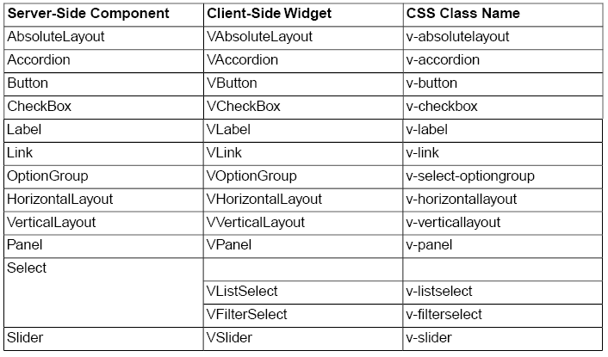
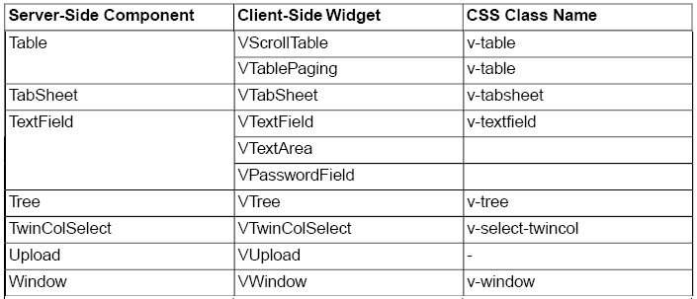
Themes

Slide 34
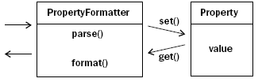
Data binding
Data binding is the ability of an application to link the value displayed by a widget with the underlying data.
The Data Model is realized as a set of interfaces in the com.vaadin.data package like Property, Item, and Container.
Data binding properties are: renderer and editor, buffering, and value-widget binding. The renderer component is able to display data items on the screen. The editor component allows to change objects.
Buffering is a way for widgets to discard changes made to it concerning the underlying data. The widget provides a way to commit the buffered value to the underlying data, or to reset the buffer from the latter.
The Property interface is the base of the Vaadin Data Model. The type of a property can be any Java class. The value of a property is written with setValue() and read with getValue(). Changes in the property value usually emit a ValueChangeEvent, which can be handled with a ValueChangeListener.
ObjectProperty is a straight implementation of Property and ValueChangeNotifier.
Vaadin provides the PropertyFormatter that allows formatting and parsing features.

Slide 35
Data Binding (cont.)
The Item interface provides access to a set of named properties. Each property is identified by a property identifier (PID). Usefull implementations include a a configurable property set (PropertysetItem) and a bean-to-item adapter (BeanItem). Also forms can even be generated automatically from items.
The PropertysetItem is a generic implementation of the Item interface that allows storing properties. The properties are added with addItemProperty(), which takes a name and the property as parameters.
The BeanItem implementation of the Item interface is a wrapper for Java Bean objects. We can use MethodProperty or NestedMethodProperty for binding complex bean objects.
Default captions use the property name and convert it to upper cased spaced text. If the caption is not desired, Form has a field getter method, getField(Object propertyId). Changing a caption is just a matter of getting a reference on the right field and changing its caption property.
Container is the highest-level of the data model and provides a very flexible way of managing a set of items that share common properties. Contained items are identified by an item identifier or IID. Items can be added to a container with the addItem() method. Containers can be unordered, ordered, indexed, or hierarchical, they can interface practically any kind of data representation.
Vaadin includes data connectors for some common data sources, such as the simple tabular data, with IndexedContainer, and the filesystem, with FilesystemContainer.

Slide 36
Data Binding (cont.)
The BeanContainer is an in-memory container for JavaBean objects. Each contained bean is wrapped inside a BeanItem wrapper. The item properties are determined automatically by inspecting the getter and setter methods of the class.
BeanItemContainer is a container for JavaBean objects where each bean is wrapped inside a BeanItem wrapper. The item properties are determined automatically by inspecting the getter and setter methods of the class.
As the items in a Container are not necessarily indexed, iterating over the items has to be done using an Iterator. The getItemIds() method of Container returns a Collection of item identifiers over which you can iterate.
Containers that implement the Container.Filterable interface can be filtered.
Filters can be classified as atomic and composite. Atomic filters (ex: SimpleStringFilter, IsNull, Equal) define a single condition, usually for a specific container property. Composite filters make filtering decisions based on the result of one or more other filters.The built-in composite filters implement the logical operators AND, OR, or NOT.

Slide 37
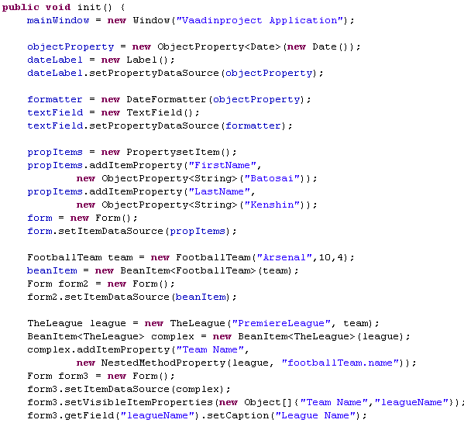
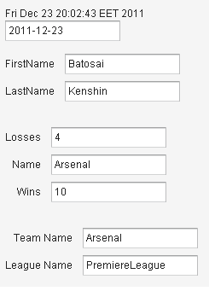
Data Binding (cont.)

Slide 38
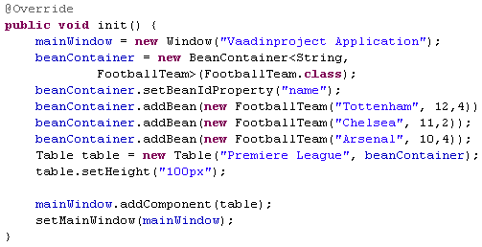
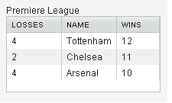
Data Binding (cont.)

Slide 39
Vaadin Add-ons
Vaadin add-ons are packaged as Zip package and required only few setups to start working with them(copy JAR files to WEB-INF/lib directory). In some cases we need to compile the client-side implementations of the add-on components that is a widget set. Vaadin Eclipse plugin provide a "Compile widgetset" button or we can run an ant script that compiles the widget set.
An useful addon is SQLContainer. SQLContainer can use SimpleJDBCConnectionPool or J2EEConnectionPool to access the SQL datasource. The query package contains the QueryDelegate interface, which defines everything the SQLContainer needs to enable reading and writing data to and from a database.
JDBCConnectionPool pool = new SimpleJDBCConnectionPool("org.hsqldb.jdbc.JDBCDriver“, "jdbc:hsqldb:mem:sqlcontainer", "SA", "", 5, 10);
TableQuery tq = new TableQuery("tablename", connectionPool);
SQLContainer container = new SQLContainer(tq);
Other popular addons: Vaadin Calendar, Vaadin Timeline, Vaadin JPAContainer, Vaadin TouchKit, Vaadin TestBench.

Slide 40
Conclusion
PROS
  open source for RIA
  fast and stable.
  API is documented.
  compatible with most browsers.
  has many widgets and add-ons.
  Easy to use in Visual IDEs.
CONS
  Increase network traffic
  Can generate lot of HTML and CSS code

Slide 41
Bibliography
https://vaadin.com/home
Packtpub.Learning.Vaadin.Oct.2011
book-of-vaadin 4th edition
http://en.wikipedia.org/wiki/Vaadin

Slide 42
Questions?

