Slide 1

Vert.x
Dima Ionut Daniel

Slide 2
Contents
What is Vert.x?
Architecture
Features
Core
Web Sockets
File System
DNS Client
Distribution
Conclussion
Bibliography

Slide 3

What is Vert.x?
Vert.x is a polyglot event-driven application framework that runs on the Java Virtual Machine.
Vert.x exposes the API currently in Java, JavaScript, Groovy, Ruby and Python.
Scala and Clojure support is on the roadmap.
In August 2013, the core Vert.x project completed was moved to the Eclipse Foundation.

Slide 4
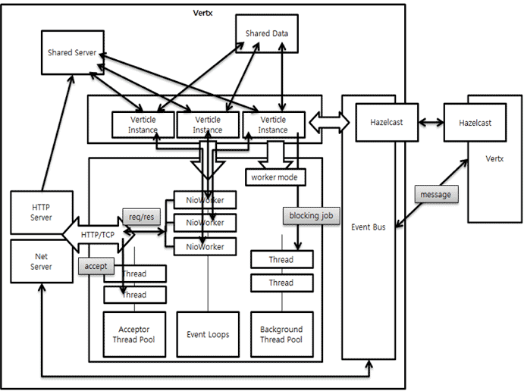
Architecture

Slide 5
Features
Polyglot:
application components can be written in Java, JavaScript, Groovy, Ruby or Python.
Simple concurrency model:
all code is single threaded, freeing from the hassle of multi-threaded programming.
Simple:
asynchronous programming model for writing truly scalable non-blocking applications.
application consists of one more loosely coupled components, called Verticles, running concurrently.
Distributed event bus:
spans the client and server side. The event bus even penetrates into in-browser JavaScript allowing to create so-called real-time web applications.
Modularity:
Module system and public module repository, to re-use and share components.

Slide 6
Core
Vert.x uses Hazelcast, an In-Memory Data Grid (IMDG).
When Vert.x is started, Hazelcast is started as an embedded element.
Hazelcast is a type of distributed storage.
When storage is embedded and used in a server framework, we can obtain expected effects from a distributed environment.
By using this distributed storage as a queue, the server application implemented by using Vert.x becomes a message processing server application and a distributed queue.

Slide 7
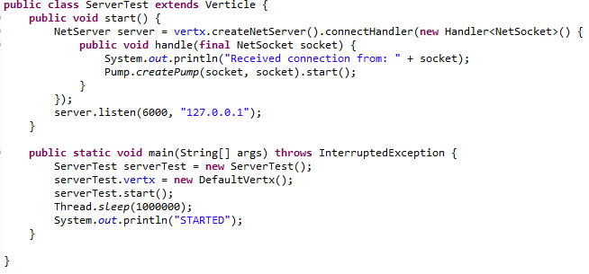
Core (cont.)
We can create a TCP server by calling createNetServer() method on the vertx instance.
The listen() method will start the TCP server on certain port and interface.
The close() method will close the TCP server.
We can use useful methods like: setTCPNoDelay, setSendBufferSize, setReceiveBufferSize, setTCPKeepAlive, setReuseAddress, setSoLinger, setTraffiClass.

Slide 8
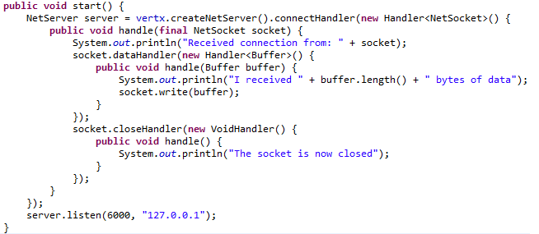
Core (cont.)
To read data from socket we can use the dataHandler() on the socket.
To write data to a socket we invoke the write() function.
We can find the remote and local address of the socket using: remoteAddress() and localAddress().
We can use the closeHandler() to determine when the socket is closed.
We can set exception handlers in case exception occurs asynchronously using the exceptionHandler() method.

Slide 9
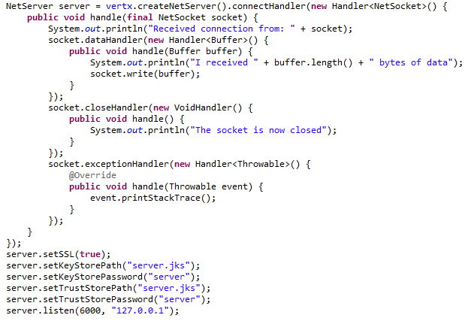
Core (cont.)
Net servers can also be configured to work with TLS.
We can also enable SSL connections we need to call setSSL(true) on the Net Server.
The server must be configured with a key store and an optional trust store.
These are both Java keystores which can be managed using the keytool utility.
To configure key store we use setKeyStorePath() and setKeyStorePassword().

Slide 10
Core (cont.)
User Datagram Protocol(UDP) can be send and received using Vert.x
UDP is a connection-less transport which means there is no persistent connection to a remote peer.
To use UDP we need to create a DatagramSocket.
If we want to receive packets we need to call the listen() method.

Slide 11
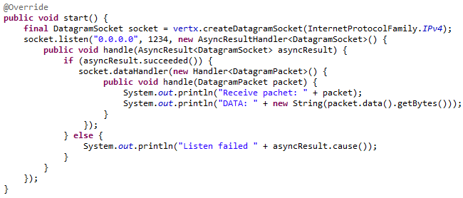
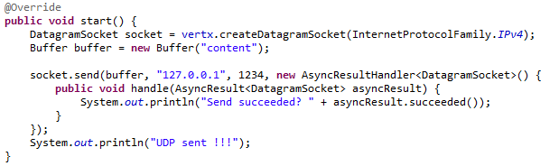
Core (cont.)

Slide 12
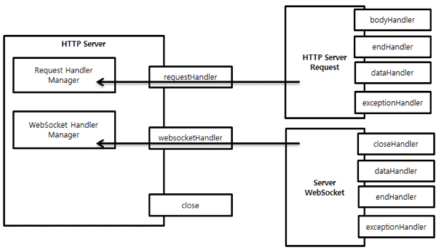
Core (cont.)
HTTP Server and Net Server control network events and event handlers.
HTTP Server allows registering a handler to an HTTP event such as GET or POST.
HTTP Server supports WebSocket as well as HTTP.

Slide 13
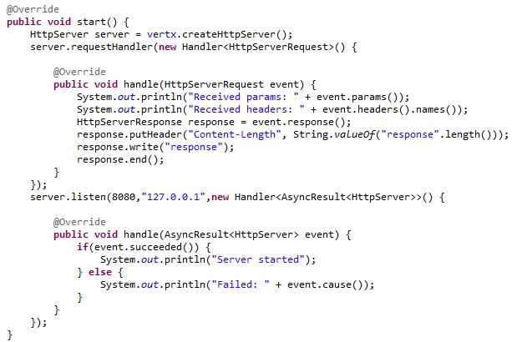
Core (cont.)
In order to create HTTP server we need to use the createHttpServer() method on the vertx instance.
When a request arrives, the request handler is called passing in an instance of HttpServerRequest.
The handler is called when the headers of the request have been fully read.
By calling response() method we can retrieve the object that represents the server side HTTP response for the object.

Slide 14
Core (cont.)
In order to retrieve the path of the request the path() method is used.
In order to retrieve the query of the request the query() method is used.
Other useful methods: headers, params, absoluteURI, remoteAddress.
Vert.x can handle uploads HTML forms using the uploadHandler() and set expectMultiPart(true) before.
In order to set the status code/message we use setStatusCode, setStatusMessage methods.
Once we finished the HTTP response we need to call the end() method.

Slide 15
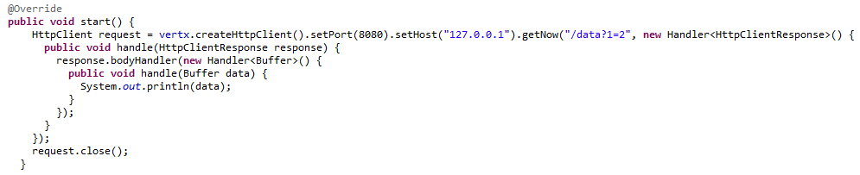
Core (cont.)
Vert.x has the HTTP compression support and the setCompressionSupported(true) needs to be used.
It means that can send the body compressed back to the client.
To create HTTP client we need to call createHttpClient() method on vertx instance.
Any HTTP client created in a verticle are automatically closed when the verticle is stopped, but it can be closed explicitly using the close() method.

Slide 16
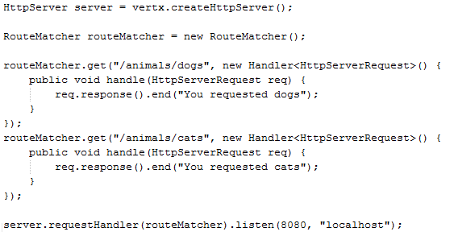
Core (cont.)
The HTTP client and server request and responses all implement either ReadStream or WriteStream.
Https client/server are very easy to write, similar to Http client/server.
Vert.x allows to route HTTP requests to different handlers based on pattern matching on the request path.
It enables to extract values from the path and use them as parameters in the request.
For this the RouteMatcher can be used as request handler.

Slide 17
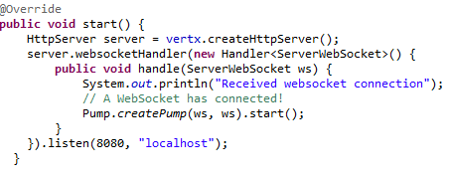
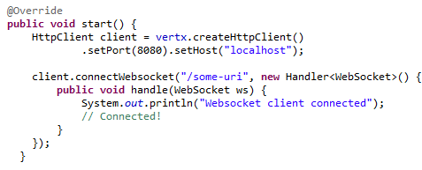
Web Sockets
WebSockets is a web technology that allows a full duplex socket-like connection between HTTP servers and HTTP clients.
In order to create a web socket server we create the HttpServer and we use websocketHandler() method to handle incoming web socket clients.
To use WebSockets form HTTP Client we call connectWebsocket() method that have all details where to connect.

Slide 18
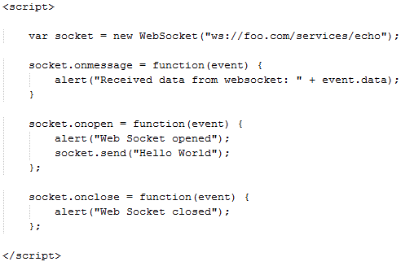
Web Sockets (cont.)
In order to use WebSockets from a compliant browser we use standard WebSocket API in client side JavaScript.

Slide 19
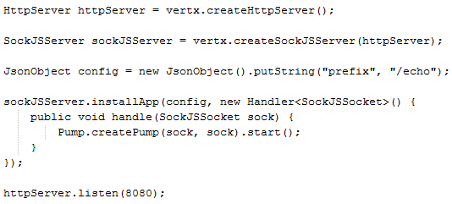
Web Sockets (cont.)
SockJS is aclient side JavaScript library and protocol which provides simple WebSocket interface.
Vert.x provides complete server side SockJS implementation.
To create SockJS server we call createSockSJServer(httpServer) in order to create SockJSServer object.
JSON object needs some configuration like: prefix ,insert_JSESSIONID, session_timeout, heartbeat_period, max_bytes_streaming, library_url.

Slide 20
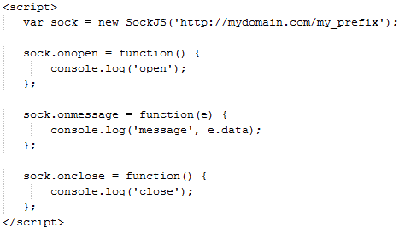
Web Sockets (cont.)
Sample SockJS JavaScript client sample.

Slide 21
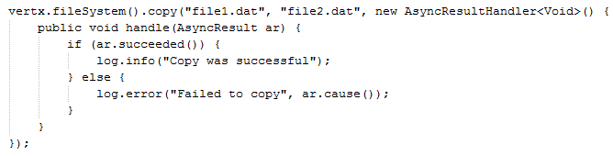
File System
Vert.x can manipulate files on the file system.
File system operations are asynchronous and all is done via handlers.
The handler is called when the operation is completed.
Usual operations: copy, move, truncate, chmod, props, lprops, link, unLink, symLink, readSymLink, delete, mkdir, readDir, readFile, writeFile, createFile,exists, open.
Instace of AsyncFile is returned from calls to open and we can use them to read/write to files asynchronously.

Slide 22
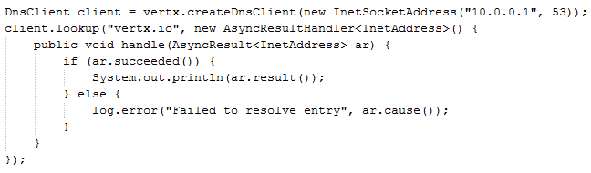
DNS Client
Vert.x has it's own API for DNS resolution which is fully asynchronous.
Useful methods: lookup, lookup4, lookup6, resolveA, resolveAAAA, resolveCNAME, resolveMX, resolveTXT, resolveNS, resolveSRV, reverseLookup.

Slide 23
Distribution
Because Vert.x is built in Java, the distribution package is the same regardless of your operating system or hardware.
The version can be checked using: “vertx version “ command from bin folder.
Vert.x can run embedded in java applications.
The JARs are available in the Vert.x installation directory, and also as Maven dependencies.

Slide 24
Conclussion
PROS:
Performance
Fewer dependencies
Embedded SockJS
Built in clustering
CONS:
No WAR deployments
Async programming challenges

Slide 25

Bibliography
http://en.wikipedia.org/wiki/Vert.x
PacktPub Real-time Web Application Development using Vert.x.2.0
http://vertx.io
http://www.cubrid.org/blog/dev-platform/understanding-vertx-architecture-part-2/

Slide 26
Questions ?

