Slide 1

WS-BPEL
Dima Ionut Daniel

Slide 2
Contents
What is WS-BPEL?
Goals
Why WS-BPEL?
WS-BPEL 2.0 features
Implementations
Apache ODE Features
Apache ODE Arhitecture
Riftsaw Features
Riftsaw Arhitecture
Orchestration
BPEL Activities
BPEL Process
Correlation Sets
Conclusions
Bibliography

Slide 3

What is WS-BPEL?
WS-BPEL is an XML-based language for defining business processes that orchestrate web services.
WS-BPEL is an OASIS standard executable language for specifying actions within business processes with web services.
With WS-BPEL we build a business process by integrating a collection of Web services into a business process flow.
BPEL is an orchestration language that specifies an executable process that involves message exchanges with other systems.
BPEL stands for Business Process Execution Language.

Slide 4
Goals
define business processes that interact with external entities through web service operations defined using WSDL 1.1.
define business processes using an XML-based language.
define a set of Web service orchestration concepts that are used for business process.
provide data manipulation functions for the simple manipulation of data needed to define process data and control flow.
support the implicit creation and termination of process instances as the basic lifecycle mechanism.(ex: suspend, resume).
define a long-running transaction model.
use Web Services as the model for process decomposition and assembly.
build on Web services standards.
supports XPath 1.0 by default.

Slide 5
Why WS-BPEL?
Integration
Intra-enterprise integration (Enterprise Application Integration)
Integrating with partners (Business-to-Business Integration)
Web services
Applications are viewed as "services"
Loosely coupled, dynamic interactions
Heterogeneous platforms
No single party has complete control
WSDL defined Web services as a stateless interaction model.
BPEL provides the ability to express stateful, long-running interactions.

Slide 6
WS-BPEL 2.0 features
New activities types: repeatUntil, validate, forEach (parallel and sequential), rethrow, extensionActivity, compensateScope
Renamed activities: switch/case renamed to if/else, terminate renamed to exit
Termination Handler added to scope activities to provide explicit behavior for termination
Variable initialization
XSLT for variable transformations
XML schema variables in Web service activities
Locally declared messageExchange
Clarification of Abstract Processes
Enable expression language overrides at each activity

Slide 7
Implementations
WS-BPEL is implemented by:
Apache ODE
Jboss Riftsaw
OW2 Orchestra – OW2
WSO2 Business Process Server
Open ESB – Oracle
Oracle BPEL Process Manager was included in Oracle SOA Suite
Petals ESB
BizTalk Server – Microsoft
SAP Exchange Infrastructure – SAP AG
WebSphere Process Server - IBM

Slide 8
Apache ODE Features
Support for both the WS-BPEL 2.0 OASIS standard and the legacy BPEL4WS 1.1 vendor specification.
Supports 2 communication layers: Axis2 and JBI.
Support for the HTTP WSDL binding, allowing invocation of REST-style web services.
Hot-deployment of your processes.
Compiled approach to BPEL that provides detailed analysis and validation at the command line or at deployment.
Management interface for processes, instances and messages.
High level API to the engine that allows you to integrate the core with virtually any communication layer.

Slide 9
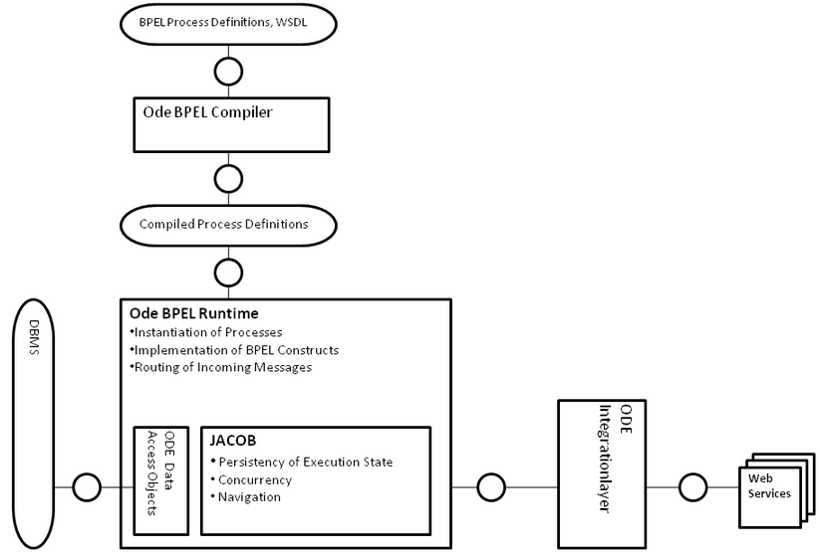
Apache ODE Arhitecture
ODE architecture include the ODE BPEL Compiler, ODE BPEL Engine Runtime, ODE Data Access Objects (DAOs), ODE Integration Layers (ILs), and user tooling.

Slide 10
Apache ODE Arhitecture (cont.)
ODE BPEL Compiler
responsible for the conversion of the source BPEL artifacts into a compiled representation suitable for execution.
compiled BPEL representation is an object model similar in structure to the underlying BPEL process document.
the compiled representation (.cbp extension) is the main artifact required by the BPEL runtime.
ODE BPEL Engine Runtime
executes the compiled BPEL processes.
the runtime relies on Data Access Objects (DAOs) to provide persistence facilities.
uses JaCob(Java Concurrent Objects) framework.
JaCOb provides a persistent virtual machine for executing BPEL constructs.
ODE Data Access Objects
interaction between the BPEL Engine Runtime and an persistent data store.
the data store is a JDBC relational database.
ODE Integration Layers
it relies on an the ODE Integration Layers (ILs).
there are integration layers for AXIS2 and JBI
thread scheduling mechanisms
manages the life-cycle of the runtime

Slide 11
Riftsaw Features
Riftsaw is based on Apache ODE(Orchestration Director Engine) :
WS-BPEL 2.0 OASIS standard and the legacy BPEL4WS 1.1 vendor specification.
JBossWS Native and CXF Web Service stack support
UDDI registration of BPEL endpoints
High level API for integration.
Process persistence & recovery.
Process versioning.
Ant-based deployment.
Integrated with the JBoss ESB.
Eclipse-based BPEL designer and deployment(JBoss Tools)
Short-lived and long-running process executions
JBoss deployment architecture, enabling hot deployment.

Slide 12
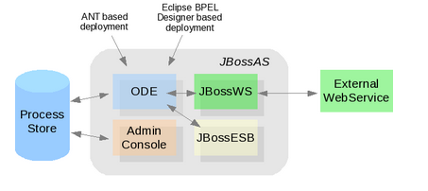
Riftsaw Arhitecture
RiftSaw project also provides a GWT based administration console.
RiftSaw replaces the Axis2 based transport with JBossWS(can be configured to use Apache CXF).
RiftSaw provides tighter integration with JBossESB.

Slide 13
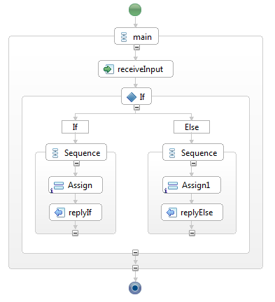
Orchestration
Orchestration takes control over the business services and coordinates the execution of different operations on the services involved in the process.
The involved services do not know and do not need to know that they are involved in an orchestrated process.
This centralized orchestration is called an executable business process.

Slide 14
BPEL Activities
Most common BPEL activities:
<process> - root element of each BPEL process definition
<invoke> - invoke operations on WS.
<receive> - waiting for incoming message request.
<reply> - generate synchronous response, most often as a result of a completed process.
<assign> - for assigning variables and partner links.
<sequence> - define activities that will be invoked in an ordered sequence
<flow> - define activities that will be invoked in parallel
<switch> - implement branches.
<while> - define loops
<pick> - select one of a number of alternative paths
<throw> - indicate faults
<faultHandler> - define fault handler
<scope> - group activities into logical scopes
<wait> - delay execution of a process for a specific period of time
<terminate> - terminate the entire process
<variable>,<variables> - section for declaring variables

Slide 15
BPEL Process
A client will usually invoke an operation on the BPEL process to start it.
BPEL process operation can be synchronous or asynchronous.
The WS-BPEL process can be Abstract or Executable.
Results from asynchronous processes are usually sent back to the client using callbacks.
BPEL process is a web service itself and receives invocations from its clients.
BPEL processes have three type of handlers:
Fault handlers are invoked when a fault occurs.
Event Handlers allow a process to react to external events.
Compensation handlers used for rollback.
There are 2 types of events:
message events: triggered by incoming messages
alarm events: time related events

Slide 16
BPEL Process (cont.)
Each BPEL process will have at least the following parts:
Declaration of partner links
Declaration of variables
Process sequence
Partner links define different parties that interact with the BPEL process.
Partner Links are clients that are calling web services.
Variables are used to store messages and to reformat and transform them.
Variables are used to store messages that are exchanged between BPEL process partners.
The process definition is the heart of each BPEL process.

Slide 17
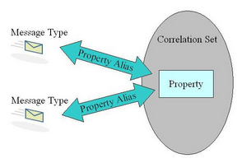
Correlation Sets
CSs represents the data that is used to maintain the state of the interaction("conversation").
At the process end of the interaction, CSs allow incoming messages to reach the right process instance.
We can use correlation sets in invoke, receive, pick, and reply activities to indicate which correlation sets occur in the messages that are sent and received.
The values of each correlation set uniquely identify the process instance.

Slide 18
Conclusions
Portability and Interoperability
Flexible Integration
Third-party composition of existing services
Increased scalability and reuse
Stateful conversations and lifecycle management
Supports multiple stateful long-running conversations

Slide 19

Bibliography
http://en.wikipedia.org/wiki/Business_Process_Execution_Language
https://community.jboss.org/wiki/RiftSaw
http://www.jboss.org/riftsaw
GettingStartedGuide.pdf (from Riftsaw distribution)
UserGuide.pdf (from Riftsaw distribution)
http://ode.apache.org/developerguide/architectural-overview.html
http://en.wikipedia.org/wiki/Apache_ODE
PacktPub - SOA Approach to Integration
http://docs.oasis-open.org/wsbpel/2.0/wsbpel-v2.0.pdf
https://blogs.oracle.com/reynolds/entry/bpel_correlation

