Slide 1

Rest – Web Service
Dima Ionut Daniel

Slide 2
Contents
What is REST?
RESTful web services
What is JAX-RS?
WADL
JAX-RS annotations
JAX-RS Code
JAX-RS Advanced
JAX-RS Deployment
JAX-RS Security
JAX-RS Scaling
HATEOAS
JAX-RS Implementations
JAX-RS 2.0
Conclusions
Bibliography

Slide 3

What is REST?
REpresentational State Transfer (REST) is a style of software architecture for distributed systems such as the World Wide Web.
REST has increasingly replaced other design models such as SOAP and WSDL due to its simpler style.
REST is client/server architecture.
REST does not require XML parsing and does not require a message header to and from a service provider.
REST goals: scalability, enforce security, simplifies component implementation, separation of concerns.
The important concept in REST is the existence of resources (sources of specific information), which is referenced with a global identifier (URI).
Requests and responses are built around the transfer of representations of resources.
The final principle of REST is the idea of using Hypermedia As The Engine Of Application State (HATEOAS).

Slide 4
RESTful web services
A RESTful web service (RESTful web API) is a web service implemented using HTTP and the principles of REST.
Set of operations supported by the web service using HTTP methods: GET, PUT, POST, or DELETE.
The PUT and DELETE methods are idempotent methods.
The GET method is a safe method (or nullipotent), meaning that calling it produces no side-effects
The PUT method can be use to create/update resources.
The POST method is common use to create/update resource.
The DELETE method is used to delete resources.
Data interchange can be in many formats: XML,XHTML, Text, JSON, etc.

Slide 5
What is JAX-RS?
JAX-RS represents Java API for RESTful Web Services is a Java programming language API that provides support in creating web services according to the Representational State Transfer (REST) architectural style.
JAX-RS uses annotations, introduced in Java SE 5, to simplify the development and deployment of web service.
JAX-RS 1.1(JSR-311) was added to Java EE 6.
In Java EE there is no configuration necessary to start using JAX-RS.
For non-Java EE 6 environments a small entry in the web.xml deployment descriptor is required.
JAX-RS 2.0(JSR-339) is still in review phase and the public release is planed for spring 2012. It’s in discussion if the new API will be included in Java EE 7 stack.
JAX-RS implementation:
Apache CXF
Jersey (reference implementation from Sun)
RESTeasy (JBoss implementation)
Restlet
Apache Wink

Slide 6
WADL
The Web Application Description Language (WADL) is an XML document format that describes web applications.
WADL is the WSDL of RESTful web services.
WADL allows service providers to document the resources offered, the HTTP methods that we can use on those resources and the representation formats supported.
WADL is not yet widely supported.
WADL is more easy to understand than the WSDL.

Slide 7
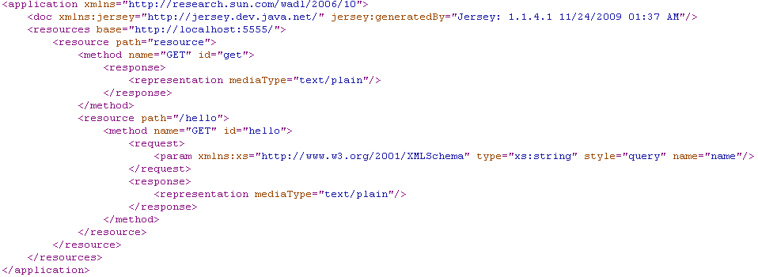
WADL
From the WADL generated file(Jersey implementation) we can see that there are 2 resources: resource and resource/hello.
The “resource” resource generates “test/plain” content and accepts GET http method.
The “resource/hello” resource generates “test/plain” content and has a query String input parameter named name.

Slide 8
JAX-RS annotations
JAX-RS provides annotations to help in mapping a resource class (a POJO) to a web resource.
@Path specifies the relative path for a resource class or method.
@GET, @PUT, @POST, @DELETE and @HEAD specify the HTTP request type of a resource.
@Produces specifies the response MIME media types.
@Consumes specifies the accepted request media types.
JAX-RS provides a mechanism to extract information from request using:
@PathParam binds the parameter to a path segment.
@QueryParam binds the parameter to the value of an HTTP query parameter.
@MatrixParam binds the parameter to the value of an HTTP matrix parameter.
@HeaderParam binds the parameter to an HTTP header value.
@CookieParam binds the parameter to a cookie value.
@FormParam binds the parameter to a form value.
@DefaultValue specifies a default value for the above bindings when the key is not found.

Slide 9
JAX-RS Core
If we want to access the all method body we use InputStream as input parameter to our WS method.
In JAX-RS, any non-JAX-RS-annotated parameter is considered to be a representation of the HTTP input request’s message body.
The method javax.ws.rs.core.Response can create a Response object that contains an HTTP status code.
The javax.ws.rs.WebApplicationException is an uncheck comes in handy to wrap exceptions into HTTP Response codes.
We could write manually to the client using java.io.OutputStream. In JAX-RS we implement and return an instance of the javax.ws.rs.core.StreamingOutput interface, method write().
The interface javax.ws.rs.core.UriInfo provides data about the request.
We can view all headers within the incoming request using javax.ws.rs.core.HttpHeaders interface.
We can obtain an instance of the UriInfo or HttpHeaders by using the @javax.ws.rs.core.Context injection annotation.

Slide 10
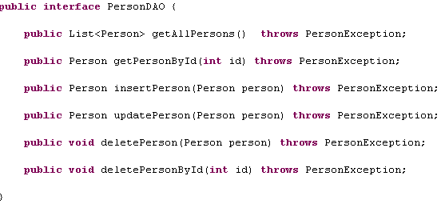
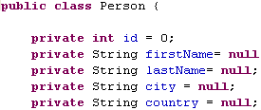
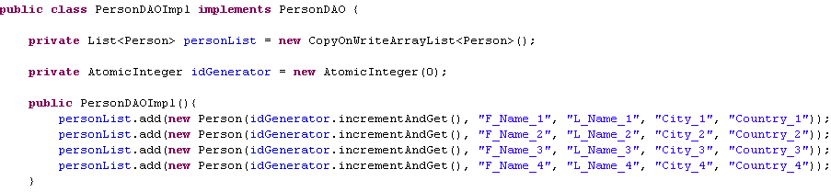
JAX-RS Core

Slide 11
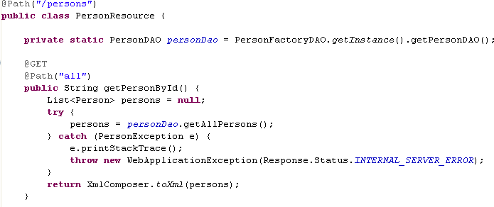
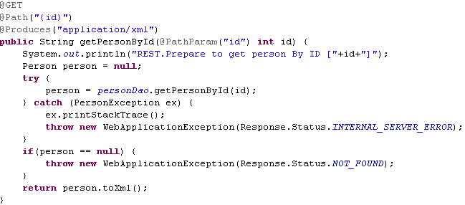
JAX-RS Core
We map PersonResource class to /persons URL.
When the URL /persons/all will be called using a GET HTTP method the method getPersonById will be executed and will return a String.
Also when the URL /persons/{some-id} will be called using the GET method the method getPersonById will be called and will produce a String output that is wrapper inside the HTTP body.

Slide 12
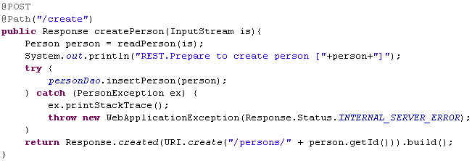
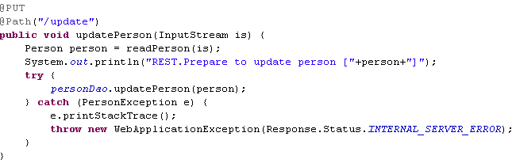
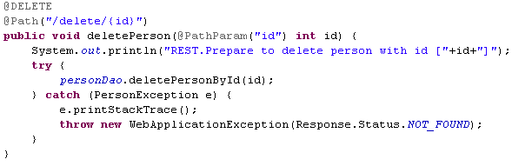
JAX-RS Core
When POST, PUT and DELETE requests will be called to the specific URL paths defined in the Rest implementation the code will be executed and will generate an output.
The Response class can be use to easy generate an HTTP Response.

Slide 13
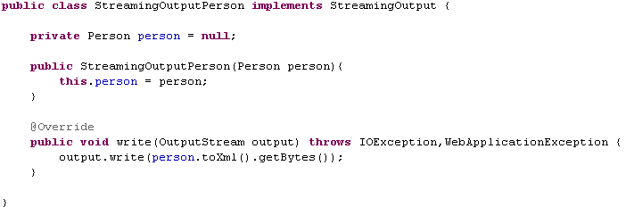
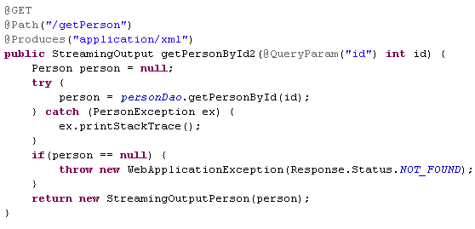
JAX-RS Core
We can use custom StreamingOutput implementation to generate output that will be send to the REST client.

Slide 14
JAX-RS Advanced
JAX-RS converts data into any Java type, provided that it matches one of the following criteria:
It's a primitive type: int, short, float, double, byte, char, and boolean types.
It is a Java class that has a constructor with a single String parameter.
Types that have a static method named valueOf with a single String argument.
List<T>, Set<T>, or SortedSet<T>, where T satisfies the above conditions.
The ResponseBuilder class is a factory that is used to create one individual Response instance.
In JAX-RS we use @Provider is use to declare custom providers. By default a single instance of each provider class is instantiated for each JAX-RS application.
As example to plug the JAXBContext instances we implement javax.ws.rs.ext.ContextResolver to override the default JAXBContext.
Default the JSON provider is setup and we can produce json output if we setup @Produces("application/json").
Entity providers supply mapping services between representations and their associated Java types: MessageBodyReader and MessageBodyWriter.

Slide 15
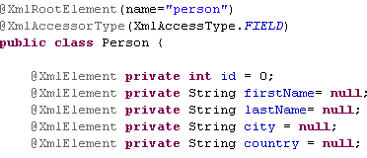
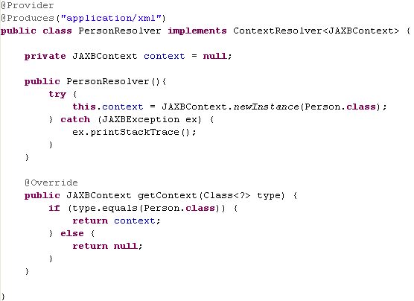
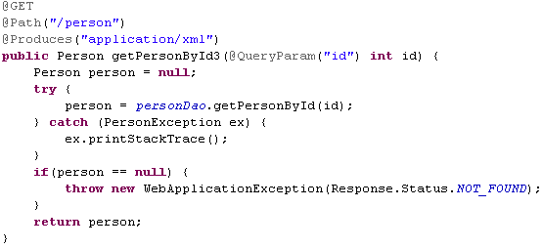
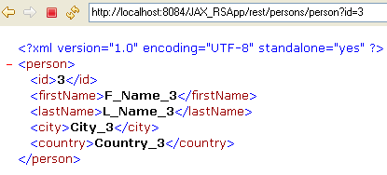
JAX-RS Advanced

Slide 16
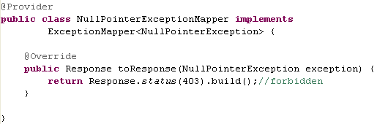

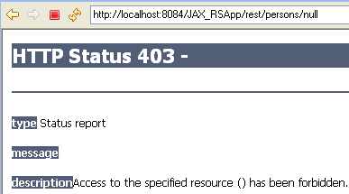
JAX-RS Advanced
We can implement and register instances of javax.ws.rs.ext.ExceptionMapper to map exceptions to Response objects as Provider.
JAX-RS supports exception inheritance.

Slide 17
JAX-RS Security
Java EE provide a set of security services and protocols for RESTful web services. They are:
Authentication - the validity of the identity of a client that is trying to access resources/services. Modes: BASIC, DIGEST, Client Certificate
Authorization - certain user is allowed or not to access and invoke on a specific URI. Can be set for certain roles/groups.
Encryption - encrypting the communication exchange data using HTTPS/SSL.
JAVA EE annotations from the javax.annotation.security package and are @RolesAllowed, @DenyAll, @PermitAll and @RunAs.
The javax.ws.rs.core.SecurityContext interface can determine the identity of the user making the secured HTTP invocation.

Slide 18
JAX-RS Deployment
JAX-RS applications can be deployed within a servlet container. We need to define a web.xml file for the JAX-RS application. The javax.ws.rs.core.Application class is the only portable way of telling JAX-RS as well which providers we want to deploy.
The getClasses() method returns a list of JAX-RS web service and @Provider-annotated classes.
The getSingletons() method returns a list of preallocated JAX-RS web services and @Provider-annotated classes.
If we are running within a JAX-RS-unaware servlet container, the JAX-RS implementation needs to register a custom Servlet.
If we are deploying into a JAX-RS-aware servlet container, we register the Application implementation as a servlet.
In Java EE 6, the servlet container is JAX-RS-aware and supports declaring an Application class as a servlet within web.xml. Classes annotated with @Path and @Provider will be scanned and deployed.
JAX-RS resource classes are required to support Java EE injection annotations like @Resource, @PersistenceContext, @PersistenceUnit, and @EJB.

Slide 19
JAX-RS Scaling
Caching is one of the more important features of the Web. Any service that provides static unchanging data is an candidate.
In HTTP 1.0 the response header called Expires tells the browser that it can cache and for how long.
In HTTP 1.1 the Expires header was deprecated in favor of the Cache-Control header.
The ResponseBuilder class has a method called cacheControl() that can accept a CacheControl object.
Example: Expires: Tue, 15 May 2010 16:00 GMT
Example Cache-Control: private, no-store, max-age=300
The server will send back a Last-Modified and/or an ETag header(MD5 hash) with its initial response to the client.
JAX-RS provides an injectable helper class called javax.ws.rs.core.Request, with the evaluatePreconditions() method that takes a javax.ws.rs.core.Entity as argument.
We can use from input POST/PUT/DELETE requests the following headers: ETag, Last-Modified, If-Match, If-Unmodified-Since to identify if similar request was made and not do the same CRUD operations on the server-side.

Slide 20
HATEOAS
The final principle of REST is the idea of using Hypermedia As The Engine Of Application State (HATEOAS).
Hypermedia is a document approach with the added support for embedding links to other services and information within that document format.
The idea of HATEOAS is that your data format provides extra information on how to change the state of your application.
The idea is to embed links within your XML or JSON documents.
As example, we want to get a list of products available.
<products>
<product id="89“><name>headphones</name><price>$26.89</price></product>
<product id="90“><name>Mouse</name><price>$7</price></product>
</products>
This could be problem if we had lots of products to send back to the client. Instead we could list only the first 10 products and provide a link to get the next set.
<products>
<link rel="next" href="http://domain.com/store/products?startIdx=10"/>
<product id="89“><name>headphones</name><price>$26.89</price></product>
...
</products>

Slide 21
JAX-RS Implementations
Jersey
Jersey is the open source reference implementation of JAX-RS.
Jersey is usually deployed within a servlet container and also can be embedded within simple Java application.
The Jersey client API is a high-level Java-based API for interoperating with any RESTful web service.
Jersey generates a WADL document for any individual resources.
The jersey-multipart module adds the capability to read multipart/form-data request using @FormDataParam annotation.
Jersey has the capability to provide support for the MVC pattern.
Jersey has support for EJB, Spring, and Guice 2.0.
Apache CXF
Apache CXF is a popular open source web services framework, has client API and has many options for doing request interception. In addition, Apache CXF allows you to register request and response filters, custom invokers.
We can control the life cycle of a given invocation so that it can perform asynchronous activity.
Apache CXF has both an implementation of the Distributed OSGi (DOSGi) specification.
CXF supports the auto-generation of WADL instances.

Slide 22
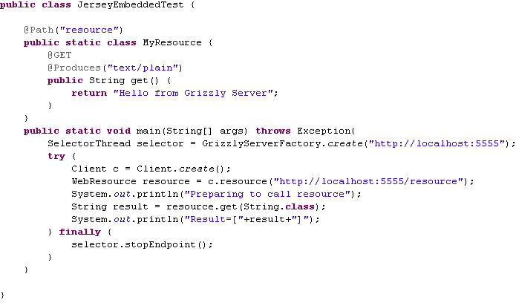
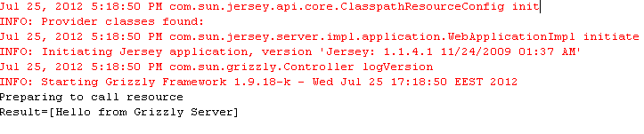
JAX-RS Implementations

Slide 23
JAX-RS Implementations
RESTEasy
JBoss RESTEasy is Red Hat’s implementation of JAX-RS and has embedded features.
The @Suspend annotation tells RESTEasy to suspend the request processing of the current thread so that a different thread can process the HTTP response.
RESTEasy can intercept JAX-RS invocations and route them through interceptors.
RESTEasy also has an in-memory server-side cache and client-side cache features.
RESTEasy supports tight integration with JBoss Seam, EJB, Spring, and Guice.

Slide 24
JAX-RS 2.0
JSR 339 – JAX-RS 2.0
Client API was added to access Web resources.
Filters and Interceptors are a benefit to separate business logic from certain common features: log, security,etc.
The Bean Validation specification is added to support the input request parameters validation.
With JAX-RS 2.0, asynchronous processing is supported both in the Client API and in the Server API.
JAX-RS 2.0 has improved the connection negotiation.

Slide 25
Conclusions
We can expose POJO and other services very easy to HTTP Clients using JAX-RS annotations.
JAX-RS allows to customize the format of the output very easy.
We can plug JAXB, JSON, XML and other default or custom providers for the exchange format.
We can use CRUD operations and mapped them to HTTP methods.
The exception handler is very useful.
The exchange data between client and server is less than using classic SOAP requests(lost of payload).
JAX-RS can be use inside or outside a Java EE container.

Slide 26

Bibliography
http://en.wikipedia.org/wiki/Restful_web_service
http://en.wikipedia.org/wiki/Representational_state_transfer
http://en.wikipedia.org/wiki/Web_Application_Description_Language
http://en.wikipedia.org/wiki/Java_API_for_RESTful_Web_Services
Restful Java with Jax-RS.pdf
JSR 311 - jaxrs-1.0-final-spec.pdf
JSR 339 - jaxrs-2_0-edr3-spec.pdf

