Slide 1

WebSocket
Dima Ionut Daniel

Slide 2
Contents
What is WebSocket?
Why WebSocket?
WebSocket Protocol
WebSocket W3C API
WebSocket implementations
WebSocket JSR 356
Conclusions
Bibliography

Slide 3

What is WebSocket?
Web Socket represents:
technology providing full-duplex communications channels over a single TCP connection.
a protocol standardized by IETF as RFC 6455.
API that is being standardized by W3C.
Java API being standardized under JSR 356.
Web is designed to be implemented in web browsers and web servers.
The protocol is designed to create more interaction between a browser and a web site. Previous to this technology the same effect can be made using non-standardized ways using Comet(Reverse Ajax).
Currently WebSocket is supported in several browsers like: Google Chrome, Internet Explorer, Firefox, Safari, Opera.

Slide 4
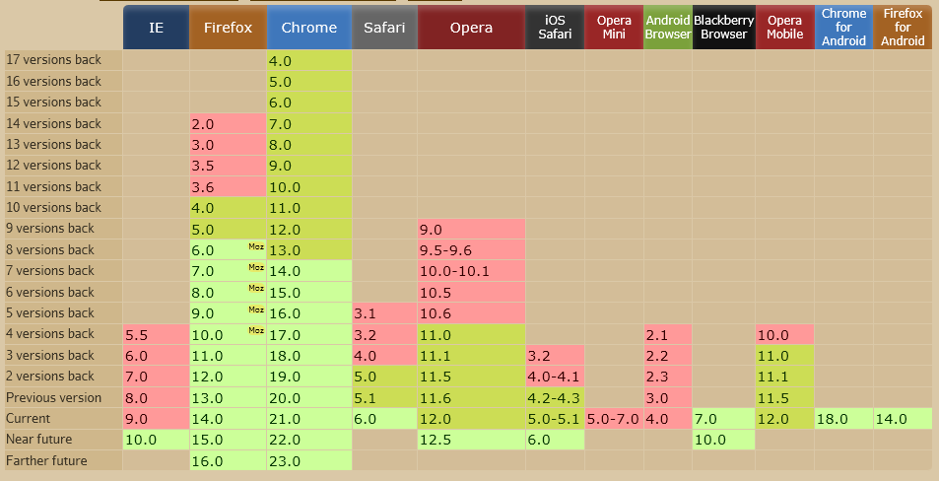
What is WebSocket?
From global user statistics only 48.31% from internet users have the browser compatible to this technology.

Slide 5
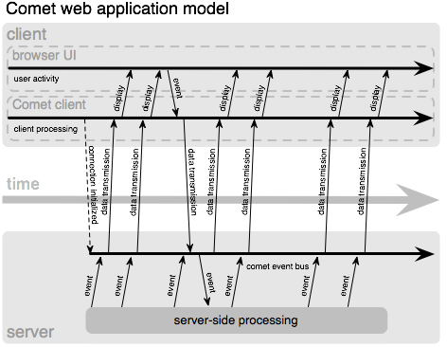
Why WebSocket?
Many of web applications need “real-time” communication with minimal latency(online games, collaborative platforms, social networks, financial applications, etc).
HTTP is half-duplex and it’s hard to achieve real-time applications because of this limitation.

Slide 6
Why WebSocket?
Web applications are using Ajax or Commit to simulate real-time communications. In the case of Comet lots of traffic is made because of the long polling strategy used.
WebSocket uses “frames” for information exchange and the polling overhead is removed.
The WebSocket connection is established by upgrading from HTTP to WebSocket protocol.
The WebSocket protocol specification defined 2 URI schemas: ws: and wss: for unsecure and secure connections respectively.

Slide 7
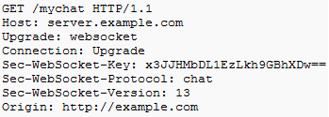

WebSocket Protocol
The protocol has 2 parts: handshake and data transfer.
Example of WebSocket handshake is described bellow:
The client sends a Sec-WebSocket-Key encoded base64.
The handshake answer has Sec-WebSocket-Accept for a success handshake.

Slide 8
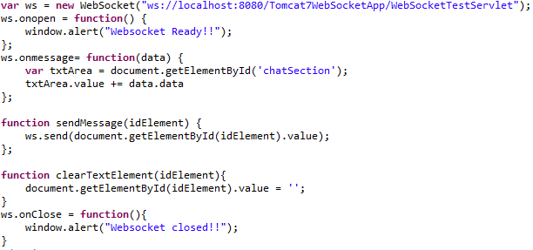
WebSocket W3C API
The WebSocket W3C API contains the WebSocket interface.
The interface contains callback functions like: onopen, onmessage, onerror, onclose, methods like send,close

Slide 9
WebSocket implementations
Before JSR 356, WebSocket was implemented in Java in non-standardized ways by:
Apache Tomcat 7
Atmosphere
GlassFish 3.1, Grizzly
Jboss 7
Jetty 8, 9
jWebSocket
Netty 3.3.x
Vert.x

Slide 10
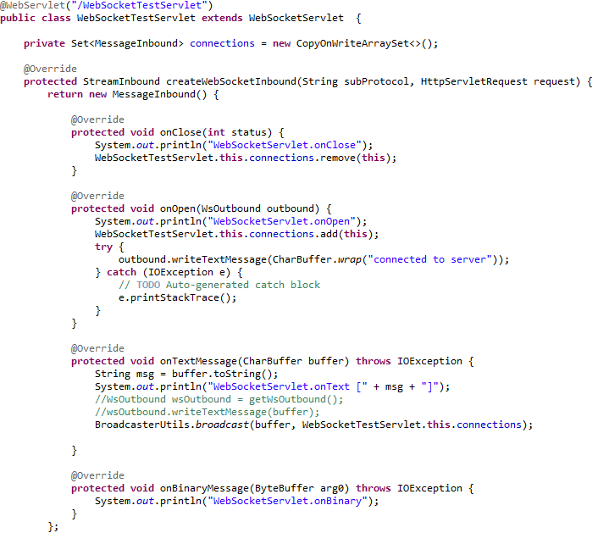
WebSocket implementations
Apache Tomcat 7 provides WebSocketServlet that contains the createWebSocketInbound method. The method return a StreamInbound object. The object implementation contains methods like: onClose, onOpen, onTextMessage, onBinaryMessage.
All Tomcat 7 specific to WebSocket implmentation can be found in the package: org.apache.catalina.websocket

Slide 11
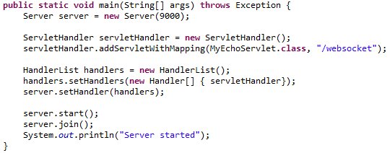
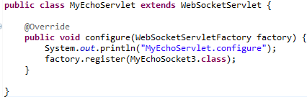
WebSocket implementations
Jetty 9 has a proprietary WebSocket Java API. There are 3 ways to build WebSocket server side components using Jetty 9. All of these methods needs to be configured into the WebSocketServlet.
1)Using WebSocketListener interface
2)Using WebSocketAdapter class
3)Using annotations: @WebSocket, @OnWebSocketMessage, @OnWebSocketConnect, @OnWebSocketClose, @OnWebSocketFrame.

Slide 12
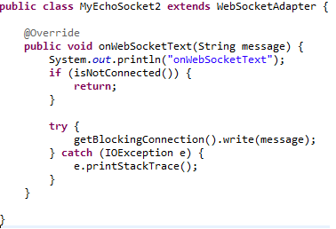
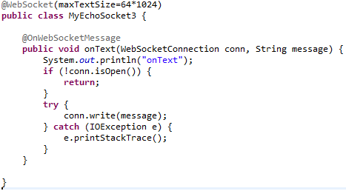
WebSocket implementations
Above there are some examples using Jetty 9 WebSocket API.

Slide 13
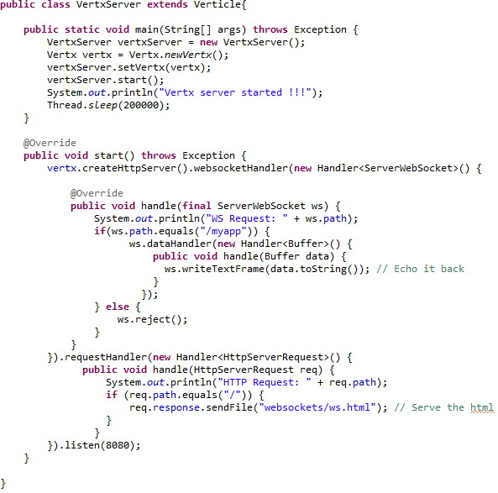
WebSocket implementations
Using Vert.x java library we can create very easy a server that handles websocket connections and HTML content.
We need to extend the Verticle class and create a websocket handler.

Slide 14
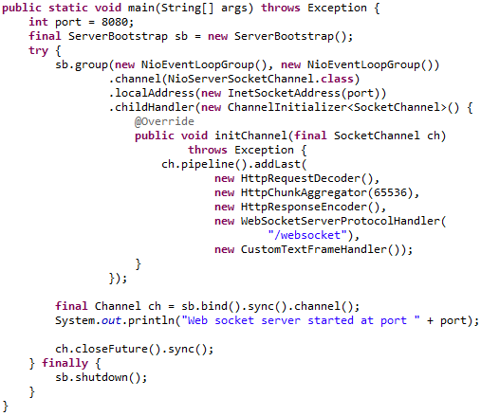
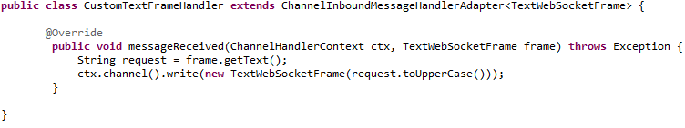
WebSocket implementations
Using Netty 4 package io.netty.handler.codec.http.websocketx we can handle websocket protocol on server side.

Slide 15
WebSocket JSR 356
WebSocket implementation is a combination of IETF RFC 6455 protocol and W3C JavaScript API.
The API enables web pages to use WebSocket protocol for two-way communication with the remote host.
Tyrus represents an open source Web Socket RI for JSR 356.
Tyrus is already integrated into GlassFish 4.0 Promoted builds.
A websocket connection is the networking connecting between the two endpoints which are interacting using the websocket protocol.
A websocket session is used to represent a sequence of websocket interactions between an endpoint and a single peer.

Slide 16
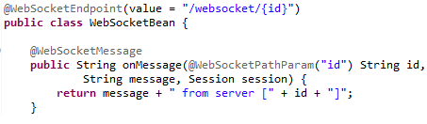
WebSocket JSR 356
The abstract class javax.websocket.Endpoint represents one side of a sequence of websocket interactions between two connected peers and contains methods like onOpen, onClose, onError.
As alternative @WebSocketEndpoint annotation indicates that a Java class is to become a websocket endpoint at runtime.
@WebSocketOpen and @WebSocketClose annotations allow the developers to decorate methods on their @WebSocketEndpoint.
The @WebSocketMessage is used to process incomming messages.
The @WebSocketPathParam is used for retrieving path information.

Slide 17
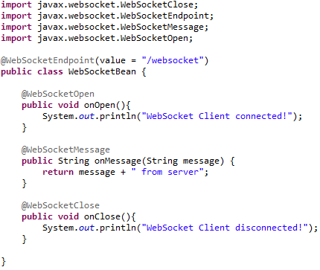
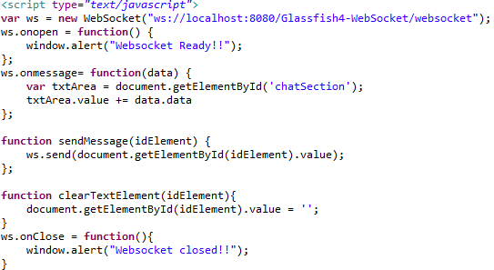
WebSocket JSR 356
WebSocket implementation and JavaScript setup for communication.

Slide 18
Conclusions
PROS:
Delivers full duplex communication model for the Web
Increases client and server communication efficiency
Easy to use API

Slide 19

Bibliography
http://en.wikipedia.org/wiki/WebSocket
http://tools.ietf.org/html/rfc6455
https://netty.io/Blog/WebSocket+Enhancement
http://webtide.intalio.com/2012/10/jetty-9-updated-websocket-api/
https://blogs.oracle.com/arungupta/entry/websocket_applications_using_java_jsr
https://wikis.oracle.com/display/GlassFish/PlanForGlassFish4.0
JavaWebSocket_JSR356_011_PublicDraft.pdf

