Slide 1

jUDDI
Dima Ionut Daniel

Slide 2
Contents
What is jUDDI?
Features
Arhitecture
UDDI
Authentication
Data Model
UDDI SOAP API
jUDDI Client
Internals
Conclusions
Bibliography

Slide 3

What is jUDDI?
jUDDI is an open source Java implementation of the UDDI v3 specification for (Web) Services.
UDDI stands for Universal Description, Discovery, and Integration.
jUDDI project includes Scout(implementation of the JSR 93 - JavaTM API for XML Registries 1.0).

Slide 4
Features
Can be deployed on any Servlet 2.3 server compliant.
supports clustered deployment configuration.
easy integration with authentication systems
supports InVM embeddable mode
UDDI v3 compliant
UDDI v2 compliant

Slide 5
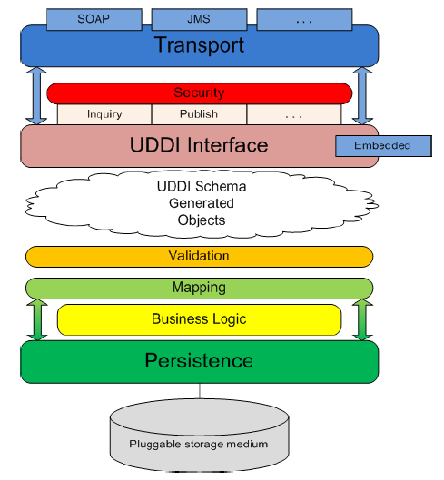
Arhitecture
Tranport: receive and send messages.
Security: provided by UDDI specification
UDDI Interface: methods for interaction with the registry.
UDDI Schema Objects: XML schema for data structures.
Validation
Mapping: mapping UDDI schema objects to persistance layer.
Business Logic: works with persistance layer.
Persistence: responsible for persisting registry data

Slide 6
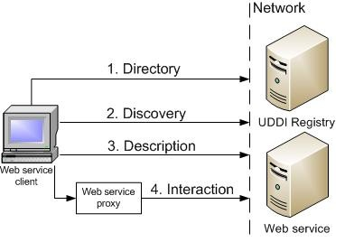
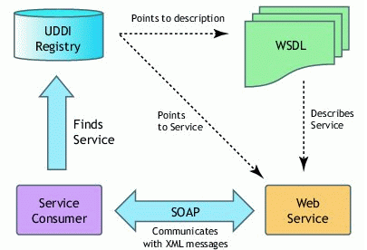
UDDI
UDDI is a set of Web Service that supports the description and discovery of Web service providers.
UDDI v3 defines 9 SOAP APIs based for interoperability reasons.
Core UDDI API:
Security API: API for security token.
Inquiry API: locate and obtain details on entries in the UDDI registry.
Publication API: publish and update information in the UDD registry.
Subscription API: API to register for updates on a particular business service.
Replication API: API used for replication registry between UDDI nodes.
Custody Transfer API: transfer of custody between UDDI nodes.

Slide 7
Authentication
Each request to jUDDI needs a valid authToken.
The property juddi.auth in the juddi.properties configuration file can be used to configure how jUDDI is going to check the credentials passed in on the GetAuthToken request.
Custom implementation can be made using org.apache.juddi.auth.Authenticator interface.
Authenticators:
JUDDIAuthenticator: default
XMLDocAuthentication: users are defined in a XML file
CryptedXMLDocAuthentication: similar with XMLDocAuthentication, but passwords are encrypted
LdapSimpleAuthenticator: authentication using ldap simple authentication(juddi.auth.url needs to be config)
JBossAuthenticator: a custom JAAS implementation

Slide 8
Authentication (cont.)
There are two phases involved in Authentication:
authenticate
identity
The goal of authentication phase is to turn a user id and credentials into a valid publisher id("authorized name" in UDDI terminology).
Upon completion of the GetAuthToken request, an authentication token is issued to the caller.
The identify phase is responsible for turning the authentication token into a valid UddiEntityPublisher object.
The UddiEntityPublisher object contains all the properties necessary to handle ownership of UDDI entities.

Slide 9
Data Model
UDDI identifies five basic data structures:
businessEntity: who is registering
businessService: the name and description of the service being published.
bindingTemplate: information about the service,entry-point address for accessing the service.
tModel: collection of information uniquely identifying the service specification.
publisherAssertion: relationship between businessEntity structures.
When the data is submitted for the first time the UDDI operator assigns a GUI (globally unique identifier).
Queries can be made based on identifiers or category keys.
BindingTemplate structure include the following URL types: mailto, http, https, ftp, fax, phone, other.
A tModel uniquely identifies a Web service.
A tModel can be shared by multiple businesses.

Slide 10
UDDI SOAP API
UDDI APIs are separated into publisher and consumer APIs.
The registration APIs are used by publishers.
The search APIs are used by registry consumers to find business information.
Publishers must be authorized by operators.
UDDI accepts HTTP POST operations only.
Inquiry APIs:
find_binding: locates binding info an return bindinDetail that includes access point.
find_business: main API for the initial search; return business list message.
find_relatedBusinesses: business related info.
find_service: return specific services.
find_tModel: return tModel structures.
get_bindingDetail: return bindingTemplate information.
get_businessDetail: full detail for a specific registered business.
get_businessDetailExt: retrieves extended information.
get_serviceDetail: return information about a given set of registered business service.
get_tModelDetail: full details for a set of registered tModel data.

Slide 11
UDDI SOAP API (cont.)
Publisher APIs is used store, update, and delete registry information.
add_publisherAssertions: adds relationship assertions
delete_binding: removes a bindingTemplate
delete_business: deletes a registered businessEntity
delete_publisherAssertions: deletes relationship information
delete_service: deletes a registered businessService
delete_tModel
get_assertionStatusReport
get_publisherAssertions: lists active assertions for a given publisher
get_registeredInfo: summary information registered .
save_binding
save_business
save_service
save_tModel
set_publisherAssertions

Slide 12
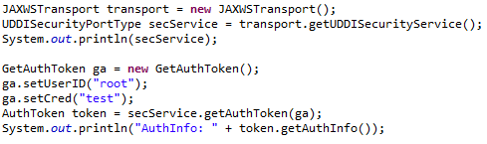
jUDDI Client
The jUDDI-Client uses the UDDI v3 API and connect to the Registry.
The UDDI client has a configuration file called uddi.xml.
Using the uddi.xml file the client will use JAX-WS to communicate with the (remote) registry server.

Slide 13
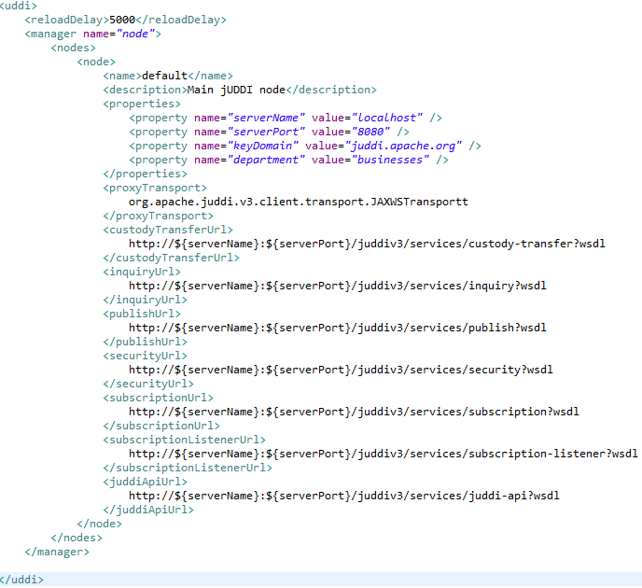
jUDDI Client (cont.)

Slide 14
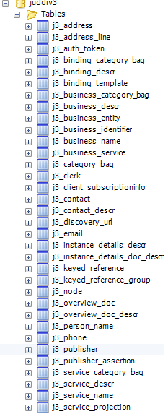
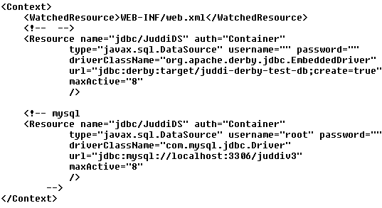
Internals
By default jUDDI uses an embedded Derby database.
UDDI uses the Java Persistence API (JPA).
The persistence file can be found in the juddi.war/WEB-INF/classes/META-INF/persistence.xml
The datasource is defined in juddi/META-INF/context.xml.
Tomcat copies the context.xml to conf/CATALINA/localhost/juddiv3.xml, so it’s good to delete
the file in case of database updates.

Slide 15
Internals (cont.)
In UDDI v3 each registry need to have a "root” publisher.
jUDDI installs two Publishers: "root" and "uddi".
For each publisher there are four seed data files that will be read the first time you start jUDDI:
<publisher>_Publisher.xml
<publisher>_tModelKeyGen.xml
<publisher>_BusinessEntity.xml
<publisher>_tModels.xml
These files are found in juddi-core-3.x.jar under juddi_install_data.

Slide 16
Conclusions
jUDDI is free.
jUDDI is a solid implementation of the UDDI 3.x specification.
jUDDI uses a standard JDBC to abstract the database layer.
jUDDI is documented
jUDDI has a configurable WS client for invoking from Java code.

Slide 17

Bibliography
juddi-devguide.pdf
juddi-userguide.pdf

