Slide 1

mybatis
Dima Ionut Daniel

Slide 2
Contents
What is Mybatis?
Features
Arhitecture
Configuration
Core Classes
Mapper Files
Cache
Dynamic SQL
Annotations
Integration
Conclussion
Bibliography

Slide 3

What is Mybatis?
MyBatis is a persistence framework available for Java and .NET.
It couples objects with stored procedures or SQL statements using an XML descriptor or annotations.
MyBatis is free software that is distributed under the Apache License 2.0.
MyBatis was formerly known as iBATIS.

Slide 4
Features
Unlike ORM frameworks MyBatis does not map Java objects to database tables but methods to SQL statements.
It simplifies coding compared to JDBC.
MyBatis provides a mapping engine that maps SQL results to object trees in a declarative way.
SQL statements can be built dynamically by using a custom dynamic language with XML-like syntax.
MyBatis integrates with Spring Framework and Google Guice.
MyBatis supports declarative data caching.
MyBatis integrates with: OSCache, EHcache, Hazelcast and Memcached and supports custom integration with other cache tools.

Slide 5
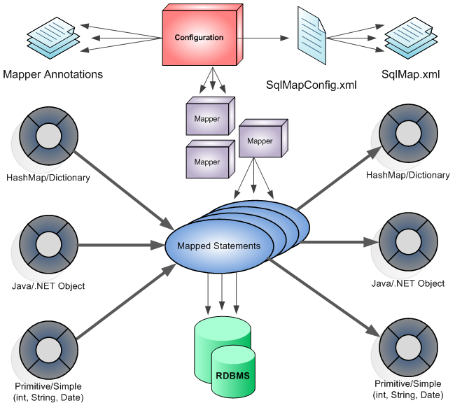
Arhitecture

Slide 6
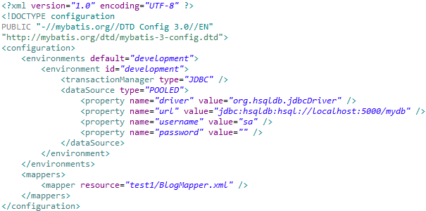
Configuration
The configuration XML file contains:
settings for the core of the MyBatis system.
DataSource for acquiring database Connection instances.
TransactionManager for determining how transactions should be scoped.
As alternative we can create Configuration instance using environment identifier, transaction manager and data source instances.

Slide 7
Configuration (cont.)
MyBatis configuration contains the following elements:
properties - are externalizable. Can be passed to SqlSessionBuilder.build().
settings - very important because they modify how MyBatis behaves at runtime.
typeAliases - shorter name for a Java type. We can specify a package where to search for beans.
typeHandlers - used for setting a parameter on a PreparedStatement or retrieving a value from a ResultSet.
plugins - used for intercepting calls to at certain points within the execution of a mapped statement.
objectFactory - used for creating instances of a result object.
envirnoments - for configuring multiple environments; use 1 per SqlSessionFactory instance.
envirnoment
transactionManager - JDBC|MANAGED are included in MyBatis.
dataSource - the source of JDBC Connection objects using the standard JDBC DataSource interface. Values: UNPOOLED|POOLED|JNDI.
databaseIdProvider - is able to execute different statements depending on your database vendor.
mappers - where to look for mapped SQL statements.

Slide 8


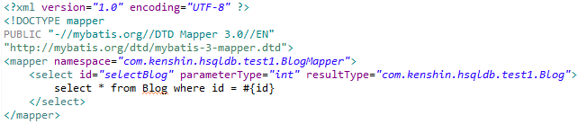
Core Classes
A SqlSessionFactory instance can be acquired by using the SqlSessionFactoryBuilder.
SqlSessionFactoryBuilder can build a SqlSessionFactory instance from an XML configuration file or Configuration instance.
We use SqlSession to execute SQL statements.
Instances of SqlSession are not to be shared and are not thread safe.

Slide 9
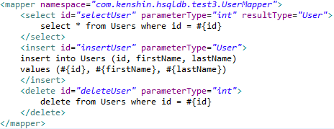
Mapper Files
Mapper XML files elements:
cache: cache configuration for a given namespace.
cache-ref: reference to a cache config from another namespace.
resultMap: used for loading objects from ResultSet(s).
parameterMap: map parameters. deprecated!
sql: reusable SQL referenced by other statements.
insert – A mapped INSERT statement.
update – A mapped UPDATE statement.
delete – A mapped DELETE statement.
select – A mapped SELECT statement.

Slide 10
Cache
MyBatis includes a powerful transactional query caching feature very configurable and customizable.
By default local session caching is enabled that is used for the duration of a session.
All results from select statements in the mapped statement file will be cached.
All insert, update and delete statements in the mapped statement file will flush the cache.
cache will use LRU algorithm for eviction.
cache will not flush on any sort of time based schedule.
cache will store 1024 references to lists or objects.
cache will be treated as a read/write cache, meaning objects retrieved are not shared and can be safely modified by the caller.
Custom pluggable cache need to implement the interface org.apache.ibatis.cache.Cache.
Other third library cache implementations: EhCache, OSCache, Hazelcast.

Slide 11
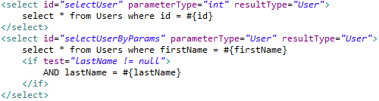
Dynamic SQL
MyBatis employs powerful OGNL(Object Graph Navigation Language) based expressions
if
choose (when, otherwise)
trim (where, set)
foreach
bind → allows to create OGNL expression and bind it to the context.
Based on vendor DB capabilities we can use these expressions in creating SQL statements.

Slide 12
Annotations
@Select: define SQL SELECT statement
@Insert: define SQL INSERT statement
@Update: define SQL UPDATE statement
@Delete: define SQL DELETE statement
@SelectKey: used with @Insert to define how primary key is generated
@Alias: used on bean to declare it as alias as mapping metadata
@Options: used for configuration options(SQL engine, cache)
@InsertProvider, @UpdateProvider, @DeleteProvider, @SelectProvider: alternatives for @Insert, @Update, @Delete, @Select
@ResultMap: declares xml mapping metadata for passing parameters to SQL statements.

Slide 13
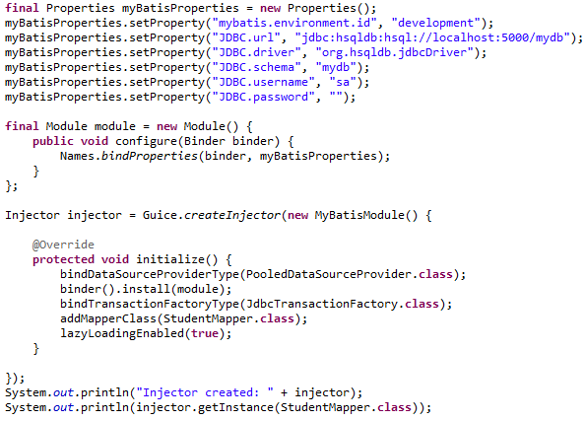

Integration
When working with Spring:
If working with XML, SqlSessionDaoSupport needs to be configure with SqlSessionFactory.
If using annotations, MapperFactoryBean needs to have the SqlSessionFactory and the mapper proxy interfaces.
When using Google Guice:
We create Proxy interfaces using Injector and Guice classes.
For injecting the proxy we use @javax.inject.Inject annotation.

Slide 14
Conclussion
PROS:
Setting up MyBatis is so clean and easy.
The interface proxying approach (which allows you define mappers as simple interfaces) is a win!
Dynamic SQL.
SQL is stored outside of the code.
Templating SQL for easier DB vendor Independence.
CONS:
The lack of return ids

Slide 15

Bibliography
http://en.wikipedia.org/wiki/MyBatis
Manning – iBatis in Action

Slide 16
Questions ?

