Slide 1

SCTP
Dima Ionut Daniel

Slide 2
Contents
What is SCTP?
Features
Terms
SCTP vs TCP
Core
Components
Packet Format
State
Bibliography

Slide 3

What is SCTP?
Stream Control Transmission Protocol (SCTP) is designed to transport Public Switched Telephone Network (PSTN) signaling messages over IP.
SCTP is a reliable transport protocol operating on top of a connectionless packet network such as IP.

Slide 4
Features
Data fragmentation confirming to discovered path MTU(max transmission unit)
Sequenced delivery of user messages within each stream
Bundling of multiple user messages into a single SCTP packet
Fault-tolerance by supporting multi-homing at either/both ends of an association and heart-beat/keep alive messages
Acked error-free non duplicated user data transfer
Message boundaries preserved
Option for out-of-delivery of a user message
SACK

Slide 5
Terms
Active destination transport address: transport address on a peer endpoint that a transmitting endpoint considers available for receiving user messages.
Bundling: optional multiplexing operation, where many user messages may be carried in the same SCTP packet. Each user message occupies it's own DATA chunk.
Chunk: unit of information within an SCTP packet, consisting of a chunk header and chunk-specific content.
Congestion window(cwnd): SCTP variable that limits the data in no. of bytes, a sender can send to a particular destination address before receiving an ACK.
Cumulative TSN Ack Point: The TNS of the last DATA chunk acknowledged via the Cumulative TSN Ack field of a SACK.

Slide 6
Terms (cont.)
Idle destination address: address that has not have user messages sent to it within some time.
Inactive destination transport address: address that is considered inactive due to errors and unavailable to transport user messages.
Message(user message): data submitted to SCTP by the Upper layer Protocol (ULP).
Ordered Message: user message that is delivered in order.

Slide 7
Terms (cont.)
Receiver Window (rwnd): SCTP variable a data sender uses to store the most recently calculated receiver window of it's peer in number of bytes.
SCTP endpoint: logical sender/received of SCTP packets.
SCTP packet: unit of data delivery across the interface between SCTP and the connectionless packet network.
SCTP user application: logical higher-layer application entity which used the services of SCTP also called ULP(Upper-Layer Protocol).

Slide 8
TCP vs SCTP
TCP like SCTP
uses a checksum and sequence number(Transmission Sequence Number)
is connection oriented
implements tcp-like mechanisms of:
reliable transmission
ordered delivery
flow and congestion control follow TCP algorithms
slowstart
fast recovery
fast retransmit--upon receiving 4 consecutive SACKs
delayed acks
SACK
ssthresh, RTO, CWND, etc.

Slide 9
TCP vs SCTP (cont.)
SCTP unlike TCP
uses a 32-bit checksum as opposed to a 16-bit checksum
can have several streams within an association
uses 4 messages in setting up an association and data may be sent with 3 & 4
uses 3 messages for shutdown--there are no half-open connections
can use multi-homed endpoints for redundancy
IP multicast and broadcast are NOT supported
a packet includes a common header plus one or more chunks which can be control or data

Slide 10
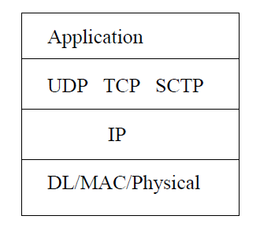
Core
Protocol stack

Slide 11
Core (cont.)
TCP issues:
Head of line blocking in TCP
TCP is stream (byte) oriented)
Fault-tolerance
TCP vulnerable to Denial of Service attacks

Slide 12
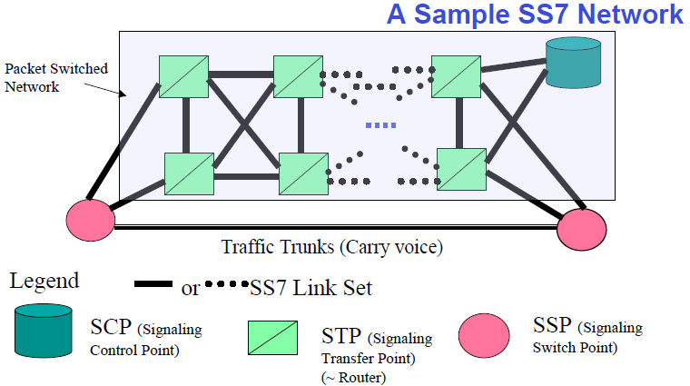
Core (cont.)
SCTP can carry SS7 signal on IP networks.

Slide 13
Core (cont.)
When a packet is lots, retransmission will occur:
repeated SACKs occur reporting missing packet(via holes) 4 times
a time-out on the packet.
Receiver SACKs every packet when a hole exists.
All gaps/fragments reports describe what has been received.
All gaps/fragments numbers are offsets from the cumulative TSN.
Retransmissions are made to alternate destinations if possible.

Slide 14
Core (cont.)
Heart Beat is sent on idle destinations at predetermined rate.
Receiver responds with Ack.
If the primary destination is down then switch all traffic to an alternate IP address.

Slide 15
Core (cont.)
SCTP uses validation/verification tags to verify packages belong to an association.
Blind attacks are not possible.
COOKIE-Protect against SYN attacks.
There is no protection to data contents.

Slide 16
Components
Association startup and teardown
Sequences delivery within streams
User data fragmentation
Sack, congestion avoidance
Chunk bundling
Packet validation
Path management

Slide 17
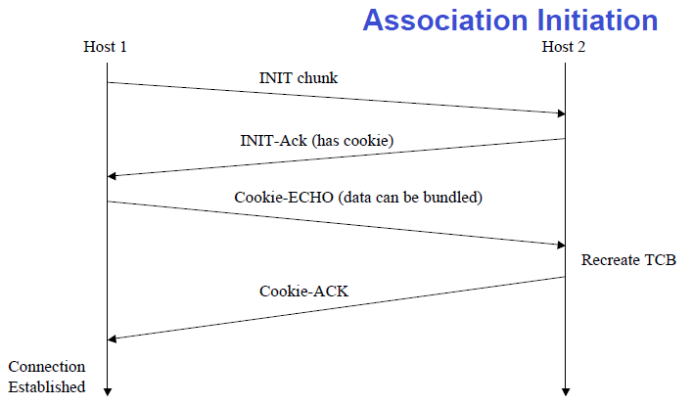
Components (cont.)

Slide 18
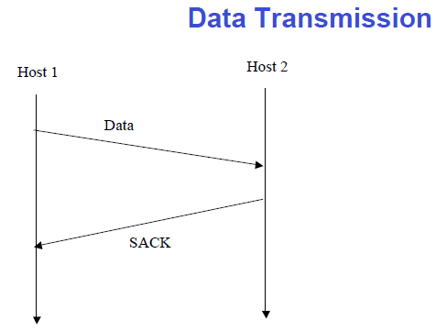
Components (cont.)

Slide 19
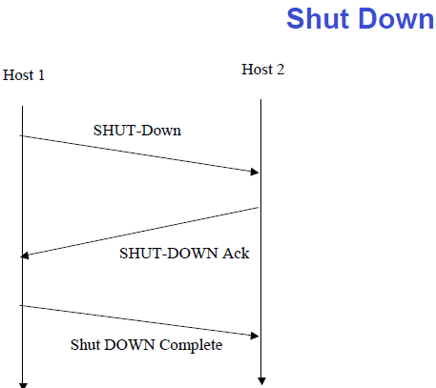
Components (cont.)

Slide 20
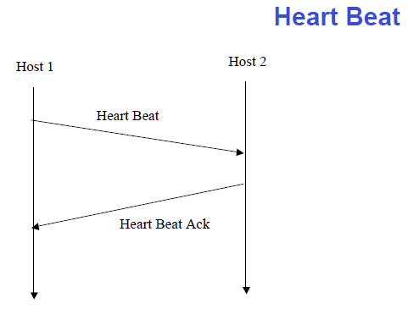
Components (cont.)

Slide 21
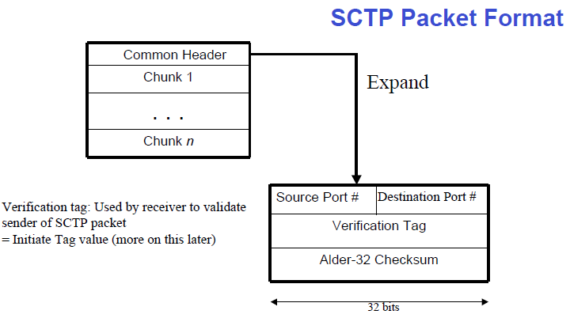
Packet Format

Slide 22
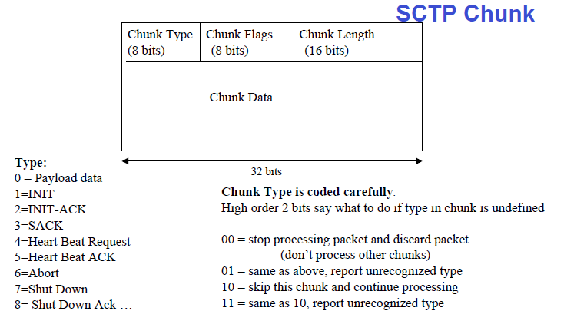
Packet Format (cont.)

Slide 23
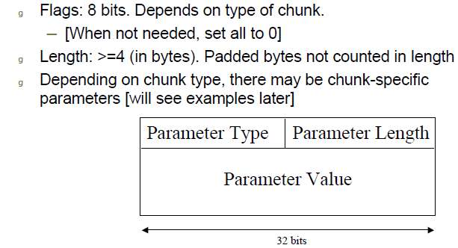
Packet Format (cont.)

Slide 24
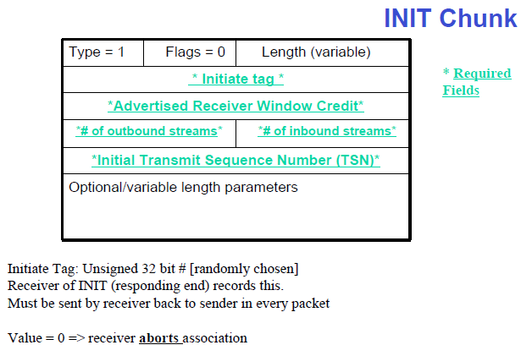
Packet Format (cont.)

Slide 25
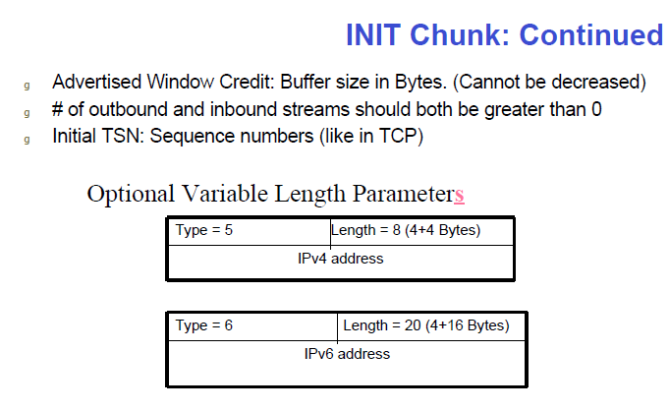
Packet Format (cont.)

Slide 26
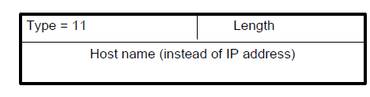
Packet Format (cont.)
Incoming packets may be addressed to any one of the multiple IP addresses(multi-homing).
If no IP addresses are defined then use IP sender address from IP packet.

Slide 27
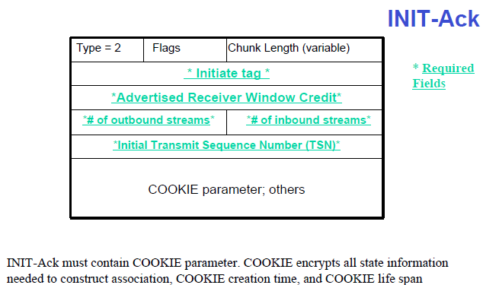
Packet Format (cont.)
COOKIE expires to protect against replay attacks
Sender of COOKIE destroys all state

Slide 28
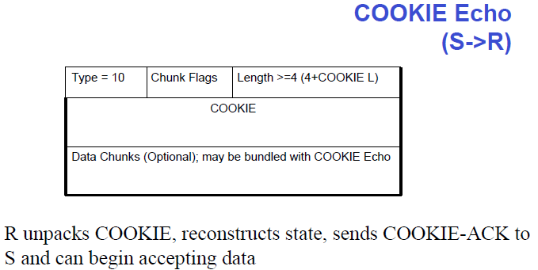
Packet Format (cont.)

Slide 29
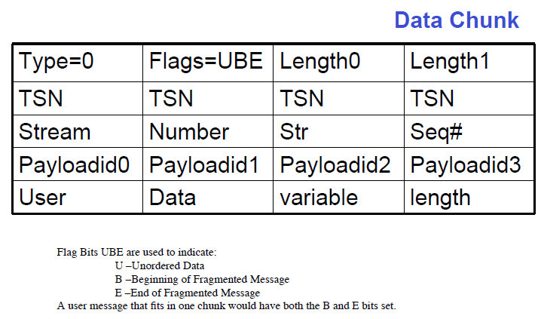
Packet Format (cont.)

Slide 30
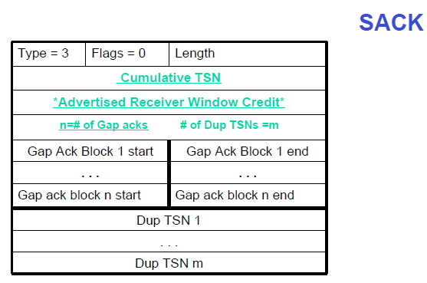
Packet Format (cont.)

Slide 31
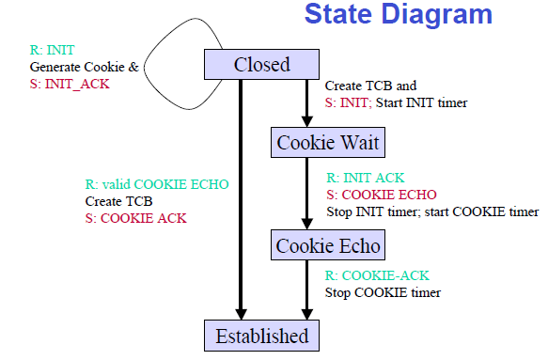
State

Slide 32
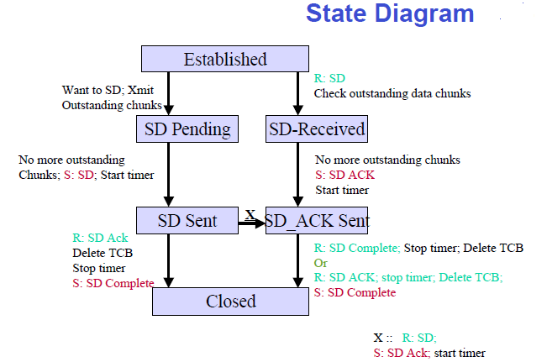
State (cont.)

Slide 33

Bibliography
https://en.wikipedia.org/wiki/Stream_Control_Transmission_Protocol
SCTP - University of Texas
SCTP - RFC 4960

