Slide 1

Glasshfish 4
Dima Ionut Daniel

Slide 2
Contents
What is Glassfish?
Glassfish Goals
Architecture
Java EE 7
Glassfish Core
Glassfish Administration
Deploy Applications
Glassfish Domains
EJB Container
Security Realm
Conclusion
Bibliography

Slide 3


What is Glassfish?
GlassFish is an open-source application server project started by Sun Microsystems for the Java EE platform and now sponsored by Oracle Corporation.
GlassFish is free software, dual-licensed under two free software licences: the Common Development and Distribution License (CDDL) and the GNU General Public License (GPL) with the classpath exception.
Glassfish is a highly configurable server that is capable of delivering high quality of service.
GlassFish supports all Java EE API specifications. GlassFish is based on source code released by Sun and Oracle Corporation's TopLink persistence system. It uses a derivative of Apache Tomcat as the servlet container for serving Web content, with an added component called Grizzly which uses Java New I/O (NIO) for scalability and speed.

Slide 4
What is Glassfish? (cont.)
Sun Microsystems launched the GlassFish project on 6 June 2005. On 4 May 2006, Project GlassFish released the first version that supports the Java EE 5 specification.
On 10 December 2009 GlassFish v3 was released being the Java EE 6 reference implementation for Java EE 6 JSR 316. In this version GlassFish adds new features to ease migration from Tomcat to GlassFish. The other main new features are around modularity (GlassFish v3 Prelude already shipped with an Apache Felix OSGi runtime), startup time (a few seconds), deploy-on-change (provided by NetBeans and Eclipse plugins), and session preservation across redeployments.
On 12 June 2013, Oracle Corporation released GlassFish 4.0. This major release brings Java Platform, Enterprise Edition 7 support.
On 9 September 2014, Oracle Corporation released GlassFish 4.1 and includes many bug fixes and the latest MR releases of CDI and WebSockets.

Slide 5
Glassfish goals
The Glassfish community defines the goals:
Open source, modular, extensible platform
Easy, fast, reliable server
Massive scalability and sophisticated administration
Support for OSGI
Support for java EE 7
Support for dynamic languages as PHP and Groovy

Slide 6
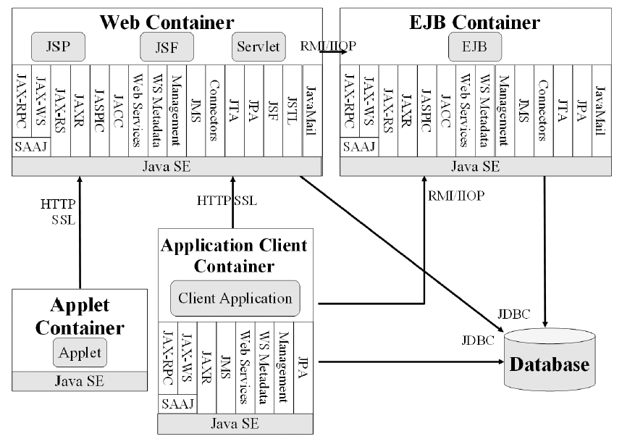
Architecture
Containers are Java EE runtime environments that provide certain services to the components they host such as lifecycle management, dependency injection, and so on. They need to be packaged in a standard way (via archive files) before being deployed.

Slide 7
Architecture (cont.)
The Java EE runtime environment defines 4 types of components that an implementation must support: applets, applications, web applications, EJBs.
The Java EE infrastructure is partitioned into logical domains called containers . Each container has a specific role, supports a set of APIs, and offers services to components like security, database access, transaction handling, naming directory, resource injection.
Containers hide technical complexity and enhance portability.
Components need first to be packaged in a standard formatted archive before been deployed in a container. Java EE defined different types of modules that have their own packaging format based on this common jar format.
The main features of an application server are: data integrity, load balancing, security, centralized configuration, scalability, robustness.

Slide 8
Java EE 7
Java Platform, Enterprise Edition or Java EE is a enterprise java computing platform.
The platform provides an API and runtime environment for developing and running enterprise software, including network and web services, and other large-scale, multi-tiered, scalable, reliable, and secure network applications.
Java EE is a set of specifications intended for enterprise applications.
A Java EE application server can handle transactions, security, scalability, concurrency and management of the components that are deployed to it, in order to enable developers to concentrate more on the business logic of the components rather than on infrastructure and integration tasks.

Slide 9

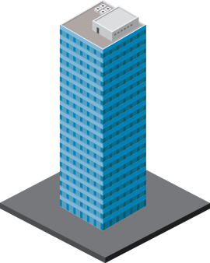





Java EE 7 (cont.)
ENTERPRISE EDITION
DEVELOPER
PRODUCTIVITY
MEETING ENTERPRISE DEMANDS
Java EE 7
More annotated POJOs
Less boilerplate code
Cohesive integrated platform
Batch
Concurrency
Simplified JMS
WebSockets
JSON
Servlet 3.1 NIO
REST

Slide 10
Java EE 7 (cont.)
There are 3 major themes of Java EE 7:
Delivering HTML5 dynamic, scalable applications
Reduce response time with low latency data exchange using WebSockets
Simplify data parsing for portable applications with standard JSON support
Deliver asynchronous, scalable, high performance RESTful Services and Async Servlets
Increasing developer productivity through simplification and new container services
Simplify application architecture with a cohesive integrated platform
Increase efficiency with reduced boiler-plate code and broader use of annotations
Enhance application portability with standard RESTful web service client support
Meeting the additional demands of the enterprise by adding new enterprise technologies.
Break down batch jobs into manageable chunks for uninterrupted OLTP performance
Easily define multithreaded concurrent tasks for improved scalability
Deliver transactional applications with choice and flexibility

Slide 11
Java EE 7 (cont.)
Java EE 7
JMS 2.0, Batch, Caching, TX Interceptor, WebSocket, JSON
Java EE 6
Pruning, Extensibility Ease of Dev,
CDI, JAX-RS
Java EE 5
Ease of
Development,
EJB 3.0, JPA, JSF, JAXB, JAX-WS, StAX, SAAJ
JAX-RPC, CMP/ BMP, JSR 88
J2EE 1.4
Web Services
Mgmt, Deployment,
Async
Connector
J2EE 1.3
CMP, Connector
Architecture
Web Profile
Servlet 3.0, EJB 3.1 Lite
J2EE 1.2
Servlet, JSP, EJB, JMS, RMI
Web Profile
JAX-RS 2.0
History of J2EE/Java EE

Slide 12
Java EE 7 (cont.)
Java EE 7 is defined in the JSR342.
New specifications were added into Java EE7.
Technology | JSR
Java API for WebSocket | JSR 356
Java API for JSON Processing | JSR 353
Batch applications for Java platform | JSR 352
Concurrency Utilities for Java EE | JSR 236
Debugging support for other languages | JSR 45

Slide 13
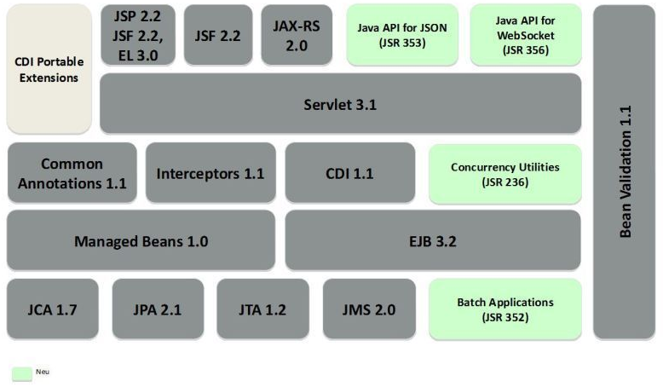
Java EE 7 (cont.)
Glassfish 4 implements the Java EE 7 specifications.
Glassfish is the first server compatible with the enterprise Java standard.

Slide 14
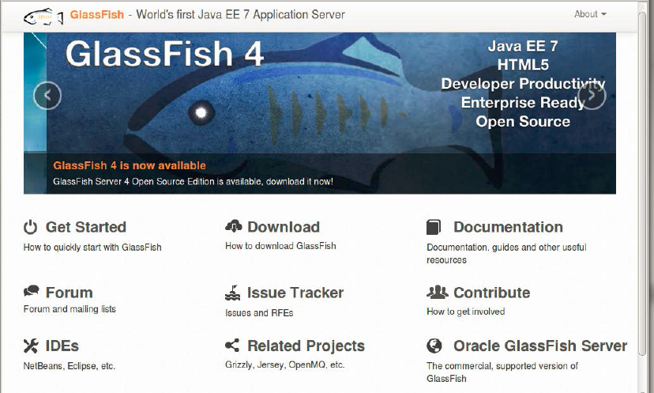
Glassfish Core
GlassFish can be downloaded at https://glassfish.java.net.
GlassFish 4.0 is also bundled with the NetBeans IDE version 7.4 or newer.

Slide 15
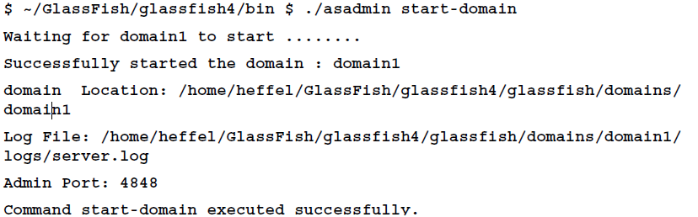
Glassfish Core (cont.)
To start GlassFish from the command line go to /glassfish4/bin folder and execute the following command:
./asadmin start-domain domain1

Slide 16
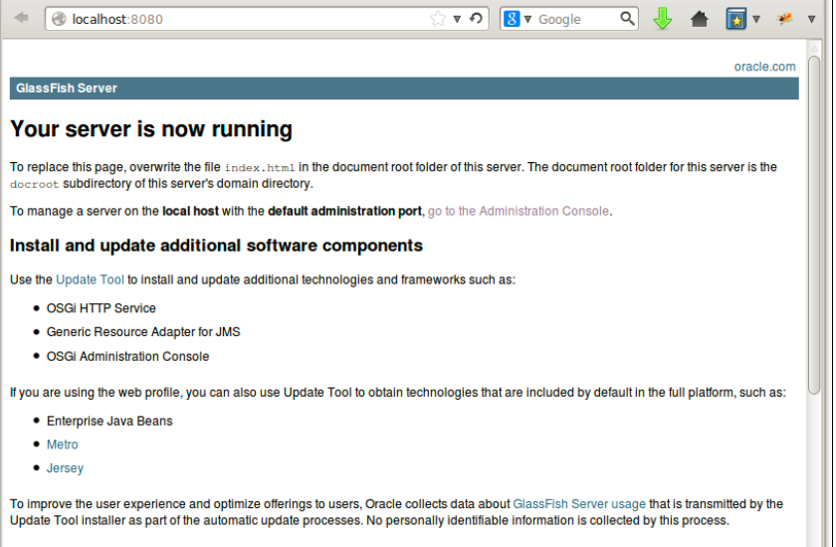
Glassfish Core (cont.)

Slide 17
Glassfish Administration
GlassFish 4 implements the Java EE 7 specifications, but it also has additional features ,such as its administrative capabilities, be it through the admin console or via a powerful asadmin command-line interface. Almost all the configuration is stored in a file called domain.xml (located in domains\domain1\config).
By default the port number for the Web Console is 4848 and the listener listens on all available network interfaces on the server machine.
Glassfish uses a separate Virtual Server for Web Console for independent configuration.

Slide 18
Glassfish Administration (cont.)
From the Web Console we can create JDBC connection pools, JMS destinations, thread pools, listeners, security, clusterization, container configuration, etc.
We can also administrate Glassfish using the CLI(Command Line Interfaces).
The administration CLI is accessible through the asadmin utility located at glassfish_home/bin directory. It is either a batch file named asadmin.bat for Windows or a shell script named asadmin for Linux and UNIX.
We can run the asadmin help command to see a list of possible commands.
The CLI also enables automation of routine tasks through shell scripts, as well as integration with provisioning tools.
The 2 essential components of Glassfish from the administration view are :
The server instance
The administrative domain

Slide 19
Glassfish Administration (cont.)
The Server instance is the Java EE process that hosts the Java EE applications. It implements the containers for the Java EE components .
The Server instance provides the capability necessary for enabling client access and resource management.
The administrative domain(s) is a group of one or multiple server instance that are administrate together.
Each domain has one domain administration server and one or multiple server instances.
A domain maintains its own configuration, log files, and application deployment areas.

Slide 20
Glassfish Administration (cont.)
A server instance always belong to a single domain and server instances in a single domain can run on different physical hosts.
Glassfish allows the clustering of application server instances. Clusters in an application server enhance scalability and availability Clusters provide high availability by using failover and load-balancing.
Server instances can be added to a cluster, even while the application is running making clustering scalable.
Node agents, server instances, and clusters can be created at GlassFish installation time.
Clusters and instances are organized into administrative domains, that are characterized by the Domain Administration Server (DAS).
The administrative infrastructure in the DAS is based on Java Management Extensions (JMX) technology.

Slide 21
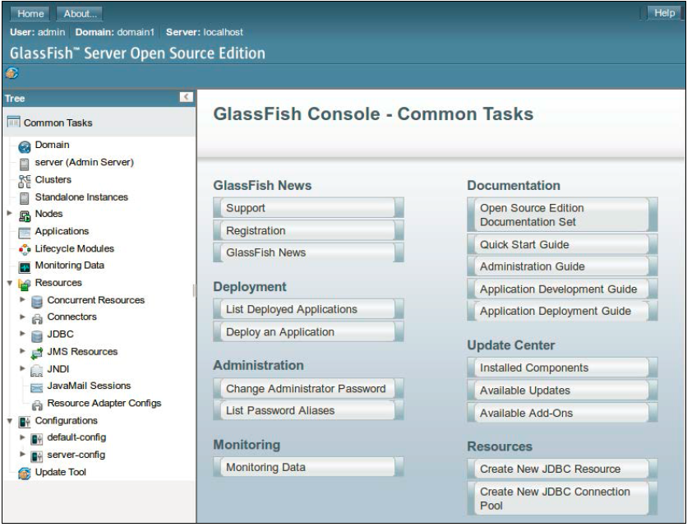
Deploy Applications
To deploy an application(war, ear) navigate to http://localhost:4848.

Slide 22
Deploy Applications (cont.)
An alternate way of deploying an application through the command line we can use the asadmin command:
asadmin deploy [path to file]/app.war
The asadmin executable can be used to undeploy an application as well:
asadmin undeploy app

Slide 23
Glassfish Domains
GlassFish has a concept of domains.
Domains allow a collection of related applications to be deployed together.
Several domains can be started concurrently.
GlassFish domains behave like individual GlassFish instances;
The default domain is called domain1 and it's created when installing GlassFish.

Slide 24
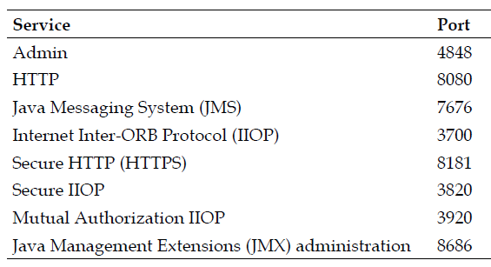
Glassfish Domains (cont.)
Additional domains can be created from the command line:
asadmin create-domain domainname
The default ports for the default domain1 domain are listed in the following table:

Slide 25
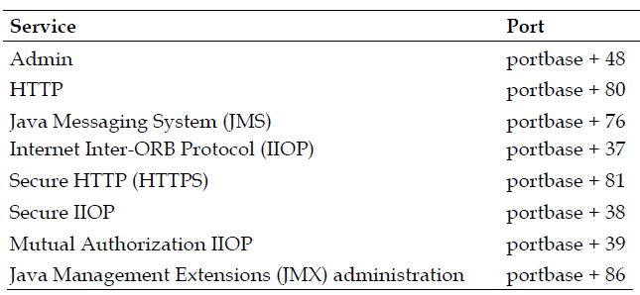
Glassfish Domains (cont.)
An alternate method of creating a domain, without having to specify ports for every service:
asadmin create-domain --portbase [port number] domainname
The value of the --portbase parameter dictates the base port for the domain.

Slide 26
Glassfish Domains (cont.)
Deleting a domain can be done using the following command:
asadmin delete-domain domainname
A domain that is running can be stopped by issuing the following command:
asadmin stop-domain domainname
If only one domain is running, the domainname argument is optional:
asadmin stop-domain
To start a domain the following command cna be used:
asadmin start-domain domainname
The domain can be restarted by executing the following command:
asadmin restart-domain domainname

Slide 27
EJB Container
Enterprise JavaBeans go through different states in their life cycle.
Session beans were required to implement the javax.ejb.SessionBean interface.
This interface provided methods to be executed at certain points in the session bean's life cycle.
Methods provided by the SessionBean interface include:
ejbActivate()
ejbPassivate()
ejbRemove()
setSessionContext(SessionContext ctx)

Slide 28
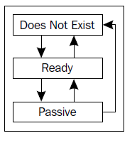
EJB Container (cont.)
The life cycle of a stateful session bean is different from that of a stateless session bean.
A stateful session bean's life cycle contains three states: Does Not Exist, Ready, and Passive.
Before a stateful session bean is deployed, it is in the Does Not Exist state.
Upon successful deployment, the EJB container does any required dependency injections for the bean and the bean goes into the Ready state.

Slide 29
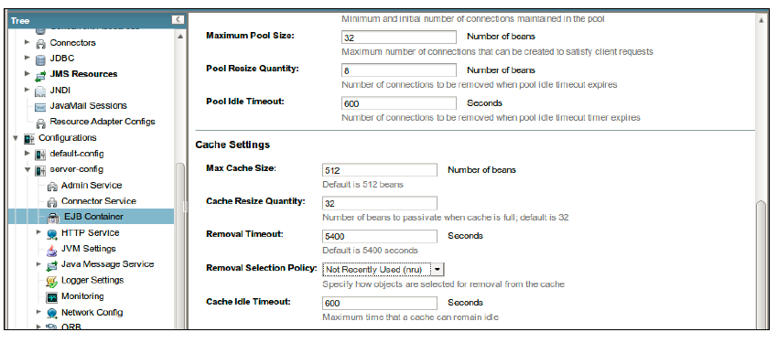
EJB Container (cont.)
When a stateful session bean is in Ready state, the EJB container may decide to passivate it, that is, to move it from main memory to secondary storage; the bean goes into Passive state.
If an instance of a stateful session bean hasn't been accessed for a period of time, the EJB container will set the bean to the Does Not Exist state.
By default, GlassFish will send a stateful session bean to the Does Not Exist state after 90 minutes of inactivity.

Slide 30
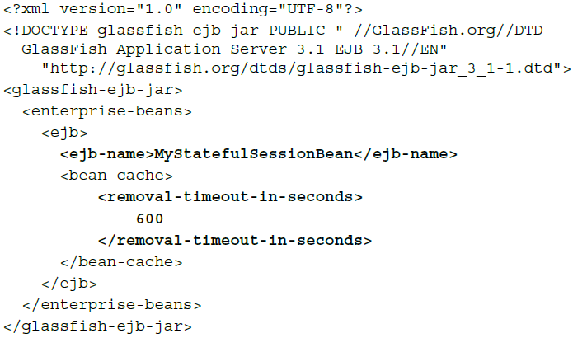
EJB Container (cont.)
We can modify the timeout value for a specific session bean using glassfish-ejb-jar.xml deployment descriptor in the JAR file containing the session bean.
In the deployment descriptor, we can set the timeout value using <removal-timeout-in-seconds> element:

Slide 31
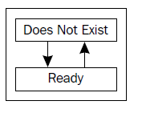
EJB Container (cont.)
A stateless session bean life cycle contains only the Does Not Exist and Ready states.
Stateless session beans are never passivated.
A stateless session bean's methods can be decorated with the @PostConstruct and @PreDestroy annotations.

Slide 32
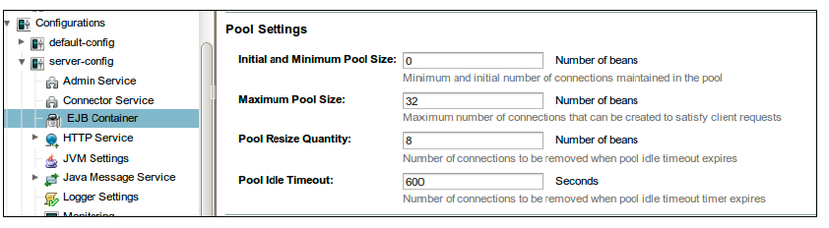
EJB Container (cont.)
We can control how GlassFish manages the life cycle of stateless session beans (and message-driven beans) via the administration web console:

Slide 33
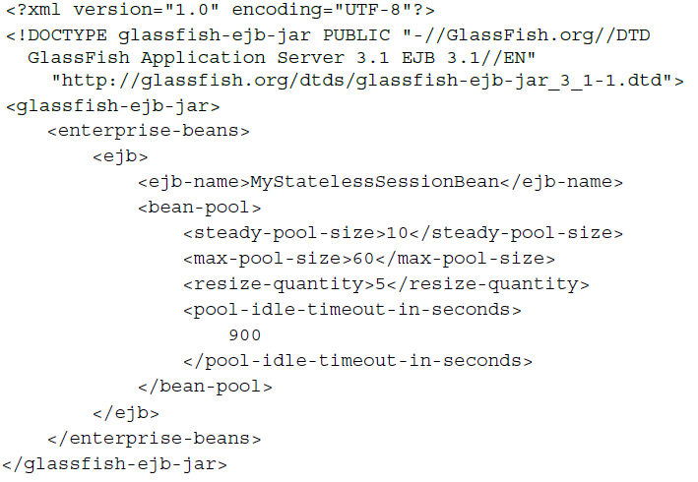
EJB Container (cont.)
We can override the poolable EJB settings using the glassfish-ejb-jar.xml deployment descriptor as:

Slide 34
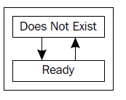
EJB Container (cont.)
Message-driven beans exist only in the Does Not Exist and Ready states:
A message-driven bean can have methods decorated with the @PostConstruct and @PreDestroy methods.

Slide 35
Security Realm
Security realms are collections of users and related security groups.
A user can belong to one or more security groups.
The groups that the user belongs to define what actions the system will allow the user to perform.
Security realms store user information (user name, password, and security groups).
Applications don't need to implement this functionality and can simply be configured to obtain this information from a security realm.
A security realm can be used by more than one application.

Slide 36
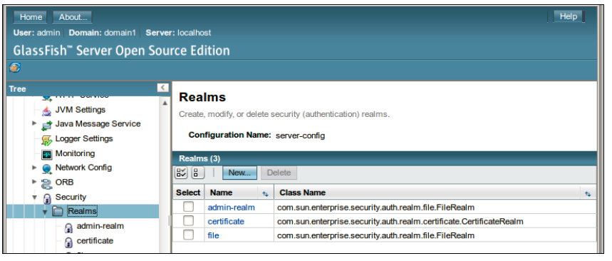
Security Realm (cont.)
GlassFish comes preconfigured with three predefined security realms: admin-realm, file, and certificate.

Slide 37
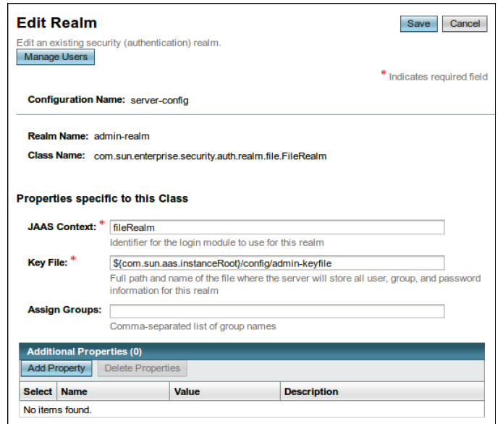
Security Realm (cont.)
The admin-realm has a predefined user called admin, which belongs to a predefined group called asadmin.

Slide 38
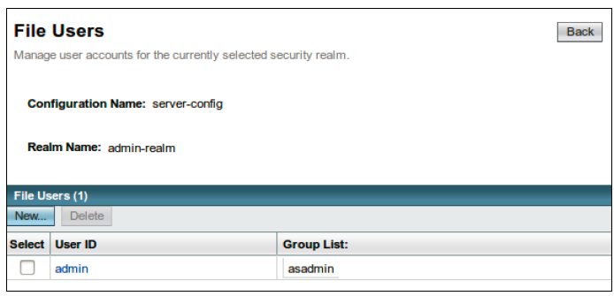
Security Realm (cont.)
To add a user to the realm, click on the button to the top-left labeled Manage Users.

Slide 39
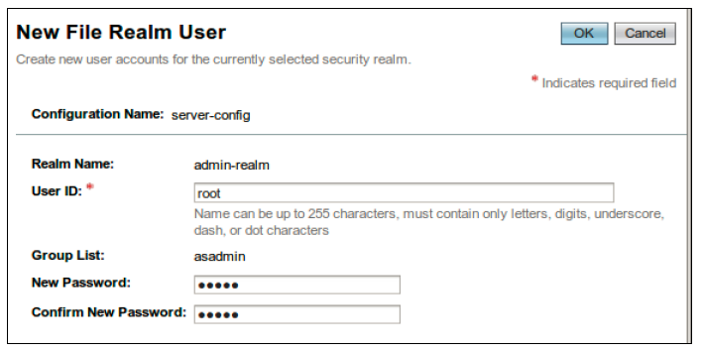
Security Realm (cont.)
To add a new user to the realm, simply click on the New... button to the top-left of the screen and then enter the new user information

Slide 40
Conclussion
Glassfish seems richer in features
Glassfish has management interface to configure many different aspects e.g. jdbc connectors
Glassfish has built-in scalability features
App server (implements J2EE spec fully)

Slide 41

Bibliography
Packt Publishing – Java EE 7 with Glassfish 4 Application Server

