Slide 1

Java Enterprise Edition 7
Dima Ionut Daniel

Slide 2
Contents
What is Java EE?
History
Java EE7 Themes
JAVA EE7 Specifications
Java EE7 new features
Java EE7 Implementations
Servlet 3.1
EJB 3.2
JPA 2.1
JMS 2.0
JAX-RS 2.0
JSF 2.2
Expression Language 3.0
Bean Validation 1.1
WebSocket 1.0
CDI 1.1
JTA 1.2
JSON –P 1.0
Interceptors 1.2
Batch API 1.0
Java Mail 1.5
JASPIC 1.0
Concurrent Utilities
Java EE 8 and Beyond
Bibliography

Slide 3

What is Java EE?
Java Platform, Enterprise Edition or Java EE is Oracle's enterprise Java computing platform.
Java EE extends the Java Platform, Standard Edition providing an API for object-relational mapping, distributed and multi-tier architectures, and web services.
Java EE is defined by its specification.

Slide 4
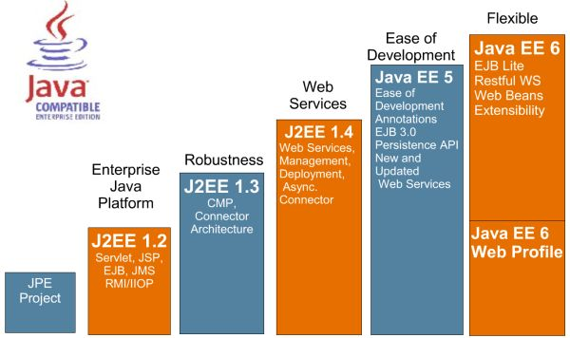
History

Slide 5







Java EE 7 Themes
ENTERPRISE EDITION
DEVELOPER
PRODUCTIVITY
MEETING ENTERPRISE DEMANDS
Java EE 7
More annotated POJOs
Less boilerplate code
Cohesive integrated platform
Batch
Concurrency
Simplified JMS
WebSockets
JSON
Servlet 3.1 NIO
REST

Slide 6
Java EE 7 Themes
There are 3 major themes of Java EE 7:
Delivering HTML5 dynamic, scalable applications
Reduce response time with low latency data exchange using WebSockets
Simplify data parsing for portable applications with standard JSON support
Deliver asynchronous, scalable, high performance RESTful Services and Async Servlets
Increasing developer productivity through simplification and new container services
Simplify application architecture with a cohesive integrated platform
Increase efficiency with reduced boiler-plate code and broader use of annotations
Enhance application portability with standard RESTful web service client support
Meeting the additional demands of the enterprise by adding new enterprise technologies.
Break down batch jobs into manageable chunks for uninterrupted OLTP performance
Easily define multithreaded concurrent tasks for improved scalability
Deliver transactional applications with choice and flexibility

Slide 7
Java EE 7 Specifications
Java EE 7 is defined in the JSR342.
New specifications were added into Java EE7.
Technology | JSR
Java API for WebSocket | JSR 356
Java API for JSON Processing | JSR 353
Batch applications for Java platform | JSR 352
Concurrency Utilities for Java EE | JSR 236
Debugging support for other languages | JSR 45

Slide 8
Java EE 7 new features
Servlets 3.1:
Asynchronous IO based on NIO 2.0
Simplified asynchronous servlets
Utilized java EE concurrency utilities
Enable support for WebSockets
Java Message Server 2.0:
Integration with CDI
Java Server Faces 2.2
Support implementation for Portlet Bridge 2.0
Integration with CDI, OSGI, JSF artefacts

Slide 9
Java EE 7 new features (cont.)
EJB 3.2
New annotations
Bean Validation 1.1
Integration with javaEE specs
Jcache
New API for temporary, in-memory cache
Java API for JSON
Produces and consumes JSON using api similar to DOM and StaX
Batch application for Java platform
Programming model for batch applications

Slide 10
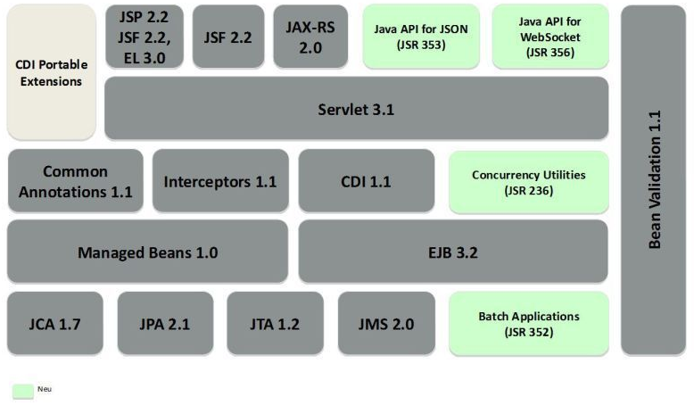
Java EE 7 Implementations
Glassfish 4 implements the Java EE 7 specifications.
Glassfish is the first server compatible with the enterprise Java standard.

Slide 11
Servlet 3.1
Servlets 3.1 includes features like:
Non-Blocking I/O API
WebSocket API for working with WebSocket protocol
Security enhancements
Miscellaneous updates
ReaderListener/WriteListener were added for nonblocking API and have callback methods.
AsyncContext context = request.startAsync();
ServletInputStream input = request.getInputStream();
input.setReadListener(new ReadListenerImpl(input, context));
AsyncContext was added in Servlet 3.0 for asynchronous operation and servlet should be annotated as @WebServlet and asyncSupported attribute set to true.

Slide 12
Servlet 3.1 (cont.)
The Servlet 3.0 API included a new FileUpload mechanism.
Servlet marked with the @MultipartConfig annotation can handle file upload requests.
In the Servlet 3.1 there is support for containers that do not provide multipart/form-data processing.
If the container does not provide the processing, then the data will be available via HttpServletRequest.getInputStream.
Security roles that are defined for a particular application can be mapped to a servlet by annotating the servlet class with @RunAs.

Slide 13
Servlet 3.1 (cont.)
Security Enhancements:
Applying run-as security roles to #init and #destroymethods
Session fixation attack by adding HttpServletRequest. changeSessionId and a new interface HttpSessionIdListener. You can listen for any session id changes using these methods.
Default security semantic for non-specified HTTP method in <security-constraint>.
Clarifying the semantics if a parameter is specified in the URI and payload.
Addition of <deny-uncovered-http-methods/>to web.xml in order to block HTTP methods not covered by an explicit constraint.

Slide 14
EJB 3.2
Enhancing EJB architecture to enable the PaaS model with features such as multi-tenancy
Factorization of container-managed transactions to use other component technologies of the Java EE platform
Enhanced use of annotations to simplify EJB programming model
Alignment and integration with other specifications related to JSRs within the Java EE 7 platform such as CDI, JMS, Bean Validation, etc

Slide 15
JPA 2.1
Schema generation
Entity converters
Stored procedures
Unsynchronized persistence contexts

Slide 16
JPA 2.1 (cont.)
Schema Generation
What: Generation of database artifacts
Tables, indexes, constraints, generators, …
Scenarios: Prototyping, database provisioning (e.g. in cloud), production
To: Database, DDL, Both
From: O/R mapping metadata, SQL DDL scripts
When: Prior to app deployment

Slide 17
JPA 2.1 (cont.)
Schema Generation Properties
javax.persistence.schema-generation-action
“none”, “create”, “drop-and-create”, “drop”
javax.persistence.schema-generation-target
“database”, “scripts”, “database-and-scripts”
javax.persistence.ddl-create-script-target/source
javax.persistence.ddl-drop-script-target/source
javax.persistence.sql-load-script-source

Slide 18
JPA 2.1 (cont.)
Schema Generation Example
@Table(indexes= {@Index(columnList=“NAME”), @Index(columnList=“DEPT_ID”)})
@Entity public class Employee {
@Id private Integer id;
private String name;
...
@ManyToOne
private Department dept;
…
}

Slide 19
JPA 2.1 (cont.)
Stored Procedures
@Entity
@NamedStoredProcedureQuery(name="topGiftsStoredProcedure”, procedureName="Top10Gifts")
public class Product {
StoredProcedreQuery query = EntityManager.createNamedStoredProcedureQuery("topGiftsStoredProcedure");
query.registerStoredProcedureParameter(1, String.class, ParameterMode.INOUT);
query.setParameter(1, "top10");
query.registerStoredProcedureParameter(2, Integer.class, ParameterMode.IN);
query.setParameter(2, 100);
. . .
query.execute();
String response = query.getOutputParameterValue(1);

Slide 20
JPA 2.1 (cont.)
Unsynchronized Persistence Context
@Stateful public class ShoppingCart {
@PersistenceContext(type=EXTENDED, synchronization=UNSYNCHRONIZED)
EntityManager em;
Customer customer;
Order order;
public void startToShop(Integer custId) {
customer = em.find(Customer.class, custId);
order = new Order();
}
public void addToCart(Book book) {
Item item = new Item(book);
order.addItem(item);
}
public void confirmOrder() {
em.joinTransaction();
customer.addOrder(order);
}
}

Slide 21
JPA 2.1 (cont.)
Added new identifiers for persistence query language (JPQL), such as FUNCTION for supporting JPQL built-in functions, TREAT for down casting within path expressions in the FROM and WHERE clauses, and ON for specifying the relationship between the tables.
The entity listeners can be annotated with @PostConstruct and @PostDestroy for their lifecycle. Also, the usual lifecycle callback methods, such as @PrePersist, @PostPersist, @PreUpdate and @PreRemove can be used for entities.

Slide 22
JPA 2.1 (cont.)
The javax.persistence.criteria.AbstractQuery interface has been refactored by CriteriaUpdate, CriteriaDelete and CommonAbstractQuery interfaces.
CriteriaUpdate q = cb.createCriteriaUpdate(Customer.class);
Root c = q.from(Customer.class);
q.set(c.get(Customer_.status), “outstanding”).where(cb.lt(c.get(Customer_.balance), 10000));

Slide 23
JMS 2.0
Previous versions of JMS required lots of boilerplate code.
The new JMS API is using dependency injection.

Slide 24
JMS 2.0 (cont.)
Example of OLD JMS usage.
@Resource(lookup = "java:global/jms/demoConnectionFactory")
ConnectionFactory connectionFactory;
@Resource(lookup = "java:global/jms/demoQueue")
Queue demoQueue;
public void sendMessage(String payload) {
try {
Connection connection = connectionFactory.createConnection();
try {
Session session = connection.createSession(false,
Session.AUTO_ACKNOWLEDGE);
MessageProducer messageProducer =
session.createProducer(demoQueue);
TextMessage textMessage = session.createTextMessage(payload);
messageProducer.send(textMessage);
} finally {
connection.close();
}
} catch (JMSException ex) {
Logger.getLogger(getClass().getName()).log(Level.SEVERE, null, ex);
}
}

Slide 25
JMS 2.0 (cont.)
Example of NEW(simplified) JMS usage.
@Inject
private JMSContext context;
@Resource(mappedName = "jms/inboundQueue")
private Queue inboundQueue;
public void sendMessage (String payload) {
context.createProducer().send(inboundQueue, payload);
}

Slide 26
JMS 2.0 (cont.)
Example of Resource Definition
@JMSConnectionFactoryDefinition(
name="java:global/jms/demoConnectionFactory",
className= "javax.jms.ConnectionFactory",
description="ConnectionFactory to use in demonstration")
@JMSDestinationDefinition(
name = "java:global/jms/demoQueue",
description = "Queue to use in demonstration",
className = "javax.jms.Queue",
destinationName="demoQueue")

Slide 27
JAX-RS 2.0
Client API.
Message Filters & Entity Interceptors
Asynchronous Processing – Server & Client
Hypermedia Support
Content Negotiation
Common Configuration

Slide 28
JAX-RS 2.0 (cont.)
Client API.
Client client = ClientFactory.newClient(); String name = client.target(“../orders/{orderId}/customer”) .pathParam(”orderId", ”10”) .queryParam(”shipped", ”true”) .request() .get(String.class);

Slide 29
JAX-RS 2.0 (cont.)
Logging Filter.
public class RequestLoggingFilter
implements ContainerRequestFilter {
@Override
public void filter(ContainerRequestContext requestContext) {
log(requestContext);
// Non-wrapping => returns without invoking next filter
}
...
}

Slide 30
JSF 2.2
HTML5 Support
@FlowScoped
@ViewScoped for CDI
Managed beans deprecated/CDI alignment
File upload component
View actions
Multi-templating
Security
Fixes and enhancements

Slide 31
JSF 2.2 (cont.)
Component identification and Ajax.
Support implementation of Portlet Bridge 2.0.
Support for HTML5 features, such as Forms, Heading, Metadata and Section content model, Flow management, Listener for page navigation events, and new components like FileUpload and BackButton.

Slide 32
JSF 2.2 (cont.)
Faces Flow provides an encapsulation of related views/pages with an application defined entry and exit points.
JavaServer Faces 2 introduced Facelets as the default View Declaration Language.
Facelets allows to create templates using XHTML and CSS providing a consistent look-and-feel across different pages of an application.
JSF 2.2 defines Resource Library Contracts that allows facelet templates to be applied to an entire application in a reusable and interchangeable manner.

Slide 33
JSF 2.2 (cont.)
File Upload Component
<h:inputFile id="file“ value="#{fileUploadBean.uploadedFile}">
<f:validator validatorId="FileValidator" />
</h:inputFile>
@Named @RequestScoped
public class FileUploadBean {
private Part uploadedFile; // getter/setter
public String getFileText() {
String text = "";
if (null != uploadedFile) { try {
InputStream is = uploadedFile.getInputStream();
text = new Scanner( is ).useDelimiter("\\A").next();
} catch (IOException ex) {} }
return text;
}
}

Slide 34
JSF 2.2 (cont.)
Pass value through HTML 5 Components
<html>
...
<input type=“color” jsf:value=“#{colorBean.color2}” />
<input type=“date” jsf:value=“#{calendarBean.date1}” />
...
</html>

Slide 35
Expression Language 3.0
Lambda Expressions
Collection
Operators
Standalone API

Slide 36
Expression Language 3.0 (cont.)
Separate expression language context into parsing and evaluation contexts independent of the JSP specification.
Introduction of new customizable expression language coercion rules.
Reference static methods and members directly in EL expressions without having to define them in Tag Library Descriptor, similar to instance method invocation.
Adding equality, string concatenation, and sizeof operators.
CDI Integration so that events can be generated before/during/after the expressions are evaluated.

Slide 37
Bean Validation 1.1
Method constraints
Bean Validation artifacts injectable

Slide 38
Bean Validation 1.1 (cont.)
Method Level Restrictions
public void placeOrder( @NotNull String productName, @NotNull @Max(“10”) Integer quantity, @Customer String customer) { . . . }
@Future public Date getAppointment() { . . . }

Slide 39
Web Socket 1.0
Web Socket represents:
technology providing full-duplex communications channels over a single TCP connection.
a protocol standardized by IETF as RFC 6455.
API that is being standardized by W3C.
Java API being standardized under JSR 356.
Web is designed to be implemented in web browsers and web servers.
The protocol is designed to create more interaction between a browser and a web site. Previous to this technology the same effect can be made using non-standardized ways using Comet(Reverse Ajax).
Currently WebSocket is supported in several browsers like: Google Chrome, Internet Explorer, Firefox, Safari, Opera.

Slide 40
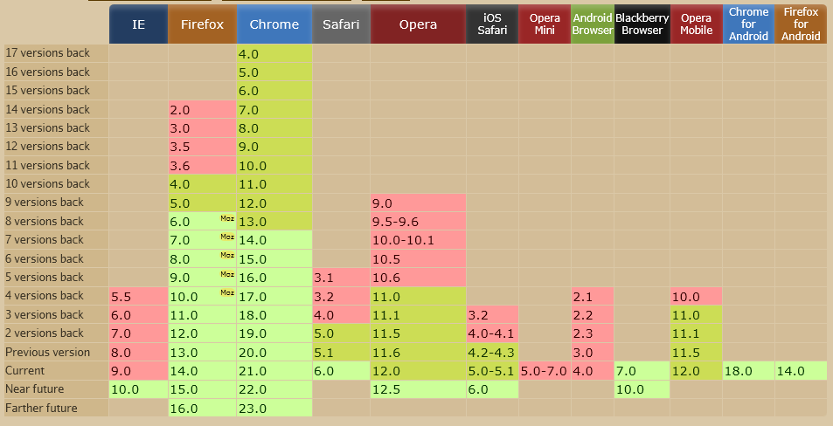
Web Socket 1.0 (cont.)
From global user statistics only 48.31% from internet users have the browser compatible to this technology.

Slide 41
Web Socket 1.0 (cont.)
Web applications are using Ajax or Commit to simulate real-time communications. In the case of Comet lots of traffic is made because of the long polling strategy used.
WebSocket uses “frames” for information exchange and the polling overhead is removed.
The WebSocket connection is established by upgrading from HTTP to WebSocket protocol.
The WebSocket protocol specification defined 2 URI schemas: ws: and wss: for unsecure and secure connections respectively.

Slide 42
Web Socket 1.0 (cont.)
WebSocket implementation is a combination of IETF RFC 6455 protocol and W3C JavaScript API.
The API enables web pages to use WebSocket protocol for two-way communication with the remote host.
Tyrus represents an open source Web Socket RI for JSR 356.
Tyrus is already integrated into GlassFish 4.0 Promoted builds.
A websocket connection is the networking connecting between the two endpoints which are interacting using the websocket protocol.
A websocket session is used to represent a sequence of websocket interactions between an endpoint and a single peer.

Slide 43
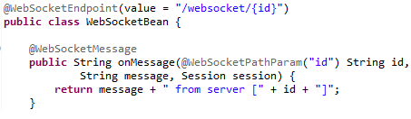
Web Socket 1.0 (cont.)
The abstract class javax.websocket.Endpoint represents one side of a sequence of websocket interactions between two connected peers and contains methods like onOpen, onClose, onError.
As alternative @WebSocketEndpoint annotation indicates that a Java class is to become a websocket endpoint at runtime.
@WebSocketOpen and @WebSocketClose annotations allow the developers to decorate methods on their @WebSocketEndpoint.
The @WebSocketMessage is used to process incomming messages.
The @WebSocketPathParam is used for retrieving path information.

Slide 44
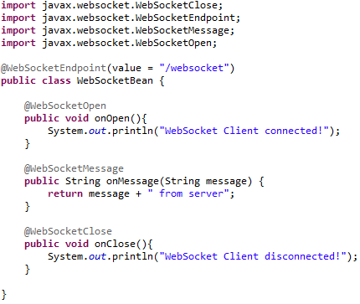
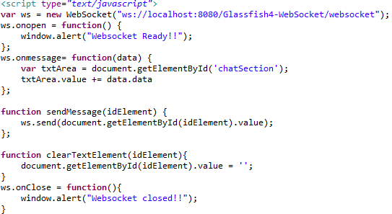
Web Socket 1.0 (cont.)
WebSocket implementation and JavaScript setup for communication.

Slide 45
CDI 1.1
CDI is making the platform lot more cohesive and is becoming a core component model.
CDI is now enabled by default in Java EE 7, without the requirement to specify a beans.xml descriptor.
A new annotation @Vetoed is added to enable programmatic disablement of classes.

Slide 46
CDI 1.1 (cont.)
If beans.xml exists with version 1.1, then a new attribute bean-discovery-mode can be specified on the top level <beans>.
Bean discovery mode:
“all” value can be specified to enable injection all beans in the archive.
“annotated” value is used to inject beans with a bean defining annotation – such as one with a CDI scope.
“none” can be used to completely disable CDI.
Global ordering/priority of interceptors and decorators can be configured.

Slide 47
CDI 1.1 (cont.)
By default, CDI interceptors are disabled and can be enabled and ordered via the @javax.interceptor.Interceptor.Priority annotation as shown:
@Priority(Interceptor.Priority.APPLICATION+10)
@Interceptor
@Logging
public class LoggingInterceptor {
//. . .
}

Slide 48
JTA 1.2
@Transactional: Define transaction boundaries on CDI managed beans
@TransactionScoped: CDI scope for bean instances scoped to the active JTA transaction

Slide 49
JTA 1.2 (cont.)
@Transactional annotations
@Inherited
@InterceptorBinding
@Target({TYPE, METHOD}) @Retention(RUNTIME)
public @interface Transactional {
TxType value() default TxType.REQUIRED;
Class[] rollbackOn() default {};
Class[] dontRollbackOn() default {};
}
@Transactional(rollbackOn={SQLException.class},
dontRollbackOn={SQLWarning.class})
public class UserService {...}

Slide 50
JSON-P 1.0
JSON(JavaScript Object Notation) is a text-based open standard format.
The JSON format is described into RFC 4627.
This format is used for transmitting structured data over a network connection, between a client/server application.

Slide 51
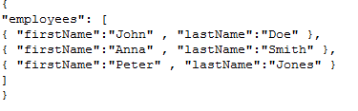
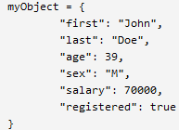

JSON-P 1.0 (cont.)
JSON can represent 4 primitive types: strings, numbers, Booleans and nulls.
Objects are an unordered collection of 0 or more name/value pairs.
JSON design goals were: portable, human-readable, minimal.
JSON default encoding is UTF-8. JSON can be represented using: UTF-8,UTF-16,UTF-32, Unicode.
The MIME media type for JSON is application/json.

Slide 52
JSON-P 1.0 (cont.)
JSON-P offers both object oriented and stream based approaches, in this post I will introduce the stream APIs.
Java will have a standard set of APIs for processing JSON as part of Java EE 7.
It includes
streaming API to produce/consume JSON (similar cu StAX)
object model API to represent JSON
javax.json.stream.JsonGenerator creates JSON objects very easy.
javax.json.stream.JsonParser provides a depth first traversal of events corresponding to the JSON structure.
JsonProvider is searching for JSON providers using ServiceLoader mechanism.
JSONP tries to find custom providers or will load the "org.glassfish.json.JsonProviderImpl" as default.
The Object Model API core classes include JasonObject and JsonArray as well as JsonBuilder, JsonReader, and JsonWriter.

Slide 53
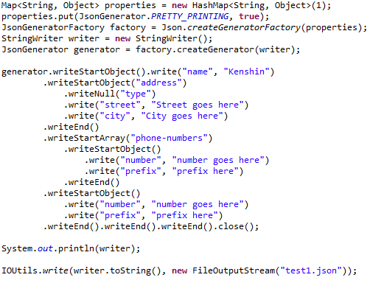
JSON-P 1.0 (cont.)
Bellow example shows how to create a JSON complex object using JSON Stream API.

Slide 54
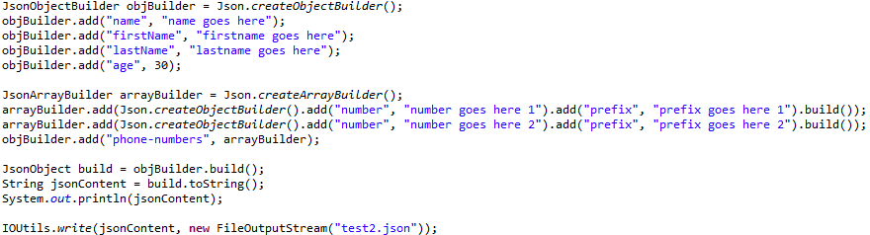
JSON-P 1.0 (cont.)
Bellow example shows how to create a JSON complex object using JSON Object API.
javax.json.Json is a core class because using we can create different builder starting from it.

Slide 55
Interceptors 1.2
Associating interceptors using InterceptorBinding is now part of this specification,instead of CDI.
@AroundConstruct designates an interceptor method that receives a callback when the target class constructor is invoked.
Method-level interceptors can be extended to life-cycle callbacks, adding constructor-level interceptors.
Priority ranges can be dedicated for ordering interceptors using interceptor binding.

Slide 56
Batch API 1.0
API for batch processing.

Slide 57
Batch API 1.0 (cont.)
Step Example
<step id=”sendStatements”>
<chunk reader=”AccountReader”
processor=”AccountProcessor” writer=”EmailWriter”
chunk-size=”10” />
</step>
@ReadItem
public Account readAccount() { // read account using JPA
}
@ProcessItem
public Account processAccount(Account account) { // calculate balance
}
@WriteItems
public void sendEmail(List<Account> accounts) { // use JavaMail to send email
}

Slide 58
Batch API 1.0 (cont.)
Each item is read, processed, and aggregated for writing. item-count number of items are processed within a container-managed transaction.
Different elements define the sequence of a job:
Step: Independent and sequential phase of a job
Flow: Sequence of execution elements that execute together as a unit
Split: Set of flows that execute concurrently
Decision: Customized way of determining sequencing among step, flows, and splits

Slide 59
Batch API 1.0 (cont.)
Public API from javax.batch:
BatchRuntime → represents the JSR 352 runtime
JobOperator → Interface for operating on batch jobs
ItemReader → reads item for chunk processing
ItemProcessor → operates on an input and produces output
ItemWriter → writes a list of item for chunk processing
Batchlet → batch step for item-oriented processing
BatchProperty → annotation to define a batch property injected from job xml
JobListener → interface that intercepts job execution
StepListener → interface that intercepts step execution
ChunkListener → interface that intercepts chunk processing

Slide 60
Java Mail 1.5
The JavaMail API has two parts:
an application-level interface used by the application components to send mail.
service provider interface used at the Java EE SPI level.
The JavaMail API allows for access to email messages contained in message stores, and for the creation and sending of email messages using a message transport.
@MailSessionDefinition and @MailSessionDefintions defines MailSession to be registered with JNDI.

Slide 61
Java Mail 1.5 (cont.)
The JavaMail API specification does not require any specific protocol providers.
The JavaMail reference implementation includes:
IMAP message store provider
POP3 message store provider
SMTP message transport provider

Slide 62
JASPIC 1.0
JASPIC stands for Java Authentication Service Provider Interface for Containers.
JASPIC specificaton defines a service provider interface (SPI) by which providers implementing message authentication mechanisms may be integrated in client or server.
They transform outgoing messages such that the source of the message may be authenticated by the receiving container, and the recipient of the message may be authenticated by the message sender.

Slide 63
Concurrent Utilities
Provides simple, safe API for concurrency in Java EE
Builds on Java SE concurrency
java.util.concurrent.ExecutorService
Relatively low-level API
Important enabler for Java EE ecosystem

Slide 64
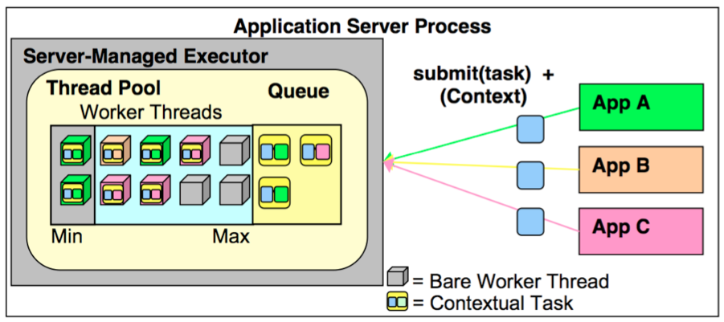
Concurrent Utilities (cont.)
Managed Execution

Slide 65
Concurrent Utilities (cont.)
Managed Task Executor
public class TestServlet extends HTTPServlet { @Resource(name=“concurrent/MyExecutorService”) ManagedExecutorService executor; Future future = executor.submit(new MyTask()); class MyTask implements Runnable { public void run() { ... // Task logic } } }

Slide 66
Concurrent Utilities (cont.)
Provides 4 types of managed objects
ManagedExecutorService
ManagedScheduledExecutorService
ManagedThreadFactory
ContextService
Context Propagation
A new default instance of these objects is available for injection in the following JNDI namespace:
java:comp/DefaultManagedExecutorService
java:comp/DefaultManagedScheduledExecutorService
java:comp/DefaultManagedThreadFactory
java:comp/DefaultContextService

Slide 67

Java EE 8 and Beyond
JSON-B
JCache
More CDI/EJB alignment
Cloud, PaaS, multitenancy/SaaS
JMS.next()?
JAX-RS.next()?
Modularity?
NoSQL?
HTML 5?
Configuration API?
Caching
NoSQL
JSON-B
HTML5++
Java EE 7
Modularity
PaaS
State Management
Cloud

Slide 68

Bibliography
http://javathreads.de/2010/01/java-ee-6-web-profile-technologien/
http://en.wikipedia.org/wiki/Java_Platform,_Enterprise_Edition
http://docs.oracle.com/javaee/7/tutorial/doc/home.htm
http://www.h-online.com/open/news/item/Java-EE-7-reference-implementation-GlassFish-4-0-released-1886390.html
Apress – Beginning Java EE 7
Packt Publishing - Java EE First Look
Packt Publishing - Java EE 7 with Glassfish 4 Application Server

