Slide 1

Git
Dima Ionut Daniel

Slide 2
Contents
What is Git?
Version Control
Git Basics
Branching
Server
Distributed
GitHub
Conclussion
Bibliography

Slide 3

What is Git?
Git is a distributed revision control system with an emphasis on speed, data integrity, and support for distributed, non-linear workflows.
Git is free software distributed under the terms of the GNU General Public License version 2.
Git's design was inspired by BitKeeper and Monotone(software tools for distributed revision control).

Slide 4
Version Control
Version control is a system that records changes to a file or set of files over time.
Version Control System (VCS) allows you to revert files to a previous state, revert the entire project to a previous state, compare changes over time, see who last modified something that might be causing a problem, who introduced an issue and when, etc.

Slide 5
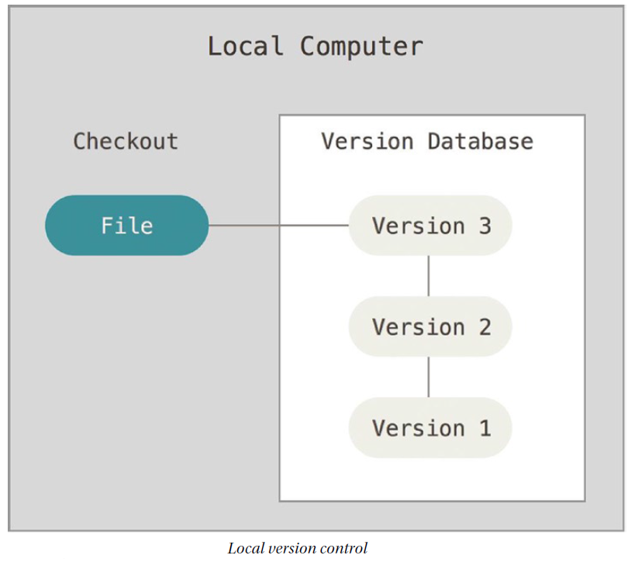
Version Control (cont.)
Long ago developed local VCSs that had a simple database that kept all the changes to files under revision control.

Slide 6
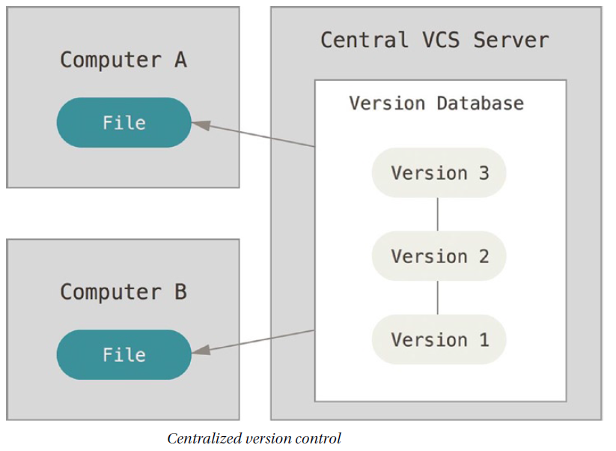
Version Control (cont.)
Centralized Version Control Systems (CVCSs) such as CVS, Subversion, and Perforce, have a single server that contains all the versioned files, and a number of clients that check out files from that central place.

Slide 7
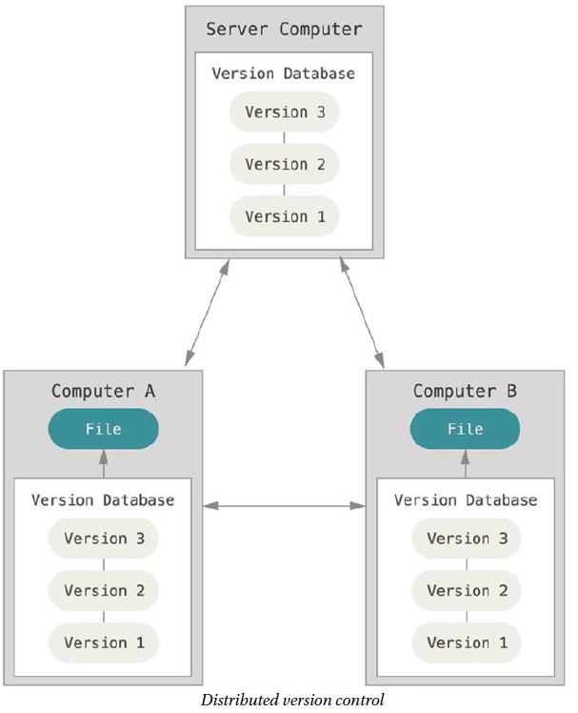
Version Control (cont.)
Distributed Version Control Systems (DVCSs) such as Git, Mercurial, Bazaar, or Darcs, clients don’t just check out the latest snapshot of the files they fully mirror the repository.
If any server dies, and these systems were collaborating via it, any of the client repositories can be copied back up to the server to restore it. Every checkout is really a full backup of all the data.

Slide 8
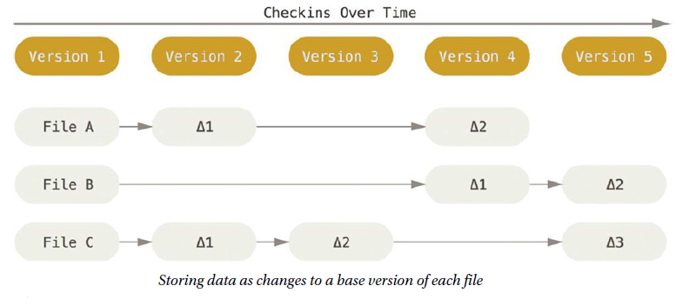
Git Basics
The major difference between Git and any other VCS (Subversion, etc) is the way Git thinks about its data.
Most systems store information as a list of file-based changes.

Slide 9
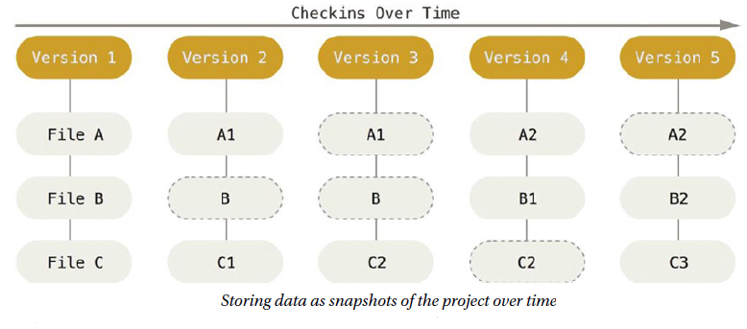
Git Basics (cont.)
Git thinks of its data more like a set of snapshots of a miniature filesystem.
At every commit Git takes a picture of what all your files look like at that moment and stores a reference to that snapshot.

Slide 10
Git Basics (cont.)
To browse the history of the project, Git will read directly from local database.
We can commit locally and later get to a network connection to upload.
The mechanism that Git uses for this checksumming is called a SHA-1 hash.

Slide 11
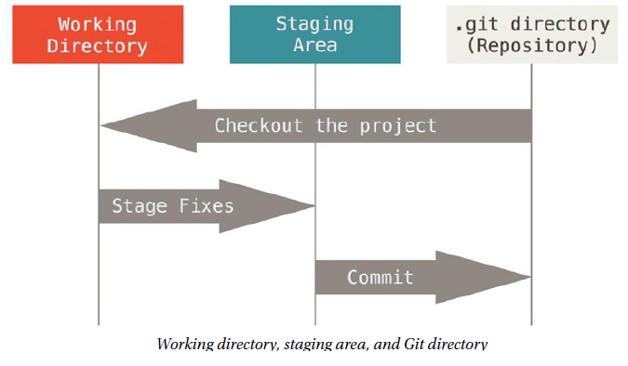
Git Basics (cont.)
Git has three main states that your files can reside in: committed, modified, and staged.
Committed means that the data is safely stored in your local database.
Modified means that you have changed the file but have not committed it to your database yet.
Staged means that you have marked a modified file in its current version to go into your next commit snapshot.

Slide 12
Git Basics (cont.)
The Git directory is where Git stores the metadata and object database for the project.
The working directory is a single checkout of one version of the project.
These files are pulled out of the compressed database in the Git directory and placed on disk for you to use or modify.
The staging area is a file, generally contained in your Git directory, that stores information about what will go into your next commit.
Sometimes it’s referred as “index”, but it’s also common to refer to it as the staging area.

Slide 13
Git Basics (cont.)
"git init" command will create a new subdirectory ".git" what contains all necessary repository files.
"git add" command will add files to staging area.
"git commit" command will upload files to local repository.
“git clone [url]” command will initialize a Git local repository and will pull data from remote Git URL.
Git has a number of different transfer protocols you can use.
Example: https:// protocol,git:// or user@server:path/to/repo.git, which uses the SSH transfer protocol.

Slide 14
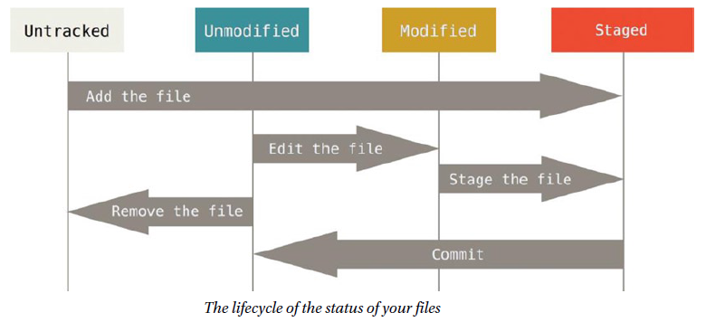
Git Basics (cont.)
Each file in your working directory can be in one of two states: tracked or untracked.
Tracked files are files that were in the last snapshot: unmodified, modified, or staged.
Untracked files are in the working directory, were not in your last snapshot and are not in your staging area.

Slide 15
Git Basics (cont.)
"git status" command determines which files are in which state.
"git status -s" command shows a short status of changes.
The .gitignore file is used for files that we don't want to track.
"git rm" command will remove files from working directory.

Slide 16
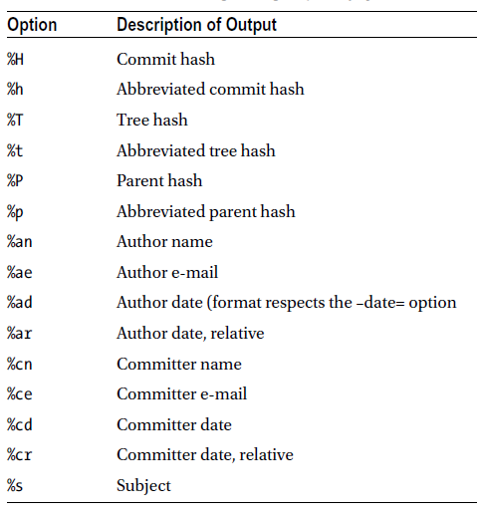
Git Basics (cont.)
"git log" command will show the existing commit history.
Examples:
git log --pretty=oneline
git log --pretty=format:"%h - %an, %ar : %s"

Slide 17
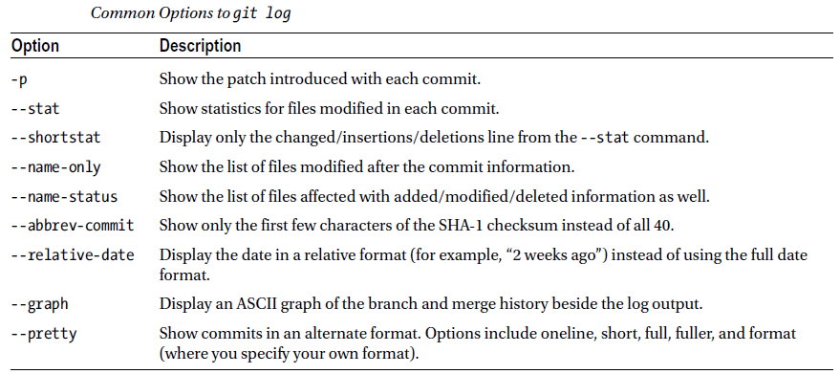
Git Basics (cont.)

Slide 18
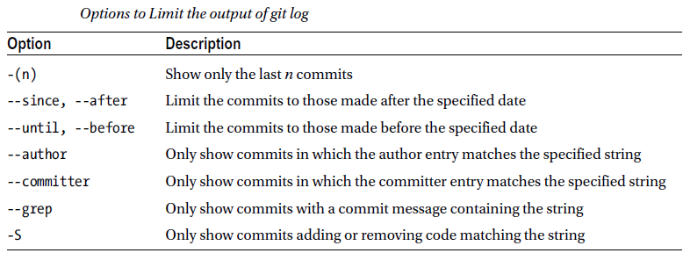
Git Basics (cont.)
We can filter the log:
git log --pretty="%h - %s" --author=john --since="2010-10-01" \ --before="2010-10-10" --no-merges -- t/

Slide 19
Git Basics (cont.)
"git commit -amend" can be used in case we commit data but we forgot something.
Sample:
$ git commit -m 'initial commit'
$ git add forgotten_file
$ git commit --amend
"git reset" can be use to revert changes done on files from staging area.
Ex: git reset HEAD readme.txt

Slide 20
Git Basics (cont.)
Git has the ability to tag specific points in history.
Git uses two main types of tags: lightweight and annotated.
A lightweight tag is like a branch that doesn’t change, a pointer to a specific commit.
Annotated tags, are stored as full objects in the Git database.

Slide 21
Git Basics (cont.)
"git tag -l" command will list all tags.
git tag -a v1.4 -m 'my version 1.4' → creates annotated tag.
"git show v1.4" will display information about the tag.

Slide 22
Git Basics (cont.)
We can create Git command aliases.
$ git config --global alias.unstage 'reset HEAD --'
$ git config --global alias.last 'log -1 HEAD‘
$ git config --global alias.co checkout
$ git config --global alias.br branch
$ git config --global alias.ci commit
$ git config --global alias.st status

Slide 23
Branching
Branching means you diverge from the main line of development and continue to do work on different line different than main line.
Git branches is incredibly lightweight, making branching operations nearly instantaneous, and switching back and forth between branches generally just as fast.
Switching branches changes files in the working directory.

Slide 24
Branching (cont.)
The "git branch" command can create, delete branches.
The "git fetch" command will fetch down all the changes on the server that you don’t have yet, it will not modify your working directory at all.
It will simply get the data for you and let you merge it yourself.
The "git pull" command will fetch data followed by a git merge in most cases.

Slide 25
Server
A remote repository is generally a bare repository, a Git repository that has no working directory.
Git can use four major protocols to transfer data: Local, HTTP, Secure Shell (SSH), and Git.
The most basic is the Local protocol, in which the remote repository is in another directory on disk.
Git can communicate over HTTP in two different modes: Smart HTTP and Dumb HTTP.
The “Smart” HTTP protocol operates very similarly to the SSH or Git protocols but runs over standard HTTP/S ports and can use various HTTP authentication mechanisms.
If the server does not respond with a Git HTTP smart service, the Git client will try to fall back to the simpler Dumb HTTP protocol.
The Dumb protocol expects the bare Git repository to be served like normal files from the web server.

Slide 26
Server (cont.)
A common transport protocol for Git when self-hosting is over SSH.
The Git protocol is a special daemon that comes packaged with Git;
It listens on a dedicated port (9418) and provides a service similar to the SSH protocol, but with absolutely no authentication.

Slide 27
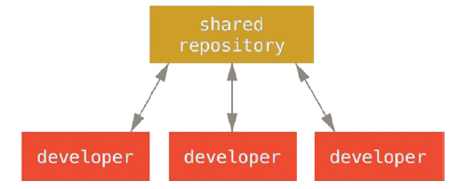
Distributed
Unlike Centralized Version Control Systems (CVCSs), the distributed nature of Git allows you to be far more flexible in how developers collaborate on projects.
In centralized systems, every developer is a node working more or less equally on a central hub.
In Git, every developer is potentially both a node and a hub.

Slide 28
GitHub
GitHub is the single largest host for Git repositories, and is the central point of collaboration for millions of developers and projects.
A large percentage of all Git repositories are hosted on GitHub, and many open-source projects use it for Git hosting, issue tracking, code review, etc.
GitHub maps your Git commits to your user by email address.

Slide 29
Conclussion
PROS:
Network-free access to all old commits
Really quick
Quick to start a new repository
github is easy to use

Slide 30

Bibliography
http://en.wikipedia.org/wiki/Git_%28software%29
Apress – Pro Git Second Edition

Slide 31
Questions ?

