Slide 1

QUIC
Dima Ionut Daniel

Slide 2
Contents
What is QUIC ?
Features
Arhitecture
Terms
Why QUIC ?
Core
Encryption
HTTP2 vs HTTP3
Conclusions
Bibliography

Slide 3

What is QUIC ?
QUIC is a transport layer network protocol designed, implemented and deployed by Google in 2012. Initially the proposed names was "Quick UDP Internet Connections", but IETF chosen QUIC. It establish several multiplied connections between 2 endpoints using UDP, and it's designed to obsolesce TCP at the network layer for many applications.
QUIC works hand-in-hand with HTTP/2 multiplexed connections, allowing multiple streams of data to reach all the endpoints independently.

Slide 4
What is QUIC ? (cont.)
QUIC secondary's goal include reduced connection and transport latency, and bandwidth estimation in each direction to avoid congestion.
It moves "congestion control" algorithms into the "user space" at both endpoints, rather than the "kernel space", which it's claimed will allow these algorithms to improve more rapidly.

Slide 5
Features
QUIC aims to be nearly equivalent to a TCP connection but with much reduced latency.
The first change it to greatly reduce the overhead during connection setup.
The second change is to use UDP rather than TCP as tis bases, which does not include loss recovery.
Each QUIC stream is separately flow controller and lost data retransmitted at the level of QUIC, not UDP.
QUIC aims to fix a major problem of HTTP/2 called "head-of-line-blocking": because the parallel nature of HTTP/2 's multiplexing it not visible to TCP's loss recovery mechanism. A lost or reordered packet causes all active transactions to experience a stall regardless of whether that transaction was impacted by the lost packet.

Slide 6
Features (cont.)
0-RTT connection handshake
0-RTT encryption handshake
Connections survive IP address change
Enhanced packet loss recovery
Always encrypted
FEC(Forward Error Correction) data recovery

Slide 7
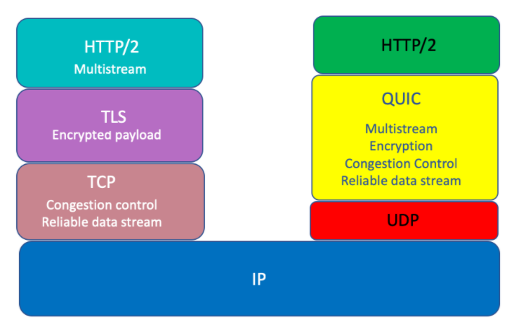
Arhitecture

Slide 8
Terms
Frame: a unit of structured protocol information.
Stream: a unidirectional or bidirectional channel of ordered bytes within a QUIC connection.
Endpoint: an entity that can participate in a QUIC connection by generating, receiving and processing QUIC packets. There are only 2 types of endpoint in QUIC: client and server.

Slide 9
Why QUIC ?
Current issues in TCP:
TCP head of line blocking
handshake cost by 3way handshake
small initcwnd and slow start
large backoff caused by packet loss
increase socket buffer
NAT timeout and IP roaming
TCP buffer bloat - random packet drop in router

Slide 10
Why QUIC ? (cont.)
Current issues in TLS:
handshake cost in TLS negotiation
blocking in Change Cipher Spec
256 bytes limit in ClientHello by Load Balancer bug
Server Certificate Chain gets large to send
Renegotiation and Resumption is not optimized

Slide 11
Core
Streams in QUIC provide a lightweight, ordered byte-stream abstraction to an app.
Streams can be created by sending data.
QUIC allows for an arbitrary number of streams to operate concurrently and for an arbitrary amount of data to be sent on any stream, subject to flow control constraints and stream limits.
Stream are identified within a connection by a numeric value referred to as stream ID. A stream ID is a 62-bit integer that is unique for all streams on a connection. A QUIC endpoint must NOT reuse a stream ID within a connection.

Slide 12
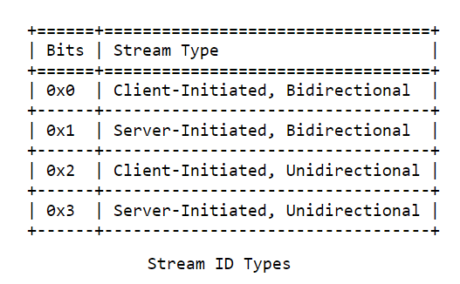
Core (cont.)
Streams can be unidirectional or bidirectional. Unidirectional streams carry data in one direction: from the initiator of the stream to tis peer. Bidirectional streams allow for data to be sent in both directions.
Stream multiplexing can have a significant effect on application performance if resources allocated to streams are correctly prioritized.
QUIC does NOT provide a mechanism for exchanging prioritization information.

Slide 13
Core (cont.)
Operations on streams:
1)For sending part of a stream:
- write data
- end stream (clean termination) resulting in a STREAM frame with the FIN bit set
- reset of the stream (abrupt termination), resulting in a RESET_STREAM frame
2)On receiving part of a stream:
- read data
- abort reading the stream and request close, resulting in a STOP_SENDING frame.

Slide 14
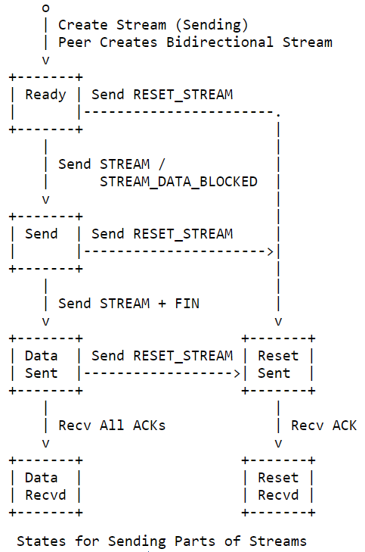
Core (cont.)

Slide 15
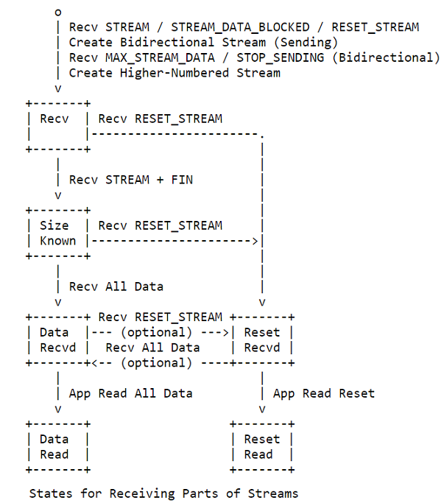
Core (cont.)

Slide 16
Core (cont.)
TLS 1.3 version has "zero roundtrip time connection resumption" mode.
This allows a client to start sending application data, such as HTTP requests without having to wait for the TLS handshake to complete, thus reducing the latency penalty incurred in establishing a new connection.
The idea being 0-RTT connection resumption is that if the client and server had previously established a TLS connection between each other, they can use information cached from that session to establish a new one without having to negotiate the connection's parameters from scratch.

Slide 17
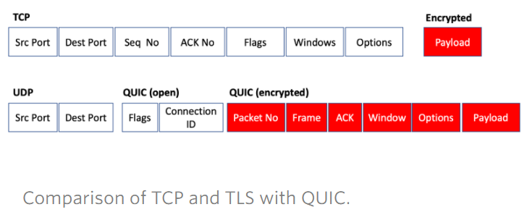
Encryption
QUIC uses end-to-end encryption. This encryption is performed on the UDP payload.

Slide 18
HTTP2 vs HTTP3
Feature | HTTP2 | HTTP3
Transport | TCP | QUIC
Streams | HTTP/2 | QUIC
Clear text version | Yes | No
Independent streams | No | Yes
Header Compression | HPACK | QPACK
Server Push | Yes | Yes
Early Data | In theory | Yes
0-RTT Handshake | No | Yes

Slide 19
Conclusions
The QUIC design keeps all information about connections it carries private.
HTTP/3 uses as transport protocol QUIC.

Slide 20

Bibliography
https://en.wikipedia.org/wiki/QUIC
https://tools.ietf.org/html/draft-ietf-quic-transport-34
https://blog.apnic.net/2019/03/04/a-quick-look-at-quic

