Slide 1

Appium
Dima Ionut Daniel

Slide 2
Contents
What is Appium?
History
Architecture
Features
Core
Components
Appium Inspector
Conclusions
Bibliography

Slide 3

What is Appium?
Appium is an open-source automation tool for running scripts and testing native applications, mobile-web applications and hybrid applications on Android or iOS using a webdriver.
It is backed by Sauce Labs and its first official launch was in May, 2014.

Slide 4
History
Appium was originally developed by Dan Cuellar in 2011 under the name "iOSAuto", written in the C# programming language.
The program was open-sourced in August 2012 using the Apache 2 license.
In January 2013, Sauce Labs agreed to fund Appium's development and motivated its code to be rewritten using Node.js.
In October 2016, Appium joined the JS Foundation.

Slide 5
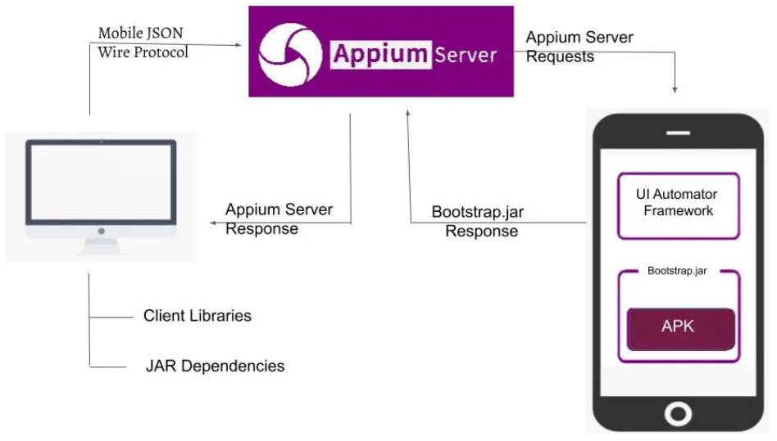
Architecture

Slide 6
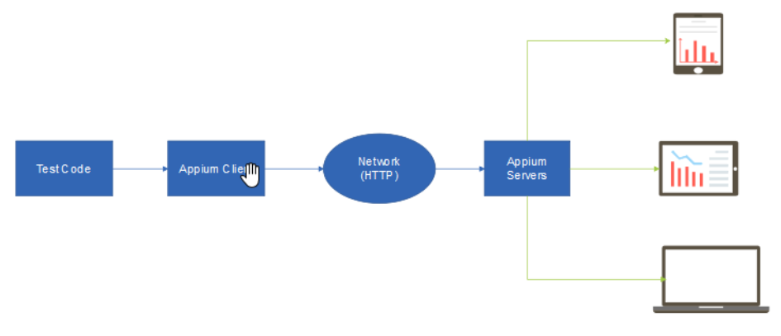
Architecture (cont.)

Slide 7
Features
Cross-Platform Compatibility
makes testing mobile applications easier.
helps us to write test scripts that work on both, iOS and Android applications.
allows one to develop tests at once and execute them on various devices.
Open Source
supports community contributions and is freely available
Supports Multiple Programming Languages
Appium supports multiple programming languages: Java, Python, C#, etc.

Slide 8
Features (cont.)
No App Modification Required
testing technique is totally different because it simulates user interaction with the app.
Integration with Continuous Integration (CI) Tools
it integrates with CI tools like Jenkins streamlines.
it ensures a continuous and efficient testing pipeline.
Supports Native, Hybrid and Mobile Web Applications
testing process inside the development is simplified.

Slide 9
Features (cont.)
Real Device and Emulator/Simulator Testing
testing environment is more real because of its ability to run tests on emulators and simulators.
Built-in Inspector for Element Identification
Inspector tool that comes with Appium, makes it easier to find and tests your app.
offers a visual interface for interacting with the app’s parts.
It helps us to identify UI elements and improves accuracy.
Parallel Execution of Tests
multiple tests may be runs at same time.
reduces the total time needed for testing the performance of apps.

Slide 10
Core
Appium is an HTTP server written in Node.js
The client communicates with the server using a session identifier, the payload is JSON.
The client creates a session and sends commands to the Appium server.
The server differentiates between iOS and Android requests using the desired capabilities.
The Appium server then processes the request and executes the commands on the emulator/real device.
The results of the test session are exchange using JSON format.

Slide 11
Core (cont.)
The client initiates session using the Desired Capabilities.
Android driver session uses the UiAutomator2 driver.
iOS driver session uses the XCUITest driver.
Types of mobile applications:
Native: Android SDK, Swift
Hybrid: native container WebView (HTML, JS, CSS)
Mobile Web

Slide 12
Core (cont.)
Appium is based on W3C driver specifications which implies it implements a client-server architecture.
WebDriver protocol specification: https://www.w3.org/TR/webdriver2 .
JWP(JSON Wire Protocol) is old legacy protocol, W3C Standard Protocol is the new one.
Some browsers has stopped to support JWP in latest version, like Safari.

Slide 13
Core (cont.)
JSON (JavaScript Object Notation) is a lightweight data interchange format that is easy for humans to read and write and easy for machines to parse and generate.
Benefits of Wire Protocol
Enables writing tests in any programming language.
Allows tests to be run on cloud services or local Selenium Grid setups.
Supports the creation of different browser-specific drivers using the same standards.

Slide 14
Core (cont.)
Appium prerequisite:
Java
Android SDK
Node JS

Slide 15
Core (cont.)
ADB (Android Debug Bridge):
Command line tool that allows the communication with a device.
It’s used for installing and debugging apps in emulator and real devices.
It’s client-server program that has 3 components:
Client, which sends commands.
Daemon (adbd), which runs commands on a device.
Server, which manages communication between client and daemon.

Slide 16
Core (cont.)
The adb is included in the Android SDK Platform tools package and after the installation can be found in android_sdk/platform-tools folder.
When we start an adb client, the client first checks whether there is an adb server process already running. If there isn't, it starts the server process and it binds to local TCP port 5037 and listens for commands sent from adb clients.
The server then sets up connections to all running devices.

Slide 17
Core (cont.)
adb help → list all commands
adb install <path_to_apk> → installs apk to device.
adb kill-server → stops the server process.
adb force-stop package → force-stop everything associated with package.
adb shell <command> → starts an interactive shell and executes the command on the device.
adb devices → shows all the connected devices.

Slide 18
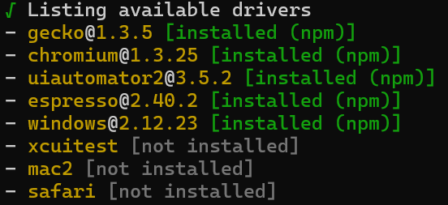
Core (cont.)
Appium driver management:
Appium has 3 main commands: server, driver, plugin.
appium driver list

Slide 19
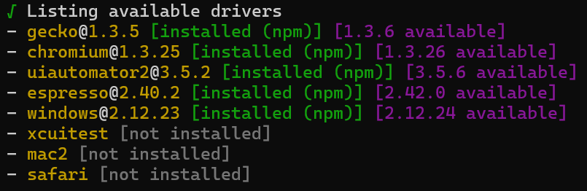
Core (cont.)
appium driver list – updates ➔ checks for any potential driver updates

Slide 20
Core (cont.)
appium driver install <driver_name> ➔ installs driver
appium driver unninstall <driver_name> ➔ uninstalls driver
appium driver intall –source npm <nmp_name>
appium driver install –source git <GIT_REPO.git> --package <package_name>
appium driver update <driver_name> ➔ updates driver

Slide 21
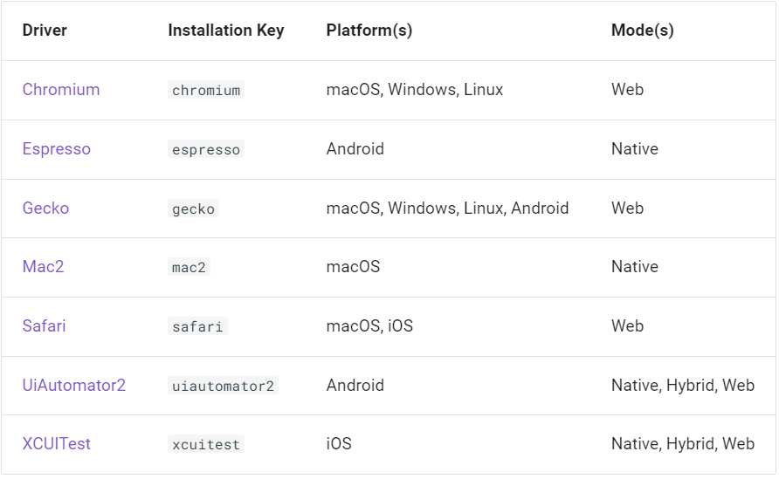
Core (cont.)

Slide 22
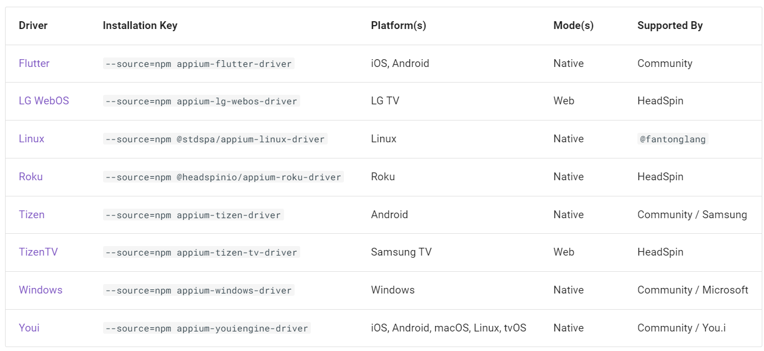
Core (cont.)

Slide 23
Components
Major components in the Appium architecture:
Test code – scripts that are being executed
Clients – are responsible for sending the requests to Appium server.
Desired Capabilities – properties that set specific properties for the used devices: iOS, Android, etc.
Appium Server – Node.JS REST controller that reads the desired capabilities and route the requests to the devices/emulators.
Drivers – build upon Appium libraries to support various OS, common ones are iOS and Android.
Plugins – change or extend Appium’s core functionality.

Slide 24

Appium Inspector
Appium Inspector is a GUI tool for Appium, providing visual inspection of the application under test.
It can show the application page screenshot along with its page source, and includes various features for interacting with the app.

Slide 25
Appium Inspector (cont.)
Appium Inspector features:
Specify the Appium server details
Interact with the app screenshot
Search for elements using supported locator strategies and your own selectors
Search for elements and interact with them
Run Appium driver commands
Attach to an existing Appium session
Create and save custom gestures
Switch to different application contexts

Slide 26
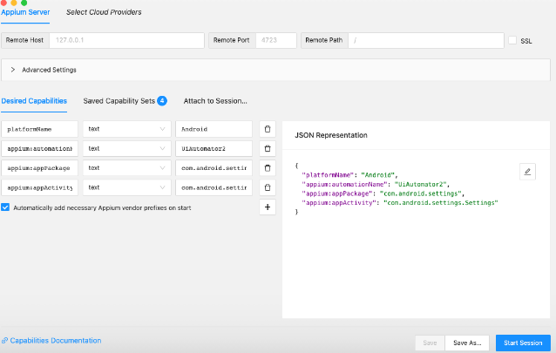
Appium Inspector (cont.)
Tool capabilities setup:

Slide 27
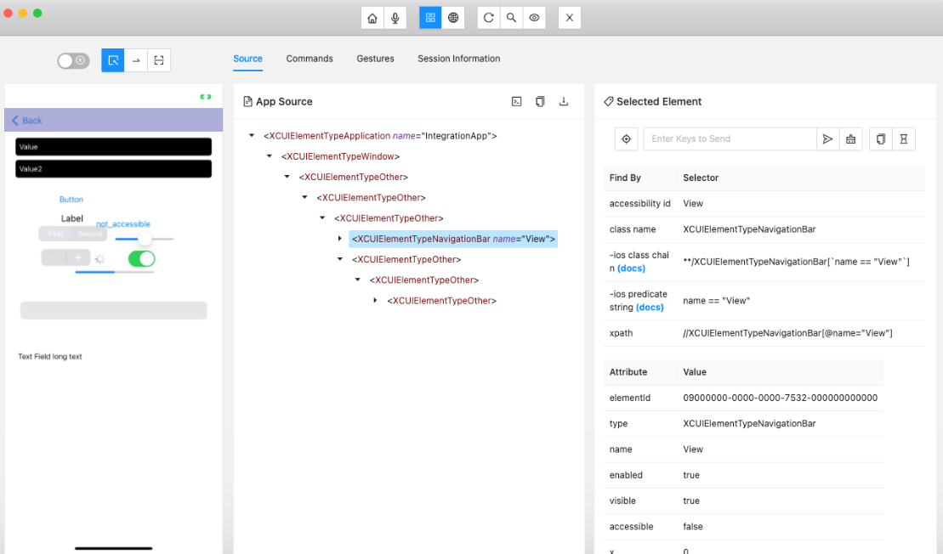
Appium Inspector (cont.)
Example inspecting app:

Slide 28

Appium Inspector (cont.)
The Inspector has built-in integrations with various cloud service provider platforms.

Slide 29
Conclusions
PROS:
Open source
Cross platform
Framework support
Community support
CONS:
Lack of detailed reports
It depends on remote web driver (might be slow)

Slide 30

Bibliography
https://en.wikipedia.org/wiki/Appium
https://appium.io/docs/en/latest
https://www.geeksforgeeks.org/features-of-appium/
https://medium.com/swlh/appium-architecture-793ae79cc85c
https://github.com/appium/appium-inspector
https://www.javatpoint.com/appium
https://developer.android.com/tools/adb

