Slide 1

Kerberos
Dima Ionut Daniel

Slide 2
Contents
What is Kerberos?
History
Architecture
Features
Core
Implementations
Drawbacks and Limitations
Bibliography

Slide 3

What is Kerberos?
Kerberos is a network authentication protocol which works on the basis of 'tickets'.
It allow nodes communicating over a non-secure network to prove their identity to one another in a secure manner.
It is designed after client–server model and it provides mutual authentication—both the user and the server verify each other's identity.

Slide 4
What is Kerberos? (cont.)
Kerberos protocol messages are protected against eavesdropping and replay attacks.
Kerberos builds on symmetric key cryptography and requires a trusted third party, and optionally may use public-key cryptography during certain phases of authentication.
Kerberos uses UDP port 88 by default.

Slide 5
History
Version 5, designed by John Kohl and Clifford Neuman, appeared as RFC 1510 in 1993 and was made obsolete by RFC 4120 in 2005.
Authorities in the United States classified Kerberos as "Auxiliary Military Equipment" on the US Munitions List and banned its export because it used the Data Encryption Standard (DES) encryption algorithm (with 56-bit keyss)
MIT makes an implementation of Kerberos freely available, under copyright permissions similar to those used for BSD.
In 2007, MIT formed the Kerberos Consortium to foster continued development.

Slide 6
Architecture
The client authenticates itself to the Authentication Server (AS) which forwards the username to a key distribution center (KDC).
The KDC issues a ticket-granting ticket (TGT), which is time stamped, encrypts it using the user's password and returns the encrypted result to the user's workstation.
This is done rarely, typically at user logon.
The TGT expires at some point, though may be transparently renewed by the user's session manager while they are logged in.

Slide 7
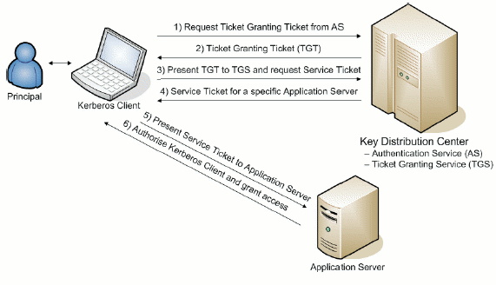
Architecture (cont.)

Slide 8
Features
Kerberos v5 is a system designed to provide mutual authentication of trusted parties in un-trusted environments.
Kerberos v5 is a trusted third-party authentication system.
Kerberos v5 uses symmetric encryption.
Single Sign-On: authenticate to multiple services after an initial credential acquisition.
Kerberos v5 provides federated authentication via cross-realm paths between administrative realms.
Kerberos v5 is an example of "middleware" -it is designed to be used by other applications.

Slide 9
Features (cont.)
Kerberos supports multiple encryption algorithms (DES, 3DES, RC4, AES-128, AES-256).
Each principal can have multiple keys of different encryption types.
In Kerberos messages, the encrypted parts are tagged with the encryption type so Kerberos peers can select the appropriate key.
Kerberos principals can also have multiple keys of the same encryption type.
These are distinguished by the key version number (kvno).
The Kvnois incremented when keys are changed and are used to select the appropriate key for decryption.

Slide 10
Core
Entities:
Client corresponds to a user.
Application server corresponds to a service a user wants to access.
Key Distribution Center (KDC) holds all encryption keys for clients and servers.

Slide 11
Core (cont.)
All Kerberos clients and servers are assigned an encryption key.
Clients send messages to the KDC and get "tickets" to prove their identity to AS.
The ticket is encrypted with the application server's encryption key (the client doesn't know the application server's key).
The application server decrypts the ticket and uses the information inside of the ticket to authenticate the client.

Slide 12
Core (cont.)
The Kerberos ticket contains:
Client identity (e.g., kenh@CMF.NRL.NAVY.MIL)
Application server identity (afs@CMF.NRL.NAVY.MIL)
Session encryption key
Start time
Expiration time
Kerberos Authenticator contains:
Client identity
Checksum
Timestamp
Optional sub-session encryption key
Optional sequence number
Kerberos authenticator is created by the client, and is encrypted with the session key in the ticket.

Slide 13
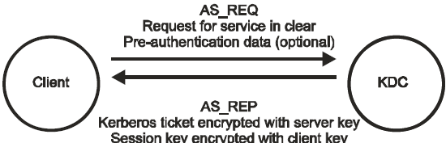
Core (cont.)
The message sent from the client to the KDC is called AS_REQ.
This is a request for a ticket for the desired service.
This request is sent in the clear
This request may include pre-authentication data.
The message sent from the KDC to the client is called AS_REP. This contains the Kerberos ticket and a session key.
The ticket is encrypted with the application server's key.
The session key is encrypted with the client's key.
Note that a copy of the session key is included in the ticket.

Slide 14
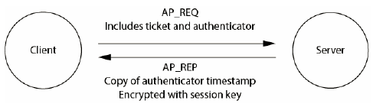
Core (cont.)
The message sent from the client to the application server is AP_REQ.
This includes the ticket (encrypted with server's key), and the authenticator (encrypted with session key).
A new authenticator is generated by the client for every AP_REQ.
Application server decrypts ticket, which contains client identity and session key.
The session key is then used to decrypt the authenticator.
The authenticator timestamp is then verified to be recent (within 5 minutes) in order to reduce the risk of replay attacks.
If the authenticator is up-to-date, then the server knows that it is talking to the client, and they both have a session key.

Slide 15
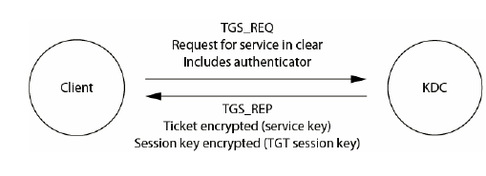
Core (cont.)
The AS_REQ requires that the client knows it's encryption key every time it wants to talk to a new service.
This isn't convenient for users (they have to keep typing in their password every time they connect to a service).
In Kerberos there exists a special service called the Ticket Granting Service, who's job it is to issue tickets for other services.
This service is located on the KDC.
It has a special ticket name: krbtgt/REALM@REALM.
It uses a special messages to talk to the KDC: TGS_REQ and TGS_REP

Slide 16
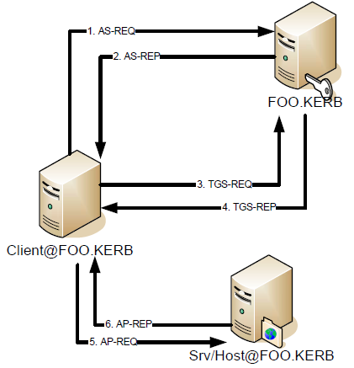
Core (cont.)
TGS_REQ includes ticket (for krbtgtservice) and authenticator.
TGS_REP has session key encrypted with TGT session key, NOT the user's key.

Slide 17
Core (cont.)
The Authentication Service (AS) Exchange
The client obtains an "initial" ticket from the Kerberos authentication server (AS), typically a Ticket Granting Ticket (TGT).
The AS-REQ may optionally contain pre-authentication data to prove the client’s identity.
The AS-REP, containing an authenticator (aka ticket), is encrypted in the client’s long term key.

Slide 18
Core (cont.)
The Ticket Granting Service (TGS) Exchange
The client subsequently uses the TGT to authenticate and request a service ticket for a particular service, from
The Client/Server Authentication Protocol (AP) Exchange
The client then makes a request with an AP-REQ message, consisting of a service ticket and an authenticator that certifies the client's possession of the ticket session key. The server may optionally reply with an AP-REP message. AP exchanges typically

Slide 19
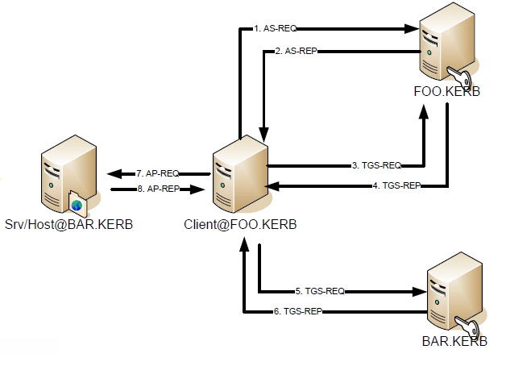
Core (cont.)
Cross Realm works when realmFOO.KERB shares a key withrealm BAR.KERB.
KDC must share a key with the applicationService.

Slide 20
Implementations
The GSS API is the Kerberos authentication in Java.
GSS stands for Generic Security Services API.
It provides a generic way of performing security/authentication services, that does not tie you down to a specific implementation (e.g. Kerberos).

Slide 21
Implementations (cont.)
SASL is a generic protocol framework for negotiating different authentication mechanisms in a protocol.
One of the supported mechanisms in SASL is GSSAPI.
If a protocol uses SASL for authentication, then it supports GSSAPI, which means the protocol has a defined way of supporting Kerberos v5.

Slide 22
Drawbacks and Limitations
Single point of failure: It requires continuous availability of a central server. When the Kerberos server is down, new users cannot log in.
Kerberos has strict time requirements, which means the clocks of the involved hosts must be synchronized within configured limits.
The tickets have a time availability period and if the host clock is not synchronized with the Kerberos server clock, the authentication will fail.
The administration protocol is not standardized and differs between server implementations. Password changes are described in RFC 3244.

Slide 23
Drawbacks and Limitations (cont.)
Each network service which requires a different host name will need its own set of Kerberos keys. This complicates virtual hosting and clusters.
Kerberos cannot be used in scenarios where users want to connect to services from unknown/untrusted clients.
Kerberos requires user accounts, user clients and the services on the server to all have a trusted relationship to the Kerberos token server.
In case of symmetric cryptography adoption, since all authentications are controlled by a centralized key distribution center (KDC), compromise of this authentication infrastructure will allow an attacker to impersonate any user.

Slide 24

Bibliography
https://en.wikipedia.org/wiki/Kerberos_(protocol)

