Slide 1

MariaDB
Dima Ionut Daniel

Slide 2
Contents
What is MariaDB?
Architecture
Features
SQL Commands
Plugins
Storage Engines
Conclusions
Bibliography

Slide 3

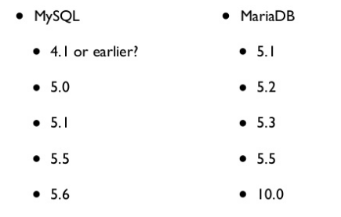
What is MariaDB?
MariaDB is a community edition of MySQL RDBMS intended to remain free under the GNU GPL.
MariaDB version number up to 5.5 followed MySQL numbers.
After version 5.5, MariaDB developers decided to start a branch numbered 10.

Slide 4
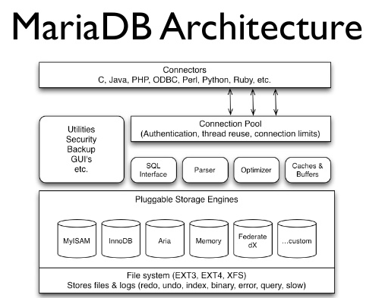
Architecture

Slide 5
Features
MariaDB Features
Storage engines
Scalability enhancements
Administration & Monitoring
Packaging & Connectors
Replication
Optimizer

Slide 6
SQL Commands
Usual commands:
SHOW DATABASES --> lists available databases
SHOW TABLES --> lists tables from current selected database
DESCRIBE <table> --> display information about table(columns, types, etc)
SHOW GRANTS --> display security rights granted to users
SHOW CREATE DATABASE <db> --> shows create db statement
SHOW CREATE TABLE <table> --> shows create table statement

Slide 7
SQL Commands (cont.)
CREATE USER --> The ability to create a user using the CREATE USER statement.
FILE --> The ability to use the LOAD DATA INFILE statement and the LOAD_FILE() function.
RELOAD --> The ability to use the FLUSH statement.
REPLICATION CLIENT --> e ability to use the SHOW MASTER STATUS and SHOW SLAVE STATUS commands.
REPLICATION SLAVE --> The ability to get updates made on the replication master server.
SHUTDOWN --> The ability to shut down the server using the mysqladmin shutdown command.

Slide 8
SQL Commands (cont.)
CREATE USER 'username'@'host' IDENTIFIED BY 'password';
GRANT <privileges> ON <database> TO <user>;
REVOKE <privileges> ON <database> FROM <user>;
SHOW GRANTS FOR <user>;
SET PASSWORD FOR <user> = PASSWORD('<password>');
DROP USER <user>;

Slide 9
SQL Commands (cont.)
MariaDB has a client-server architecture.
mysql [-u <user>] [-p] [-h <host>] [<database>]
mysqldump [-u username] [-p] database_name [table_name]
mysqlimport [--local] [-u username] [-p] database_name filename
mysqlcheck -u root -p --all-databases

Slide 10
Plugins
There are many third-party tools that can enhance MariaDB server.
We can locate plugin directory: SHOW GLOBAL VARIABLES LIKE 'plugin_dir';
We can deploy plugins in that directory.(ex: Audit)
We can install/uninstall plugins using INSTALL PLUGIN, UNINSTALL PLUGIN.

Slide 11
Storage Engines
MariaDB can use many storage engines with different features
MyISAM
PROS:
excellent INSERT performance
small footprint
supports full-text search (FTS)
CONS:
no transactions
no foreign key support
Usages:
logging
auditing
data warehouse

Slide 12
Storage Engines (cont.)
InnoDB
maintains its own buffer pool
uses tablespaces
used for OLTP operations

Slide 13
Storage Engines (cont.)
Archive
store large amounts of data without indexes, in small disk footprint
SELECT and INSERT operations only
good for data audit use
uses AZIO (zlib) compression

Slide 14
Storage Engines (cont.)
FederatedX
create logic points to tables that exists on other Mysql servers
a federated table can point to an InnoDB table or nother server
can be used for synchronization replication

Slide 15
Storage Engines (cont.)
Memory
Previously known as HEAP tables
In-memory engine
Hash index used by default

Slide 16
Storage Engines (cont.)
Aria
based on the 5.1 code
used for data warehousing
uses big log files (1GB by default)
8K pages used by default
ACID compliant,MVCC transactional storage engine based on MyISAM

Slide 17
Conclusions
MariaDB includes many features/plugins.
MariaDB is easy to use.
MariaDB is documented.

Slide 18

Bibliography
http://en.wikipedia.org/wiki/MariaDB
Packt Publishing - MariaDB Cookbook
Addison Wesley MariaDB Crash Course

