Slide 1

SNMP
Dima Ionut Daniel

Slide 2
Contents
What is SNMP?
Architecture
Core
Data Types
Operations
SNMP v3
Java Implementations
Bibliography

Slide 3

What is SNMP?
Simple Network Management Protocol (SNMP) is an Internet-standard protocol for collecting and organizing information about managed devices on IP networks and for modifying that information to change device behavior.
Devices that typically support SNMP include routers, switches, servers, workstations, printers, modem racks and more.
SNMP exposes management data in the form of variables on the managed systems, which describe the system configuration.

Slide 4
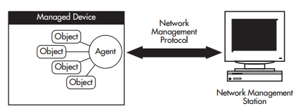
Architecture
Network management components:
One or more managed devices, each containing an agent that provides the management functions.
One or more Network Management Stations (NMS). An NMS is a host system running a network management protocol and network management applications, enabling the user to manage the network.
Network management protocol used by the NMS and agents to exchange information.

Slide 5
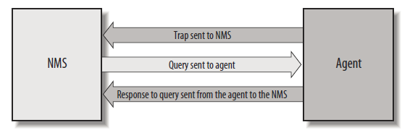
Core
The core of SNMP is a simple set of operations that gives administrators the ability to change the state of some SNMPbased device.
A manager is a server running some software system that can handle management tasks for a network.
Managers are often referred to as Network Management and are responsible for polling and receiving traps from agents in the network.
A trap is a way for the agent to tell the NMS that something has happened.
The agent runs on the network devices we are managing.

Slide 6
Core (cont.)
The Structure of Management Information (SMI) provides a way to define managed objects and their behavior.
An agent has in its possession a list of the objects that it tracks.
The Management Information Base (MIB) can be thought of as a database of managed objects that the agent tracks.
An agent may implement many MIBs, but all agents implement a particular MIB called MIB-II (RFC 1213).
This standard defines variables for things such as interface statistics (interface speeds, MTU, octets* sent, octets received, etc.)

Slide 7
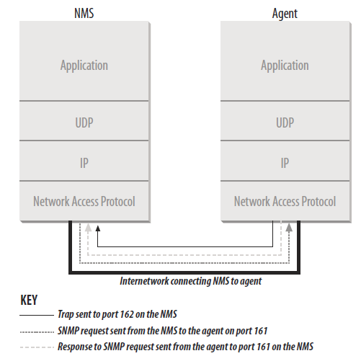
Core (cont.)
SNMP uses the User Datagram Protocol (UDP) as the transport protocol for passing data between managers and agents.
SNMP uses UDP port 161 for sending and receiving requests and port 162 for receiving traps from managed devices.

Slide 8
Core (cont.)
SMIv1 is defined under RFC 1155 and defines precisely how managed objects are named and specifies their associated datatypes.
SMIv1 is defined under RFC 2578 and provides enhancements for SNMPv2.
Attributes:
Name: or OID uniquely defines a managed object. Names commonly appear in two forms: numeric and “human readable.”
Type and syntax: A managed object’s datatype is defined using a subset of Abstract Syntax Notation One (ASN.1)
Encoding: Basic Encoding Rules (BER) is used.

Slide 9
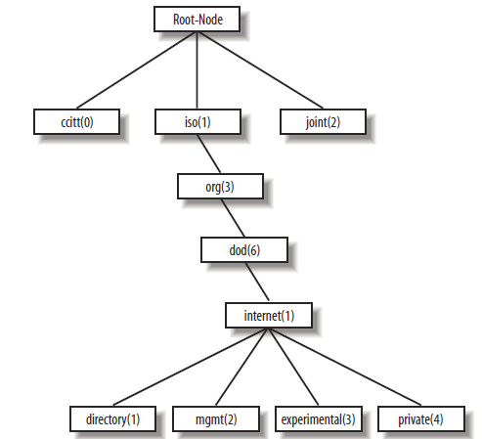
Data Types
Managed objects are organized into a treelike hierarchy and represents the basis for SNMP’s naming scheme.

Slide 10
Data Types (cont.)
The SYNTAX attribute provides for definitions of managed objects through a subset of ASN.1.
SMIv1 defines several datatypes:
INTEGER: A 32-bit number often used to specify enumerated types within the context of a single managed object.
OCTET STRING: A string of zero or more octets generally used to represent text strings.
Counter: A 32-bit number used to track information such as the number of octets sent and received on an interface or the number of errors and discards seen on an interface.
OBJECT IDENTIFIER: A dotted-decimal string that represents a managed object within the object tree.
NULL: Not currently used in SNMP.

Slide 11
Data Types (cont.)
SEQUENCE: Defines lists that contain zero or more other ASN.1 datatypes.
SEQUENCE OF: defines a managed object that is made up of a SEQUENCE of ASN.1 types.
IpAddress: Represents a 32-bit IPv4 address. Neither SMIv1 nor SMIv2 discusses 128-bit IPv6 addresses.
NetworkAddress: Same as the IpAddress type, but can represent different network address types.
Gauge: A 32-bit number and can increase and decrease at will, but it can never exceed its maximum value.
TimeTicks: A 32-bit number that measures time in hundredths of a second.
Opaque: Allows any other ASN.1 encoding to be stuffed into an OCTET STRING.

Slide 12
Data Types (cont.)
SMIv2 also defines some new datatypes:
Integer32: same as INTEGER.
Counter32: same as Counter.
Gauge32: same as Gauge.
Unsigned32: Represents decimal values in the range of 0 to 2^32 - 1, inclusive.
Counter64: Similar to Counter32 with longer range, ideal for situations in which a Counter32 may wrap back to 0 in a short amount of time.
BITS: an enumeration of nonnegative named bits.

Slide 13
Operations
An agent is configured with three community names: readonly, read-write, and trap.
SNMP Operations:
get
getnext
getbulk (SNMPv2 and SNMPv3)
set
getresponse
trap
notification (SNMPv2 and SNMPv3)
inform (SNMPv2 and SNMPv3)
report (SNMPv2 and SNMPv3)

Slide 14
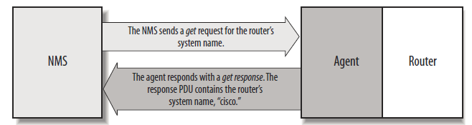
Operations (cont.)
The get request is initiated by the NMS, which sends the request to the agent.
Some devices that are under heavy load, such as routers, may not be able to respond to the request and will have to drop it.

Slide 15
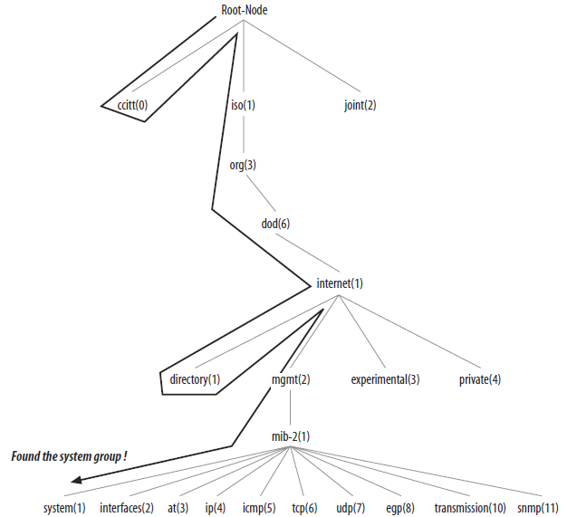
Operations (cont.)
The getnext operation lets you issue a sequence of commands to retrieve a group of values from a MIB.
For each MIB object we want to retrieve, a separate getnext request and getresponse are generated

Slide 16
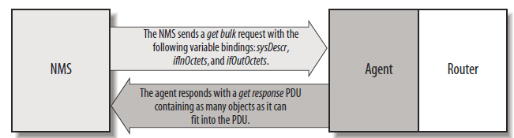
Operations (cont.)
SNMPv2 defines the getbulk operation, which allows a management application to retrieve a large section of a table at once..
The getbulk operation, on the other hand, tells the agent to send back as much of the response as it can.

Slide 17
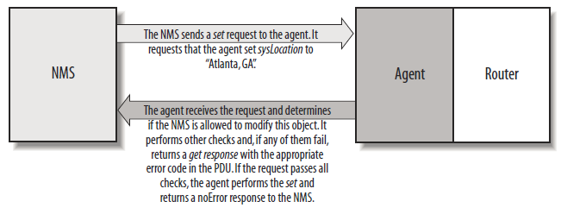
Operations (cont.)
The set command is used to change the value of a managed object or to create a new row in a table.
Objects that are defined in the MIB as read-write or read-only can be altered or created using this command.
It is possible for an NMS to set more than one object at a time.

Slide 18
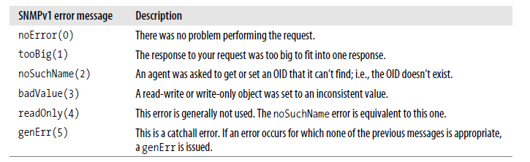
Operations (cont.)
Error responses help you determine whether your get or set request was processed correctly by the agent.
The get, getnext, getbulk, and set operations can return the error responses shown bellow.

Slide 19
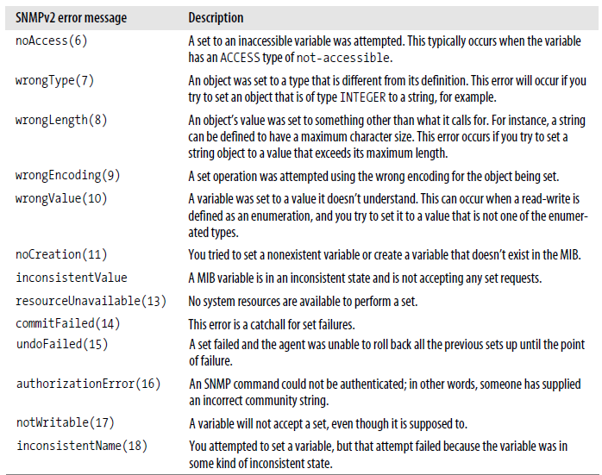
Operations (cont.)
SNMPv2 defines additional error responses that are valid for get, set, getnext, and getbulk operations, provided that both the agent and the NMS support SNMPv2.

Slide 20
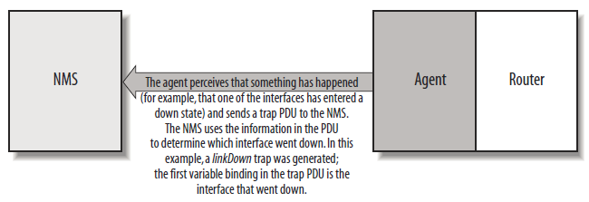
Operations (cont.)
A trap is a way for an agent to tell the NMS that something bad has happened.
The trap originates from the agent and is sent to the trap destination, as configured within the agent itself.
The trap destination is typically the IP address of the NMS.
When an NMS receives a trap, it needs to know how to interpret it.
A trap is first identified by its generic trap number.

Slide 21
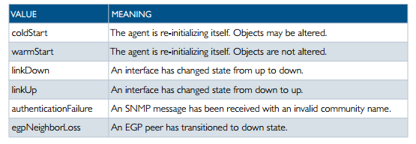
Operations (cont.)
Generic SNMP traps:

Slide 22
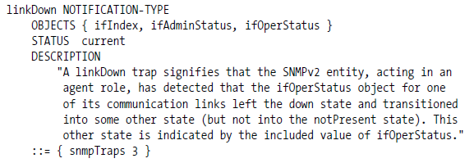
Operations (cont.)
In an effort to standardize the PDU format of SNMPv1traps, SNMPv2 defines a NOTIFICATION-TYPE.
The PDU format for NOTIFICATION-TYPE is identical to that for get and set.
RFC 2863 redefines the linkDown generic notification type.

Slide 23
Operations (cont.)
SNMPv2 provides an inform mechanism, which allows for acknowledged sending of traps.
This operation can be useful when the need arises for more than one NMS in the network.
When an inform is sent, the receiver sends a response to the sender acknowledging receipt of the event.
The agent will be notified when the NMS receives the trap.

Slide 24
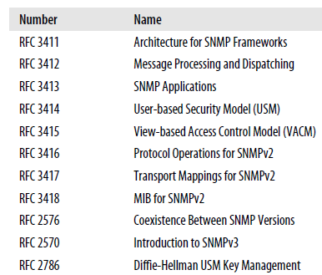
SNMP v3
SNMPv3 addresses the security problems that have plagued both SNMPv1and SNMPv2.

Slide 25
SNMP v3 (cont.)
The engine is composed of four pieces:
The Dispatcher sends and receives messages.
The Message Processing Subsystem prepares messages to be sent and extracts data from received messages.
The Security Subsystem provides authentication and privacy services.
The Access Control Subsystem is responsible for controlling access to MIB objects.

Slide 26
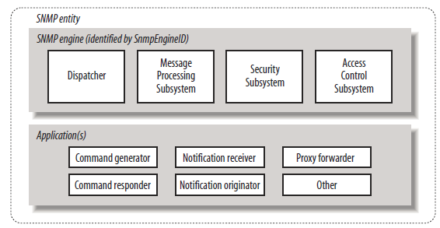
SNMP v3 (cont.)
Version 3 divides most of what we have come to think of as SNMP into a number of applications:
Command generator: generates get, getnext, getbulk, and set requests and processes the responses.
Command responder: responds to get, getnext, getbulk, and set requests.
Notification originator: generates SNMP traps and notifications.
Notification receiver: receives traps and inform messages.
Proxy forwarder: facilitates message passing between entities.

Slide 27
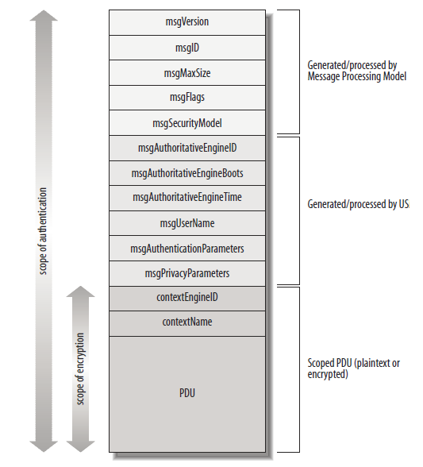
SNMP v3 (cont.)
SNMPv3 Message format:

Slide 28
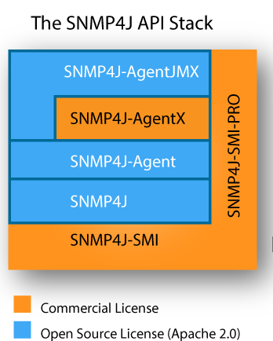
Java Implementations
SNMP4J is an oject Oriented SNMP API for Java Managers and Agents
SNMP4J is an enterprise class free open source and state-of-the-art SNMP implementation for Java™ SE 1.4 or later.
SNMP4J supports command generation (managers) as well as command responding (agents).

Slide 29

Bibliography
https://en.wikipedia.org/wiki/Simple_Network_Management_Protocol
https://www.alliedtelesis.com/sites/default/files/snmp_feature_overview_guide.pdf
O’Reilly - Essential SNMP, 2nd Edition

