Slide 1

Microservices
Dima Ionut Daniel

Slide 2
Contents
What is Servlet?
Features
MSA
SOA
Shared Libraries
OSGI
Synchronous vs Asynchronus
Core
Implementations
Best Practices
Bibliography

Slide 3

What are Microservices?
Microservices are a more concrete and modern interpretation of service-oriented architectures (SOA) used to build distributed software systems.
Services in a microservice architecture (MSA) are processes that communicate with each other over a network in order to fulfill a goal.
The services use technology-agnostic protocols.

Slide 4
Features
The benefit of distributing different responsibilities of the system into different smaller services is that it enhances the cohesion and decreases the coupling.
This makes it much easier to change and add functions and qualities to the system at any time.
It allows the architecture of an individual service to emerge through continuous refactoring.
It reduces the need for a big up-front design and allows for releasing software early and continuously.

Slide 5
Features (cont.)
The microservice is a separate entity.
It can be deployed as an isolated service on a platform as a service(PAAS).
The communication between the services are via network calls to enforce between the services and avoid tight coupling.
With microservices we can change a single service and deploy it independently of the rest of the system.
We allow the functionality to be consumed in different wayts for different purposes.

Slide 6
MSA
The services are easy to replace
Services are organized around capabilities, user interface front-end, recommendation, logistics, billing, etc.
Services can be implemented using different programming languages, databases, hardware and software environment, depending on what fits best
Architectures are symmetrical rather than hierarchical (producer - consumer)

Slide 7
SOA
SOA(Service-oriented architecture) is a design approach where multiple services collaborate to provide a set of capabilities.
Communication between these services occurs via calls across a network.
The microservice approach has emerged from sa real-world use taking our better understanding of systems and architecture to do SOA well.

Slide 8
Shared Libraries
A good technique in any language is breaking down a codebase into multiple libraries.
Libraries hare functionality between services.
The libraries can be reused.
Shared code used to communicate between services can become a point of coupling.

Slide 9
OSGI
OSGI (Open Source Gateway Initiative) is a technology specific approach to modular decomposition.
The modules have a specific lifecycle management such the they can be deployed into a running process, allowing to make changes without taking the whole process down.

Slide 10
Synchronous vs Asynchronous
With synchronous communication a call is made to a remote server which blocks until the operation completes.
With asynchronous communication the caller doesn't wait for the operation to complete before returning.
There are 2 different modes of communication with 2 different styles od collaboration: request/response or event-based.

Slide 11
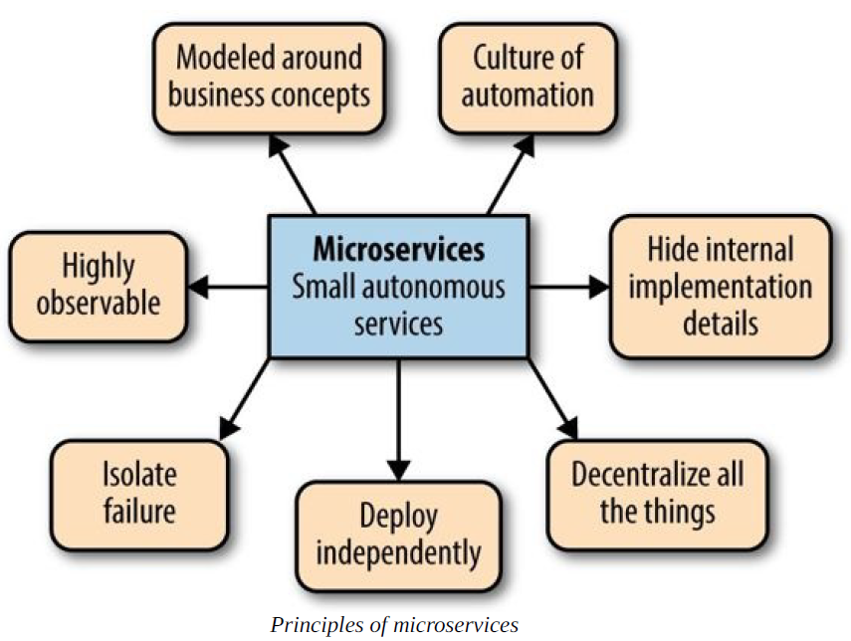
Core

Slide 12
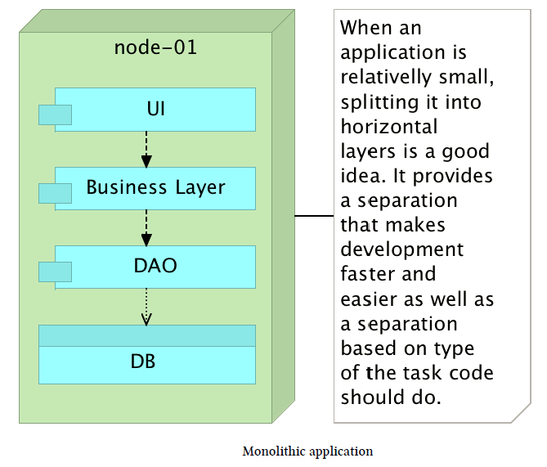
Core (cont.)

Slide 13
Implementation
Docker
Microsoft Service Fabric
Red Hat Openshift: platform as a Service (PaaS) that allows developers to quickly develop, host, and scale applications in a cloud environment
Vert.x
Spring Cloud: provides tools for Spring Boot developers to quickly build some of the common patterns in distributed systems
KumuluzEE: open-source microservice framework for Java EE.

Slide 14
Best Practices
Containers contains everything we need to run in an isolated process and are immutable.
Proxy Microservices or API gateway helps in case there are many requests to the system.
Reverse proxy are used to decouple consumers from microservices like: HAProxy, nginx.
API versioning should be applied to any API.

Slide 15
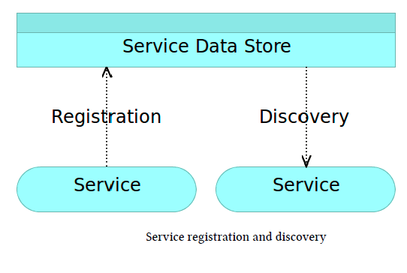
Best Practices (cont.)
The service discovery is the key to distributed services.
The more services we have, the bigger the change for a conflict to occur if we are using predefined ports.
Service registration: stores the configuration like host, port, etc.
Service discovery: allows others to be able to discover the information stored during registration process.

Slide 16

Bibliography
https://en.wikipedia.org/wiki/Microservices
O’Reilly – Building Microservices

