Slide 1

Vagrant
Dima Ionut Daniel

Slide 2
Contents
What is Vagrant?
Architecture
Features
Core
Provisioning
Bibliography

Slide 3

What is Vagrant?
Vagrant is computer software that creates and configures virtual development environments.
It can be seen as a higher-level wrapper around virtualization software such as VirtualBox, VMware, KVM and Linux Containers (LXC), and around configuration management software such as Ansible, Chef, Salt, and Puppet.

Slide 4
What is Vagrant? (cont.)
Vagrant is written in Ruby, but can be used in projects written in other programming languages such as PHP, Python, Java, C# and JavaScript.
Vagrant is open source software distributed under an MIT license.
It provides a unified and simple command-line interface to manage VMs.

Slide 5
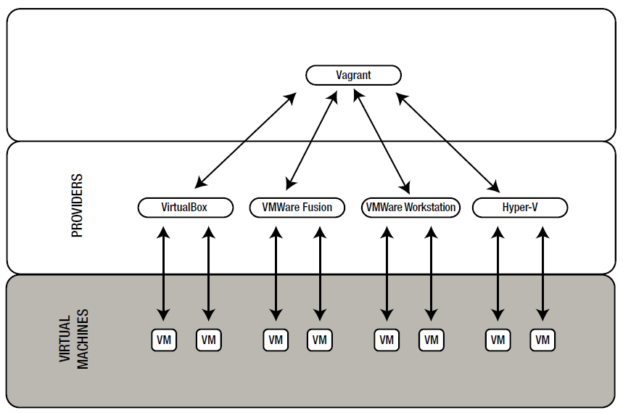
Architecture

Slide 6
Features
Offers a very simple command-line interface to manage VMs.
Supports all major virtual solutions: VirtualBox, VMWare, and Hyper-V.
Supports most popular software configuration tools, including Ansible, Chef, Puppet, and Salt.
Facilitates procedures to distribute and share virtual environments.

Slide 7
Core
The first step in configuring any Vagrant project is to create a Vagrantfile.
Vagrant has a built-in command for initializing a directory for usage with Vagrant: vagrant init.
The configuration of a VM used within a project is stored on a per-project basis inside the Vagrantfile file.

Slide 8
Core (cont.)
Boxes are added to Vagrant with vagrant box add.
This stores the box under a specific name so that multiple Vagrant environments can re-use it: vagrant box add hashicorp/precise64.
If the box was not added before, Vagrant will automatically download and add the box when it is run.
We can specify an explicit version of a box by specifying config.vm.box_version:
Vagrant.configure("2") do |config|
config.vm.box = "hashicorp/precise64"
config.vm.box_version = "1.1.0"
end

Slide 9
Core (cont.)
We can specify the URL to a box directly using config.vm.box_url:
Vagrant.configure("2") do |config|
config.vm.box = "hashicorp/precise64"
config.vm.box_url = "http://files.vagrantup.com/precise64.box"
End
More boxes can be found on following address: https://atlas.hashicorp.com/boxes/search .

Slide 10
Core (cont.)
Using "vagrant up" command we can boot the environment.
In order to connect we can use "vagrant ssh".
To perform cleanup we can use "vagrant destroy" command that will cleanup the resources.
The vagrant destroy command does not actually remove the downloaded box file.
We can see the installed boxes using following command: "vagrant box list“.
We can connect to the image using: "vagrant ssh".

Slide 11
Core (cont.)
We can turn of the VM using: "vagrant halt" or suspend it using "vagrant suspend".
To query the status of the VM we can use: "vagrant status".
The command "vagrant reload" is equivalent using halt and up commands.
We can check the state of all active Vagrant environments using: "vagrant global-status".
To resume a VM that was suspended we can use "vagrant resume".
"vagrant port" command displays the full list of gusts ports mapped to the host machine ports.
All commands can be check here: https://www.vagrantup.com/docs/cli/

Slide 12
Core (cont.)
We can check ssh configuration using: "vagrant ssh-config":
Host default
HostName 127.0.0.1
User vagrant
Port 2222
UserKnownHostsFile /dev/null
StrictHostKeyChecking no
PasswordAuthentication no
IdentityFile C:/HashiCorp/ubuntu_img/.vagrant/machines/default/virtualbox/private_key
IdentitiesOnly yes
LogLevel FATAL

Slide 13
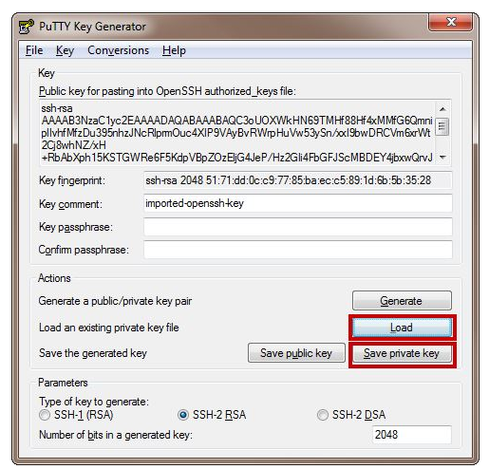
Core (cont.)
For windows in order to connect using putty we need the private key in PPK format.
We can use Putty Gen to “Load” the vagrant image key and save the private key using PPK format.

Slide 14
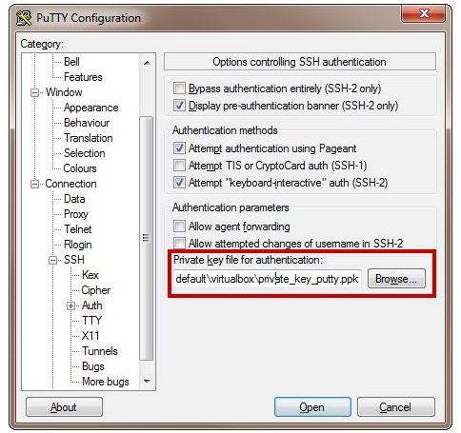
Core (cont.)
We configure putty using localhost, port 222, we set the private key and we use login username: vagrant.

Slide 15
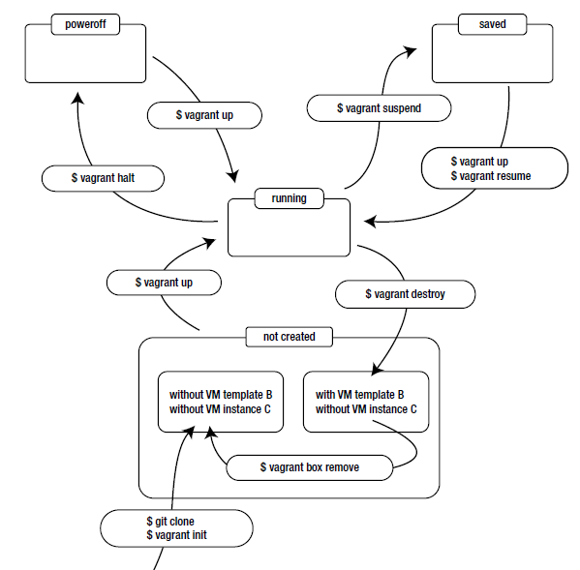
Core (cont.)
The diagram shows how vagrant commands affects the VM state.

Slide 16
Core (cont.)
When we need to create a new box it's best to use supported boxes like:
- ubuntu/trusty64
- ubuntu/trusty32
- ubuntu/precise64
- ubuntu/precise32
- chef/centos-6.5
- chef/debian-7.4
- chef/fedora-20
- chef/freebsd-9.2
To initialize a certain VM we use: "vagrant init ubuntu/trusty64"

Slide 17
Core (cont.)
After we configure a certain VM we can save it using: "vagrant package"
Sample: "vagrant package --output custom.box"
We can edit the VM configuration to forwards ports.
Vagrant.configure(2) do |config|
config.vm.box = "custom"
config.vm.network :forwarded_port, guest: 4000, host: 8080, host_ip: "127.0.0.1"
end

Slide 18
Provisioning
When we need to prepare a development environment first we need to a manual approach.
First we run certain commands on OS to install required packages.
After we have all setup we don't need to run them by hand again.
Vagrant has built-in support for many popular configuration management tools.
Provisioning configuration is stored in the Vagrant file.
Vagrant.configure(2) do |config|
...
config.vm.provision "THE-NAME-OF-THE-PROVISIONER"
end

Slide 19
Provisioning (cont.)
Provision types: shell, puppet, ansible, chef-solo.
Vagrant.configure(2) do |config|
...
config.vm.provision "shell", path: "script.sh"
config.vm.provision "puppet"
config.vm.provision "ansible", playbook: "playbook.yml"
end
After the configuration we can use: "vagrant up --provision" or "vagrant up --no-provision".

Slide 20
Provisioning (cont.)
If we want to call shell script from the VM we can use the inline parameter.
Vagrant.configure(2) do |config|
...
config.vm.provision "shell", inline: “sudo /script.sh"
end
After we make the configuration we need to restart the VM: “vagrant reload –provision”.

Slide 21

Bibliography
https://en.wikipedia.org/wiki/Vagrant_(software)
https://www.vagrantup.com/docs/
Apress – Pro Vagrant

