Slide 1

DNS
Dima Ionut Daniel

Slide 2
Contents
What is DNS?
History
Architecture
Core
Records
Operations
Conclussion
Bibliography

Slide 3

What is DNS?
The Domain Name System (DNS) is a hierarchical and decentralized naming system for computers, services, or other resources connected to the Internet or a private network.
It associates various information with domain names assigned to each of the participating entities.
The Domain Name System maintains the domain name hierarchy and provides translation services between it and the address spaces.

Slide 4
What is DNS? (cont.)
The DNS database is distributed worldwide
A DNS name server is a server that stores the DNS records for a domain; a DNS name server responds with answers to queries against its database.
The DNS database contains individual records that are called Resource Records (RR).
Individual parts of the DNS database called zones are placed on name servers.

Slide 5
History
The Diameter protocol was initially

Slide 6
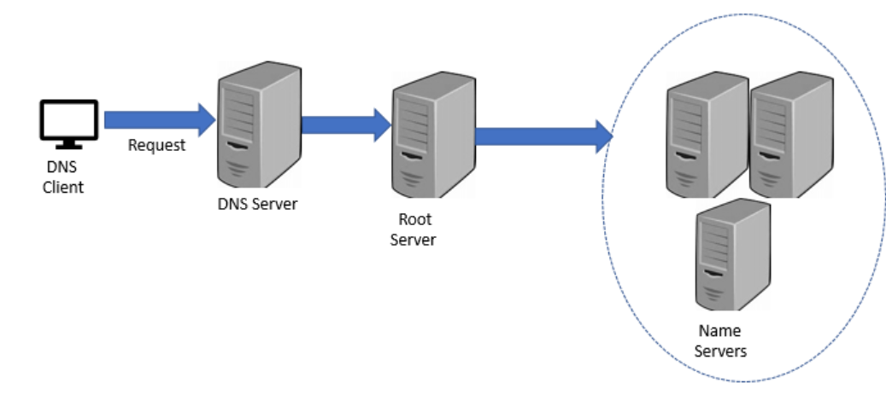
Architecture

Slide 7
Core
The entire Internet is divided into domains, name groups that logically belong together.
It is possible to create subgroups within a domain that are called subdomains.
The domain name consists of strings separated by dots. The name is processed from left to right.
Top Level Domains (TLD) are defined in the root domain. There are 2 kind of TLD:
Generic Top Level Domain (gTLD)
Country Code Top Level Domain (ccTLD).

Slide 8
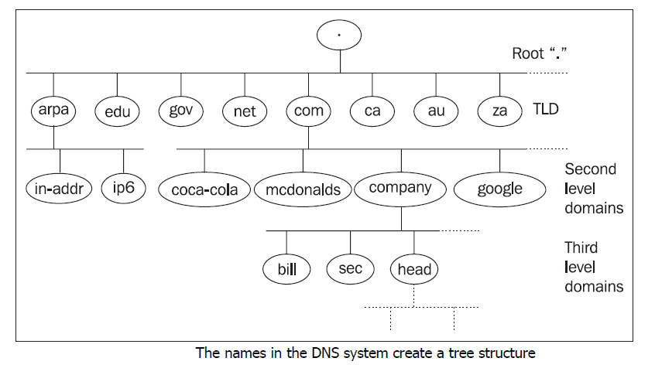
Core (cont.)
Well known gTLDs are edu, com, net, and mil which are used mostly in the USA.

Slide 9
Core (cont.)
Well known gTLDs are edu, com, net, and mil which are used mostly in the USA.
Some applications need to find a name for an IP address, find the reverse record.
This process is the translation of an IP address into a domain name, which is often called reverse translation.
As with domains, IP addresses also create a tree structure.
Domains created by IP addresses are often called reverse domains.

Slide 10
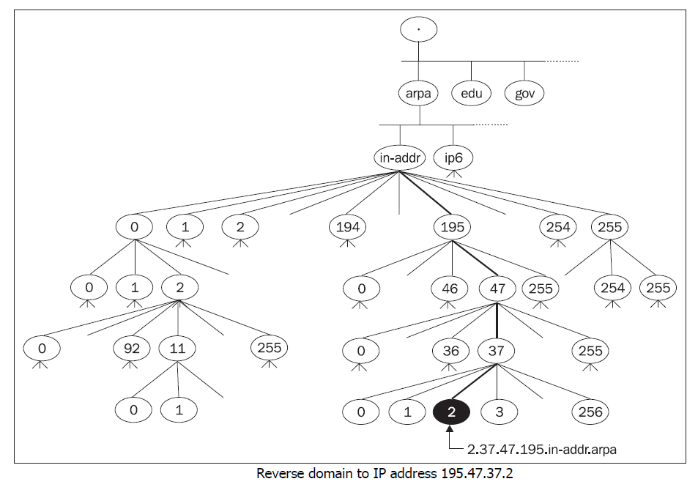
Core (cont.)

Slide 11
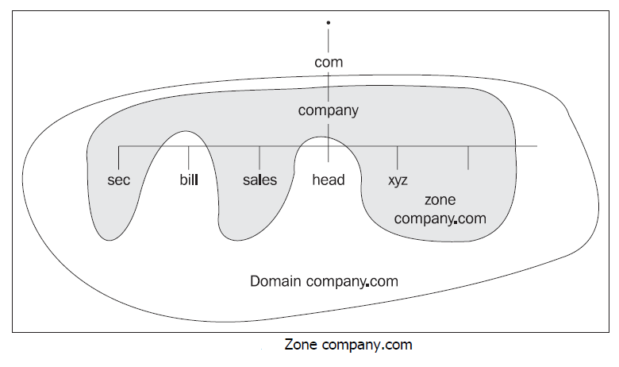
Core (cont.)
A zone is a part of the domain namespace that is administered by a particular name server.
A zone containing data of a lower-level domain is usually called a subordinate zone.

Slide 12
Core (cont.)
Besides classic zones, which contain data about parts of the domains or subdomains, special zones are also used for DNS implementation.
Zone stub: Zone stub is a subordinate zone that only contains information about what name servers administer in a particular subdomain.
Zone cache/hint: A zone hint contains a list of root name servers (non-authoritative data read into memory during the start of the name server). In previous versions, a name cache zone was used.

Slide 13
Core (cont.)
Most common queries are translation of a hostname to an IP address.
Queries(Translations) are mediated by a resolver.
The resolver is a DNS client that asks the name server.
All communication consists of queries and answers.

Slide 14
Core (cont.)
The name server searches in its cache memory for the data for the zone it administers during its start.
The primary name server reads data from the local disk; the secondary name server acquires data from the primary name server by a query zone transfer of the administered zones and saves them into the cache memory.
The data stored within the primary and secondary name servers is called authoritative data.
The name server reads from its memory cache/hint the zone data, which is not part of the data from its administered zone (local disk), but nonetheless enables this data to connect with the root name servers. This data is called nonauthoritative data.

Slide 15
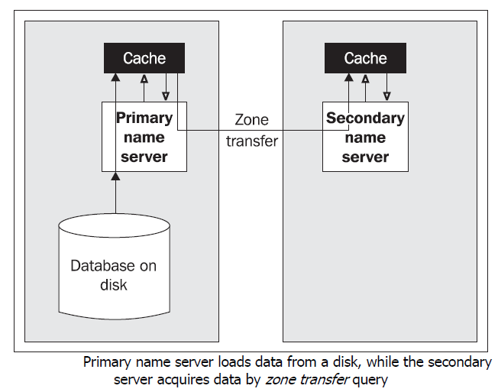
Core (cont.)

Slide 16
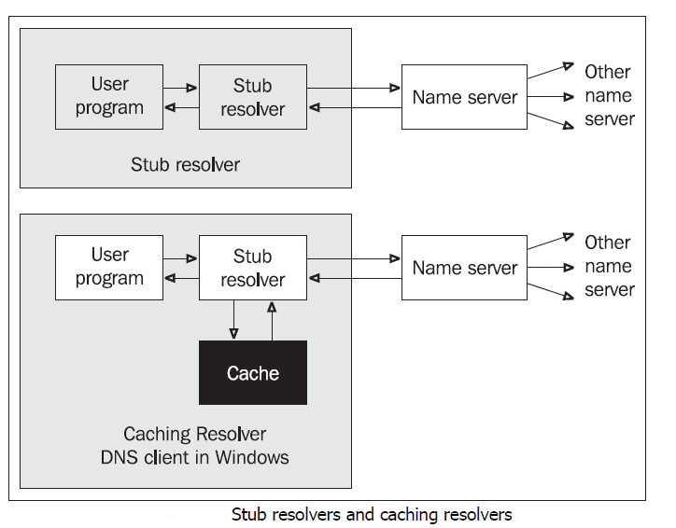
Core (cont.)

Slide 17
Core (cont.)
The user program asks a component within the operating system, which is called a resolver, for a translation.
The resolver transfers the query for translation to a name server.
A resolver without cache memory is called a stub resolver.
DNS uses both UDP and TCP protocols for the transport of its queries/answers. It uses port 53 for both protocols.

Slide 18
Core (cont.)
The length of data transported by UDP protocol is implicitly limited to 512B.
Queries transporting zone transfer data occur between the primary and secondary name servers and are transported by TCP protocol.
Common queries are performed with the help of datagrams in UDP protocol.
The content of a resolver cache can even be written out by ipconfig /displayDNS command or deleted by ipconfig /flushDNS command

Slide 19
Records
A name server (also referred to as a DNS server) loads data into its cache in several ways.
Authoritative data are read from files on a disk or obtained via a zone transfer query from another authoritative servers.
Nonauthoritative data are obtained by the server from other servers as it answers of individual DNS queries.

Slide 20
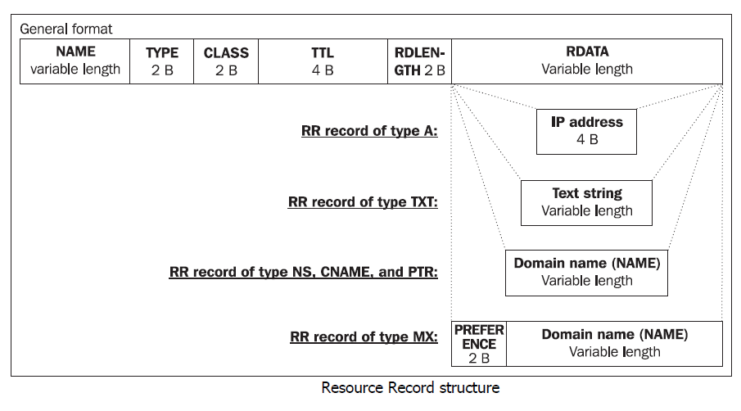
Records (cont.)

Slide 21
Records (cont.)
Each RR field consists of:
NAME: Domain name.
TYPE: Record type.
CLASS: Record class.
TTL: Time to live. A 32-bit number indicating the time the record can be kept valid in a server cache. When this time expires, the record must be considered invalid. The value 0 keeps nonauthoritative servers from saving the RR to their cache memory.
RDLENGTH: A 16-bit number specifying the length of the RDATA field.
RDATA: The data stored as a string of variable length. The format of the field depends on the RR type and class.

Slide 22
Records (cont.)
Type | Name | Description of RDATA field
A | Host Address | 32-bit IP address.
NS | Authoritative Name Server | The domain name of the name server, which is the authoritative name server for the domain.
CNAME | Canonical name for an alias | A domain name specifying a synonym to the NAME field
SOA | Start Of Authority | Each zone data file must have exactly one SOA record
PTR | Domain name pointer | Domain name. The record is used for reverse translation.
HINFO | Host information | Contain descriptions of the HW and the SW used in the NAME computer, respectively.
MX | Mail Exchange | Contains unsigned 16-bit containing the preference value and the second is the domain name of the exchange server

Slide 23
Records (cont.)
Name | Type | Description of RDATA field
TXT | Text string | Text string containing a description.
AAA | IP6 address | 128-bit IP address (IP version 6).
WKS | Well known service description | A description of well known server services in TCP and UDP. It consists of three parts: 32-bit address, protocol number, and service ports.
SIG | Security signature | A description record used for authentication in Secure DNS.
KEY | Security key | A public zone key used as a signature in authentication.
NXT | Next domain | Name of another domain. Authenticating a nonexistent domain name and type.
A6 | A6 host address | Can contain up to three fields: prefix length, part of an IP version 6 address, and prefix name.

Slide 24
Operations
The DNS protocol works with several types of operations: QUERY, NOTIFY, UPDATE.
The DNS protocol operates on a query/answer basis.
A client sends a query to a server and the server answers it.
DNS protocol uses name compression in order to make DNS packets as compact as possible.
UDP is preferred with translation queries, asking RR.

Slide 25
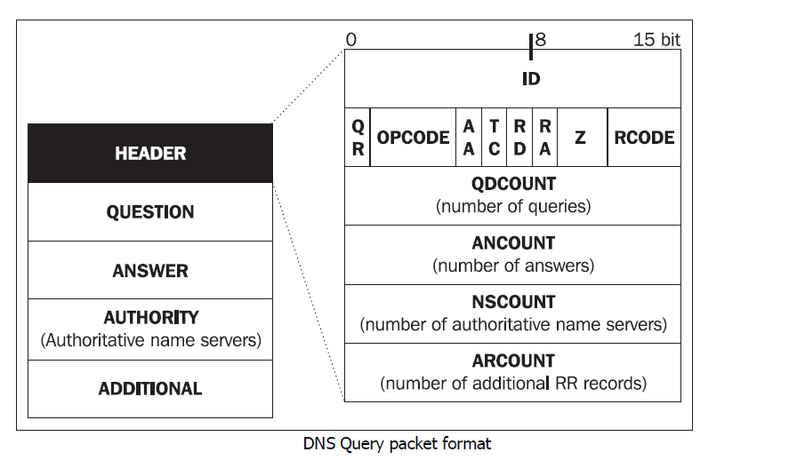
Operations (cont.)
The DNS QUERY operation consists of a query and an answer.

Slide 26
Operations (cont.)
The first two bytes (16 bits) of a header contain a query identifier (query ID).
A query ID is generated by a client and copied into the answer by a server.
The ID is used to match a query with an answer.
The next two bytes of a header contain the control bits.

Slide 27
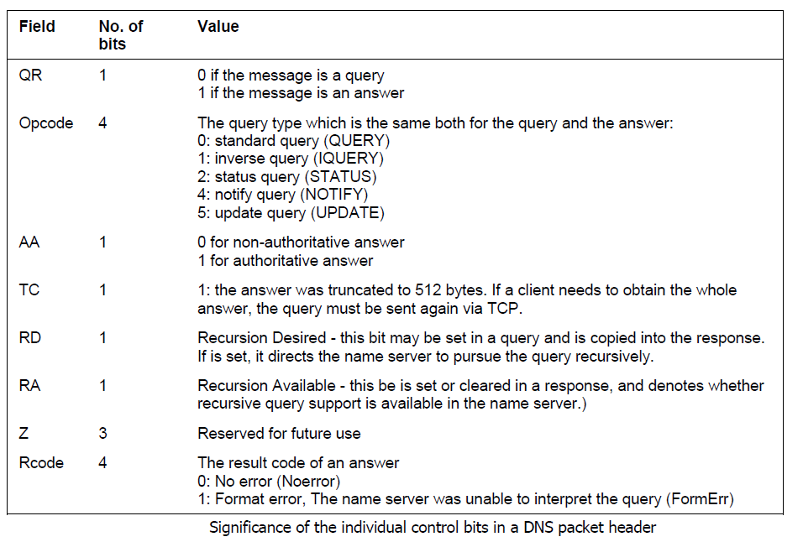
Operations (cont.)

Slide 28
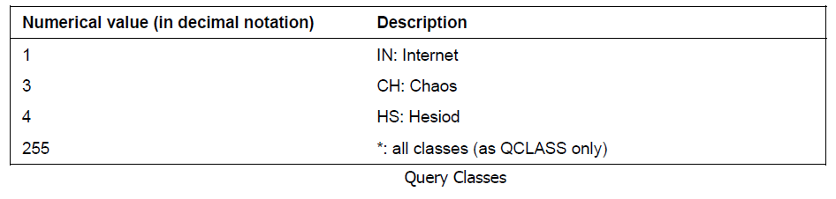
Operations (cont.)
The question section consists of three fields:
QNAME: contains a domain name.
QTYPE: specifies the query type, the RR type required in the answer.
QCLASS: stands for query class.

Slide 29
Operations (cont.)
Answer packets contain another 3 sections: an answer section, an authoritative server's section, and an additional information section
The answer itself is included in the answer section.
The authoritative name server section holds the names of the name servers in NS records.
The additional information section usually holds IP addresses of authoritative name servers.

Slide 30
Operations (cont.)
Inverse queries must not be mistaken for reverse queries.
With inverse queries, for example, the IP address is translated back to the name, but the search is based on an A type RR.
Reverse translation is based on a PTR type RR. Not all name servers support inverse queries.
They are specified in RFC 1035. Inverse query is an obsolete query.

Slide 31
Operations (cont.)
The DNS Update mechanism is described in RFC 3007.
The DNS Update operation enables dynamic correction of entries in the DNS database.
DNS Update provides for adding/deleting one or more records to/from the zone file.
DNS Update operations are also composed of requests and answers.

Slide 32
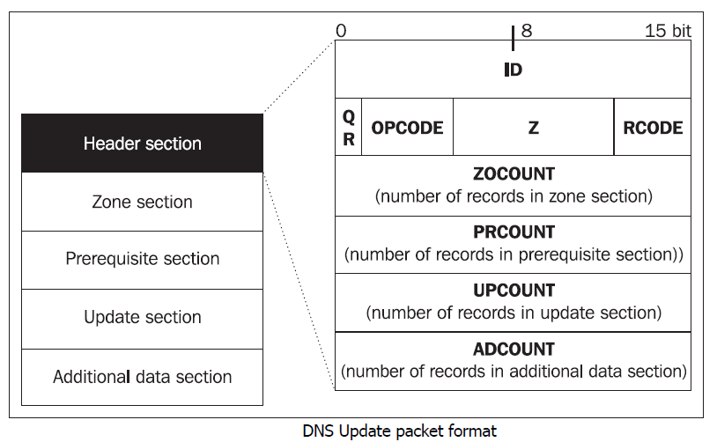
Operations (cont.)

Slide 33
Operations (cont.)
DNS Update packet:
Header section: Contains control information
Zone section: Defines the zone to which corrections apply
Prerequisite section: A set of RR records that must exist in the zone
Update section: A set of RR records that are to be corrected or deleted
Additional data section: Contains information that is not a part of the update, but is necessary for updating

Slide 34
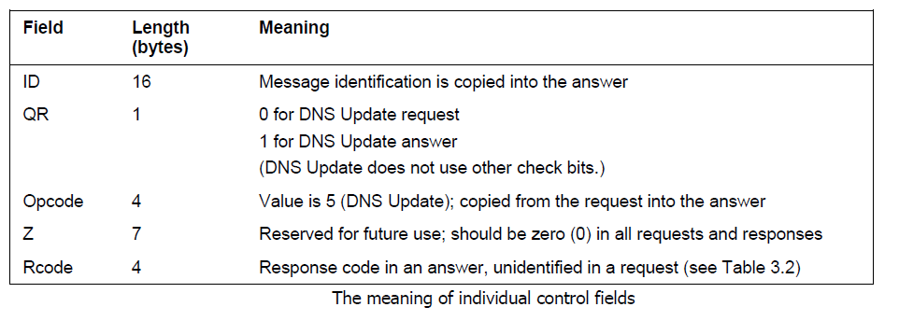
Operations (cont.)

Slide 35
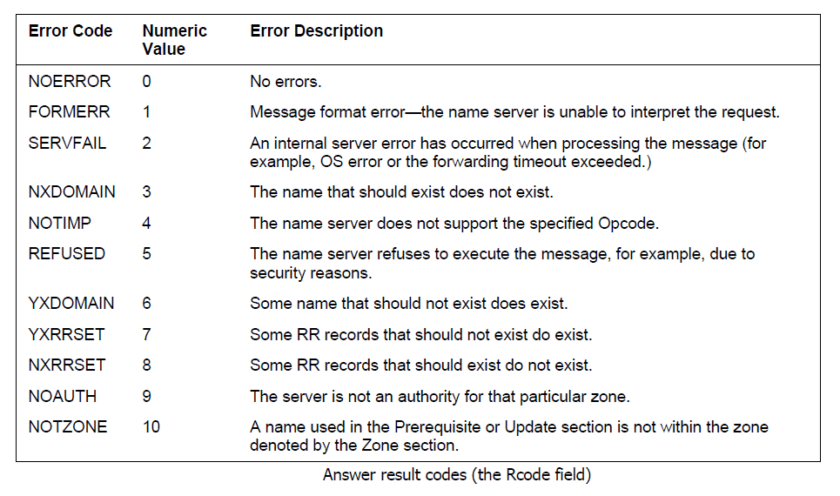
Operations (cont.)

Slide 36
Operations (cont.)
The changes carried out via the DNS Update operation do not update the zone files directly.
The name server saves all the changes in the zone journal files.
The contents of the zone journal file are then reflected in the zone files on a regular basis.

Slide 37
Operations (cont.)
The DNS Notify operation is described in RFC 1996.
DNS Notify can inform the slave servers about data changes in the zone.
Communication between the master and slave servers concerning the zone is initiated, when using the DNS Notify operation, by the master server.
The master server informs slave servers of any possible changes in zones.

Slide 38
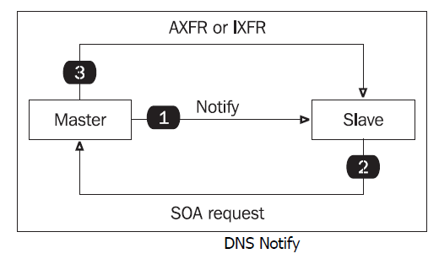
Operations (cont.)
The DNS notify message will be received by all severs that are listed in the NS records for the given zone.
The set of servers for which the DNS Notify is generated is called the Notify Set.

Slide 39
Operations (cont.)
The 4.2 RR Format
Names in the database must start – parg 93

Slide 40
Operations (cont.)
The

Slide 41
Conclussion
jDiameter is an open source

Slide 42

Bibliography
https://en.wikipedia.org/wiki/Domain_Name_System
Packt Publishing - DNS In action

Slide 43
Questions ?

