Slide 1

ElasticSearch
Dima Ionut Daniel

Slide 2
Contents
What is ElasticSearch?
Architecture
Features
Terms
Configuration
Core
REST API
Indexing
Searching
Clustering
Bibliography

Slide 3

What is ElasticSearch?
Elasticsearch is a search server based on Lucene.
it provides a distributed, multitenant-capable full-text search engine with a REST web interface and schema-free JSON documents.
Elasticsearch is developed in Java, and it released as open source under the terms of the Apache License.

Slide 4
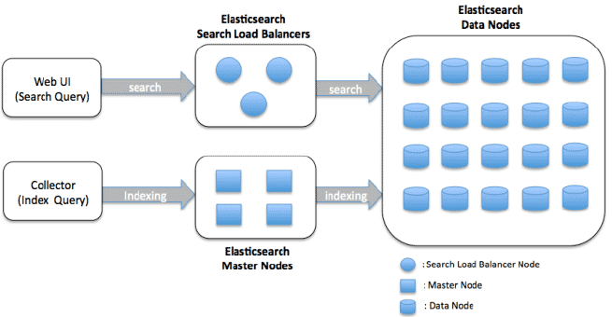
Architecture

Slide 5
Features
REST API based
used for communication
Scalable Map/Reduce model
every operation results in multiple Hadoop tasks that interact in parallel.
Memory and I/O efficient
focused on performance.
Adaptive I/O
elasticsearch detects transport errors and retries automatically.
Facilitates data co-location
integrates with Hadoop exposing its network access information, allowing co-located Elasticsearch and Hadoop clusters to be aware of each other and reduce network IO.

Slide 6
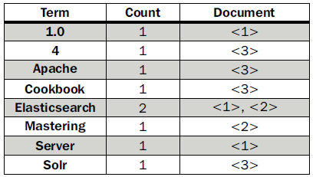
Terms
Document : main data carrier used during indexing and searching, comprising one or more fields that contain the data.
Field: section from document which is build of 2 parts: the name and the value.
Term: unit of search representing a word from the text.
Token: occurrence of a term in the text of the field.
If we have 3 documents the index will look like:
Elasticsearch Server 1.0 (document 1)
Mastering Elasticsearch (document 2)
Apache Solr 4 Cookbook (document 3)

Slide 7
Configuration
The configuration is in the config directory.
There are 2 files: elasticsearch.yml(or elasticsearch.json) and logging.yml.
Elasticsearch.yml is setting the default configuration.
These values can be changed at runtime without the cluster.name and node.name values.
Logging.yml file defines which information should be logged.

Slide 8
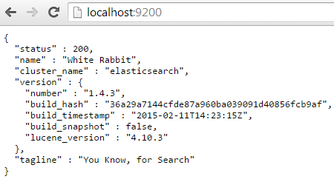
Core
Analysis represents the process of transforming the data.
Analysis is done by the analyzer, which is built of a tokenizer and 0 or more token filters and can have 0 or more-character mappers.
The Lucene tokenizer is spliting text into tokens, and the work is called token stream.
The default port used for the HTTP API is 9200 and if we access http://127.0.0.1:9200/ we get from ElasticSearch the following response.
The output is structured as a JSON (JavaScript Object Notation) object.

Slide 9
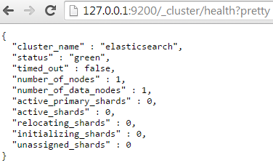
Core (cont.)
We can check cluster health using the URL: http://127.0.0.1:9200/_cluster/health?pretty.
We can close the ElasticSearch by closing the process POST request to http://localhost:9200/_cluster/nodes/_shutdown.

Slide 10
Core (cont.)
Elasticsearch is built to be always available and scalable.
A node is a running instance of Elasticsearch, while a cluster consists of one or more nodes with the same cluster.name that are working together to share their data and workload.
As nodes are added to or removed from the cluster, the cluster reorganizes itself to spread the data evenly.
One node in the cluster is elected to be the master node, which is in charge of managing cluster-wide changes like creating or deleting an index or adding or removing a node from the cluster.

Slide 11
Core (cont.)
To add data to Elasticsearch, we need an index, a place to store related data.
An index is just a “logical namespace” which points to one or more physical shards.
A shard is a low-level “worker unit” which holds just a slice of all the data in the index.
Shards are how Elasticsearch distributes data around your cluster.
The documents are stored and indexed in shards, but the applications don’t talk to them directly, they talk to an index.
A shard can be either a primary shard or a replica shard.
Replicas are used to provide redundant copies of your data to protect against hardware failure, and to serve read requests like searching or retrieving a document.

Slide 12
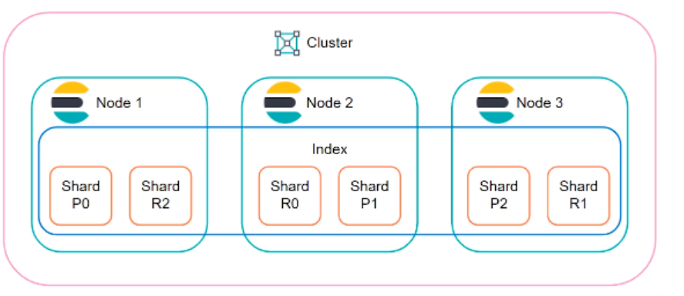
Core (cont.)
Elasticsearch distributes data around the cluster.

Slide 13
Core (cont.)
In Elasticsearch, all data in every field is indexed by default.
Most entities or objects in most applications can be serialized into a JSON object, with keys and values.
A document doesn’t consist only of its data because it contains metadata:
_index: Where the document lives.
_type: The class of object that the document represents.
_id: The unique identifier for the document.
An index is like a “database” in a relational database — it’s the place we store, and index related data.
In Elasticsearch the type attribute for documents represent the same class of “thing”, because they share the same data structure.
The id is a string that, when combined with the _index and _type, uniquely identifies a document in Elasticsearch.

Slide 14
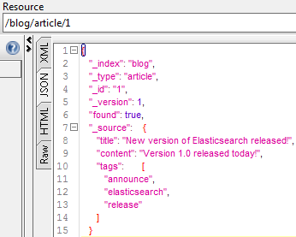
REST API
In Elasticsearch we can store information using the PUT HTTP request.
curl -XPUT http://localhost:9200/blog/article/1 -d '{"title": "New version of Elasticsearch released!", "content": "Version 1.0 released today!", "tags": ["announce", "elasticsearch", "release"] }'
We can retrieve the stored information using the GET request.
curl -XGET http://localhost:9200/blog/article/1
In order to delete the document, the DELETE HTTP method can be used:
curl -XDELETE http://localhost:9200/blog/article/1

Slide 15
REST API (cont.)
In order to check if a document exists from an index, we need to use HEAD /blog/article/1.
In Elasticsearch documents are immutable.
Every time the document is updated, the _version meta field is increased.
In order to update a document, we need to use POST method using the _update at the end of the URL.
Elasticseach reads the document, updates the changed field (or can add/remove other fields), then re-index the document increasing the version.

Slide 16
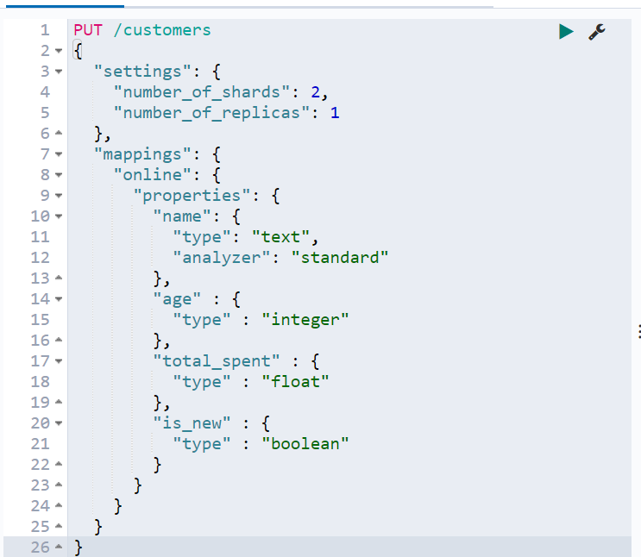
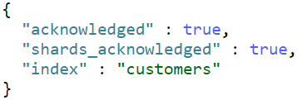
REST API (cont.)
We can obtain the structure of an index using GET /{index}
To delete the index, we need to issue DELETE /{index}
To create an index structure, we use the PUT /${index} method.

Slide 17
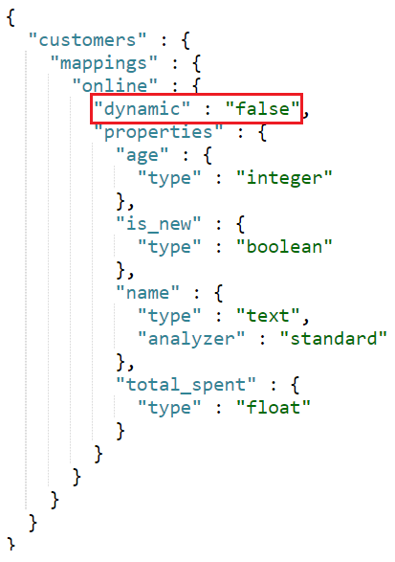
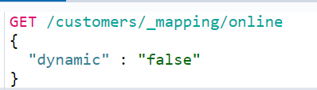
REST API (cont.)
To enforce the index structure, we need to specify during index creation.
dynamic:
if set false, then indexing field will be ignored
if set to strict, then indexing will throw error

Slide 18
REST API (cont.)
Elasticsearch ships with a wide range of built-in analyzers, which can be used in any index.
standard: divides text into terms on word boundaries.
simple: divides text into terms whenever it encounters a character which is not a letter.
whitespace: divides text into terms whenever it encounters any whitespace character.
stop: it like the simple analyzer, but also supports removal of stop words.
keyword: is a "noop" analyzer that accepts whatever text it is given.
pattern: users a regular expression to split the text into terms.
language: provides many language-specific analyzers like english or french.
fingerprint: creates a fingerprint which can be used for duplicate detection.

Slide 19
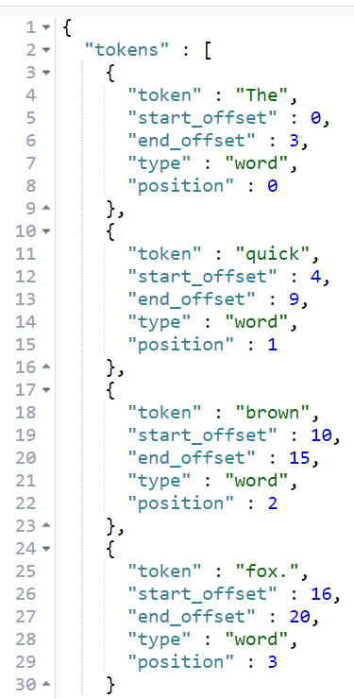
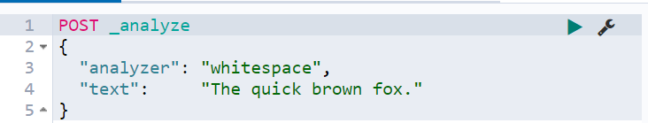
REST API (cont.)
The analyze API is an important tool for viewing terms produces by an analyzer.

Slide 20
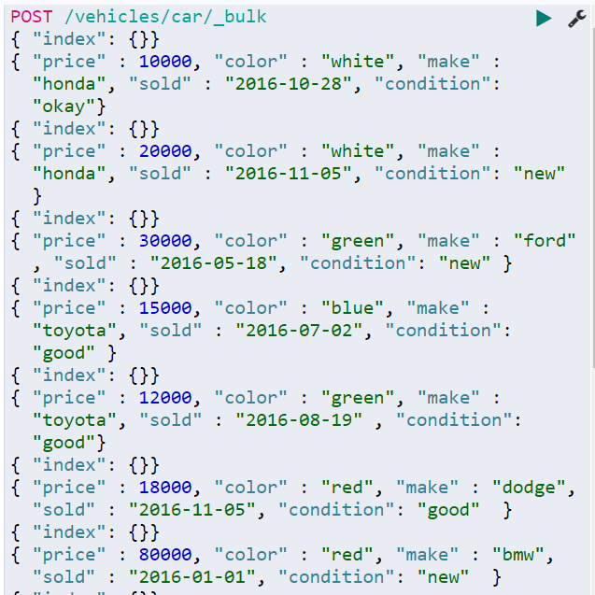
REST API (cont.)
The bulk API performs multiple indexing or delete operations in a single API call.
This reduces overhead and can greatly increase indexing speed.

Slide 21
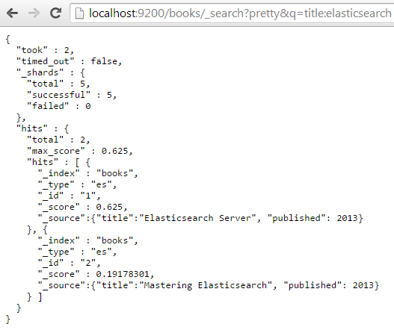
REST API (cont.)
By default, Elasticsearch increments the version when a document is added, changed or deleted.
We can perform query using in the URL the "q" parameter and we need to specify the terms.

Slide 22
REST API (cont.)
The default_operator property can be set to OR or AND and allows to specify the default Boolean operator used for query.
By default, it's set to OR, which means that a single query term match will be enough for a document to be returned.
By default, Elasticsearch doesn't have timeout for queries, but we can use the timeout parameter to return data using timeout.
Sample query URL: http://localhost:9200/books/_search?pretty&q=published:2013&df=title&explain=true&default_operator=AND.

Slide 23
REST API (cont.)
We can use the sort parameter to specify custom sorting.
By default, Elasticsearch is returning documents by their score in descending order.
We can sort by certain field like: sort=published:desc.
We can specify the window size results using 2 parameters: size and from.
The size parameter has 10 as default and defines the maximum number of results returned.
The from parameter defaults to 0 and specifies from which document the results should be returned.
If we want to retrieve 5 documents starting from the 11 one, we use in the query: size=5&from=10.

Slide 24
REST API (cont.)
Sample update request:
POST /website/blog/1/_update
{
"doc" : {
"tags" : [ "testing" ],
"views": 0
}
}

Slide 25
Indexing
Elasticsearch index is build of 1 or more shards and each of them contains part of document set.
Each of these shards can have replicas(copies of the shard).
During index creation we can specify how many shards and replicas should be created.
Having a shard and its replica, in general, means that when we index a document, we will modify them both.

Slide 26
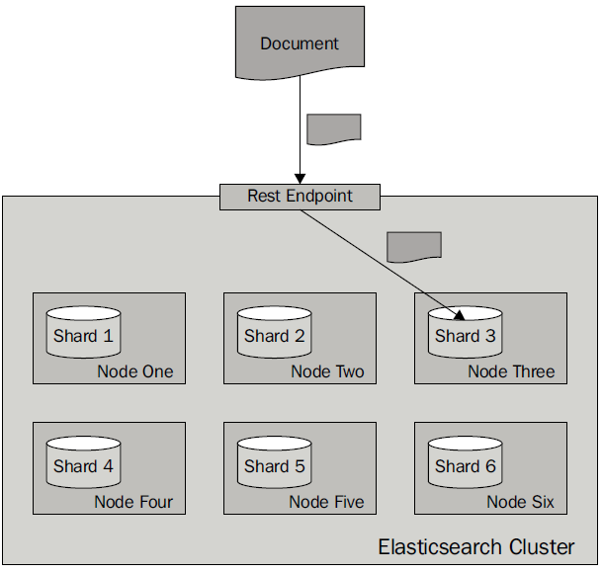
Indexing (cont.)
More shards allow to spread indices to more server, and we can handler more documents without losing performance.
More shards means that fewer resources are required to fetch a particular document because fewer document are stored in a single shared compared to the documents stored in a deployment with fewer shards.
When we have more replicas the higher the query throughput will be because the query can use either a shard or any of its copies.

Slide 27
Indexing (cont.)
Indexing corresponds to both "Created" and "Update" documents based on a given type and ID.
URL: http://localhost:9200/<index>/<type>/[<id>]
Index and type are required while the id part is optional.
If we don't specify an ID ElasticSearch will generate one.
If we don't specify an ID it's best to use POST method instead of PUT.
The index name is arbitrary.

Slide 28
Searching
Elasticsearch supports two kinds of queries: basic ones and compound ones.
Basic queries such as the term query are used for querying the actual data.
The second type of query is the compound query, such as the bool query, which can combine multiple queries.
In addition, we can have filter queries that are used to filter the results with certain criteria.

Slide 29
Searching (cont.)
In order to search with ElastiSearch we can use the _search endpoint optionally with an index and type.
The search URL pattern is <index>/<type>/_search where index and type are both optional.
http://localhost:9200/_search - Search across all indexes and all types.
http://localhost:9200/movies/_search - Search across all types in the movies index.
http://localhost:9200/movies/movie/_search - Search explicitly for documents of type movie within the movies index.

Slide 30

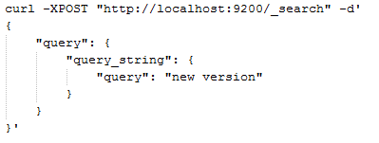
Searching (cont.)
ElasticSearch can search using the query DSL.
The request body should be a JSON object that can contain certain query property.
The query result will contain information about:
execution time
actual results
total number of documents that match the query
array with search hits
metadata about the hit

Slide 31
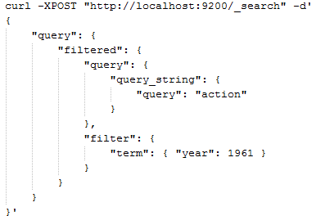
Searching (cont.)
To the query DSL we can add filters like:

Slide 32
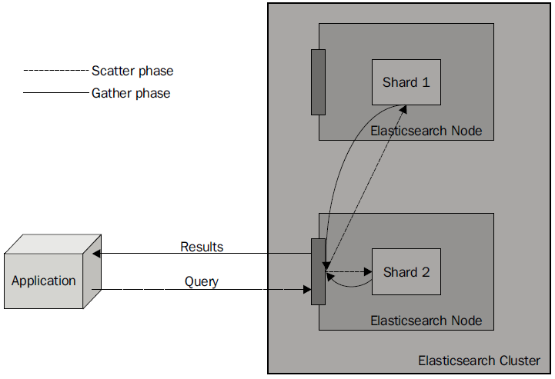
Searching (cont.)
the query process will consist of two phases: scatter and gather.

Slide 33
Searching (cont.)
When we send a query, we send it to one of the Elasticsearch nodes.
The query is distributed to all the shards that our index is built of.
Ex: if it is built of five shards and one replica, then five physical shards will be queried.
Each of the queried shards will only return the document identifier and the score of the document.
After all the documents have been gathered, the final response is built and returned as the query result.

Slide 34
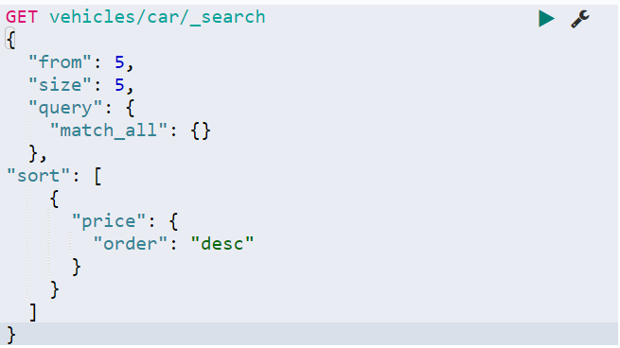
Searching (cont.)
The size parameter can limit the results.
The from parameter can be used for pagination.
The sort parameters can be used for sorting, specifying the sort parameters

Slide 35
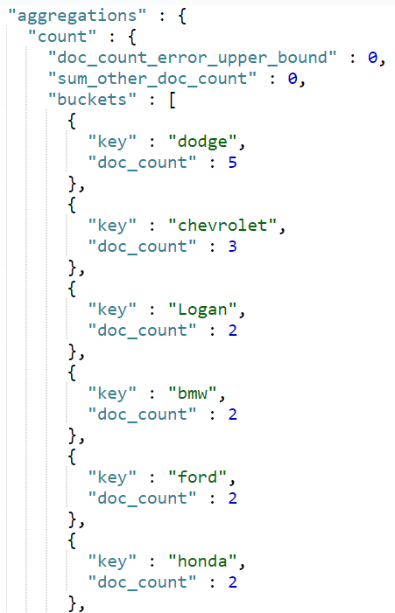
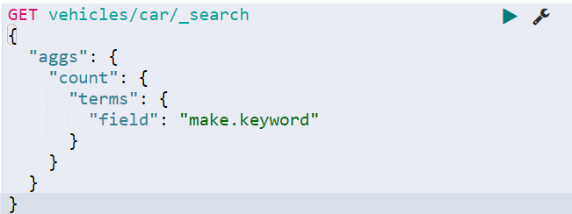
Searching (cont.)
For aggregations we need to use "aggs".

Slide 36
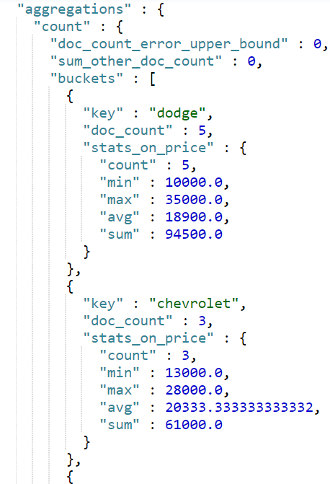
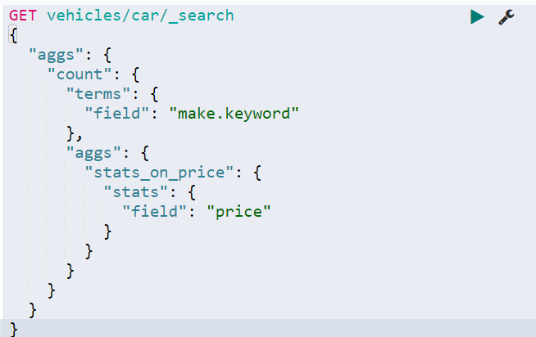
Searching (cont.)
The “stats” aggregation gives stats info about a numeric field: min, max, avg, sum.

Slide 37
Clustering
When Elasticsearch node start it looking for a master node that has the same cluster name and is visible.
If a master is found, the node joins a cluster that is already formed.
If no master is found, the node itself is selected as a master.
The process of forming a cluster and finding nodes is called discovery.
By default, Elasticsearch uses the zen discovery, which provides multicast and unicast discovery.

Slide 38
Clustering (cont.)
Master node
The master node is the one that checks all the other nodes to see if they are responsive.
Other nodes ping the master too.
The master node will also accept the new nodes that want to join the cluster.
If the master is somehow disconnected from the cluster, the remaining nodes will select a new master from among themselves.

Slide 39
Clustering (cont.)
By default, Elasticsearch allows every node to be a master node and a data node.
For performance reasons is best to have different data nodes.
We need to setup in elasticsearch.yml configuration file:
node.master: false
node.data: true

Slide 40

Bibliography
http://en.wikipedia.org/wiki/Elasticsearch
Packt Publisher – Elasticsearch Server 2nd Edition
http://joelabrahamsson.com/elasticsearch-101/
http://www.elasticsearch.org/guide/en/elasticsearch/hadoop/current/features.html

