Slide 1

Filebeat
Dima Ionut Daniel

Slide 2
Contents
What is Filebeat ?
Arhitecture
Core
Modules
Conclusions
Bibliography

Slide 3

What is Filebeat ?
Beats is a collection of light-wight data shippers
They are installed on server and send data to outputs
The most used Beats are Filebeat and Metricbeat.
Modules reduce configuration and provide Kibana dashboards
Sending data over the network has numerous advantages

Slide 4
What is Filebeat ? (cont.)
Beats are data shippers:
Filebeat: collects log files (mysql/apache/nginx)
Metricbeat: collects system-level and service-level metrics: CPU and memory usage
Packetbeat: collects network data
Winlogbeat: collects windows events logs
Auditbeat: collects audit data from linux
Heartbeat: monitors service uptime

Slide 5
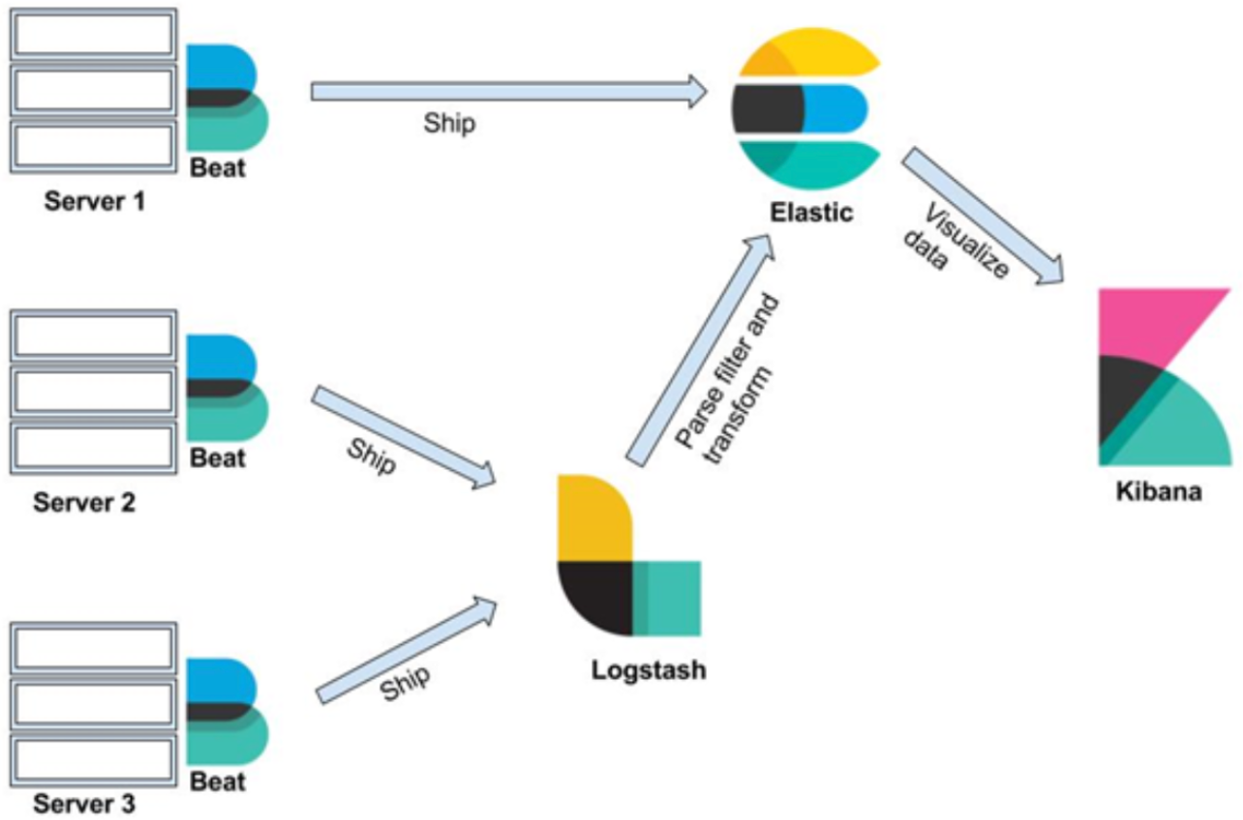
Arhitecture
The Elastic Stack today is comprised of four components, Elasticsearch, Logstash, Kibana, and Beats.

Slide 6
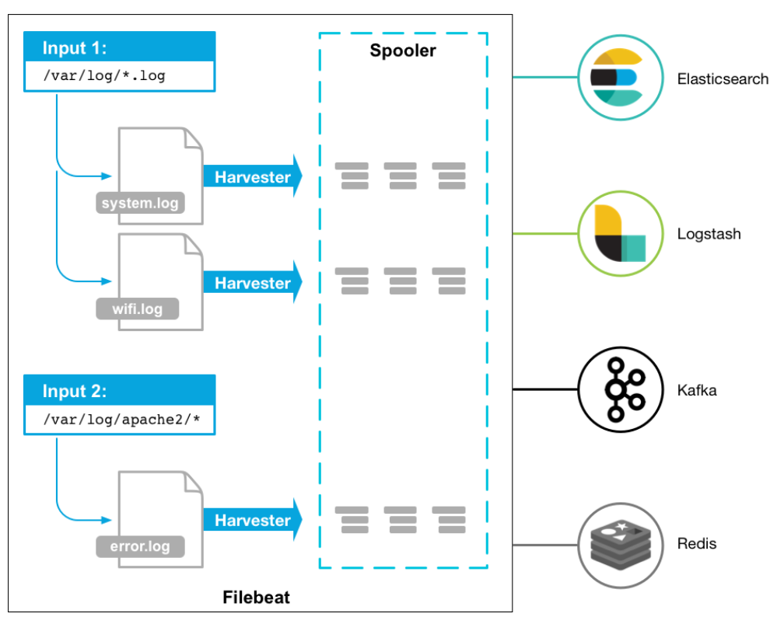
Arhitecture

Slide 7
Core
Filebeat consists of 2 main components:
inputs
harversters
These components work together to tail files and send event data to the output that you specify.

Slide 8
Core (cont.)
A harvester is responsible for reading the content of a single file.
One harvester is started for each file.
The harvester is responsible for opening and closing the file, which means that the file descriptor remains open while the harvester is running.

Slide 9
Core (cont.)
An input is responsible for managing the harvesters and finding all sources to read from
Filebeat currently supports several input types.
Each input type can be defined multiple times.

Slide 10
Core (cont.)
An input starts up a harvester for each file matched by its file pattern
Harvesters read files and keep track of their offsets
The file offsets and other information is persisted to a registry
Each Filebeat event is delivered at least once
The registry file is located at data/registry folder
Delete the file to clear the registry

Slide 11
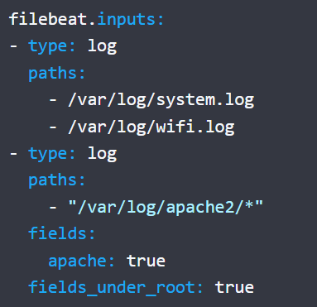
Core (cont.)
To configure Filebeat, edit the configuration file.
The default configuration file is called filebeat.yml.
To configure Filebeat manually (instead of using modules), you specify a list of inputs in the filebeat.inputs section of the filebeat.yml.

Slide 12
Core (cont.)
For logstash, the beats input plugin is listening by convention on port 5044
input {
beats {
port => 5044
host => "0.0.0.0"
}
}
output {
stdout {
codec => rubydebug {
metadata => true
}
}
}

Slide 13
Core (cont.)
Filebeat by default will redirect error events to log file.
In development phase we can see the error logs in console using the -e parameter when we start filebeat.
To start filebeat with different configuration use the –c parameter: “filebeat –e –c different_beats.yml”
The fields.yml configuration it's related to Elasticsearch fields.

Slide 14
Core (cont.)
filebeat.exe setup --dashboards
Dashboards can be added with a command or automatically when Filebeat starts up
Prefer adding dashboards at startup if Filebeat can access Kibana

Slide 15
Core (cont.)
Tags:
use the "tags" option to add one or more tags to Filebeat events
these tags can then be used within the configured output (eg: Logstash)
tags can be used for filtering in Logstash, exactly with any other tags
tags are added to all events, for all inputs

Slide 16
Core (cont.)
Multiple Logstash pipelines cannot bind to the same pot
A Filebeat instance can only send data to a single output
To send data to multiple Logstash pipelines, we need to run severel filebeat tinstance, with different output configurations
Sending different events to a Logstash pipeline, increases its complexity and decreases the scalability

Slide 17
Core (cont.)
timeout option:
specifies the timeout after which Filebeat will flush multiline events to the configured output
Filebeat doesn't know when new lines are added to files
the default value is 5 seconds
corresponds to Logstash's auth_flush_interval option

Slide 18
Core (cont.)
flush_pattern option:
when a line matches the pattern, the event will be flushed
use the "pattern" option to match the first line, and the "flush_pattern" option to match the last line

Slide 19
Core (cont.)
max_lines option:
rarely useful
specifies the maximum number of lines an event can span
any lines after this number, are discarded
the default value is 500

Slide 20
Core (cont.)
Log file:
---BEGIN EVENT---
Event
--END EVENT--
filebeat configuration:
multiline.pattern: '---BEGIN EVENT---'
multiline.negate: true
multiline.match: after
multiline.flush_pattern: '---END EVENT---’

Slide 21
Core (cont.)
To test the filebeat configuration is ok run: "filebeat test config"
To test the filebeat output is ok run: "filebeat test output"

Slide 22
Modules
Filebeat modules:
using modules with Logstash requires additional configuration
reduces simplicity and convenience, but increases flexibility
in some cases, we save a lot of configuration with modules
automatically benefit from boilerplate configuration
reduces the risk of mistakes

Slide 23
Modules (cont.)
To enable apache module type: "filebeat.exe modules enable apache"
"filebeat.exe modules list" --> displays the enable and disable modules
In modules.d the modules configuration are found.
For apache module, the module.d/apache.yml needs to be configured.

Slide 24
Modules (cont.)
Filebeat modules simplify the collection, parsing, and visualization of common log formats.
A typical module is composed of one or more filesets.
A fileset contains the following:
Filebeat input configurations, which contain the default paths where to look for the log files. These default paths depend on the operating system. The Filebeat configuration is also responsible with stitching together multiline events when needed.
Elasticsearch ingest pipeline definition, which is used to parse the log lines.
Fields definitions, which are used to configure Elasticsearch with the correct types for each field. They also contain short descriptions for each of the fields.
Sample Kibana dashboards, when available, that can be used to visualize the log files.

Slide 25
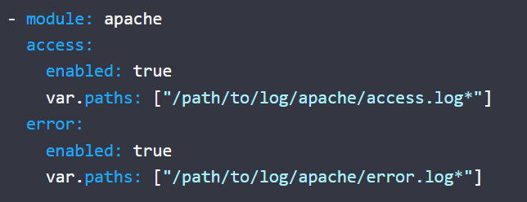
Modules (cont.)
The apache module parses access and error logs created by the Apache HTTP server.
To configure paths for Apache logs we need to configure modules.d/apache.yml file.

Slide 26
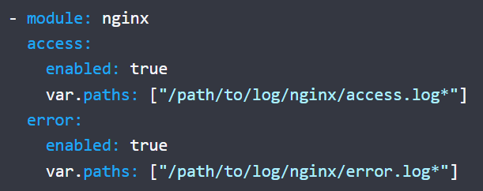
Modules (cont.)
The nginx module parses access and error logs created by the Nginx HTTP server.

Slide 27
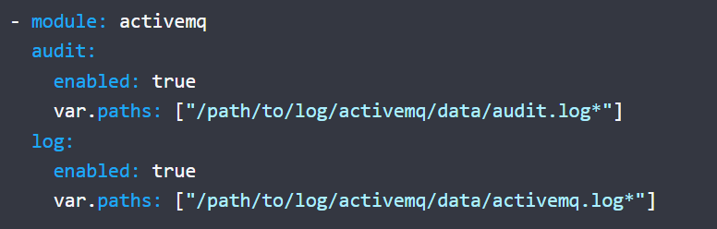
Modules (cont.)
The activeMQ module parses Apache ActiveMQ application and audit logs.

Slide 28
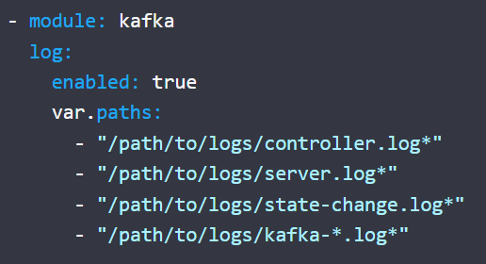
Modules (cont.)
The kafka module parses Apache Kafka application and audit logs.
The module has additional support for parsing thread ID from logs.

Slide 29
Modules (cont.)
Useful modules for databases:
Mongodb
Mysql
Mssql
IIS
Postgresql
RabitMQ
Redis
Oracle

Slide 30
Conclusions
Lightweight utility which allows you to decouple your log processing from application logic
Natively supports load-balancing among multiple instances of logstash destinations
Logs can be enriched with additional fields

Slide 31

Bibliography
https://www.elastic.co/guide/en/beats/filebeat/current
Udemy - Data Processing with Logstash (and Filebeat)

