Slide 1

JUnit 5
Dima Ionut Daniel

Slide 2
Contents
What is JUnit 5?
Features
Architecture
Testing
Core
Extension API
Assertions
Assumptions
Annotations
Conclusions
Bibliography

Slide 3

What is Junit 5 ?
JUnit is one the most popular unit-testing frameworks for Java developers.
JUnit rejected the idea of GUI-based tests, instead provides a lightweight framework which enables the test creation by writing code.
JUnit 5 is backward compatible with Junit 4 and 3.8.

Slide 4
Features
better assertions
better testing
modularity
better extensibility
the usage of lambda in JUnit tests

Slide 5
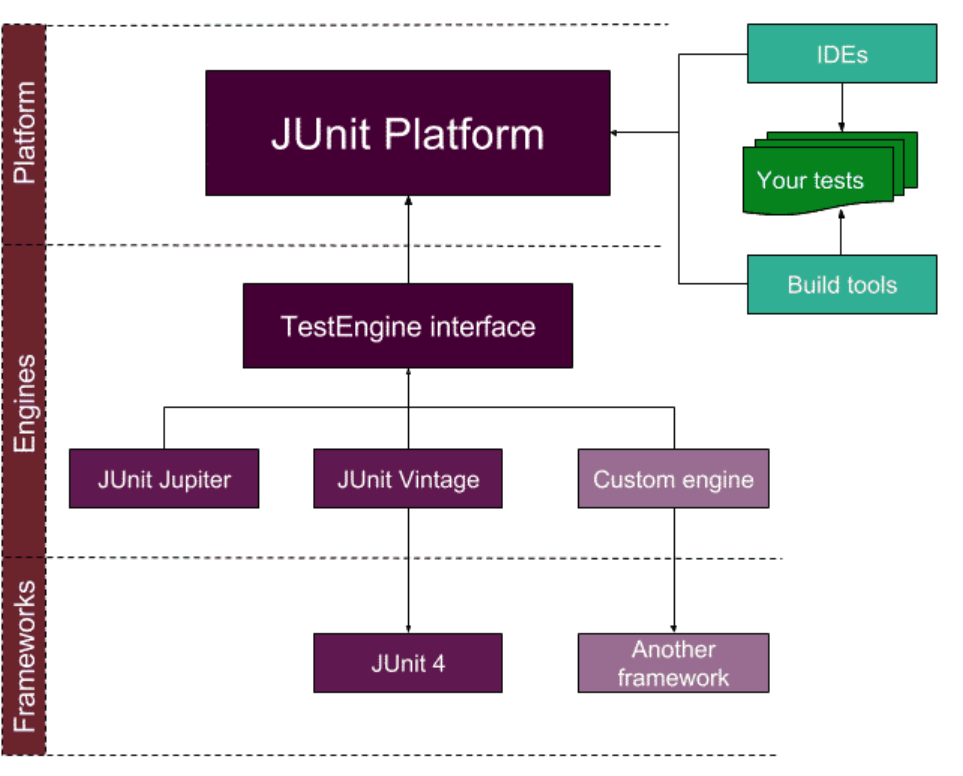
Architecture

Slide 6
Testing
Tests need to have several characteristics so that they remain useful:
Readable: what the unit being tested will do
Fast: Tests should run in few seconds so that they provide quick feedback
Independent and Isolated: good unit tests are independent of execution order.
Correct: Good unit test does what it says.
Environment agnostic: A good unit test does not depend on the environment.
Repeatable: A good unit test produces the same result each time you run it.

Slide 7
Testing (cont.)
Benefits of testing:
Determines specifications
Provides early error detection
Supports maintenance
Improves design
Product documentation

Slide 8
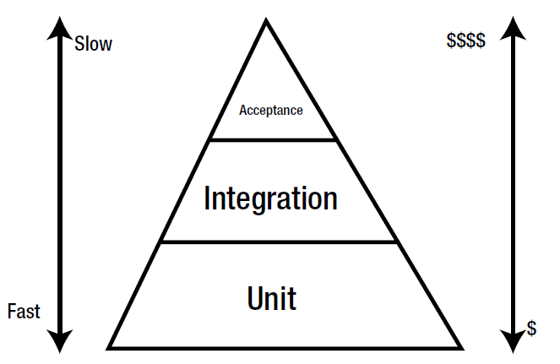
Testing (cont.)
Test pyramid

Slide 9
Core
JUnit 5 was called JUnit Lambda, a complete rewrite or JUnit in Java 8 to overcome mistakes and limitations of previous JUnit versions.
JUnit 5 is composed of three subprojects, each of these have multiple modules:
JUnit Platform: foundation for launching, includes a TestEngine API.
JUnit Jupiter: new programming model for writing tests, it implements the TestEngine API.
JUnit Vintage: provides a TestEngine implementation for running JUnit 3 and JUnit 4 tests.

Slide 10
Core (cont.)
The main modules in JUnit 5 are
junit-jupiter-api: This module defines the API that you need to write your tests.
junit-platform-launcher: This module defines the launcher API that external tool use. Launchers can be used to discover, filter, and execute tests.
junit-platform-engine: This provides the API that you can use to write your own TestEngine. TestEngine is responsible for the discovery and execution of tests.
junit-jupiter-engine: It is the implementation of junit-platformengine API for JUnit 5.
junit-vintage-engine: It is the implementation of junit-platformengine API for JUnit 3 and JUnit 4.
junit-platform-commons: It contains all the utilities which are used across different modules.
junit-platform-console: This provides an implementation of a launcher called ConsoleLauncher. ConsoleLauncher is a standalone application used to launch JUnit platform from the console.
junit-platform-gradle-plugin: This is a Gradle plug-in that can be used to run JUnit 5 tests.
junit-platform-surefire-provider: This module provides Maven integration for JUnit 5.

Slide 11
Core (cont.)
JUnit5 does not require a test class to have a public no-arg constructor.
The constructor can be package protected, protected or even private.
With JUnit 5 a test method can be either protected or package protected.
Tests in JUnit 5 must be annotated with org.junit.jupiter.api.Test annotation.

Slide 12
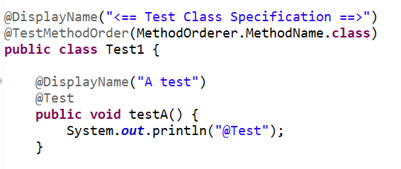
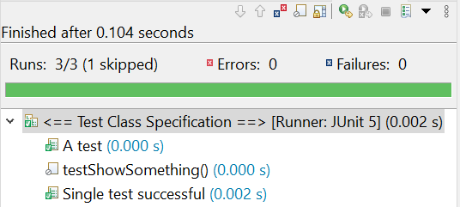
Core (cont.)
JUnit 5 allows setting custom names for test classes by using @DisplayName annotation.
The annotation can be used on class and method level.

Slide 13
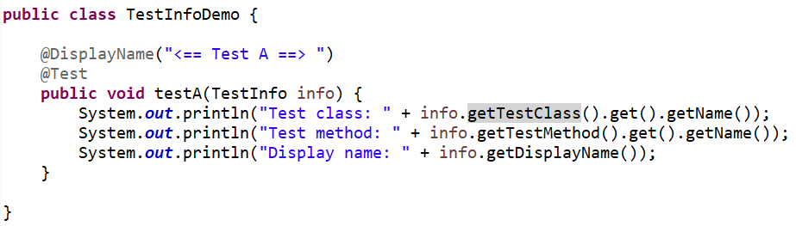

Core (cont.)
We can use TestInfo object, as parameter to the test method to obtain metadata.

Slide 14
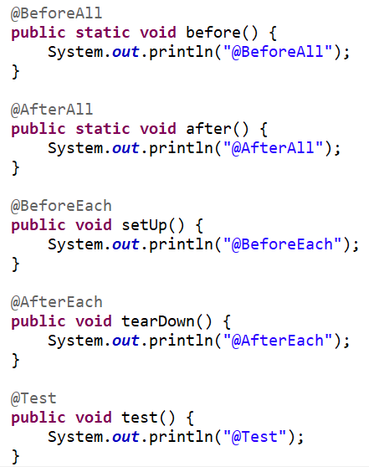
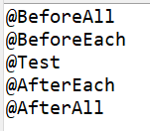
Core (cont.)

Slide 15
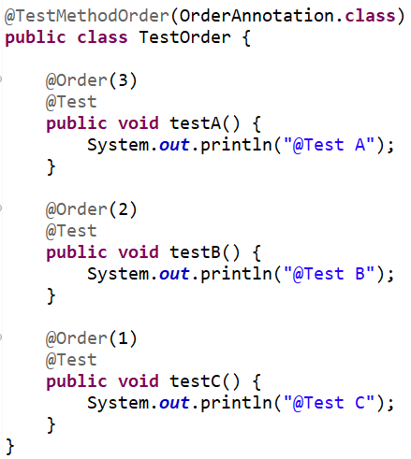
Core (cont.)
We can specify the order of the tests with @Order and @TestMethodOrder(OrderAnnotation.class)

Slide 16
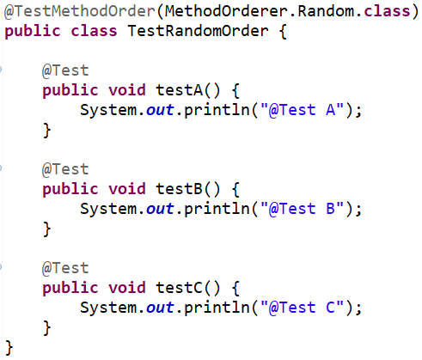
Core (cont.)
We can run tests in a random order using @TestMethodOrder(MethodOrderer.Random.class)
We can configure a custom seed using the junit.jupiter.execution.order.random.seed.
Create a file called junit-platform.properties and set the property
junit.jupiter.execution.order.random.seed=100

Slide 17
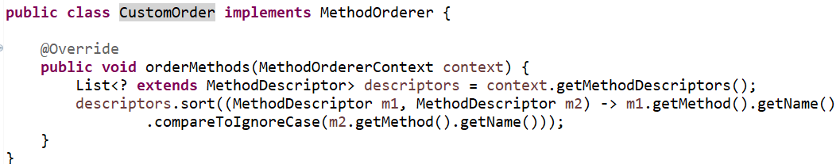
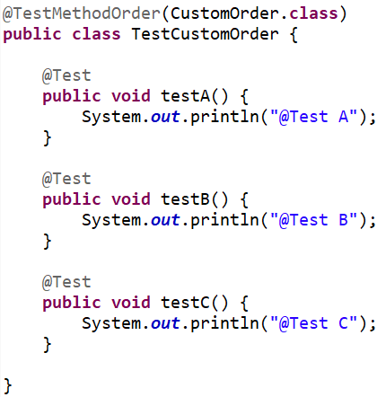
Core (cont.)
We can use our own custom order by implementing the MethodOrderer interface

Slide 18
Core (cont.)
We can configure the default order parameter in the junit-platform.properties file:
junit.jupiter.testmethod.order.default = org.junit.jupiter.api.MethodOrderer$DisplayName

Slide 19
Core (cont.)
JUnit 5 is divided into various modules.
junit-platform-launcher defined the API that is used by tools like IDE to discover and execute tests.
junit-platform-engine provides an API that we can use to write our own test engine.
We create an org.junit.platform.launcher.Launcher instance
The launcher detects supported test engines and engines will execute the tests.
JUnit 5 provides a default org.junit.platform.launcher.core.DefaultLauncher implementation.

Slide 20
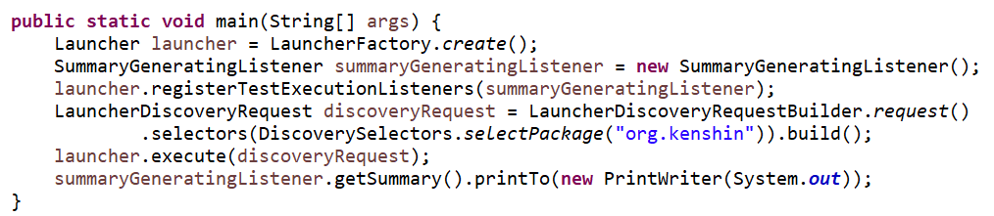
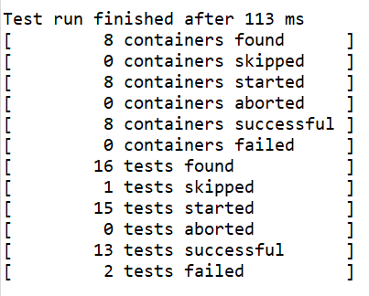
Core (cont.)

Slide 21
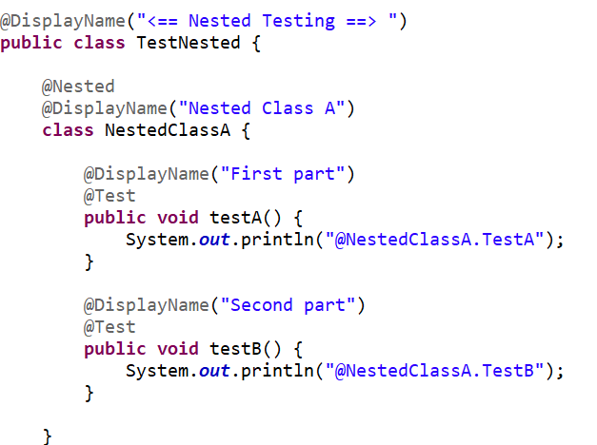
Core (cont.)
JUnit 5 provides the @Nested annotation to provide a logical grouping of test cases in the form of static inner member classes.

Slide 22
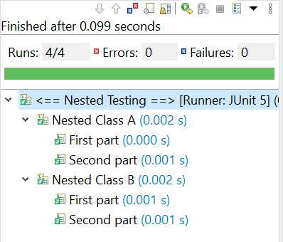
Core (cont.)
These methods will be executed in hierarchical order.
Additionally, the nested classes can be marked with @DisplayName, giving us all the benefits of proper test names.

Slide 23
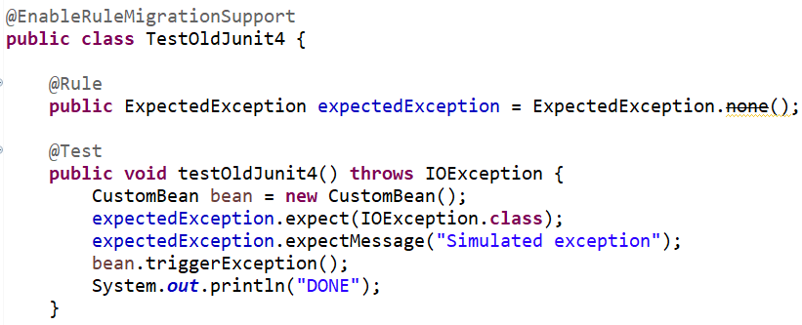
Core (cont.)
JUnit 5 has limited support for JUnit 4 Rule API support.
The support for Rule API is defined in the junit-jupiter-migration-support module.

Slide 24
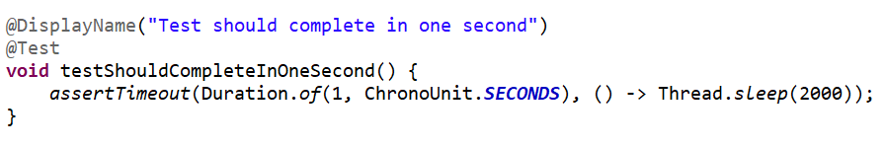
Core (cont.)
Timeouts are useful when we don't want to wait for the test indefinitely.
Until the previous version of JUnit, the @Test annotation had an attribute to provide timeout value.
JUnit 5 test annotation does not support any attribute, but instead provides new assertion methods: assertTimeout() and assertTimeoutPreemptively().

Slide 25
Core (cont.)
assertTimeout executes the executable code in the same thread as the calling code
assertTimeoutPreemptively
overcomes the limitation of assertTimeout.
It makes sure that the test completes before the timeout.
It runs the test in a different thread than the calling thread.
It will abort the code when the timeout is exceeded.

Slide 26
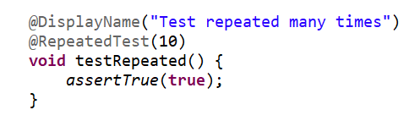
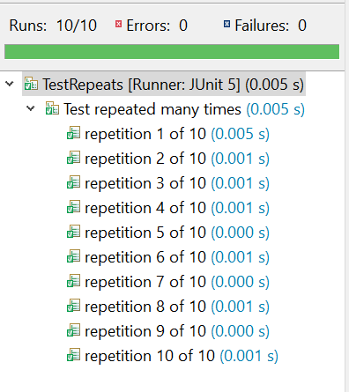
Core (cont.)
JUnit 5 has added support for running a test a specified number of times, using @RepeatedTest annotation.

Slide 27
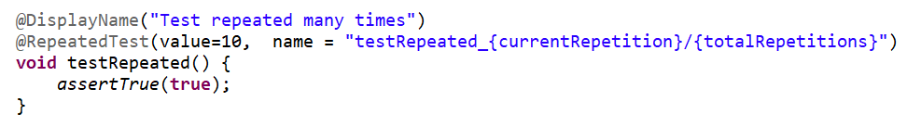
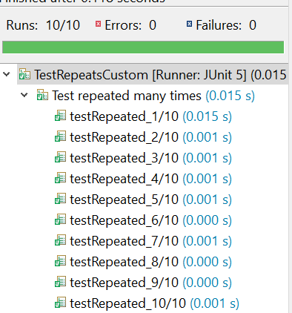
Core (cont.)
We can customize the name of the test using a predefined set of placeholders.

Slide 28
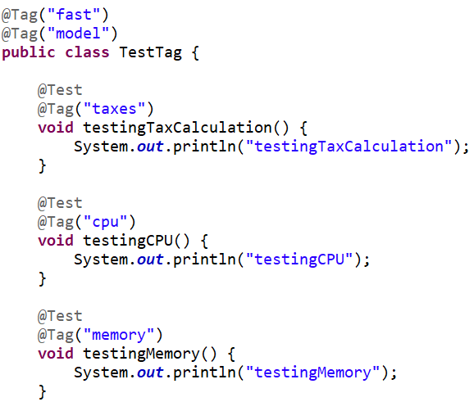
Core (cont.)
Tags are a JUnit Platform concept for marking and filtering tests.
Test classes and methods can be tagged via the @Tag annotation.
Those tags can later be used to filter test discovery and execution.

Slide 29

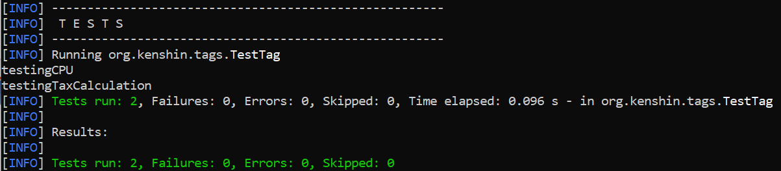
Core (cont.)
Using maven, we can include or exclude tags for execution.
mvn -Dgroups="integration, fast, feature-168"
mvn -DexcludedGroups="slow"

Slide 30
Core (cont.)
In order to allow individual test methods to be executed in isolation and to avoid unexpected side effects due to mutable test instance state, JUnit creates a new instance of each test class before executing each test method.
This "per-method" test instance lifecycle is the default behavior in JUnit Jupiter.
If we prefer that JUnit Jupiter execute all test methods on the same test instance, we need to annotate the test class with @TestInstance(Lifecycle.PER_CLASS).

Slide 31
Extension API
One of the core principles of JUnit is to prefer extension points over features.
Extensions are not new to JUnit.
JUnit 4 offered two extension mechanisms: Runner API and Rule API.

Slide 32
Extension API (cont.)
Runner API was added to JUnit 4 to provide capability for writing custom runners.
A runner manages the full life cycle of a test–instantiation of test class, calling setup and tear-down methods,
executing test cases, notifying RunNotifier with progress of your tests.
Anyone can write their own custom runner by extending the Runner class.
To instruct JUnit to a use custom runner, you use the @RunWith annotation and specify your custom runner.

Slide 33
Extension API (cont.)
Rule API was introduced in JUnit 4.7 to provide a lightweight mechanism to extend JUnit.
To use a rule, you create a public instance variable of the rule and annotate it with @Rule annotation.
Rule API works by wrapping test methods into a statement.
The statement will first run any @Before methods, then the @Test method, and finally any @After methods.
The Rule API overcomes the limitations of the Runner API, but they were limited by what they could do.

Slide 34
Extension API (cont.)
The extension API is part of JUnit Jupiter engine.
There are 5 main extension points that you can hook into.
Test life cycle callbacks
Test instance post-processing
Conditional test execution
Parameter resolution
Exception handling

Slide 35
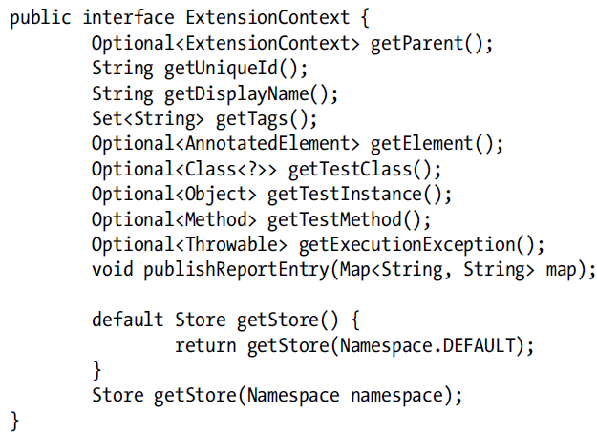
Extension API (cont.)
All the extension point interfaces extend a marked interface call Extension.
The ExtensionContext interface is used to encapsulate the context in which the test or test container is executed.

Slide 36
Extension API (cont.)
Jupiter creates a tree of test nodes, and each node will have ExtensionContext.
A test node will have a test class node as its parent.
So, getParent will be Optional.empty when called on the test class node but it will non-empty when getParent is called on the test method.
The getExecutionException() method is used to get the exception thrown during the execution of a test or container.

Slide 37
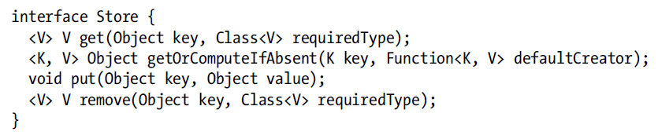
Extension API (cont.)
JUnit extensions make use of a Store to write and read data.
Store is a namespaced, hierarchical, key/value data store.
To access a store via ExtensionContext, you call the getStore() method with a Namespace object.

Slide 38
Extension API (cont.)
The test class is composed of following life cycle methods:
BeforeAll: The methods marked with the @BeforeAll annotation are executed before all tests in the current test class. They are only executed once for a test class.
BeforeEach: The methods marked with the @BeforeEach annotation are executed before each test method in the current test class. They are called once for each test in the current test class.
Test: All methods marked with the @Test annotation are actual test methods.
AfterEach: The methods marked with @AfterEach are executed after each test method in the current test class. They are executed once for each test in the current test class.
AfterAll: The methods marked with @AfterAll are executed after all tests in the current test class. They are only called executed once for a test class.

Slide 39
Extension API (cont.)
For each of these test life cycle stages JUnit 5 provides an extension interface.
BeforeAllCallback: This extension is executed before all the test methods are executed.
AfterAllCallback: This extension is executed after all the test methods are executed.
BeforeEachCallback: This extension is executed before each test method is executed.
AfterEachCallback: This extension is executed after each test method is executed.
BeforeTestExecutionCallback: This extension is executed immediately before the test is executed.
AfterTestExecutionCallback: This extension is executed immediately after the test is executed.

Slide 40
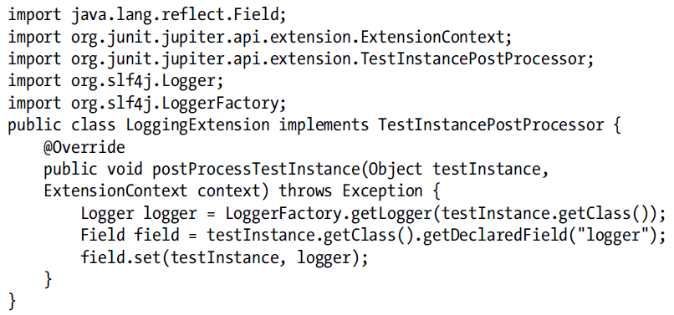
Extension API (cont.)
Test Instance Post-Processing extension allows to hook after a test instance has been created.

Slide 41
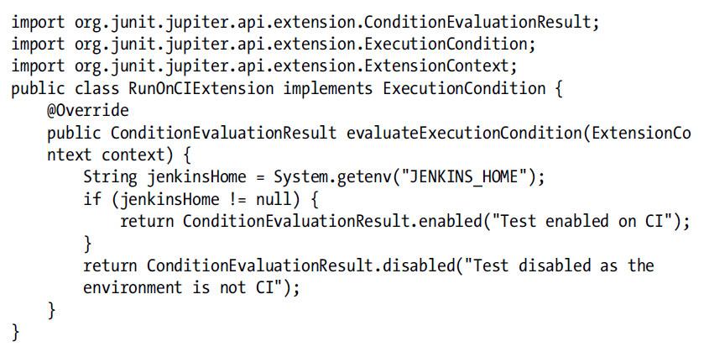
Extension API (cont.)
There are situations in which we would like to control whether we should run a test case or not.
JUnit 5 provides the ExecutionCondition extension interface for implementing this use case.

Slide 42
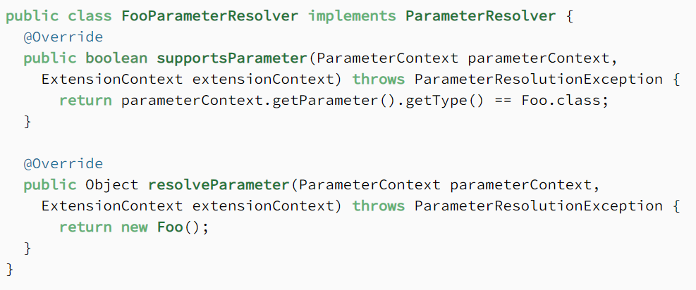
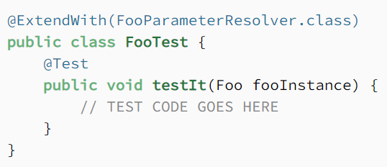
Extension API (cont.)
The parameter resolution extension is used to resolve a parameter received by a constructor or test method.

Slide 43
Extension API (cont.)
JUnit 5 bundles the following three ParameterResolvers:
TestInfoParameterResolver: provides an instance of org.junit.jupiter.api.TestInfo.
TestReporterparameterResolver: provides an instance of org.junit.jupiter.api.TestReporter.
RepetitionInfoParameterResolver: provides an instance of org.junit.jupiter.api.RepetitionInfo.

Slide 44
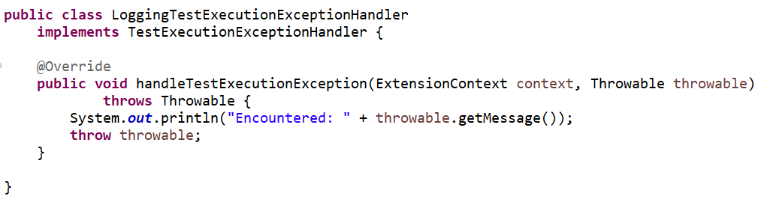
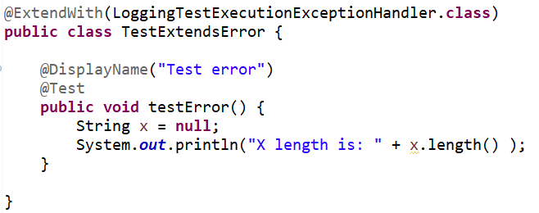
Extension API (cont.)
The TestExecutionExceptionHandler Extension interface is called when the test results in an exception.

Slide 45
Extension API (cont.)
The JUnit team used the extension model to develop the following new test types:
@TestTemplate: Define a template which generates tests at runtime.
@ParametrerizedTest: Defines a test method with parameters.

Slide 46
Extension API (cont.)
JUnit 5 enables us to create test skeletons which are instantiated with TestTemplateInvocationContext to generate tests at runtime.
The generated tests are like @Test method.
The templates support the complete test life cycle: @BeforeAll/@BeforeEach/@AfterEach/@AfterAll.

Slide 47
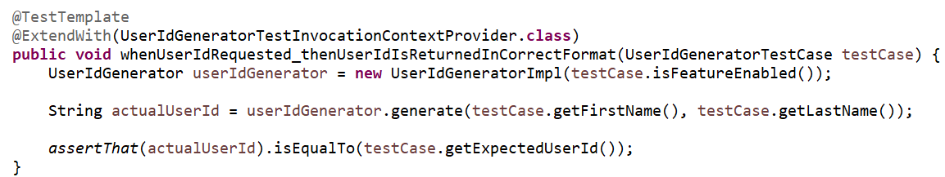
Extension API (cont.)
A test template is created by marking a non-static method test class with org.junit.jupiter.api.TestTemplate annotation.
Additionally, we must register an implementation of TestTemplateInvocationContextProvider Extension, which is used to generate an actual test from the template.

Slide 48
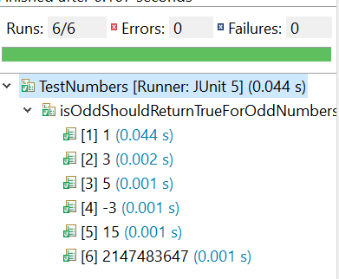
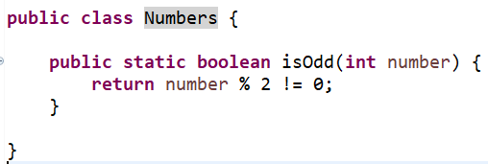
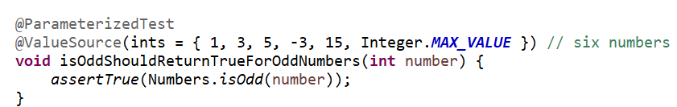
Extension API (cont.)
JUnit 5 allows us to inject parameters into a test using @ParameterizedTest annotation.
With the @ValueSource annotation, we can pass an array of literal values to the test method.

Slide 49
Extension API (cont.)
@ValueSource can be used to specify an array of primitive (integer/double/long) and String.
The package also provides the following sources:
EnumSource: The source can be used to inject values from an Enum. The source allows to select/deselect a subset of specified Enum values.
MethodSource: The source can be used provide a Stream/Array/Iterable of values. The method must be static and must not take any arguments.
CSVSource: The source can be used to inject a list of comma separated values. Each of the comma separated values can be used to match a test method argument.
CSVFileSource: The source can be used to inject a list of comma separated values from a specified file. Each of the comma separated values can be used to match a test method argument.
ArgumentSource: The source can be used to register a custom provider of Stream<Arguments>. The registered provider can be

Slide 50
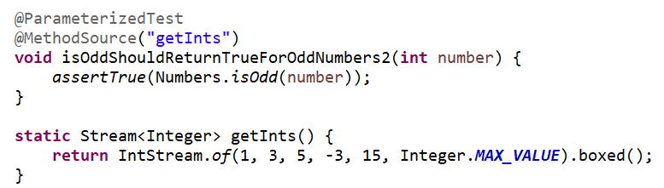
Extension API (cont.)

Slide 51
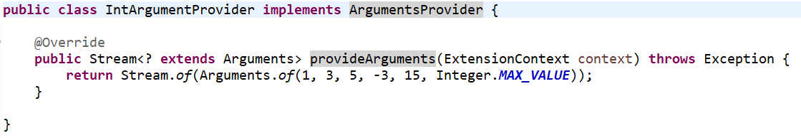
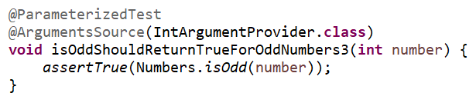
Extension API (cont.)

Slide 52
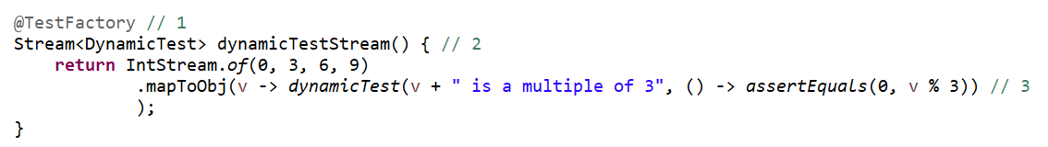
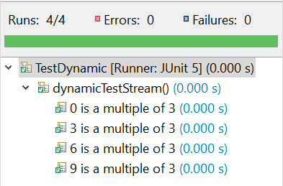
Extension API (cont.)
The dynamic test is generated at runtime by a factory method that is annotated with @TestFactory.
A method annotated with @TestFactory must return a Stream/Collection/Iterable/Iterator of DynamicTest.
The static method org.junit.jupiter.api.DynamicTest.dynamicTest created a dynamic test.
Each dynamicTest consists of 2 parts: a string for the display name and an Executable for the assertions.

Slide 53
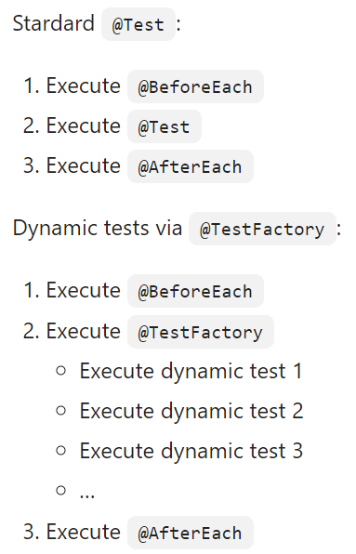
Extension API (cont.)
The @ParameterizeTest is more suitable over @TestFactory because it has full lifecycle support (@BeforeEach and @AfterEach), while the test factory doesn’t.
Both support display name.
There are 2 reasons for using dynamic tests: when the tests cannot be expressed at compile-time or when the parameterized tests are not good enough.

Slide 54
Assertions
Assertions are statis methods that we call to verify expected behavior.
All JUnit 5 assertions are defined as part of org.junit.jupiter.api.Assertions class.
Each assertXXX method provided by Junit has at least 3 overloaded methods.

Slide 55
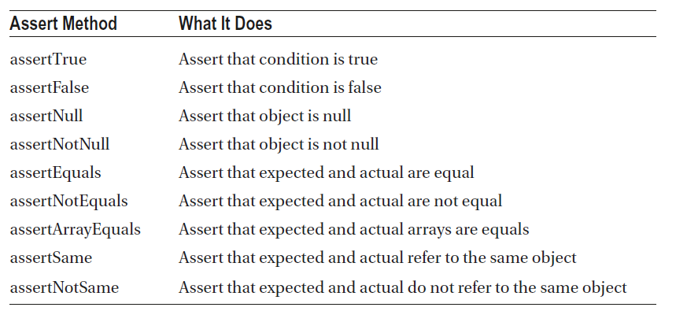
Assertions (cont.)

Slide 56
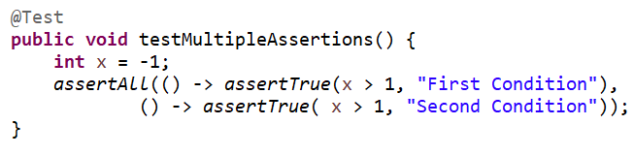
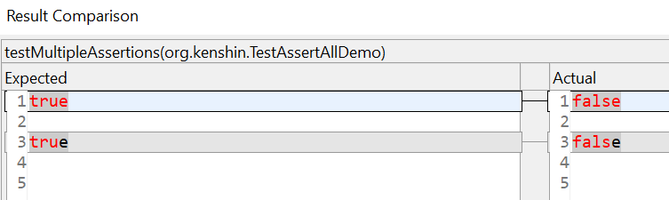
Assertions (cont.)
The assertAll() method can group multiple assertions and have all run.

Slide 57
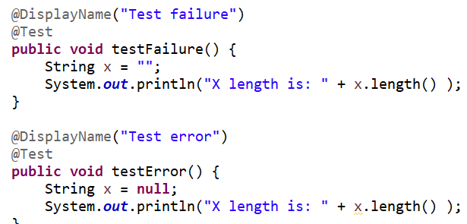
Assertions (cont.)
In JUnit, there is a difference between error and failure.
A test fails when an assertion it not met, and an error occurs when the test throws unexpected exception.

Slide 58
Assumptions
JUnit Jupiter comes with a subset of the assumption methods.
All JUnit Jupiter assumptions are static methods in the org.junit.jupiter.api.Assumptions class.
If assumeTrue(), assertFalse() are not success, then the execution of the test is stop.

Slide 59
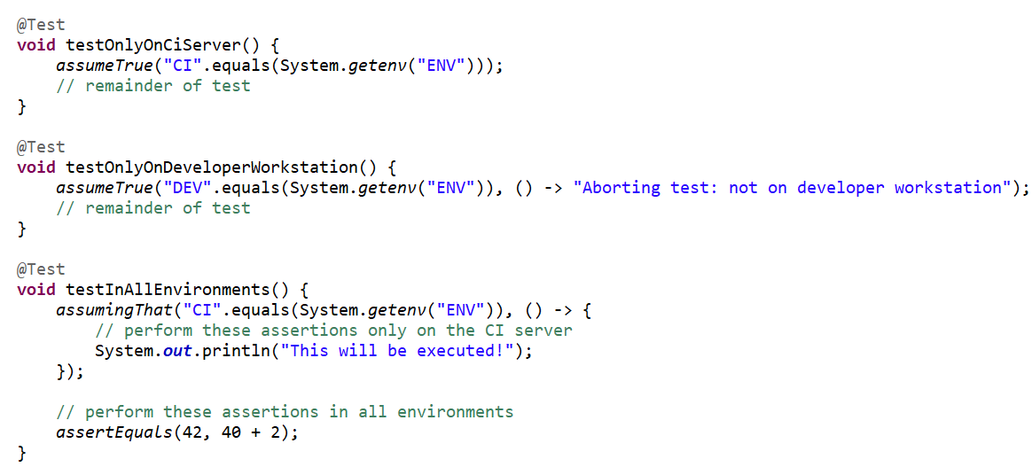
Assumptions (cont.)

Slide 60
Annotations
All core annotations are in the org.junit.jupiter.api package in the junit-jupiter-api module.
JUnit Jupiter supports the following annotations for configuring tests and extending the framework.
Annotation | Description
@Test | denotes that a method is a test method
@ParameterizedTest | denotes that a method is a parameterized test
@RepeatedTest | denotes that a method is a test template for a repeated test
@TestFactory | denotes that a method is a template for test cases designed to be invoked multiple times depending on the number of invocation contexts returned by the registered providers.
@TestMethodOrder | used to configure the test method execution order for the annotated test class
@TestInstance | used to configure the test instance lifecycle for the annotated test class.
@DisplayName | declares a custom display name for the test class or test method

Slide 61
Annotations (cont.)
Annotation | Description
@DisplayNameGeneration | declares a custom display name generator for the test class.
@BeforeEach | method should be executed before each @Test, @RepeatedTest, @ParameterizedTest, or @TestFactory method in the current class
@AfterEach | method should be executed before after @Test, @RepeatedTest, @ParameterizedTest, or @TestFactory method in the current class
@BeforeAll | method should be executed before all @Test, @RepeatedTest, @ParameterizedTest, and @TestFactory methods in the current class
@AfterAll | method should be executed after all @Test, @RepeatedTest, @ParameterizedTest, and @TestFactory methods in the current class

Slide 62
Annotations (cont.)
Annotation | Description
@Nested | denotes that the annotated class is a non-static nested test class. @BeforeAll and @AfterAll methods cannot be used directly in a @Nested test class unless the "per-class" test instance lifecycle is used
@Tag | used to declare tags for filtering tests, either at the class or method level
@Disabled | used to disable a test class or test method; analogous to JUnit 4’s @Ignore
@Timeout | used to fail a test, test factory, test template, or lifecycle method if its execution exceeds a given duration.

Slide 63
Annotations (cont.)
Annotation | Description
@ExtendWith | used to register extensions declaratively
@RegisterExtension | used to register extensions programmatically via fields
@TempDir | used to supply a temporary directory via field injection or parameter injection in a lifecycle method or test method; located in the org.junit.jupiter.api.io package.

Slide 64
Conclusions
Easy to learn
Has brand new features
Solves JUnit 4 problems

Slide 65

Bibliography
Apress - Java Unit Testing with JUnit 5
https://junit.org/junit5/docs/current/user-guide/

